Slide 1
Group Workshop（1）
——The Tidyverse
Chengshu
Mora Lab
24/05/2019
Notes:
1

Slide 2
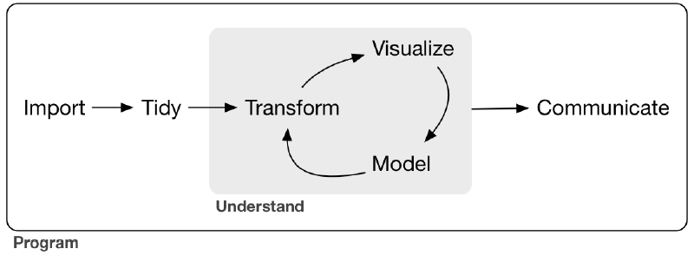
Data science
Here Wickham shows the model of the tools needed in a typical data science project:
Wrangle
Data handling
https://r4ds.had.co.nz/
Notes:
2

Slide 3
Data Handling
Import: to get your data from disk and into R
Tidy: to store your data that makes transformation,
visualization, and modelling easier
Transform: filter rows、
arrange rows、
select columns、
add new variables……
Tidyverse
https://r4ds.had.co.nz/wrangle-intro.html
Notes:
3

Slide 4
Tidyverse
Why to use Tidyverse?
What is Tidyverse?
How to use Tidyverse?
Notes:
4

Slide 5
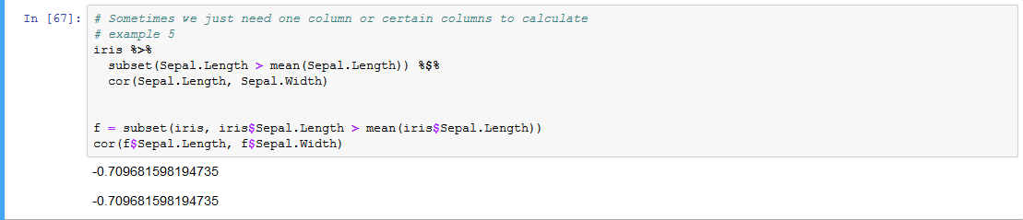
Why to use Tidyverse?
To make data science fast, fluent and fun…
Simplify R codes(like basic pipes in `magrittr`): %>%、%$% (Details in “magrittr”)
Avoid repeated codes
Notes:
5

Slide 6
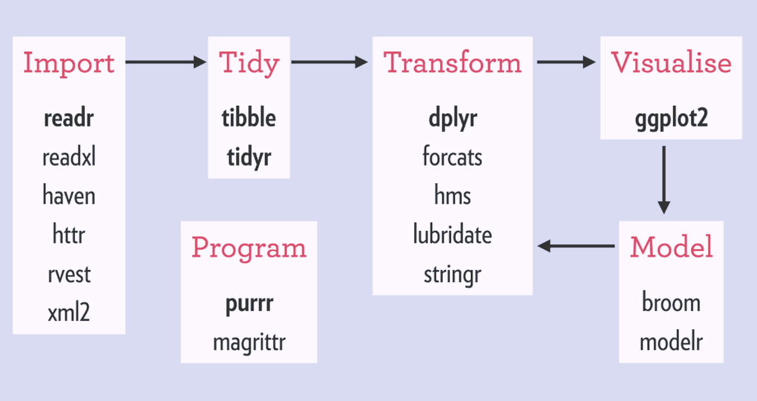
What is Tidyverse?
"The tidyverse is an opinionated collection of R packages designed for data science. All packages share an underlying design philosophy, grammar, and data structures. ”
—wickham “R for data science”
A collection of R packages designed to work together to make data science fast, fluent and fun. — Official website “tidyverse.org”
https://www.tidyverse.org/packages/
Notes:
6

Slide 7
What is Tidyverse?
readr: used to read format data into R, data import
dplyr: manipulate data
tibble: a new data frame used to process data better
tidyr: tidy data, make it more suitable to further process
magrittr: offers a set of operators which make codes more readable by
Notes:
7

Slide 8
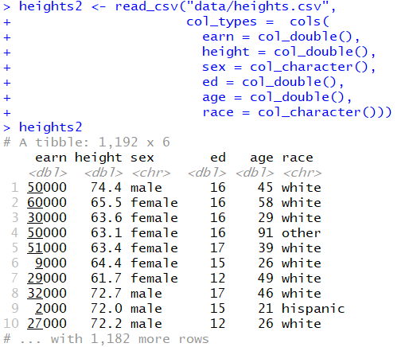
Tibble
a new data frame used to process data better.
Data type can be changed into what we want,
through “col_types” parameter.
Data type
Notes:
If meet problems, while it doesn’t show up the track, using `problems()`
Notes:
8

Slide 9
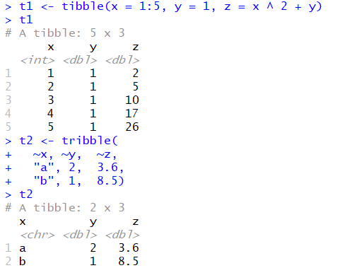
Tibble
Create own data frame by `tribble()` or `tibble()`.
1. https://cran.r-project.org/web/packages/tibble/vignettes/tibble.html
2. https://tibble.tidyverse.org/
Notes:
9

Slide 10
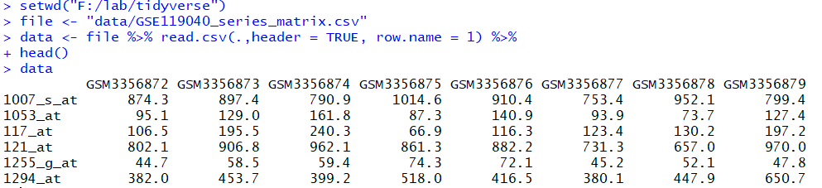

How to use Tidyverse?
magrittr
Basic piping
1. Find the file to read, file path. Can be changed
%>% : forward-pipe operator
A %>% B %>% C
%T>% : tee operator
A %T>% B %>% C
%$% : exposition pipe-operator
%<>%: compound assignment pipe-operator
A %<>% B %>% C
Differences:
Any pipeline starting with the . will return a function which can later be used to apply the pipeline to values.
1
Codes meaning ：import data and show the first 6 rows
Notes:
10

Slide 11
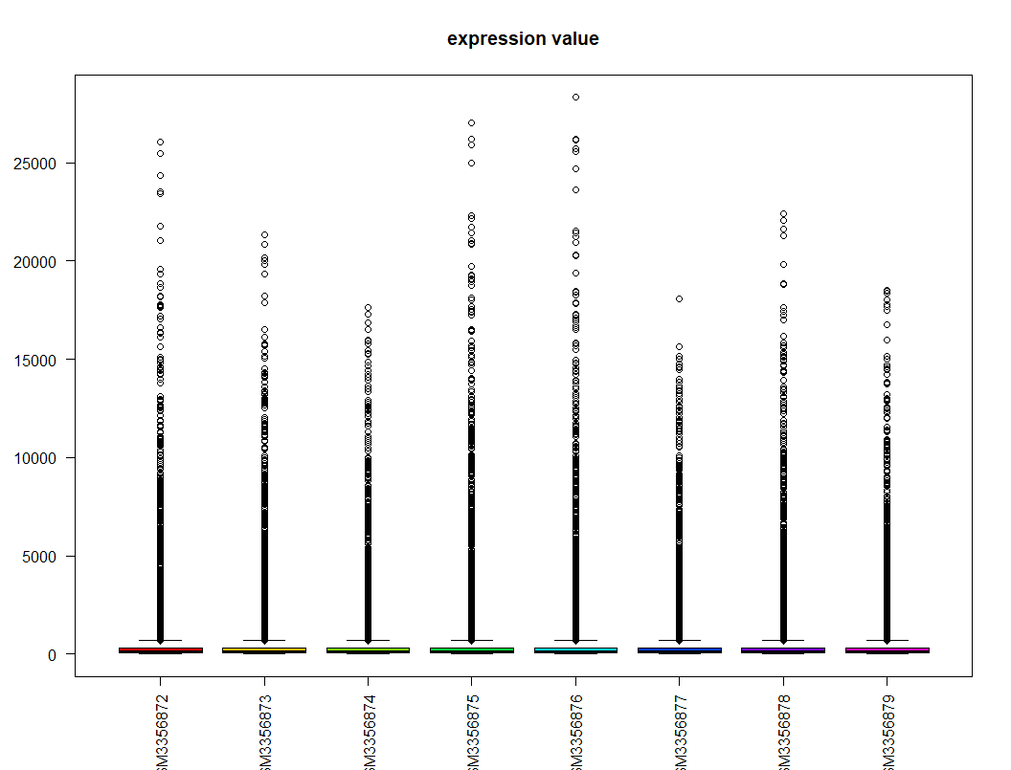
How to use Tidyverse?
magrittr
Basic piping
%>% : forward-pipe operator
A %>% B %>% C
%T>% : tee operator
A %T>% B %>% C
%$% : exposition pipe-operator
%<>%: compound assignment pipe-operator
A %<>% B %>% C
The data used to plot boxplot is the result of `as.matrix()`,
while the imput of `head()` is the output of `as.matrix()`, rather than `boxplot()`
Codes meaning ：import data and have a boxplot of these data
Notes:
11

Slide 12
How to use Tidyverse?
magrittr
Basic piping
%>% : forward-pipe operator
A %>% B %>% C
%T>% : tee operator
A %T>% B %>% C
%$% : exposition pipe-operator
%<>%: compound assignment pipe-operator
A %<>% B %>% C
> data = read.csv(file, header = TRUE, row.name = 1 ) ###read data
> data = as.matrix(data) ### change data type
> data1 = as.data.frame(data) ### change data type
> data1 = subset(data1, data1$GSM3356872 > mean(data1$GSM3356873)) ####subset two columns of data
> cor(data1$GSM3356872 , , data1$GSM3356873) ###calculate correlation of data chosen
Notes:
12

Slide 13
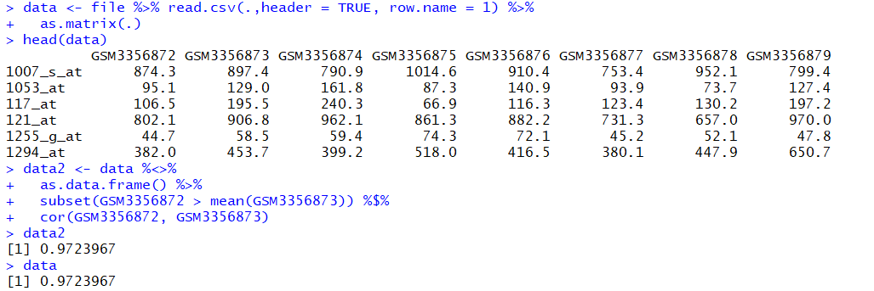
How to use Tidyverse?
magrittr
Basic piping
%>% : forward-pipe operator
A %>% B %>% C
%T>% : tee operator
A %T>% B %>% C
%$% : exposition pipe-operator
%<>%: compound assignment pipe-operator
A %<>% B %>% C
Notes:
13

Slide 14
How to use Tidyverse?
readr used to read format data into R, data import
`read_csv()` for comma delimited files
`read_csv2()` for semicolon separated files
`read_tsv()` for tab delimited files
`read_fwf()` for fixed width files, and `fwf_widths()`, `fwf_positions()` two important parameters
`read_table()` for common variation of fixed width files where columns are separated by white space
`read_log()` for Apache style log files
After using readr, the data will come to a tibble.
If we have some annotation of our data in a `tibble` frame,
We can skip those words via the following parameters:
`comment = “…”` or `skip = 1`
As it shown:

Slide 15
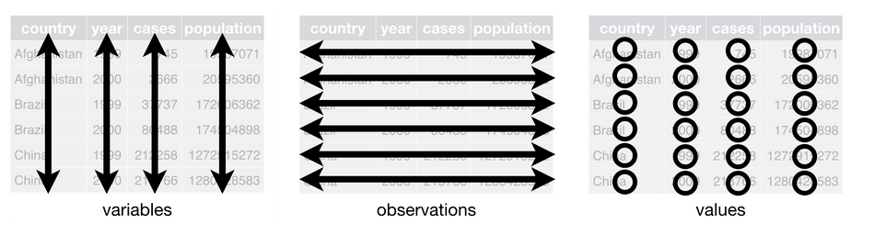
How to use Tidyverse?
3. tidyr: tidy data, make it more suitable to further process
`gather()`: handle “values of one variable are in multi-columns”
`spread()`: “values of one observation are in multi-rows”
`separate()`: “one value means two or more variables”, separate one column into multi-columns
`unite()`: “one value means two or more variables”, combine multi-columns into one column
For `NA` value :
complete(data, ..., fill = list()) ### show up all data, including the `NA` value
fill(data, ..., .direction = c("down", "up"))
### fill in the `NA` value using the former one(`direction = up`) or later one (`direction = down`)

Slide 16
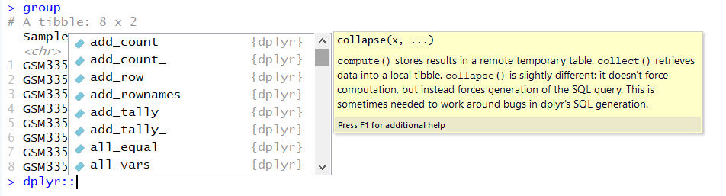
How to use Tidyverse?
4. dplyr: manipulate data
`mutate()` adds new variables that are functions of existing variables
`select()` picks variables based on their names.
`filter()` picks cases based on their values.
`summarise()` reduces multiple values down to a single summary.
`arrange()` changes the ordering of the rows.
https://dplyr.tidyverse.org/

Slide 17
Exercises
Exercise 1 : magrittr
Exercise 2 : tibble and readr
Exercise 3: tidyr
Exercise 4: dplyr

Slide 18
Thank you

