Slide 1
Group Workshop（2）
—— ggplot2
Chengshu
Mora Lab
27/06/2019
Notes:
1

Slide 2
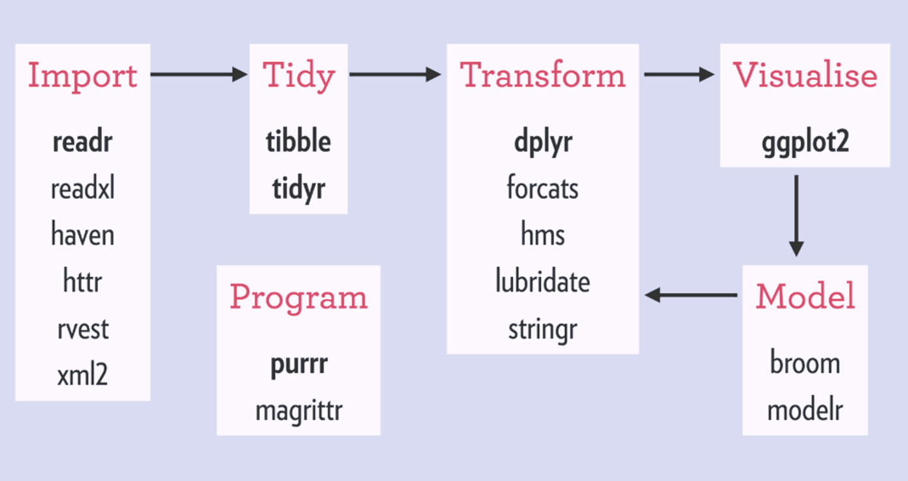
Visualization
Used to explore data in a systematic way.
“ggplot2” is a system for declaratively creating graphics, based on The Grammar of Graphics.
-Tidyverse
Notes:
2

Slide 3
Main function in ggplot2
Notes:
3

Slide 4
Key points in plots
Data.
Aesthetic mappings.
A geometric object (geom).
A statistical transformation (stat).
A position adjustment.
Annotation
Facetting
Scales
Guides: axes and legends
Coordinate systems
Themes
Basics
Layer
Layers are responsible for creating the objects that we perceive on the plot.
A layer combines data, aesthetic mapping, a geom (geometric object), a stat (statistical transformation), and a position adjustment.
Notes:
4

Slide 5
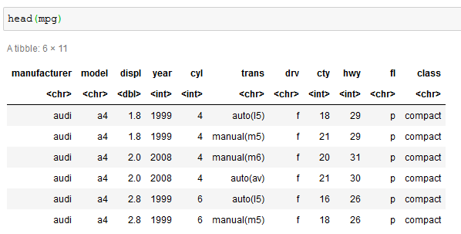
Data
Data should be the section of data frame that you want to visualize, and
the data must be in a tidy data frame.
If we want to visualize the displ~cyl, only to choose the two columns of data like:
“ mpg$displ ~ mpg$cyl ”
So begin with : “ggplot(mpg,…)”
Notes:
5

Slide 6
Aesthetic mappings
Aesthetic mappings describe how variables in the data are mapped to visual properties
(aesthetics) of geoms.
Could be set in `ggplot2()` and in individual layers.
ggplot(.., aes()) or ggplot(…) + geom_point(aes())
Main functions in aesthetic mapping:
Function | Description
aes | Construct aesthetic mappings
aes_ | Define aesthetic mappings programmatically
aes_colour_fill_alpha | Colour related aesthetics: colour, fill and alpha
aes_group_order | Aesthetics: groupin
aes_linetype_size_shape | Differentiation related aesthetics: linetype, size, shape
aes_position | Position related aesthetics: x, y, xmin, xmax, ymin, ymax, xend, yend
Notes:
6

Slide 7
Layer : geometrics
Geometric objects, geoms for short, describes how to render each observation.
Function | Description
geom_point() | Points
geom_density() | Smoothed density estimates
geom_abline() | Reference lines: horizontal, vertical, and diagonal
geom_smooth () | Smoothed conditional means
geom_bar() | Bar charts
geom_boxplot() | A box and whiskers plot (in the style of Tukey)
geom_freqpoly()/geom_histgram() | Histograms and frequency polygons
geom_violin() | Violin plot
geom_bin2d() | Heatmap of 2d bin counts
geom_blank() | Draw nothing
geom_contour() | 2d contours of a 3d surface
geom_count() | Count overlapping points
geom_crossbar() | Vertical intervals: lines, crossbars & errorbars
geom_density_2d() | Contours of a 2d density estimate
geom_jitter() | Jittered point
geom_label() | Text
geom_quantile() | Quantile regression
geom_map() | Polygons from a reference map
geom_polygon() | Polygons
geom_qq_line() | A quantile-quantile plot
geom_raster() | Rectangles
geom_segment() | Line segments and curves
geom_errorbarh() | Horizontal error bars
geom_hex() | Hexagonal heatmap of 2d bin counts
geom_path() | Connect observations
geom_ribbon() | Ribbons and area plots
geom_rug() | Rug plots in the margins
Always used
https://cran.r-project.org/web/packages/ggplot2/ggplot2.pdf
2. https://ggplot2.tidyverse.org/
Notes:
7

Slide 8
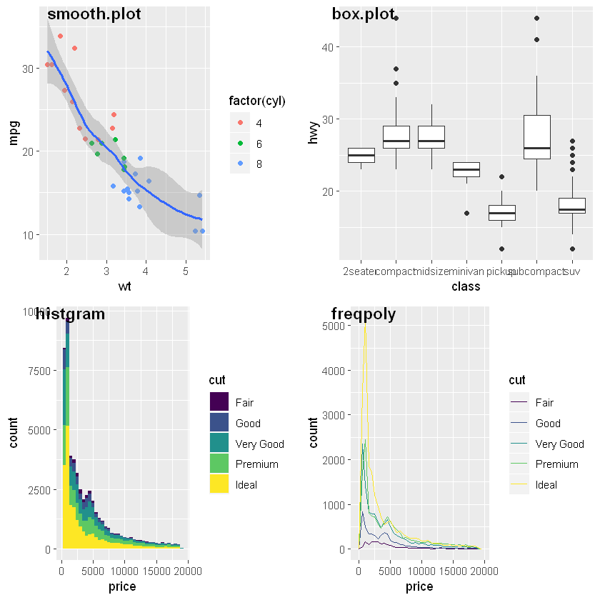
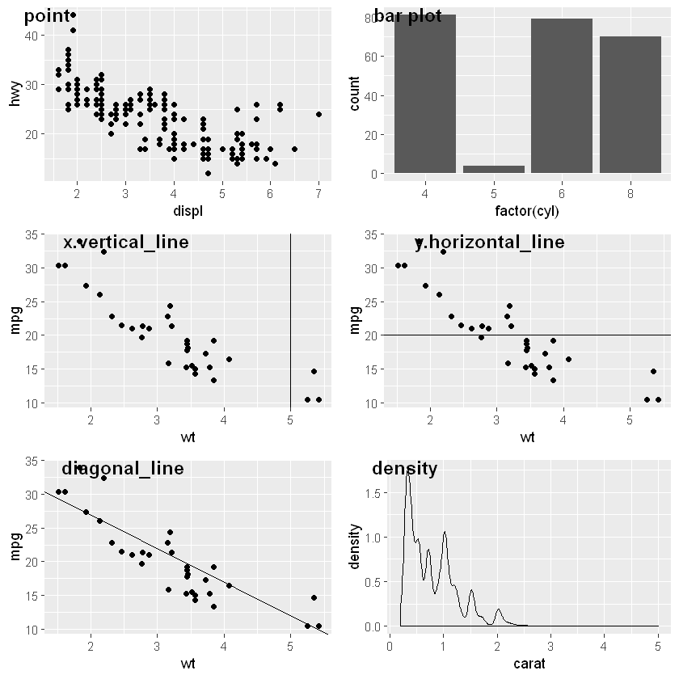
Examples of geometrics
https://cran.r-project.org/web/packages/ggplot2/ggplot2.pdf
2. https://ggplot2.tidyverse.org/
Notes:
8

Slide 9
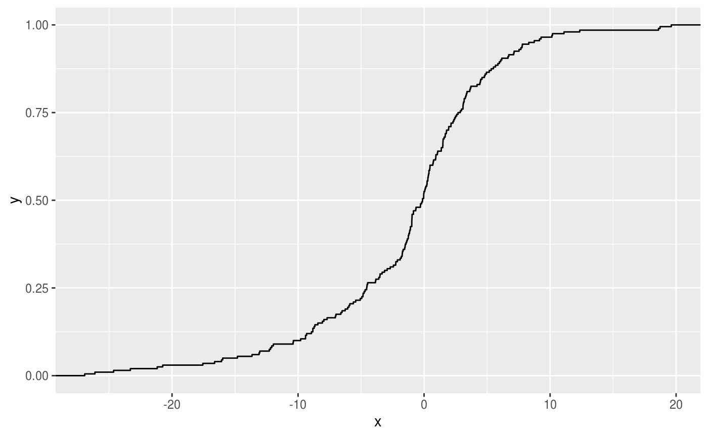
Layer : stat
“stat”, a statistical transformation, transforms the data, typically by summarizing it in some manner.
More functions:
Function | Description
stat_ecdf() | Compute empirical cumulative distribution
stat_ellipse() | Compute normal confidence ellipses
stat_function() | Compute function for each x value
stat_identity() | Leave data as is
stat_summary_2d() stat_summary_hex() | Bin and summarise in 2d (rectangle & hexagons)
stat_summary_bin() stat_summary() | Summarise y values at unique/binned x
stat_unique() | Remove duplicates
stat_sf_coordinates() | Extract coordinates from 'sf' objects
stat() | Calculated aesthetics
Example:
use “stat_ecdf()” to compute empirical cumulative distribution
Notes:
9

Slide 10
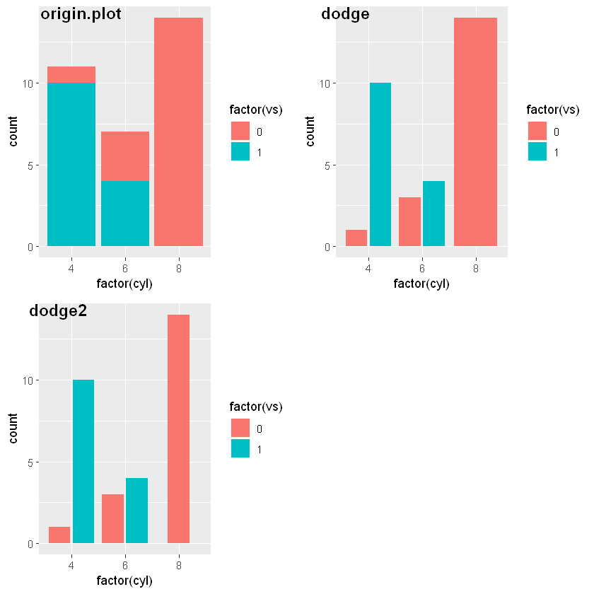
Layer: position adjustment
All layers have a position adjustment that resolves overlapping geoms.
More functions:
Function | Description
position_dodge()/position_dodge2() | Dodge overlapping objects side-to-side
position_identity() | Don't adjust position
position_jitter() | Jitter points to avoid overplotting
position_jitterdodge() | Simultaneously dodge and jitter
position_nudge() | Nudge points a fixed distance
position_stack()/position_fill() | Stack overlapping objects on top of each another
Examples :
Plot with function about dodge and dodge2.
Notes:
10

Slide 11
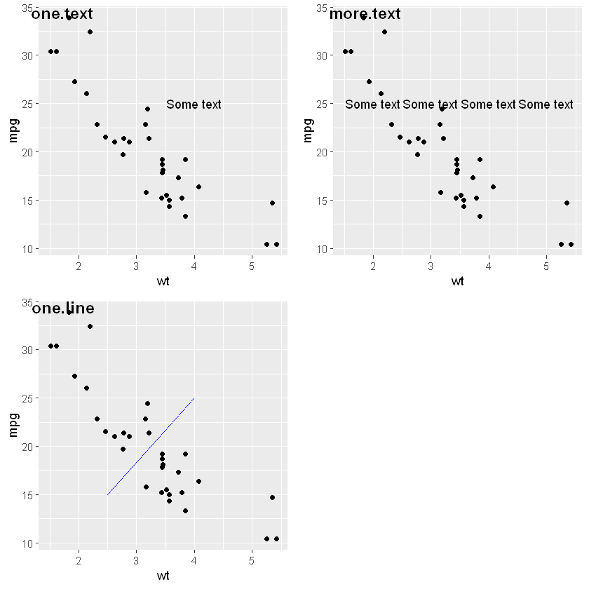
Layer: annotations
Annotations are a special type of layer that don’t inherit global settings from the plot.
They are used to add fixed reference data to plots.
More functions:
Function | Description
geom_abline()/geom_hline()/geom_vline() | Reference lines: horizontal, vertical, and diagonal
annotate() | Create an annotation layer
annotation_custom() | Annotation: Custom grob
annotation_logticks() | Annotation: log tick marks
annotation_map() | Annotation: a maps
annotation_raster() | Annotation: high-performance rectangular tiling
borders() | Create a layer of map borders
Notes:
11

Slide 12
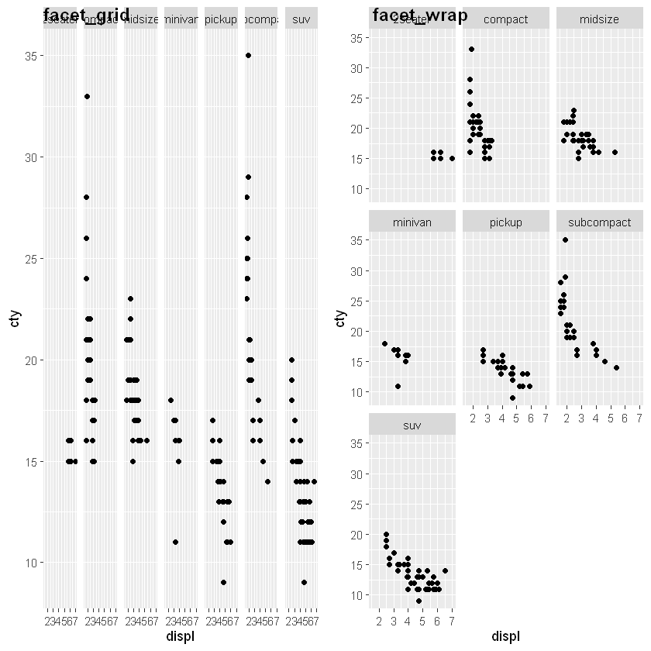
Facetting
Facetting generates small multiples, each displaying a different subset of the data.
Facets are an alternative to aesthetics for displaying additional discrete variables.
More functions:
Function | Description
facet_grid() | Lay out panels in a grid
facet_wrap() | Wrap a 1d ribbon of panels into 2d
vars() | Quote faceting variables
Notes:
12

Slide 13
Scales
Scales control the details of how data values are translated to visual properties.
“labs()” and “lims()” are convenient helpers for the most common adjustments to the labels and limits.
Function | Description
labs() | Modify axis, legend, and plot labels
xlab()
ylab()
ggtitle()
lims()/ xlim()/ ylim() | Set scale limits
expand_limits() | Expand the plot limits, using data
expand_scale() | Generate expansion vector for scales.
scale_alpha() | Alpha transparency scales
scale_alpha_continuous()
scale_alpha_discrete()
scale_alpha_ordinal()
scale_colour_brewer() | Sequential, diverging and qualitative colour scales from colorbrewer.org
scale_fill_brewer()
scale_colour_distiller()
scale_fill_distiller()
scale_colour_continuous() | Continuous colour scales
scale_fill_continuous()
scale_x_continuous() | Position scales for continuous data (x & y)
scale_y_continuous()
scale_x_log10()
scale_y_log10()
scale_x_reverse()
scale_y_reverse()
scale_x_sqrt()
scale_y_sqrt()
scale_x_date() | Position scales for date/time data
scale_y_date()
scale_x_datetime()
scale_y_datetime()
scale_x_time()
scale_y_time()
scale_x_discrete() | Position scales for discrete data
scale_y_discrete()
scale_colour_gradient() | Gradient colour scales
scale_fill_gradient()
scale_colour_gradient2()
scale_fill_gradient2()
scale_colour_gradientn()
scale_fill_gradientn()
More functions:
Notes:
13

Slide 14
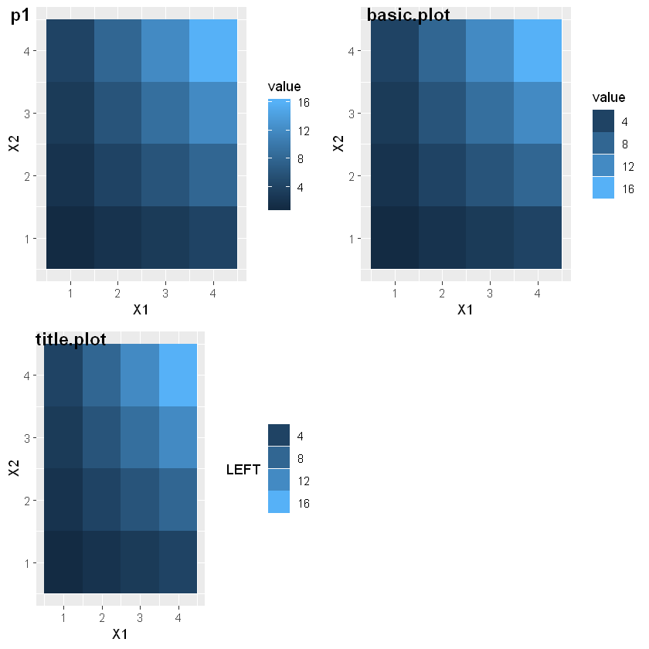
Guides: axes and legends
The guides (the axes and legends) help readers interpret your plots.
More functions:
Function | Description
guide_colorbar() | Continuous colour bar guide
guide_colourbar()
guide_legend() | Legend guide
guides() | Set guides for each scale
sec_axis() | Specify a secondary axis
dup_axis()
derive()
Notes:
14

Slide 15
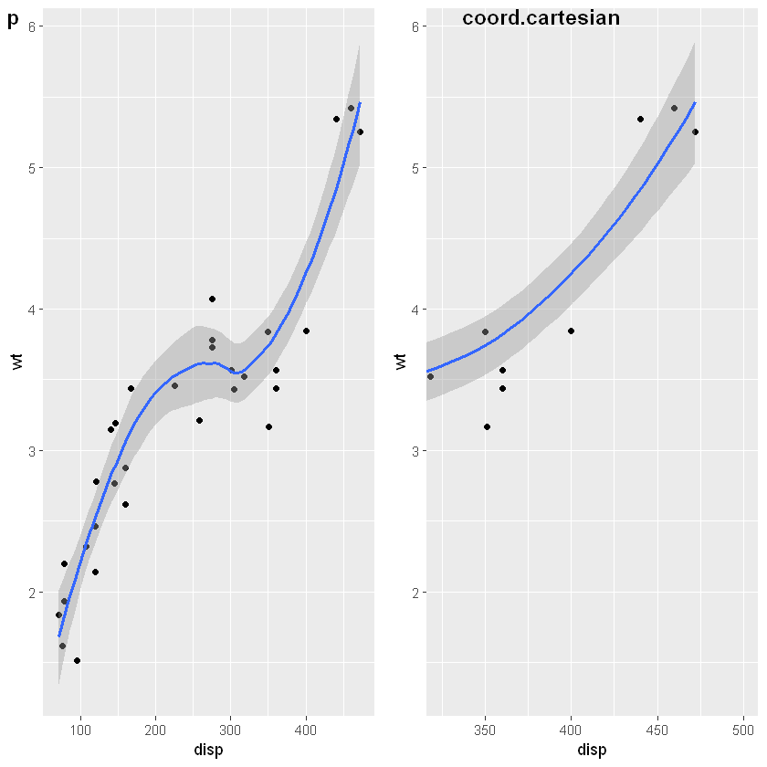
Coordinate systems
The coordinate system determines how the x and y aesthetics combine to position elements in the plot.
More functions:
Function | Description
coord_cartesian() | Cartesian coordinates
coord_fixed() | Cartesian coordinates with fixed "aspect ratio"
coord_flip() | Cartesian coordinates with x and y flipped
coord_quickmap() | Map projections
coord_map()
coord_polar() | Polar coordinates
coord_trans() | Transformed Cartesian coordinate system
Notes:
15

Slide 16
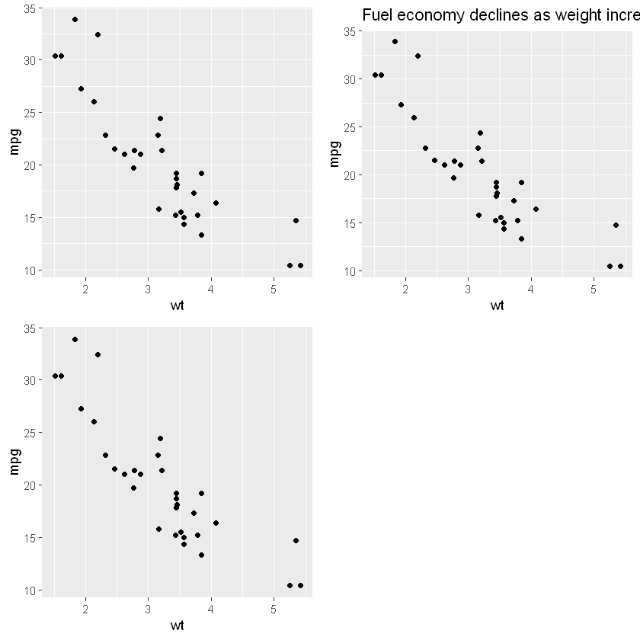
Theme
Themes control the display of all non-data elements of the plot.
More functions:
Function | Description
theme() | Modify components of a theme
theme_gray() | Complete themes
theme_grey()
theme_bw()
theme_linedraw()
theme_light()
theme_dark()
theme_minimal()
theme_classic()
theme_void()
theme_test()
theme_get() | Get, set, and modify the active theme
theme_set()
theme_update()
theme_replace()
`%+replace%`
margin() | Theme elements
element_blank()
element_rect()
element_line()
element_text() rel()
Notes:
16

Slide 17
Exercises
Exercises seen in jupyter notebook : ggplot2.ipython
In fact, there are many functions contributing on creating a complex plot via ggplot2, to get more information, turn to: https://ggplot2.tidyverse.org/reference/index.html

