Slide 1
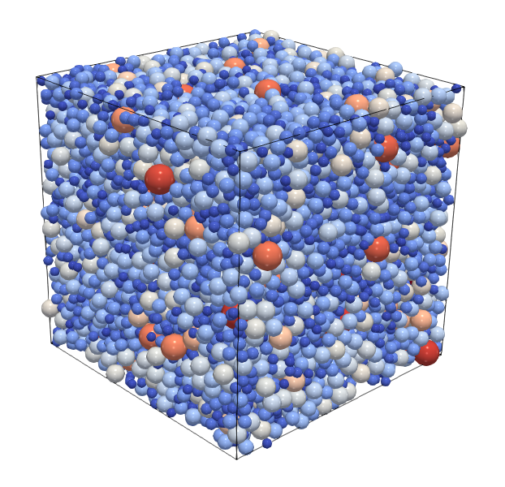
DEMGen
A standard particle packing generator for DEM

