Slide 1
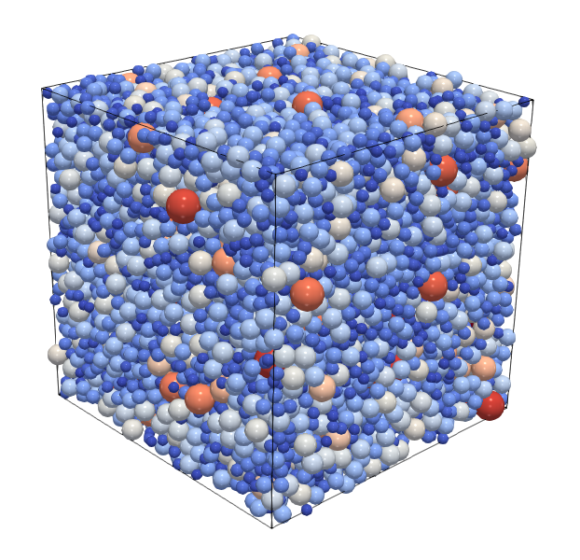
DEMGen
A standardized particle packing generator for DEM

