Slide 1
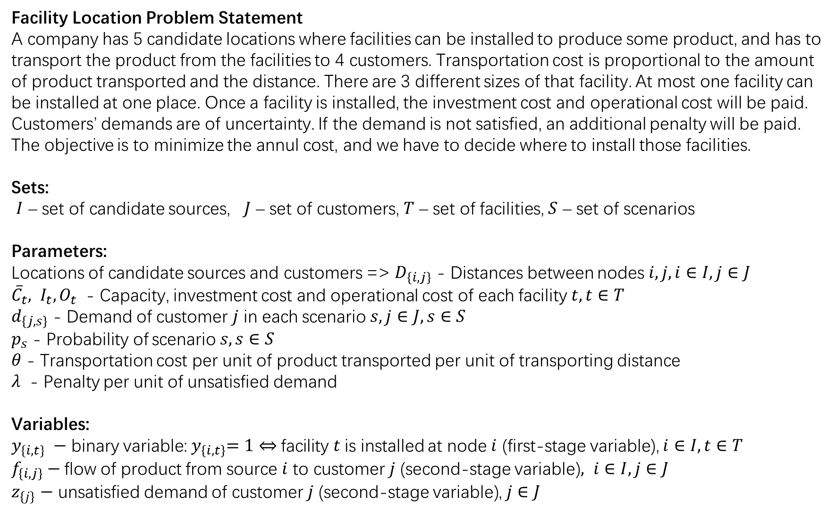
Facility Location Problem Statement
A company has 5 candidate locations where facilities can be installed to produce some product, and has to transport the product from the facilities to 4 customers. Transportation cost is proportional to the amount of product transported and the distance. There are 3 different sizes of that facility. At most one facility can be installed at one place. Once a facility is installed, the investment cost and operational cost will be paid. Customers’ demands are of uncertainty. If the demand is not satisfied, an additional penalty will be paid. The objective is to minimize the annul cost, and we have to decide where to install those facilities.
Sets:
$I$ – set of candidate sources, $J$ – set of customers, $T$ – set of facilities, $S$ – set of scenarios
Parameters:
Locations of candidate sources and customers => $D_{\left\{i,j\right\}}$ - Distances between nodes $i,j, i∈I, j∈J$
${\overline{C}}_{t}, I_{t}, O_{t}$ - Capacity, investment cost and operational cost of each facility $t, t∈T$
$d_{\left\{j,s\right\}}$ - Demand of customer $j$ in each scenario $s, j∈J, s∈S$
$p_{s}$ - Probability of scenario $s, s∈S$
$θ$ - Transportation cost per unit of product transported per unit of transporting distance
$λ$ - Penalty per unit of unsatisfied demand
Variables:
$y_{\{i,t\}} −$ binary variable:${ y}_{\left\{i,t\right\}}=1⇔$facility $t$ is installed at node $i$ (first-stage variable), $i∈I, t∈T$
$f_{\left\{i,j\right\}}−$flow of product from source $i$ to customer $j$ (second-stage variable)$, i∈I, j∈J$
$z_{\left\{j\right\}}$ $−$ unsatisfied demand of customer $j$ (second-stage variable), $j∈J$

Slide 2
Parameters:
#Source | X(km) | Y(km)
A | 0 | 0
B | 10 | 40
C | 45 | 35
D | 60 | 95
E | 100 | 30
Pr 0.33 0.5 0.17
#Customer | X(km) | Y(km)
I | 25 | 55
II | 50 | 65
III | 70 | 15
IV | 90 | 85
d1(t/yr) | d2(t/yr) | d3(t/yr)
120 | 100 | 160
65 | 45 | 90
480 | 390 | 600
275 | 380 | 100
#Facility | Capacity (ton/yr) | Investment ($) | Operational ($/year)
t1 | 100 | 10000 | 1000
t2 | 200 | 16000 | 1600
t3 | 300 | 21000 | 2100

Slide 3

Model:
$$\min_{y} \frac{1}{20}\sum_{i}{\sum_{t}{I_{t}y_{\left\{i,t\right\}}}}+\sum_{i}{\sum_{t}{O_{t}y_{\left\{i,t\right\}}}}+\sum_{s}{p_{s}Q_{s}\left(y\right)}$$
s.t.
$$\sum_{t}{y_{\left\{i,t\right\}}≤1, ∀ i∈I}$$
$$y_{\left\{i,t\right\}}∈\left\{0,1\right\}, ∀ i∈I, ∀ t∈T$$
where
$$Q_{s}\left(y\right)=\min_{z,f}{\sum_{i}{\sum_{j}{θf_{\left\{i,j\right\}}D_{\left\{i,j\right\}}}}+\sum_{j}{λz_{j}}}$$
s.t.
$$\sum_{i}{f_{\left\{i,j\right\}}+z_{j}≥d_{\left\{j,s\right\}}}, ∀ j∈J$$
$$\sum_{j}{f_{\left\{i,j\right\}}≤\sum_{t}{y_{\left\{i,t\right\}}}}{\overline{C}}_{t}, ∀ i∈I$$
$$f_{\left\{i,j\right\}}≥0, z_{j}≥0, ∀i∈I, ∀ j∈J$$

