Slide 1
混合遗传算法及应用
开题报告

Slide 2
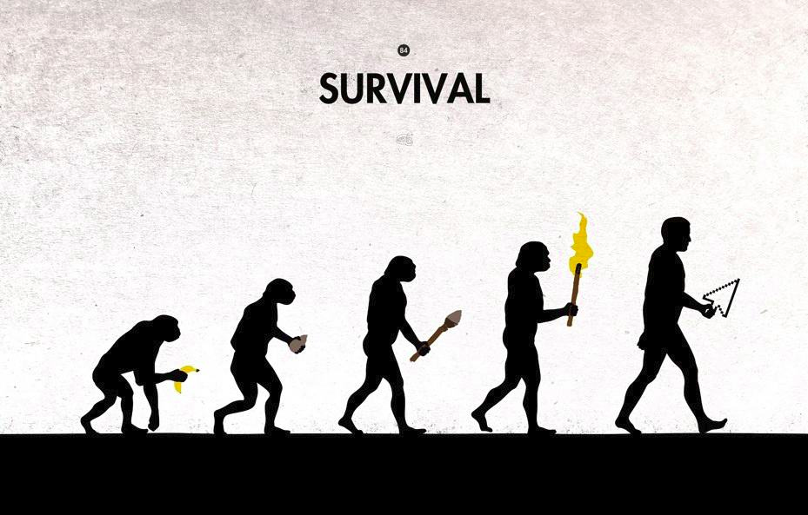
Genetic algorithm
-John Holland
Adaption in Natural and artificial system, 1975
-Inspired by and loosely based on Darwin's Theory
survival of the fittest
-Basic Ideas
Each solution to the problem is represented as a chromosome
The initial solution may be randomly generated
Solutions are evolved during generations
Improved gradually based on the principle of natural evolution

Slide 3
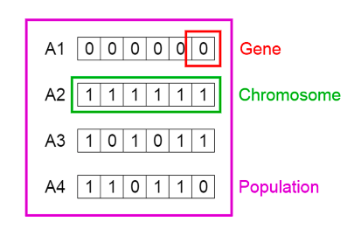
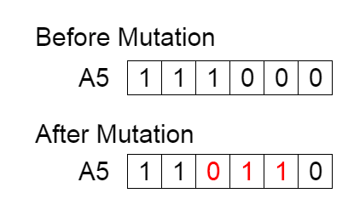
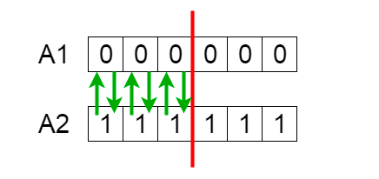
Basic Components
-Represemtation
Individual(Chromosome)
A vector that represents a specific solution to the problem
Population
A set of individuals
GAs maintain and evolve a population of individuals
parallel search→Global optimization
-Genetic operators
Crossover
Exchange genetic materials between two chromosomes
Mutation
Randomly modify gene values at selected locations
-Selection strategy
Select the offspring which has the opportunity to survive
(Roulette Wheel Selection, Rank Selection, Tournament Selection)

Slide 4
GA Framework
Initialization: Generate a random population P of M individuals
Evaluation: Evaluate the fitness f(x) of each individual
Repeat until the stopping criteria are met:
Reproduction: Repeat the following steps until all offspring are generated
Parent Selection: Select two parents from P
Crossover: Apply crossover on the parents with probability P_{c}
Mutation: Apply mutation on offspring with probability P_{m}
Evaluation: Evaluate the newly generated offspring
Offspring Selection: Create a new population from offspring and P
Output: Return the best individual found

Slide 5
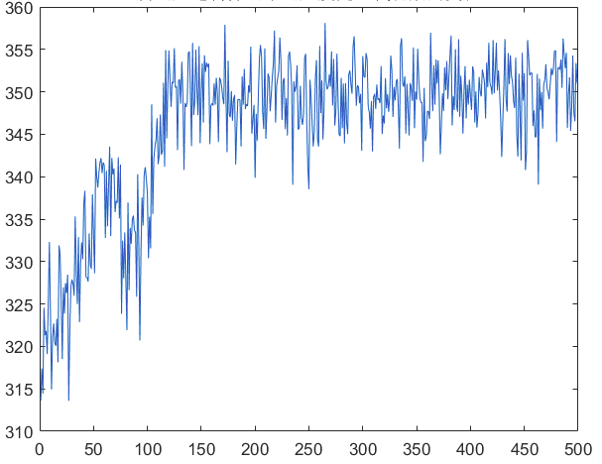
Weakness
-Degeneracy
The two genetic operator make individuals change randomly and indirectly during the whole process, they not only give the individuals the evlutionary chance but also cause certain degeneracy.
-Meeting an actual situation
The crossover and mutation operators in GA lack the capability of meeting and actual situation, so that some torpidity appears when solving problems, which is conducive to the universality of the algorithm but neglects the assistant function of the characteristics or knowledge.

Slide 6
Improvement && Experiment
-Adaptive Genetic Algorithm
-hybrid genetic algorithm
-Travelling sales person problem
-Clustering

