Slide 1
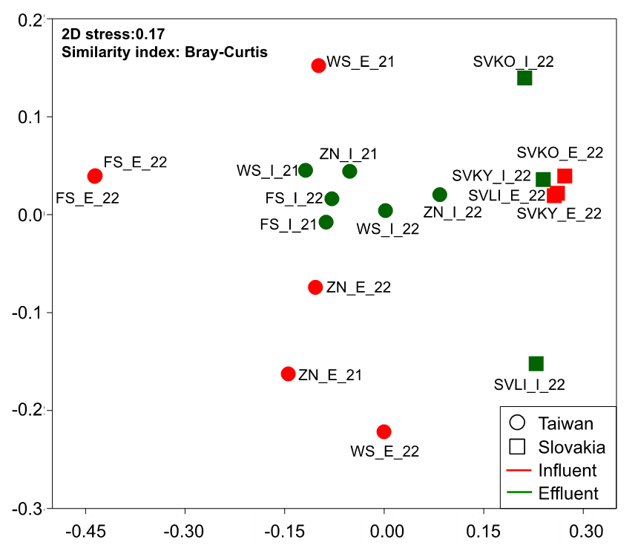
Figure S1. Non-metric multidimensional scaling (NMDS) ordination of taxonomic profiles of the samples in this study.

Slide 2
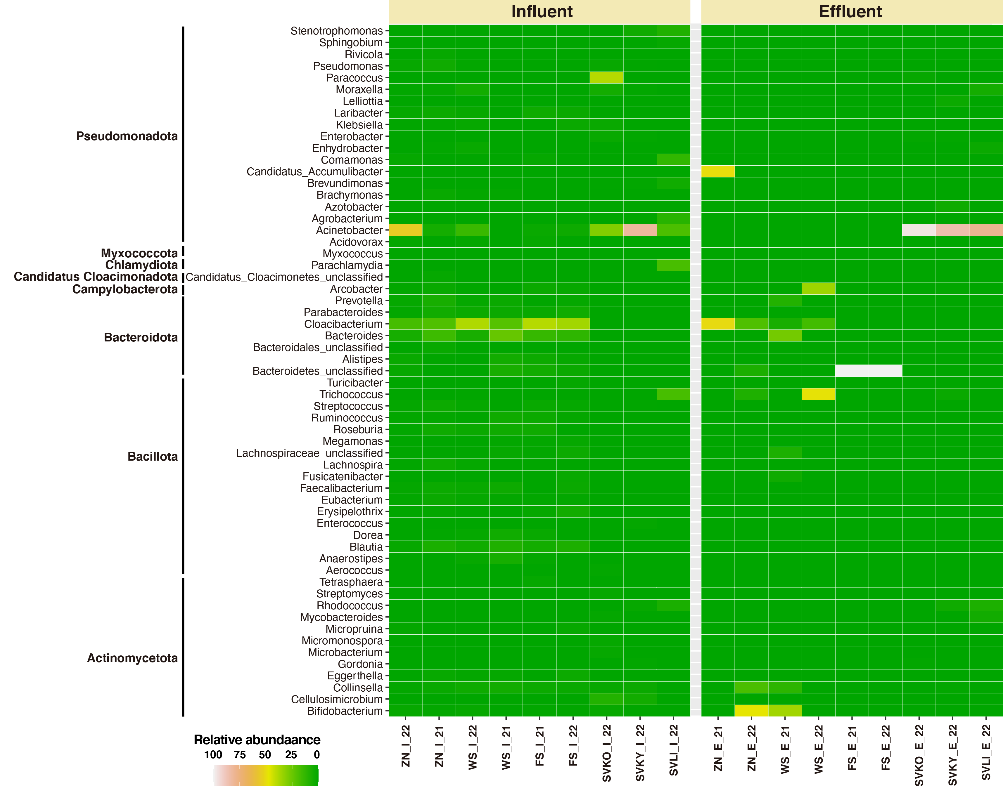
Figure S2. Heatmap illustrating the distribution of relative abundance of bacterial genera detected in influent and effluent samples from WWTPs in Taiwan and Slovakia. The corresponding phylum taxa are shown at the left of the panel. Sample information refers to Table S1. WWTP site: WS, ZN, and FS designated for the sites in the central, northern, and southern in Taiwan, respectively. SVKO, SVKY, and SVLI represented the sites in Komárno, Kysucké Nové Mesto, and Liptovský Mikuláš in Slovakia, respectively. Sample location: I and E designated for the influent and effluent samples of WWTPs, respectively. Sampling year: 21 and 22 designated for the samples at 2021 and 2022, respectively.

Slide 3
Influent
Effluent
Figure S3. Relative concentrations of ARGs categorized in corresponding drug classes in the (a) influent and (b) effluent samples of WWTPs in Taiwan and Slovakia.

Slide 4
(a)
(b)
Figure S4. Box plot illustrating the distribution of plasmid- or chromosomal-based core ARGs in the effluent samples from (a) Taiwan and (b) Slovakia. p-values are annotated as follows: ns (not significant) for p > 0.05, * for p < 0.05, ** for p < 0.01, *** for p < 0.001, and **** for p < 0.0001.

Slide 5
Figure S5. Distribution and relative concentrations of metal resistance genes in the corresponding metal classes in influent and effluent samples of WWTPs in Taiwan and Slovakia.

