Slide 1

Course Timetable Project
Programming : Java Programming Language
Taught By Professor: Mr Chim Bunthoeurn
RUPP, Year 3, Semester 2, Group 2

Slide 2
Group Member
Try Chenhai
Nhak Seakleang
Souern Rothana
Kong Pengsea
Tres Sambath

Slide 3
Problem
Course Timetable is schedule of Instructor and Student that was managed by the institution’s employees or the university’s employees.
It is important and difficult to manage it.
To make this task to easy manage , We need to have some information such as Classrooms, Courses, Instructors, Student and Timetable for instructor and student for current semester.

Slide 4
Solution
To Solution the problem above :
Create form for user to security to using system by Login, Sign up , and Reset Password.
Create form data entry to allows the user to add, update, delete, search from database administrative on each form such Faculty, Department, Classroom, Course, Instructor, Student, Timetable, etc.

Slide 5
Solution
Create database to store data info by using store procedure.
Create report for these information like report for Faculty, Faculty, Department, Classroom, Course, Instructor, Student, Timetable, etc

Slide 6




Requirement
Java Programming
NetBeans IDE
Microsoft SQL Sever
Crystal Report

Slide 7
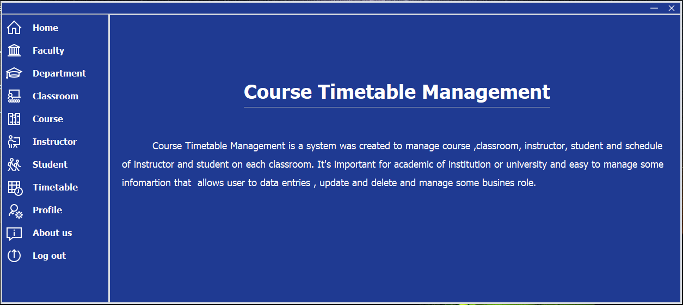
Demo

Slide 8
Thank You for pay attention !

