Slide 1
CAMP DIGITAL 2026
Hiring is broken.
What we measure, AI has eaten.
What now matters, we do not test for.
Aditya Shah · Final-year CS, University of Manchester
Camp Digital 2026 · Royal Northern College of Music, Manchester
Notes:
[0:00 — 4:20] This slide stays up for the entire spoken talk. Switch to slide 2 (QR codes) at the start of the Basanite plug.
FULL SCRIPT:
[0:00 — opening scene]
There is an app called Cluely. It runs underneath the screen-sharing layer when a candidate joins your video call. It feeds them real-time AI answers to whatever question you ask. The interviewer sees a clean desk. The candidate sees the answer.
Cluely was started by a Columbia student who got expelled for it. Within a year he raised millions in venture capital from investors who knew exactly what he had built. There are now half a dozen tools just like it.
In June last year, fifteen percent of people taking technical interviews were using one. By December, thirty-five percent. The trajectory says it is the majority by the end of this year. They are not getting caught. They are getting hired.
[~0:50 — not just engineers]
This is not an engineering hiring problem only. Seventy-five percent of global knowledge workers now use AI tools daily. Designers, researchers, copywriters, analysts. The same cheating tools work on any screen-share. They will draft your case study, write your design rationale, fabricate your research insights. Gartner forecasts that one in four candidate profiles globally will be fake by 2028. The hiring problem is knowledge-work-wide. And if you hire designers, researchers, or content people, you are going to feel this within twelve months.
[~1:25 — what changed]
The skills that mattered for the last twenty years were retrievable. Things you could memorise. Frameworks. Methods. Definitions. You tested for them on a whiteboard, in a portfolio walkthrough, in a written brief. If a candidate could reproduce them under pressure, that was decent signal.
That assumption no longer holds. Twenty-five percent of all new code at Google is written by AI. Designers are using Figma AI to generate flows. Researchers are using ChatGPT to draft personas. The execution layer of knowledge work is being absorbed.
The bottleneck is the thing AI is worst at. Knowing when the model is confidently wrong. Knowing when to reframe a problem instead of solving the wrong one faster. Knowing where the edge of competence is and when to override it.
That is the new core skill. Not using AI. Calibrating it. And almost no hiring process measures it.
[~2:20 — personal stake + Dell'Acqua]
I will be honest. I am the wrong person to lecture anyone in this room about how to hire. I am twenty-three, a final-year student in Manchester, and I have not hired anyone in my life. What I have done is sit on the candidate side of more interviews than I can count, and spent the last six weeks deep in the data on what is happening to hiring right now.
The Harvard and BCG frontier study from last year tells you most of what you need to know. Seven hundred consultants, real client tasks, half with AI and half without. For tasks within the model's competence, the AI users were twenty-five percent faster and produced higher-quality work. For tasks just outside it, the same AI users were nineteen percent more likely to be wrong than the consultants without it. They could not feel where the edge was. They trusted confident-sounding output.
That blindness, to the boundary of what AI can actually do, is the capability that matters most now in any knowledge role. A designer who cannot tell when the AI suggestion is plausible but wrong will ship wrong work faster. A researcher who cannot tell when the synthesis is hallucinated will mislead a stakeholder more confidently. And we are not testing for that capability anywhere.
[~3:35 — the new instrument]
So what does the new instrument look like.
It does not stop candidates using AI. It requires them to use it, on a real piece of work in your domain. It triangulates two signals. How they think under conversational pressure. How they actually ship when they sit down to do the work. It produces evidence, not opaque scores, so the human in the final round knows exactly what to probe. The hiring decision stays with the human. The instrument just stops you flying blind.
*** SWITCH TO SLIDE 2 NOW ***
[~4:20 — Basanite plug, last 30 seconds]
That is what we are building at Basanite. We started with technical hires because the cheating problem was loudest there, but the philosophy generalises to design, research, content, product, anything where AI is changing what good looks like. Live at basanite.co.uk, QR code on the right. First paid pilots this month. If anyone here wants honest reactions or wants to put it on a hire of yours, scan the QR on the left and connect with me on LinkedIn, or just find me afterwards.
[~4:50 — landing line]
We have spent twenty years screening for what AI is replacing.
We need to start screening for what it can't.
Thank you.

Slide 2

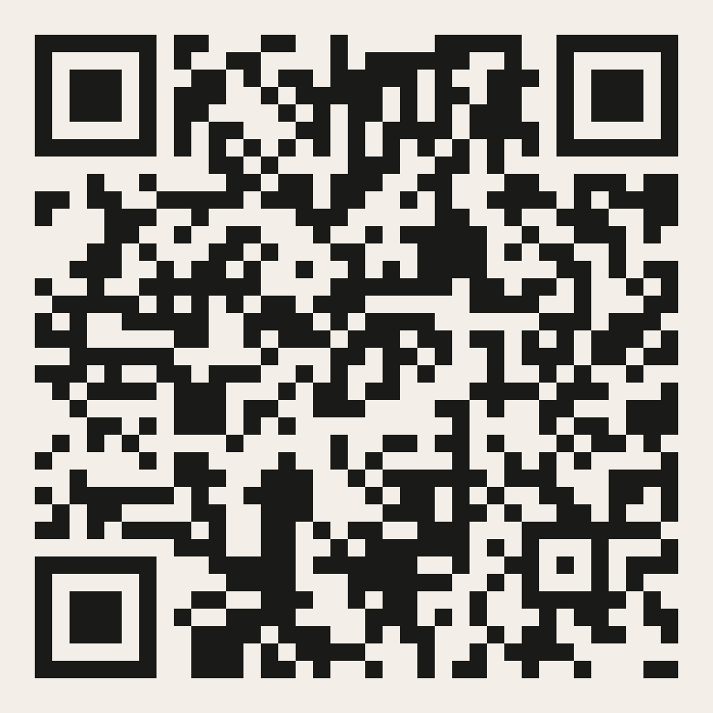
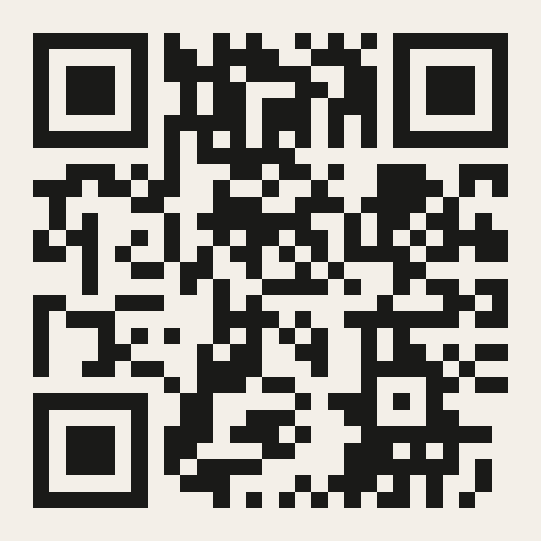
Basanite
Two ways to keep the conversation going.
CONNECT ON LINKEDIN
TRY BASANITE
Aditya Shah
First paid pilots this month
Notes:
[~4:20 — end] Switch to this slide at the start of the Basanite plug. Leave it up for any Q&A and conversations afterwards.
Left QR → linkedin.com/in/adityashah100
Right QR → basanite.co.uk

