Slide 1
Probabilistic constituent parsing: why and how?

Slide 2
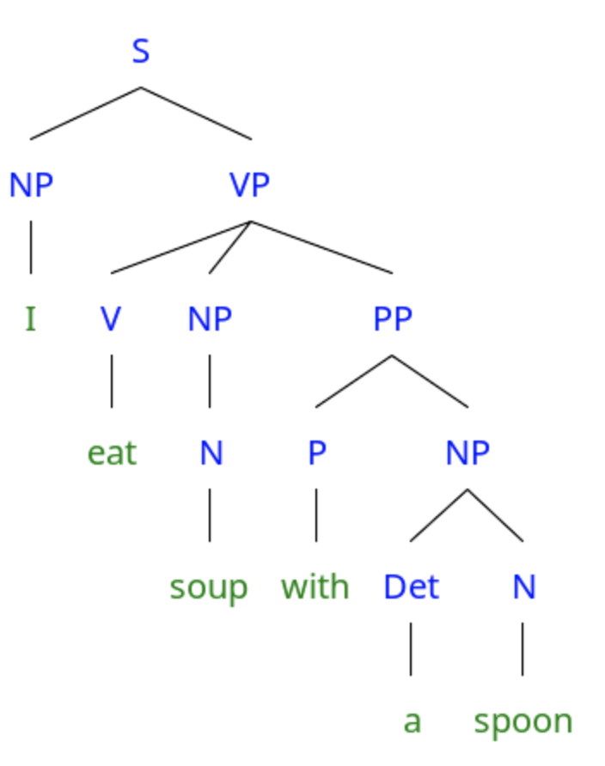
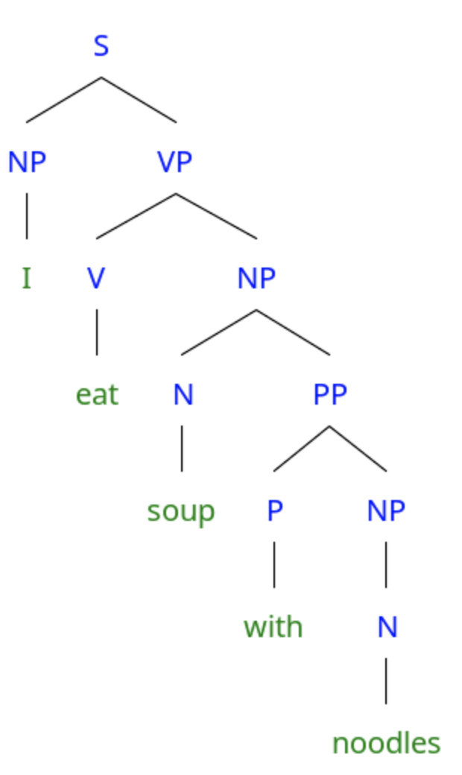
Syntactic ambiguity
S → NP VP
VP → V NP PP
VP → V NP
NP → N
NP → N PP
NP → Det N
PP → P NP
P → with
Det → a
NP → I
V → eat
N → soup / spoon / noodles
(Mostly) disambiguated by plausibility

Slide 3
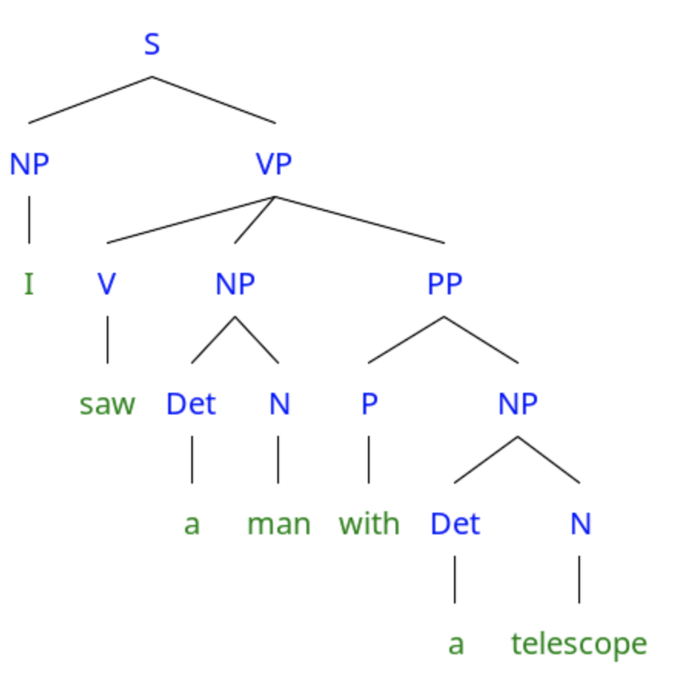
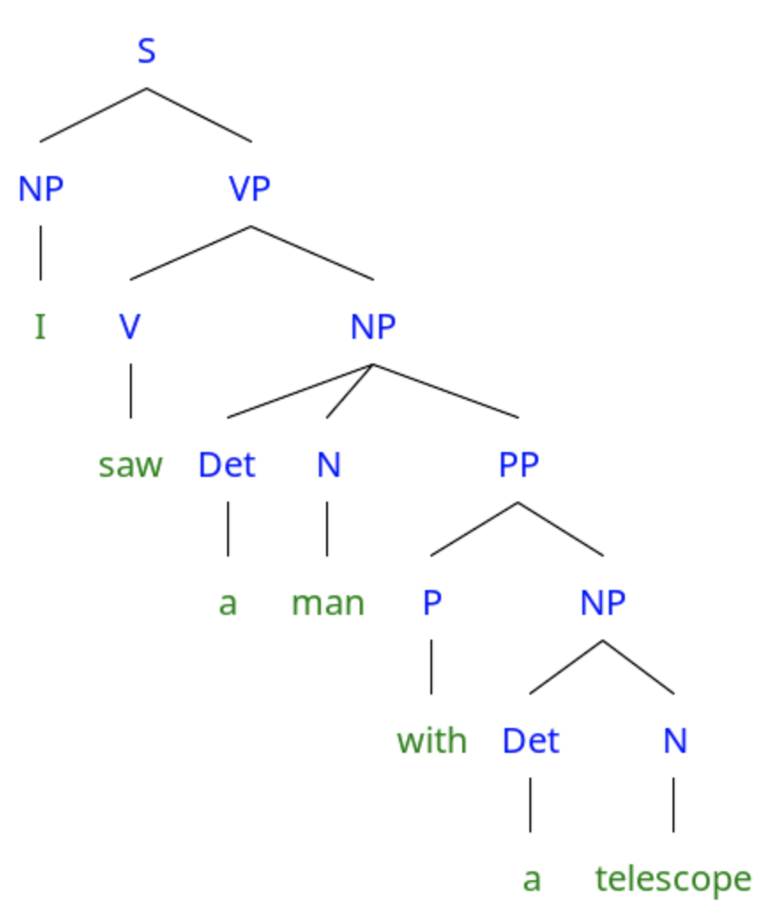
Syntactic ambiguity
S → NP VP
VP → V NP PP
VP → V NP
NP → Det N PP
NP → Det N
PP → P NP
Another source of disambiguating information: rule probability (based on our experience)

Slide 4
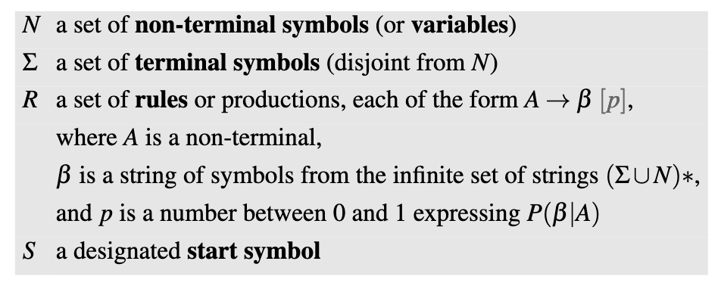
Probabilistic context-free grammar

Slide 5
Probabilistic context free grammars
S → NP VP (1)
VP → V NP PP (0.5)
VP → V NP (0.5)
NP → Det N PP (0.2)
NP → Det N (0.8)
PP → P NP (1)
$${\text{parse}}_{1}$$
$${\text{parse}}_{2}$$
$$P({\text{parse}}_{1})=1×0.5×0.8×1×0.8$$
$$P({\text{parse}}_{2})=1×0.5×0.2×1×0.8$$

Slide 6
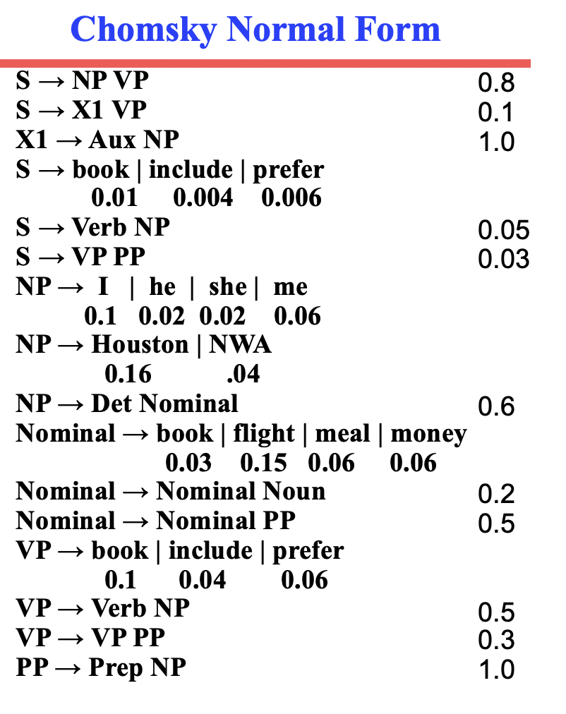
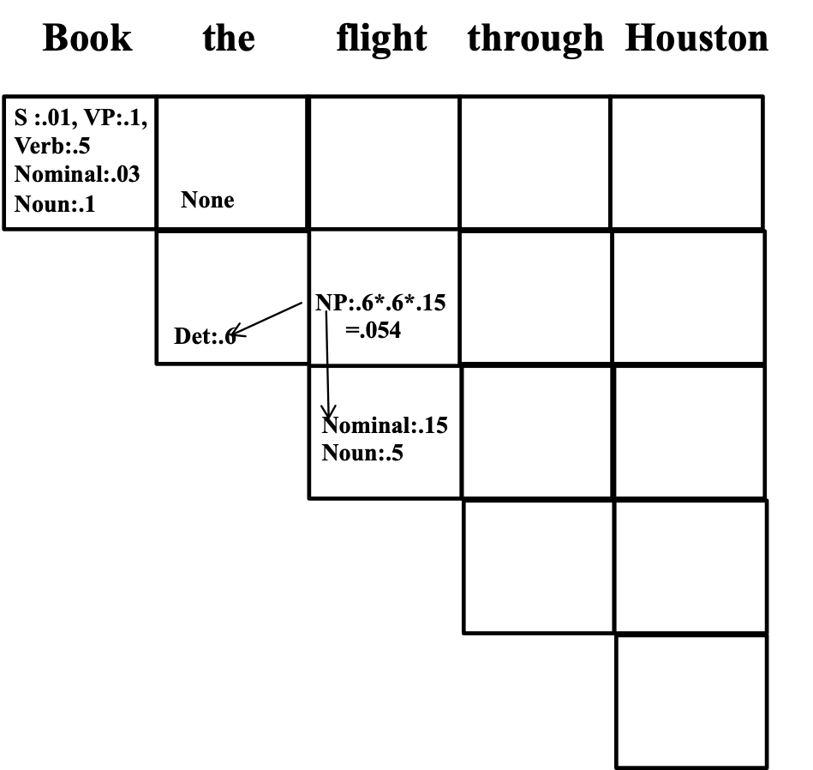
Probabilistic CKY
Goal: find most likely parse
Store maximal probability NP
in chart cells
(Credit: Ray Mooney)

Slide 7
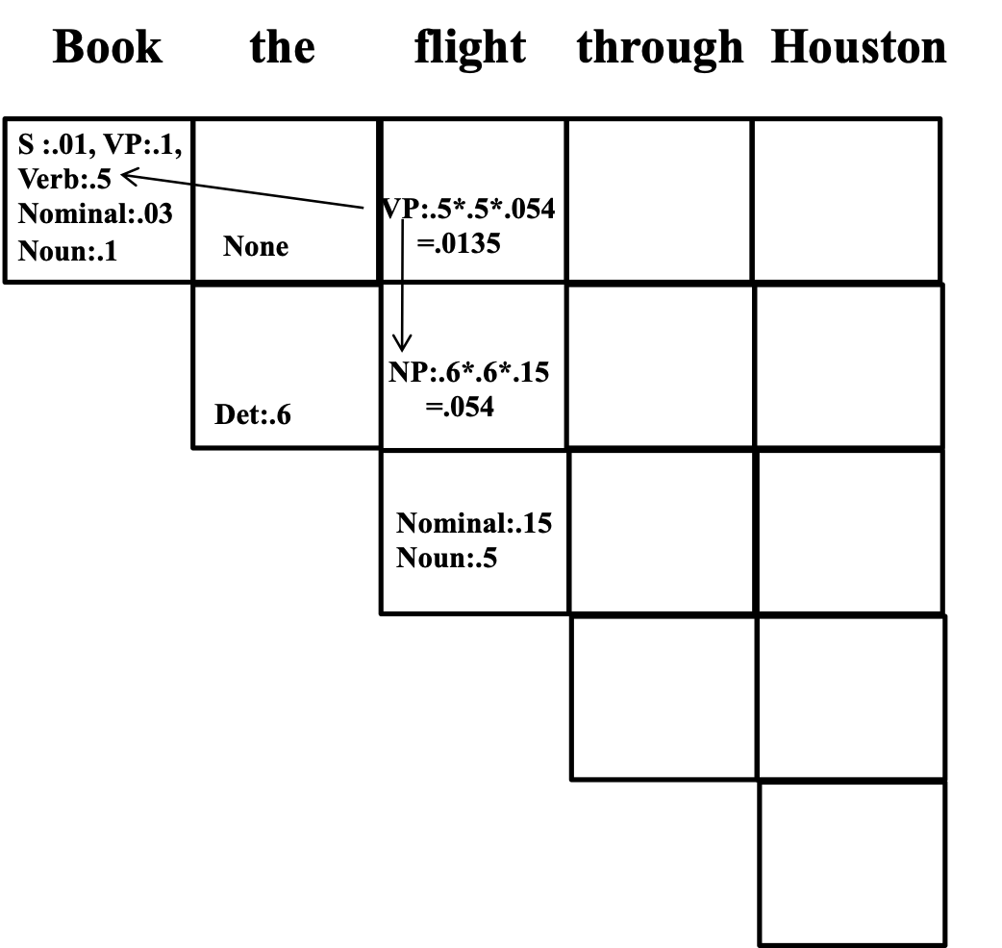
Probabilistic CKY

Slide 8
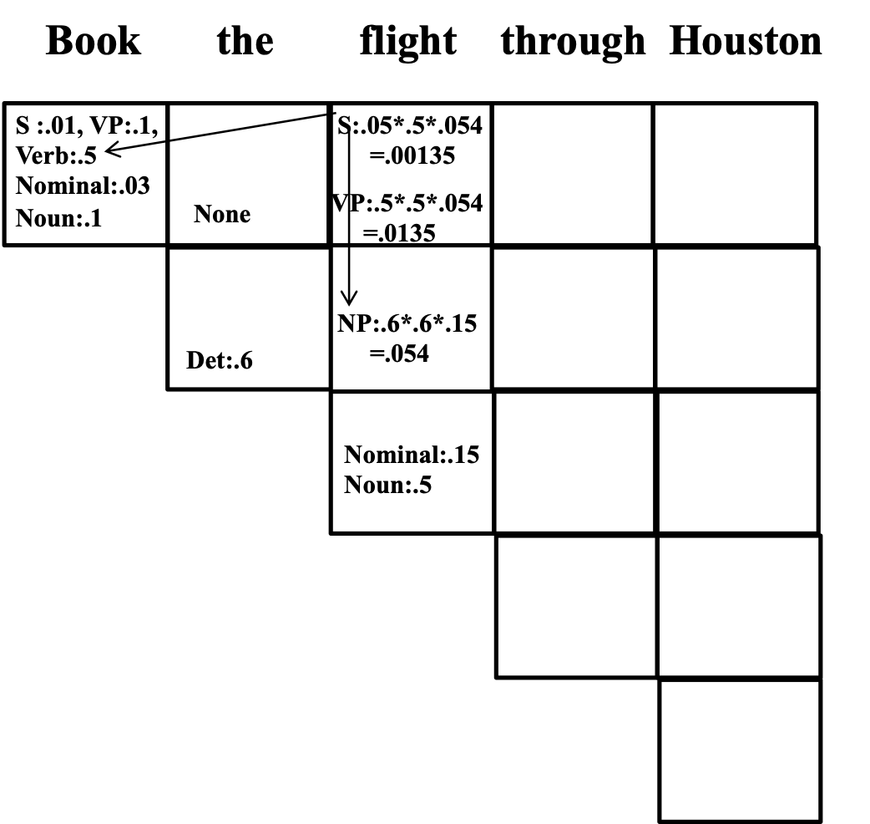
Probabilistic CKY

Slide 9
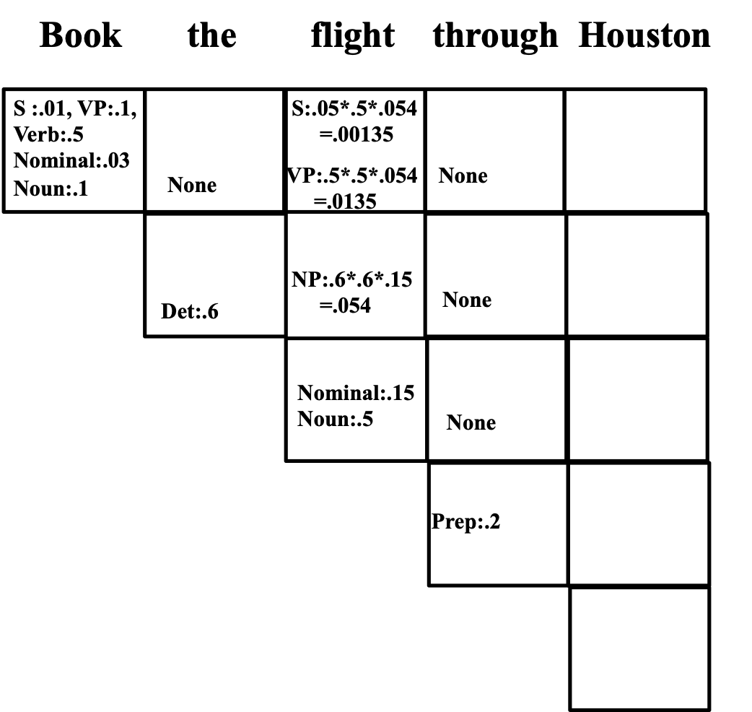
Probabilistic CKY

Slide 10
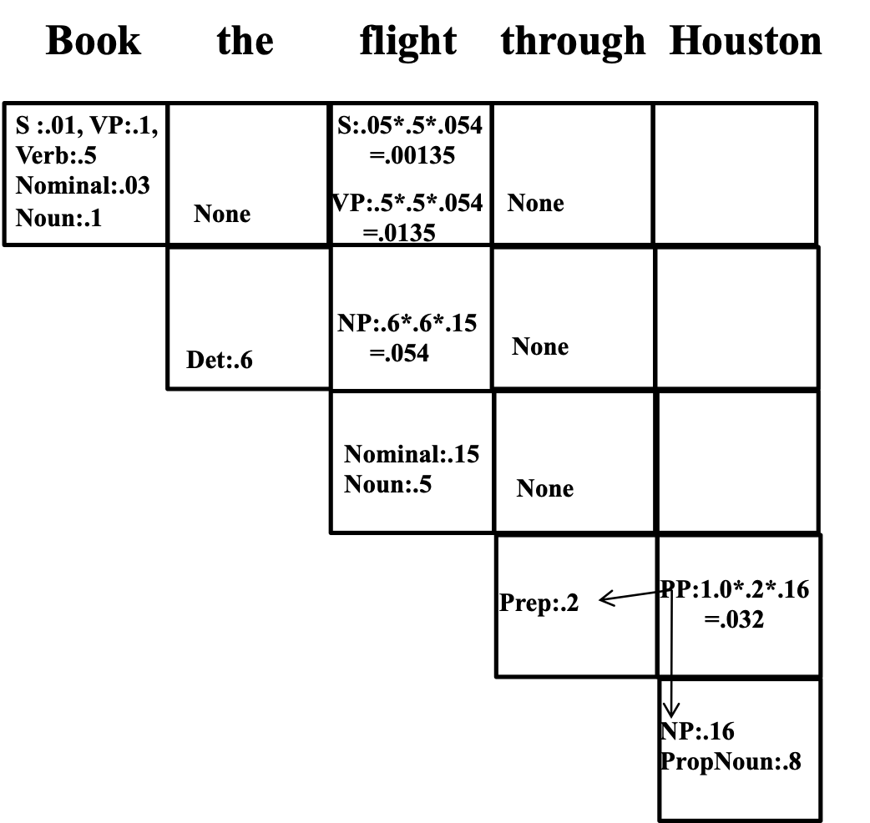
Probabilistic CKY

Slide 11
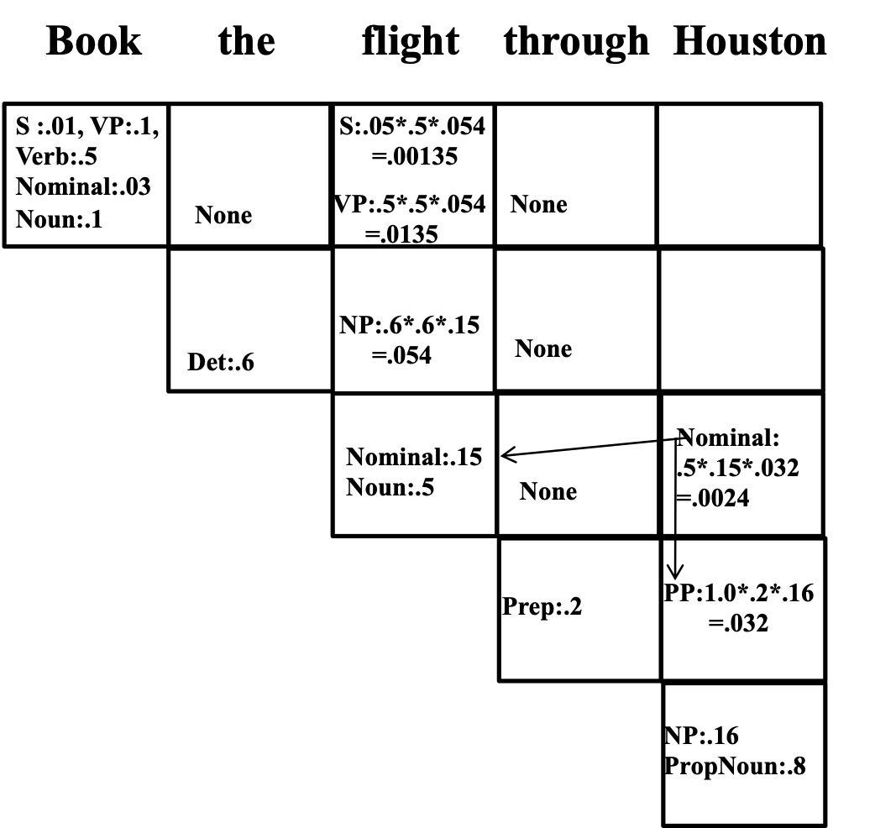
Probabilistic CKY

Slide 12
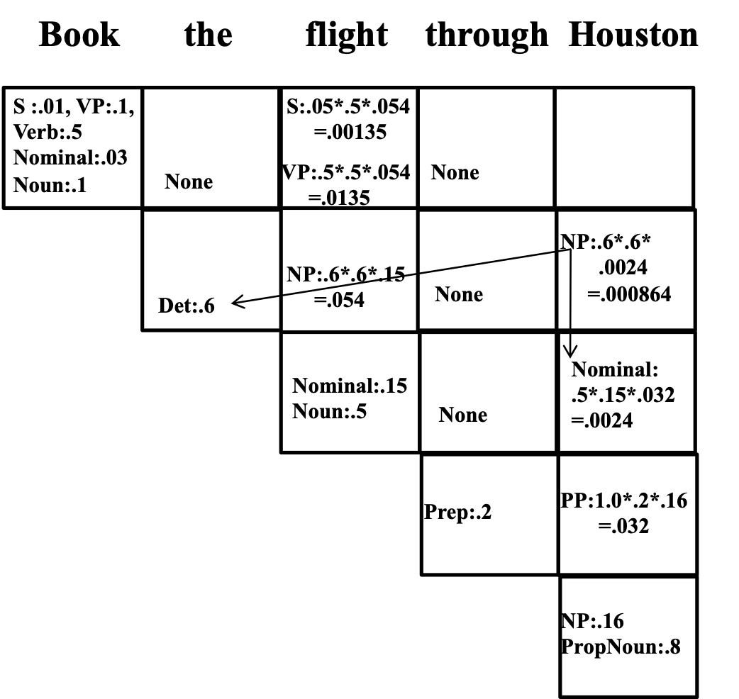
Probabilistic CKY

Slide 13
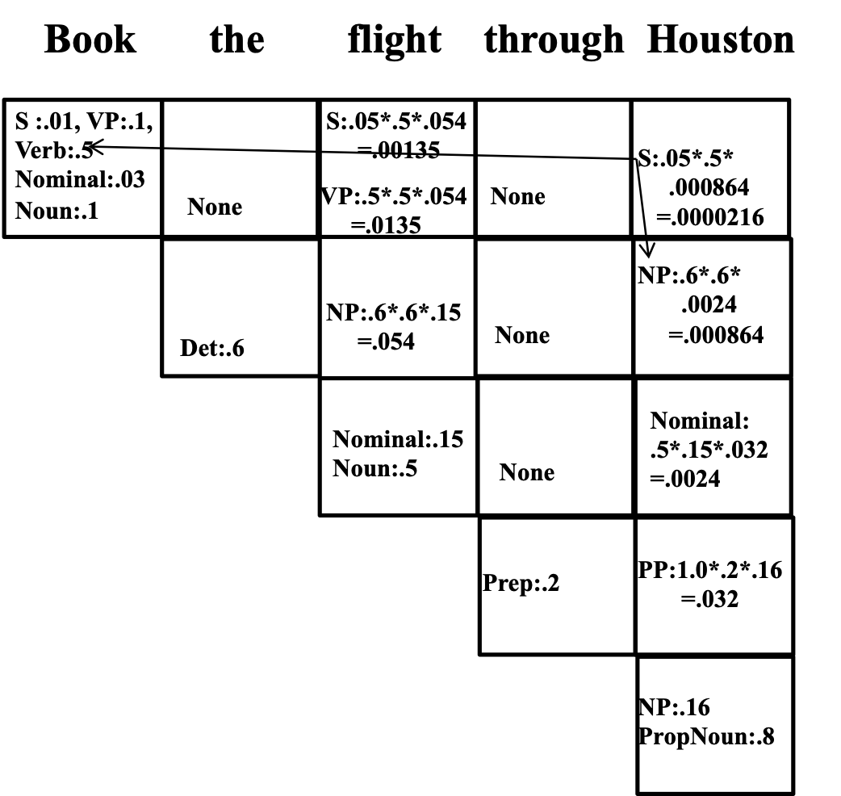
Probabilistic CKY

Slide 14
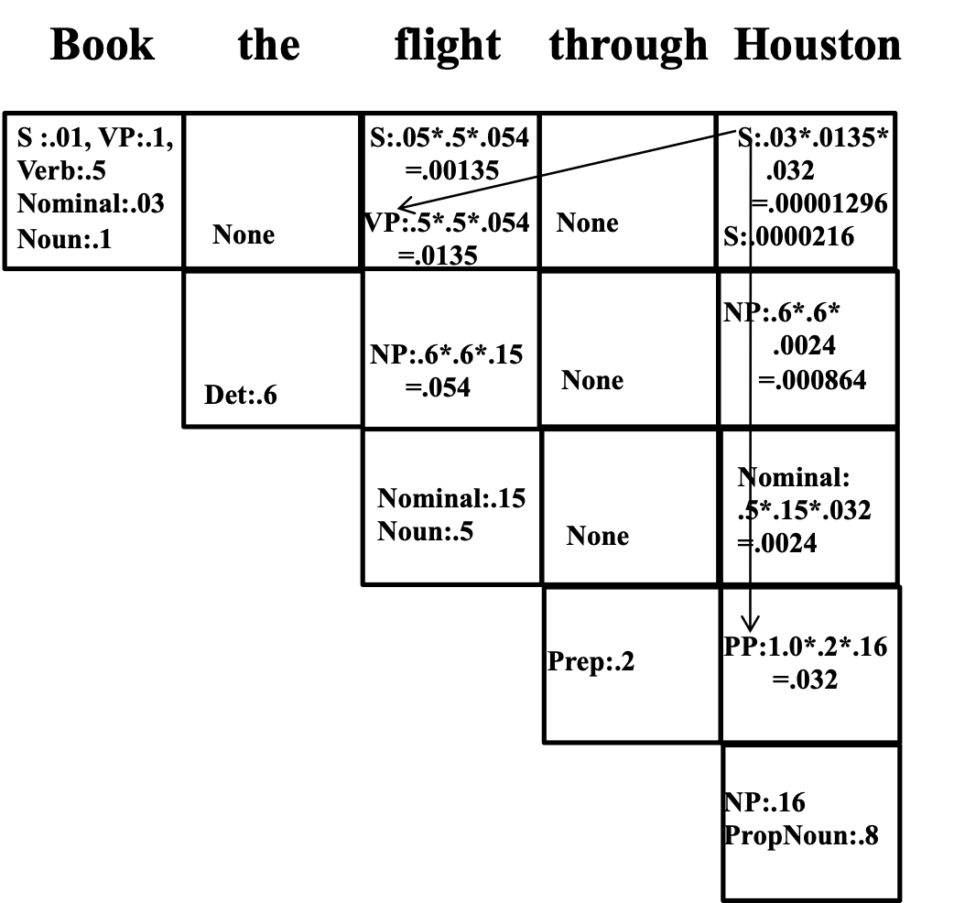
Probabilistic CKY

Slide 15
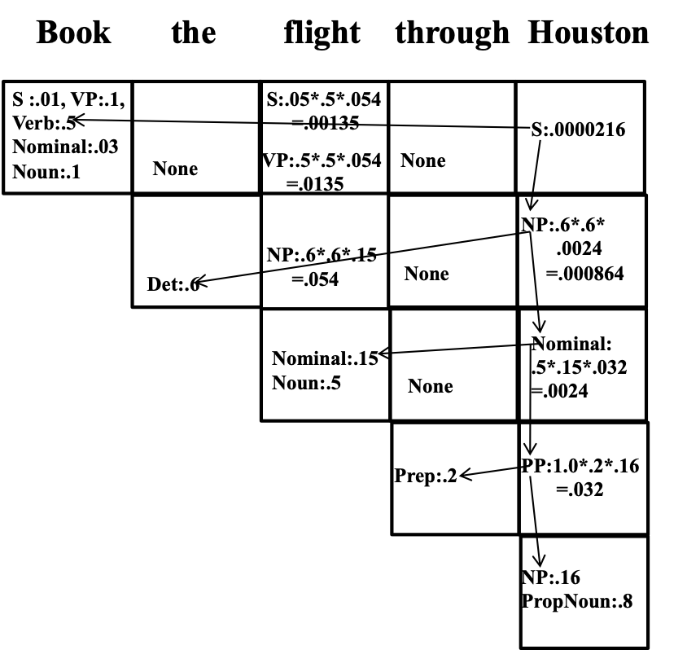
Probabilistic CKY
Why do we only take the highest probability example of a particular category?
Can we have just one category per cell?
Why doesn’t the top right corner (S) sum to one?
What if the top right corner is left empty at the end?

Slide 16
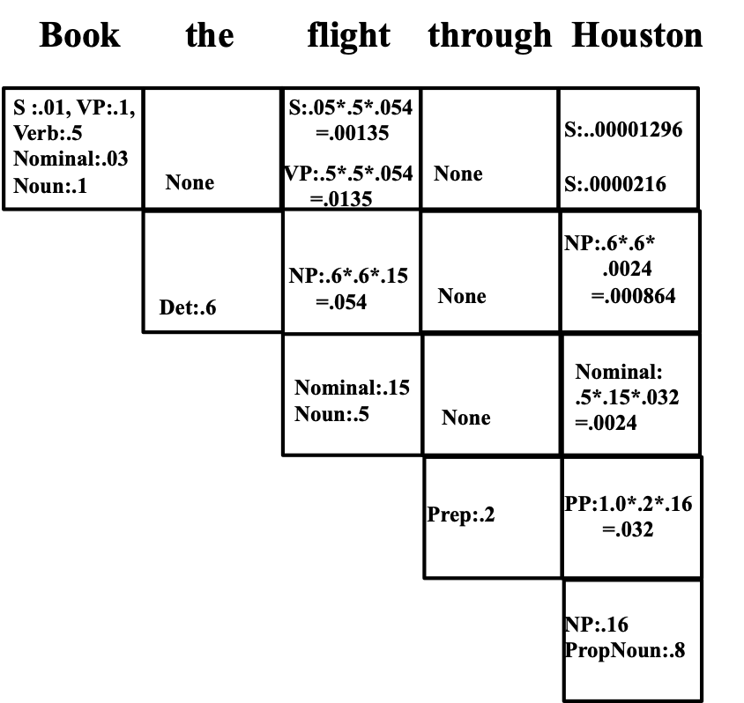
What if we want the probability of a string rather than a parse?
The probability of a string is the sum of the probabilities of all of its possible parses

Slide 17
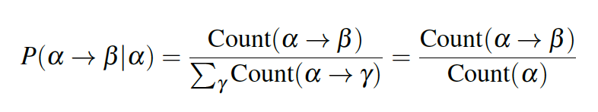
How can we estimate the probability of PCFG rules?
English Penn Treebank: About 1.2 million words from the Wall Street Journal

Slide 18
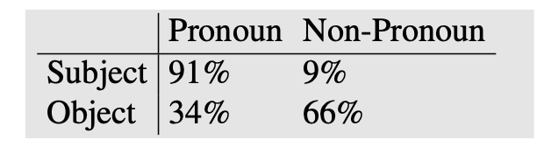
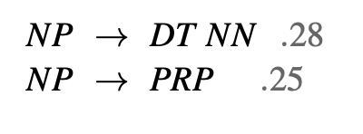
PCFGs make strong independence assumptions
Can’t capture this asymmetry using rules such as:

Slide 19
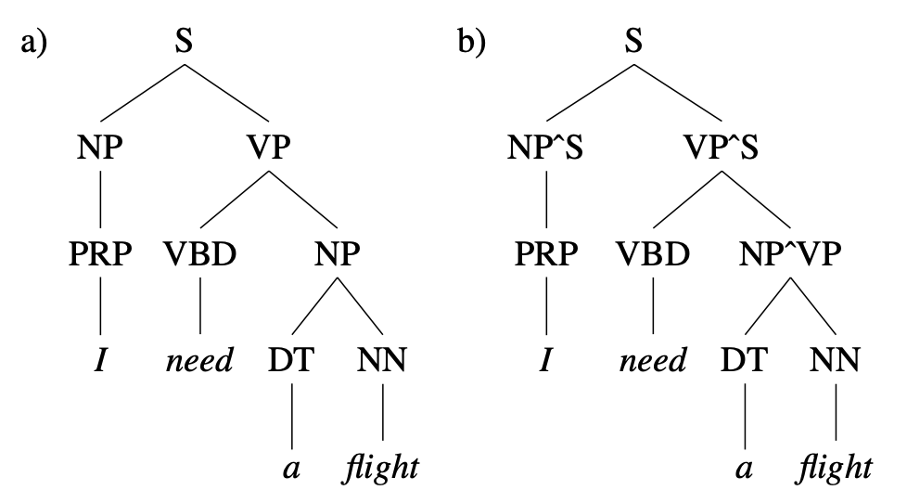
Relaxing independence assumption using parent annotation

Slide 20
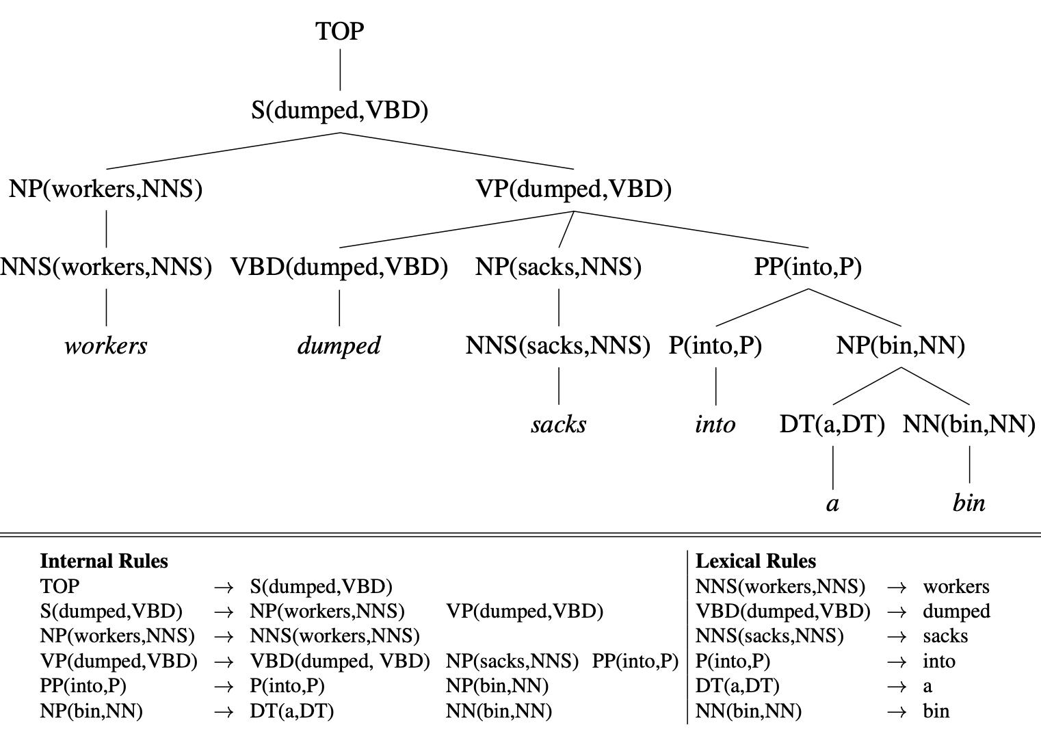
A lexicalized grammar can express verb-specific attachment preferences

Slide 21
Applications: PCFG language model
We can use a PCFG to help us disambiguate perceptual input:
P(I want to recognize speech.) >
P(I want to wreck a nice beach.)
What are we missing if we want to calculate the conditional probability of each word, sequentially?
$$P(w_{n}|w_{1},…,w_{n-1})$$
“An Efficient Probabilistic Context-Free Parsing Algorithm that Computes Prefix Probabilities” (Stolcke 1995)

Slide 22
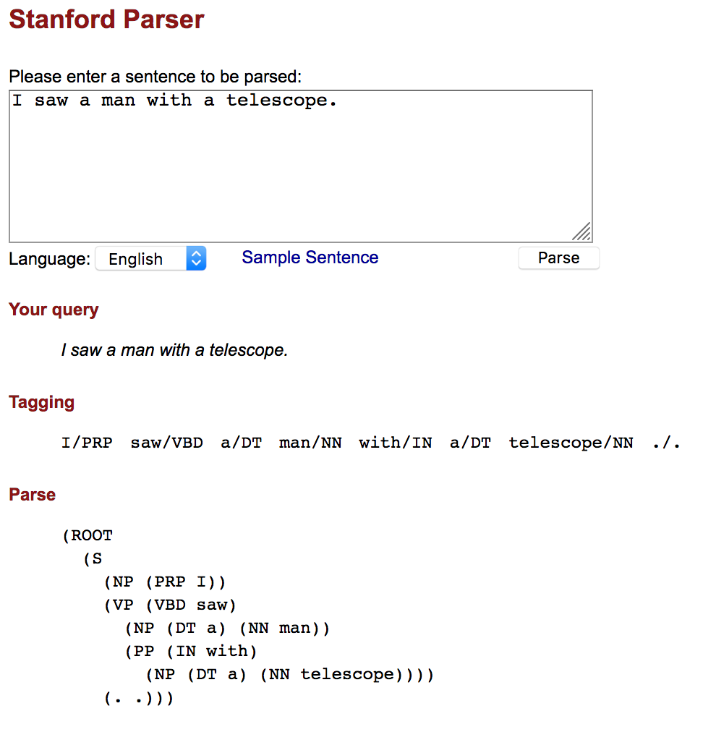
Applications: parsing
Determining the most probable parse of a sentence
Statistical parsers are trained on a parsed corpus (a “Treebank”)
Parses can be useful in NLP (applied natural language processing)
http://nlp.stanford.edu:8080/parser/

Slide 23
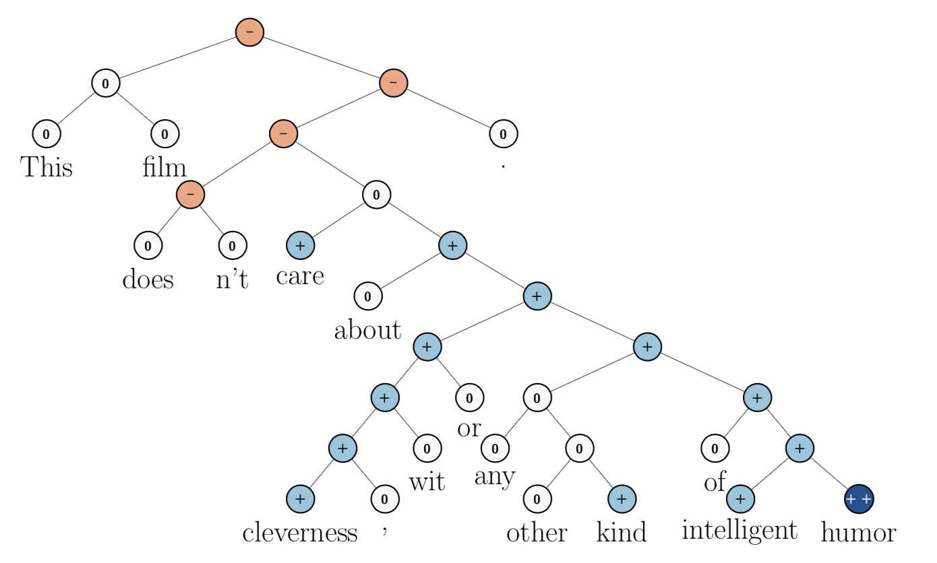
Applications: sentiment analysis
Is this a positive or negative review of the film?
(Socher et al, 2013)

Slide 24
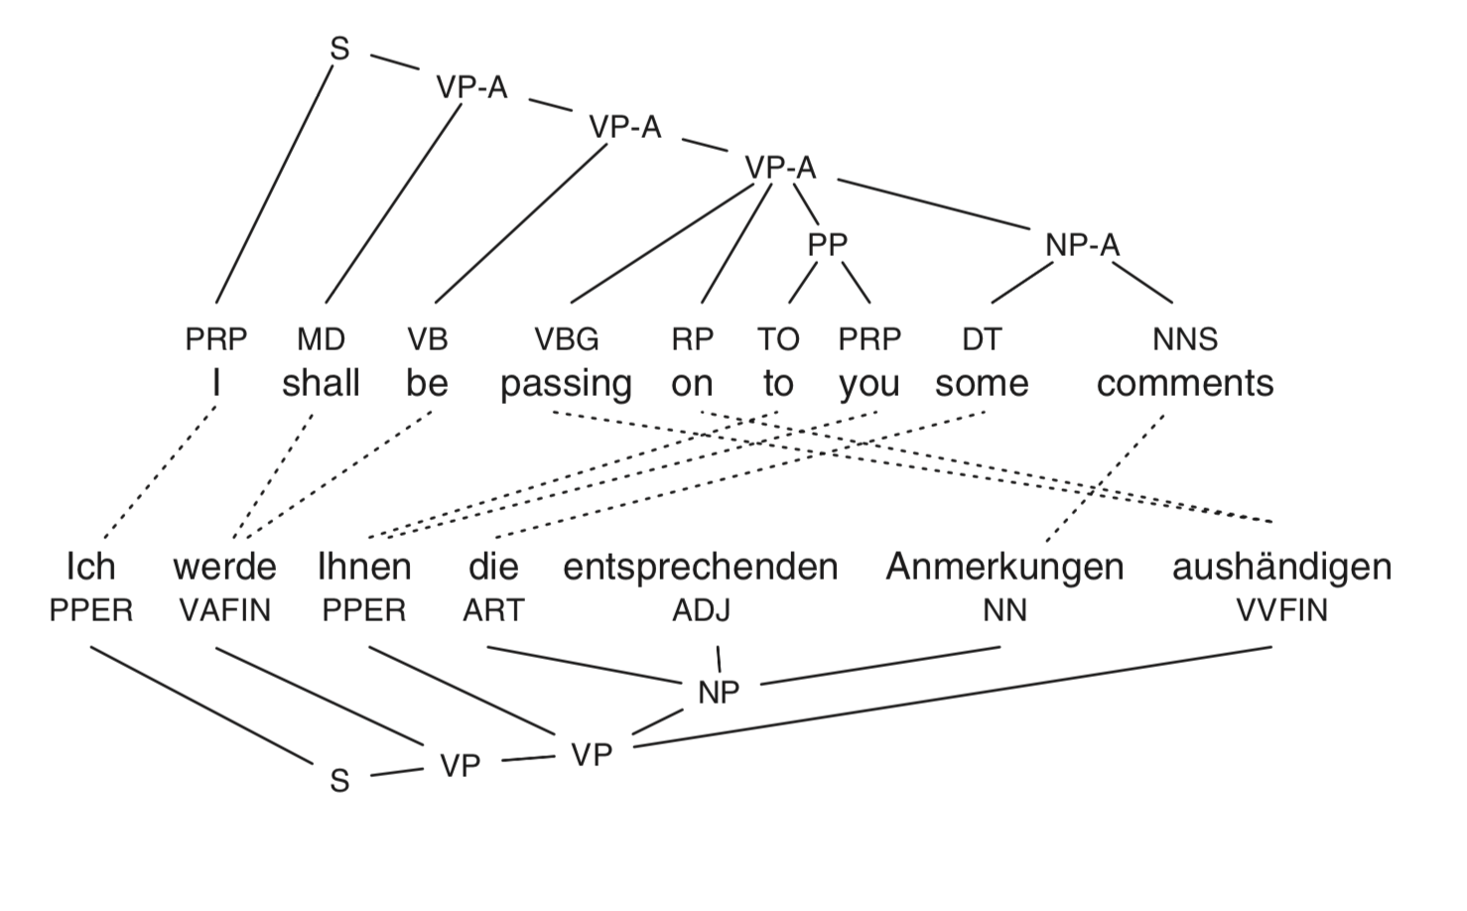
Applications: machine translation
(Koehn et al, 2009)

