Slide 1
(Vector-space) lexical representations

Slide 2
Lexicon and grammar
The lexicon is a (finite) list of units (e.g., words or morphemes) that can be combined to create an infinite number of sentences
The grammar defines the rules by which these units can be combined
Notes:
We’ve mentioned before that there’s a useful division between the grammar and the lexicon: the lexicon is a finite list of words and morphemes, and the grammars tells us how we can combine those morphemes to form sentences.

Slide 3
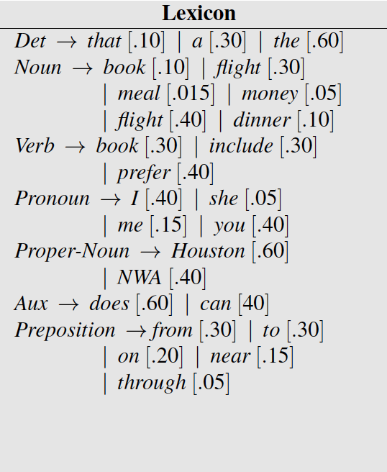
The lexical representations we have so far don’t tell us anything about the meaning of those words!
We know about the meaning of words?
Similarity, taxonomic relations, valence, visual features…

Slide 4
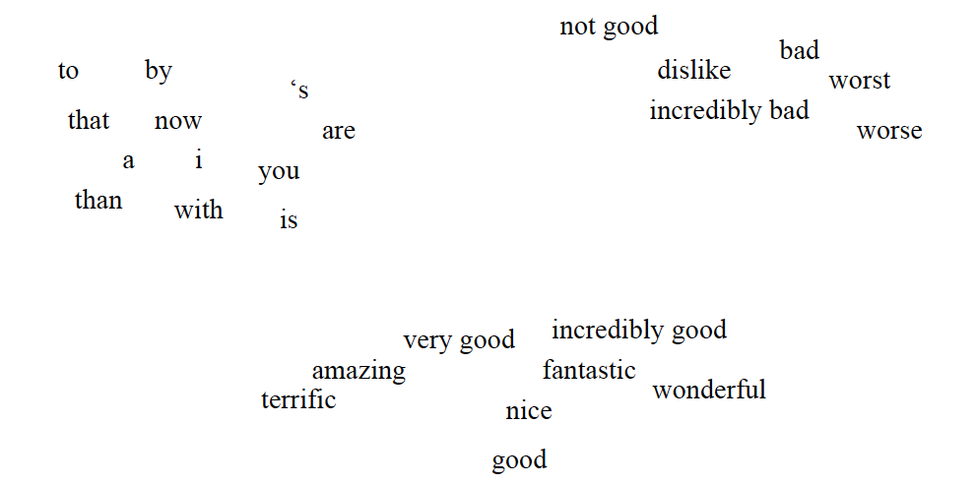
Word vector representations (word embeddings) capture similarity
bad: (1, -0.5, 3, 2)
worse: (1.2, -0.6, 3.2, 2)
with: (-3, 4.3, 0.5, -1)
(PCA, tSNE)

Slide 5
One-hot word representations: also vectors, but do not capture similarity
bad: (1, 0, 0, 0)
worse: (0, 1, 0, 0)
than: (0, 0, 1, 0)
with: (0, 0, 0, 1)

Slide 6
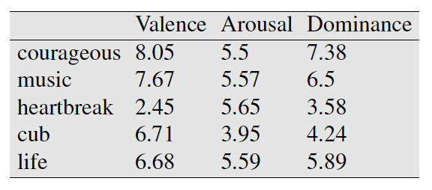
How do we come up with those vectors?
(Osgood, 1957)

Slide 7
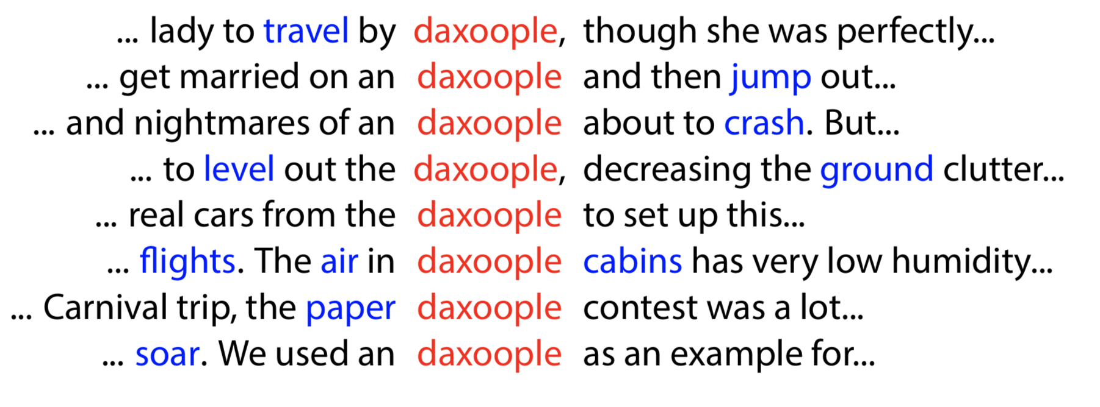
Distributional semantics

Slide 8
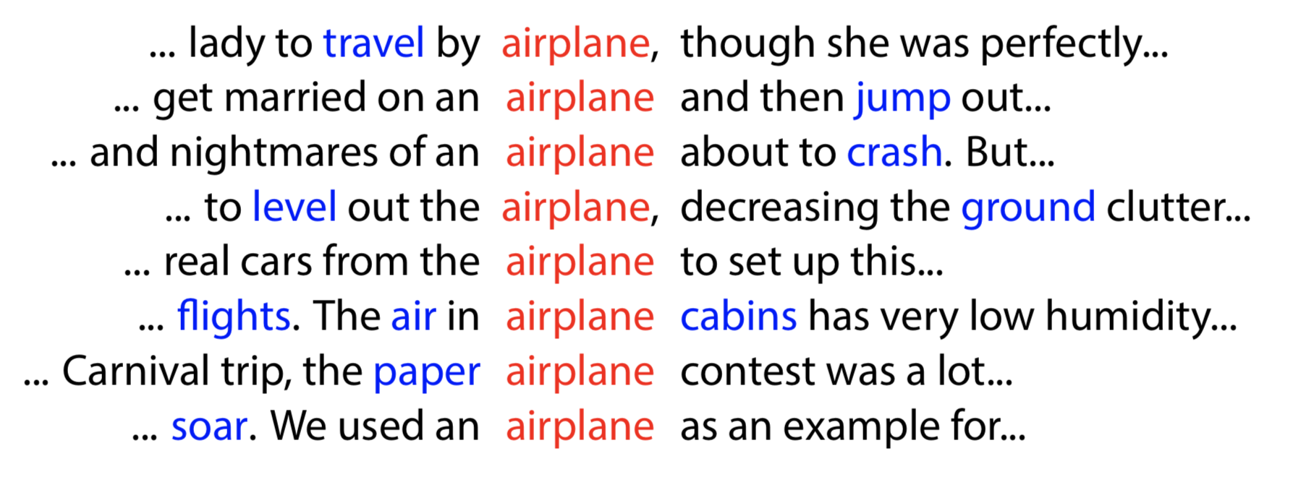
Distributional semantics

Slide 9
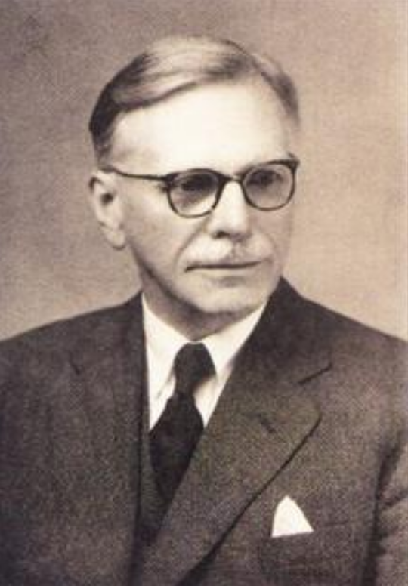
Distributional semantics
“You shall know a word by the company it keeps.” (J. R. Firth, 1957)

Slide 10
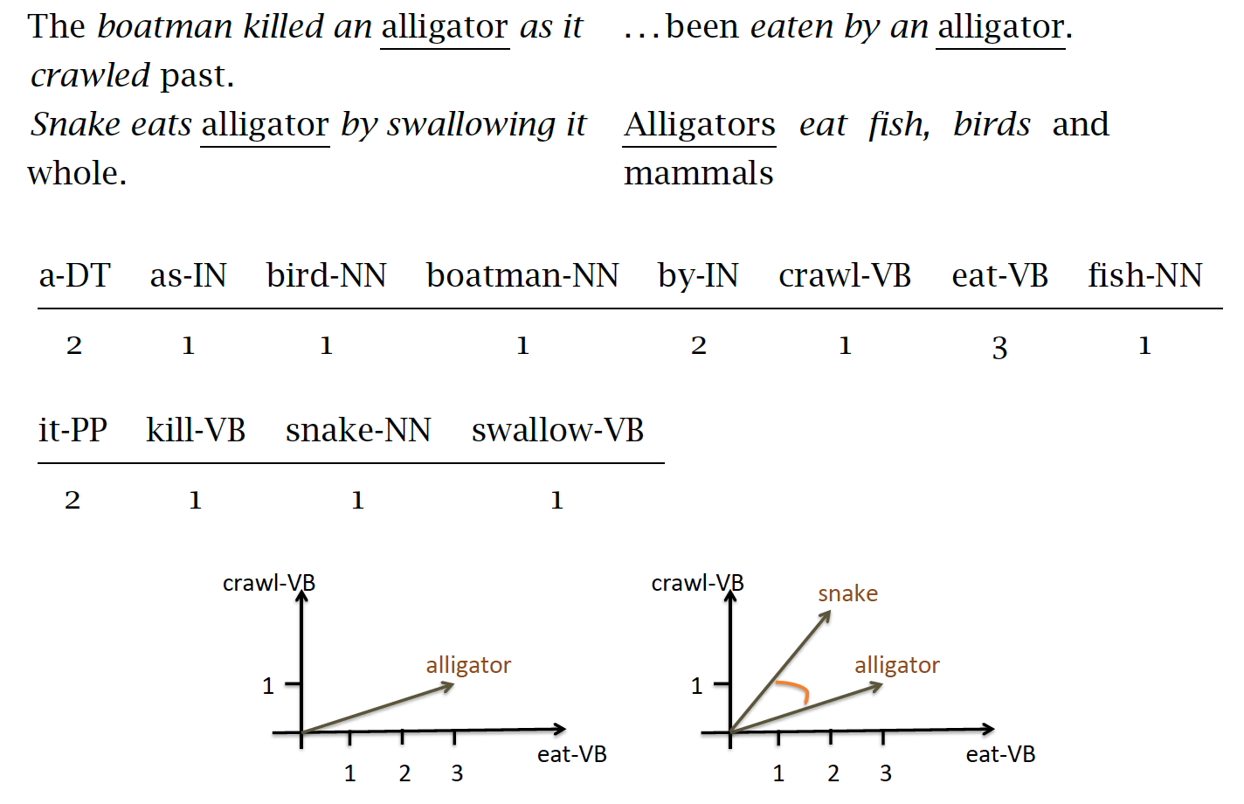
Context words as the dimensions of the vector
(Erk, 2016)

Slide 11
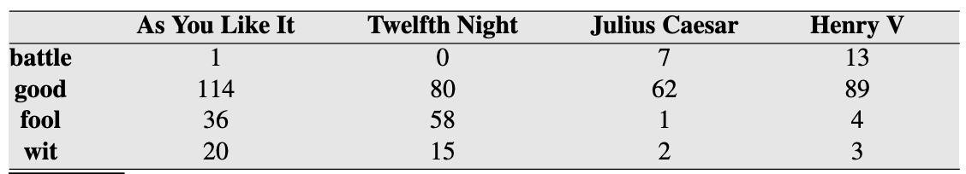
Documents as the dimension of the vector
Term-document matrix

Slide 12
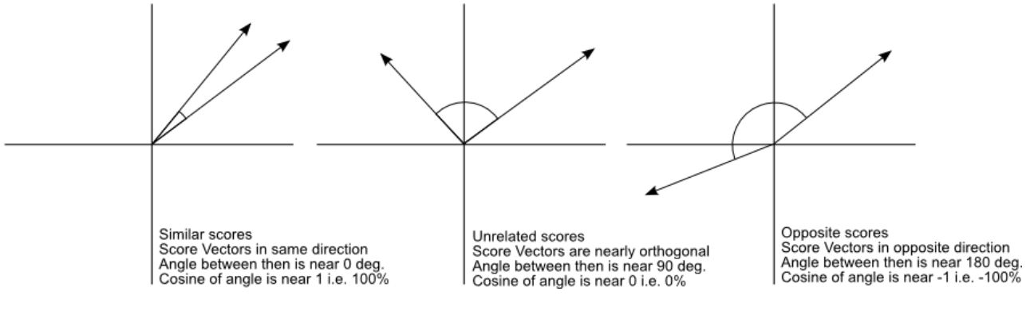
Cosine similarity
credit

Slide 13
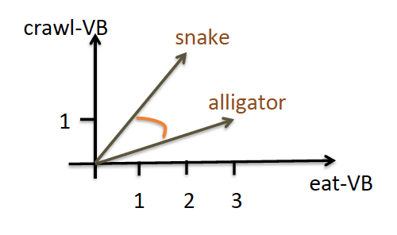
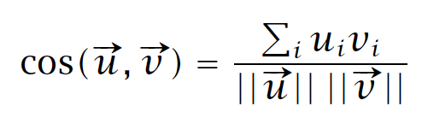
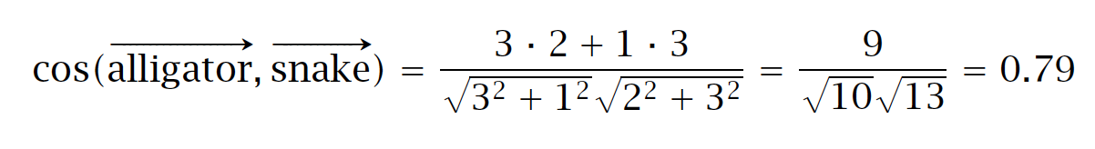
Cosine similarity
(Erk, 2016)

Slide 14
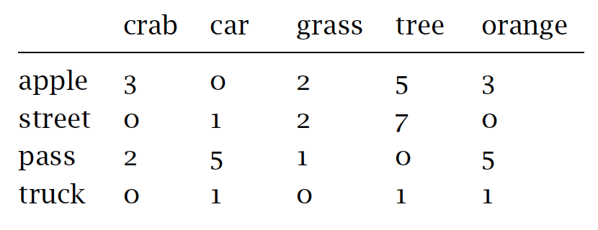
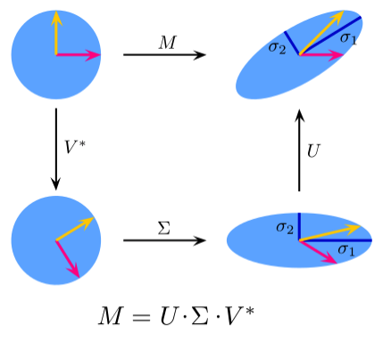
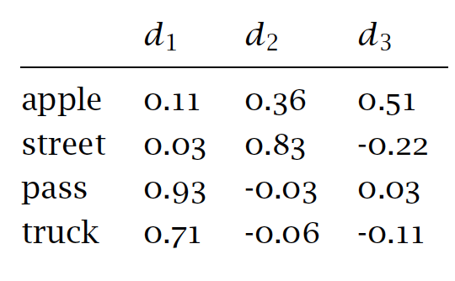
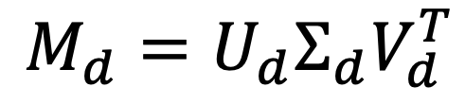

Dimensionality reduction
The vocabulary can have tens
of thousands of words!
SVD:
$$M=UΣV^{T}$$
Take only top d dimensions:
$$M_{d}=U_{d}Σ_{d}V_{d}^{T}$$

Slide 15
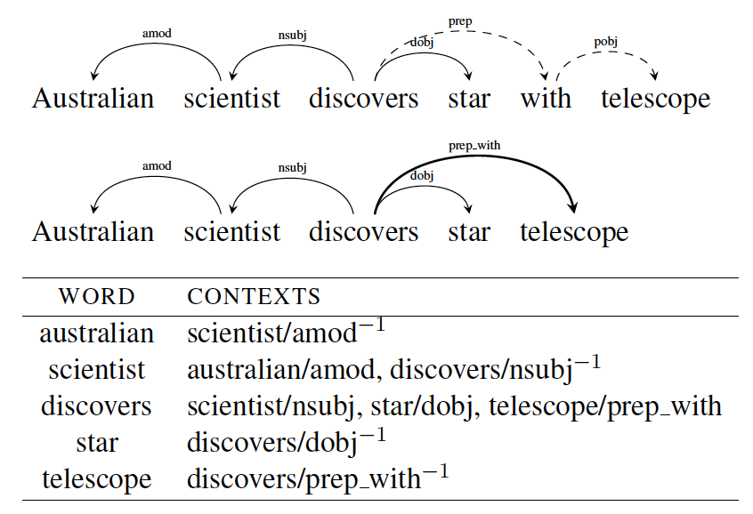
Other contextual features
Bag-of-words
Positional
Dependency-based
Visual features of pictures used in the same document as the word (Feng & Lapata, 2010; Lazaridou et al., 2015)
Other perceptual features: auditory (Kiela & Clark, 2015), olfactory (Kiela et al., 2015)…

Slide 16
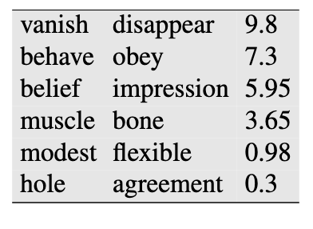
Intrinsic evaluation: Similarity
Are the similarity values derived from the vector space correlated with human similarity judgments?
(Hill et al, 2015)

Slide 17
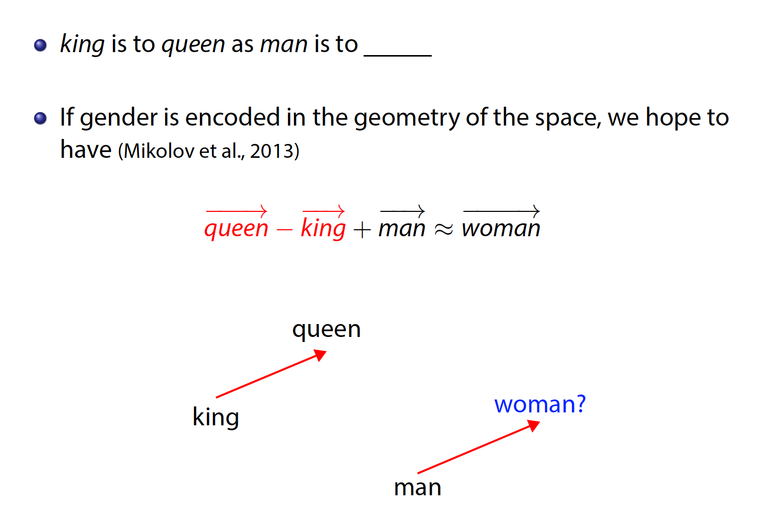
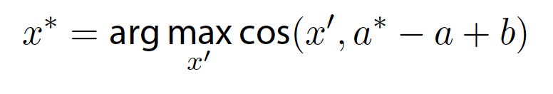
Intrinsic evaluation: Analogies

Slide 18
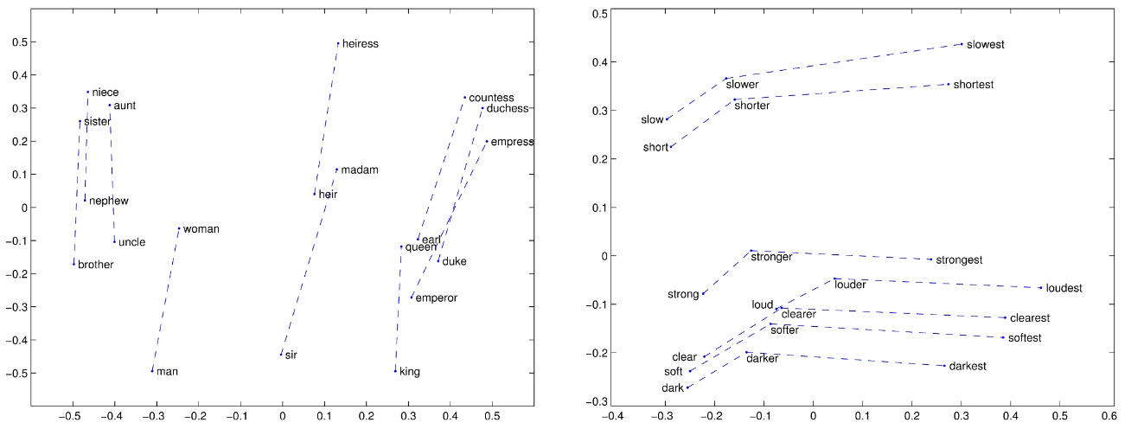
Intrinsic evaluation: Analogies
(Pennington et al, 2014)

Slide 19
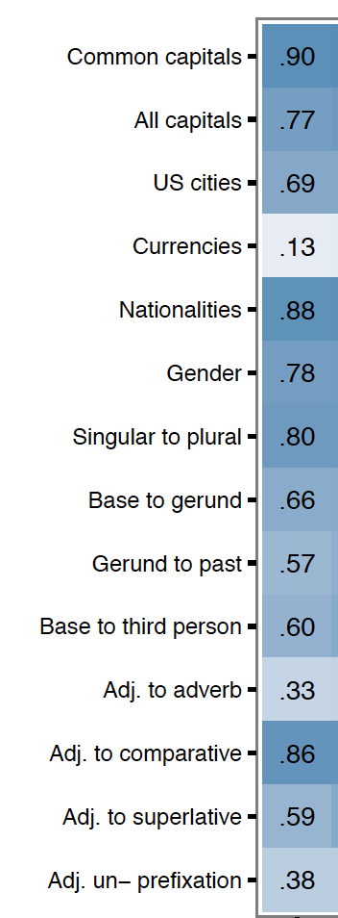
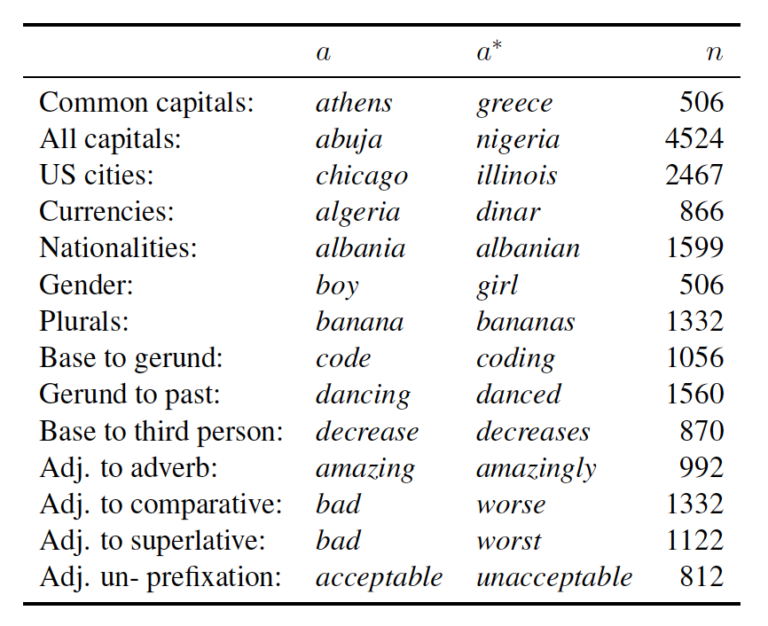
Intrinsic evaluation: Analogies
(Mikolov et al., 2013; Linzen, 2016)

