Slide 1
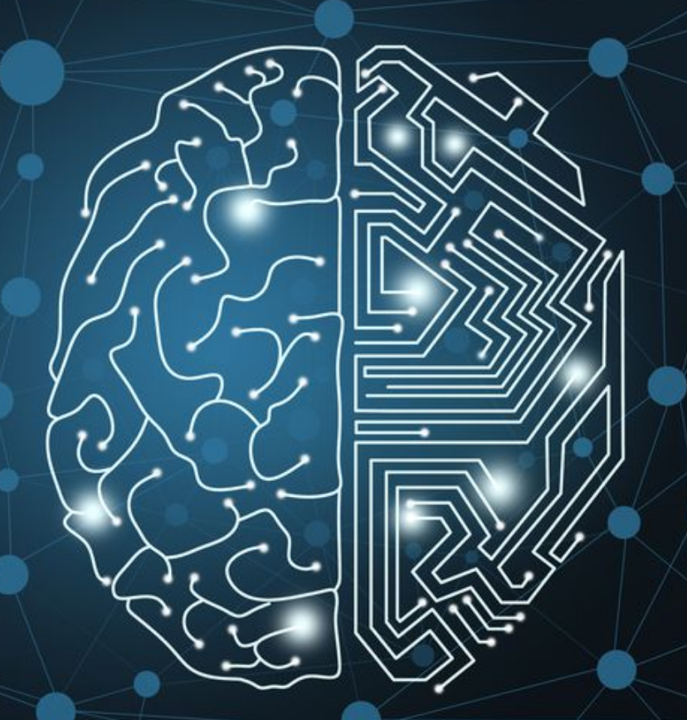
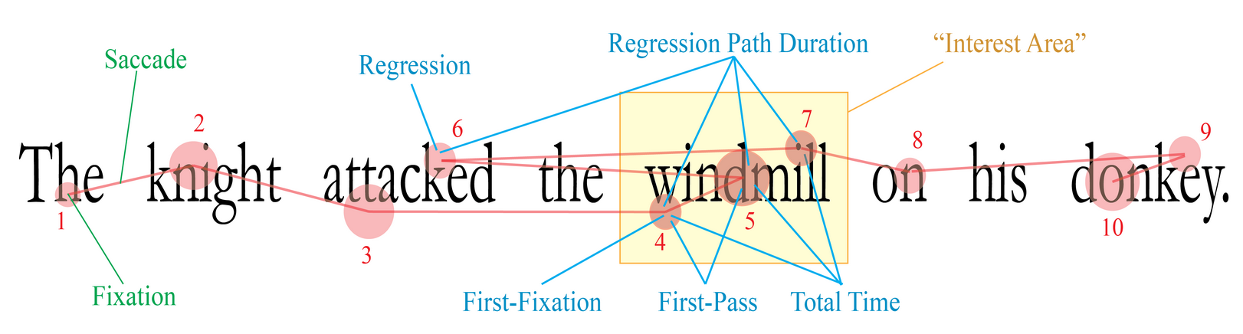
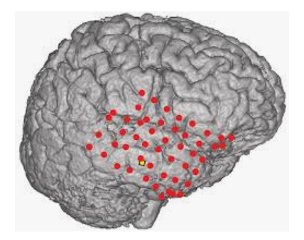
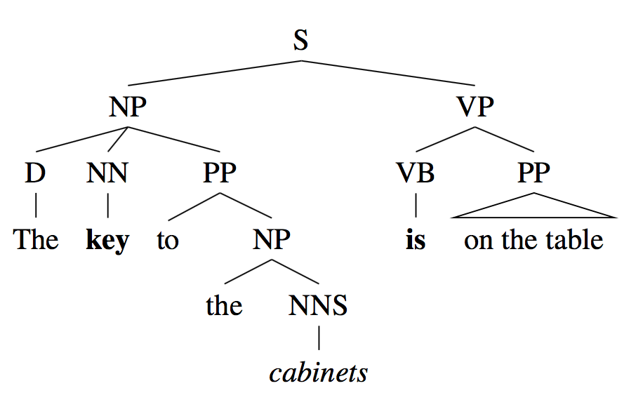
Tal Linzen’s research
Notes:
In this video I’ll tell you a little bit about my own research, and how it’s related to what we’ll talk about in this class.

Slide 2
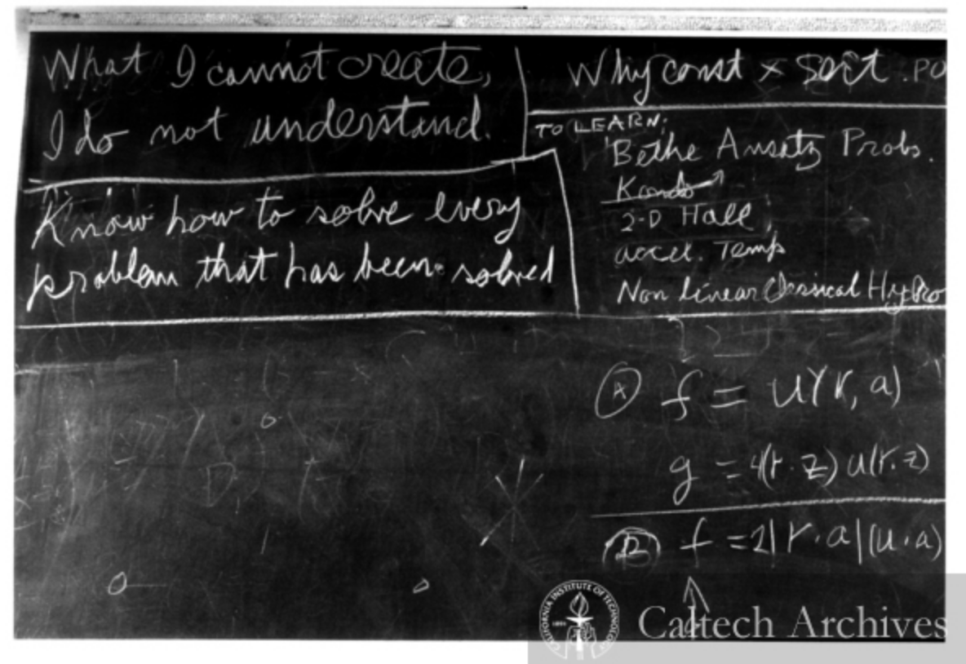
Computational cognitive science
Goal 1: Understand the human mind better by developing computational cognitive models that make quantitative predictions
Notes:
Broadly I think of what I do as computational cognitive science, applied to language. Computational cognitive science has two goals that are intertwined with each other. The first goal is a scientific goal: understand the human mind better by creating computer simulations of what goes on in the mind. There’s a famous quote from the physicist Richard Feynman that was reportedly written on the blackboard the day he died, in 1988, that says - you see in on the top left corner - what I cannot create, I do not understand. And the idea here is that you can have a lot of verbal theories and hypotheses about, let’s say, the motion of the planets, but you don’t really understand how the solar system works until you’ve created a computer program, or a mathematical model, that tells you exactly where your theory predicts Venus will be, I don’t know, on September 18, 2087. So the goal here is to do the same for human language acquisition, understanding and production.

Slide 3
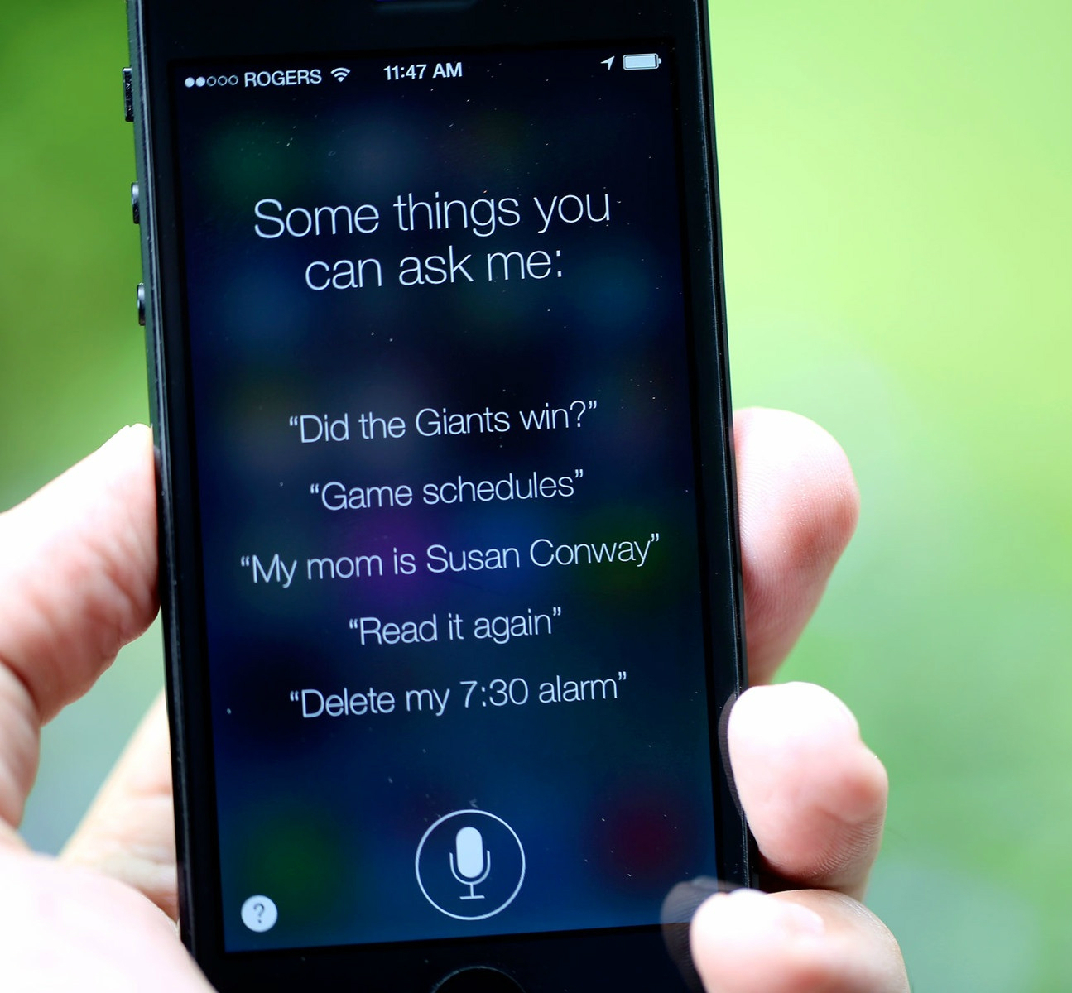

Computational cognitive science
Goal 1: Understand the mind better by developing computational cognitive models that make quantitative predictions
Goal 2: Produce intelligent behavior in machines by studying the problems that the mind solves and the ways in which it solves them
Notes:
The flip side of this kind of research is that if we understand the principles of human intelligence - and language is a central component of intelligence - then we can use those principles to create machines that can do intelligent things. If we understand how humans detect and avoid obstacles on the road, we can build better self-driving cars. If we understand how humans recognize the intent of the person they’re talking to, we can build better automated assistants like Siri. Now, it’s not the case that mimicking humans is necessarily the best way to create intelligent systems - but, because we know that humans can accomplish a lot of intelligent behaviors, it’s a good bet to have the cognitive approach be at least one of the research directions we explore.

Slide 4
The Computation and Psycholinguistics Lab
Notes:
So, as I said, my research group applies this general research philosophy to language. It’s called the “computation and psycholinguistics lab”, and, as you can tell from the name, it combines three disciplines. The first is computer science - the stock photo on the upper left here. Then there is cognitive psychology, measurements of human behavior, for example of people’s eye movements when they read a sentence; or measurements of the activity of their brain when they’re doing something with language. And finally there is linguistics, which is the field that’s concerned with understanding language itself, the differences between languages, and so on. And, of course, the arrows connecting these disciplines that show how interdisciplinary the whole thing is.

Slide 5
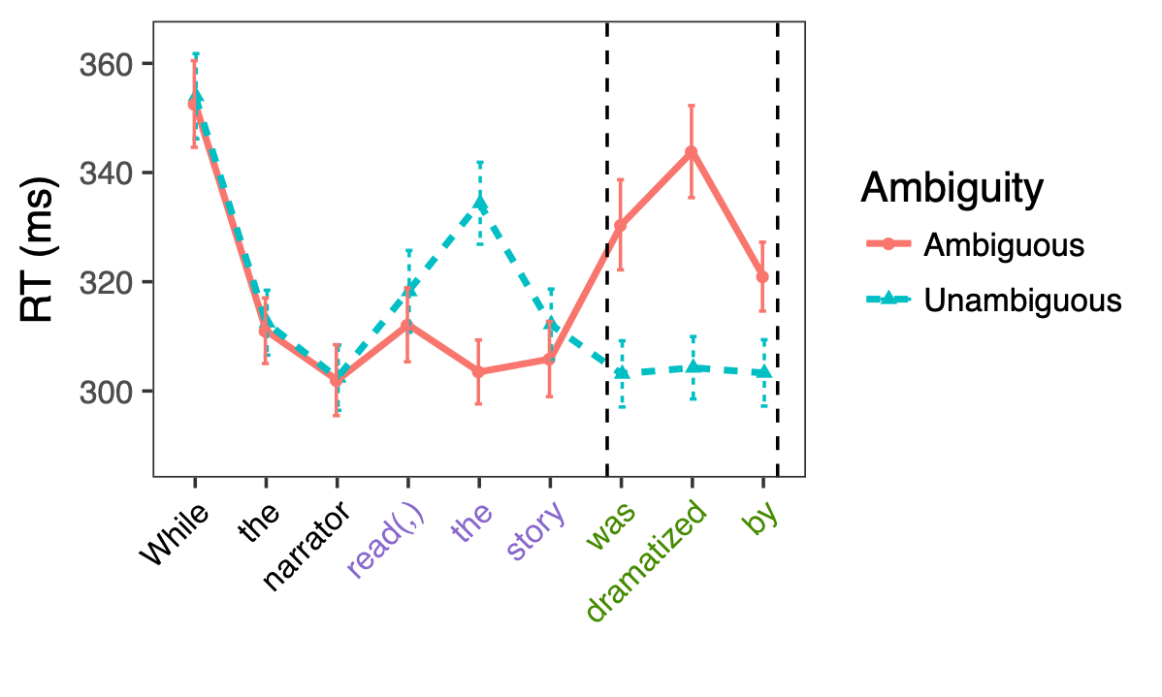
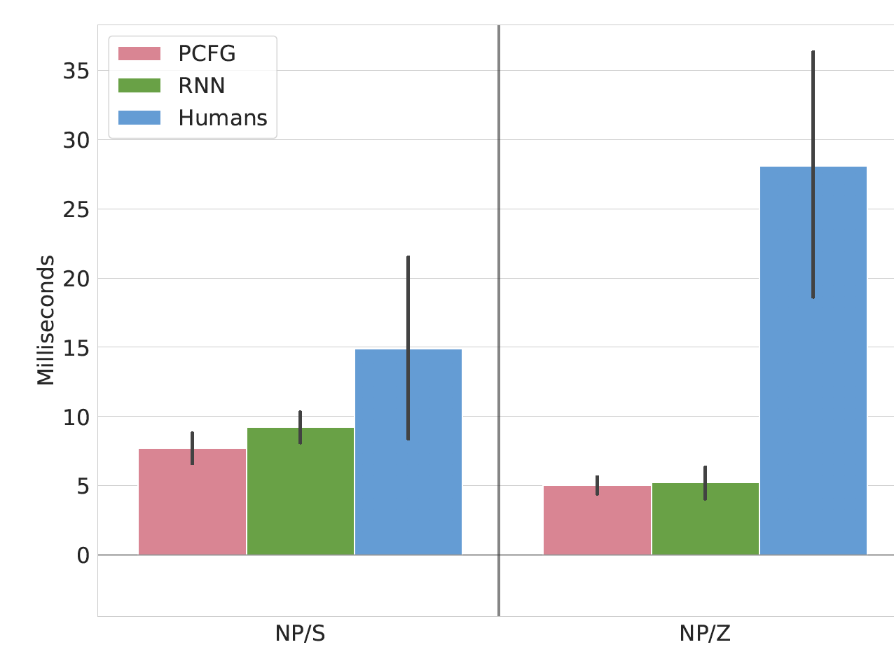
1. Human sentence comprehension
Notes:
I’ll give you three examples of the types of research we are doing in my group. These examples are also going to be a bit of a preview of some of the techniques and ideas we’ll encounter again in this class. There are a lot more projects that are going on right now that I’m not going to be able to get into. But you can find a lot of the work on my website.
So one of the areas we work on is human sentence comprehension - how do you figure out the structure of the sentence, things like, which noun goes with which verb? For example, take a few seconds to read this sentence……….. Read it? Many of you were probably confused when you reached the underlined words. You probably started out by interpreting “the story” as the direct object of “the narrator” - the narrator was reading the story. But when you reached the underlying words, you realized that that can’t be right - this verb needs a subject, but “the story” is already taken, as the direct object of “the narrator”. So you need to rethink your analysis of the structure of the sentence.
You’re not alone in making this double take at “was dramatized by”. This plot shows the results of a human reading experiment we did; on the right you can see that the red solid line, sentence like the one you just read, is much higher than the blue dashed line, a very similar sentence that doesn’t have the same issue.
The next plot compares the human results, in blue, to simulations we ran with two computational models, which we’ll talk about later in this class: a probabilistic context free grammar, in pink, and a recurrent neural network, in green. You can see that neither model fits the human data very well, which means we still have a lot of work to do!

Slide 6
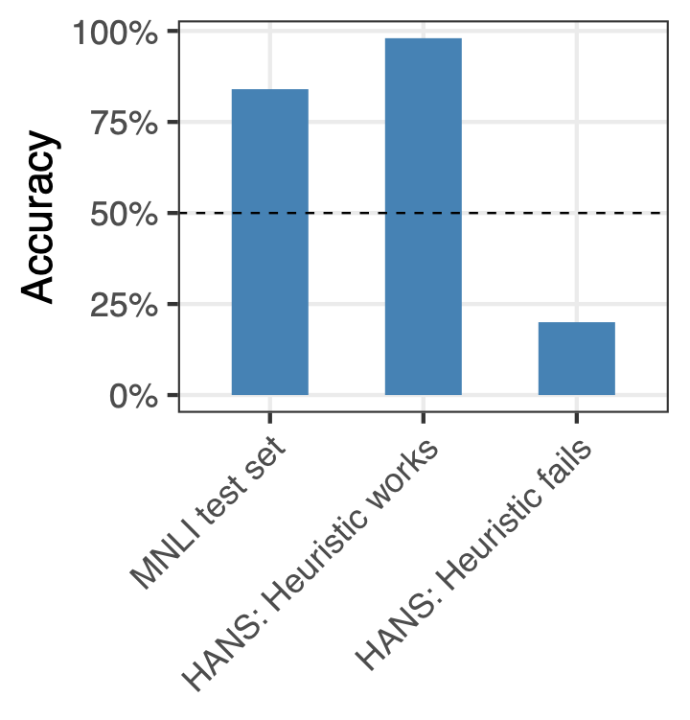
2. Do AI systems generalize like humans?
A soccer game with multiple males playing.
Entailment
Some men are playing a sport.
1. The judge was paid by the lawyer →
the lawyer paid the judge.
2. The doctor was paid by the actor. ↛
The doctor paid the actor.
Notes:
Another direction focuses on analyzing AI systems and finding ways to measure whether they’re really as good as they seem at first glance. As we’ll see in this class, many of the best NLP systems we have these days are based on neural networks that learn to do stuff with language from a large number of examples. Even though we’re the ones who designed the learner, we often don’t understand what exactly it learned from those examples, and it’s hard to understand how it’s making its decisions. You can often make some progress towards understanding what’s going on if you understand the problem really well and can design diagnostic tests - almost like unit tests in software engineering.
Here’s one example of the work we’ve done in this area. An NLP task we’ll talk about later in this class is inference: you get two sentences, and you need to decide if the second sentences follows from the first one. In this case, if multiple males are playing soccer, it’s true that some men are playing a sport.
We suspected the neural networks that are trained to perform this task may be relying too much on word overlap: any time there’s a lot of word overlap between the two sentences, the model says that the first sentence entails the second ones. To test this hypothesis, we designed test examples where word overlap makes the right prediction, like sentence number 1; and examples where word overlap makes the wrong prediction, like number 2.
When we tested the models, we found pretty good accuracy on the kinds of examples that the model was trained on, on the left; ever better accuracy on examples where word overlap makes the correct prediction; and really low accuracy on cases where word overlap makes the wrong prediction. We’ll talk more about this in the second half of the class.

Slide 7
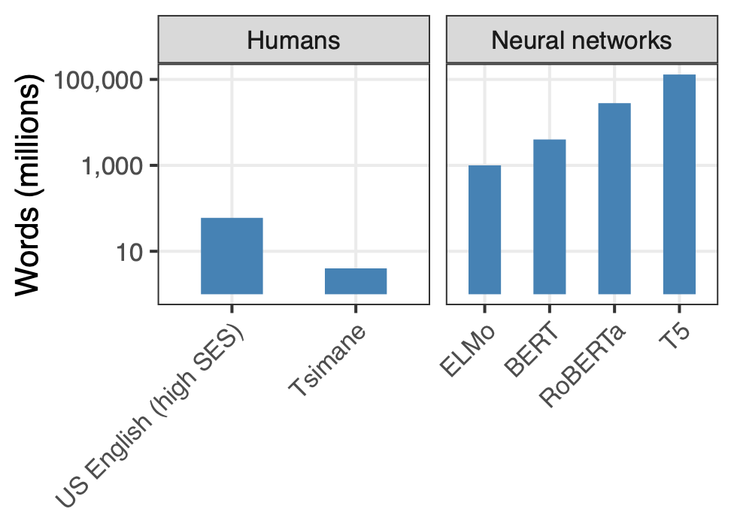
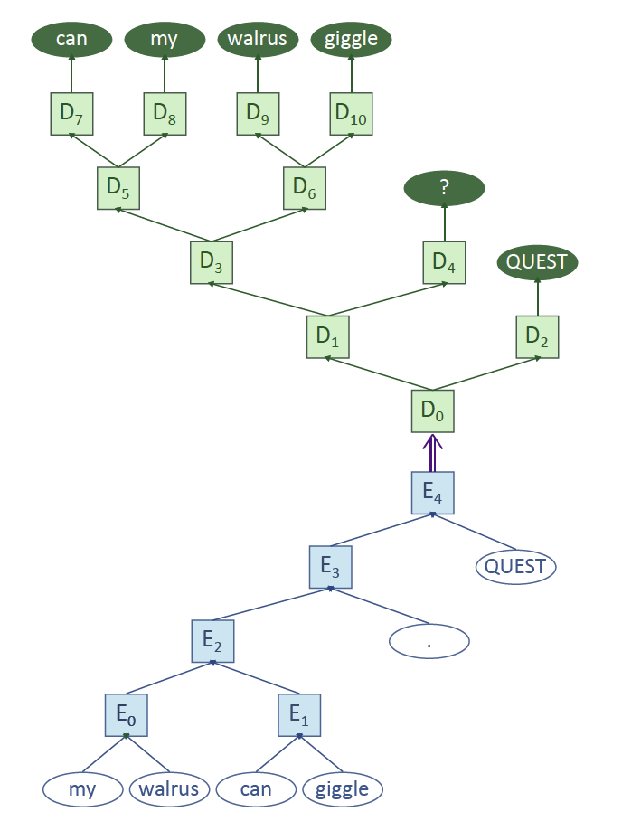
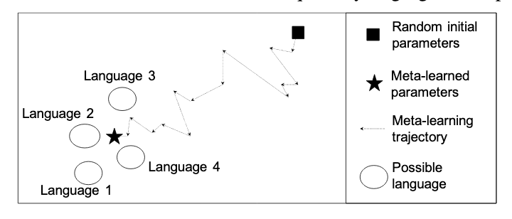
3. How can we build neural networks that learn and generalize like humans?
Notes:
The last direction I mentioned here is building NLP models that learn and generalize more like humans than the kinds of neural network systems that are popular these days. This figure compares how many words humans are exposed to when learning language to the amount of works that we show our neural network models. This plot is on a log scale: a child hears something like 50 million words in the first ten years of its life, but the T5 neural network needs more than 100 billion words! We would like to have systems that learn more quickly, because in most languages we don’t have such a massive amount of data.
I’m not going to be able to say much right now about the research directions we’ve been exploring, but one involves building into our neural networks the kind of representations from linguistics that we’ll discuss in the first few weeks of this class,
and the other involves a technique called meta-learning, which gives the neural network a good starting point for learning, so it can learn from a smaller amount of data. So, this was an extremely quick sneak peak at the kind of things I work on; this is all going to make a lot more sense later in the semester after we spent more time, well, talking about NLP.

