Slide 1
Grammar
The lexicon is a (finite) list of units (e.g., words or morphemes) that can be combined to create an infinite number of sentences
The grammar defines how these units are combined
One simple grammar: combine any words in any order. Why doesn’t this work?

Slide 2
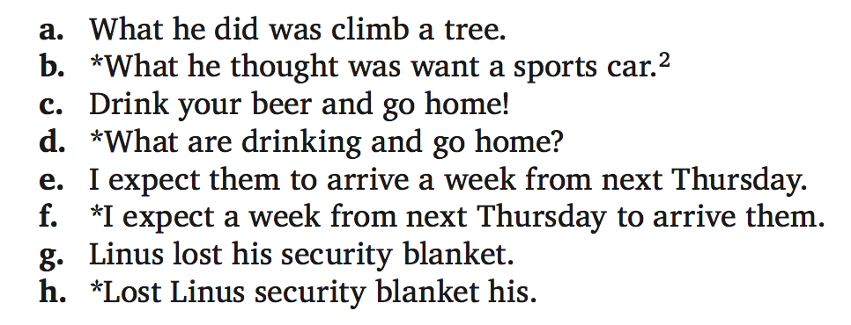
Grammar
Not every string of words is a possible English sentence:

Slide 3
Grammar
(Chomsky:) The role of grammar is to describe the grammar of a natural language in the most restrictive way possible:
Keep in all of the grammatical strings
Keep out the ungrammatical strings

Slide 4
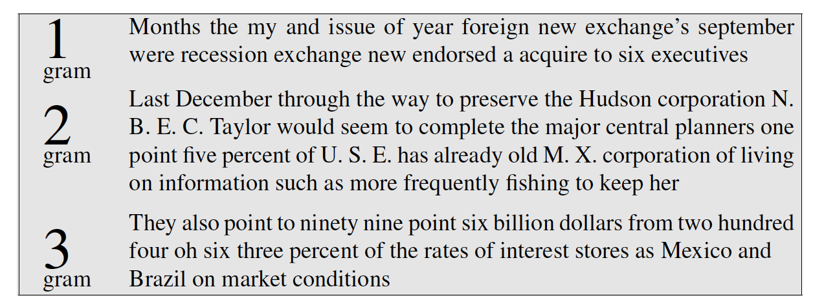
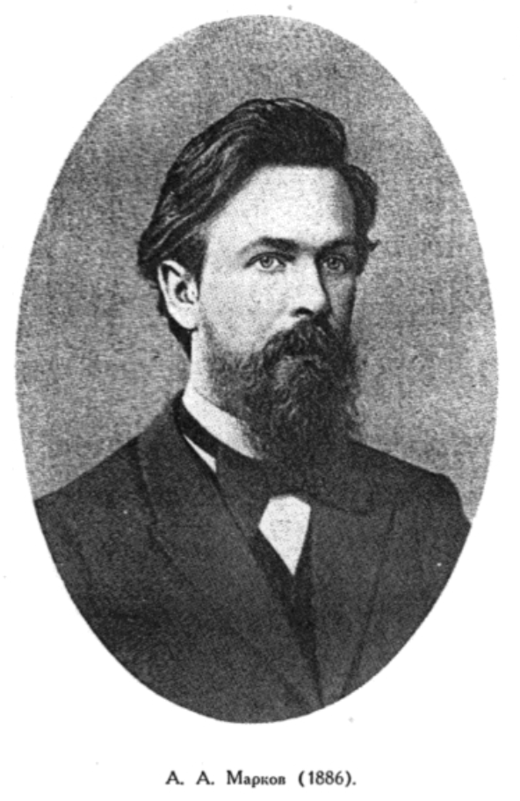
Is a Markov model enough?
Andrey Markov
No fixed n can capture long-distance dependencies:
The key that I left on the table by the armchairs is

Slide 5
What about regular languages?
Alphabet (simplified lexicon): {a, b}
Concatenation: {a, ab, abab} (a finite language)
a*b = {b, ab, aab, aaab, aaaab, …}
But not: aaa, aaaabb
a?b = {b, ab}
But not: {aab}
(ab)* = {ε, ab, abab, ababab, ….} (ε = the empty string)
(ab)+ = ab(ab)* = {ab, abab, ababab, …} (but not ε)

Slide 6
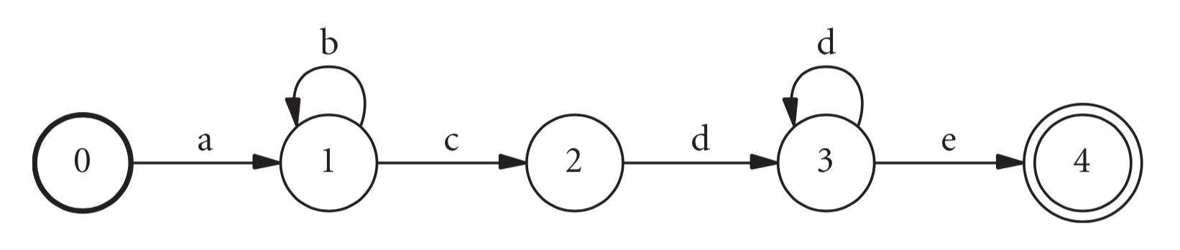
Finite state machine
Transitions
Start state
Accepting state
ab*cd+e

Slide 7
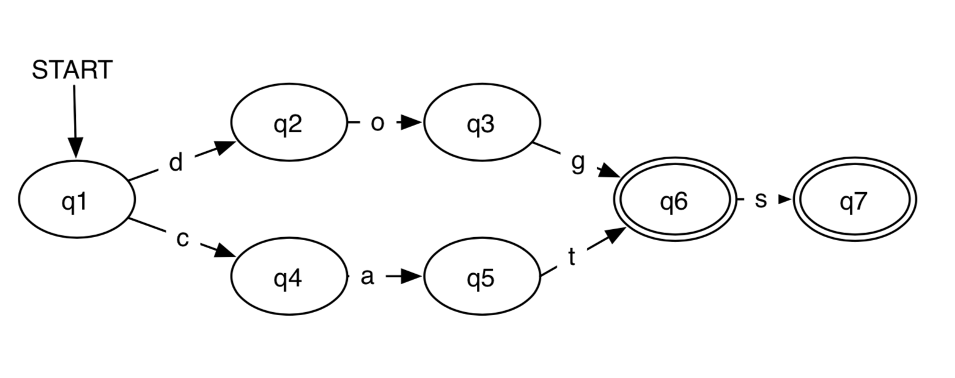
Finite state machines for morphology
Finite state machines can be used for both recognition and generation
(Credit: Jordan Boyd-Graber)

Slide 8
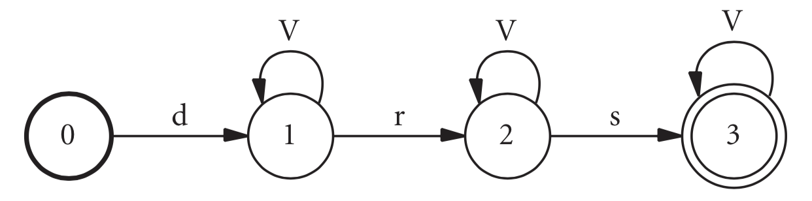
Finite state machines for morphology
Some words derived from the Arabic root drs:
dars ‘lesson’
darasu ‘they learned’
durisa ‘it was learned’

Slide 9
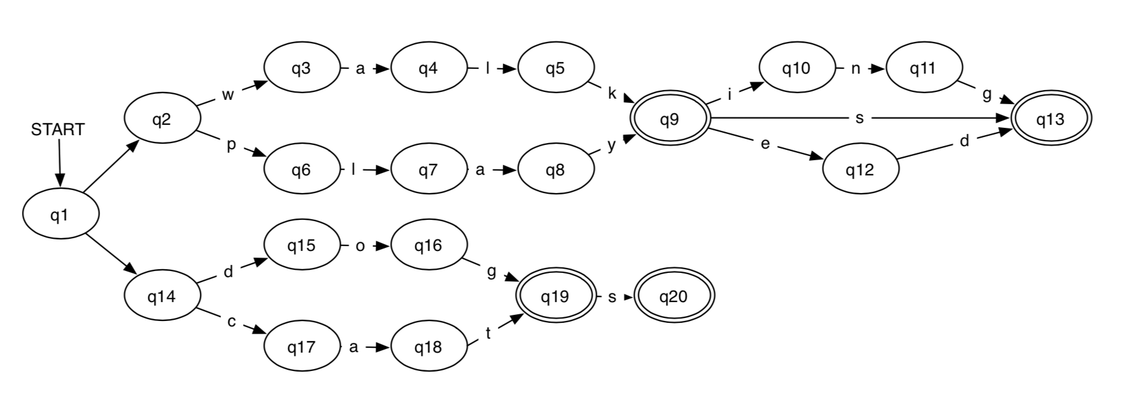
Finite state machines for morphology
(Credit: Jordan Boyd-Graber)

Slide 10
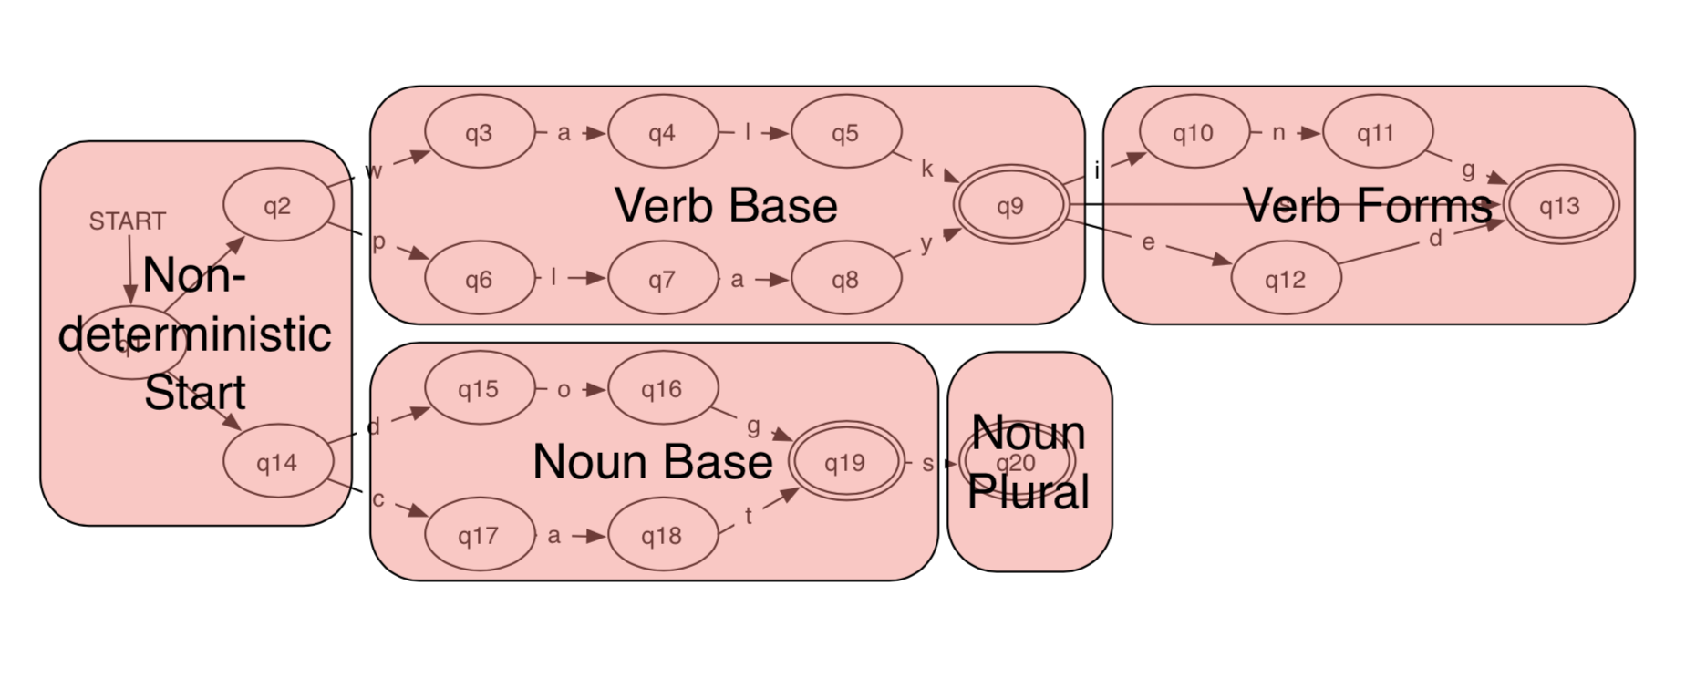
Finite state machines for morphology
(Credit: Jordan Boyd-Graber)

Slide 11
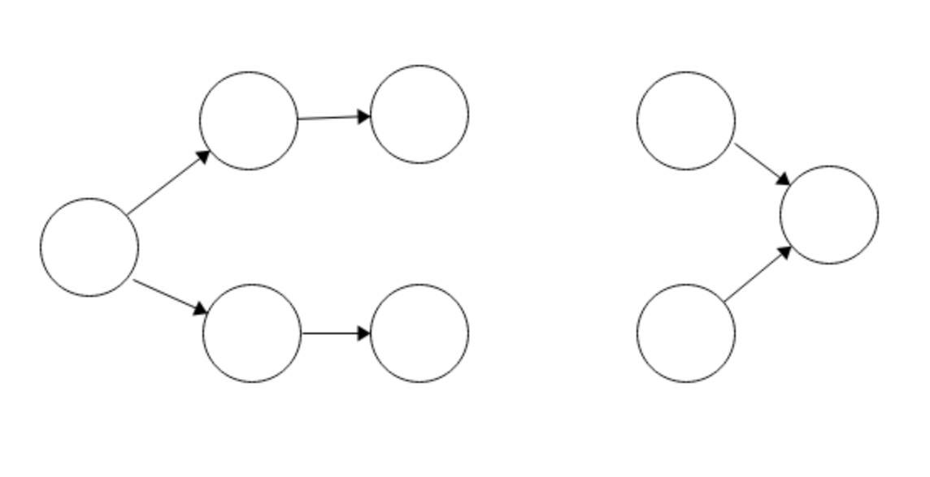
Regular languages for syntax?
The key that I left on the table by the armchairs is
…
is
key
keys
…
are

Slide 12
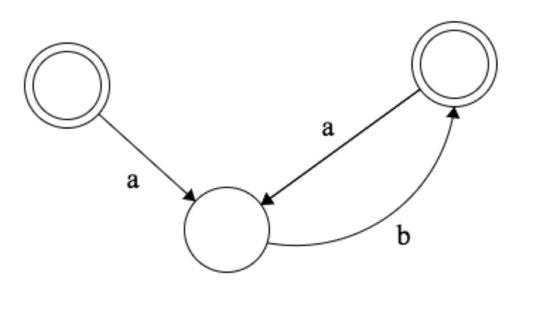
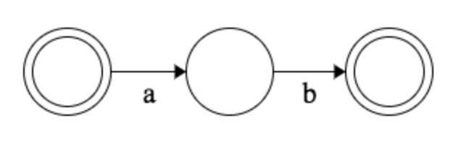
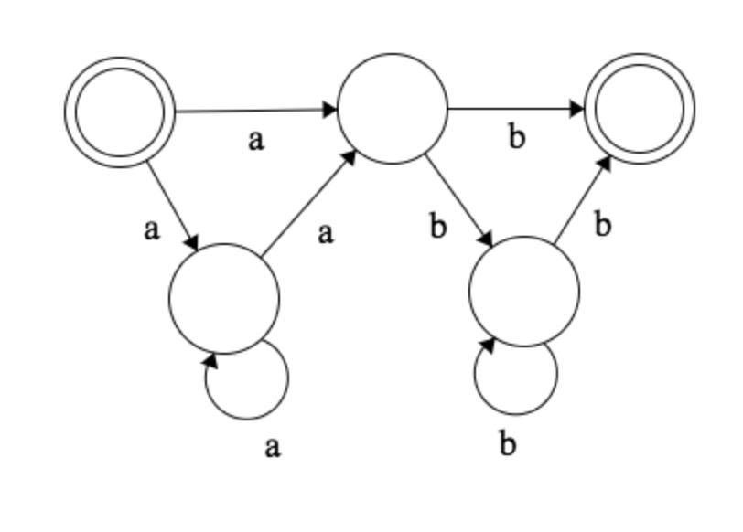
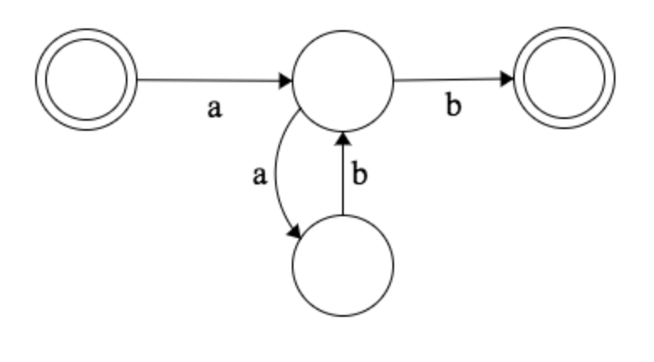
Counting in finite state languages
a^{n}b^{n} = {ε, ab, aabb, aaabbb, aaaabbbb, …}

Slide 13
Context-free grammars
The following context-free grammar generates a^{n}b^{n}:
S → aSb
S → ε
(a, b: terminals; S: nonterminal)
When there are multiple production rules with the same left-hand side, either one can be applied

Slide 14

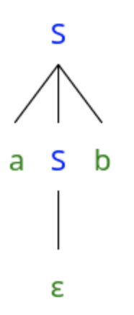
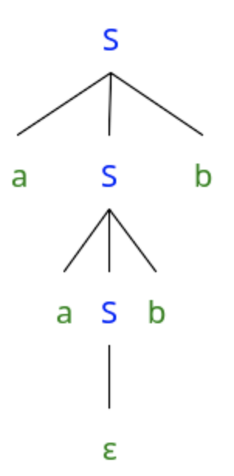
Context-free grammars
S → aSb
S → ε
ε
ab
aabb
Empty string

Slide 15
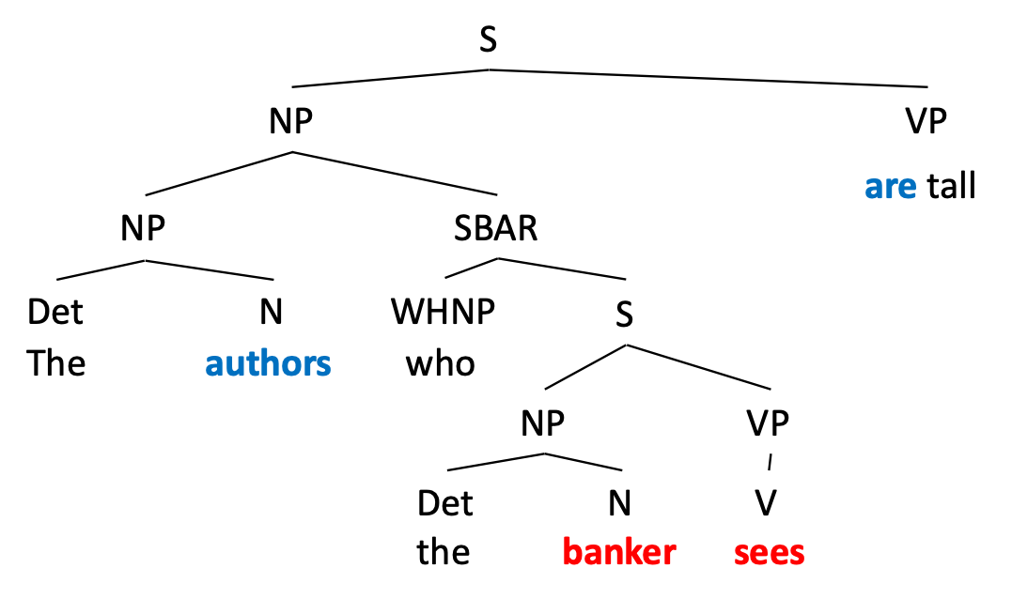
Why are context free languages relevant to natural language?
The authors who the banker sees are tall.
*The authors who the banker sees is tall.

Slide 16
A grammar with nested agreement dependencies
S → SingularNoun S SingularVerb
S → PluralNoun S PluralVerb
S → ε
PluralNoun → keys | books | students …
The keys fell.
The keys the student needs fell.
*The keys the student need fell.

Slide 17
Why “context-free”?
context-free
context-sensitive
S → aSb
S → ε
xSy → axSyb
zSw → ε

Slide 18
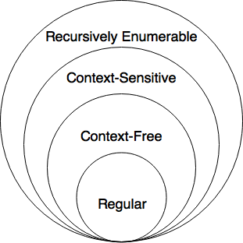
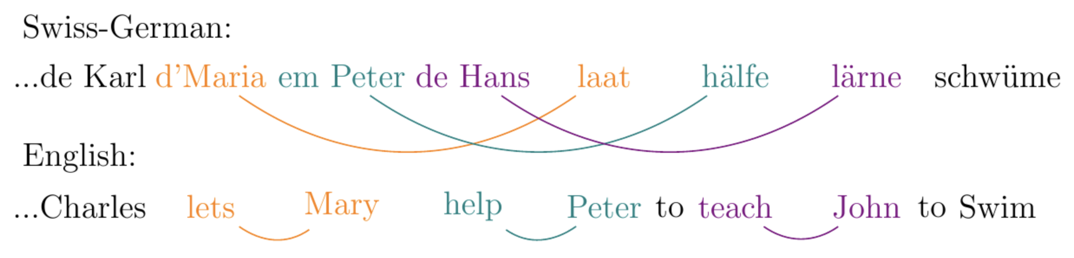
The Chomsky hierarchy
Some simple formal languages are context-sensitive (and not context free)
Copy language: {abab, bb, baabaa, …}
There are phenomena in natural language that require this power (Shieber 1985):

Slide 19
A grammar with nested agreement dependencies
S → SingularNoun S SingularVerb
S → PluralNoun S PluralVerb
S → ε
PluralNoun → keys | books | students …
The keys fell.
The keys the student needs fell.
*The keys the student need fell.

Slide 20
Center embedding
The dog barked.
The cat the dog bit meowed.
The mouse the cat the dog bit chased squeaked.
Is this sentence ungrammatical?

Slide 21
Competence and performance
A methodological distinction proposed by Noam Chomsky
Competence refers to our knowledge of grammar
Performance refers to the way in which we use grammar in practice
I know that you know that I know that you know that I like pizza
Hard to understand, but grammatical: difficult to think of a reason to say this sentence is not a part of the English language

Slide 22
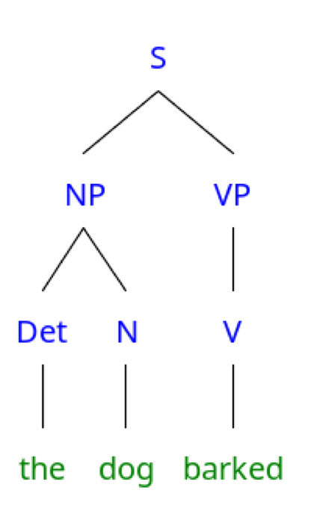
Competence and performance: center embedding

Slide 23
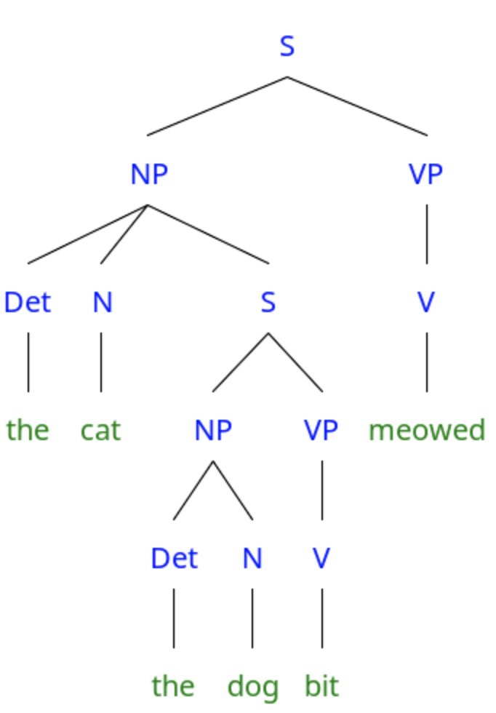
Competence and performance: center embedding
NP → Det N S

Slide 24
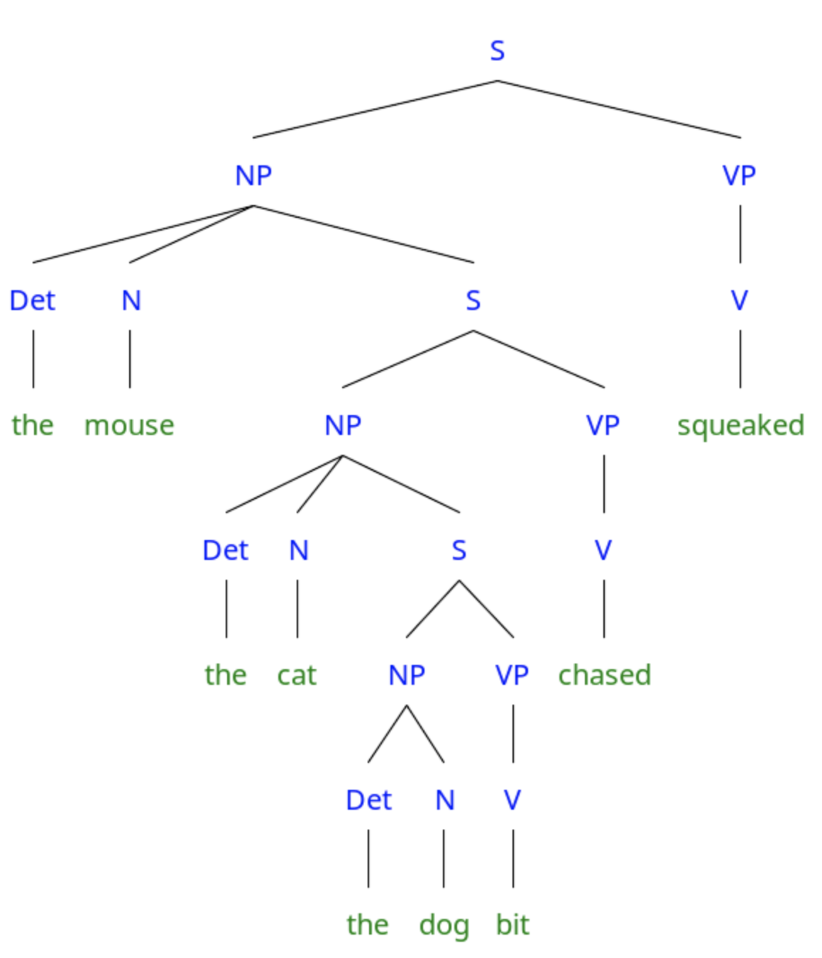
Competence and performance: center embedding
NP → Det N S

Slide 25
Is there a grammatical restriction on embedding depth?
Why would that be critical for what we think about the expressive capacity of syntax?
He likes pizza.
He said he likes pizza.
She thinks he said he likes pizza.

Slide 26
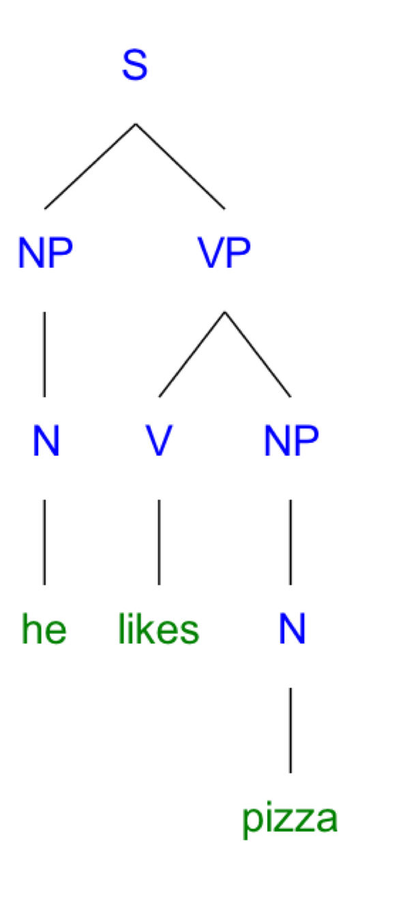
Is there a grammatical restriction on embedding depth?

Slide 27
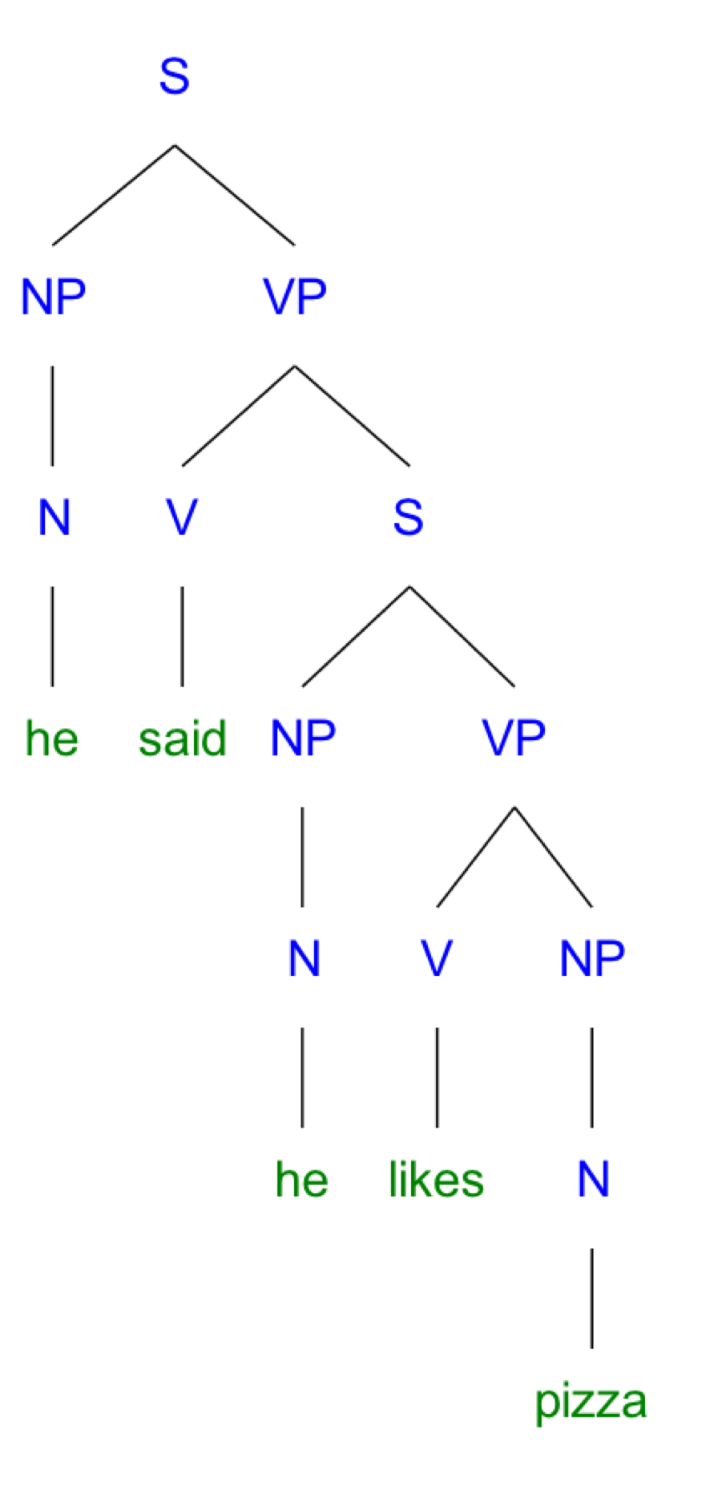
Is there a grammatical restriction on embedding depth?
VP → V S
(For some verbs)

Slide 28
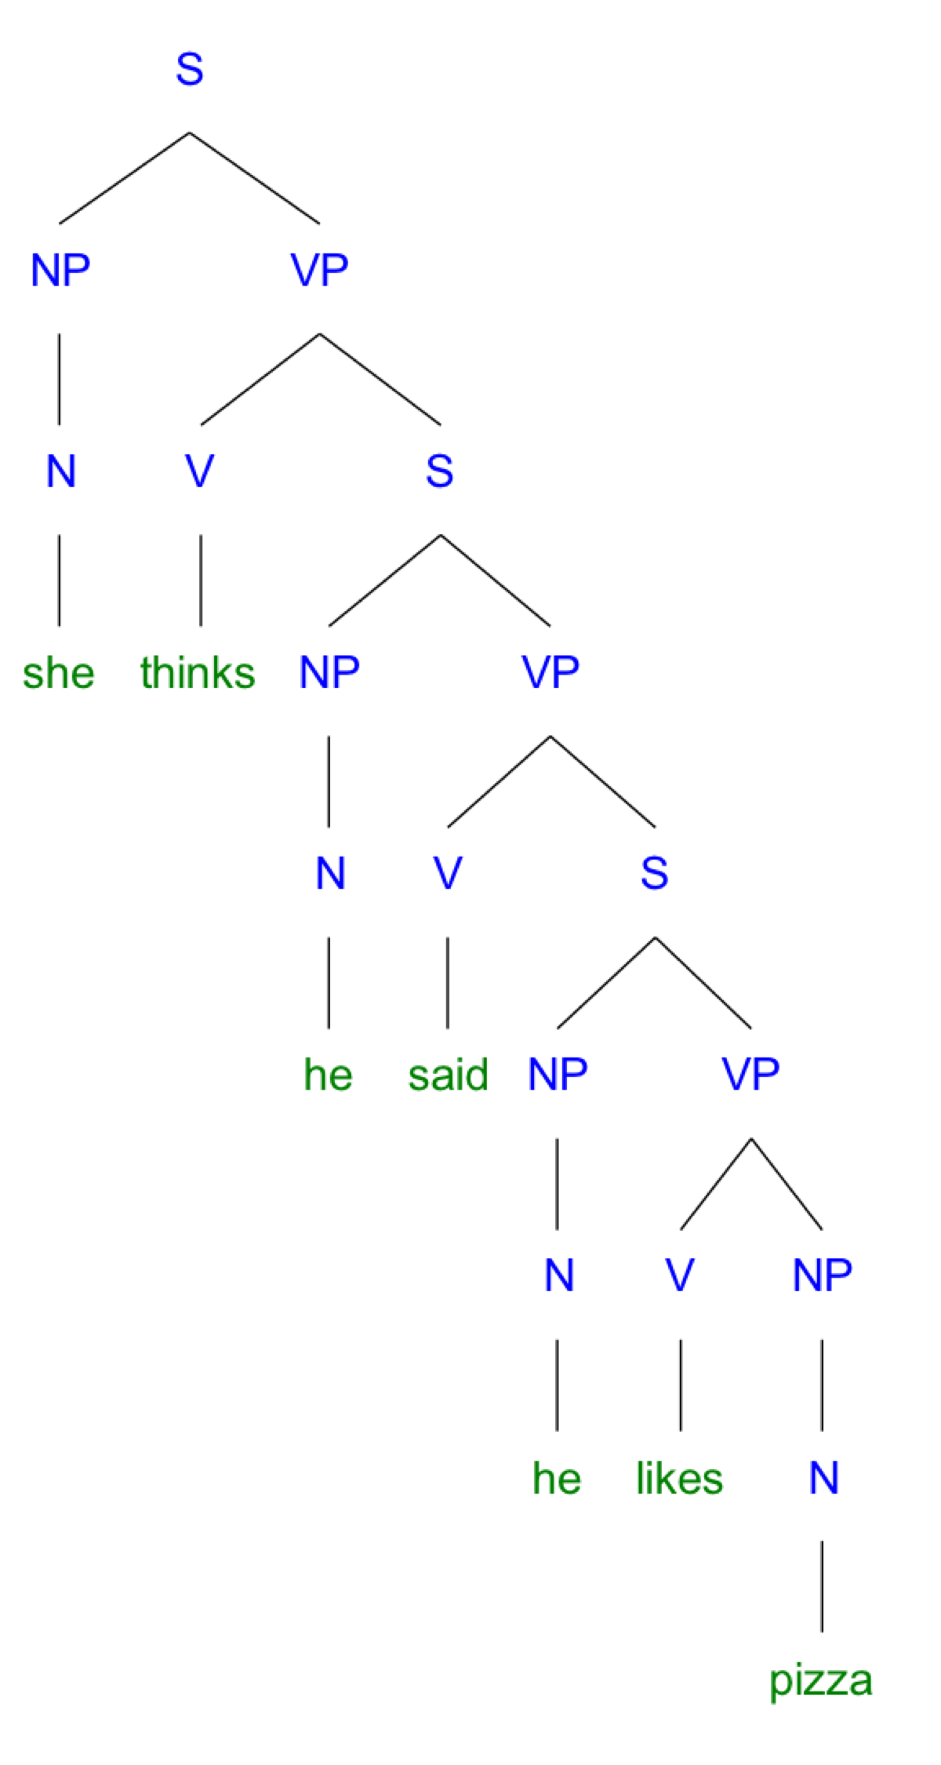
Is there a grammatical restriction on embedding depth?

Slide 29
Competence and performance
Competence refers to our knowledge of grammar
Performance refers to the way in which we use grammar in practice
I know that you know that I know that you know that I like pizza
Hard to understand, but grammatical: difficult to think of a reason to say this sentence is not a part of the English language

