Slide 1
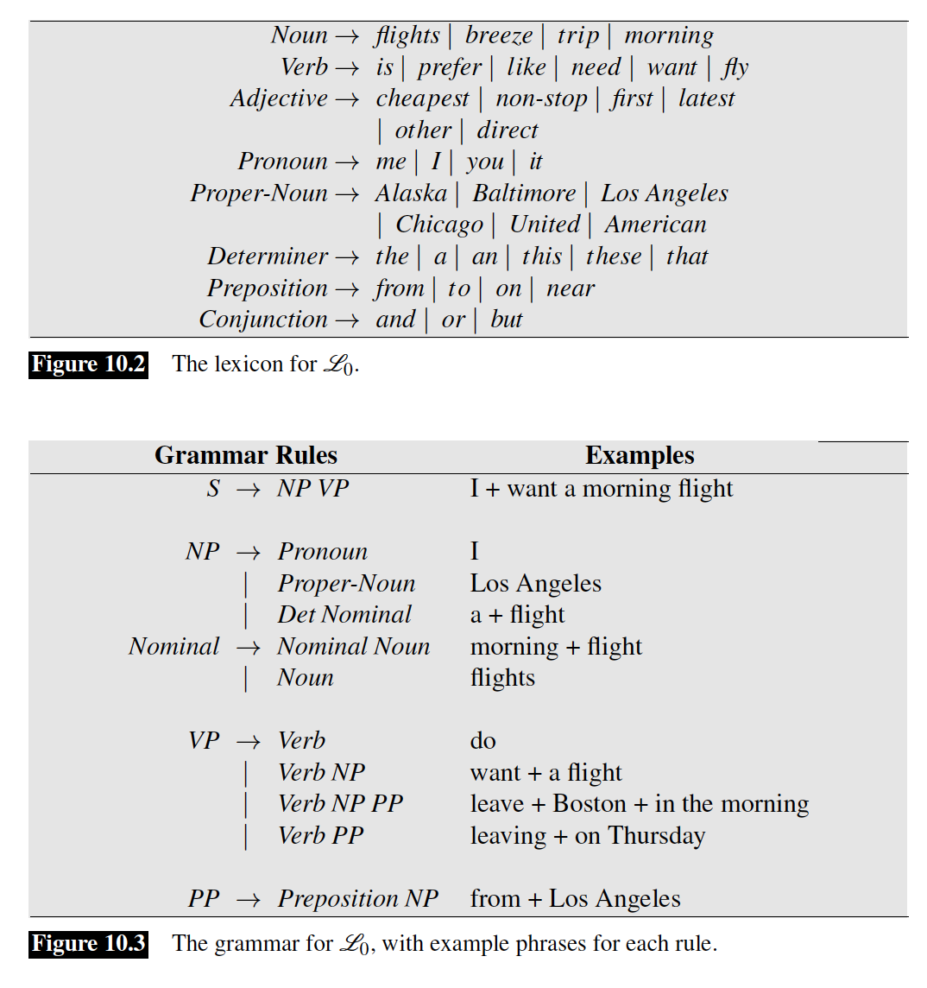
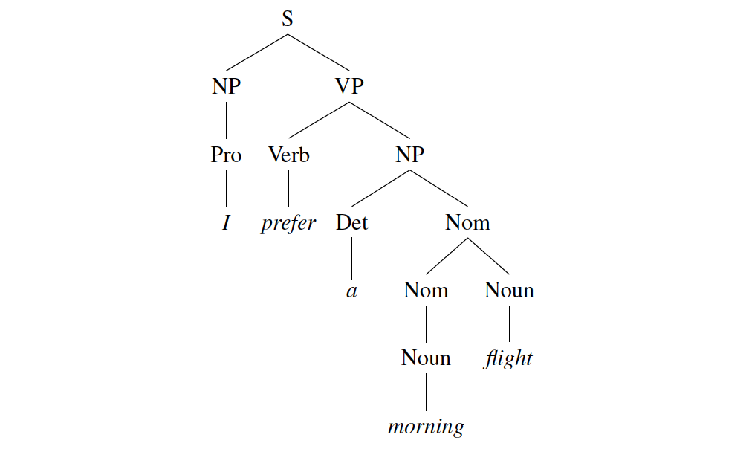
Parsing
Assign a structural description to a string of words (in accordance with a grammar)

Slide 2
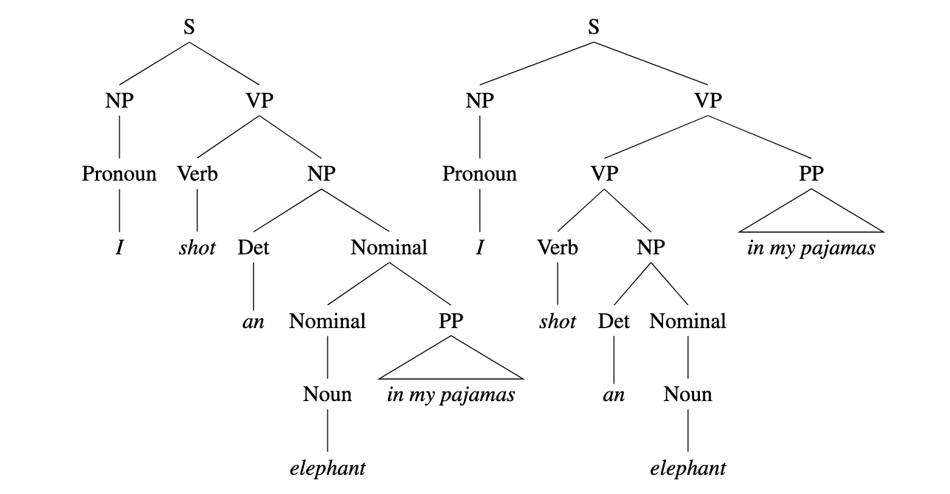
Ambiguity

Slide 3
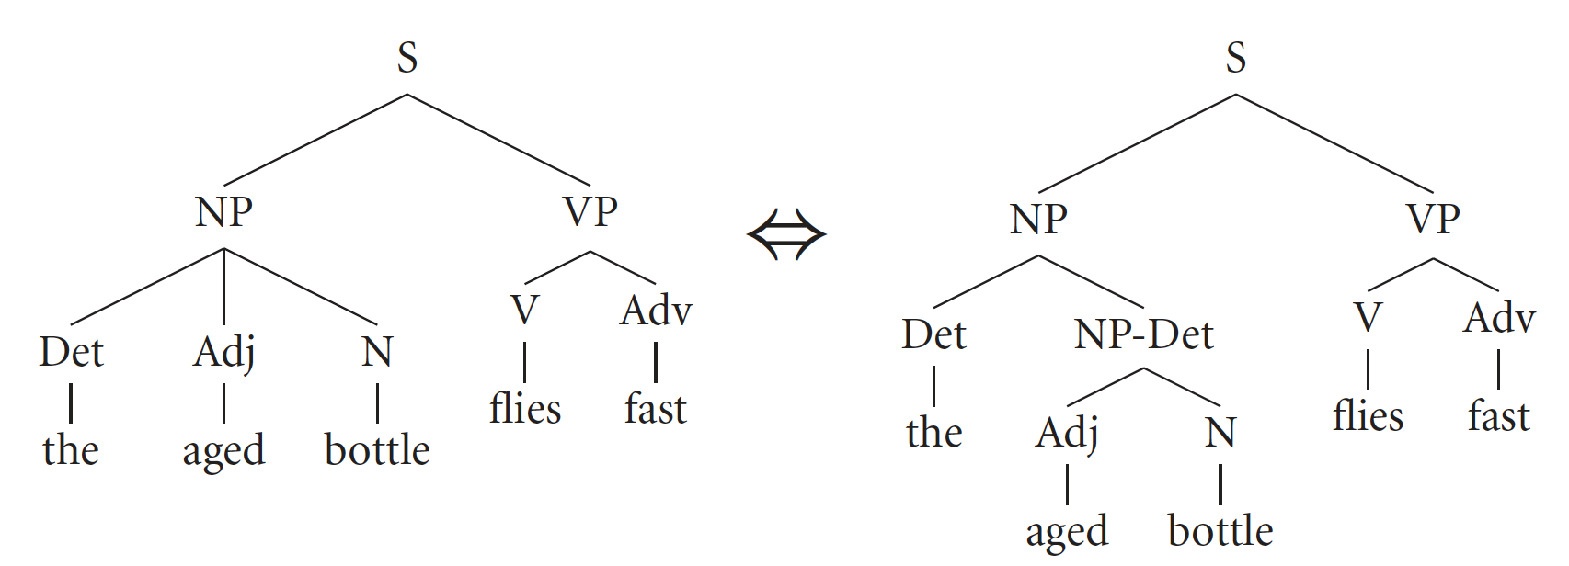
Chomsky Normal Form: only binary branching
Same weak generative capacity (the strings are the same, but not the trees)
(Roark and Sproat, 2007)

Slide 4
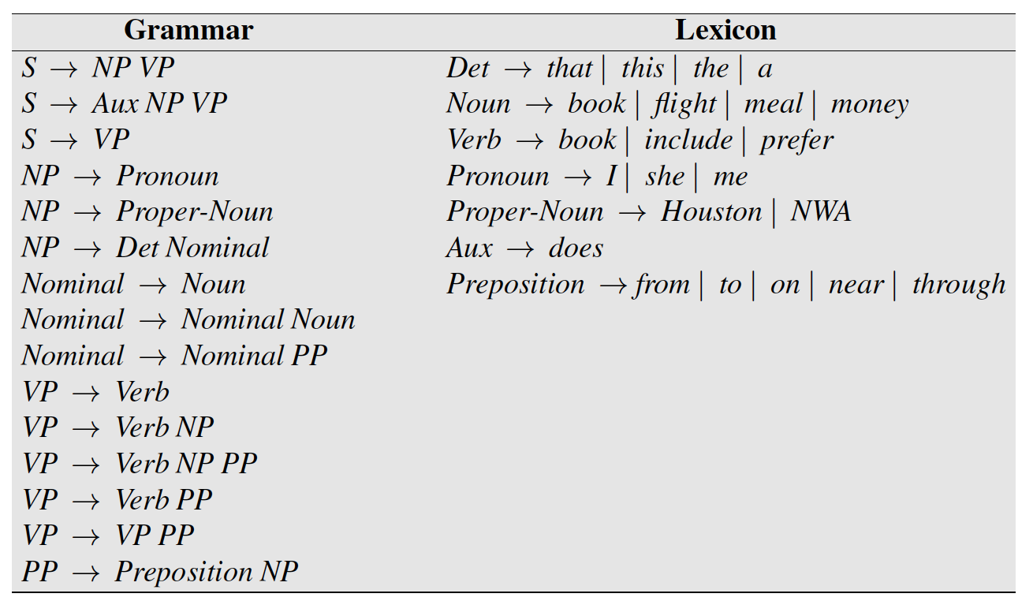
Eliminating ternary productions
VP → X2 PP
X2 → Verb NP
VP → Verb NP PP

Slide 5
Eliminating ternary productions
Same weak generative capacity (the strings are the same, but not the trees)
(Roark and Sproat, 2007)

Slide 6
Eliminating unary productions
S → VP
VP → Verb
Verb → book
S → book

Slide 7
CKY intuition: spans
Book the flight through Houston
Only binary productions in Chomsky Normal Form!
CFG constituents are contiguous spans of words
[ Book ] [ the flight through Houston ] ] [0:1, 1:5]
[ [ Book the ] [ flight through Houston ] ] [0:2, 2:5]
[ [ Book the flight ] [ through Houston ] ] [0:3, 3:5]
[ [ Book the flight through ] [ Houston ] ] [0:4, 4:5]

Slide 8
CKY intuition: spans
Suppose the correct segmentation is:
[ [ Book the ] [ flight through Houston ] ]
Only two possible ways to further segment the
second span:
[ [ flight ] [ through Houston ] ]
[ [ flight through ] [ Houston ] ]

Slide 9
CKY intuition: spans
In addition to identifying the constituents, we want to know what their labels (nonterminals) are:
[NP [Noun flight ] [PP through Houston ] ]

Slide 10
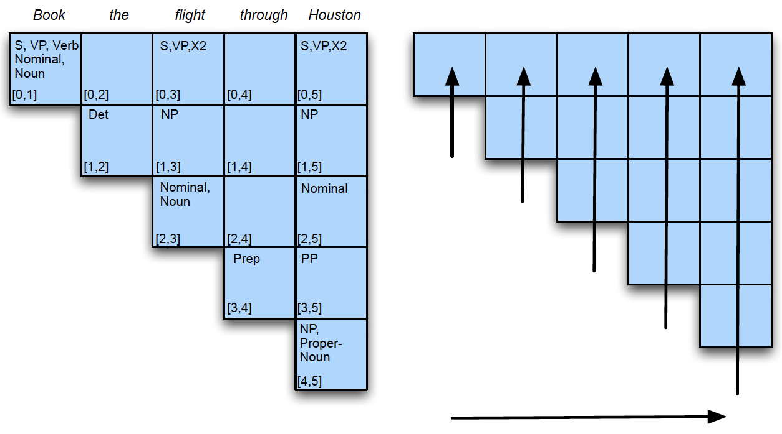
CKY algorithm

Slide 11
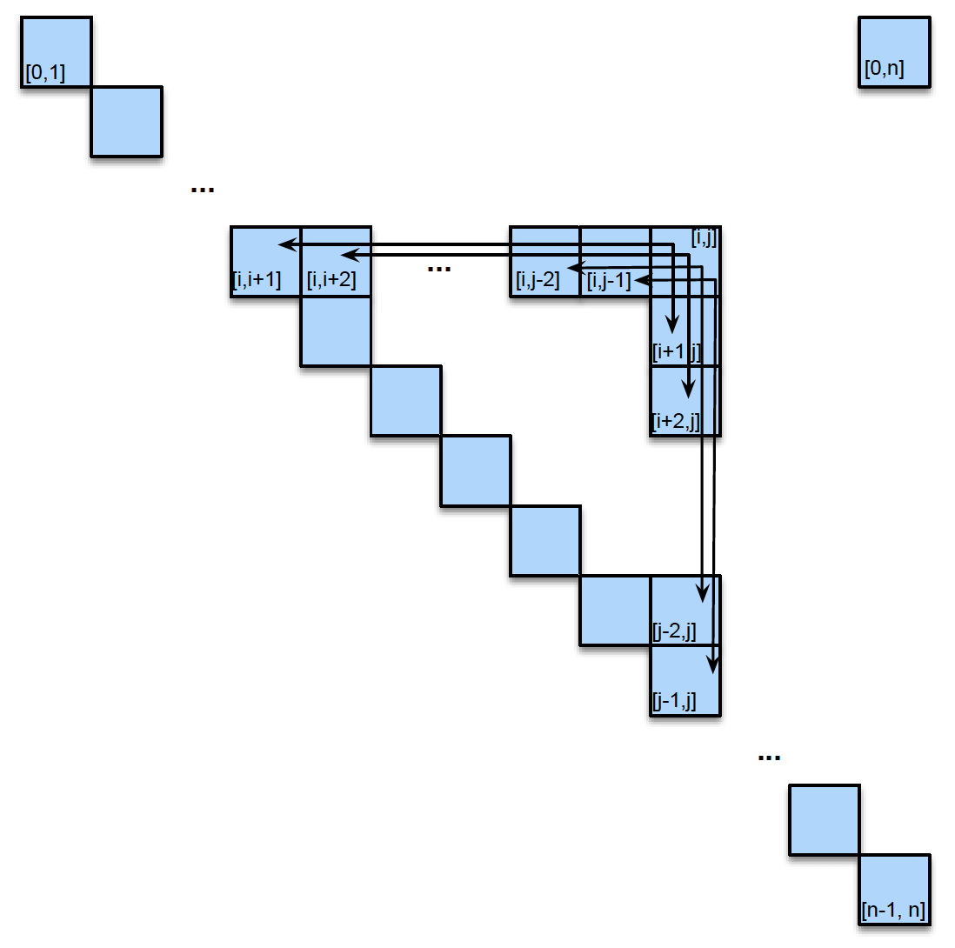
Which pairs of cells do we consider?

Slide 12
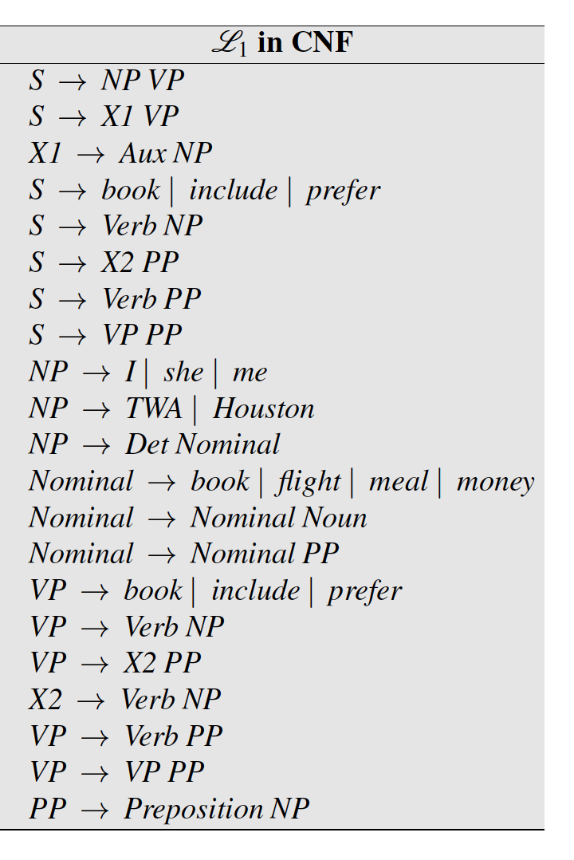
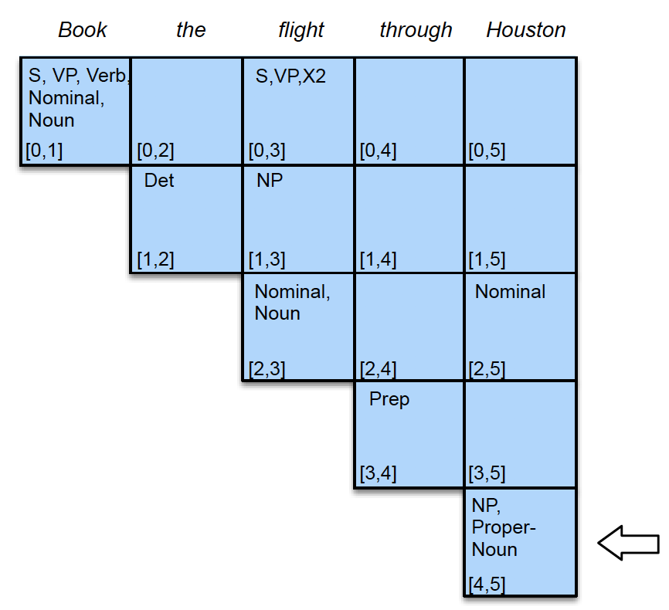
Filling cells

Slide 13
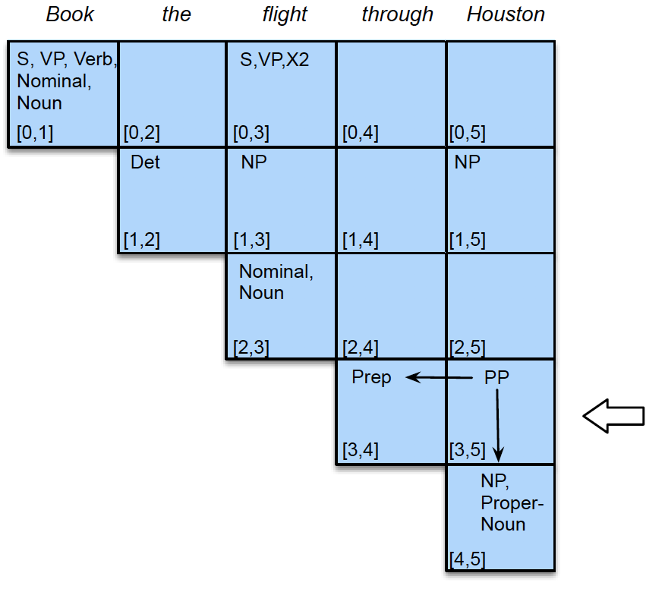
Filling cells

Slide 14
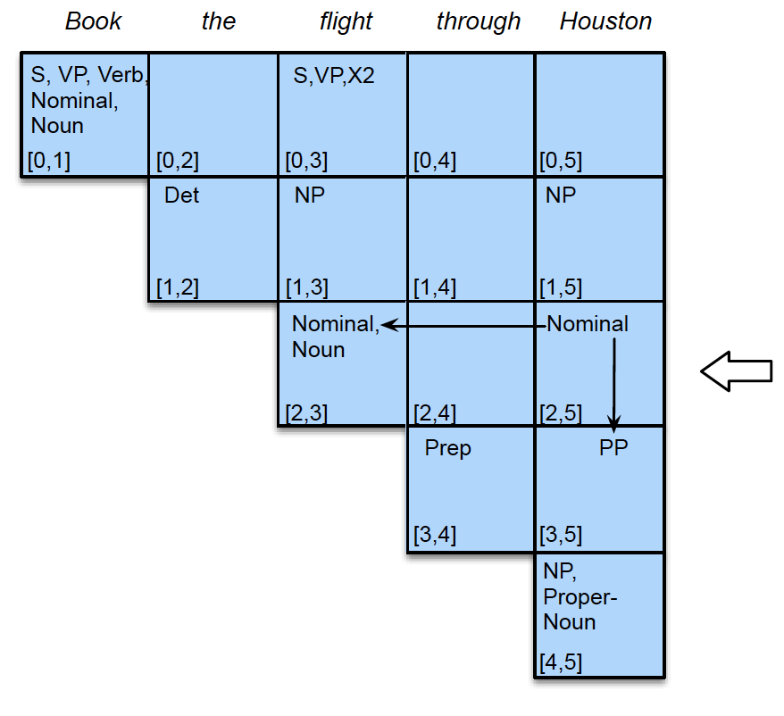
Filling cells

Slide 15
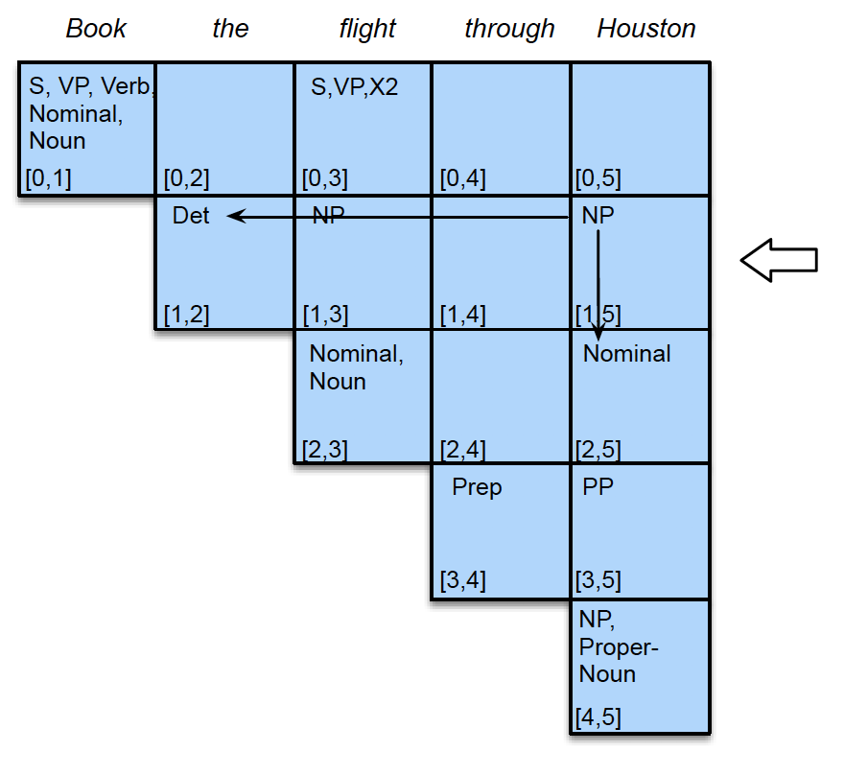
Filling cells

Slide 16
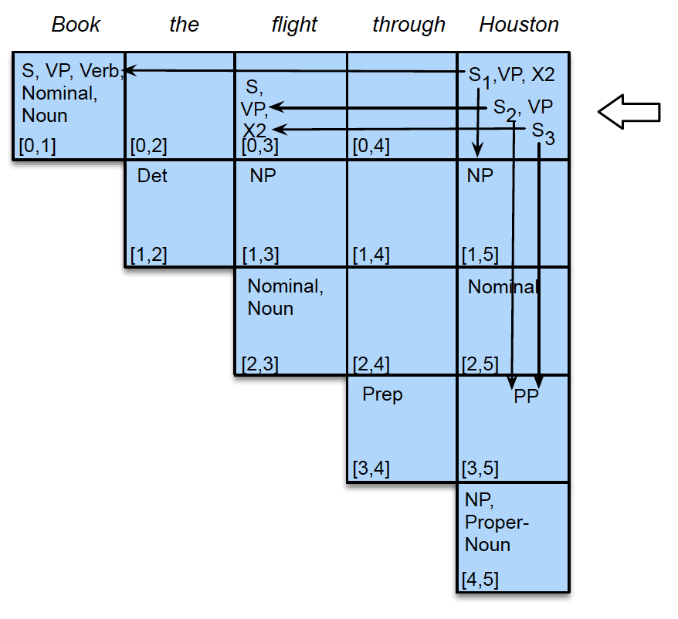
Filling cells

Slide 17
If start symbol spans the whole sentence, track back how we arrive at this symbol (keep pointers to make this possible)

