Slide 1
Chapter 7: Reinforcement Learning
Hankui Zhuo
March 29, 2019

Slide 2
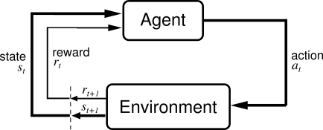
Reinforcement Learning
Basic idea:
Receive feedback in the form of rewards
Agent’s utility is defined by the reward function
Must (learn to) act so as to maximize expected rewards

Slide 3
Reinforcement Learning
Reinforcement learning:
Still assume an MDP:
A set of states s ∈ S
A set of actions (per state) A
A model T(s,a,s’)
A reward function R(s,a,s’)
A discount factor γ (could be 1)
Still looking for a policy π(s)
New twist: don’t know T or R
i.e. don’t know which states are good or what the actions do
Must actually try actions and states out to learn

Slide 4
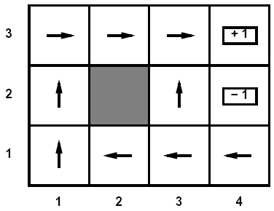
Passive Learning
Simplified task
You don’t know the transitions T(s,a,s’)
You don’t know the rewards R(s,a,s’)
You are given a policy π(s)
Goal: learn the state values
In this case:
No choice about what actions to take
Just execute the policy and learn from experience
This is NOT offline planning! You actually take actions in the world and see what happens…

Slide 5
Model-Based Learning
Idea:
Learn the model empirically through experience
Solve for values as if the learned model were correct
Simple empirical model learning
Count outcomes for each s,a
Normalize to give estimate of T(s,a,s’)
Discover R(s,a,s’) when we experience (s,a,s’)
Solving the MDP with the learned model
Iterative policy evaluation, for example
s
π(s)
s, π(s)
s, π(s),s’
s’

Slide 6
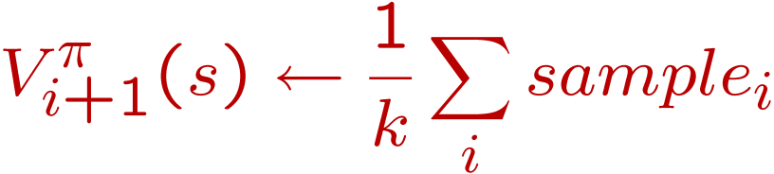
Sample-Based Policy Evaluation?
s
Approximate the expectation with samples (drawn from T!)
π(s)
s, π(s)
s, π(s),s’
s₂’
s₁’
s₃’
s’

Slide 7
Temporal-Difference Learning
Big idea: learn from every experience!
Update V(s) each time we experience (s,a,s’,r)
Likely s’ will contribute updates more often
Temporal difference learning
Policy still fixed!
Move values toward value of whatever successor occurs: running average!
s
π(s)
s, π(s)
s’
Sample of V(s):
Update to V(s):

Slide 8

Exponential Moving Average
Exponential moving average
Makes recent samples more important
Forgets about the past (distant past values were wrong anyway)
Easy to compute from the running average
Decreasing learning rate can give converging averages

Slide 9
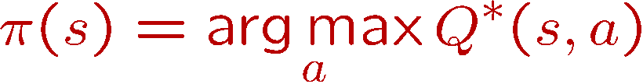
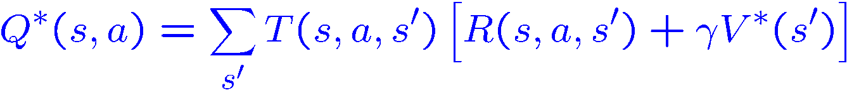
Problems with TD Value Learning
TD value leaning is a model-free way to do policy evaluation
However, if we want to turn values into a (new) policy, we’re sunk:
Idea: learn Q-values directly
Makes action selection model-free too!
s
a
s, a
s,a,s’
s’

Slide 10
Active Learning
Full reinforcement learning
You don’t know the transitions T(s,a,s’)
You don’t know the rewards R(s,a,s’)
You can choose any actions you like
Goal: learn the optimal policy
In this case:
Learner makes choices!
Fundamental tradeoff: exploration vs. exploitation
This is NOT offline planning! You actually take actions in the world and find out what happens…

Slide 11

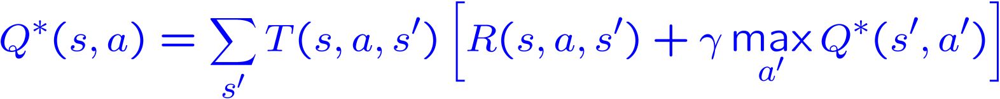
Q-Learning
Learn Q*(s,a) values
Receive a sample (s,a,s’,r)
Consider your old estimate:
Consider your new sample estimate:
Incorporate the new estimate into a running average:

Slide 12
Q-Learning Properties
Amazing result: Q-learning converges to optimal policy
If you explore enough
If you make the learning rate small enough
… but not decrease it too quickly!
Basically doesn’t matter how you select actions (!)

Slide 13
Exploration / Exploitation
Several schemes for forcing exploration
Simplest: random actions (ε greedy)
Every time step, flip a coin
With probability ε, act randomly
With probability 1-ε, act according to current policy
Problems with random actions?
You do explore the space, but keep thrashing around once learning is done
One solution: lower ε over time

Slide 14
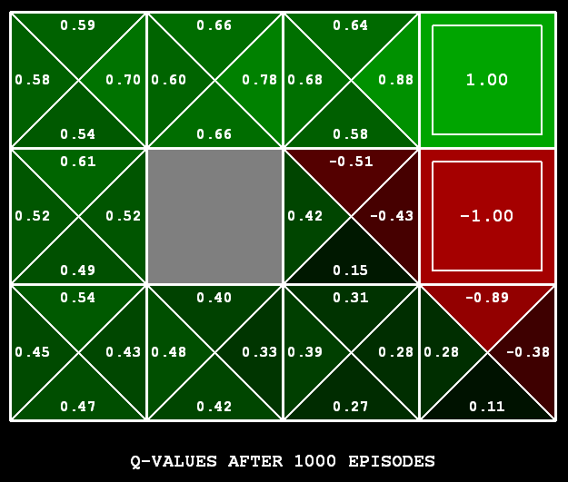
Q-Learning
Q-learning produces tables of q-values:

Slide 15
The Story So Far: MDPs and RL
Things we know how to do:
Techniques:
If we know the MDP
Compute V*, Q*, π* exactly
Evaluate a fixed policy π
If we don’t know the MDP
We can estimate the MDP then solve
We can estimate V for a fixed policy π
We can estimate Q*(s,a) for the optimal policy while executing an exploration policy
Model-based DPs
Value and policy Iteration
Policy evaluation
Model-based RL
Model-free RL:
Value learning
Q-learning

Slide 16
Q-Learning
In realistic situations, we cannot possibly learn about every single state!
Too many states to visit them all in training
Too many states to hold the q-tables in memory
Instead, we want to generalize:
Learn about some small number of training states from experience
Generalize that experience to new, similar states
This is a fundamental idea in machine learning

Slide 17
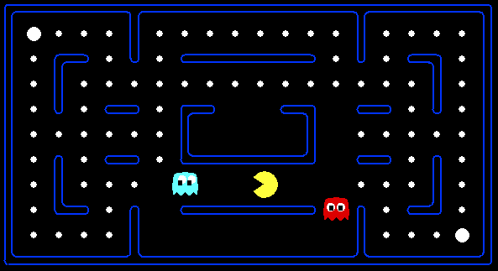



Feature-Based Representations
Solution: describe a state using a vector of features
Features are functions from states to real numbers (often 0/1) that capture important properties of the state
Example features:
Distance to closest ghost
Distance to closest dot
Number of ghosts
1 / (dist to dot)²
Is Pacman in a tunnel? (0/1)
…… etc.
Can also describe a q-state (s, a) with features (e.g. action moves closer to food)

Slide 18
Linear Feature Functions
Using a feature representation, we can write a q function (or value function) for any state using a few weights:
Advantage: our experience is summed up in a few powerful numbers
Disadvantage: states may share features but be very different in value!

Slide 19
Function Approximation
Q-learning with linear q-functions:
Intuitive interpretation:
Adjust weights of active features
E.g. if something unexpectedly bad happens, disprefer all states with that state’s features

Slide 20
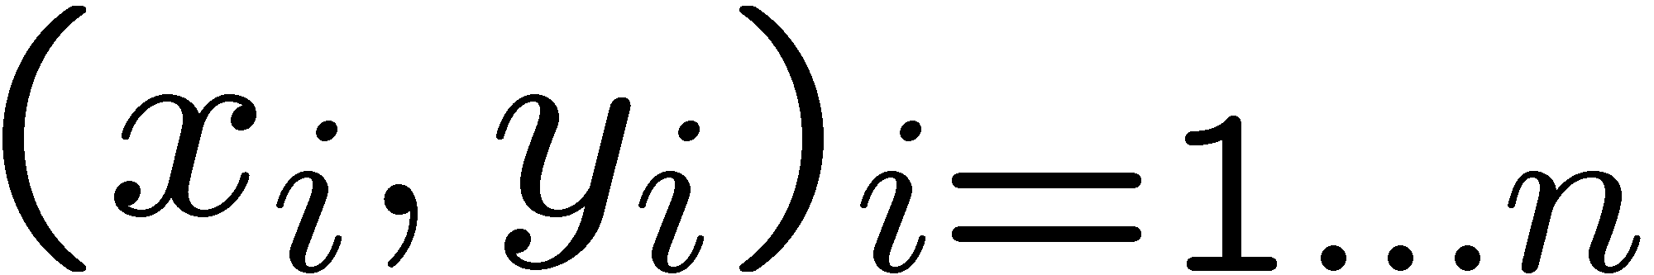
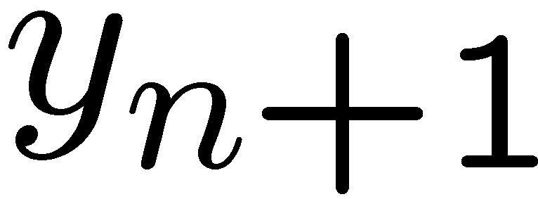
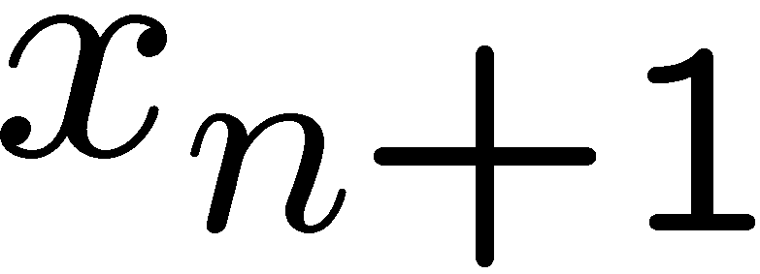
Linear regression
40
26
24
20
22
20
30
20
40
30
0
10
20
0
10
20
0
10
0
Given examples
Predict
given a new point
Notes:
Figure 1: scatter(1:20,10+(1:20)+2*randn(1,20),'k','filled'); a=axis; a(3)=0; axis(a);

Slide 21
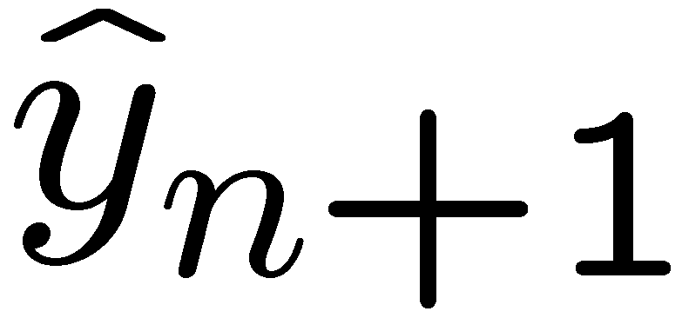
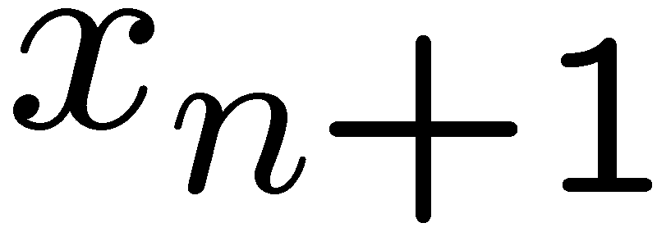
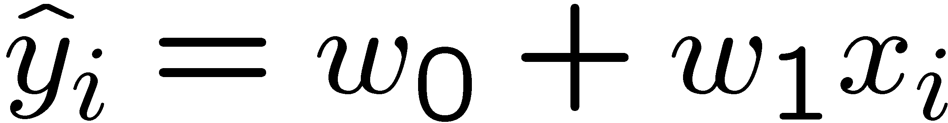
Linear regression
40
26
24
20
22
20
30
20
40
30
0
10
20
0
20
0
10
0
Prediction
Prediction
Notes:
Figure 1: scatter(1:20,10+(1:20)+2*randn(1,20),'k','filled'); a=axis; a(3)=0; axis(a);

Slide 22
The End!

