Slide 1
Deep Feedforward Networks
Hankz Hankui Zhuo
May 10, 2019
http://xplan-lab.org

Slide 2
What’s DFN
Information flows through the function being evaluated from x, through the intermediate computations used to define f, and finally to the output y
No feedback connections
Extended to include feedback connections
Recurrent Neural Networks
Also called feedforward neural networks
Or multilayer perceptions (MLPs)

Slide 3
Structure
Chain structures:
three layers: f(x) = f³(f²(f¹(x)))
“three” is the depth of the model
Output layer: the desired output is specified in the training data
Hidden layers: the desired output is not specified in the training data
Width of the model: the dimensionality of hidden layers

Slide 4
Mapping of input
Linear model of input x
y=w^{T}x
Nonlinear model
Introducing mapping ϕ
y=w^{T}ϕ(x)
How to choose ϕ?
1. use a very generic ϕ:
kernel machines, e.g., RBF kernel
If ϕ (x) is of high enough dimension, we can always have enough capacity to fit the training set
2. manually engineer ϕ

Slide 5
Mapping of input
3. The strategy of deep learning is to learn ϕ
y=f(x;θ,w)=ϕ(x; θ)^{T}w
This approach can capture the benefit of the first approach by being highly generic
we do so by using a very broad family φ(x;θ).
Can also capture the benefit of the second approach
Human practitioners can encode their knowledge to help generalization by designing families φ(x; θ) that they expect will perform well.

Slide 6
Example: Learning XOR
XOR is an operation on two binary values
When exactly one of these binary values is equal to 1, the XOR function returns 1
Training data with four points
X={[0,0],[0,1],[1,0],[1,1]}
MSE (mean squared error) loss function:
J(θ)=1/4Σ_{x}(f(x)-f(x;θ))²
Choose the form of our model f(x;θ)
Linear model: f(x;w,b)=x^{T}w+b
We got w=0 and b=1/2, i.e., The linear model simply outputs 0.5 everywhere

Slide 7
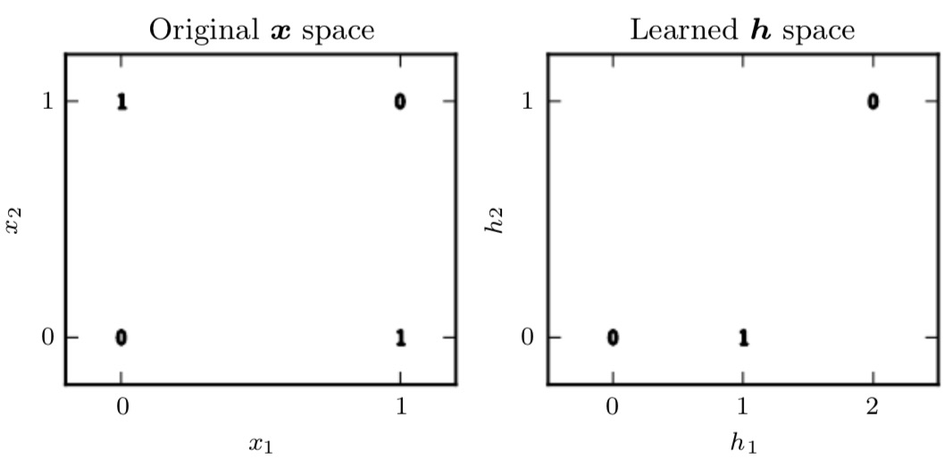
Why?
When x₁ = 0, the model’s output must increase as x₂ increases.
When x₁ = 1, the model’s output must decrease as x₂ increases.
A linear model must apply a fixed coefficient w₂ to x₂.
The linear model therefore cannot use the value of x₁ to change the coefficient on x₂ and cannot solve this problem.

Slide 8
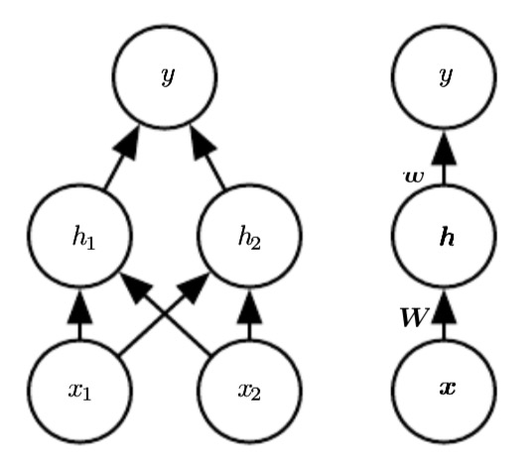
A simple feedforward network
One hidden layer with two hidden units
Hidden layer:
h = f¹(x; W, c)
Output layer:
y=f²(h;w,b)
Complete model:
f(x;W,c,w,b)=f²(f¹(x))
If f¹ use linear model, then
h=f¹(x)=W^{T}x, f²(h)=h^{T}w,
Then we have y=f(x)=w^{T}W^{T}x
Or just f(x)=x^{T}w’, where w’=Ww
We thus cannot solve the problem
We need a nonlinear function
Use a fixed nonlinear function called activation function
h=g(W^{T}x+c)
g is typically chosen to be a function that is applied element-wise
h_{i}=g(x^{T}W_{:,i}+c_{i})

Slide 9
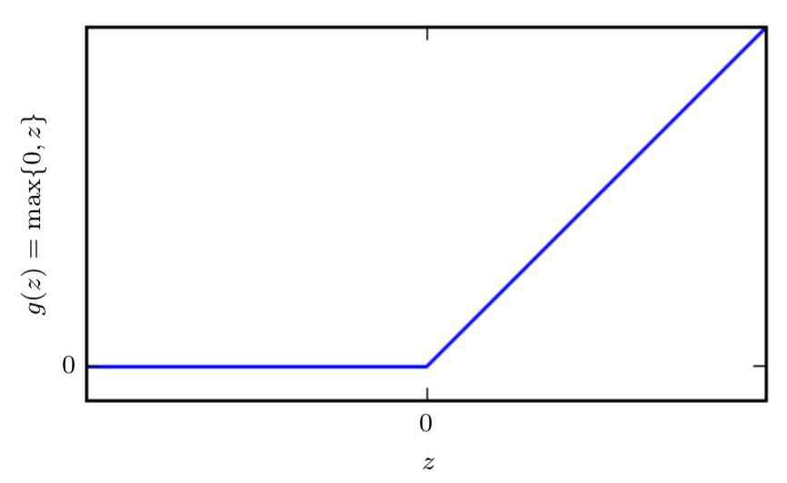
Rectified Linear Unit (ReLU)
The activation function g is defined by
g(z)=max{0,z}
i.e., the complete network is:
f(x;W,c,w,b)=w^{T}max{0,W^{T}x+c}+b

Slide 10
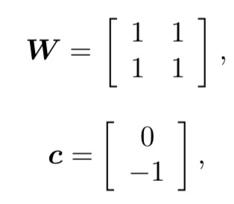
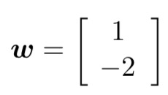

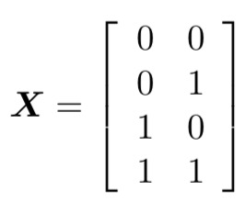
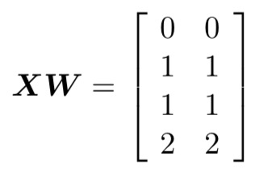
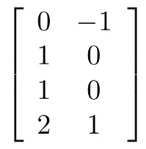
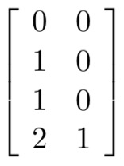
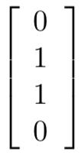
A solution to XOR
A solution as show below:
We can walk through the way the model processes based on f(x;W,c,w,b)=w^{T}max{0,W^{T}x+c}+b
add c
apply ReLU
multiply w

Slide 11
Gradient-Based Learning
difference between the linear models and neural networks is
the nonlinearity of a neural network causes most interesting loss functions to become non-convex
This means that neural networks are usually trained by using iterative, gradient-based optimizers that merely drive the cost function to a very low value, rather than the linear equation solvers used to train linear regression models or the convex optimization algorithms with global convergence guarantees
Stochastic gradient descent applied to non-convex loss functions has no such convergence guarantee, and is sensitive to the values of the initial parameters.
For feedforward neural networks, it is important to initialize all weights to small random values.

Slide 12
Gradient-Based Learning
The biases may be initialized to zero or to small positive values.
For the moment, it suffices to understand that the training algorithm is almost always based on using the gradient to descend the cost function in one way or another.
The specific algorithms are improvements and refinements on the ideas of gradient descent
Computing the gradient is slightly more complicated for a neural network, but can still be done efficiently and exactly

Slide 13

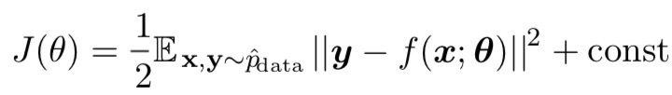
Cost Function
Cross-entropy between training data and the model distribution
The specific form of the cost function changes from model to model, depending on the specific form of logp_{model}
For
We have

Slide 14

Output Units
suppose that the feedforward network provides a set of hidden features defined by
h = f(x;θ)
Linear Units for Gaussian Output Distributions
Maximizing the log-likelihood is then equivalent to minimizing the mean squared error

Slide 15

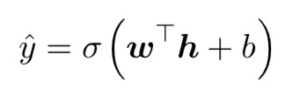
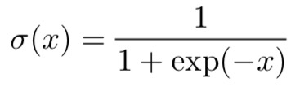
Output Units (continued)
Sigmoid Units for Bernoulli Output Distributions
Suppose we were to use a linear unit, and threshold its value to obtain a valid probability
A sigmoid output unit is defined by
logistic sigmoid

Slide 16
Output Units (continued)
The sigmoid output unit as having two components
First, it uses a linear layer to compute z=w^{T}h+b
Next, it uses the sigmoid activation function to convert z into a probability
We omit the dependence on x for the moment to discuss how to define a probability distribution over y using the value z

Slide 17

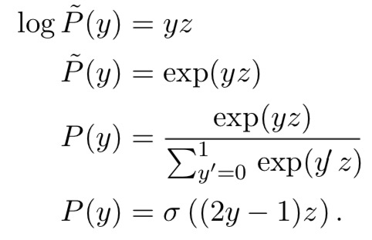
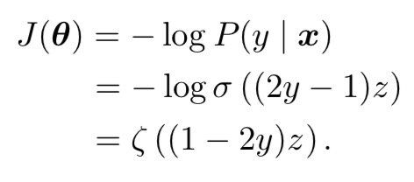
Output Units (continued)
omit the dependence on x for the moment to discuss how to define a probability distribution over y using the value z
The sigmoid can be motivated by constructing an unnormalized probability distribution
We then normalize to see that this yields a Bernoulli distribution controlled by a sigmoidal transformation of z
The loss function for maximum likelihood learning of a Bernoulli parametrized by a sigmoid is

Slide 18
To be continued!

