Slide 1
Recurrent Neural Networks
Hankui Zhuo
May 22, 2019
http://xplan-lab.org/IAA-Course

Slide 2

Example Application
Slot Filling
I would like to arrive Guangzhou on November 2nd.
ticket booking system
Destination:
Guangzhou
Slot
time of arrival:
November 2nd

Slide 3
Example Application
Solving slot filling by Feedforward network?
Input: a word
(Each word is represented as a vector)
Guangzhou

Slide 4
1-of-N encoding
How to represent each word as a vector?
1-of-N Encoding
lexicon = {apple, bag, cat, dog, elephant}
The vector is lexicon size.
apple = [ 1 0 0 0 0]
bag = [ 0 1 0 0 0]
Each dimension corresponds to a word in the lexicon
cat = [ 0 0 1 0 0]
The dimension for the word is 1, and others are 0
dog = [ 0 0 0 1 0]
elephant = [ 0 0 0 0 1]
Notes:
Can be very large

Slide 5
Beyond 1-of-N encoding
Dimension for “Other”
Word hashing
apple
0
a-a-a
0
bag
0
a-a-b
0
…
…
cat
0
a-p-p
1
dog
0
…
…
…
26 X 26 X 26
elephant
0
p-l-e
1
…
…
p-p-l
1
“other”
1
…
…
w = “apple”
w = “Gandalf”
w = “Sauron”

Slide 6
Example Application
time of departure
dest
Solving slot filling by Feedforward network?
Input: a word
(Each word is represented as a vector)
Output:
Probability distribution that the input word belonging to the slots
Guangzhou

Slide 7
Example Application
time of departure
dest
arrive GZ on November 2nd
other
dest
other
time
time
Problem?
leave GZ on November 2nd
place of departure
Neural network needs memory!
Guangzhou

Slide 8
Recurrent Neural Networks (RNNs)
The output of hidden layer are stored in the memory.
store
Memory can be considered as another input.

Slide 9





Example
Input sequence:
$$\left[\begin{aligned}1 \\ 1\end{aligned}\right]$$
$$\left[\begin{aligned}1 \\ 1\end{aligned}\right]$$
$$\left[\begin{aligned}2 \\ 2\end{aligned}\right]$$
$$……$$
output sequence:
$$\left[\begin{aligned}4 \\ 4\end{aligned}\right]$$
4
4
store
2
2
given Initial values
0
0
All the weights are “1”, no bias
1
1
All activation functions are linear

Slide 10

Example
Input sequence:
$$\left[\begin{aligned}1 \\ 1\end{aligned}\right]$$
$$\left[\begin{aligned}1 \\ 1\end{aligned}\right]$$
$$\left[\begin{aligned}2 \\ 2\end{aligned}\right]$$
$$……$$
output sequence:
$$\left[\begin{aligned}4 \\ 4\end{aligned}\right]$$
$$\left[\begin{aligned}12 \\ 12\end{aligned}\right]$$
12
12
store
6
6
2
2
All the weights are “1”, no bias
1
1
All activation functions are linear

Slide 11

Example
Input sequence:
$$\left[\begin{aligned}1 \\ 1\end{aligned}\right]$$
$$\left[\begin{aligned}1 \\ 1\end{aligned}\right]$$
$$\left[\begin{aligned}2 \\ 2\end{aligned}\right]$$
$$……$$
output sequence:
$$\left[\begin{aligned}4 \\ 4\end{aligned}\right]$$
$$\left[\begin{aligned}12 \\ 12\end{aligned}\right]$$
$$\left[\begin{aligned}32 \\ 32\end{aligned}\right]$$
Changing the sequence order will change the output.
32
32
store
16
16
6
6
All the weights are “1”, no bias
2
2
All activation functions are linear

Slide 12
RNN
The same network is used again and again.
Probability of “GZ” in each slot
Probability of “arrive” in each slot
Probability of “on” in each slot
y¹
y²
y³
store
store
a¹
a²
a³
a¹
a²
x¹
x²
x³
arrive GZ on November 2nd

Slide 13
RNN
Different
Prob of “leave” in each slot
Prob of “GZ” in each slot
Prob of “arrive” in each slot
Prob of “GZ” in each slot
y²
……
y²
……
y¹
y¹
store
store
a¹
a²
a¹
a²
a¹
……
a¹
……
x¹
x²
……
x¹
x²
……
leave
GZ
arrive
GZ
The values stored in the memory is different.
Notes:
The same input can have totoally different output.

Slide 14
Of course it can be deep …
y^{t}
y^{t+1}
y^{t+2}
……
……
……
……
……
……
……
……
……
x^{t}
x^{t+1}
x^{t+2}

Slide 15
Elman Network & Jordan Network
Elman Network
Jordan Network
y^{t}
y^{t+1}
y^{t}
y^{t+1}
W^{h}
Wº
Wº
Wº
Wº
……
……
……
……
W^{h}
W^{i}
W^{i}
W^{i}
W^{i}
x^{t}
x^{t+1}
x^{t}
x^{t+1}

Slide 16
Bidirectional RNN
……
x^{t}
x^{t+1}
x^{t+2}
……
y^{t}
y^{t+1}
y^{t+2}
……
……
x^{t}
x^{t+1}
x^{t+2}

Slide 17
Long Short-term Memory (LSTM)
Other part of the network
Special Neuron:
4 inputs,
1 output
Signal control the output gate
Output Gate
(Other part of the network)
Memory
Cell
Forget Gate
Signal control the forget gate
(Other part of the network)
Signal control the input gate
Input Gate
LSTM
(Other part of the network)
Other part of the network

Slide 18
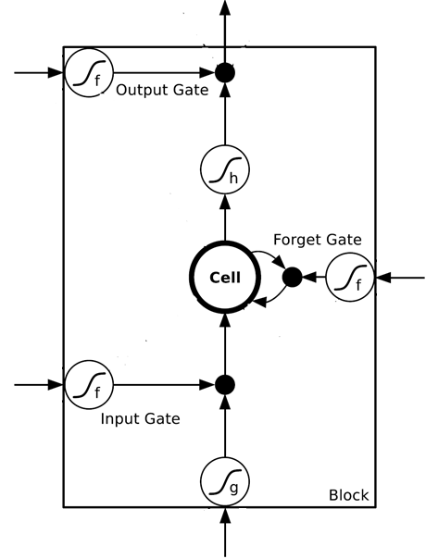
$$a$$
$$=h\left(c^{′}\right)f\left(z_{o}\right)$$
$$z_{o}$$
multiply
Activation function f is usually a sigmoid function
$$f\left(z_{o}\right)$$
$$h\left(c^{′}\right)$$
Between 0 and 1
Mimic open and close gate
$$c$$
$$f\left(z_{f}\right)$$
c
$$c^{′}$$
$$z_{f}$$
$$cf\left(z_{f}\right)$$
$$c^{′}=g\left(z\right)f\left(z_{i}\right)+cf\left(z_{f}\right)$$
$$f\left(z_{i}\right)$$
$$g\left(z\right)f\left(z_{i}\right)$$
$$z_{i}$$
multiply
$$g\left(z\right)$$
$$z$$

Slide 19




LSTM - Example
0
0
3
3
7
7
7
0
6
$$x_{1}$$
1
0
0
3
1
0
2
0
0
4
1
0
2
0
0
1
0
1
3
-1
0
6
1
0
1
0
1
$$x_{2}$$
$$x_{3}$$
$$y$$
0
0
0
0
0
7
0
0
6
When x₂ = 1, add the numbers of x₁ into the memory
When x₂ = -1, reset the memory
When x₃ = 1, output the number in the memory.

Slide 20




x₁
0
y
$$y$$
0
0
0
7
0
x₂
0
+
x₃
100
0
x₁
1
-10
100
0
0
+
x₂
x₁
0
x₃
x₂
100
+
10
1
x₃
0
1
-10
+
$$x_{1}$$
3
1
0
4
1
0
2
0
0
1
0
1
3
-1
0
1
0
0
0
$$x_{2}$$
x₁
x₂
x₃
1
$$x_{3}$$

Slide 21
3
0
≈0
y
$$y$$
0
0
0
7
0
1
0
+
≈0
3
0
100
0
3
1
-10
0
100
0
3
+
1
3
≈1
0
0
100
≈1
3
1
+
10
1
3
0
0
1
-10
+
$$x_{1}$$
3
1
0
4
1
0
2
0
0
1
0
1
3
-1
0
1
0
0
0
$$x_{2}$$
3
1
0
1
$$x_{3}$$

Slide 22
4
0
≈0
y
$$y$$
0
0
0
7
0
1
0
+
≈0
7
0
100
0
4
1
-10
7
100
0
3
+
1
4
≈1
0
0
100
≈1
4
1
+
10
1
4
0
0
1
-10
+
$$x_{1}$$
3
1
0
4
1
0
2
0
0
1
0
1
3
-1
0
1
0
0
0
$$x_{2}$$
4
1
0
1
$$x_{3}$$

Slide 23
2
0
≈0
y
$$y$$
0
0
0
7
0
0
0
+
≈0
7
0
100
0
2
1
-10
7
100
0
+
0
2
≈1
0
0
100
≈0
0
0
+
10
1
2
0
0
1
-10
+
$$x_{1}$$
3
1
0
4
1
0
2
0
0
1
0
1
3
-1
0
1
0
0
0
$$x_{2}$$
2
0
0
1
$$x_{3}$$

Slide 24
1
0
≈7
y
$$y$$
0
0
0
7
0
0
0
+
≈1
7
1
100
0
1
1
-10
7
100
0
+
0
1
≈1
0
1
100
≈0
0
0
+
10
1
1
1
0
1
-10
+
$$x_{1}$$
3
1
0
4
1
0
2
0
0
1
0
1
3
-1
0
1
0
0
0
$$x_{2}$$
1
0
1
1
$$x_{3}$$

Slide 25
3
0
≈0
y
$$y$$
0
0
0
7
0
-1
0
+
≈0
0
0
100
0
3
1
-10
0
100
0
7
+
-1
3
≈0
0
0
100
≈0
0
-1
+
10
1
3
0
0
1
-10
+
$$x_{1}$$
3
1
0
4
1
0
2
0
0
1
0
1
3
-1
0
1
0
0
0
$$x_{2}$$
3
-1
0
1
$$x_{3}$$

Slide 26




Original Network:
Simply replace the neurons with LSTM
……
……
$$a_{1}$$
$$a_{2}$$
$$z_{1}$$
$$z_{2}$$
x₁
x₂
Input

Slide 27


$$a_{1}$$
$$a_{2}$$
+
+
+
+
+
+
+
+
4 times of parameters
x₁
x₂
Input

Slide 28
LSTM
c^{t-1}
……
vector
z^{f}
z^{i}
z
zº
4 vectors
x^{t}

Slide 29

LSTM
y^{t}
zº
c^{t-1}
$$×$$
$$＋$$
$$×$$
z^{f}
$$×$$
z^{i}
z^{f}
z^{i}
z
zº
x^{t}
z

Slide 30
LSTM
Extension: “peephole”
y^{t}
y^{t+1}
c^{t-1}
c^{t}
c^{t+1}
$$×$$
$$＋$$
$$×$$
$$×$$
$$＋$$
$$×$$
$$×$$
$$×$$
z^{f}
z^{i}
z
zº
z^{f}
z^{i}
z
zº
c^{t-1}
h^{t-1}
x^{t}
c^{t}
h^{t}
x^{t+1}

Slide 31
Learning Target
other
dest
other
0
…
1
…
0
…
…
…
…
0
1
0
0
1
0
y¹
y²
y³
copy
copy
a¹
a²
a³
a¹
a²
W^{i}
x¹
x²
x³
Training
Sentences:
arrive GZ on November 2nd
other
dest
other
time
time

Slide 32


Learning
Backpropagation through time (BPTT)
copy
$$w$$
$$w←w−η∂L∕∂w$$

Slide 33
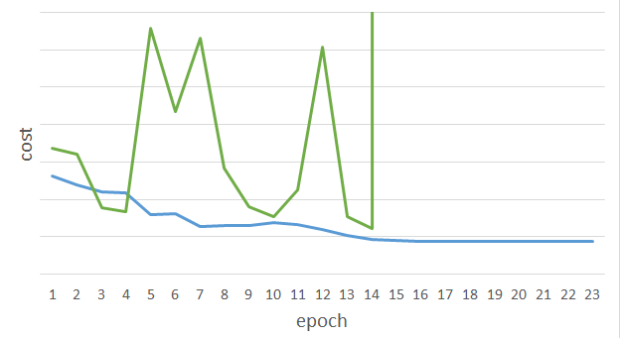
Unfortunately ……
RNN-based network is not always easy to learn
Real experiments on Language modeling
sometimes
Total Loss
Lucky
Epoch

Slide 34
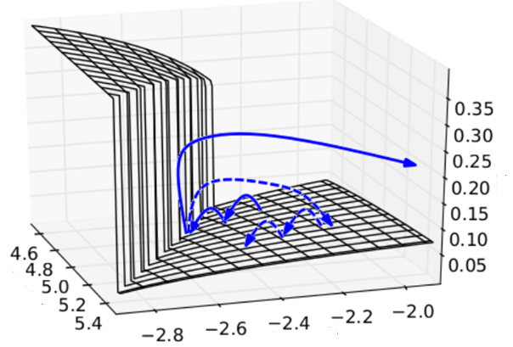

The error surface is rough.
The error surface is either very flat or very steep.
Clipping
Cost
Total Loss
w₂
w₁
[Razvan Pascanu, ICML’13]
Notes:
Even adagrad can not handle this problem, maybe RMS prop is better
Source: http://jmlr.org/proceedings/papers/v28/pascanu13.pdf

Slide 35



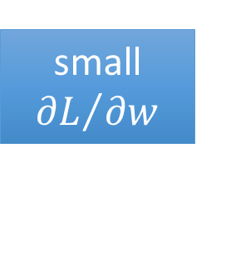

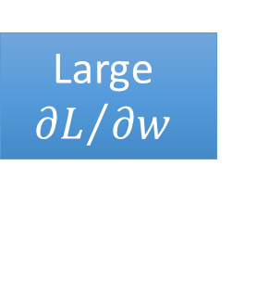




Why?
$$w=1$$
$$y^{1000}=1$$
Large
$${∂L}/{∂w}$$
Small Learning rate?
$$w=1.01$$
$$y^{1000}≈20000$$
$$w=0.99$$
$$y^{1000}≈0$$
small ${∂L}/{∂w}$
Large Learning rate?
$$w=0.01$$
$$y^{1000}≈0$$
=w⁹⁹⁹
y¹
y²
y³
y¹⁰⁰⁰
Toy Example
1
1
1
1
……
w
w
w
1
1
1
1
1
0
0
0

Slide 36
Helpful Techniques
Long Short-term Memory (LSTM)
Can deal with gradient vanishing (not gradient explode)
Memory and input are added
The influence never disappears unless forget gate is closed
No Gradient vanishing
add
(If forget gate is opened.)
Gated Recurrent Unit (GRU):
simpler than LSTM
[Cho, EMNLP’14]
Notes:
Reference: http://colah.github.io/posts/2015-08-Understanding-LSTMs/

Slide 37
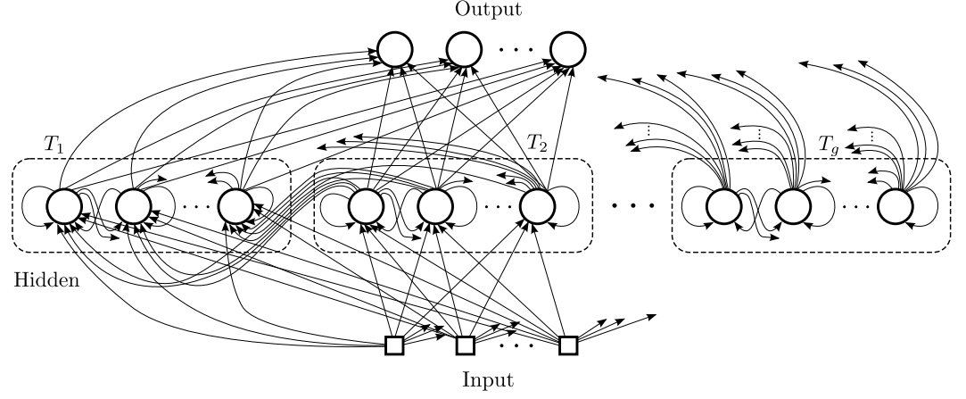
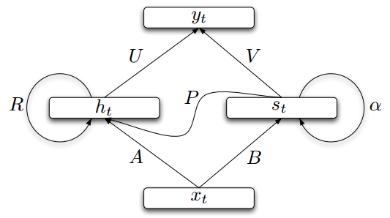
Helpful Techniques
Structurally Constrained Recurrent Network (SCRN)
Clockwise RNN
[Jan Koutnik, JMLR’14]
[Tomas Mikolov, ICLR’15]
Vanilla RNN Initialized with Identity matrix + ReLU activation function [Quoc V. Le, arXiv’15]
Outperform or be comparable with LSTM in 4 different tasks
Notes:
Gated Recurrent Unit (GRU):
http://www.wildml.com/2015/10/recurrent-neural-network-tutorial-part-4-implementing-a-grulstm-rnn-with-python-and-theano/
Structurally Constrained Recurrent Network (SCRN).
Cloclwise RNN

Slide 38
More Applications ……
Probability of “arrive” in each slot
Probability of “GZ” in each slot
Probability of “on” in each slot
y¹
y²
y³
Input and output are both sequences with the same length
store
store
a¹
a²
a³
a¹
a²
RNN can do more than that!
x¹
x²
x³
arrive GZ on November 2nd

Slide 39
Many to one
Input is a vector sequence, but output is only one vector
Sentiment Analysis
超好
好
看了这部电影觉得很高兴 …….
这部电影太糟了…….
这部电影很棒 …….
一般
差
Positive (正面)
Negative (负面)
Positive (正面)
超差
……
我
觉
得
……
太
糟
了

Slide 40
Many to one
[Shen & Lee, Interspeech 16]
Input is a vector sequence, but output is only one vector
O_{T}
Key Term
Extraction
…
Key Terms:
DNN, LSTM
V₁
V₂
V₃
V₄
…
V_{T}
Output Layer
document
Embedding Layer
x₁
x₂
x₃
x₄
…
x_{T}
Hidden Layer
Embedding Layer
V₁
V₂
V₃
V₄
V_{T}
Σα_{i}V_{i}
…
α₁ α₂ α₃ α₄ … α_{T}

Slide 41

Many to Many (Output is shorter)
Both input and output are both sequences, but the output is shorter.
E.g. Speech Recognition
Output:
“好棒”
(character sequence)
Problem?
Trimming
Why can’t it be “好棒棒”
好
好
好
棒
棒
棒
棒
棒
(vector
sequence)
Input:

Slide 42
Many to Many (Output is shorter)
Both input and output are both sequences, but the output is shorter.
Connectionist Temporal Classification (CTC) [Alex Graves, ICML’06][Alex Graves, ICML’14][Haşim Sak, Interspeech’15][Jie Li, Interspeech’15][Andrew Senior, ASRU’15]
“好棒”
Add an extra symbol “φ” representing “null”
“好棒棒”
好
φ
φ
棒
φ
φ
φ
φ
好
φ
φ
棒
φ
棒
φ
φ
Notes:
English is successful, ASRU’15 better than HMM + N-gram

Slide 43
Many to Many (Output is shorter)
CTC: Training
好
φ
棒
φ
φ
φ
Acoustic
Features:
好
φ
φ
棒
φ
φ
Label:
好
棒
All possible alignments are considered as correct.
好
φ
φ
φ
棒
φ
……

Slide 44
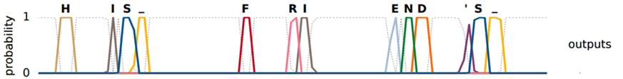
Many to Many (Output is shorter)
CTC: example
HIS FRIEND’S
φ
φ
φ
φ
φ
φ
φ
φ
φ
φ
φ
φ
φ
φ
φ
φ
φ
Graves, Alex, and Navdeep Jaitly. "Towards end-to-end speech recognition with recurrent neural networks." Proceedings of the 31st International Conference on Machine Learning (ICML-14). 2014.

Slide 45
The End!

