Slide 1
Recurrent Neural Networks
Hankui Zhuo
May 17, 2019
http://xplan-lab.org

Slide 2
Contents 1. introduction 2. unfolding computational graphs 3. recurrent neural networks structures 4. computing the gradient

Slide 3
Introduction
RNNs
A family of neural networks processing sequential data, such as,
a sequence of values x⁽¹⁾, . . . , x^{(τ)}
can scale to much longer sequences, e.g.,
text
Voice
…
can also process sequences of variable length, e.g.,
10 words or 10000 words? –- piece of cake
1min voice or 5000min voice? – piece of cake
…

Slide 4
Overall idea
Sharing parameters across different parts of a model:
extend and apply the model to examples of different forms (variable lengths)
advantages
Having separate parameters:
cannot generalize to sequence lengths not seen during training
cannot share statistical strength across different sequence lengths
Cannot share statistical strength across across different positions in time
disadvantages

Slide 5
Overall idea
Particularly important when a specific piece of information can occur at multiple positions within the sequence.
“ I went to Nepal in 2009 ”
“In 2009, I went to Nepal.”
Question:
When did the narrator go to Nepal?
Answer:
“2009”, no matter it appears in the sixth word or second word

Slide 6
Overall idea
Suppose that we trained a feedforward network that processes sentences of fixed length.
A traditional fully connected feedforward network would have separate parameters for each input feature
It would need to learn all of the rules of the language separately at each position in the sentence.
I | went | to | Nepal | in | 2009 | . | …
w₁
w₂
w₃
w₄
w₅
w₆
w₇
…

Slide 7

Unfolding computational graphs
Unfolding a recursive or recurrent computation into a computational graph that has a repetitive structure
Consider the classical form of a dynamical system
$$s^{(t)}=f(s^{\left(t−1\right)};θ)$$
Next state
State
Parameters to be learnt
It is recurrent because the definition of s at time t refers back to the same definition at time t − 1

Slide 8


How to unfold the system
For example, if we unfold the system for τ = 3 time steps, we obtain
$s^{(3)}=f\left(s^{\left(2\right)};θ\right)=$ $f\left(f\left(s^{\left(1\right)};θ\right);θ\right)$
They are shared
For a finite number of time steps τ, the graph can be unfolded by applying the definition τ − 1 times
$$s^{(t)}=f\left(s^{\left(t−1\right)},x^{(t)};θ\right)$$

Slide 9

How to unfold the system
Unfolding the equation by repeatedly applying the definition in this way has yielded an expression that does not involve recurrence.
Such an expression can now be represented by a traditional directed acyclic computational graph.
s^{(…)}
f
s^{(t-1)}
f
s^{(t)}
f
s^{(t+1)}
f
s⁽$τ$⁾

Slide 10


With external signal
a dynamical system driven by an external signal x^{(t)}
$$s^{(t)}=f\left(s^{\left(t−1\right)},x^{(t)};θ\right)$$
To indicate the state is the hidden units of the network, we use the variable h to represent the state
$$h^{(t)}=f\left(h^{\left(t−1\right)},x^{(t)};θ\right)$$
Typical RNNs will add extra architectural features such that output layers that read information out of the state h to make predictions

Slide 11
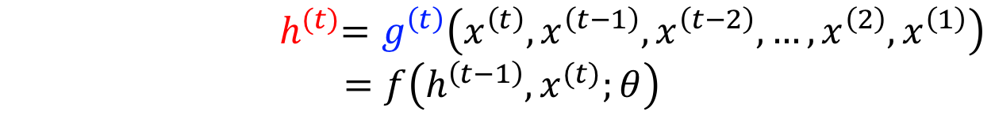
Lossy summary: hidden state h
It maps an arbitrary length sequence (x(t), x(t−1) , x(t−2), . . . , x(2) , x(1)) to a fixed length vector h(t)
$${ h}^{(t)}=g^{\left(t\right)}\left(x^{\left(t\right)},x^{\left(t−1\right)},x^{\left(t−2\right)},…,x^{\left(2\right)},x^{\left(1\right)}\right)$$
$$=f\left(h^{\left(t−1\right)},x^{(t)};θ\right)$$
Depending on the training criterion, this summary might selectively keep some aspects of the past sequence with more precision than other aspects.
For example, in language modelling, it prefers to predict the next word given previous words

Slide 12

Two ways
Circuit diagram
unfolded computational graph
h^{(…)}
f
h^{(t-1)}
f
h^{(t)}
f
h^{(t+1)}
f
h⁽$τ$⁾
h
Unfold
x
x^{(t-1)}
x^{(t)}
x^{(t+1)}
a delay of a single time step
associated with one particular time instance

Slide 13
Advantages/disadvantages
The recurrent graph is succinct.
The unfolded graph:
provides an explicit description of which computations to perform.
helps to illustrate the idea of information flow forward in time (computing outputs and losses)
backward in time (computing gradients) by explicitly showing the path along which this information flows

Slide 14
RNNs structure
With the graph unrolling and parameter sharing ideas, we can design a wide variety of recurrent neural networks
Recurrent networks that produce an output at each time step and have recurrent connections between hidden units
y^{(t-1)}
y^{(t-1)}
y^{(t-1)}
y
L
L^{(t-1)}
L^{(t-1)}
L^{(t-1)}
Unfold
o
o^{(t-1)}
o^{(t-1)}
o^{(t-1)}
V
V
V
V
h
W
h^{(…)}
W
h^{(t-1)}
W
h^{(t-1)}
W
h^{(t-1)}
W
h^{(…)}
U
U
U
U
x
x^{(t-1)}
x^{(t-1)}
x^{(t-1)}

Slide 15
RNNs structure
Recurrent networks that produce an output at each time step and have recurrent connections only from the output at one time step to the hidden units at the next time step
y^{(t-1)}
y^{(t-1)}
y^{(t-1)}
y
L
L^{(t-1)}
L^{(t-1)}
L^{(t-1)}
o
o^{(…)}
o^{(t-1)}
o^{(t-1)}
o^{(t-1)}
W
W
W
V
W
V
V
V
h
h^{(t-1)}
h^{(t-1)}
h^{(t-1)}
h^{(…)}
Unfold
U
U
U
U
x
x^{(t-1)}
x^{(t-1)}
x^{(t-1)}

Slide 16





RNNs structure
Recurrent networks with recurrent connections between hidden units, that read an entire sequence and then produce a single output
L⁽$τ$⁾
y⁽$τ$⁾
o⁽$τ$⁾
W
V
h^{(…)}
h^{(t-1)}
W
h^{(t)}
W
h^{(…)}
W
h⁽$τ$⁾
U
U
U
U
x^{(t-1)}
x^{(t)}
x^{(t)}
x⁽$τ$⁾

Slide 17


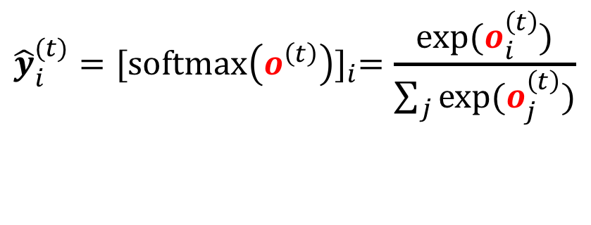


RNNs update equations
The forward propagation equations regarding the first type of RNNs
$$a^{(t)}=b+Wh^{(t−1)}+Ux^{(t)}$$
$${\hat{y}}^{(t)}=softmax⁡(o^{(t)})$$
$$h^{(t)}=tanh⁡(a^{(t)})$$
$${\hat{y}}_{i}^{(t)}={[\operatorname{softmax}\left(o^{\left(t\right)}\right)]}_{i}=\frac{exp⁡(o_{i}^{\left(t\right)})}{\sum_{j}{exp⁡(o_{j}^{\left(t\right)})}}$$
$$o^{(t)}=c+Vh^{(t)}$$

Slide 18

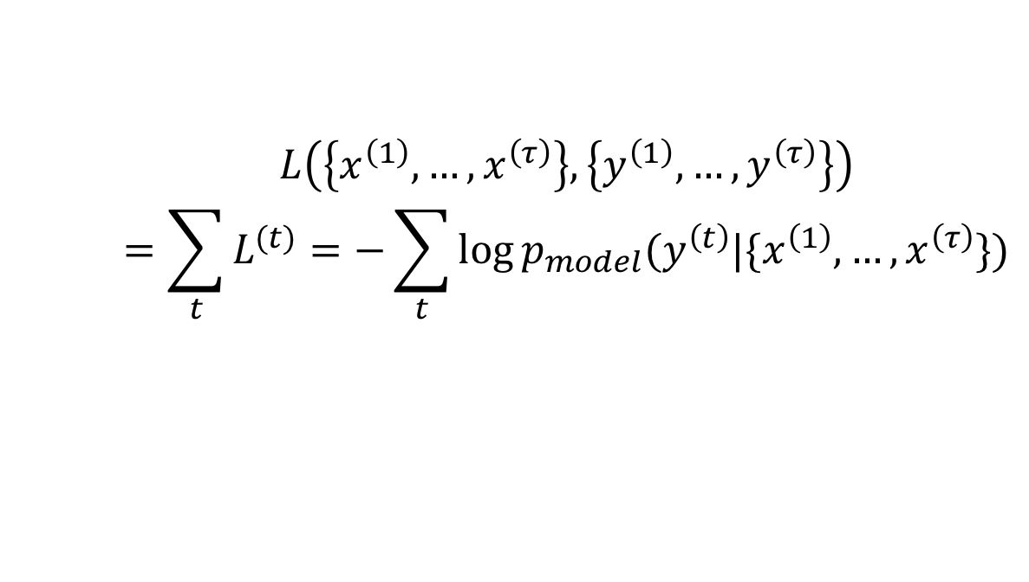

Total loss
The total loss for a given sequence of x values paired with a sequence of y values would then be just the sum of the losses over all the time steps. For example, if L(t) is the negative log-likelihood of y^{(t)} given x(1) , . . . , x(t) , then
$$L\left(\left\{x^{\left(1\right)},…,x^{\left(τ\right)}\right\},\left\{y^{\left(1\right)},…,y^{\left(τ\right)}\right\}\right)$$
$$=\sum_{t}{L^{(t)}}=−\sum_{t}{\log{p_{model}(y^{\left(t\right)}|\{x^{\left(1\right)},…,x^{\left(τ\right)}\})}}$$
is given by reading the entry for from the model’s output vector
$$y^{\left(t\right)}$$
$${\hat{y}}^{(t)}$$

Slide 19
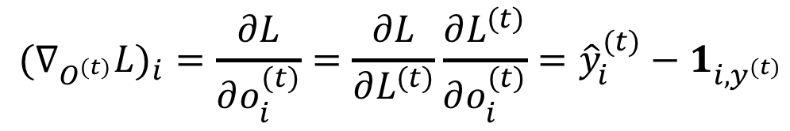
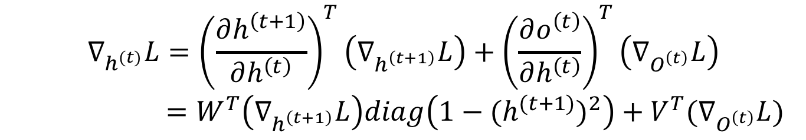

Computing the gradient
$${{(∇}_{O^{(t)}}L)}_{i}=\frac{∂L}{∂o_{i}^{(t)}}=\frac{∂L}{∂L^{(t)}}\frac{∂L^{(t)}}{∂o_{i}^{(t)}}={\hat{y}}_{i}^{(t)}−1_{i,y^{(t)}}$$
$$∇_{h^{(τ)}}L=V^{T}∇_{O^{t}}L$$
$$∇_{h^{(t)}}L={\left(\frac{∂h^{\left(t+1\right)}}{∂h^{\left(t\right)}}\right)}^{T}\left(∇_{h^{\left(t+1\right)}}L\right)+{\left(\frac{∂o^{\left(t\right)}}{∂h^{\left(t\right)}}\right)}^{T}\left(∇_{O^{\left(t\right)}}L\right)$$
$=W^{T}\left(∇_{h^{\left(t+1\right)}}L\right)diag\left(1−{(h^{(t+1)})}^{2}\right)+V^{T}(∇_{O^{\left(t\right)}}L)$

Slide 20
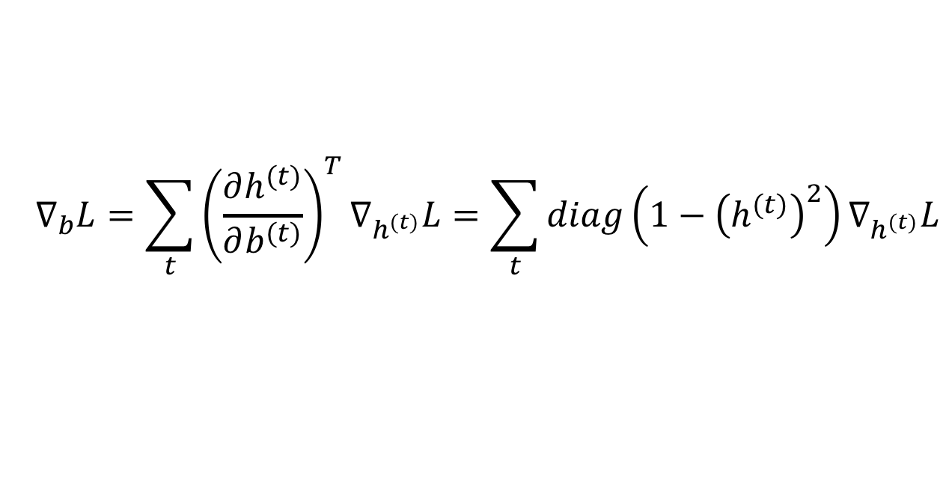
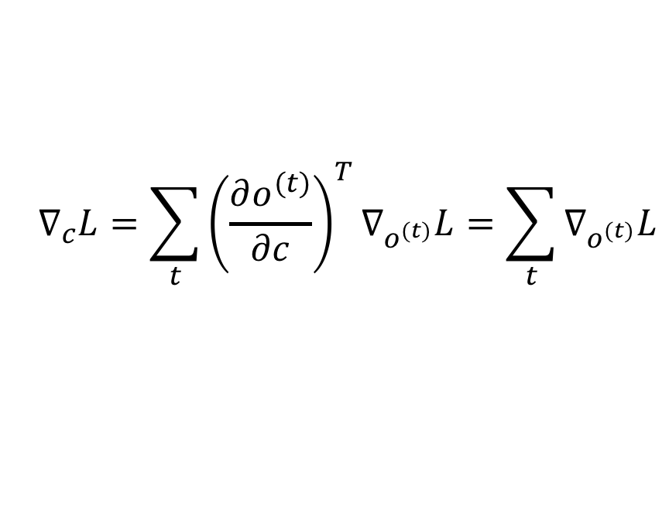
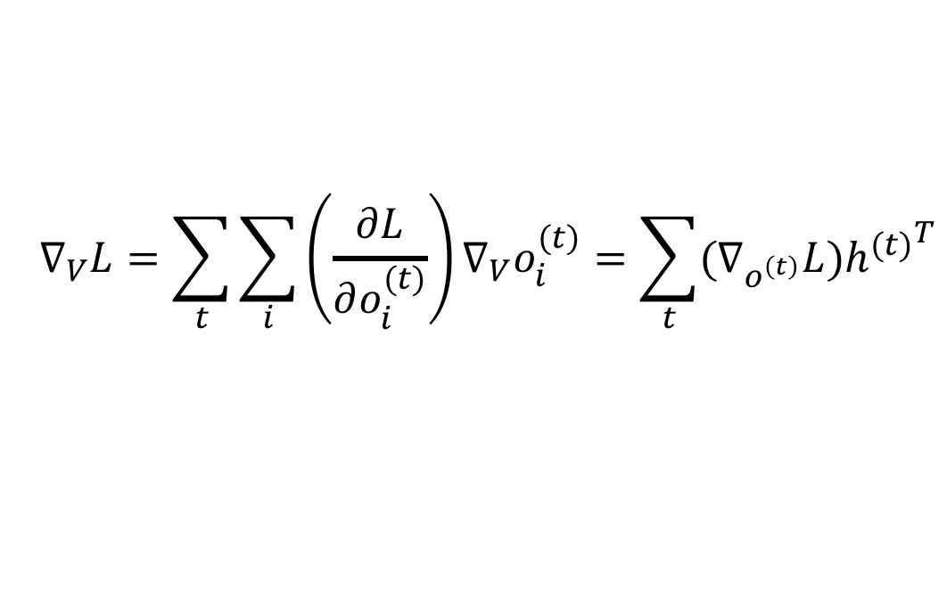
Computing the gradient
$$∇_{c}L=\sum_{t}{{\left(\frac{∂o^{(t)}}{∂c}\right)}^{T}∇_{o^{(t)}}L}=\sum_{t}{∇_{o^{(t)}}L}$$
$$∇_{b}L=\sum_{t}{{\left(\frac{∂h^{(t)}}{∂b^{(t)}}\right)}^{T}∇_{h^{(t)}}L}=\sum_{t}{diag\left(1−{\left(h^{(t)}\right)}^{2}\right)∇_{h^{(t)}}L}$$
$$∇_{V}L=\sum_{t}{\sum_{i}{\left(\frac{∂L}{∂o_{i}^{(t)}}\right)}∇_{V}o_{i}^{(t)}}=\sum_{t}{(∇_{o^{\left(t\right)}}L){h^{(t)}}^{T}}$$

Slide 21
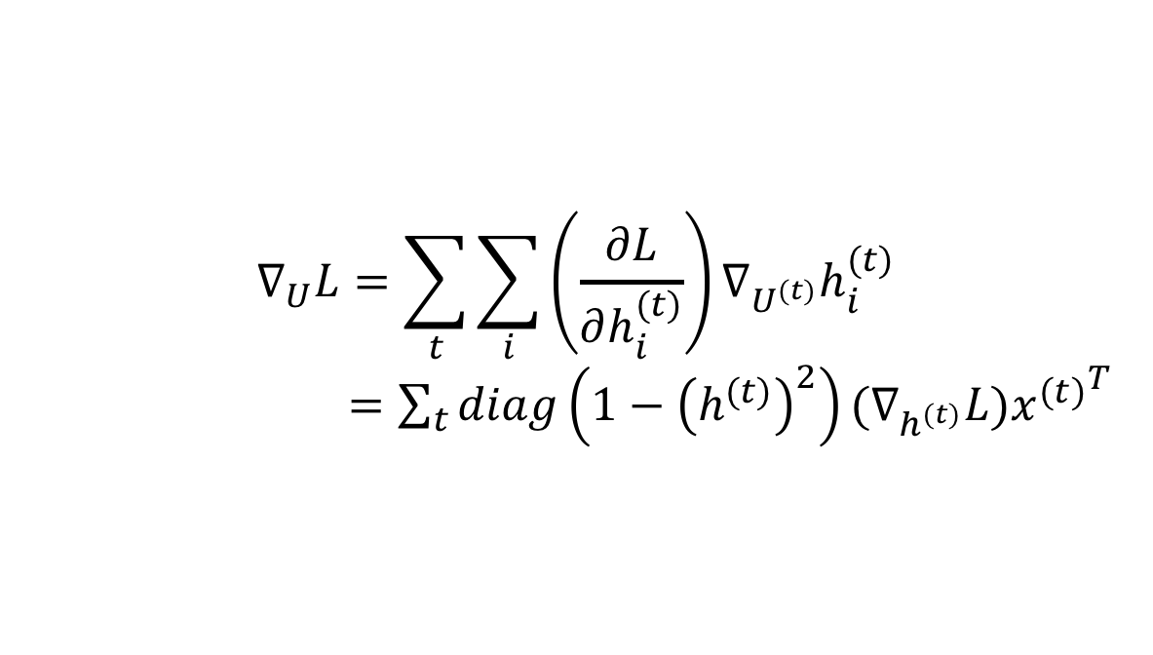
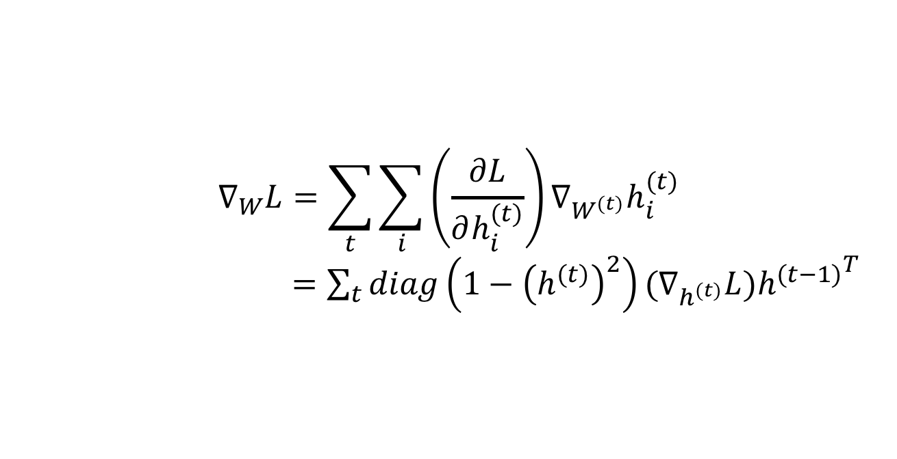
Computing the gradient
$$∇_{W}L=\sum_{t}{\sum_{i}{\left(\frac{∂L}{∂h_{i}^{(t)}}\right)}∇_{W^{(t)}}h_{i}^{(t)}}$$
$=\sum_{t}{diag\left(1−{\left(h^{(t)}\right)}^{2}\right){(∇}_{h^{(t)}}L){h^{(t−1)}}^{T}}$
$$∇_{U}L=\sum_{t}{\sum_{i}{\left(\frac{∂L}{∂h_{i}^{(t)}}\right)}∇_{U^{(t)}}h_{i}^{(t)}}$$
$=\sum_{t}{diag\left(1−{\left(h^{(t)}\right)}^{2}\right){(∇}_{h^{(t)}}L){x^{(t)}}^{T}}$

Slide 22
To be continued!

