Slide 1
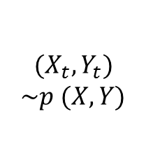
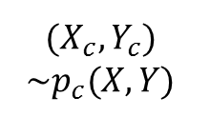
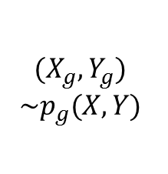



$$(X_{g}, Y_{g})$$
$$\sim p_{g}(X, Y)$$
$$X_{c}\sim p(X)$$
$$Z_{g}\sim p_{z}\left(Z\right)$$
G
C
$$Y_{g}\sim p(Y)$$
$$(X_{c}, Y_{c})$$
$$\sim p_{c}(X, Y)$$
$$(X_{t}, Y_{t})$$
$$\sim p (X, Y)$$
D

Slide 2
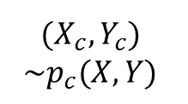
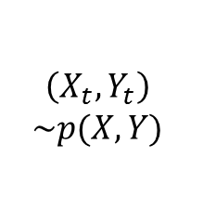
$$(X_{g}, Y_{g})$$
$$\sim p_{g}(X, Y)$$
$$\left(X_{t}, Y_{t}\right)$$
$$\sim p(X, Y)$$
$$Z_{g}\sim p_{z}\left(Z\right)$$
G
C
$$Y_{g}\sim p(Y)$$
$$(X_{c}, Y_{c})$$
$$\sim p_{c}(X, Y)$$
D

Slide 3
$$(X_{g}, Y_{g})$$
$$\sim p_{g}(X, Y)$$
$$Z_{g}\sim p_{z}\left(Z\right)$$
G
D
$$Y_{g}\sim p(Y)$$

Slide 4
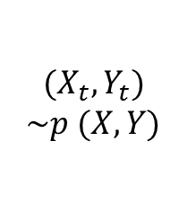
$$(X_{g}, Y_{g})$$
$$\sim p_{g}(X, Y)$$
$$\left(X_{t}, Y_{t}\right)$$
$$\sim p(X, Y)$$
$$Z_{g}\sim p_{z}\left(Z\right)$$
G
C
$$Y_{g}\sim p(Y)$$
$$(X_{c}, Y_{c})$$
$$\sim p_{c}(X, Y)$$
$$(X_{t}, Y_{t})$$
$$\sim p (X, Y)$$
D

