Slide 1
Student Online Teaching Advice Notice
The materials and content presented within this session are intended solely for use in a context of teaching and learning at Trinity.
Any session recorded for subsequent review is made available solely for the purpose of enhancing student learning.
Students should not edit or modify the recording in any way, nor disseminate it for use outside of a context of teaching and learning at Trinity.
Please be mindful of your physical environment and conscious of what may be captured by the device camera and microphone during videoconferencing calls.
Recorded materials will be handled in compliance with Trinity’s statutory duties under the Universities Act, 1997 and in accordance with the University’s policies and procedures.
Further information on data protection and best practice when using videoconferencing software is available at https://www.tcd.ie/info_compliance/data-protection/.
© Trinity College Dublin 2020

Slide 2
Module CS7CS6
Research and Innovation Methods
Students: MSc in Computer Science- 5 groups
(Data Science, Intelligent Systems, Augmented and Virtual Reality, Future Networks, Year 5s) – Different deadlines for dissertation submission for the year 5s compared to the other groups.
Delivered by
Gaye Stephens, Dave Lewis and Teaching assistants.
Gaye.stephens@tcd.ie
Dave.Lewis@tcd.ie

Slide 3
Welcoming Session
Introductions
How this module will operate
Assessment Process
Blackboard Groups
Questions and Answers
Next Steps
Module CS7CS6
Research and Innovation Methods

Slide 4
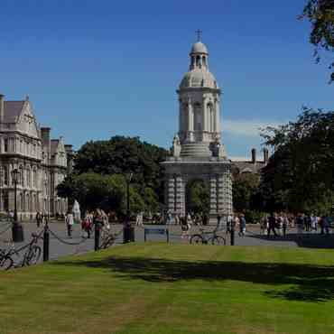
Introductions
I am normally based in our South Leinster Street Building.
I belong to the Artificial Intelligence Discipline in the school.
I am a member of the ADAPT Science Foundation Ireland centre – it is worth checking this out.
My research interests lie in the application of ICT to healthcare.
I am a reviewer on the school’s research ethics committee.
I am a the intelligent systems strand leader on the school’s MSc in computer science.

Slide 5

How this Module will operate
Course Content will be uploaded onto Blackboard in the form of lecture notes, supporting material and extra videos.
Each Wednesday during semester 1 from 2-4 O clock there will be contact time with lecturers and/or teaching assistants. We will use these sessions for face to face lectures or feedback sessions through blackboard.
We are happy to take emails anytime from individual students or class reps about how the module is progressing- Please mark the emails with CS7CS6 in the subject line
gaye.stephens@tcd.ie
dave.lewis@tcd.ie

Slide 6

Module Overview
Innovation Methods
Business model development and customer discovery
Business Model Canvas
Value Proposition & Interviewing
Channels
Customer Segments
Customer Relationships
Revenue Model,
Key Partners, Key Resources and Activities & Cost Structure
Responsible Innovation - Ethics Canvas
Research Methods
Library skills by Subject Librarian- Andrew Jones
Research Canvas development
Research ethics in the school of computer science and statistics
Dissertation critique
Dissertation Planning
Academic writing

Slide 7

Assignment Overview
Group Work
Each student will be allocated into a group
Each group will be assigned an MSc dissertation
As a group, use ideas from the dissertation, in conjunction with the innovation related course material, as the seed for an innovative technology-based business model.
Based on evidence collected continue to pivot the business idea.
Individual Work
Conceive of a research question and develop a research plan to support answering that question.
Full Assignment Sheet (showing submission deadlines and marks breakdown) will be available via Blackboard

Slide 8
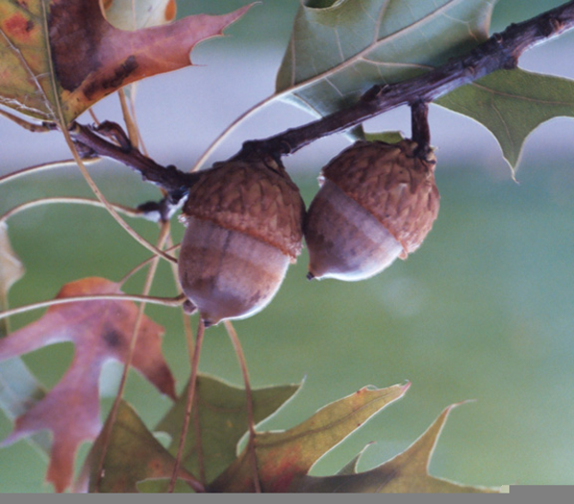
Assignment Overview
This module is assessed by 100% coursework.
The coursework component comprises
One group assignment with multiple parts.
Innovation report
Innovation presentation
Group critique of assigned dissertation
Group critique of another groups innovation presentation.
One individual assignment
Research plan related to your dissertation
Assignment work will be submitted via blackboard.
http://www.clker.com/cliparts/7/4/e/a/14985537101004445094quercus-coccinea-acorn.hi.png
Full Assignment Sheet (showing submission deadlines and marks breakdown) will be available via Blackboard

Slide 9
Group Project has 4 deliverables
1. Innovation report
Prepare and submit to blackboard a group innovation report which contains
A description of your innovation idea and how it relates to your assigned dissertation.
A business model canvas covering the value proposition, customer segment and channels.
A summary of the hypotheses you are testing and any evidence or pivots to date.
An ethics canvas for your group’s area of innovation
2. Innovation Presentation-
Contribute to a final presentation on your business model summarising the hypotheses tested, evidence collected and pivots on different fields attempted in the business model canvas and the ethics canvas and your final assessment of the viability of the business model.
3. Group critique of assigned dissertation
Using the feedback templates provided contribute to a critique of the dissertation assigned to your group. Based on lecture notes, learning from the group assignment processes and marking scheme for your dissertation.
4. Group critique of another groups innovation presentation
Using the feedback templates provided contribute to a critique of another groups final report. View the final presentation. Then as group discuss the work and complete the critique feedback form.

Slide 10
Individual work has 1 deliverable
Research Plan
For your individual MSc research project, submit a research plan captured in a set of 6 slides providing the following information
research canvas (as per template given in class) and supported by relevant references from your reference list.
motivation statement (approx. 150 words)
list of at least 7 references which support your research idea, method and motivation
research project Gantt chart
an explanation of whether or not you require to get ethical approval for your research.
list technical and research skills you have or hope to develop to carry out your research project.

Slide 11
Module Evaluation and Marking
Team mark, allocated to each participating team member
Deliverable | Type | %Weighting | Submission deadline
Innovation Report | Group | 20% | Friday 21st October 2022
Innovation Presentation | Group | 40% | Friday 18th November 2022
Dissertation Critique | Group | 10% | Friday 2nd December 2022
Innovation Critique | Group | 5% | Friday 2nd December 2022
Research Plan | Individual | 25% | Friday 16th December 2022

Slide 12
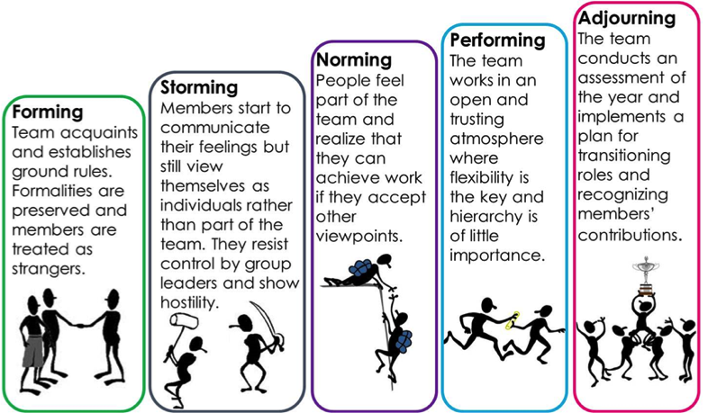
Working in Groups
There are advantages and challenges.
Conceiving of the idea
Carrying out the work
Collaborative reporting of the work
Stages of group formation (Tuckman 1965)
Roles in the group – e.g. Originator, Energizer, finisher, shaper, coordinator, collaborator – see literature review paper on blackboard.
Encourage respectful discourse.

Slide 13
Rationale: Group Project
Start thinking about the innovation process in the real world, including ethical considerations
Practice team-work.
Practice implementation of the innovation process.
Reflect on evidence for pivots
Reflect on the process and see how it relates to the process of research.
Opportunity to read, reflect on and engage with an MSc dissertation.

Slide 14
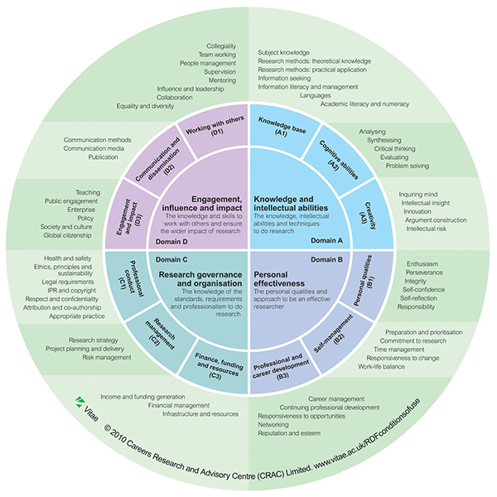
CS7CS6 – Researcher Skills and Characteristics
An example Research Development Framework
Knowledge and Intellectual abilities
B. Personal Effectiveness
C. Research Governance and Organisation
D. Engagement, Influence and Impact
https://www.adelaide.edu.au/carst/about/research-development-framework/
https://www.vitae.ac.uk/researchers-professional-development

Slide 15
CS7CS5–Project Selection
Opening of Proposal System & Start of Project Registrations: Wednesday, 31st August 2022
Deadline to register selected projects: Monday, 26th September 2022, 23:59 Presentation Period: Monday, 24th July - Friday, 4th August 2023
Dissertation Submission Deadline: Friday, 18th August 2023, 23:59
1) Project Selection A list of project proposals offered by the academics in the School of Computer Science and Statistics will be published on Wednesday, 31st August 2022 at https://projects.scss.tcd.ie/ This list is live, and being updated by staff, so please check back regularly. You can view projects by supervisor or by project topic. There is an 'Information for Students' menu item, and it is important that you read at least the 'Choosing a project' entry now so that you know how to go about selecting a project and registering it with the School. 2) Project Registration Once you have arranged supervision, please complete the form at https://projects.scss.tcd.ie/registersupervision/ Completing this form will prompt the selected supervisor for confirmation of the topic, and you will receive a confirmation email when they have done so.
Students who have not registered a project by the deadline for the registration of projects will be assigned a supervisor who will determine a project topic and supervise the project.

Slide 16
CS7CS5–e-mail template for supervision request
Dear Professor X, I am a student in the STREAM stream of the M.Sc. in Computer Science. My interests lie in the areas of AREA1, and AREA2, and I would like to discuss the possibility of you supervising my dissertation due to your expertise in/recently published work on SPECIFIC TOPIC OR PAPER. My initial draft research question is QUESTION.
I am interested in this question because YOUR MOTIVATION.
Here are some references to what I have read so far about this.. YOUR REFERENCES
Some relevant keywords for my research question are KEYWORDS
I have previously studied TOPIC and I would like to improve my knowledge in this area- GIVE EXAMPLES.
Would it be possible to meet with you to further discuss TOPIC and the possibility of supervision? I am available DAYS & TIMES (AT LEAST 3).
Sincerely, YOUR NAME

Slide 17
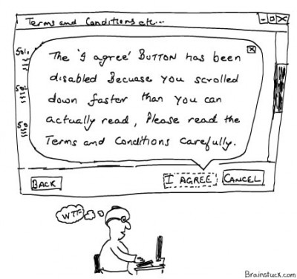
That’s All Folks Thank You for Listening

