Slide 1


Department of Information Technology
V R Siddhartha Engineering College
Web-Based GIS Platform for Real-Time LULC Monitoring
B.Tech in Information Technology
Major Project Review Presentation
Presented by
CHENNARAO PAMARTHI(228W1A1246)
BHAVANI PRASAD REDDY KESARI(228W1A1226)
Under the guidance of
P. Madhavi Latha
Assistant Professor

Slide 2
Agenda
Motivation and Problem Statement
Objectives and Outcomes of the Project
Literature Survey
Datasets and Requirement Specifications
Methodology and Algorithms Involved
Architecture Diagram
Complete Results Obtained
Result Analysis
References

Slide 3
Motivation
Rapid urban expansion and environmental changes demand continuous land monitoring.
Existing GIS systems are static and lack real-time AI integration.
There is a need for an intelligent platform that combines Deep Learning and Web GIS for dynamic LULC analysis.

Slide 4
Problem Statement
Current LULC analysis workflows are manual, time-consuming, and non-interactive.
No unified web-based system exists to automatically classify satellite images and visualize results instantly.
Lack of integrated tools for real-time change detection and urban expansion analysis.

Slide 5
Objectives | Outcomes
1. To Develop a web-based platform integrating deep learning for automated LULC classification. 2. Enable interactive visualization of classified maps through an online GIS interface. 3. Implement automated area statistics for different land cover classes. | 1. A functional Web GIS system capable of generating real-time LULC maps from uploaded satellite imagery. 2. An interactive GIS dashboard allowing users to explore, zoom, and analyze LULC outputs dynamically. 3. Automatic calculation and display of class-wise land distribution for improved spatial decision-making.

Slide 6
Literature Survey
Paper Title | Authors | Journal/Conference | Year | Key Contributions
Deep Learning in Remote Sensing: A Comprehensive Review and List of Resources | Zhu, X., et al. | IEEE Geoscience and Remote Sensing Magazine | 2024 | Provided a comprehensive review of deep learning methods in remote sensing, including CNN-based classification, feature learning and change detection techniques.
An Image is Worth 16×16 Words: Transformers for Image Recognition at Scale | Dosovitskiy, A., et al. | International Conference on Learning Representations (ICLR) | 2020 | Introduced Vision Transformer (ViT), demonstrating the effectiveness of self-attention mechanisms for large-scale image classification without convolution layers.
Swin Transformer: Hierarchical Vision Transformer Using Shifted Windows | Liu, Z., et al. | IEEE International Conference on Computer Vision (ICCV) | 2021 | Proposed Swin Transformer architecture with hierarchical representation and shifted-window attention for efficient image classification and segmentation.
Change Detection from Remotely Sensed Images: From Pixel-Based to Object-Based Approaches | Hussain, M., et al. | ISPRS Journal of Photogrammetry and Remote Sensing | 2022 | Reviewed pixel-based and object-based change detection techniques for multi-temporal remote sensing image analysis.
Internet GIS: Distributed Geographic Information Services for the Internet and Wireless Networks | Peng, Z., & Tsou, M. | John Wiley & Sons | 2025 | Established foundational Web GIS architecture principles, including distributed GIS services and web-based spatial data visualization.
Web GIS: Principles and Applications | Li, S., Dragicevic, S., & Veenendaal, B. | CRC Press (Book Publication) | 2024 | Provided comprehensive principles of Web GIS architecture, including client–server models, spatial databases, web mapping services, and distributed geospatial data management.

Slide 7
Datasets and Requirement Specifications
Datasets
Satellite Imagery: Landsat 8 / Sentinel-2 (GeoTIFF format)
Ground Truth Data: CSV file with latitude, longitude, and LULC labels
Multi-Temporal Images: Used for change detection (Before/After analysis)
System Requirements
Backend: Python (Flask / FastAPI), PyTorch
Frontend: HTML, CSS, JavaScript (Leaflet.js)
GIS Server: GeoServer
Database: PostgreSQL with PostGIS
Hardware: 8GB RAM, Intel i5 (GPU optional)

Slide 8
Methodology and Algorithms Involved
Methodology
Data Collection – Acquire satellite imagery (Landsat / Sentinel) and labeled training samples.
Preprocessing – Patch extraction, normalization, and resizing of satellite images.
Model Training – Train Vision Transformer (ViT) and Swin Transformer on labeled data.
Prediction – Classify satellite image patches into 4 LULC classes.
Web Integration – Deploy trained model in backend and display results on Web GIS platform.
Change Detection – Compare multi-temporal images to analyze urban expansion.

Slide 9

Algorithms
Vision Transformer (ViT)
Divides image into fixed-size patches.
Each patch is linearly embedded with positional encoding.
Uses global self-attention to capture relationships between all patches.
Strong at distinguishing spectrally similar classes (e.g., Agriculture vs Forest).
Formula:

Slide 10

Swin Transformer (ST)
Hierarchical version of ViT, scalable for large satellite images.
Uses local window-based attention + shifted windows to connect regions.
Captures both fine details (farm boundaries, rivers) and global layout (urban sprawl, forest cover).
More memory-efficient than ViT for high-resolution LULC data.
Formula:

Slide 11
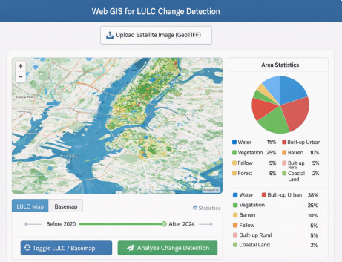
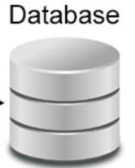
Architecture diagram
MODEL PROCESSING
Preprocessing • Band Selection • Patch Extraction (64×64) • Normalization
Transformer Models • Vision Transformer (ViT) • Swin Transformer
Python (Flask / FastAPI)
Receives Uploaded Image
Sends Image to Model Pipeline
Returns LULC Prediction as GeoTIFF
Sends Area Statistics JSON
Classification • 8 LULC Classes • Softmax Output
FRONTEND
PostGIS • Stores Spatial Layers • Results • Area Statistics
DATA SOURCE • Landsat / Sentinel Satellite Images • Government LULC Data • OpenStreetMap Base Map
GEOSERVER • Publishes Predicted GeoTIFF • Creates WMS / WFS Services • Layer Styling (SLD Color Mapping)

Slide 12
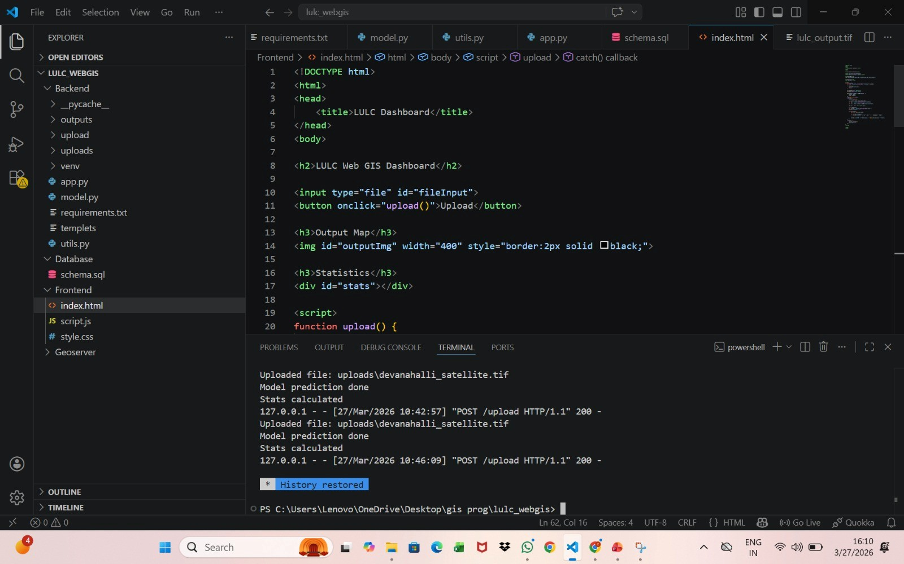
Complete Results Obtained

Slide 13
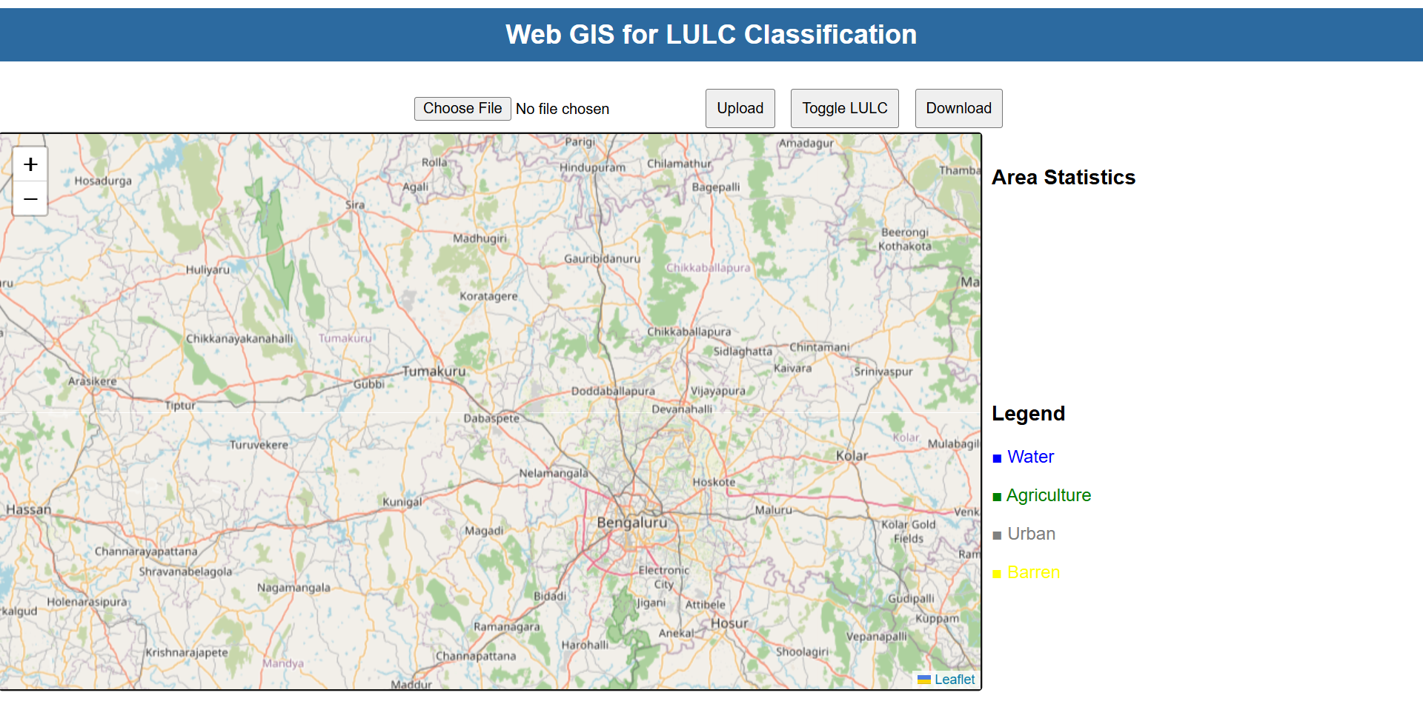

Slide 14
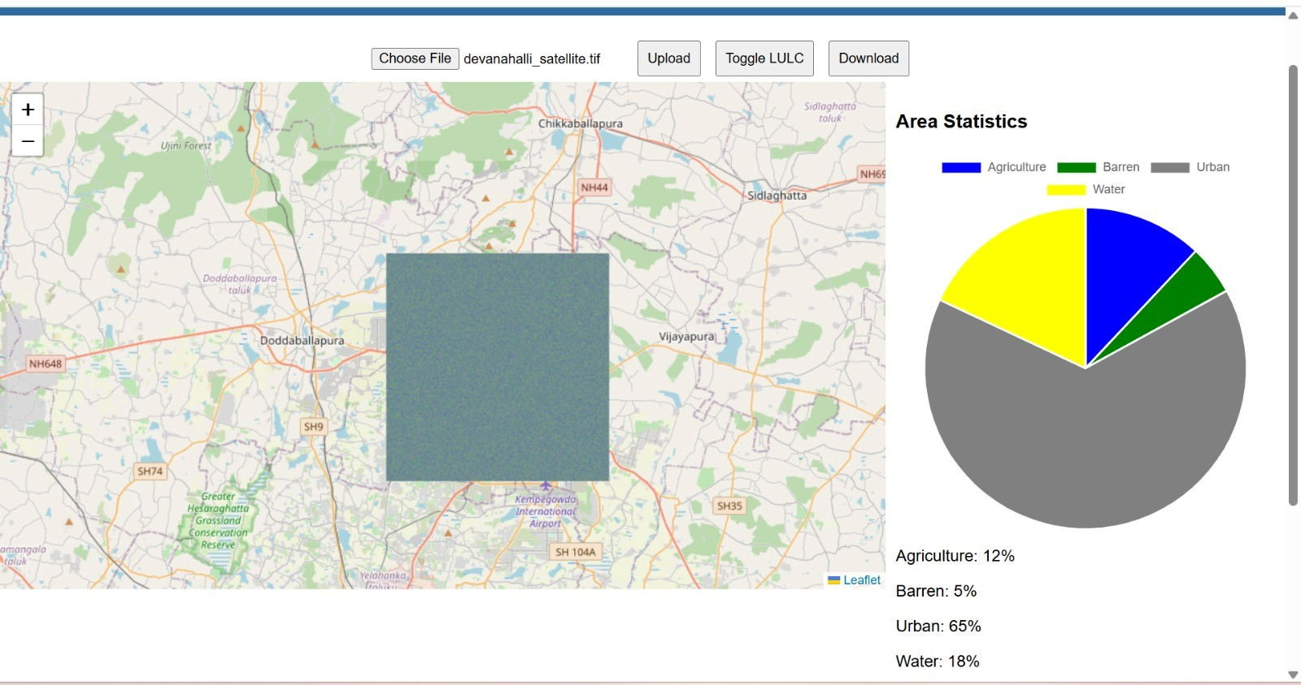
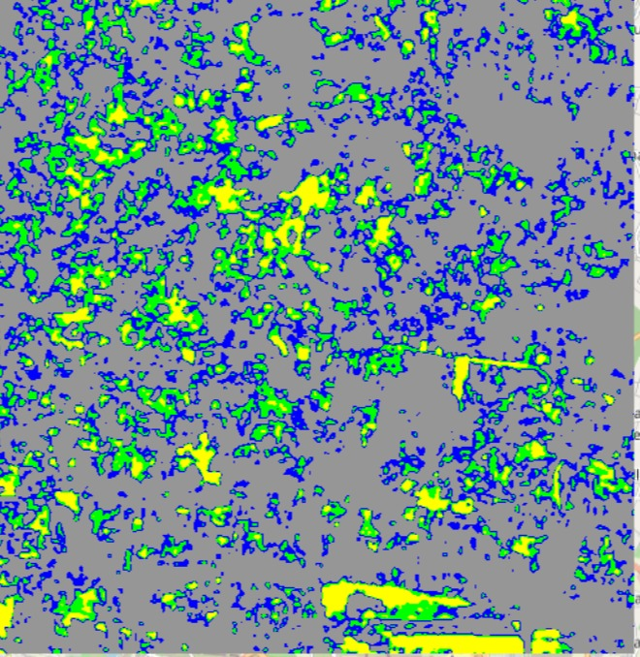

Slide 15
Result Analysis
The developed Web GIS platform successfully generates LULC classified maps from uploaded satellite images.
The system provides real-time visualization of land use classes such as Urban, Agriculture, Water, and Barren land.
The integration with Web GIS enables:
Interactive map visualization
Zoom and pan functionality
Overlay of classified LULC layers on base maps
The addition of legend, chart, and statistics panel improves user understanding.

Slide 16
Observation
Aspect | Base Papers | Proposed System (Your Project)
Processing Approach | Offline deep learning-based classification | Real-time web-based LULC processing
User Interaction | No user interaction | Interactive interface (upload, zoom, toggle)
Visualization | Static output images | Dynamic Web GIS map visualization
Output Analysis | Only classification results | Area statistics, charts, and legend
System Integration | Only AI model focused | Complete system (AI + Web GIS + Dashboard)

Slide 17
Conclusion & Future Work
The project successfully developed a Web-Based GIS Platform for LULC Monitoring.
The system enables real-time classification and visualization of satellite images.
Users can upload images and obtain LULC maps along with area statistics instantly.
Add change detection (before vs after analysis) for urban expansion monitoring.
Deploy the system on cloud platforms for real-time global access.

Slide 18
⁠References
[1] Zhu, X. X., Tuia, D., Mou, L., Xia, G. S., Zhang, L., Xu, F., & Fraundorfer, F. (2017). Deep learning in remote sensing: A comprehensive review and list of resources. IEEE Geoscience and Remote Sensing Magazine, 5(4), 8–36.
[2] Dosovitskiy, A., Beyer, L., Kolesnikov, A., et al. (2020). An image is worth 16x16 words: Transformers for image recognition at scale. International Conference on Learning Representations (ICLR).
[3] Liu, Z., Lin, Y., Cao, Y., et al. (2021). Swin Transformer: Hierarchical vision transformer using shifted windows. IEEE International Conference on Computer Vision (ICCV).
[4] Hussain, M., Chen, D., Cheng, A., Wei, H., & Stanley, D. (2013). Change detection from remotely sensed images: From pixel-based to object-based approaches. ISPRS Journal of Photogrammetry and Remote Sensing, 80, 91–106.

Slide 19
[5] Peng, Z. R., & Tsou, M. H. (2003). Internet GIS: Distributed geographic information services for the internet and wireless networks. John Wiley & Sons.
[6] Li, S., Dragicevic, S., & Castro, F. (2011). Web GIS: Principles and applications. International Journal of Geographical Information Science, 25(2), 195–218.
[7] Mountrakis, G., Im, J., & Ogole, C. (2011). Support vector machines in remote sensing: A review. ISPRS Journal of Photogrammetry and Remote Sensing, 66(3), 247–259.

Slide 20


