Slide 1
Staffing Origin Dashboards

Slide 2


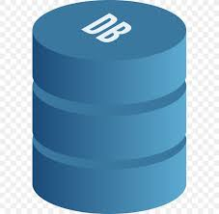




Full Load Architecture
RAW json full Load
Processed json
Tables with Data
Individual Views
Functional Views
Power BI Dashboard/Reports
Source - S3 Browser
Schedule Trigger Trigger’s ADF Pipeline
Pipeline Execute Databricks Notebook
Notebook Copying JSON from S3 to Azure Storage
Pipeline Execute Databricks Notebook
Notebook converts Raw JSON to Processed JSON
Databricks Notebook creates Dynamic External Tables and Load Data
Power BI Visualizations Processing
Databricks Notebook creates Individual Views
Databricks Notebook created Functional Views
Database
Power BI (Visualizations)
Container
Container
Database
Database
Databricks Notebook
Databricks Notebook
Azure Storage
Azure Storage
Databricks
Azure Data Factory
Azure Data Factory

Slide 3
Output
Source - S3 Browser
Azure Data Factory

Slide 4
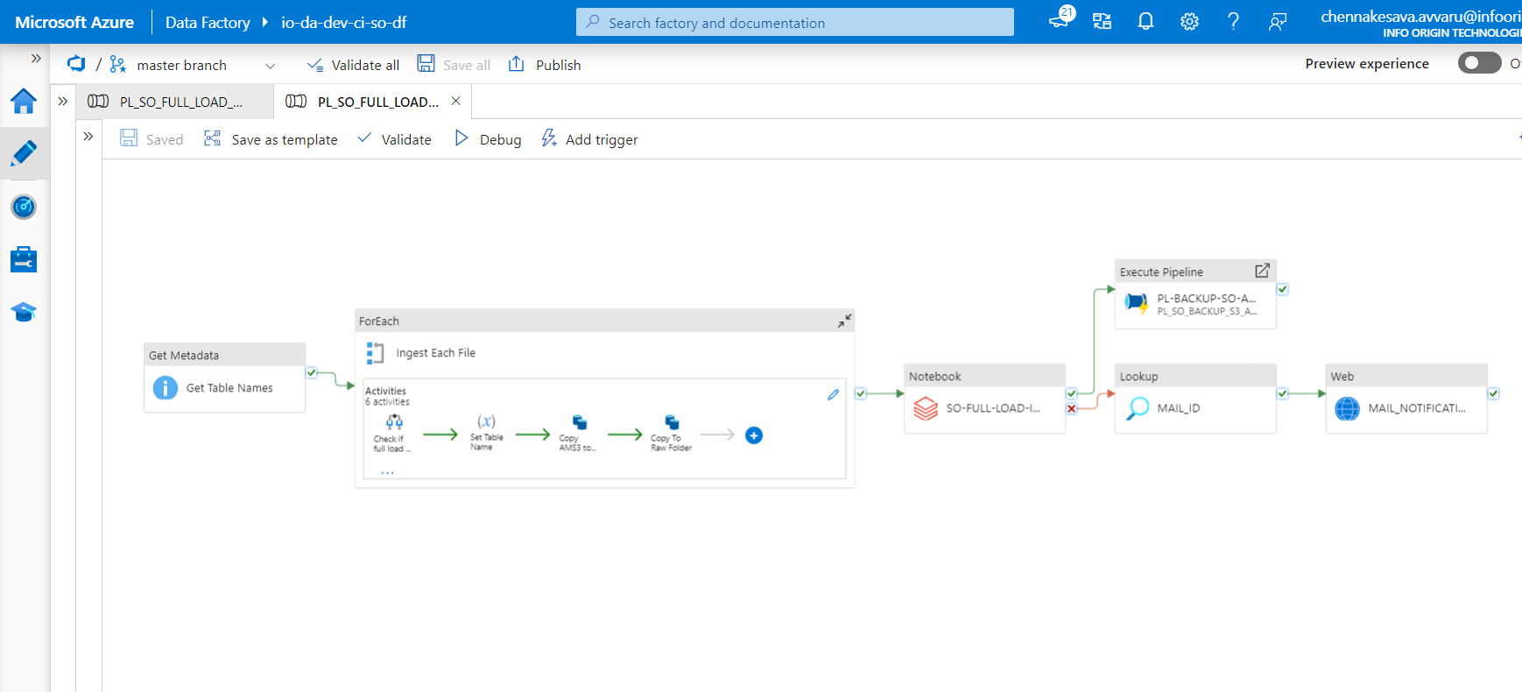

Slide 5
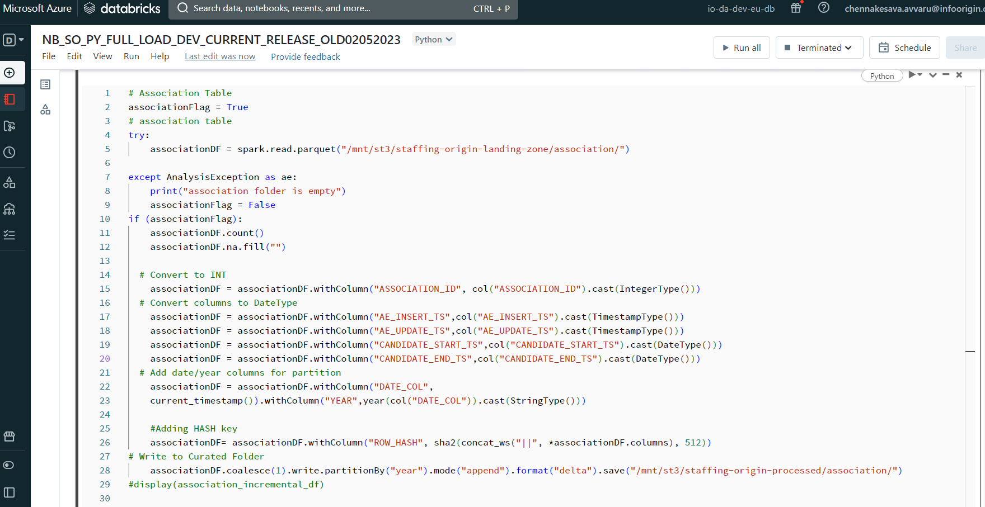

Slide 6
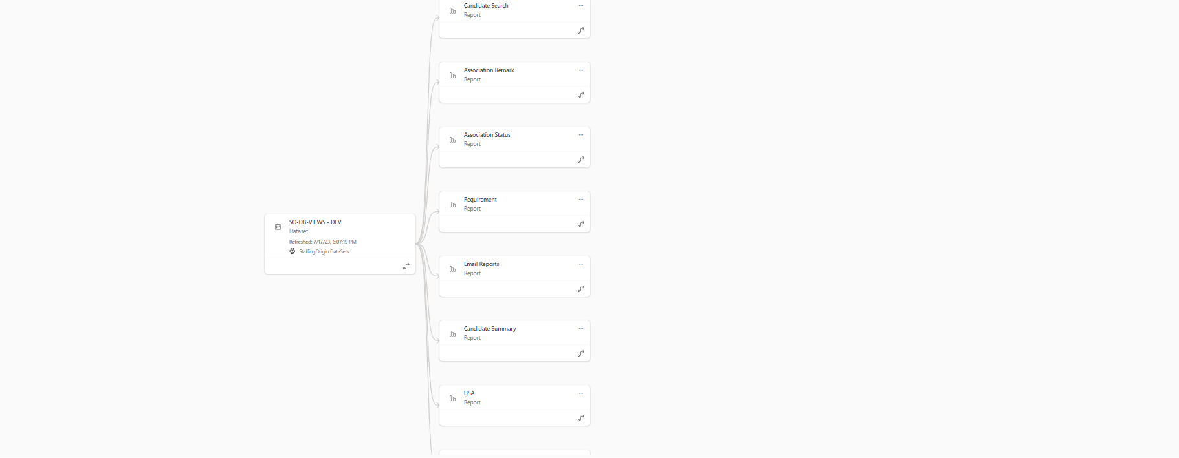

Slide 7
