Slide 1

CAPSTONE 2
Chennakesava Saipavan katragadda
Oct 2020 Cohort batch

Slide 2
Problem Statement
The data set contains information about data related jobs salary from 2017 to 2020.It includes Education level, Country of origin, Employment type,org size etc.
How to match the Data science job roles annual salary to international standard either (a) by changing the organization or (b) by graduating in specific field (c)any other variable ?​

Slide 3
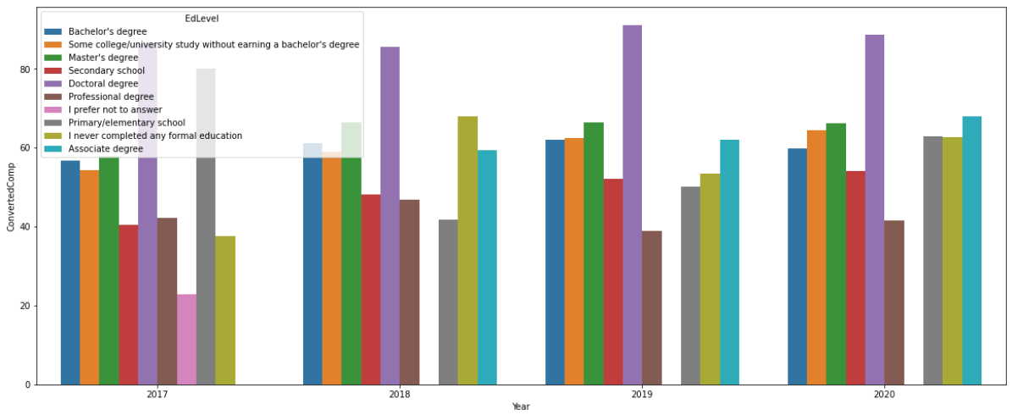
Salary can be increased by Completing Doctoral degree, or by working as Independent Contractor, or by joining an Organization with more than 10,000 employees and by learning programming as hobby,
Employees with Doctoral degree is earning High Salary

Slide 4
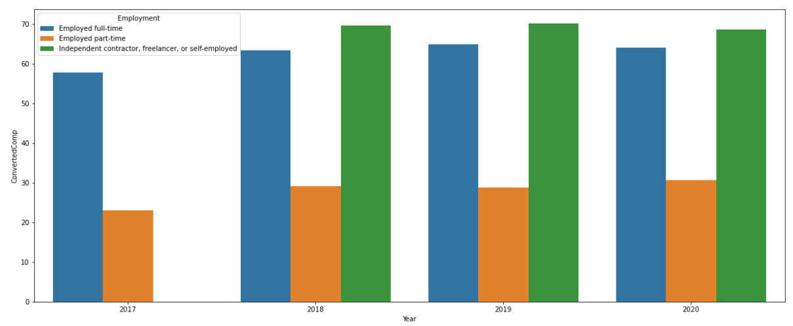
Employment type
Independent Contractor or freelancer can draw more salary

Slide 5

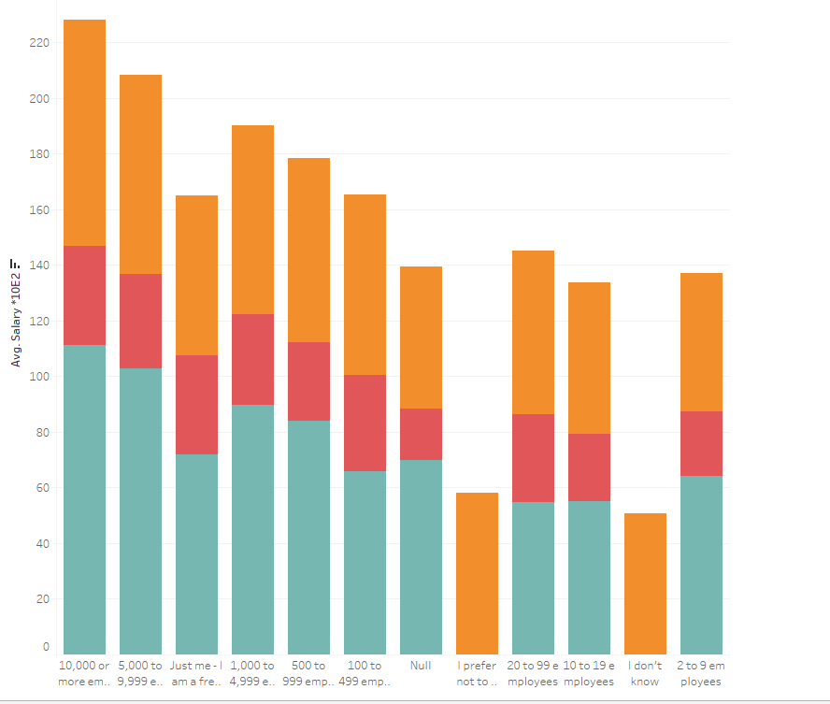
Organization size
Average Salary is high in the Organization with 10,000 or more than employees

Slide 6
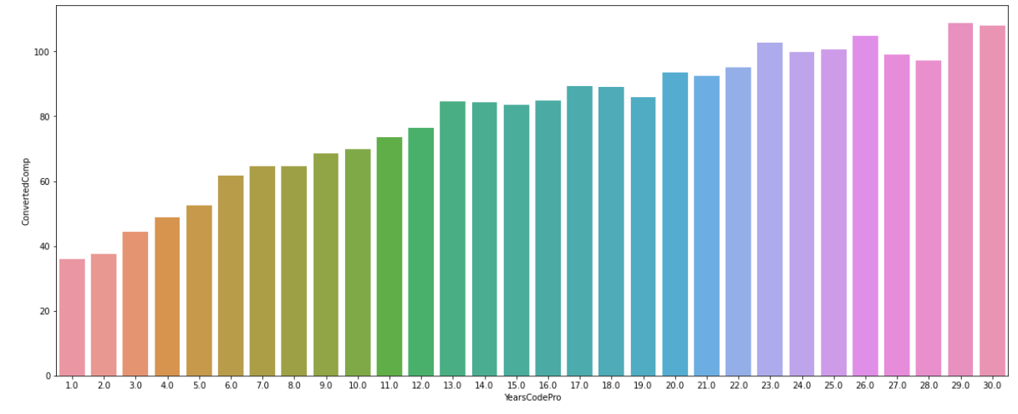
Experience
There is a linear trend in experience and salary earned

Slide 7
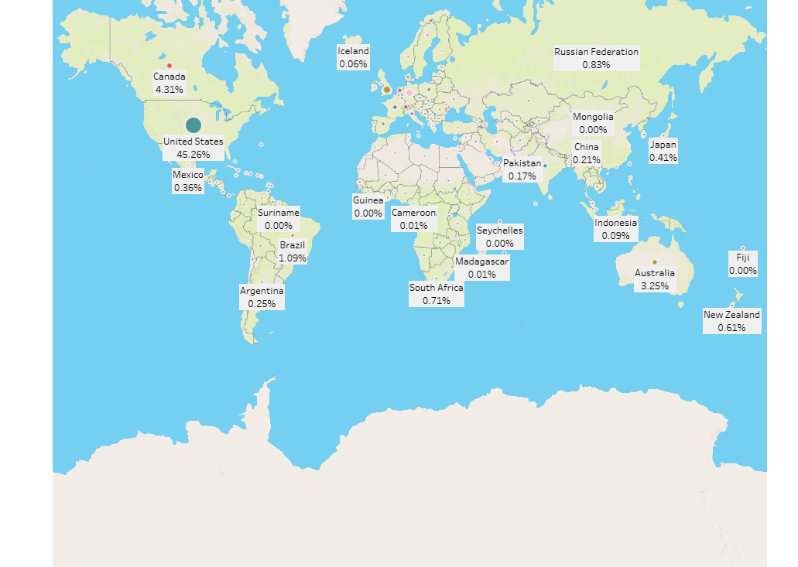
Geographical location
Job Opportunities in United States is higher

Slide 8
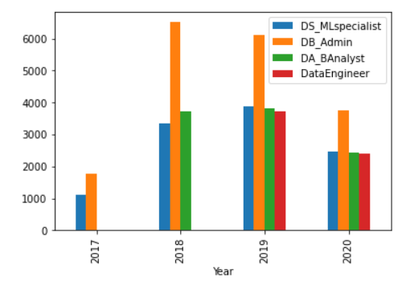
Data related jobs
Db admin employees are comparatively higher than the other Jobs

Slide 9
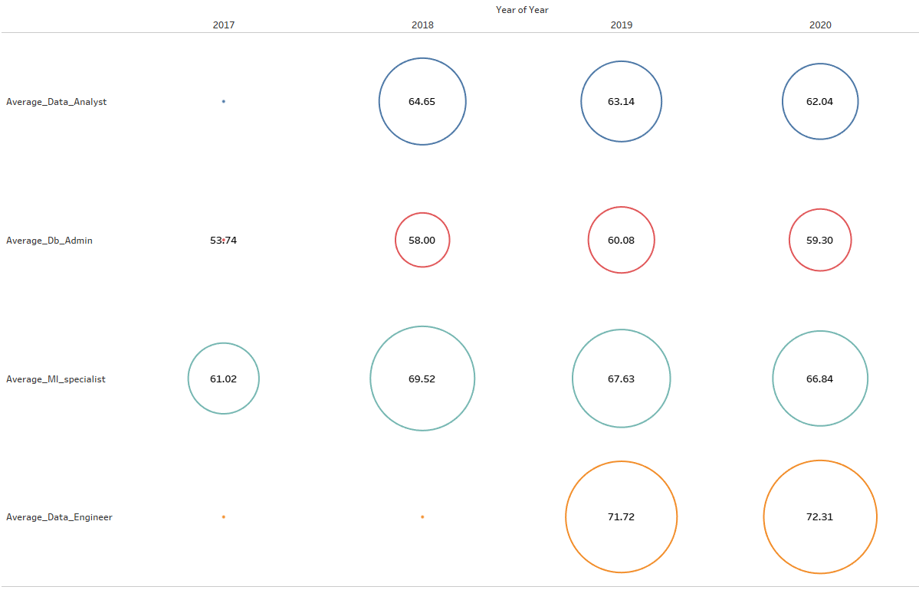
Data related jobs
Data Engineers average salary is high compared to remaining data jobs

Slide 10
Conclusion
The main factors affecting Data related jobs salary
Education
Employment type
Organization
Job Nature
Geographical location
Doctoral degree in data science can increase the Salary by 30% from Bachelors degree
Part time employees can work as freelancer to increase the salary by almost 50%
Organization with more than 10000 employees will pay salary to market Standards
As per the data available Data engineers are paid more salary(job titles could be deceiving. If the data engineer also performs serious software development work in addition to ETL work, then their compensation would be higher. That’s why it’s sometimes possible for data engineers to be paid more than data scientists.

