Slide 1


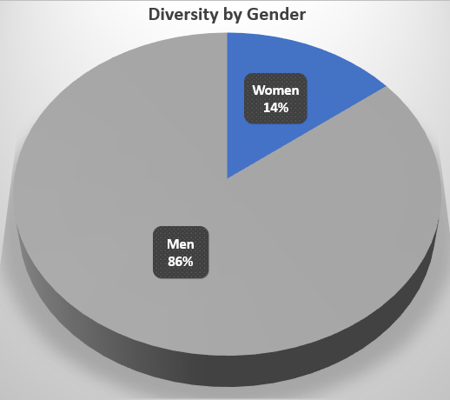
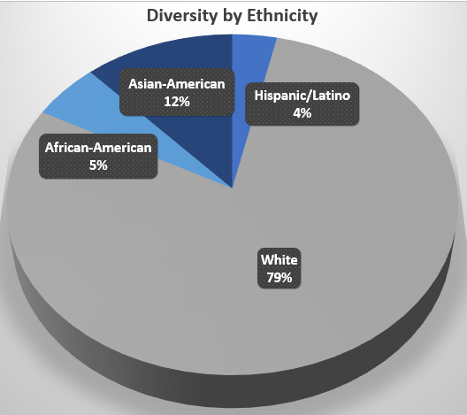
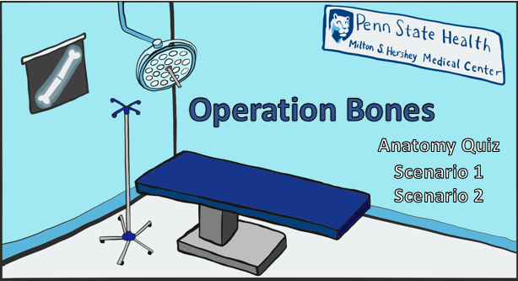
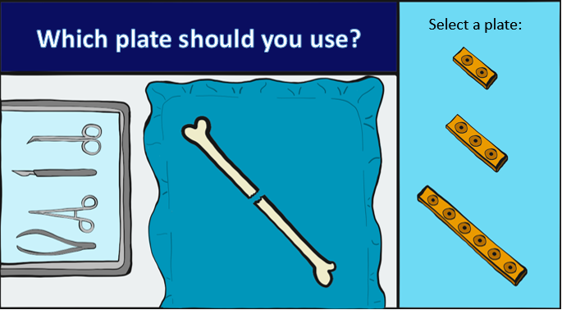

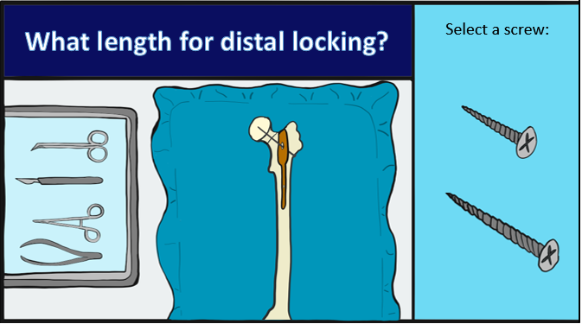
Orthopedic Surgery Gaming App
7
Nicholas Duffner, Amber Graham, Chenning Zhang
Problem Statement:
There is a considerable lack of diversity in the field of Orthopaedic Surgery
Most students are not exposed to orthopaedic surgery before they start their career path
Project Goals:
Create a gaming app that is entertaining and informative for high school students
Make the game inclusive and accessible to anyone, regardless of their demographic
Approach:
Creating a fun game:
Cartoonish graphics
Trauma Scenarios
Hands-on Experience
Scored at the end
Accessibility:
Free to Download
Available on iOS &
Android
No need for WiFi
Inclusive Design:
Neutral color-scheme
Gender-neutral Graphics
Developing with Unity:
Free to use Personal Version
Easier to make changes
Easier for Simulation/Testing
Design:
Home Screen
Navigation to:
Anatomy Quiz
Scenario 1
Scenario 2
Radius Fracture
User selects appropriate materials to perform Compression Plating
Guided procedure
Anatomy Quiz
Cycles through skeletal system
User selects bone
Shown correct bone upon incorrect guess
Femur Fracture
User selects appropriate materials to perform Intramedullary Nailing
Guided procedure
Next Steps
Publish the game on the App Store and Google Play
Receive feedback from high school students on the effectiveness of the game
Market the game so it reaches a larger audience
Further development such as additional Trauma Scenarios and improved gameplay capability
Acknowledgements
Sponsor: April D. Armstrong, MD, Penn State Hershey Medical Center
Instructor: Steven Shaffer, EdD, Penn State College of Engineering
References
American Academy of Orthopaedic Surgeons (2017). Minority Representation Among Orthopaedic Surgery Residents.
Notes:
Problem statement:
Most high school students are not exposed to orthopaedic surgery before
There is a considerable lack of diversity in the field of Orthopaedic Surgery
Project Goals:
Create a gaming app that's entertaining for high school students
Make the game accessible to anyone regardless of demographic
Next steps:
put the app on the app store
Receive feedback from high school students on the effectiveness of the game
Market the game so it reaches a larger audience

