Slide 1
From Discrete Model to Continuum Limit
Jinghao Chen
April 27, 2020
* “paper” in the following content refers to Anguige’s paper

Slide 2
Section 1.
Deriving Continuum Limit from Discrete Model

Slide 3
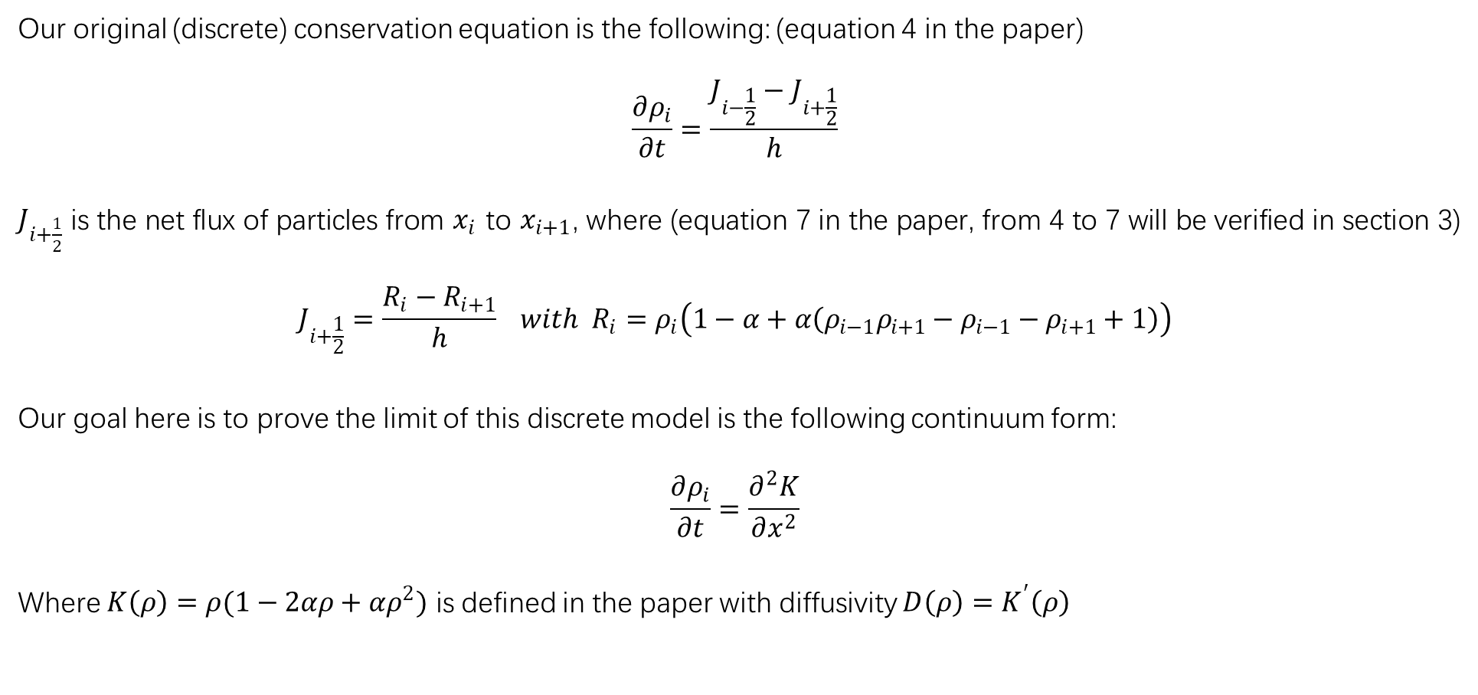
Our original (discrete) conservation equation is the following: (equation 4 in the paper)
$$\frac{∂ρ_{i}}{∂t}=\frac{J_{i−\frac{1}{2}}−J_{i+\frac{1}{2}}}{h}$$
$J_{i+\frac{1}{2}}$ is the net flux of particles from $x_{i}$ to $x_{i+1}$, where (equation 7 in the paper, from 4 to 7 will be verified in section 3)
$$J_{i+\frac{1}{2}}=\frac{R_{i}−R_{i+1}}{h} with R_{i}=ρ_{i}\left(1−α+α\left(ρ_{i−1}ρ_{i+1}−ρ_{i−1}−ρ_{i+1}+1\right)\right)$$
Our goal here is to prove the limit of this discrete model is the following continuum form:
$$\frac{∂ρ_{i}}{∂t}=\frac{∂^{2}K}{∂x^{2}}$$
Where $K\left(ρ\right)=ρ(1−2αρ+αρ^{2})$ is defined in the paper with diffusivity $D\left(ρ\right)=K^{′}\left(ρ\right)$

Slide 4
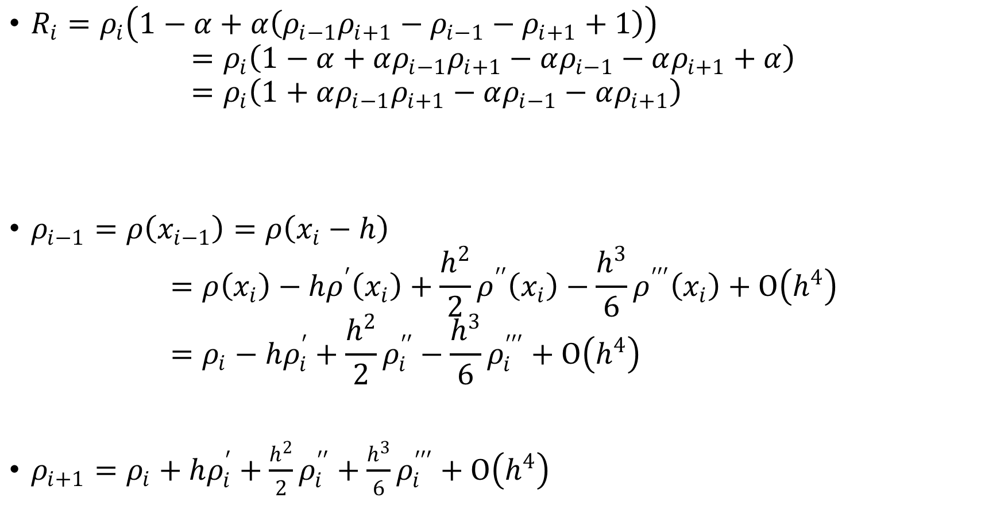
$R_{i}=ρ_{i}\left(1−α+α\left(ρ_{i−1}ρ_{i+1}−ρ_{i−1}−ρ_{i+1}+1\right)\right)$ $=ρ_{i}\left(1−α+αρ_{i−1}ρ_{i+1}−αρ_{i−1}−αρ_{i+1}+α\right)$ $=ρ_{i}\left(1+αρ_{i−1}ρ_{i+1}−αρ_{i−1}−αρ_{i+1}\right)$
$ρ_{i−1}=ρ\left(x_{i−1}\right)=ρ\left(x_{i}−h\right)$
$$=ρ\left(x_{i}\right)−hρ^{′}\left(x_{i}\right)+\frac{h^{2}}{2}ρ^{′′}\left(x_{i}\right)−\frac{h^{3}}{6}ρ^{′′′}\left(x_{i}\right)+Ο\left(h^{4}\right)=ρ_{i}−hρ_{i}^{′}+\frac{h^{2}}{2}ρ_{i}^{′′}−\frac{h^{3}}{6}ρ_{i}^{′′′}+Ο\left(h^{4}\right)$$
$ρ_{i+1}=ρ_{i}+hρ_{i}^{′}+\frac{h^{2}}{2}ρ_{i}^{′′}+\frac{h^{3}}{6}ρ_{i}^{′′′}+Ο\left(h^{4}\right)$

Slide 5
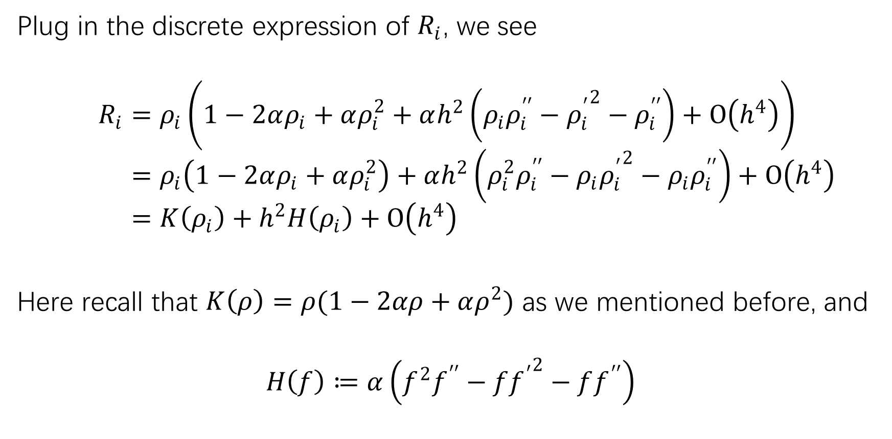
Plug in the discrete expression of $R_{i}$, we see
$$R_{i}=ρ_{i}\left(1−2αρ_{i}+αρ_{i}^{2}+αh^{2}\left(ρ_{i}ρ_{i}^{′′}−{ρ_{i}^{′}}^{2}−ρ_{i}^{′′}\right)+Ο\left(h^{4}\right)\right) \\ =ρ_{i}\left(1−2αρ_{i}+αρ_{i}^{2}\right)+αh^{2}\left(ρ_{i}^{2}ρ_{i}^{′′}−ρ_{i}{ρ_{i}^{′}}^{2}−ρ_{i}ρ_{i}^{′′}\right)+Ο\left(h^{4}\right) \\ =K\left(ρ_{i}\right)+h^{2}H\left(ρ_{i}\right)+Ο\left(h^{4}\right)$$
Here recall that $K\left(ρ\right)=ρ(1−2αρ+αρ^{2})$ as we mentioned before, and
$$H\left(f\right)≔α\left(f^{2}f^{′′}−f{f^{′}}^{2}−ff^{′′}\right)$$

Slide 6

Similarly, we can get
$R_{i−1}=K\left(ρ_{i−1}\right)+h^{2}H\left(ρ_{i−1}\right)+Ο\left(h^{4}\right)$
$R_{i+1}=K\left(ρ_{i+1}\right)+h^{2}H\left(ρ_{i+1}\right)+Ο\left(h^{4}\right)$

Slide 7
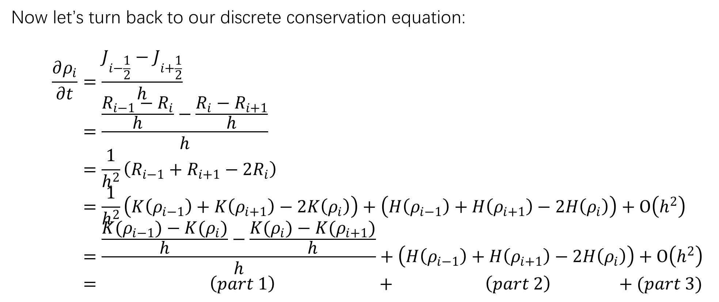
Now let’s turn back to our discrete conservation equation:
$$\frac{∂ρ_{i}}{∂t}=\frac{J_{i−\frac{1}{2}}−J_{i+\frac{1}{2}}}{h} \\ =\frac{\frac{R_{i−1}−R_{i}}{h}−\frac{R_{i}−R_{i+1}}{h}}{h} \\ =\frac{1}{h^{2}}\left(R_{i−1}+R_{i+1}−2R_{i}\right) \\ =\frac{1}{h^{2}}\left(K\left(ρ_{i−1}\right)+K\left(ρ_{i+1}\right)−2K\left(ρ_{i}\right)\right)+\left(H\left(ρ_{i−1}\right)+H\left(ρ_{i+1}\right)−2H\left(ρ_{i}\right)\right)+Ο\left(h^{2}\right) \\ =\frac{\frac{K(ρ_{i−1})−K(ρ_{i})}{h}−\frac{K(ρ_{i})−K(ρ_{i+1})}{h}}{h}+\left(H\left(ρ_{i−1}\right)+H\left(ρ_{i+1}\right)−2H\left(ρ_{i}\right)\right)+Ο\left(h^{2}\right) \\ = \left(part 1\right) + \left(part 2\right) +(part 3)$$

Slide 8
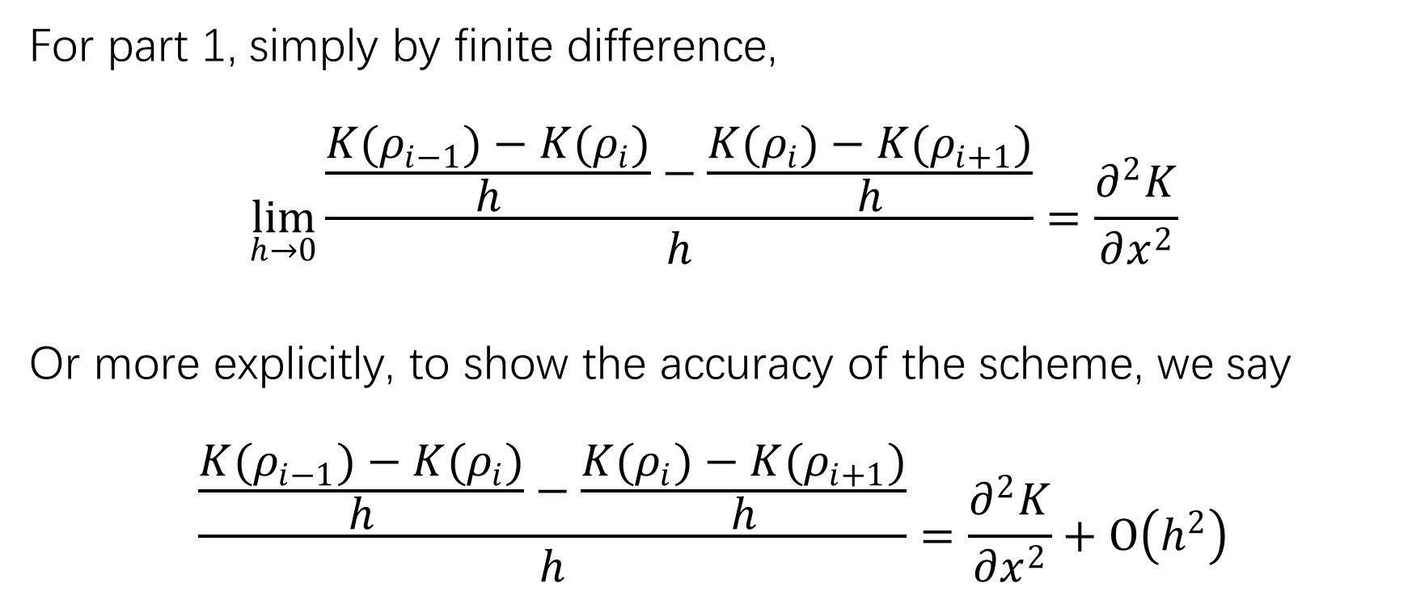
For part 1, simply by finite difference,
$$\lim_{h→0}{\frac{\frac{K(ρ_{i−1})−K(ρ_{i})}{h}−\frac{K(ρ_{i})−K(ρ_{i+1})}{h}}{h}}=\frac{∂^{2}K}{∂x^{2}}$$
Or more explicitly, to show the accuracy of the scheme, we say
$$\frac{\frac{K(ρ_{i−1})−K(ρ_{i})}{h}−\frac{K(ρ_{i})−K(ρ_{i+1})}{h}}{h}=\frac{∂^{2}K}{∂x^{2}}+Ο\left(h^{2}\right)$$

Slide 9

For part 2:
$$H\left(ρ_{i−1}\right)=α\left(ρ_{i−1}^{2}ρ_{i−1}^{′′}−ρ_{i−1}{{ρ_{i−1}}^{′}}^{2}−ρ_{i−1}{ρ_{i−1}}^{′′}\right)$$
by Taylor expansion, $ρ_{i−1}=ρ_{i}+Ο\left(h\right)$, $ρ_{i−1}^{′}=ρ_{i}^{′}+Ο\left(h\right)$， $ρ_{i−1}^{′′}=ρ_{i}^{′′}+Ο\left(h\right)$, plug into $H\left(ρ_{i−1}\right)$:
$$H\left(ρ_{i−1}\right)=α\left(ρ_{i}^{2}ρ_{i}^{′′}−ρ_{i}{ρ_{i}^{′}}^{2}−ρ_{i}ρ_{i}^{′′}\right)+Ο\left(h^{2}\right)=H\left(ρ_{i}\right)+Ο\left(h^{2}\right)$$
Similarly,
$$H\left(ρ_{i+1}\right)=α\left(ρ_{i}^{2}ρ_{i}^{′′}−ρ_{i}{ρ_{i}^{′}}^{2}−ρ_{i}ρ_{i}^{′′}\right)+Ο\left(h^{2}\right)=H\left(ρ_{i}\right)+Ο\left(h^{2}\right)$$
So the part 2 becomes
$$H\left(ρ_{i−1}\right)+H\left(ρ_{i+1}\right)−2H\left(ρ_{i}\right)=Ο\left(h^{2}\right)$$

Slide 10

Overall, the combination of those 3 parts:
$$\frac{∂ρ_{i}}{∂t}=\frac{∂^{2}K}{∂x^{2}}+Ο\left(h^{2}\right)→\frac{∂^{2}K}{∂x^{2}} as h→0$$
That is, we get exactly the following desired continuum limit equation:
$$\frac{∂ρ_{i}}{∂t}=\frac{∂^{2}K}{∂x^{2}}$$

Slide 11
Section 2.
Deriving Modified Equation

Slide 12
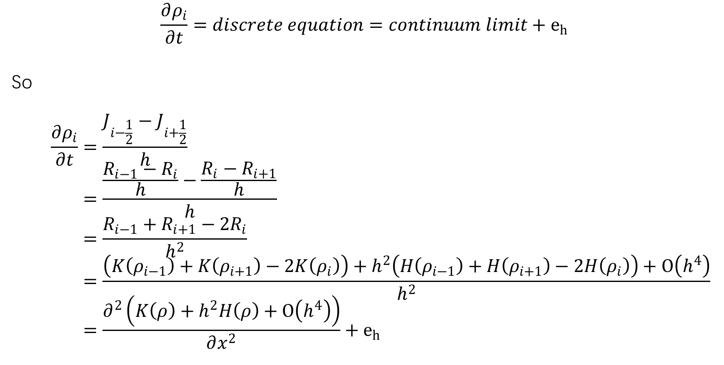
$$\frac{∂ρ_{i}}{∂t}=discrete equation=continuum limit+e_{h}$$
So
$$\frac{∂ρ_{i}}{∂t}=\frac{J_{i−\frac{1}{2}}−J_{i+\frac{1}{2}}}{h} \\ =\frac{\frac{R_{i−1}−R_{i}}{h}−\frac{R_{i}−R_{i+1}}{h}}{h} \\ =\frac{R_{i−1}+R_{i+1}−2R_{i}}{h^{2}} \\ =\frac{\left(K\left(ρ_{i−1}\right)+K\left(ρ_{i+1}\right)−2K\left(ρ_{i}\right)\right)+h^{2}\left(H\left(ρ_{i−1}\right)+H\left(ρ_{i+1}\right)−2H\left(ρ_{i}\right)\right)+Ο\left(h^{4}\right)}{h^{2}} \\ =\frac{∂^{2}\left(K\left(ρ\right)+h^{2}H\left(ρ\right)+Ο\left(h^{4}\right)\right)}{∂x^{2}}+e_{h}$$

Slide 13
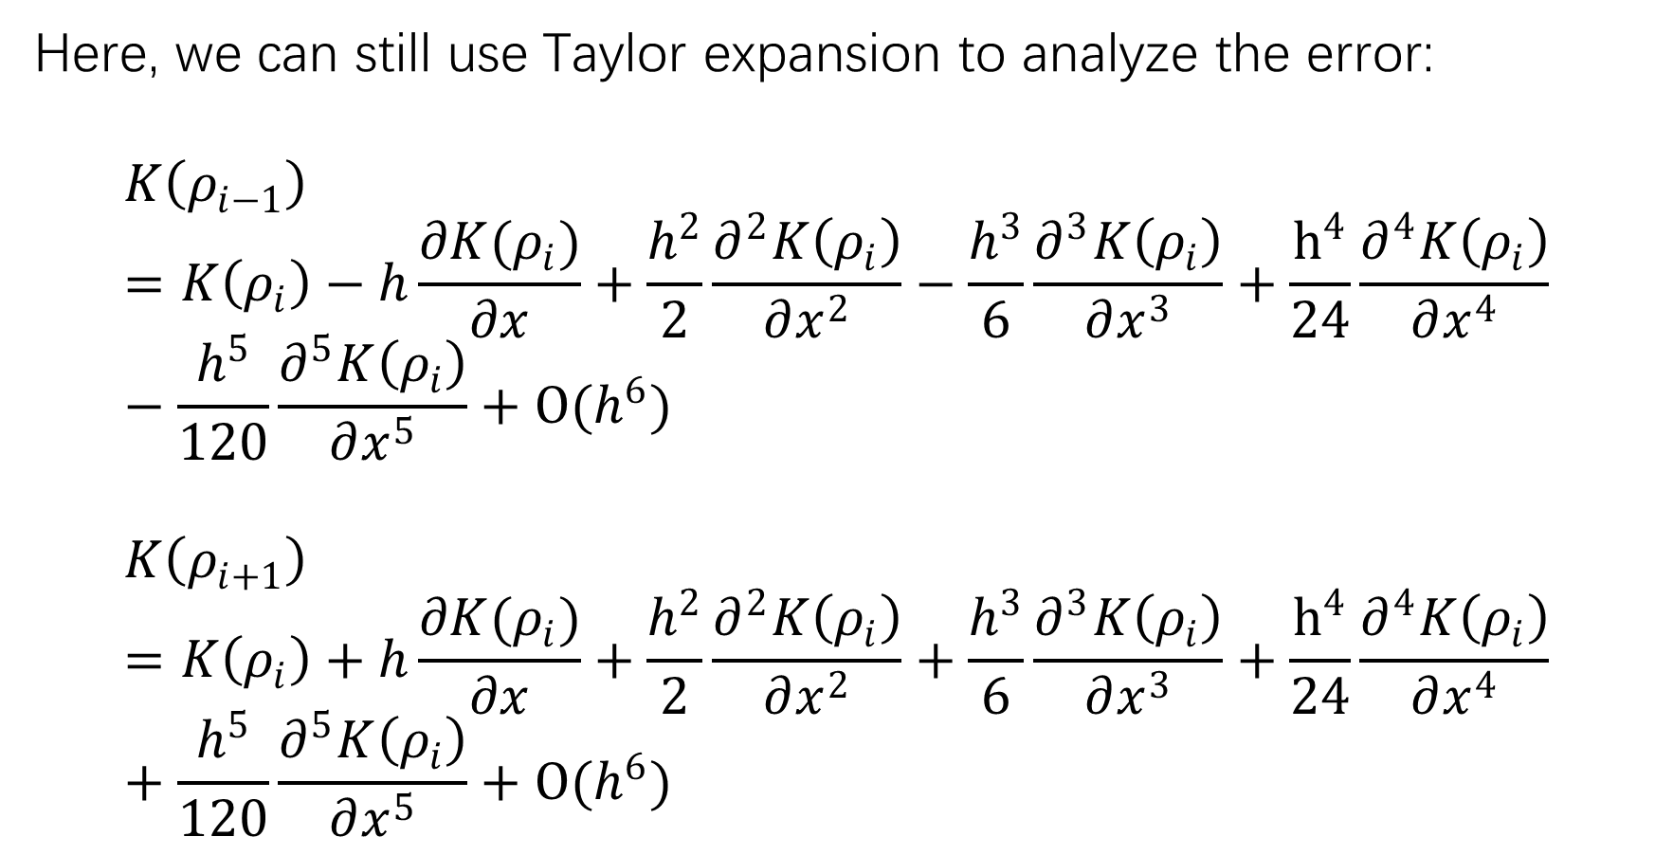
Here, we can still use Taylor expansion to analyze the error:
$$K\left(ρ_{i−1}\right)=K\left(ρ_{i}\right)−h\frac{∂K(ρ_{i})}{∂x}+\frac{h^{2}}{2}\frac{∂^{2}K\left(ρ_{i}\right)}{∂x^{2}}−\frac{h^{3}}{6}\frac{∂^{3}K\left(ρ_{i}\right)}{∂x^{3}}+\frac{h^{4}}{24}\frac{∂^{4}K\left(ρ_{i}\right)}{∂x^{4}}−\frac{h^{5}}{120}\frac{∂^{5}K\left(ρ_{i}\right)}{∂x^{5}}+Ο(h^{6})$$
$$K\left(ρ_{i+1}\right)=K\left(ρ_{i}\right)+h\frac{∂K(ρ_{i})}{∂x}+\frac{h^{2}}{2}\frac{∂^{2}K\left(ρ_{i}\right)}{∂x^{2}}+\frac{h^{3}}{6}\frac{∂^{3}K\left(ρ_{i}\right)}{∂x^{3}}+\frac{h^{4}}{24}\frac{∂^{4}K\left(ρ_{i}\right)}{∂x^{4}}+\frac{h^{5}}{120}\frac{∂^{5}K\left(ρ_{i}\right)}{∂x^{5}}+Ο(h^{6})$$

Slide 14
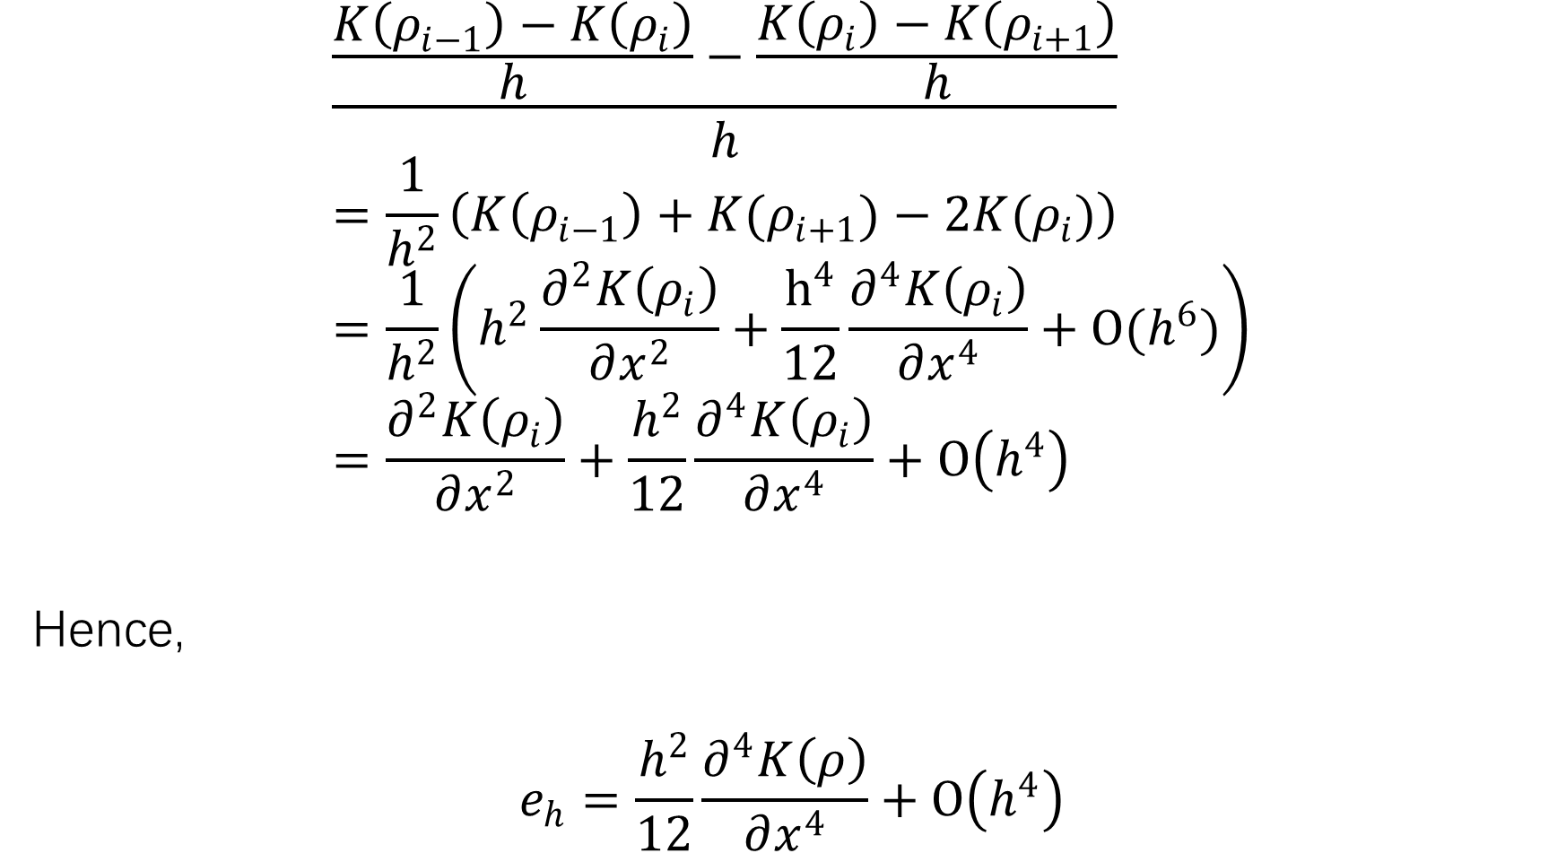
$$\frac{\frac{K\left(ρ_{i−1}\right)−K\left(ρ_{i}\right)}{h}−\frac{K\left(ρ_{i}\right)−K\left(ρ_{i+1}\right)}{h}}{h} \\ =\frac{1}{h^{2}}\left(K\left(ρ_{i−1}\right)+K(ρ_{i+1})−2K(ρ_{i})\right) \\ =\frac{1}{h^{2}}\left(h^{2}\frac{∂^{2}K\left(ρ_{i}\right)}{∂x^{2}}+\frac{h^{4}}{12}\frac{∂^{4}K\left(ρ_{i}\right)}{∂x^{4}}+Ο(h^{6})\right) \\ =\frac{∂^{2}K\left(ρ_{i}\right)}{∂x^{2}}+\frac{h^{2}}{12}\frac{∂^{4}K\left(ρ_{i}\right)}{∂x^{4}}+Ο\left(h^{4}\right)$$
Hence,
$$e_{h}=\frac{h^{2}}{12}\frac{∂^{4}K\left(ρ\right)}{∂x^{4}}+Ο\left(h^{4}\right)$$

Slide 15
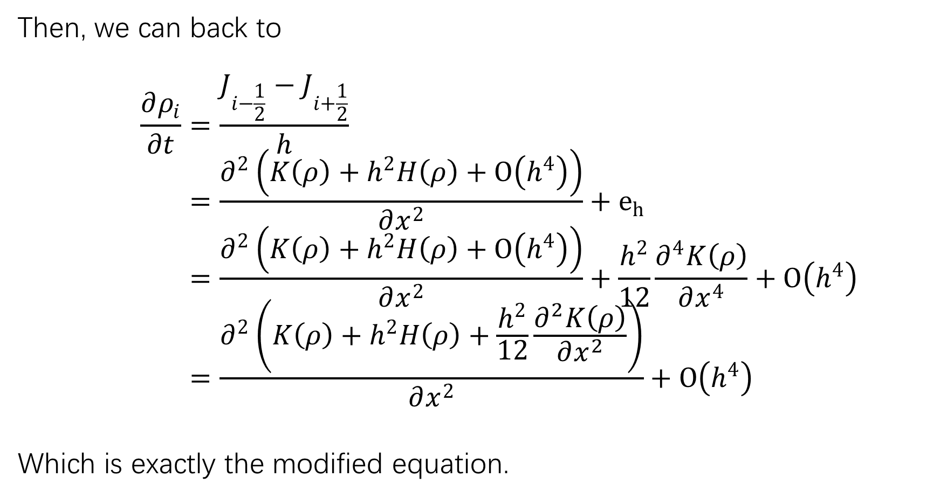
Then, we can back to
$$\frac{∂ρ_{i}}{∂t}=\frac{J_{i−\frac{1}{2}}−J_{i+\frac{1}{2}}}{h} \\ =\frac{∂^{2}\left(K\left(ρ\right)+h^{2}H\left(ρ\right)+Ο\left(h^{4}\right)\right)}{∂x^{2}}+e_{h} \\ =\frac{∂^{2}\left(K\left(ρ\right)+h^{2}H\left(ρ\right)+Ο\left(h^{4}\right)\right)}{∂x^{2}}+\frac{h^{2}}{12}\frac{∂^{4}K\left(ρ\right)}{∂x^{4}}+Ο\left(h^{4}\right) \\ =\frac{∂^{2}\left(K\left(ρ\right)+h^{2}H\left(ρ\right)+\frac{h^{2}}{12}\frac{∂^{2}K\left(ρ\right)}{∂x^{2}}\right)}{∂x^{2}}+Ο\left(h^{4}\right)$$
Which is exactly the modified equation.

Slide 16

To see this clearer, let’s rewrite $H(ρ)$ in formal way:
$$H\left(ρ\right)=α\left(ρ^{2}ρ^{′′}−ρ{ρ^{′}}^{2}−ρρ^{′′}\right) \\ =αρ^{2}\frac{∂^{2}ρ}{∂x^{2}}−αρ{\left(\frac{∂ρ}{∂x}\right)}^{2}−αρ\frac{\left(∂^{2}ρ\right)}{∂x^{2}} \\ =αρ\frac{∂^{2}ρ}{∂x^{2}}\left(ρ−1\right)−αρ{\left(\frac{∂ρ}{∂x}\right)}^{2}$$
then
$$\frac{∂ρ_{i}}{∂t}=\frac{∂^{2}}{∂x^{2}}\left(K\left(ρ\right)+h^{2}\left(H\left(ρ\right)+\frac{1}{12}\frac{∂^{2}K\left(ρ\right)}{∂x^{2}}\right)\right)+Ο\left(h^{4}\right) \\ =\frac{∂^{2}}{∂x^{2}}\left(K\left(ρ\right)+h^{2}\left(αρ\frac{∂^{2}ρ}{∂x^{2}}\left(ρ−1\right)−αρ{\left(\frac{∂ρ}{∂x}\right)}^{2}+\frac{1}{12}\frac{∂^{2}K\left(ρ\right)}{∂x^{2}}\right)\right)+Ο\left(h^{4}\right)$$

Slide 17
Section 3.
From (4) to (7): Verification of the Equivalence of 2 Discrete Expressions

Slide 18
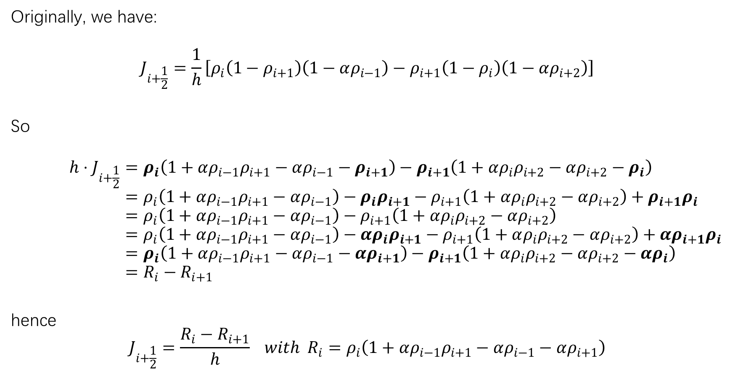
Originally, we have:
$$J_{i+\frac{1}{2}}=\frac{1}{h}\left[ρ_{i}\left(1−ρ_{i+1}\right)\left(1−αρ_{i−1}\right)−ρ_{i+1}\left(1−ρ_{i}\right)\left(1−αρ_{i+2}\right)\right]$$
So
$$h⋅J_{i+\frac{1}{2}}=ρ_{i}\left(1+αρ_{i−1}ρ_{i+1}−αρ_{i−1}−ρ_{i+1}\right)−ρ_{i+1}\left(1+αρ_{i}ρ_{i+2}−αρ_{i+2}−ρ_{i}\right) \\ =ρ_{i}\left(1+αρ_{i−1}ρ_{i+1}−αρ_{i−1}\right)−ρ_{i}ρ_{i+1}−ρ_{i+1}\left(1+αρ_{i}ρ_{i+2}−αρ_{i+2}\right)+ρ_{i+1}ρ_{i} \\ =ρ_{i}\left(1+αρ_{i−1}ρ_{i+1}−αρ_{i−1}\right)−ρ_{i+1}\left(1+αρ_{i}ρ_{i+2}−αρ_{i+2}\right) \\ =ρ_{i}\left(1+αρ_{i−1}ρ_{i+1}−αρ_{i−1}\right)−{αρ}_{i}ρ_{i+1}−ρ_{i+1}\left(1+αρ_{i}ρ_{i+2}−αρ_{i+2}\right)+αρ_{i+1}ρ_{i} \\ =ρ_{i}\left(1+αρ_{i−1}ρ_{i+1}−αρ_{i−1}−αρ_{i+1}\right)−ρ_{i+1}\left(1+αρ_{i}ρ_{i+2}−αρ_{i+2}−αρ_{i}\right) \\ =R_{i}−R_{i+1}$$
hence
$$J_{i+\frac{1}{2}}=\frac{R_{i}−R_{i+1}}{h} with R_{i}=ρ_{i}\left(1+αρ_{i−1}ρ_{i+1}−αρ_{i−1}−αρ_{i+1}\right)$$

