Slide 1
Stability Analysis of the Continuum Model
Jinghao Chen
May 3, 2020
* “paper” in the following content refers to Anguige’s paper

Slide 2
Section 1.
Linear Stability Analysis for the Continuum Equation

Slide 3

Recall the continuum limit of discrete model is the following:
$$\frac{∂ρ}{∂t}=\frac{∂^{2}K\left(ρ\right)}{∂x^{2}}$$
where $K\left(ρ\right)=ρ(1−2αρ+αρ^{2})$.
Now, consider
$$ρ\left(x,t\right)=\overline{ρ}+ε\tilde{ρ}\left(x,t\right)$$
with
$$\tilde{ρ}\left(x,t\right)=\sum_{k=−∞}^{+∞}{{\hat{ρ}}_{k}\left(t\right)e^{ikx}}$$

Slide 4

$$LHS=\frac{∂ρ}{∂t}=ε\sum_{k=−∞}^{+∞}{\frac{∂{\hat{ρ}}_{k}\left(t\right)}{∂t}e^{ikx}}$$

Slide 5
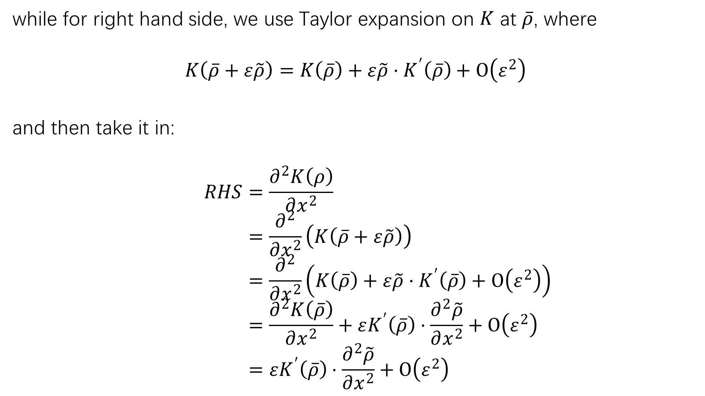
while for right hand side, we use Taylor expansion on $K$ at $\overline{ρ}$, where
$$K\left(\overline{ρ}+ε\tilde{ρ}\right)=K\left(\overline{ρ}\right)+ε\tilde{ρ}⋅K^{′}\left(\overline{ρ}\right)+Ο\left(ε^{2}\right)$$
and then take it in:
$$RHS=\frac{∂^{2}K\left(ρ\right)}{∂x^{2}} \\ =\frac{∂^{2}}{∂x^{2}}\left(K\left(\overline{ρ}+ε\tilde{ρ}\right)\right) \\ =\frac{∂^{2}}{∂x^{2}}\left(K\left(\overline{ρ}\right)+ε\tilde{ρ}⋅K^{′}\left(\overline{ρ}\right)+Ο\left(ε^{2}\right)\right) \\ =\frac{∂^{2}K\left(\overline{ρ}\right)}{∂x^{2}}+εK^{′}\left(\overline{ρ}\right)⋅\frac{∂^{2}\tilde{ρ}}{∂x^{2}}+Ο\left(ε^{2}\right) \\ =εK^{′}\left(\overline{ρ}\right)⋅\frac{∂^{2}\tilde{ρ}}{∂x^{2}}+Ο\left(ε^{2}\right)$$

Slide 6
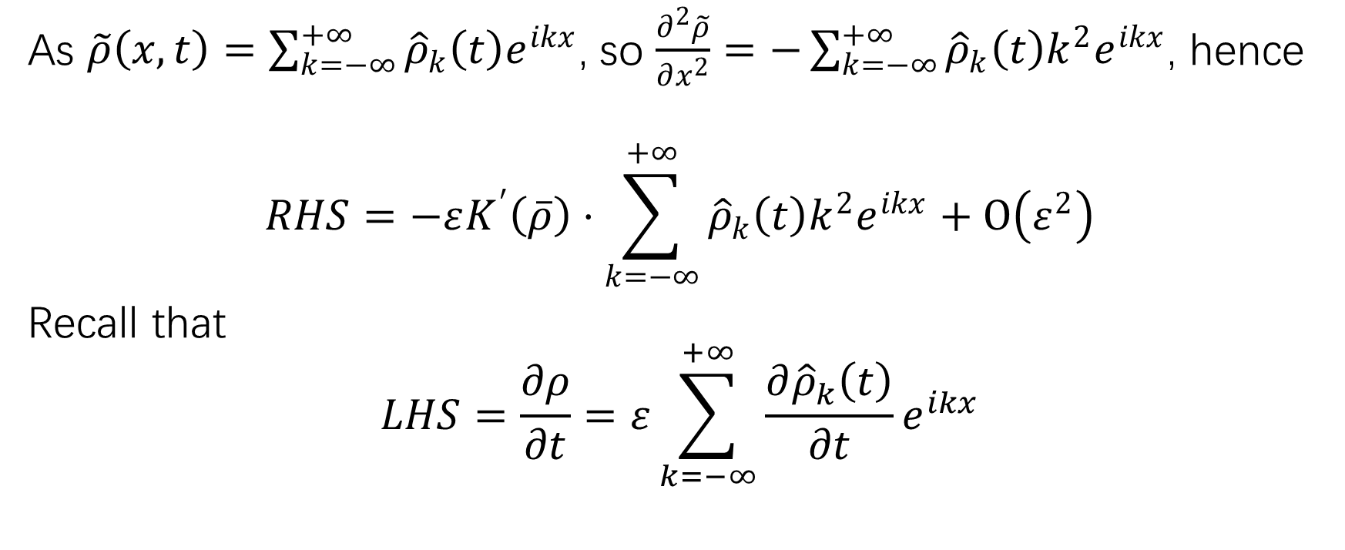
As $\tilde{ρ}\left(x,t\right)=\sum_{k=−∞}^{+∞}{{\hat{ρ}}_{k}\left(t\right)e^{ikx}}$, so $\frac{∂^{2}\tilde{ρ}}{∂x^{2}}=−\sum_{k=−∞}^{+∞}{{\hat{ρ}}_{k}\left(t\right)k^{2}e^{ikx}}$, hence
$$RHS=−εK^{′}\left(\overline{ρ}\right)⋅\sum_{k=−∞}^{+∞}{{\hat{ρ}}_{k}\left(t\right)k^{2}e^{ikx}}+Ο\left(ε^{2}\right)$$
Recall that
$$LHS=\frac{∂ρ}{∂t}=ε\sum_{k=−∞}^{+∞}{\frac{∂{\hat{ρ}}_{k}\left(t\right)}{∂t}e^{ikx}}$$

Slide 7
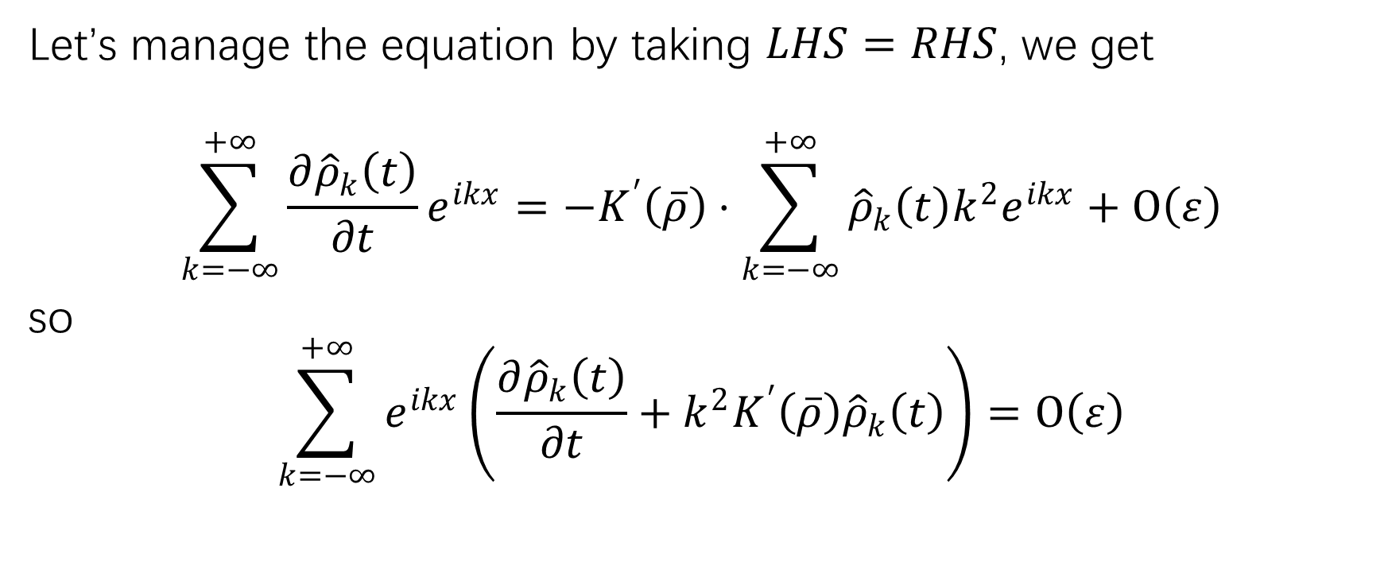
Let’s manage the equation by taking $LHS=RHS$, we get
$$\sum_{k=−∞}^{+∞}{\frac{∂{\hat{ρ}}_{k}\left(t\right)}{∂t}e^{ikx}}=−K^{′}\left(\overline{ρ}\right)⋅\sum_{k=−∞}^{+∞}{{\hat{ρ}}_{k}\left(t\right)k^{2}e^{ikx}}+Ο\left(ε\right)$$
so
$$\sum_{k=−∞}^{+∞}{e^{ikx}\left(\frac{∂{\hat{ρ}}_{k}\left(t\right)}{∂t}+k^{2}K^{′}\left(\overline{ρ}\right){\hat{ρ}}_{k}\left(t\right)\right)}=Ο\left(ε\right)$$

Slide 8
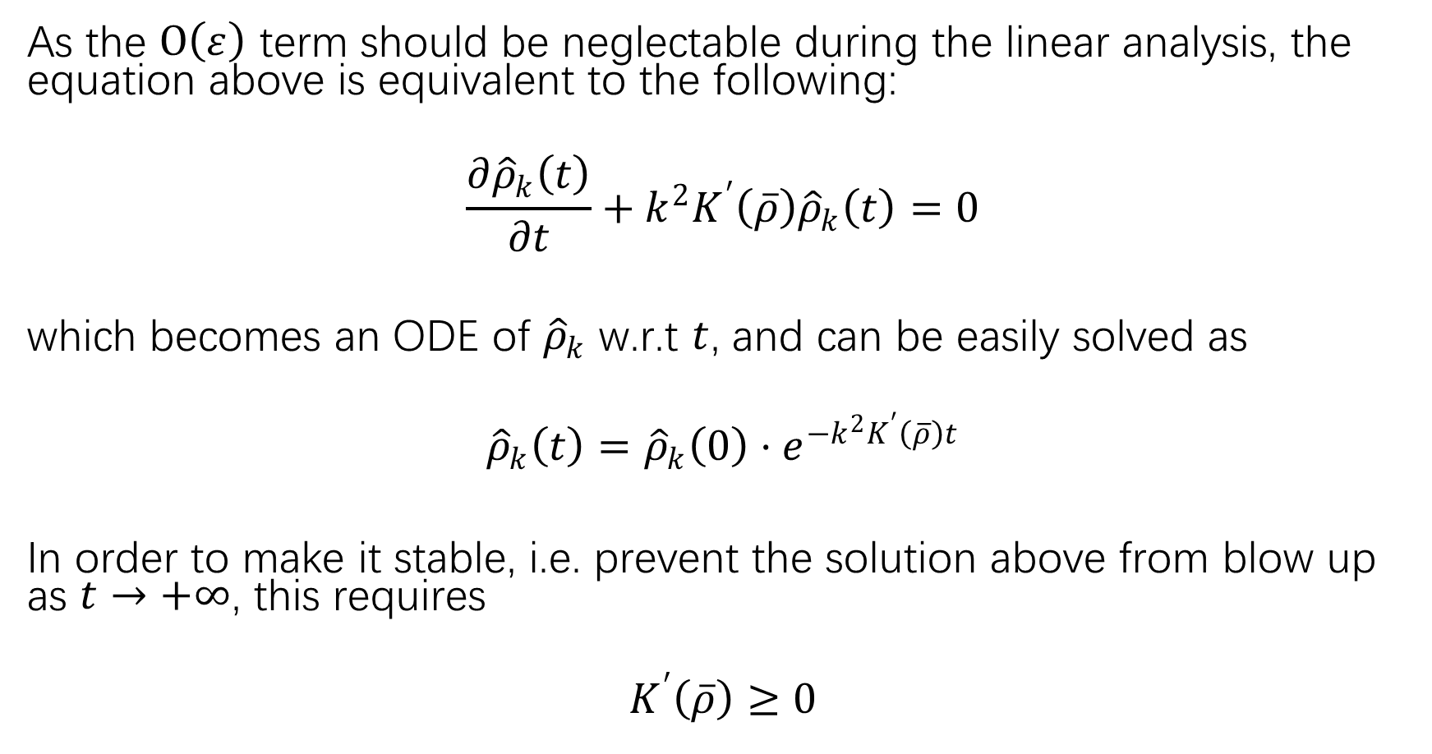
As the $Ο\left(ε\right)$ term should be neglectable during the linear analysis, the equation above is equivalent to the following:
$$\frac{∂{\hat{ρ}}_{k}\left(t\right)}{∂t}+k^{2}K^{′}\left(\overline{ρ}\right){\hat{ρ}}_{k}\left(t\right)=0$$
which becomes an ODE of ${\hat{ρ}}_{k}$ w.r.t $t$, and can be easily solved as
$${\hat{ρ}}_{k}\left(t\right)={\hat{ρ}}_{k}\left(0\right)⋅e^{−k^{2}K^{′}\left(\overline{ρ}\right)t}$$
In order to make it stable, i.e. prevent the solution above from blow up as $t→+∞$, this requires
$$K^{′}\left(\overline{ρ}\right)≥0$$

Slide 9
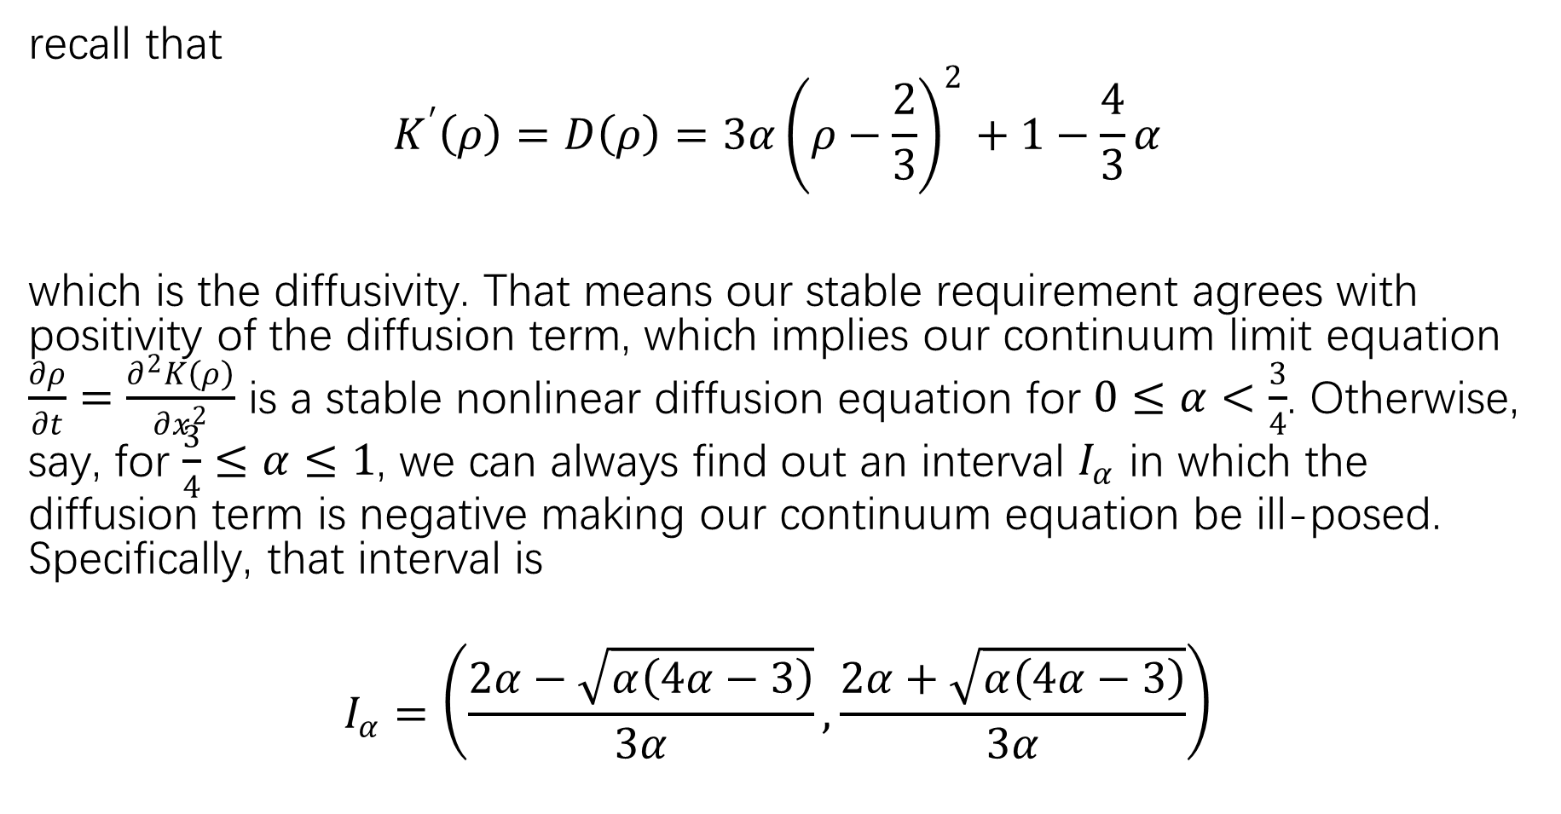
recall that
$$K^{′}\left(ρ\right)=D\left(ρ\right)=3α{\left(ρ−\frac{2}{3}\right)}^{2}+1−\frac{4}{3}α$$
which is the diffusivity. That means our stable requirement agrees with positivity of the diffusion term, which implies our continuum limit equation $\frac{∂ρ}{∂t}=\frac{∂^{2}K\left(ρ\right)}{∂x^{2}}$ is a stable nonlinear diffusion equation for $0≤α<\frac{3}{4}$. Otherwise, say, for $\frac{3}{4}≤α≤1$, we can always find out an interval $I_{α}$ in which the diffusion term is negative making our continuum equation be ill-posed. Specifically, that interval is
$$I_{α}=\left(\frac{2α−\sqrt{α\left(4α−3\right)}}{3α},\frac{2α+\sqrt{α\left(4α−3\right)}}{3α}\right)$$

Slide 10
Section 2.
Steady State Solution of Continuum Model

Slide 11
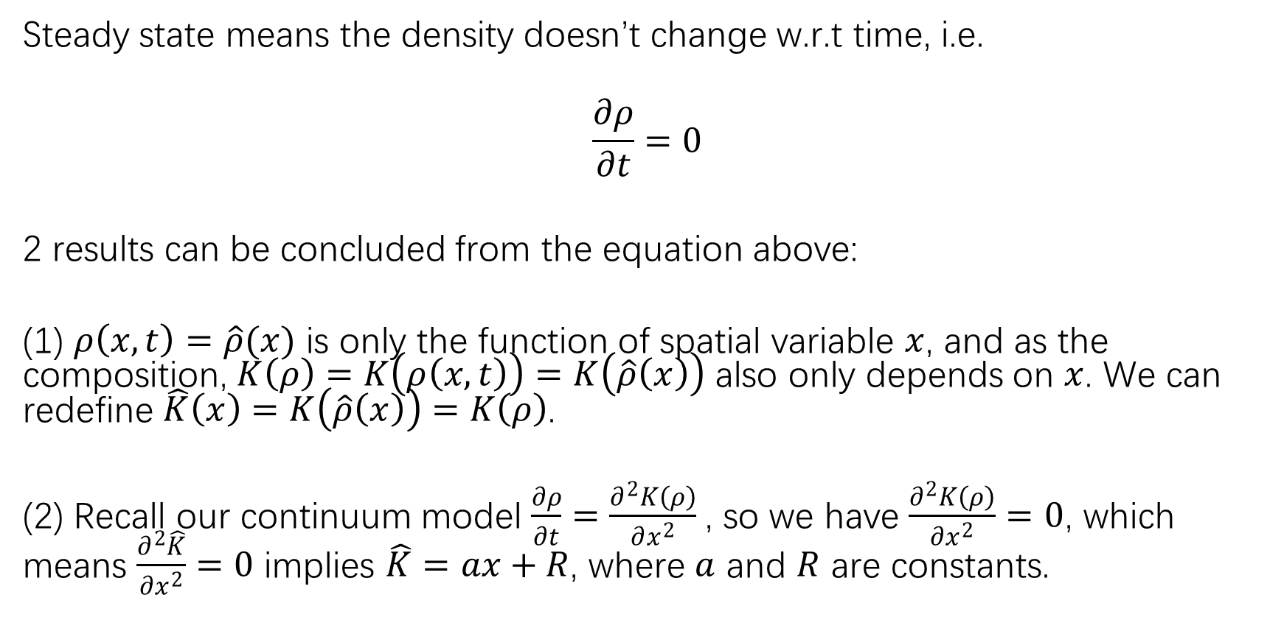
Steady state means the density doesn’t change w.r.t time, i.e.
$$\frac{∂ρ}{∂t}=0$$
2 results can be concluded from the equation above:
(1) $ρ\left(x,t\right)=\hat{ρ}(x)$ is only the function of spatial variable $x$, and as the composition, $K\left(ρ\right)=K\left(ρ\left(x,t\right)\right)=K\left(\hat{ρ}\left(x\right)\right)$ also only depends on $x$. We can redefine $\hat{K}\left(x\right)=K\left(\hat{ρ}\left(x\right)\right)=K\left(ρ\right)$.
(2) Recall our continuum model $\frac{∂ρ}{∂t}=\frac{∂^{2}K\left(ρ\right)}{∂x^{2}}$, so we have $\frac{∂^{2}K\left(ρ\right)}{∂x^{2}}=0$, which means $\frac{∂^{2}\hat{K}}{∂x^{2}}=0$ implies $\hat{K}=ax+R$, where $a$ and $R$ are constants.

Slide 12
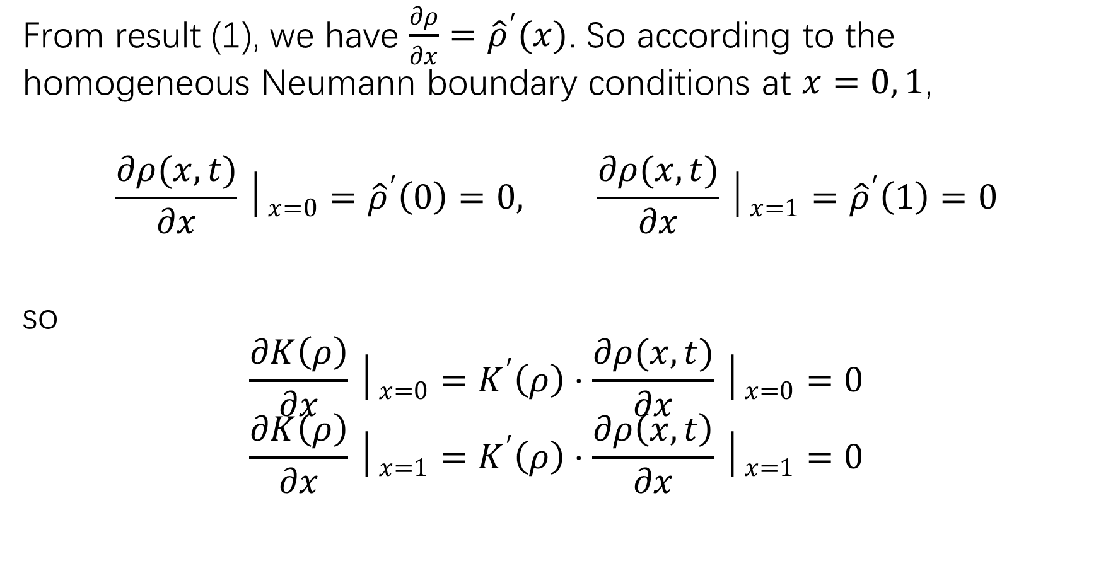
From result (1), we have $\frac{∂ρ}{∂x}={\hat{ρ}}^{′}(x)$. So according to the homogeneous Neumann boundary conditions at $x=0, 1$,
$$\frac{∂ρ(x,t)}{∂x}│_{x=0}={\hat{ρ}}^{′}\left(0\right)=0, \frac{∂ρ(x,t)}{∂x}│_{x=1}={\hat{ρ}}^{′}\left(1\right)=0$$
so
$$\frac{∂K\left(ρ\right)}{∂x}│_{x=0}=K^{′}\left(ρ\right)⋅\frac{∂ρ(x,t)}{∂x}│_{x=0}=0$$
$$\frac{∂K\left(ρ\right)}{∂x}│_{x=1}=K^{′}\left(ρ\right)⋅\frac{∂ρ\left(x,t\right)}{∂x}│_{x=1}=0$$

Slide 13

On the other hand
$$\frac{∂K\left(ρ\right)}{∂x}│_{x=0,1}={\hat{K}}^{′}│_{x=0, 1}=a=0 ⇒ K\left(ρ\right)=\hat{K}=R$$
Hence, we derive the following steady state equation
$$K\left(ρ\right)=ρ\left(1−2αρ+αρ^{2}\right)=R=const$$

Slide 14
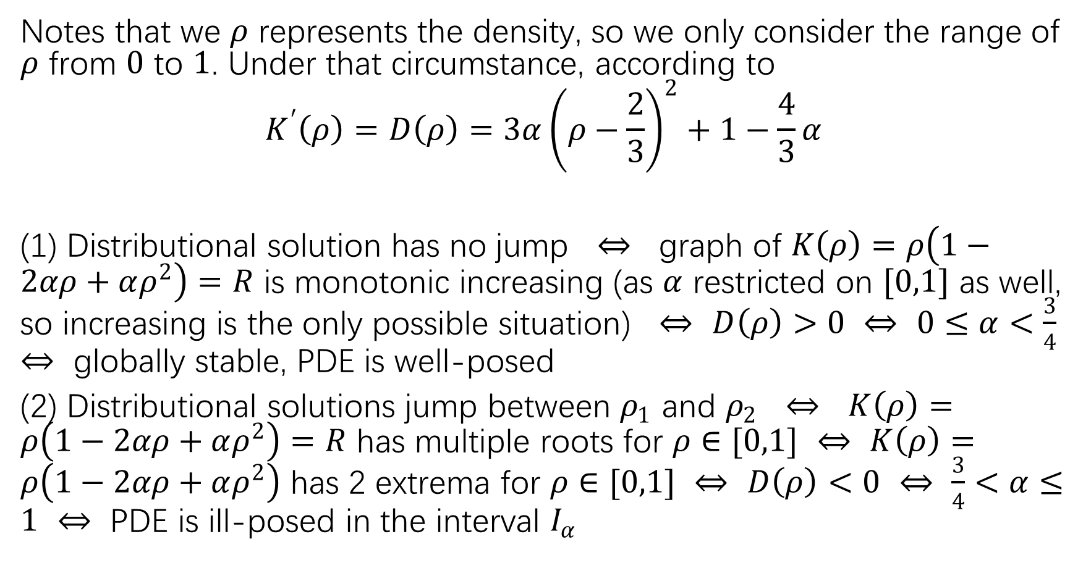
Notes that we $ρ$ represents the density, so we only consider the range of $ρ$ from $0$ to $1$. Under that circumstance, according to
$$K^{′}\left(ρ\right)=D\left(ρ\right)=3α{\left(ρ−\frac{2}{3}\right)}^{2}+1−\frac{4}{3}α$$
(1) Distributional solution has no jump $⇔$ graph of $K\left(ρ\right)=ρ\left(1−2αρ+αρ^{2}\right)=R$ is monotonic increasing (as $α$ restricted on $[0,1]$ as well, so increasing is the only possible situation) $⇔$ $D\left(ρ\right)>0$ $⇔$ $0≤α<\frac{3}{4}$ $⇔$ globally stable, PDE is well-posed
(2) Distributional solutions jump between $ρ_{1}$ and $ρ_{2}$ $⇔$ $K\left(ρ\right)=ρ\left(1−2αρ+αρ^{2}\right)=R$ has multiple roots for $ρ∈[0,1]$ $⇔$ $K\left(ρ\right)=ρ\left(1−2αρ+αρ^{2}\right)$ has 2 extrema for $ρ∈[0,1]$ $⇔$ $D\left(ρ\right)<0$ $⇔$ $\frac{3}{4}<α≤1$ $⇔$ PDE is ill-posed in the interval $I_{α}$

Slide 15
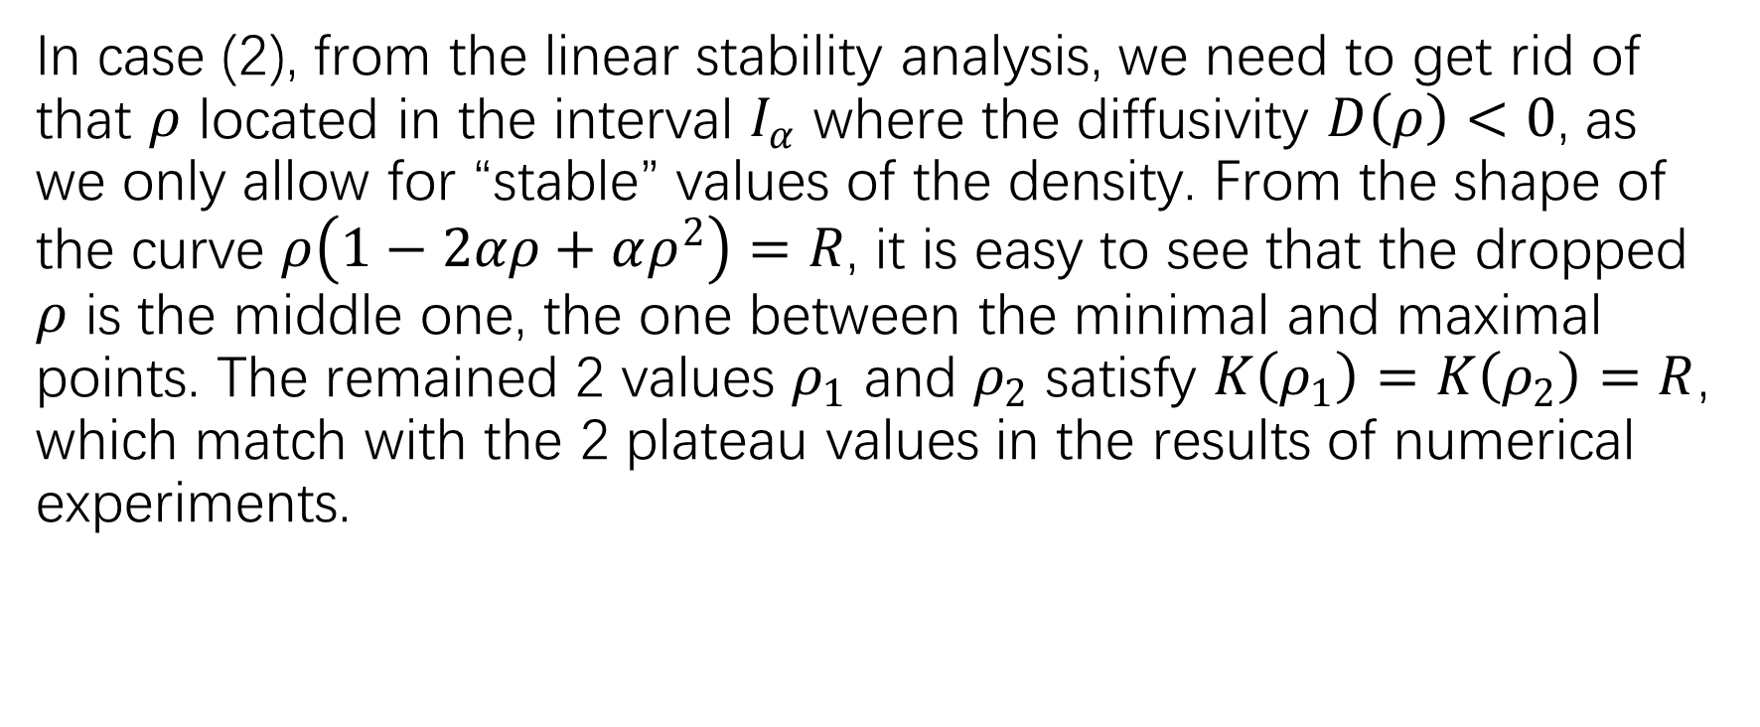
In case (2), from the linear stability analysis, we need to get rid of that $ρ$ located in the interval $I_{α}$ where the diffusivity $D\left(ρ\right)<0$, as we only allow for “stable” values of the density. From the shape of the curve $ρ\left(1−2αρ+αρ^{2}\right)=R$, it is easy to see that the dropped $ρ$ is the middle one, the one between the minimal and maximal points. The remained 2 values $ρ_{1}$ and $ρ_{2}$ satisfy $K\left(ρ_{1}\right)=K\left(ρ_{2}\right)=R$, which match with the 2 plateau values in the results of numerical experiments.

Slide 16
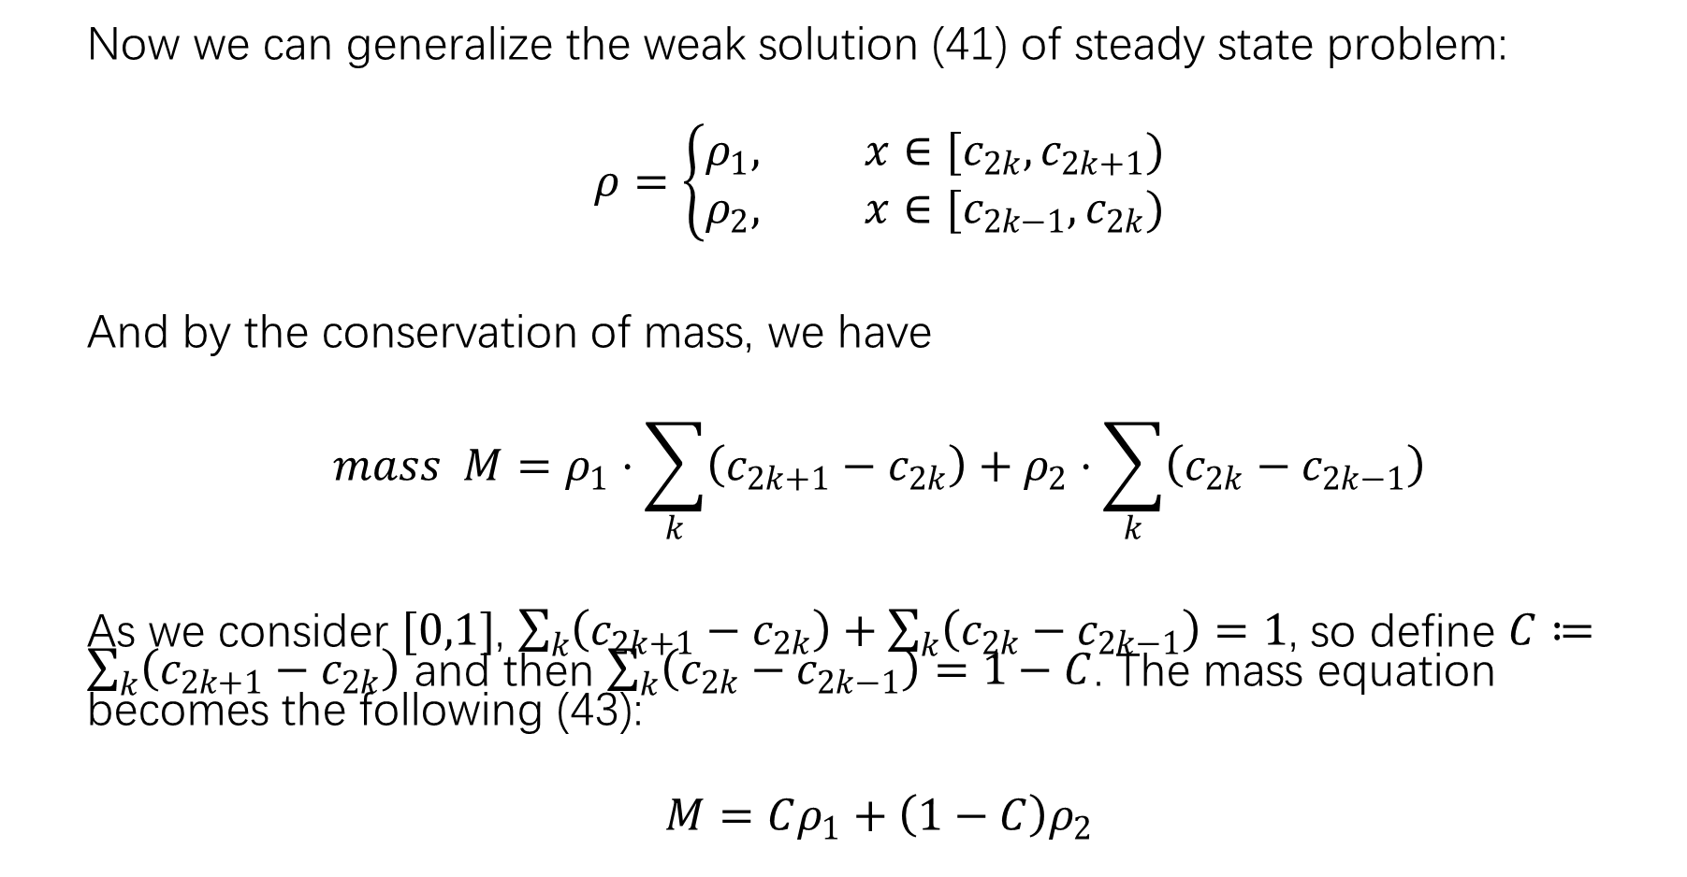
Now we can generalize the weak solution (41) of steady state problem:
$$ρ=\left\{\begin{aligned}ρ_{1}, x∈[c_{2k},c_{2k+1}) \\ ρ_{2}, x∈[c_{2k−1},c_{2k})\end{aligned}\right.$$
And by the conservation of mass, we have
$$mass M=ρ_{1}⋅\sum_{k}{\left(c_{2k+1}−c_{2k}\right)}+ρ_{2}⋅\sum_{k}{\left(c_{2k}−c_{2k−1}\right)}$$
As we consider $[0,1]$, $\sum_{k}{\left(c_{2k+1}−c_{2k}\right)}+\sum_{k}{\left(c_{2k}−c_{2k−1}\right)}=1$, so define $C≔\sum_{k}{\left(c_{2k+1}−c_{2k}\right)}$ and then $\sum_{k}{\left(c_{2k}−c_{2k−1}\right)}=1−C$. The mass equation becomes the following (43):
$$M=Cρ_{1}+\left(1−C\right)ρ_{2}$$

