Slide 1

Outline
Introduction
Definition
Traditional AI VS Agentic AI
Architectures
Single-Agent System VS Multi-Agent System
Industrial Frameworks
AutoGen by Microsoft and ADK by Google
Applications
Magentic-One by Microsoft
SciToolAgent by ZJU
Paper-to-Video Agentic System by PKU and DAMO (Alibaba)
Summary

Slide 2
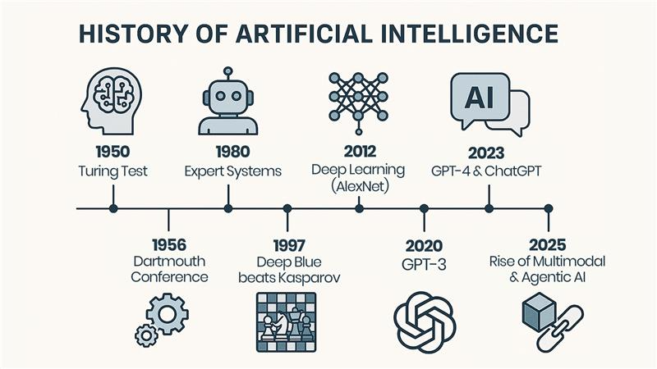
Introduction to Agentic System
The Evolution of AI
Today’s AI systems are not just tools. They're becoming collaborators and copilots.
The Philosophical Roots of AI (Before 1950)
Neeraj Bansal. "The History of Artificial Intelligence: A Timeline of Innovation from Concept to Code." May 21, 2025.
Notes:
1. The Philosophical Roots of AI (Before 1950)
2. The Birth of AI: Logic Meets Machines (1950–1956) Alan Turing (1950): Published “Computing Machinery and Intelligence” introducing the Turing Test. Claude Shannon laid the foundation for digital circuits and information theory.
3. The Golden Years: Symbolic AI and Logic (1956–1974)
4. The Rise of Expert Systems (1980s)
5. Machine Learning Revolution (1990s–2000s)
6. AI Goes Mainstream (2010–2019)
7. The Generative AI Era (2020–2025)

Slide 3
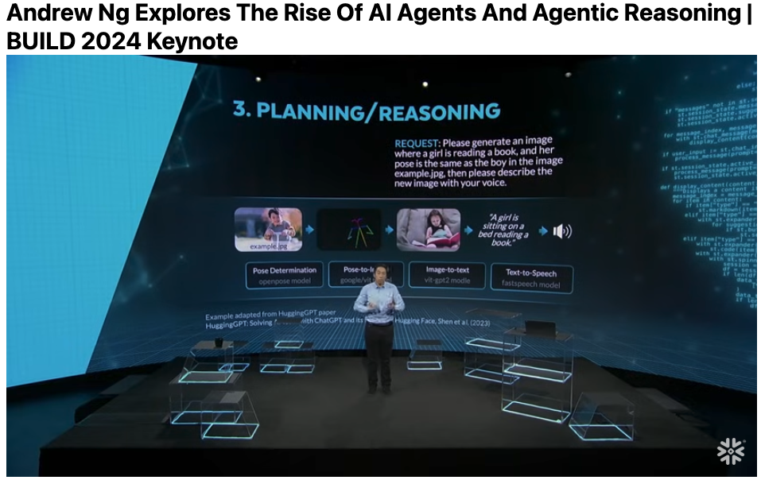

Introduction to Agentic System
How Popular the Agentic System is?
Adrew Ng mentioned the rise of agentic reasoning in BUILD 2024 keynote. Recently, he started to teach Agentic (AI) system on DeepLearning.AI.
It's predicted that by 2028, 33% of enterprise software applications will include agentic AI.
Jonathan D. Gough. “Top 10 Agentic AI Examples and Use Cases” Pellera. July 12, 2025.

Slide 4
Introduction to Agentic System
Comparison of Agentic AI and Traditional AI:
Feature | Agentic AI | Traditional AI
Primary Purpose | Goal-Oriented Autonomy | Task-Specific Automation
Human Intervention | Low | High
Adaptability | High | Limited
Environment Interaction | Dynamic and Context-Aware | Static or Limited Context
Learning Type | Reinforcement and Self-Supervised | Primarily Supervised
Decision-Making | Autonomous, Contextual Reasoning | Data-Driven, Static Rules
Acharya, Deepak Bhaskar, Karthigeyan Kuppan, and B. Divya. "Agentic ai: Autonomous intelligence for complex goals–a comprehensive survey." IEEE Access (2025).

Slide 5
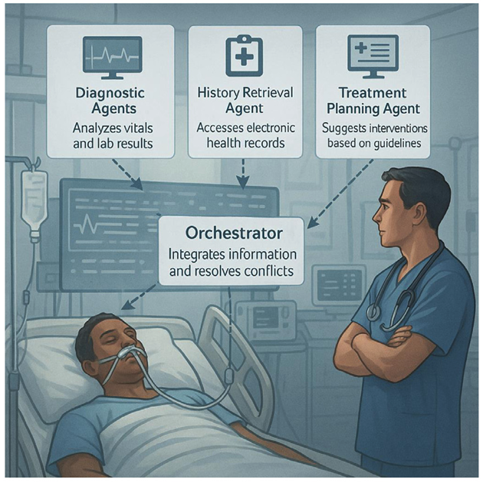
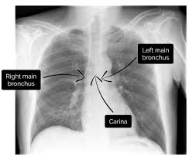

Introduction to Agentic System
Detailed Comparisons in Clinical Applications
Agentic AI System
Traditional AI
Goal-Oriented Autonomy: Clinical decision support in hospital ICUs
Autonomous Reasoning: through synchronized agents diagnostics, treatment planning, and analysis, enhancing safety and workflow efficiency.
Doctors have low intervention
Task-Specific Automation: input the data and output the result
Data-driven Prediction: only predict the results without reasoning
High intervention: doctors need further lab experimental results for diagnosis.
Sapkota, Ranjan, Konstantinos I. Roumeliotis, and Manoj Karkee. "Ai agents vs. agentic ai: A conceptual taxonomy, applications and challenges." arXiv:2505.10468.

Slide 6
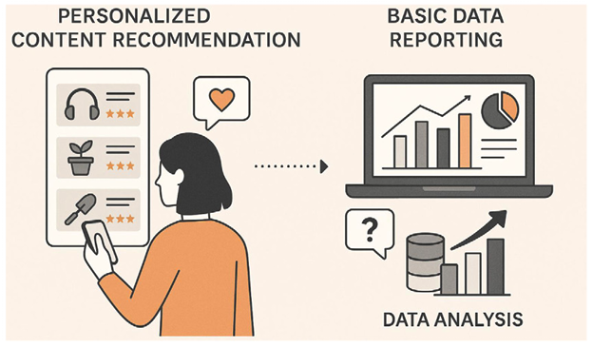

Introduction to Agentic System
Detailed Comparisons in data analytics applications
Agentic AI System
Traditional AI
High Adaptability: by analyzing data from diverse sources like sales, inventory, and shipping, agentic AI system can optimize supply chains, predict demand, and automate logistics.
Dynamic Environment Interaction: once a number or figure has been changed in the pipeline, the agentic system can quickly update for the following steps.
Low Adaptability: one model for one task, such as regression.
Static Environment Interaction: cannot respond to dynamic changes without human intervention (need to use other tools when tasks change).
Sapkota, Ranjan, Konstantinos I. Roumeliotis, and Manoj Karkee. "Ai agents vs. agentic ai: A conceptual taxonomy, applications and challenges." arXiv:2505.10468.

Slide 7
Definition of Agentic System
Overall Definition: An agentic AI system, or simply agentic system, is a collection of agents interacting with humans and the environment with the objective of fulfilling specified goals.
Components:
Agent: an LLM or large multimodal model (LMM) with access to tools — specialized components/functionalities like APIs, external services, computational resources, or domain-specific software — that allow it to perform specific operations in the environment.
Tool: both the capabilities (actions) of the agent and the information (via observations/signals) that can be obtained from the environment.
Miehling, Erik, et al. "Agentic ai needs a systems theory." arXiv preprint arXiv:2503.00237 (2025).

Slide 8
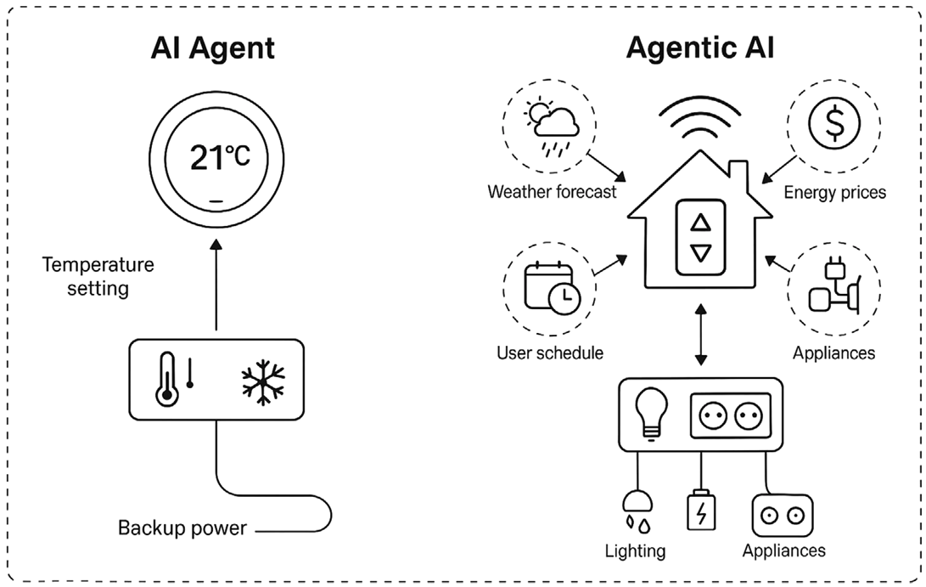
Definition of Agentic System
From AI Agents to Agentic AI Systems:
AI Agent: autonomous technologies, designed to perform tasks, make decisions, and interact with their environment to achieve specific predefined goals, with minimal human intervention.
Agentic AI System: integrate one or more agents to automate complex tasks and streamline processes across various domains.
AI Agent
Agentic AI System
A basic AI Agent managing a single task — such as maintaining a thermostat’s temperature setting based on user input.
An Agentic AI System coordinating multiple agents to manage household automation tasks including temperature regulation, weather forecasting, energy pricing, appliance scheduling, and security monitoring.
Sapkota, Ranjan, Konstantinos I. Roumeliotis, and Manoj Karkee. "Ai agents vs. agentic ai: A conceptual taxonomy, applications and challenges." arXiv:2505.10468.

Slide 9
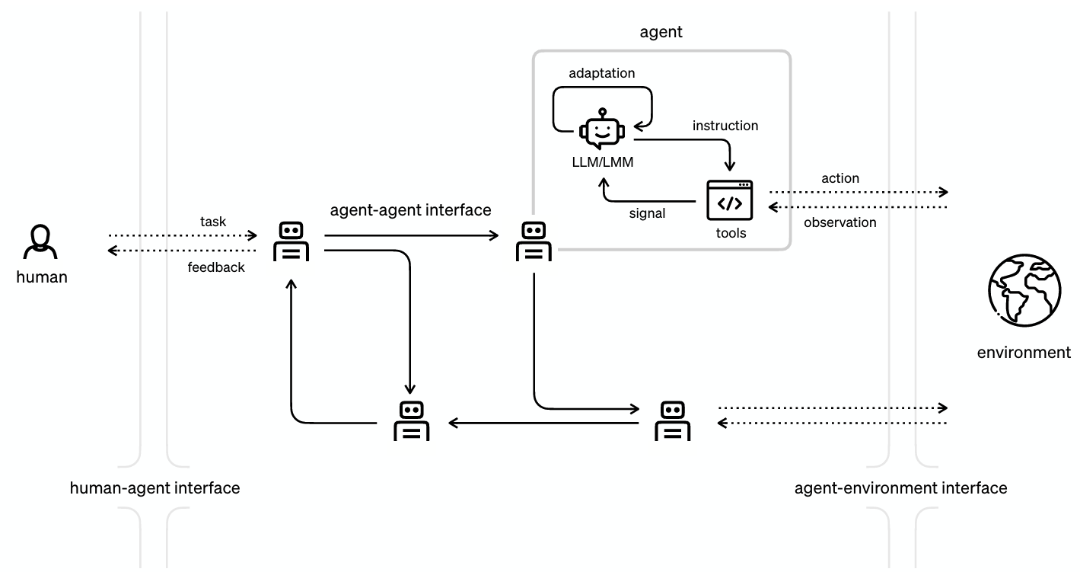
Definition of Agentic System
The Overall Pipeline of An Agentic System
agent: a LLM or LMM (large multimodal model), with tools that facilitate interaction with the external environment via actions (generated via instructions from the LLM/LMM) and observations (generating LLM/LMM-readable signals).
details
human: providing the initial task description and any feedback
Agents additionally interact with other agents, communicating any relevant information about the task or observations from the environment.
Miehling, Erik, et al. "Agentic ai needs a systems theory." arXiv preprint arXiv:2503.00237 (2025).

Slide 10

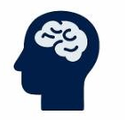
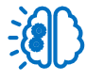
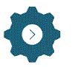
Definition of Agentic System
Key Concepts of Agentic AI System
System 1 thinking: fast and intuitive
System 2 thinking: slow and formal
Perception: Gathering information from surroundings and different sources.
Reasoning: Powered by LLMs, agentic AI system analyzes the gathered data to understand the context, identify relevant information, and formulate potential solutions.
Planning: Using gathered information to develop a plan, which involves setting goals, splitting into smaller steps, and figuring out the best way to achieve them.
Action: Performing tasks, making decisions, or interacting with other systems.
Reflection: After taking actions, the system learns from the results. It evaluates whether its actions were successful and uses this feedback to adjust its plans and actions in the future.
Google Cloud. “What is agentic AI?”. https://cloud.google.com/discover/what-is-agentic-ai

Slide 11
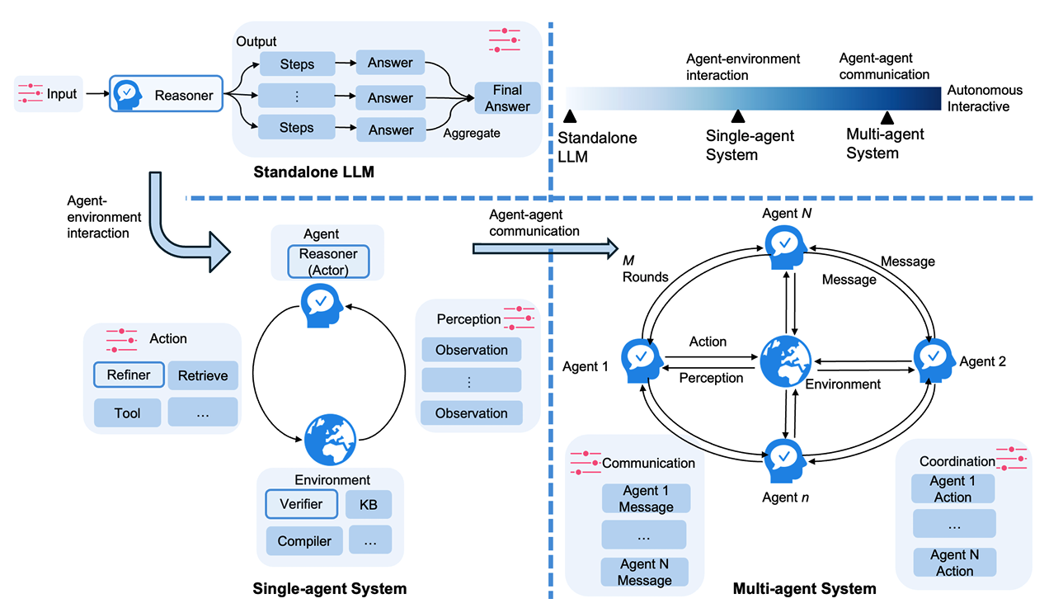
Architecture of Agentic System
Taxonomy of Agentic Systems
Multi-agent systems: goes beyond agent-environment interactions by enabling agent-agent communication. Each agent takes on a distinct role and exchanges messages with others.
Single-agent systems: a single LLM interacts with tools in its environment to refine reasoning, actions, and perceptions.
Ke, Zixuan, et al. "A survey of frontiers in llm reasoning: Inference scaling, learning to reason, and agentic systems." arXiv preprint arXiv:2504.09037 (2025).

Slide 12
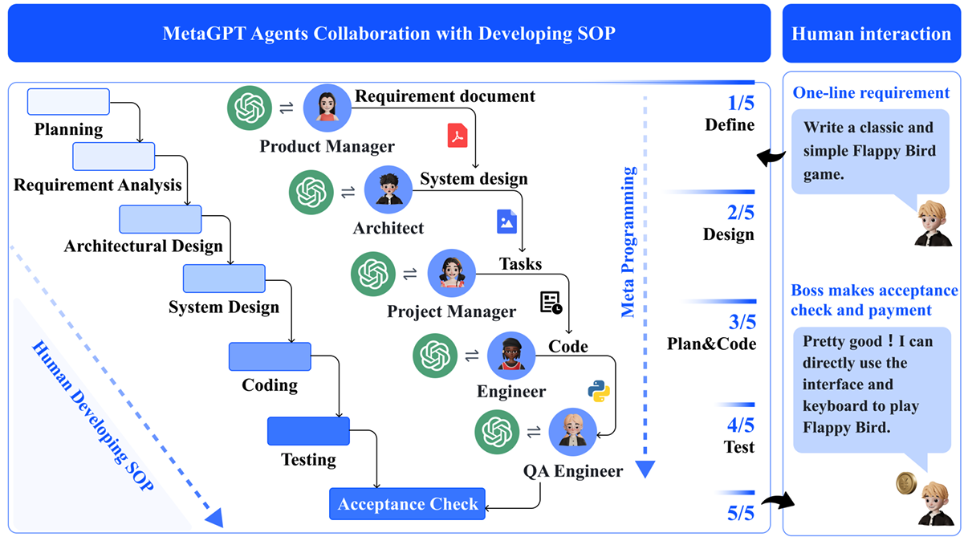
Architecture of Agentic System
Architectural Designs of Multi-Agent System (MAS)
Hierarchical Structure. These systems employ static hierarchical organizations, typically linear or tree-based, where tasks are explicitly decomposed and sequentially assigned to specific agents.
Example: Coding agent
MetaGPT showcases its ability to decompose complex tasks into specific actionable procedures assigned to various roles.
Fang, Jinyuan, et al. "A comprehensive survey of self-evolving ai agents: A new paradigm bridging foundation models and lifelong agentic systems." arXiv. 2025.
Hong, Sirui, et al. "MetaGPT: Meta programming for a multi-agent collaborative framework." ICLR. 2023.

Slide 13
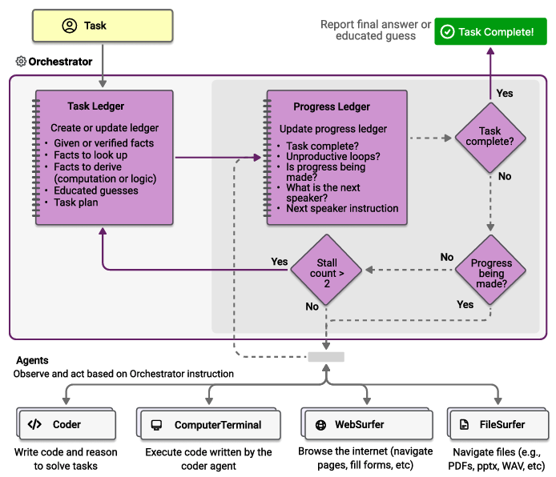
Architecture of Agentic System
Architectural Designs of Multi-Agent System (MAS)
Centralized Structure. This architecture follows a manager-follower paradigm where a central agent or higher-level coordinator handles planning, task decomposition, and delegation, while subordinate agents execute assigned subtasks.
The outer loop manages the task ledger, containing facts, guesses, and plan.
The inner loop manages the progress ledger, containing current progress, task assignment to agents.
Fourney, Adam, et al. "Magentic-one: A generalist multi-agent system for solving complex tasks." arXiv preprint arXiv:2411.04468 (2024).

Slide 14
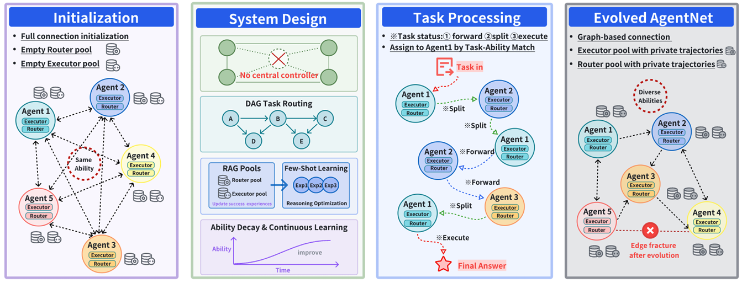
Architecture of Agentic System
The Architectural Design of Multi-Agent System (MAS)
Decentralized Structure. In this architecture, agents collaborate as peers in a distributed network, widely adopted in world simulation applications, which prevents single-point failures—damage to any node does not paralyze the entire system.
Yang, Yingxuan, et al. "Agentnet: Decentralized evolutionary coordination for llm-based multi-agent systems." arXiv preprint arXiv:2504.00587 (2025).
Notes:
Illutration of AgentNet. Initially, agents are fully connected and equipped with executors and routers. The system eliminates the need for a central controller, using a DAG for dynamic task routing and agents leveraging RAG pools and few-shot learning. In the evolved phase, the network adapts with agents developing private trajectories and diversified abilities, ensuring scalability, fault tolerance, and continuous evolution of expertise.

Slide 15
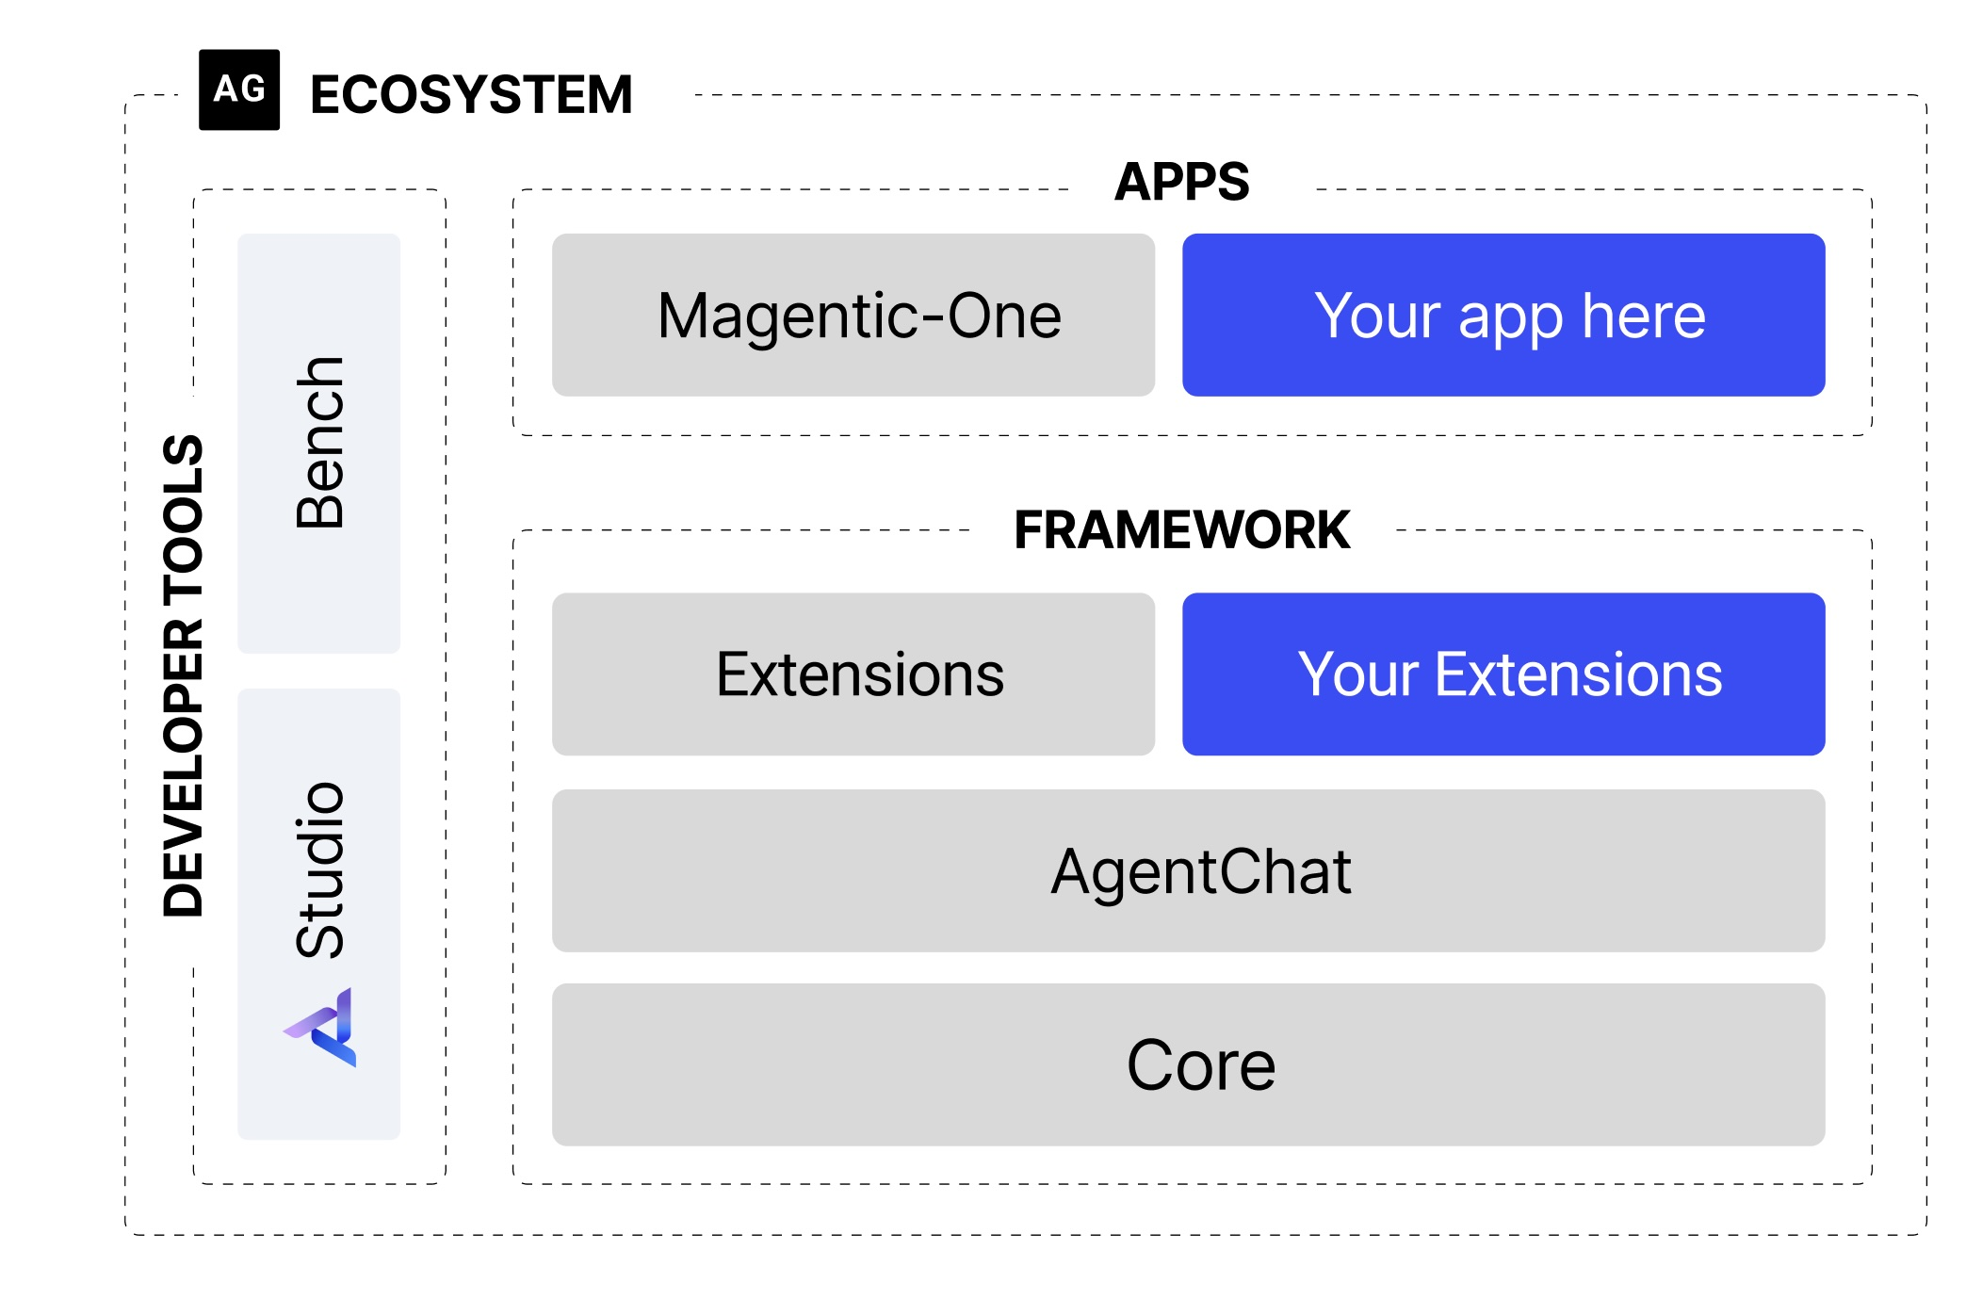
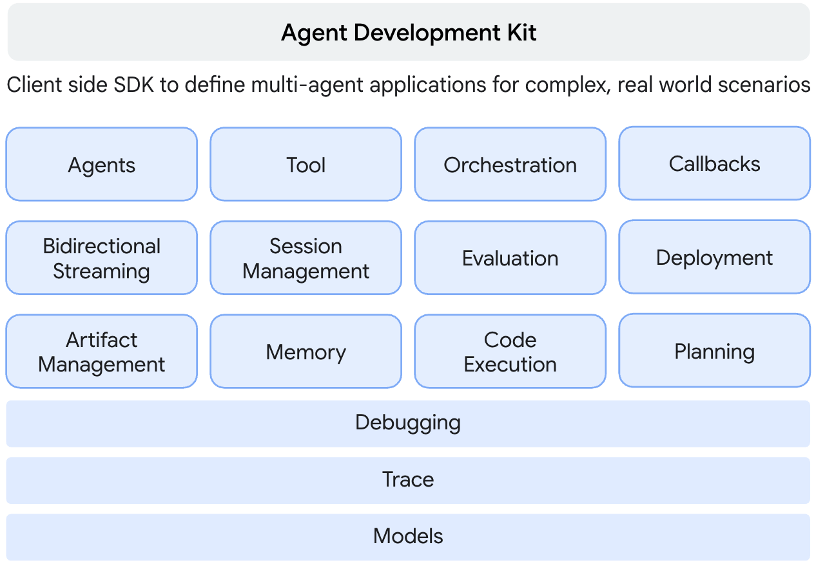
Industry Efforts in Agentic System
Microsoft
Google
AutoGen is a framework for creating multi-agent AI applications that can act autonomously or work alongside humans.
Agent Development Kit (ADK) is a flexible and modular framework for developing and deploying AI agents.

Slide 16
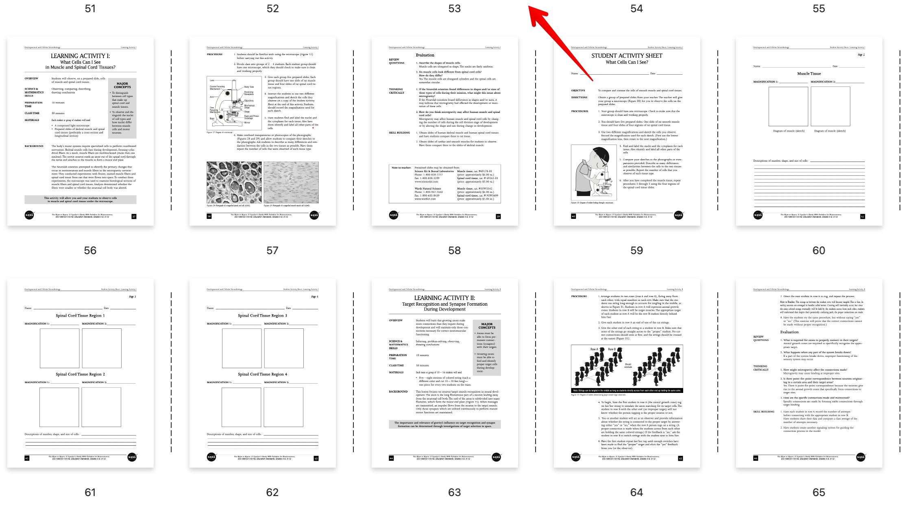
Applications of Agentic System
Magentic-One: A Generalist Multi-Agent System for Solving Complex Tasks
Definition: A task is defined as a complex task if it requires, or significantly benefits from, a process involving planning, acting, observing, and reflecting, potentially multiple times.
claim x: correct
For example, the input task is “fact-check each claim in the file as correct or incorrect” with a PDF file as an attachment.
The desired output consists either of a textual answer (possibly representing a structured object), or a specific state of the environment to reach, e.g.,
{
claim 1: correct,
claim 2: incorrect,
...
}
[Microsoft Research AI Frontiers] Fourney, Adam, et al. "Magentic-one: A generalist multi-agent system for solving complex tasks." arXiv:2411.04468 (2024).

Slide 17
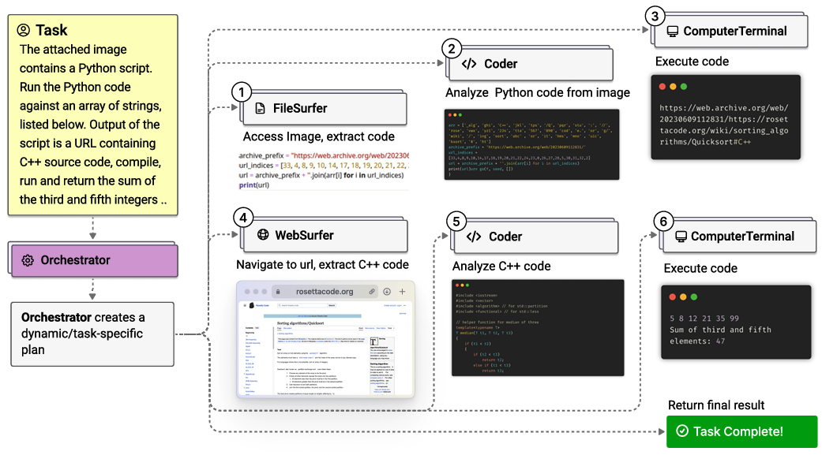
Applications of Agentic System
Magentic-One Architecture Overview
Sample task from
GAIA benchmark
The Orchestrator agent creates a plan, delegates tasks to other agents, and tracks progress towards the goal, dynamically revising the plan as needed.
The FileSurfer agent to read and handle files.
The WebSurfer agent to operate a web browser.
The Coder or Computer Terminal agent to write or execute code.
[Microsoft Research AI Frontiers] Fourney, Adam, et al. "Magentic-one: A generalist multi-agent system for solving complex tasks." arXiv:2411.04468 (2024).

Slide 18
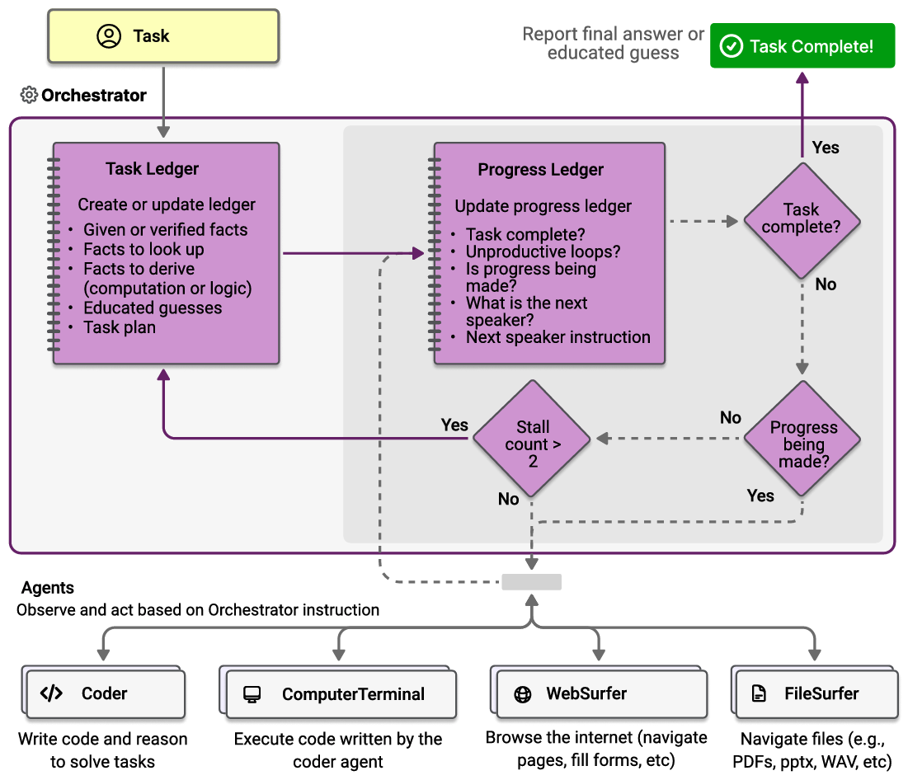
Applications of Agentic System
Magentic-One Agents
Coder
ComputerTerminal
An LLM-based agent specialized through its system prompt for writing code, analyzing information collected from the other agents, or creating new artifacts.
It provides the team with access to a console shell where the Coder’s programs can be executed.
[Microsoft Research AI Frontiers] Fourney, Adam, et al. "Magentic-one: A generalist multi-agent system for solving complex tasks." arXiv:2411.04468 (2024).

Slide 19
Applications of Agentic System
Magentic-One Workflow
WebSurfer
FileSurfer
A highly specialized LLM-based agent that is proficient in commanding and managing the state of a Chromium-based web browser.
It’s similar to the WebSurfer, except that it commands a custom markdown-based file preview application rather than a web browser.
[Microsoft Research AI Frontiers] Fourney, Adam, et al. "Magentic-one: A generalist multi-agent system for solving complex tasks." arXiv:2411.04468 (2024).

Slide 20
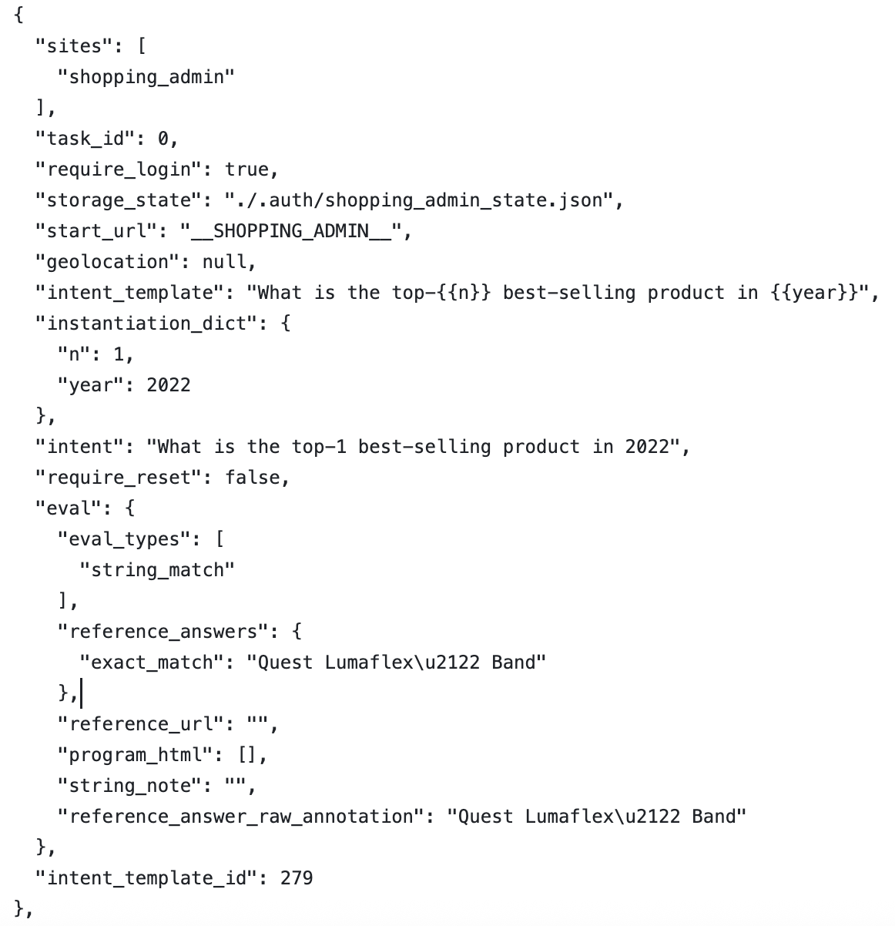
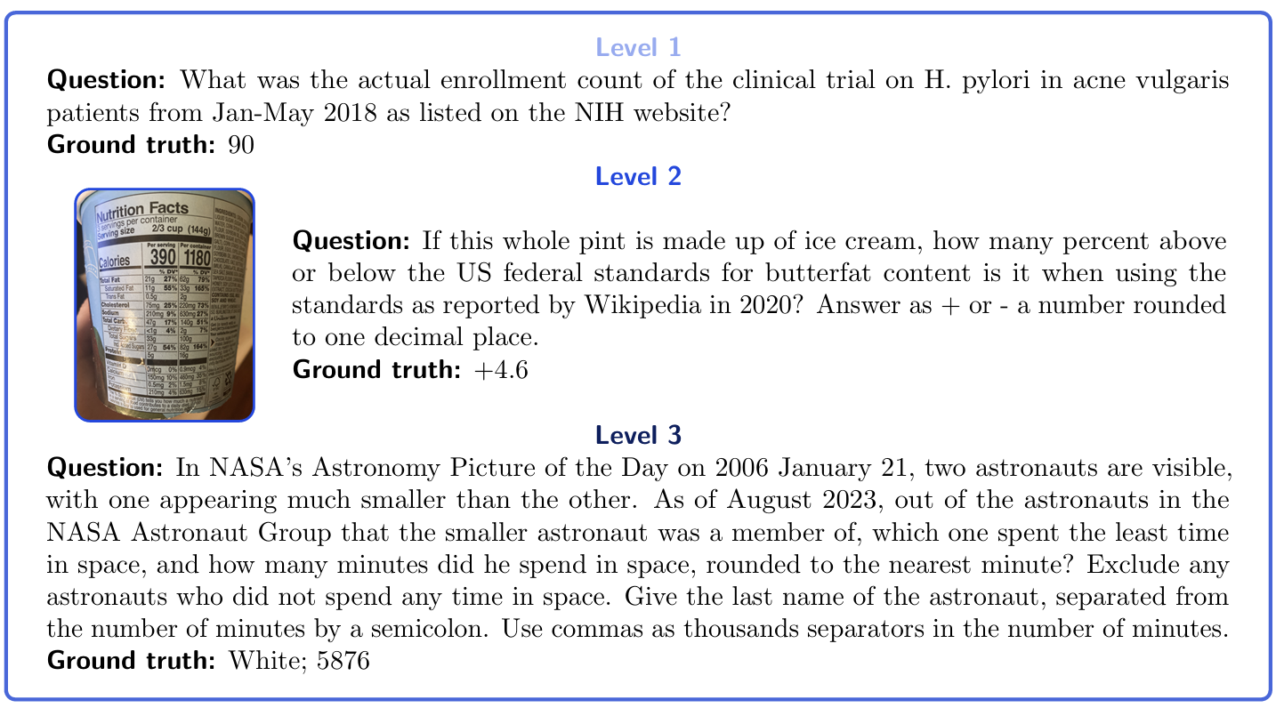
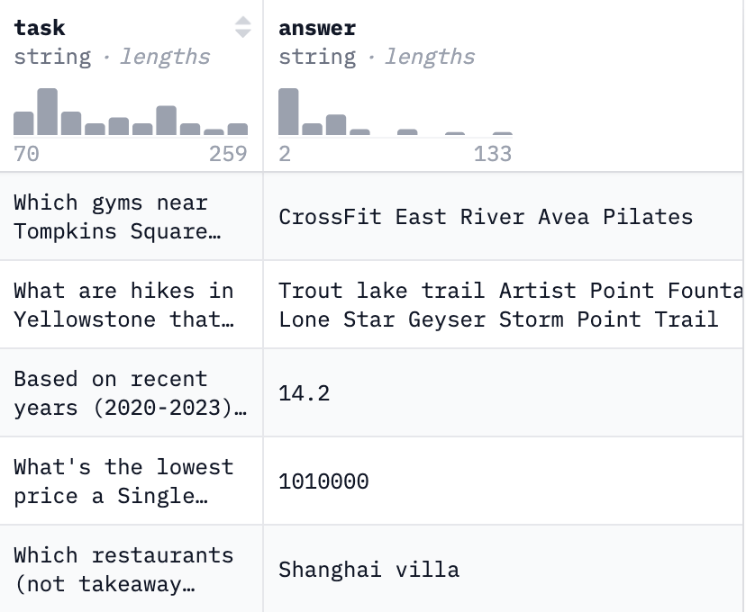
Applications of Agentic System
Magentic-One Evaluation
Benchmarks:
GAIA: a benchmark for general AI assistants with 465 multi-modal question–answer pairs, which are real-world and challenging, requiring multiple steps and multiple tools to solve.
AssistantBench: a set of 214 question–answer pairs that are realistic, time-consuming (requiring a human several minutes to perform), and require navigating real-world websites and multi-step reasoning.
WebArena: 812 tasks across five major website categories (e.g., shopping, forums, maps, etc.), and a sixth category that requires multi-step planning and interacting with multiple websites.
GAIA examples
AssistantBench examples
WebArena example
[Microsoft Research AI Frontiers] Fourney, Adam, et al. "Magentic-one: A generalist multi-agent system for solving complex tasks." arXiv:2411.04468 (2024).

Slide 21
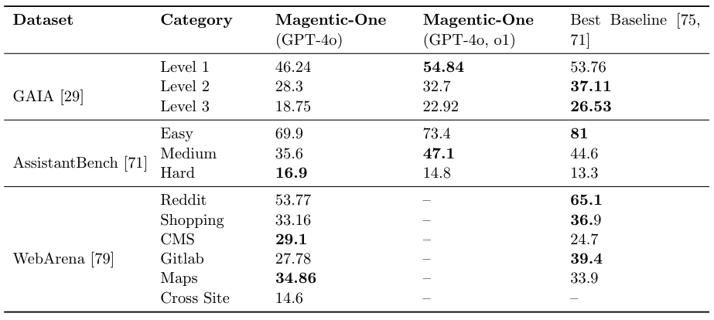
Applications of Agentic System
Magentic-One Evaluation
Performance:
Best baseline for each dataset is different.
Magentic-One complete better on hard tasks on AssistantBench.
[Microsoft Research AI Frontiers] Fourney, Adam, et al. "Magentic-one: A generalist multi-agent system for solving complex tasks." arXiv:2411.04468 (2024).

Slide 22
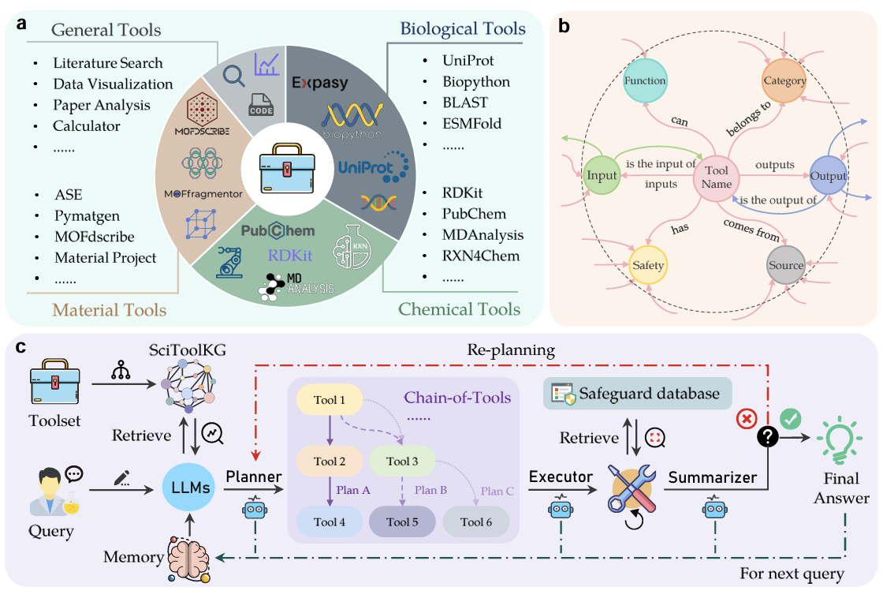
Applications of Agentic System
SciToolAgent: an LLM-based agent in scientific research
1)
Why SciToolAgent?
Issues of existing methods integrating LLMs with domain-specific scientific tools:
A restricted set of tools without semantic tool connections (SciToolKG constructed).
Overlook crucial safety and ethical considerations in scientific research (the security check in the Executor).
1)
2)
Ding, Keyan, et al. "SciToolAgent: a knowledge-graph-driven scientific agent for multitool integration." Nature Computational Science (2025): 1-11.

Slide 23
Applications of Agentic System
SciToolAgent Overview
knowledge graph of tools
SciToolAgent Implementation
LLM-based Planner
Retrieve relevant k tools
Explore neighbor tools
Generate Chain-of-Tools
LLM-based Executor
Prepare necessary data
Invoke tools with prepared inputs
Error handling and retries
Safety check
LLM-based Summarizer
Collect and verify the outputs
Refine the interation
1)
2)
3)
Ding, Keyan, et al. "SciToolAgent: a knowledge-graph-driven scientific agent for multitool integration." Nature Computational Science (2025): 1-11.

Slide 24
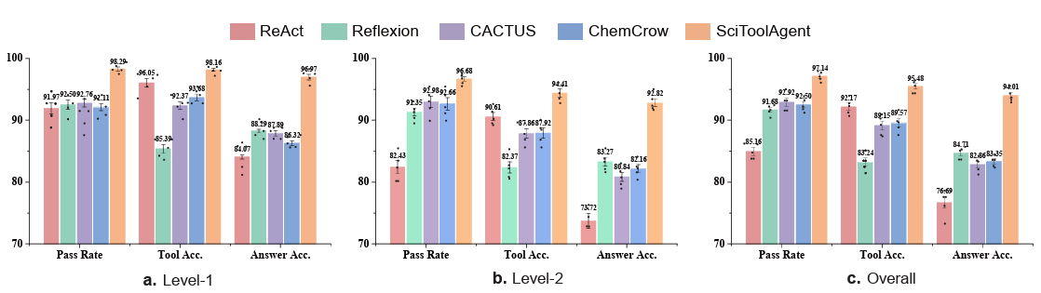
Applications of Agentic System
SciToolAgent Performance
Level-1: 152 simple questions
Level-2: 379 complex questions
Evaluation Metrics:
Pass Rate: the proportion of successfully completed queries
Tool Planning Accuracy: the alignment between the tool selection and sequencing generated by the agent and a reference plan verified by human experts
Final Answer Accuracy: the final solution generated by agents compared with the standard answer
Ding, Keyan, et al. "SciToolAgent: a knowledge-graph-driven scientific agent for multitool integration." Nature Computational Science (2025): 1-11.

Slide 25
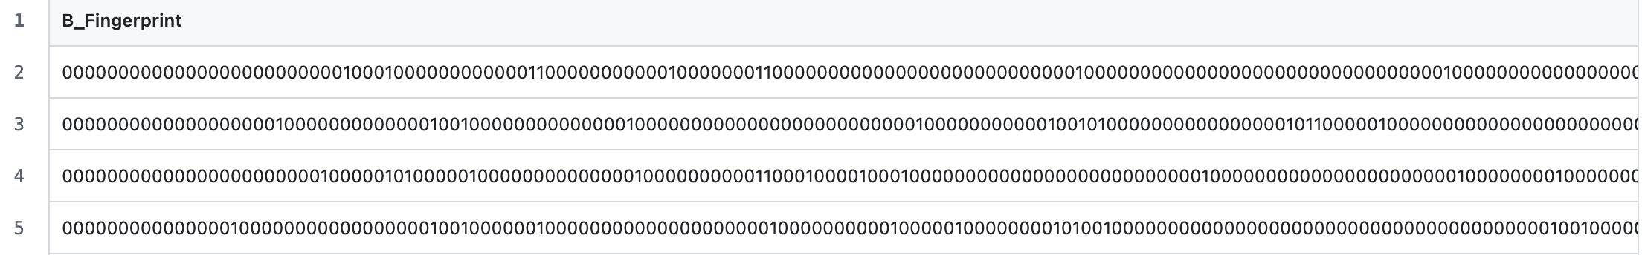
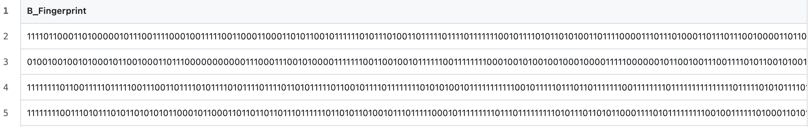
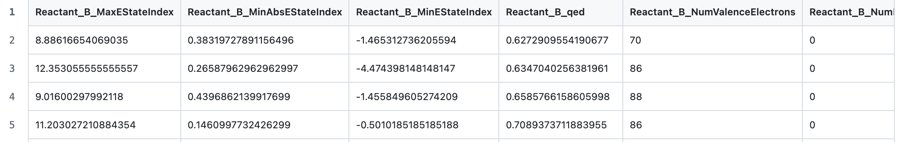
Applications of Agentic System
SciToolAgent: Raw Data Samples
molecule Morgan fingerprints
molecule RDK fingerprints
molecule electrical descriptions
Ding, Keyan, et al. "SciToolAgent: a knowledge-graph-driven scientific agent for multitool integration." Nature Computational Science (2025): 1-11.

Slide 26
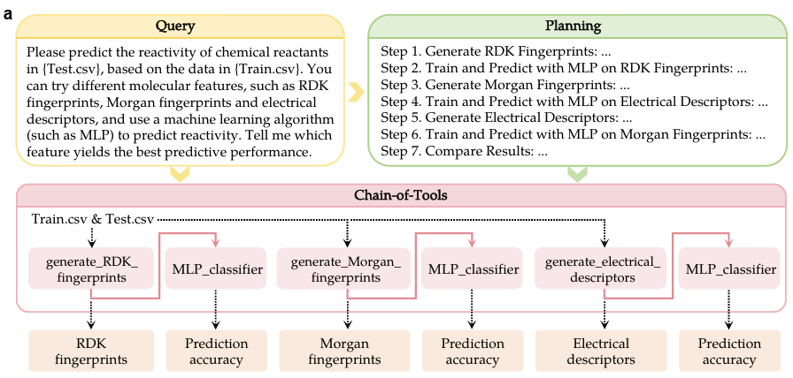
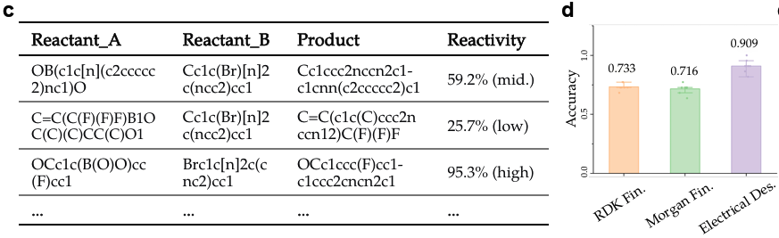
Applications of Agentic System
SciToolAgent: Case study
(c) The dataset used for training and testing. (d) The prediction accuracy with different molecular features.
(a) Overview of the input query, tool planning, chain-of-tools, and corresponding outcomes.
Open Question: How to evaluate the planning quality?
Ding, Keyan, et al. "SciToolAgent: a knowledge-graph-driven scientific agent for multitool integration." Nature Computational Science (2025): 1-11.

Slide 27
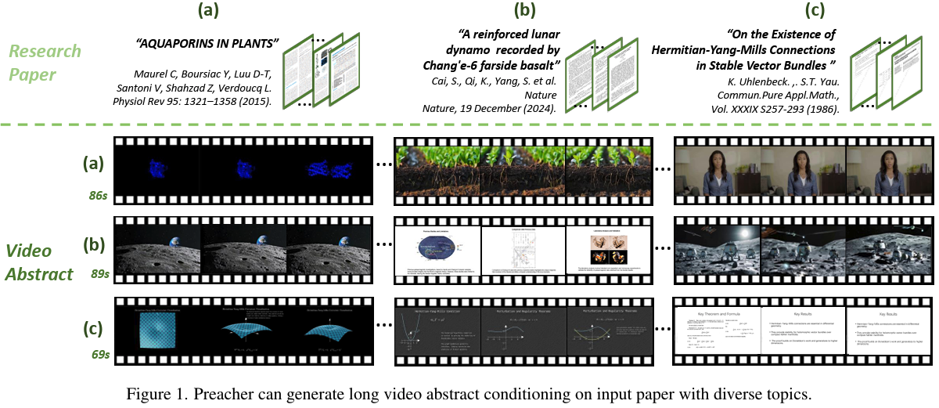
Applications of Agentic System
Preacher: Paper-to-Video Agentic System
Motivations:
Studies have shown that papers accompanied by video abstracts receive 15% more citations.
Producing video abstracts remains resource-intensive, requiring both domain-specific expertise and professional video production skills, making it a costly process.
Existing methods are hard to transfer research papers containing embedded multimodal elements and long contexts to videos
Liu, Jingwei, et al. "Preacher: Paper-to-video agentic system." ICCV. 2025.

Slide 28
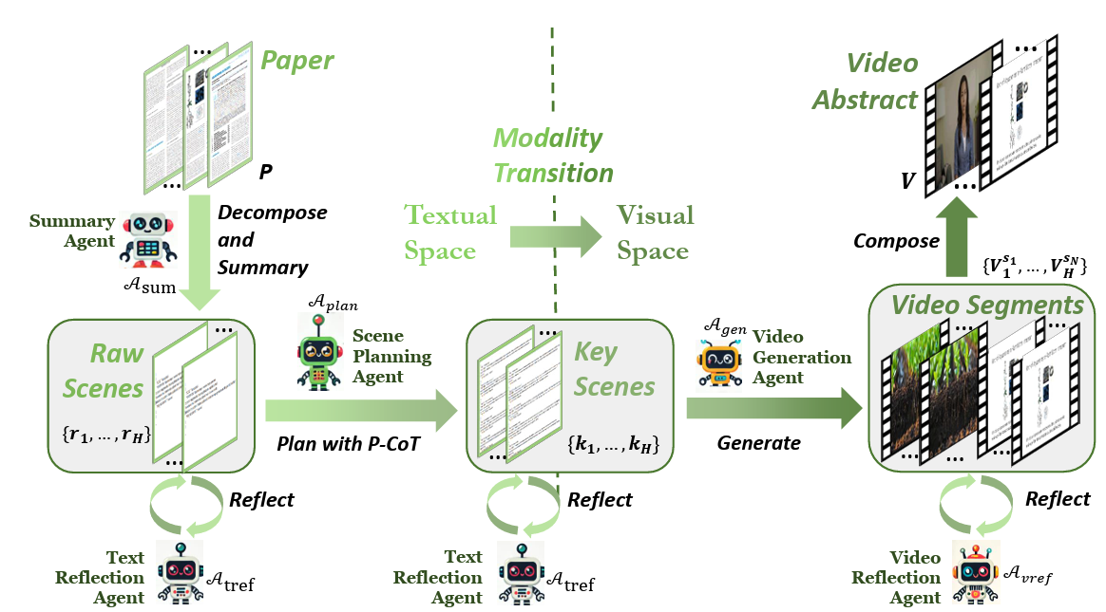
Applications of Agentic System
Preacher Overview
Top-Down Structure
Paper undergoes 1) decomposition and summarization into multiple raw scenes, serving as anchors for content segmentation.
2) Planning process continuously references the original paper, ensuring precise semantic alignment. Planning results termed key scenes.
1)
2)
Liu, Jingwei, et al. "Preacher: Paper-to-video agentic system." ICCV. 2025.

Slide 29
Applications of Agentic System
Preacher Overview
Bottom-up Structure
The video generation agent 3) reconstruct the key scenes, generating both video and corresponding audio.
Each video segment is synthesized from these elements, and all segments are 4) integrated into the final video abstract.
4)
3)
Liu, Jingwei, et al. "Preacher: Paper-to-video agentic system." ICCV. 2025.

Slide 30
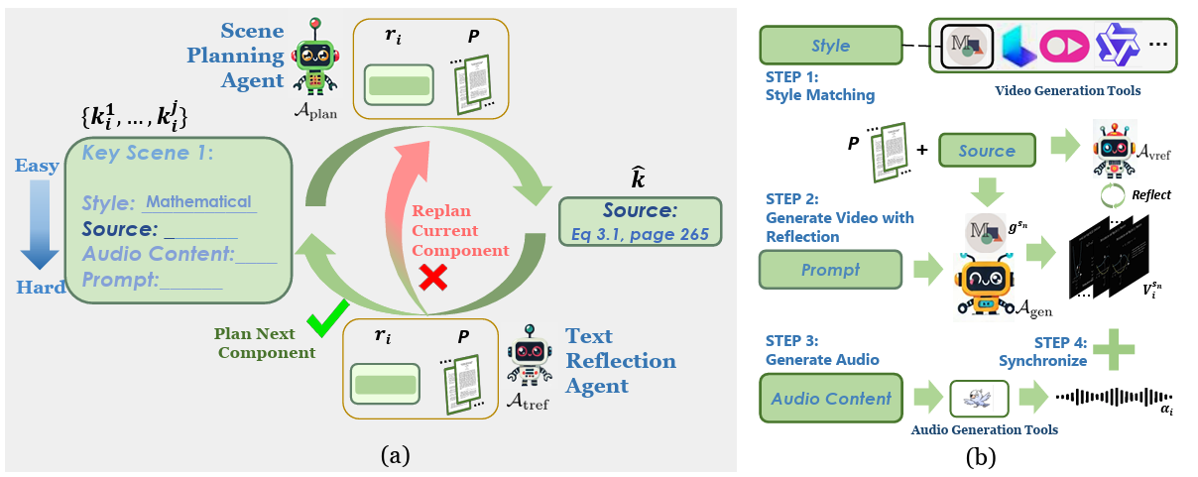
Applications of Agentic System
Progressive Chain-of-Thought Planning
The key scenes consist of multiple components requiring systematic planning.
Scene Planning Agent devises a structured plan for each component
Text Reflection Agent evaluates the planned scenes.
Based on the reflection outcome, the scene planning agent either advances to the next component using the existing plan, or revises the current component, iterating this process until all components are effectively planned.
Liu, Jingwei, et al. "Preacher: Paper-to-video agentic system." ICCV. 2025.

Slide 31
Applications of Agentic System
Generating Professional Video Abstracts
Multiple video generation tools are integrated in Video Generation Agent.
Six video styles are supported in Preacher: “talking heads,” “general,” “static concept,” “molecular visualization,” “slides,” and “mathematics”.
Evaluation criteria for generated video segments are Accuracy, Professionalism, and Alignment between the video content and the paper.
The corresponding audio will be also generated by the agent and finish the synchronization.
Liu, Jingwei, et al. "Preacher: Paper-to-video agentic system." ICCV. 2025.

Slide 32
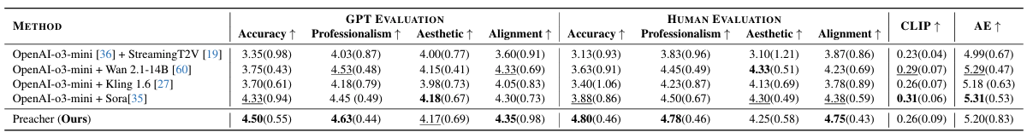
Applications of Agentic System
Preacher Evaluations
Dataset: 40 research papers spanning five distinct fields: Mathematics, Molecular Biology, Geology, Machine Learning, and Climate Science.
Evaluation Metrics:
Accuracy: Correctness of the video content, free from errors.
Professionalism: Use of domain-specific knowledge and expertise.
Aesthetic Quality: Visual appeal, design, and overall presentation.
Alignment with the Paper: Semantic Alignment with the paper.
CLIP: text-image similarity score.
Aesthetic Score (AE): evaluate the consistency with the prompt and aesthetic quality.
Liu, Jingwei, et al. "Preacher: Paper-to-video agentic system." ICCV. 2025.

Slide 33
Summary of Agentic System
Takeaways
Most agentic systems are based on LLMs / LMMs (large multimodal models) with general and domain-specific tools.
Agentic systems have been applied in general complex task planning, scientific research, et al.
The workflow of agentic systems mainly contain planning, executing, reflecting and summarizing steps.
The benchmarks for evaluating agentic systems are still limited.
Next section: How to gaurantee the responsibility of agentic systems?

