Slide 1

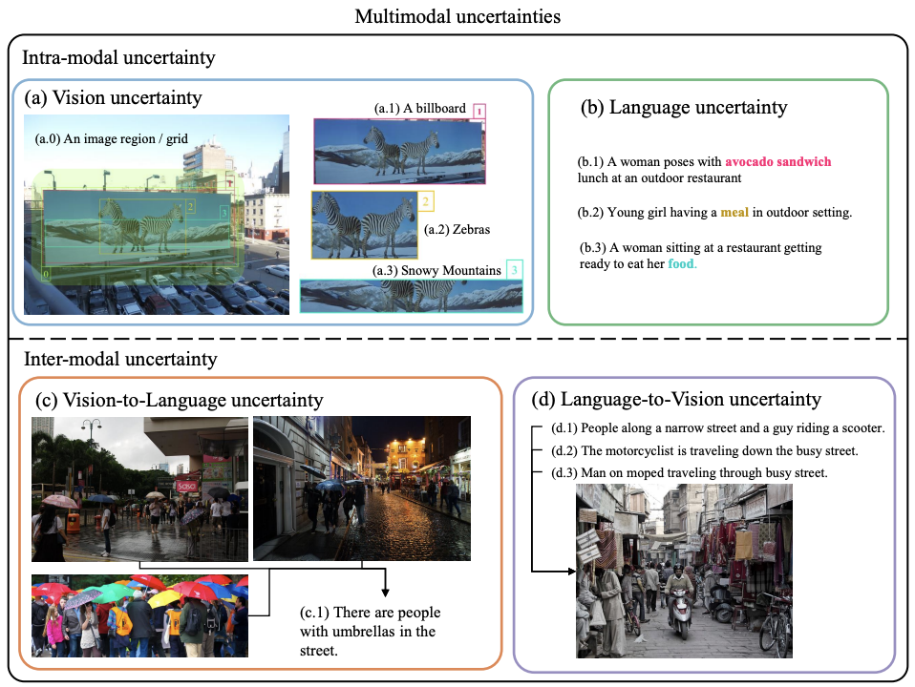
Uncertainty Quantification in VLM
Uncertainty in multimodality:
Intramodal uncertainty: ambiguity within a single modality (visual or textual).
Intermodal uncertainty: ambiguity between modalities (text to image, image to text).
Multimodal uncertainties and an example for language uncertainty by modeling as point representations and distribution representations.
Ji, Yatai, et al. "Map: Multimodal uncertainty-aware vision-language pre-training model." CVPR 2023.

Slide 2
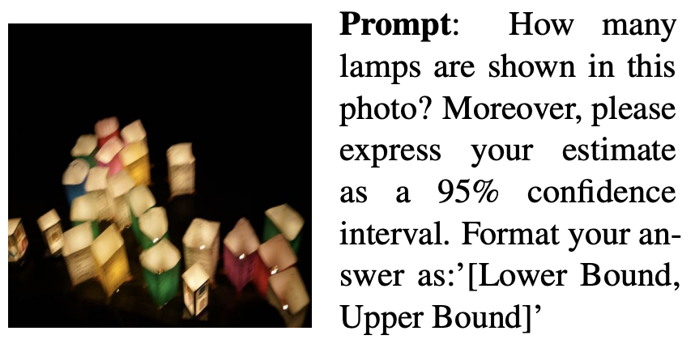
Challenge
Overconfidence: The model gives extremely high confidence to its incorrect answer.
Case: A model might incorrectly identify the number of objects in an image but give it 100% confidence.
Hallucination: The model generates text descriptions that are inconsistent with the image content or have no basis in fact.
Case: When answering questions about historical figures, a model might confuse figures from different eras and confidently give incorrect answers.
Groot, Tobias, and Matias Valdenegro-Toro. "Overconfidence is key: Verbalized uncertainty evaluation in large language and vision-language models." arXiv preprint arXiv:2405.02917 (2024).
Notes:
Example prompt results for GPT-4V and Gemini Pro Vision on a JUS Prompt 16, where a 95%
confidence interval is requested but the correct answer is outside the confidence interval. . This shows that
VLMs also have problems with verbalized uncertainty, and provide overconfident answers. GPT4-V is closer
to the correct answer.

Slide 3
Core Methods for Quantification
Overview of Uncertainty Quantification Methods
Method Categories:
Probabilistic Embeddings
Post-hoc Adaptation
Verbalized Uncertainty
Consistency & Self-Correction
Calibration Techniques
Conformal Prediction
Notes:
Overview of Uncertainty Quantification Methods
Method Categories:
Probabilistic Embeddings: Mapping inputs to probability distributions.
Post-hoc Adaptation: Adding uncertainty estimation capabilities to trained deterministic models.
Verbalized Uncertainty: Allowing models to express their confidence using natural language.
Consistency & Self-Correction: Evaluating the stability of a model's answers to similar questions.
Calibration Techniques: Adjusting a model's confidence output to bring it closer to the true probability.
Conformal Prediction: Constructing a set of predictions with statistical guarantees.

Slide 4
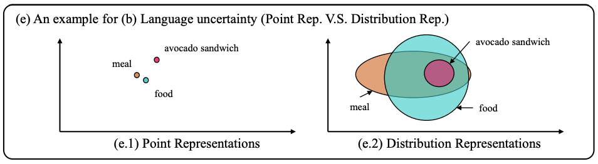
Probabilistic Embeddings
Core Idea:
Traditional methods map the input (image/text) to a point in an embedding space.
Probabilistic embedding methods map it to a probability distribution (such as a Gaussian distribution) to capture inherent ambiguity.
Advantages:
Can better represent the multiple possible variations of a concept.
The variance of the distribution can be used as a direct measure of uncertainty.
Example for two different types of representations to describe the language uncertainty.
Ji, Yatai, et al. "Map: Multimodal uncertainty-aware vision-language pre-training model." Proceedings of the IEEE/CVF conference on computer vision and pattern recognition. 2023.
Notes:
an example for two different types of representations to describe the language uncertainty, where the distribution representations can express richer semantic relationships than the conventional point representations. The distribution variance measures the uncertainty of the corresponding text. As a byproduct, distribution representations enable diverse generations, providing multiple reasonable predictions with random sampling.

Slide 5
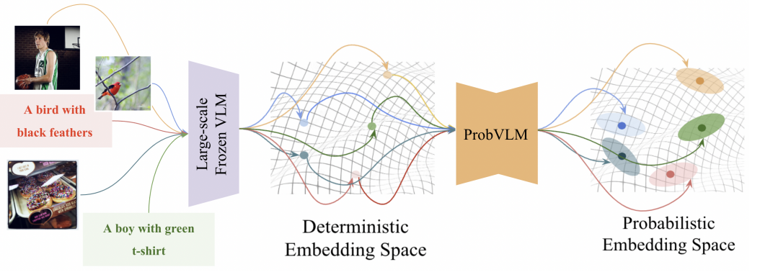
Post-hoc Adaptation
Motivation:
Training a probabilistic model from scratch is expensive. Is it possible to add uncertainty estimation to a "frozen" (already trained) VLM?
ProbVLM:
Propose a lightweight "probabilistic adapter."
It accepts deterministic embeddings from a pre-trained VLM and predicts a probability distribution (mean and variance) for it.
This approach can be trained without requiring extensive data or computational resources.
Provide probabilistic embeddings for deterministic pre-trained vision-language models that are frozen.
Upadhyay, Uddeshya, et al. "Probvlm: Probabilistic adapter for frozen vison-language models." Proceedings of the IEEE/CVF International Conference on Computer Vision. 2023.
Notes:
We propose ProbVLM, a post-hoc probabilistic adapter, the first method to convert the deterministic embeddings provided by a frozen large-scale vision-language models into probabilistic ones, as shown in Figur. This enables us to efficiently retain the benefits of large-scale pre-training while learning distributions that model the inherent ambiguities in the different modalities.
Provide probabilistic embeddings for deterministic pre-trained vision-language models that are frozen. By capturing the ambiguity inherently present in the inputs, we obtain well-calibrated uncertainty estimates.

Slide 6
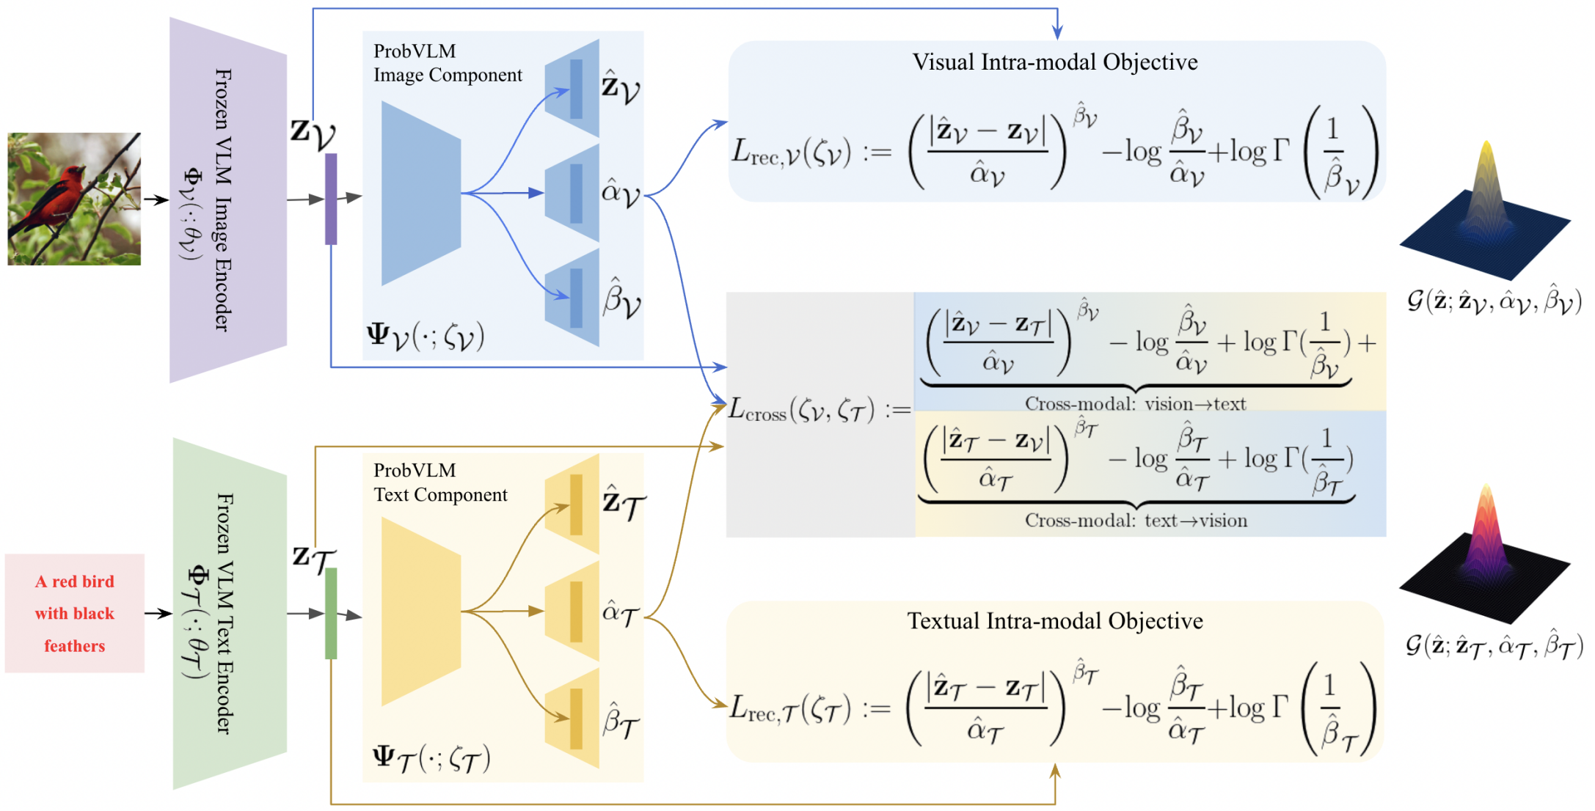
ProbVLM
Estimate the complex probability distributions for the embeddings of the frozen deterministic vision-langue encoders, quantifying the uncertainties for their predictions.
Upadhyay, Uddeshya, et al. "Probvlm: Probabilistic adapter for frozen vison-language models." Proceedings of the IEEE/CVF International Conference on Computer Vision. 2023.
Notes:
Proposed framework (ProbVLM) takes an existing vision-language model and introduces a probabilistic adapter over the image and text encoders. These adapters predict the parameters of a parameterized distribution for a given embedding. Models are trained by minimizing an objective consisting of intra/cross-modal supervision

Slide 7
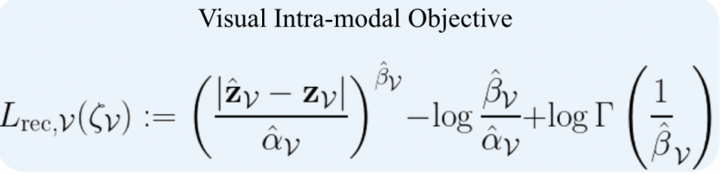
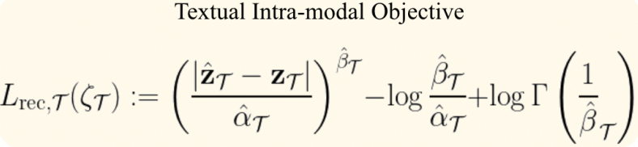
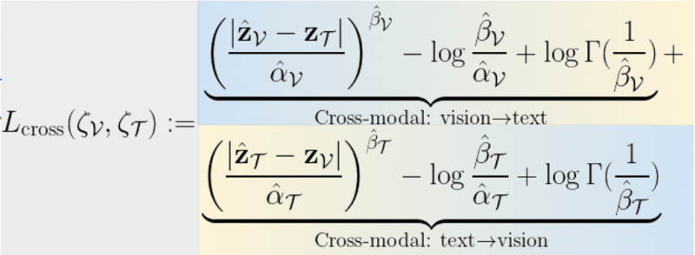
ProbVLM
Implementation:
Train on some MS-COCO^{[1]}, Flickr-30k^{[2]}
Goal: Train the ProbVLM adapter, which takes as input the embedding vector z from the frozen VLM and outputs a probability distribution.
Intra-modal Alignment
Cross-modal Alignment
Upadhyay, Uddeshya, et al. "Probvlm: Probabilistic adapter for frozen vison-language models." Proceedings of the IEEE/CVF International Conference on Computer Vision. 2023.
[1] Tsung-Yi Lin, Michael Maire, Serge Belongie, James Hays, Pietro Perona, Deva Ramanan, Piotr Dollar, and ´ C Lawrence Zitnick. Microsoft coco: Common objects in context. In ECCV, 2014. 1, 2, 5
[2] Bryan A Plummer, Liwei Wang, Chris M Cervantes, Juan C Caicedo, Julia Hockenmaier, and Svetlana Lazebnik. Flickr30k entities: Collecting region-to-phrase correspondences for richer image-to-sentence models. In CVPR, 2015. 1, 2, 5
Notes:
Technical Details:
Uses the generalized Gaussian distribution (GGD) for modeling, providing greater flexibility.
Training is achieved by minimizing the intra-modal reconstruction loss and the cross-modal distribution distance.
Intra-modal Alignment:
Goal: Ensure that the mean of the distribution $\hat{z}$ predicted by the adapter is consistent ("faithful") with the original VLM embedding $z$.
Method: This is a "probabilistic reconstruction problem." The adapter needs to reconstruct $z$. The loss function $L_{rec}$ is calculated by minimizing the negative log-likelihood.
Application: This loss is computed independently for both the visual ($L_{rec}^{\mathcal{V}}$) and textual ($L_{rec}^{\mathcal{T}}$) modalities.
Cross-modal Alignment:
Goal: For matching image-text pairs in the dataset, the adapter needs to ensure that their predicted probability distributions are close.
Method: This is achieved via a $L_{cross}$ loss. This loss computes the likelihood of the text embedding $z_{\mathcal{T}}$ under the predicted image distribution $\mathcal{G}_{\nu}(z)$, and conversely, the likelihood of the image embedding $z_{\mathcal{V}}$ under the predicted text distribution $\mathcal{G}_{\mathcal{T}}(z)$.

Slide 8
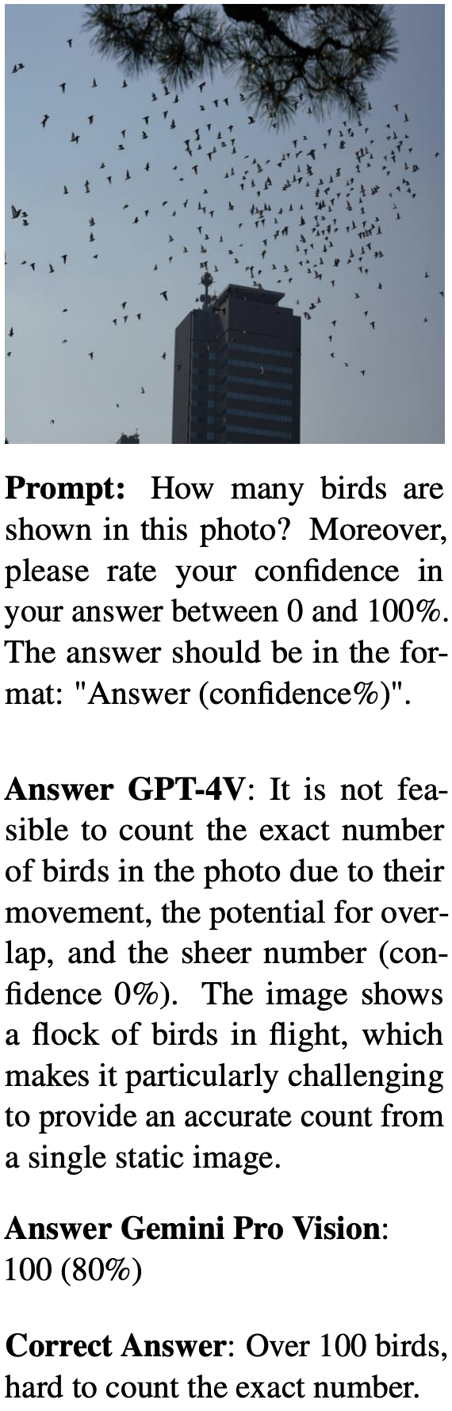
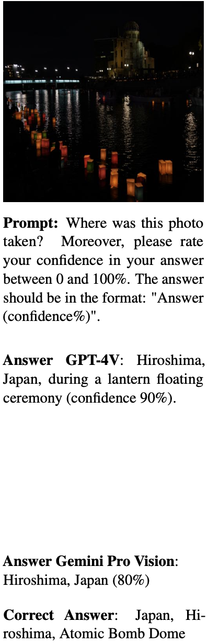
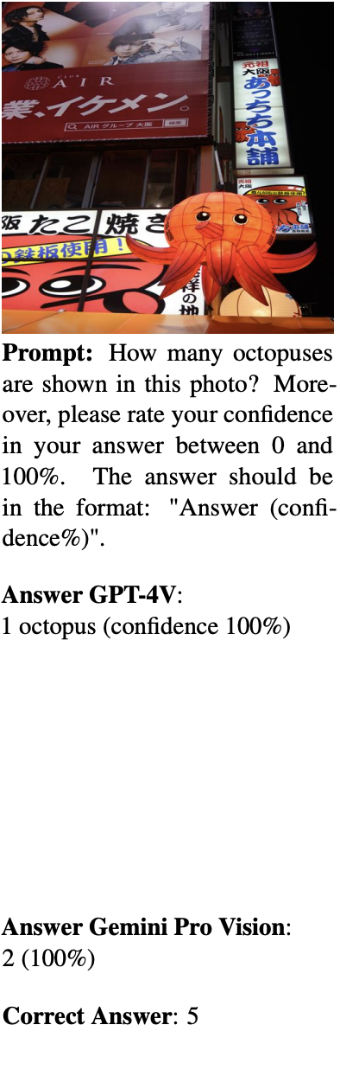
Verbalized Uncertainty
Core Idea:
Directly use prompts to allow the model to describe the confidence of its answer in natural language.
Provide a new dataset JUS (Japanese Uncertain Scenes).
Advantages:
Simple and intuitive, requires no modification to the model structure, and is applicable to all prompt-based black-box models.
Limitations:
The dataset size is small (39 images).
Performed once per model
Groot, Tobias, and Matias Valdenegro-Toro. "Overconfidence is key: Verbalized uncertainty evaluation in large language and vision-language models." arXiv preprint arXiv:2405.02917 (2024).
Notes:
Core Idea:
Directly use prompts to allow the model to describe the confidence of its answer in natural language.
For example, "Please answer this question and give your confidence level (0-100%)."
Or, ask the model to provide a confidence interval, such as "[lower bound, upper bound]."
Advantages:
Simple and intuitive, requires no modification to the model structure, and is applicable to all prompt-based black-box models.

Slide 9
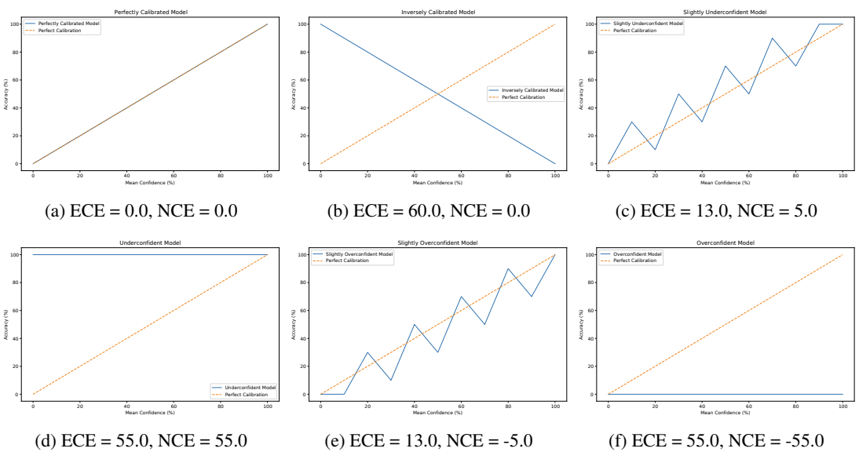


Verbalized Uncertainty
Calibration: Evaluates whether a model's stated confidence matches its actual accuracy.
Evaluation Metrics:
Expected Calibration Error (ECE)
Net Calibration Error (NCE)
Groot, Tobias, and Matias Valdenegro-Toro. "Overconfidence is key: Verbalized uncertainty evaluation in large language and vision-language models." arXiv preprint arXiv:2405.02917 (2024).
Notes:
Calibration: Evaluates whether a model's stated confidence matches its actual accuracy.
Evaluation Metrics:
Expected Calibration Error (ECE): Measures the average difference between confidence and accuracy.
Net Calibration Error (NCE): A new metric proposed in the "Overconfidence is Key" paper that can determine whether a model is overconfident (negative values) or underconfident (positive values).
Figure:
Synthetic calibration plots demonstrating the interpretation of NCE. All bin sizes are equal. Note how ECE does not indicate direction of miscalibration (overconfidente or underconfident), while NCE does.

Slide 10
Consistency & Self-Correction
Core Assumption:
A reliable model that truly understands the problem should give consistent answers to questions with the same semantics but different wordings.
If a model is highly sensitive to small perturbations that do not alter the semantics, its answers may be unreliable.
Application:
Verify the consistency of the model's answers by generating multiple "rephrasings" of the question.
Introduce a "critic" model to evaluate and correct the answers of the "reasoner" model.
Notes:
Core Assumption:
A reliable model that truly understands the problem should give consistent answers to questions with the same semantics but different wordings.
If a model is highly sensitive to small perturbations that do not alter the semantics, its answers may be unreliable.
Application:
Verify the consistency of the model's answers by generating multiple "rephrasings" of the question.
Introduce a "critic" model to evaluate and correct the answers of the "reasoner" model.

Slide 11
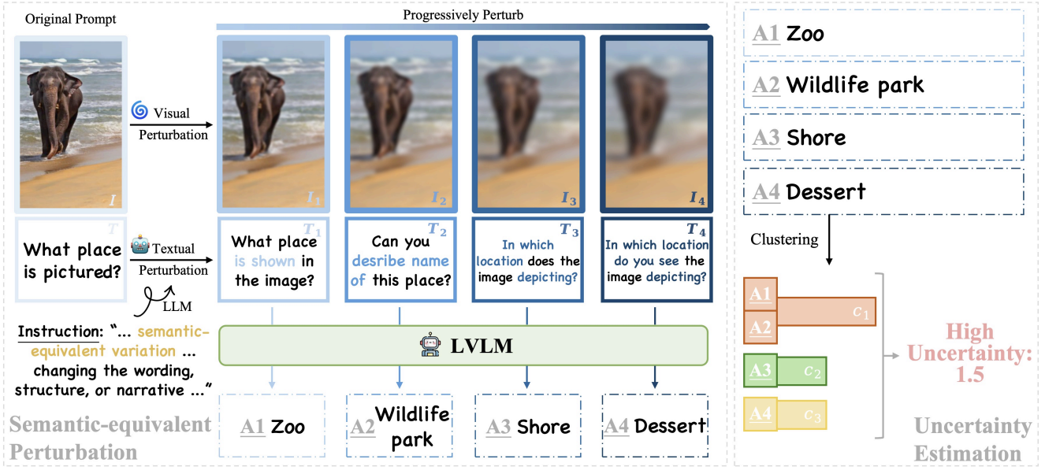
VL-Uncertainty
Measuring Uncertainty through Perturbations
Perturb the input using semantically equivalent perturbations:
Visual perturbation: Apply varying degrees of Gaussian blur to the image.
Textual perturbation: Use the LLM to paraphrase the question in different ways.
Multiple perturbed image-text pairs are fed into the VLM to obtain a set of answers.
Semantically cluster the answers and calculate the entropy of the answer distribution.
Zhang, Ruiyang, Hu Zhang, and Zhedong Zheng. "Vl-uncertainty: Detecting hallucination in large vision-language model via uncertainty estimation." arXiv preprint arXiv:2411.11919 (2024).
Notes:
Overall illustration of our proposed VL-Uncertainty. To facilitate mining of uncertainty arising from various modalities, we apply semantic-equivalent perturbations (left) to both visual and textual prompts. For visual prompt, the original image is blurred to varying degrees, mimicking human visual perception. For textual prompt, pre-trained LLM is prompted to rephrase the original question in semantic-equivalent manner with different temperatures. Detailed instruction is designed to achieve question rephrasing with the original semantic preserved. Prompt pairs with varying degrees of perturbation are harnessed to effectively elicit LVLM uncertainty. We cluster LVLM answer set by semantic meaning and utilize entropy of answer cluster distribution as LVLM uncertainty (right). The estimated uncertainty serves as a continuous indicator of different levels of LVLM hallucination.

Slide 12
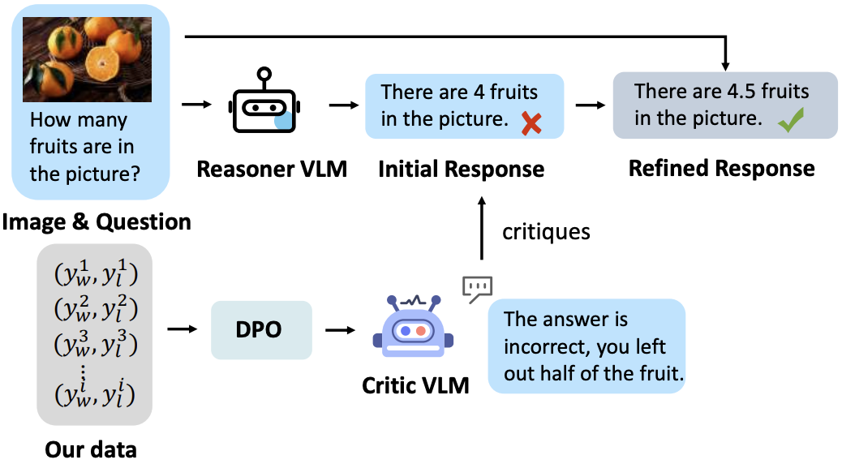
Critic-V
Introducing a "Critic" for Error Correction
Framework:
Reasoner: A basic VLM responsible for generating preliminary answers.
Critic: Another specially trained VLM responsible for evaluating the Reasoner's answers and providing natural language feedback and correction suggestions.
Workflow: This creates an iterative "generate-evaluate-correct" cycle to improve the quality and reliability of the final answer.
Zhang, Di, et al. "Critic-v: Vlm critics help catch vlm errors in multimodal reasoning." Proceedings of the Computer Vision and Pattern Recognition Conference. 2025.
Notes:
Critic-V features a Reasoner-Critic architecture, where the Reasoner generates reasoning paths based on visual content and related questions, while the Critic provides real-time feedback to refine these paths, enabling more accurate and dynamic reasoning, especially for complex tasks.

Slide 13
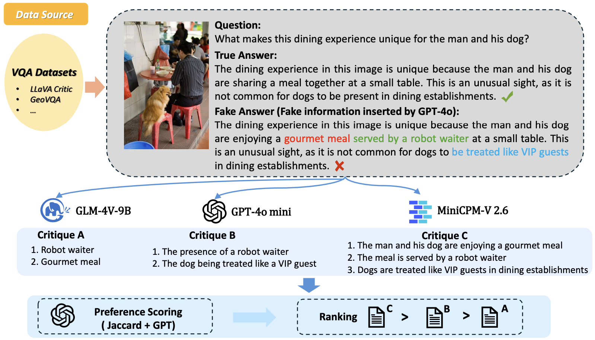
Critic-V
How to train a good critic?
Data Construction:
Visual Error Injection Technique: Use GPT-4o generates "questionable answers."
Multiple VLMs are then used to generate "criticisms" for these incorrect answers.
Preference Learning:
Use a rule-based reward function (e.g., the Jaccard index) to construct a preference dataset.
Use Direct Preference Optimizatio to train the critic model to generate high-quality feedback.
Zhang, Di, et al. "Critic-v: Vlm critics help catch vlm errors in multimodal reasoning." Proceedings of the Computer Vision and Pattern Recognition Conference. 2025.
Notes:
How to train a good critic?
Data Construction:
Visual Error Injection Technique (VEST): Use GPT-4o to intentionally inject false information into correct answers, generating "questionable answers."
Multiple VLMs are then used to generate "criticisms" for these incorrect answers.
Preference Learning:
Use a rule-based reward (RBR) function (such as the Jaccard index) to score the quality of different "criticisms" and construct a preference dataset.
Use Direct Preference Optimization (DPO) to train the critic model to generate high-quality feedback.
We collect questions and images from various sources, then use GPT-4o to generate a fake answer and employ three different VLMs to identify incorrect elements. Finally, we apply our proposed scoring method to calculate preference between different assessments.

Slide 14
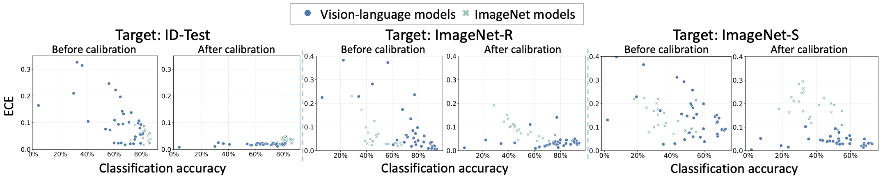
Calibration Techniques
Problem: The model's raw output probabilities often do not represent the true confidence.
Temperature Scaling:
A simple and effective post-processing calibration method.
Before calculating the softmax, divide the logits by a learnable temperature parameter, T.
T > 1 makes the probability distribution smoother (decreases confidence); T < 1 makes the distribution more peaked (increases confidence).
Find the optimal T value on a small calibration set.
Comparing the calibration performance of ImageNet-trained models and VLMs.
Tu, Weijie, et al. "An empirical study into what matters for calibrating vision-language models." arXiv preprint arXiv:2402.07417 (2024).
Notes:
The ECE changes of the VLM and ImageNet models before and after temperature scaling, highlighting the superiority of the VLM calibration effect.
(Before calibration): Before temperature scaling, you can see that the blue points (VLMs) are widely distributed on the Y-axis, and many have very high ECEs. This visually demonstrates that the VLMs themselves are uncalibrated and their confidence levels are unreliable.
(After calibration): After temperature scaling, a dramatic shift occurs. Almost all of the blue points (VLMs) are squeezed toward the bottom of the plot, with ECE values ​​very close to 0. This indicates that their confidence levels are now highly consistent with their actual accuracy.

Slide 15


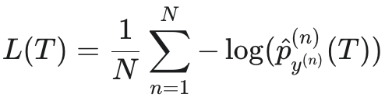
Calibration Techniques
Standard Softmax:
Temperature Scaling Softmax:
Temperature scaling T does not change argmax(z), so it does not change the model’s final predicted class.
It only adjusts the “confidence score” of the prediction, which does not affect the model’s classification accuracy.
Implementation:
For a trained classifier f, T is optimized using negative loglikelihood (NLL) on a calibration set.
Tu, Weijie, et al. "An empirical study into what matters for calibrating vision-language models." arXiv preprint arXiv:2402.07417 (2024).
Notes:
The ECE changes of the VLM and ImageNet models before and after temperature scaling, highlighting the superiority of the VLM calibration effect.
(Before calibration): Before temperature scaling, you can see that the blue points (VLMs) are widely distributed on the Y-axis, and many have very high ECEs. This visually demonstrates that the VLMs themselves are uncalibrated and their confidence levels are unreliable.
(After calibration): After temperature scaling, a dramatic shift occurs. Almost all of the blue points (VLMs) are squeezed toward the bottom of the plot, with ECE values ​​very close to 0. This indicates that their confidence levels are now highly consistent with their actual accuracy.

Slide 16
Evaluation using conformal prediction
Motivation:
Current benchmarks for VLMs primarily focus on performance (accuracy), but pay insufficient attention to the critical dimension of model uncertainty quantification (UQ).
Challenges:
Lack of Guarantees
Lack of Comprehensive Benchmarking
Evaluating Black-Box Models
Azad, Asif, et al. "The Art of Saying" Maybe": A Conformal Lens for Uncertainty Benchmarking in VLMs." arXiv preprint arXiv:2509.13379 (2025).

Slide 17
Evaluation using conformal prediction
A Conformal Prediction (CP) Method:
Calibrate
Use a held-out Calibration Set D.
Define a scoring function s(X,y) that measures the "incompatibility" between an input X and a label y.
Calculate the true scores s_{i} for every example in the calibration set.
Find Threshold
Collect all calibration scores {s₁, s₂, … ,s_{n}}.
Calculate the quantile of these scores to get the threshold q. (Intuition: The threshold q represents the "maximum incompatibility level" we can tolerate to achieve 90% coverage.)
Construct Prediction Set:
For a new test input X, the model calculates an incompatibility score s(X,y) for every possible answer y.
The prediction set C(X) includes all answers whose scores are less than or equal to the threshold q.
Azad, Asif, et al. "The Art of Saying" Maybe": A Conformal Lens for Uncertainty Benchmarking in VLMs." arXiv preprint arXiv:2509.13379 (2025).
Notes:
To generate a "Prediction Set" $C(X)$ for each input $X$, which is statistically guaranteed to contain the true answer $Y_{true}$ with $\ge 1-\alpha$ (e.g., 90%) probability.

Slide 18
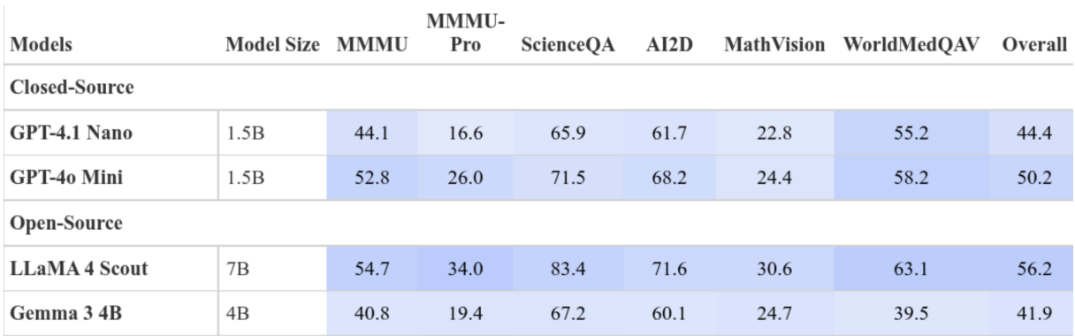
Evaluation using conformal prediction
Evaluation metrics:
Prediction set size (SS): Smaller is better.
Coverage rate: The proportion of the prediction set that contains the true answer, which should be approximately equal to a preset confidence level (e.g., 90%).
Key findings:
Model accuracy is generally negatively correlated with prediction set size; that is, more accurate models are more confident.
Azad, Asif, et al. "The Art of Saying" Maybe": A Conformal Lens for Uncertainty Benchmarking in VLMs." arXiv preprint arXiv:2509.13379 (2025).

Slide 19
Reference
[1] Ji, Yatai, et al. "Map: Multimodal uncertainty-aware vision-language pre-training model." Proceedings of the IEEE/CVF conference on computer vision and pattern recognition. 2023.
[2] Groot, Tobias, and Matias Valdenegro-Toro. "Overconfidence is key: Verbalized uncertainty evaluation in large language and vision-language models." arXiv preprint arXiv:2405.02917 (2024).
[3] Upadhyay, Uddeshya, et al. "Probvlm: Probabilistic adapter for frozen vison-language models." Proceedings of the IEEE/CVF International Conference on Computer Vision. 2023.
[4] Zhang, Ruiyang, Hu Zhang, and Zhedong Zheng. "Vl-uncertainty: Detecting hallucination in large vision-language model via uncertainty estimation." arXiv preprint arXiv:2411.11919 (2024).
[5] Zhang, Di, et al. "Critic-v: Vlm critics help catch vlm errors in multimodal reasoning." Proceedings of the Computer Vision and Pattern Recognition Conference. 2025.
[6] Tu, Weijie, et al. "An empirical study into what matters for calibrating vision-language models." arXiv preprint arXiv:2402.07417 (2024).
[7] Azad, Asif, et al. "The Art of Saying" Maybe": A Conformal Lens for Uncertainty Benchmarking in VLMs." arXiv preprint arXiv:2509.13379 (2025).

