Slide 1
STAT-6289
Network Data
Final Project

Slide 2
Background
There are 17 cities in the map (see next slide).
  cities A, B, ..., Q
All the roads were originally one-way.
  directed edges
The cities A, D, F and H were isolated for a long time.

Slide 3
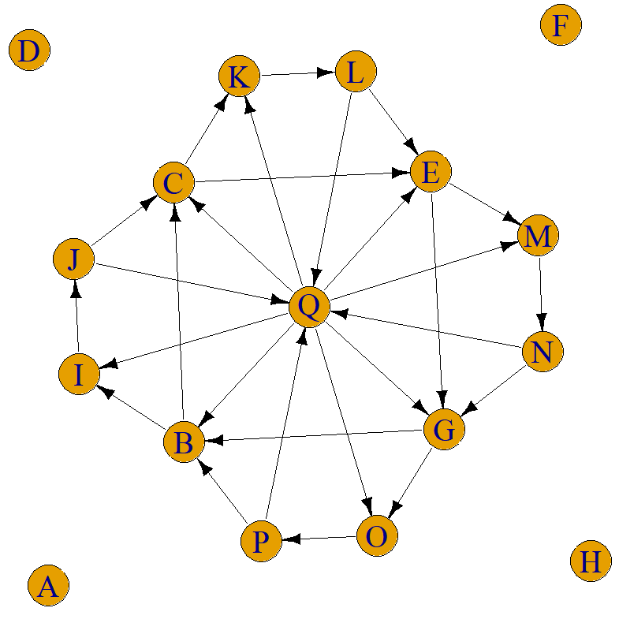

Slide 4
Background (cont.)
About ten years ago, in each of the cities A, D, F and H, a company built a site and a two-way road (see next slide) to connect the site to the nearest city (B, C, E and G, respectively)
  Notice that each road (one-way or two-way) is 100 miles long (and the edges in the graph are not proportional to this road distance).

Slide 5
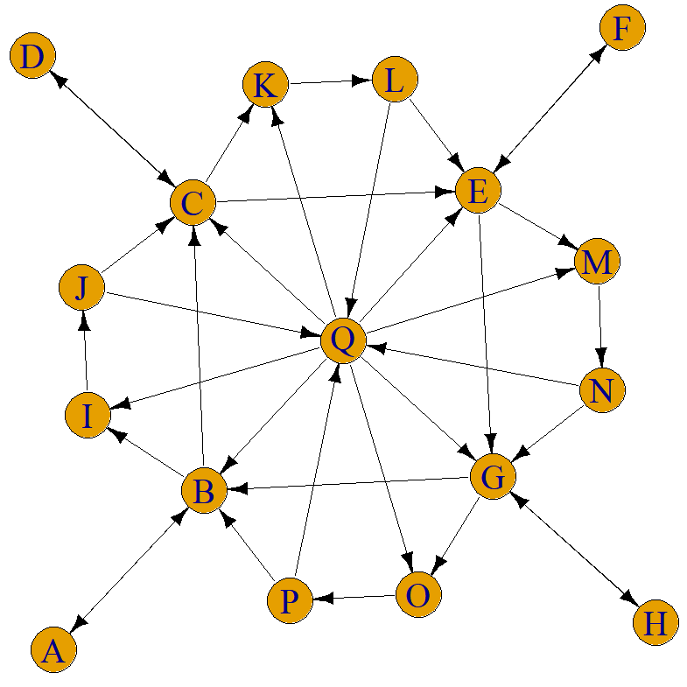

Slide 6
Background (cont.)
After the road constructions, the company transported cargoes among the cities A, D, F and H.
  (A, D, F, H) ↔ (A, D, F, H)
  The shortest paths were used by the company for the transportations among the cities A, D, F and H.

Slide 7
Background (cont.)
Eight years later, the company performed a review for the purpose of transportation efficiency improvements.
  However, the data (amounts of cargoes) transported among the cities A, D, F and H could not be found at the time of review.
  Instead, other related data were found: the amounts of cargoes transported through different roads recorded in each month of the previous eight years (see file "FinalProjectRoad.csv" for data)

Slide 8
Tasks
For each month of the previous eight years, Please use these data ("FinalProjectRoad.csv") to estimate the amounts of cargoes transported for the following cities.
  from A to D, from A to F, from A to H,
  from D to A, from D to F, from D to H,
  from F to A, from F to D, from F to H,
  from H to A, from H to D, from H to F

Slide 9
Tasks (cont.)
Assume that the company used your estimates in the review report.
A few years later, the records for cargoes transported among the cities A, D, F and H were located
  see file "FinalProjectTransportation.csv" for data
Please provide an evaluation of the quality of your estimates.

Slide 10
Report
An analysis report (your own words)
  May 11, 2021, Tuesday midnight
  Submit to Blackboard (one DOC or PDF file)
  Introduction and background
  Results and discussion
  R code and related short comments

Slide 11
Report requirement
A simple report with the following elements should be submitted
  A short introduction to the background
  Necessary figures, tables and/or representative statistics, with relevant short discussion/comments
  R code and related short programming comments
A clear answer for each task should be provided
R output should NOT be directly copied and pasted into the report. Only necessary statistics should be selected into the report. Graphs with appropriate titles/labels can be copied and pasted into the report. All the project related R code with necessary short comments should be attached as an appendix to the end of report.
The report should be either a Microsoft Word document or a PDF file. Only one file will be graded. If multiple versions are submitted, then only the most recent version will be graded. The report must be submitted through the University's Blackboard system.

Slide 12
About final
May need to read the related references
May need to check the related R help documents and statistical background
Submit your report to blackboard.gwu.edu
A simple report form
  Do not just copy/paste your R code and results
Word document or PDF file
  only one or the most recent file will be graded
Due May 11, 2021 (Tuesday midnight)

