Slide 1
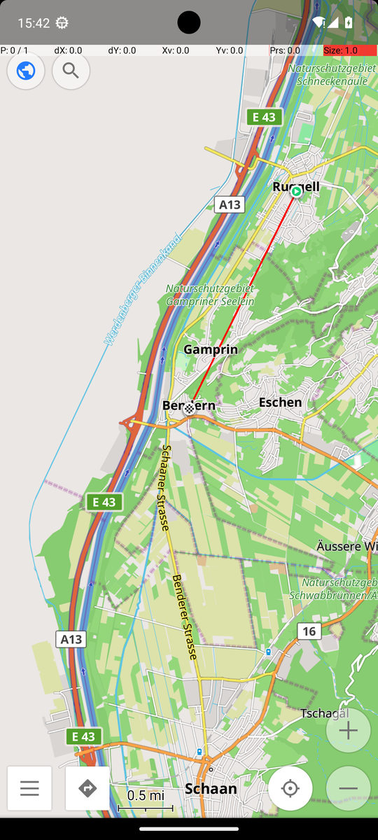
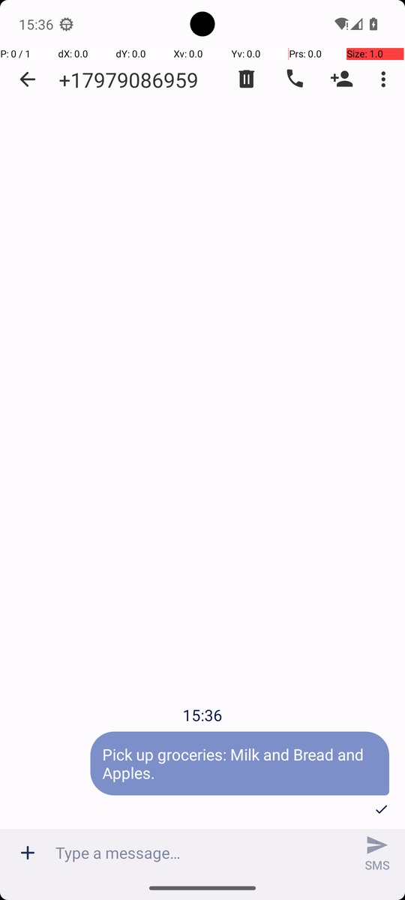
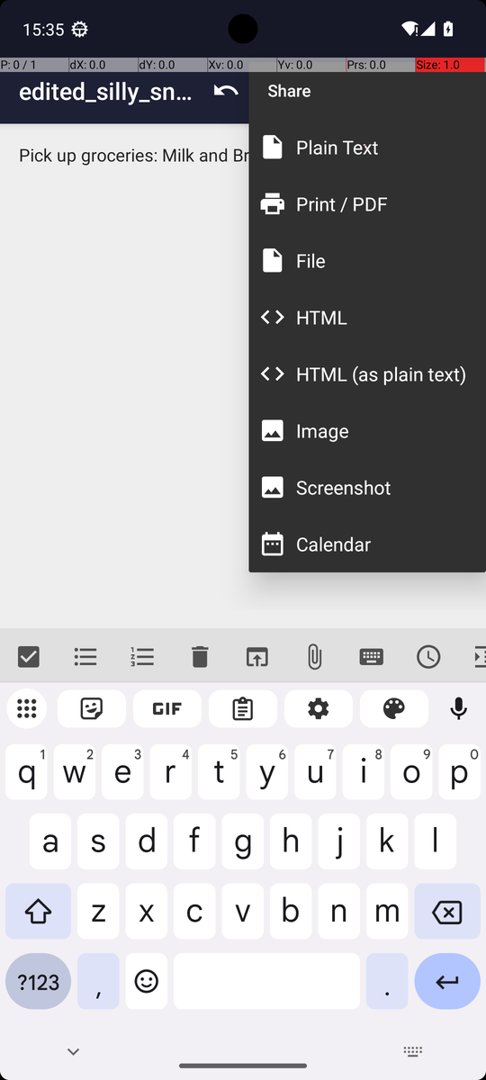
AGENTIC AI IN MODERN BUSINESS · PRESENTATION
TUM School of Management
One GUI agent for seven
AndroidWorld tasks
An agent that looks at the phone screen and decides where to tap, evaluated with the official AndroidWorld verifier.
TEAM MEMBERS
LECTURERS
Danh Phuong Le
Ssu-Cheng Chen
Hayati Ömer Koç
Jia Qi
Tin Nghia Nguyen
03824340
03827578
03801613
03812325
03826855
Haoyuan Jiang
Xuerui Zhang
Zhenyu Wang
Real screens from our evaluation runs

Slide 2
AT A GLANCE
One agent, seven tasks: 17 of 21 runs passed the official check
17 / 21
7 tasks
~300
66
runs passed the official
AndroidWorld verifier
covering easy, medium
and hard (D1 task list)
recorded runs across
the whole project
agent versions, each
change tested and logged
Rigorous
Cheap and fast
Honest
▪ Frozen, git-tagged code for all runs
▪ Every run screen-recorded
▪ Official checker decides success
▪ About 0.066 € model cost for 21 runs
▪ 1.75 s median per model call
▪ Hosted model, laptop without GPU
▪ Failures kept, analysed, not rerun
▪ Fixes tested on other task seeds
▪ Extra inputs disclosed per task
Agentic AI in Modern Business · AndroidWorld GUI agent
2

Slide 3
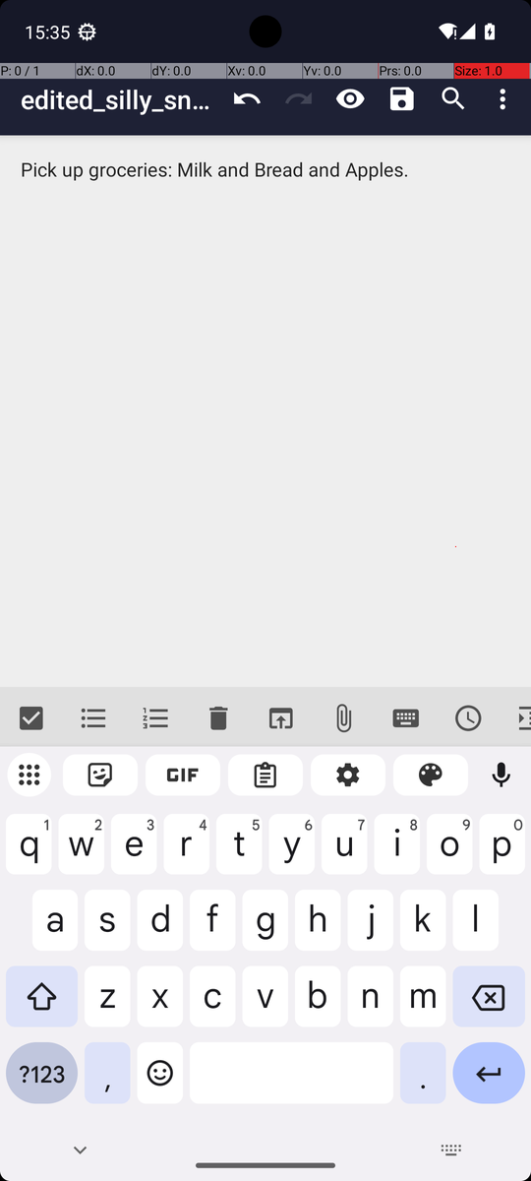
USE CASE
A phone assistant that uses apps the way a person does
Who it helps
People who find phones hard to use, busy users with repeated tasks, teams that test apps.
What it needs
Only the screen: no special app interface. It reads, taps, types and swipes like a person.
What it is told
One sentence in plain English, for example: “Create a note named … and share its content via SMS.”
One of our runs: a note in Markor, shared as an SMS
Agentic AI in Modern Business · AndroidWorld GUI agent
3

Slide 4
TASKS
Seven tasks from all three difficulty rows of the course list
Row | Task | What the agent is told (short) | Reference steps
Warm-up | SystemWifiTurnOn | Turn Wi-Fi on | 3
Warm-up | ContactsAddContact | Create a contact with a name and number | 5
Real work | SimpleSmsSend | Send a message to a number with Simple SMS Messenger | 6
Real work | FilesMoveFile | Move a file from one folder to another | 10
Real work | SimpleCalendarAddOneEvent | Create an event on a date and hour, with title and length | 17
Multi-app | MarkorCreateNoteAndSms | Create a note, then share its text with a number via SMS | 9
Multi-app | OsmAndTrack | Save a track: Ruggell, then Bendern (the slide's instance) | 60
Reference steps: the number of steps AndroidWorld lists for each task (course slide D1 p.7).
Agentic AI in Modern Business · AndroidWorld GUI agent
4

Slide 5
MODEL
Why AutoGLM-Phone-9B, and what we tried first
 | AutoGLM-Phone-9B (Z.ai API) | GELab-Zero 4B (local, Ollama)
Built for | Phone GUI control | Phone GUI control
Where it runs | Hosted API | Laptop GPU (8 GB), partial offload
Speed per model call | 1.75 s median (297 calls) | 19–21 s per screenshot request
Action format | Native do(...) / finish(...), parsed reliably | Bare tokens our parser rejected
Cost | €0.045 per million tokens | Free, but slow
Our results | 17 / 21 in the final evaluation | Contacts: 1 PASS in 6 trials
Leaderboard | AutoGLM-Mobile (9B) 80.2% on AndroidWorld* | —
Our first attempt (v1–v10)
▪ Started with GELab-Zero, the model on the course slide
▪ Model larger than the 8 GB GPU: ~20 s per screenshot request
▪ Contacts: 1 of 6 trials passed
▪ Wi-Fi: invalid action format, false “Wi-Fi is on”
▪ Switched to the hosted AutoGLM model
* Community leaderboard entry (google-research/android_world); the listed checkpoint may differ from the hosted model we call.
Agentic AI in Modern Business · AndroidWorld GUI agent
5

Slide 6
AGENT DESIGN
One class, one step(): observe, decide, check, act, record
1 Observe
2 Decide
3 Check
4 Act
5 Record
Screenshot
(+ GUI labels for
some tasks)
AutoGLM picks
one action
Format, screen point,
focus, task rules
Tap, type, swipe,
launch, back
Trajectory log
+ screen video
repeat until the model says finish, or the step budget ends → official AndroidWorld verifier: PASS / FAIL
step() in AutoGLMAgent (autoglm_agent.py)
Same agent for all seven tasks
Reads the screen and the task, chooses one action, checks it, executes it, and reports whether the model said it is done.
Task-specific knowledge is loaded as data (completion rule, optional Skill). The model still decides every action.
Agentic AI in Modern Business · AndroidWorld GUI agent
6

Slide 7
AGENT DESIGN
Context and Skills: what goes into each model request
Every request
Markor Skill (text)
OsmAnd Skill (code)
▪ System prompt: action rules
▪ Completion rule: what “done” looks like
▪ Last 20 steps of history
▪ Newest screenshot
▪ Status: step number, last result
▪ Loaded only for this task
▪ Fact: Share > File makes a failing MMS
▪ Procedure: name + extension, Save, Share > Plain Text, SMS Messenger, number, SMS
▪ Repeated each step as a reminder
▪ Recognises the screen from the GUI tree
▪ States the next step and its tap centre
▪ Refuses actions the screen shows to be wrong
▪ Model still chooses every action
No fixed list of taps: Skills add app knowledge, the model makes every decision.
Agentic AI in Modern Business · AndroidWorld GUI agent
7

Slide 8
AGENT DESIGN
A safety net: actions are checked before they reach the phone
Check | Why | Final runs
Type with no focused text field | Text would go nowhere | 3
Malformed reply | Not exactly one action | 2
Unsupported action | Not in the action list | 1
OsmAnd Favorite button | Saves a favourite, not a route point | 1
How a refusal works
▪ The action is not executed
▪ The model gets the reason in the same step
▪ One correction per step; a second invalid reply ends the run
▪ All refusals are logged
7
Without these checks, the agent would have typed into nothing, saved a favourite instead of a route point, or acted on a broken reply. Five of the six runs with a refusal still passed.
actions stopped in the final runs
(6 of 21 runs had one or more)
Agentic AI in Modern Business · AndroidWorld GUI agent
8

Slide 9
IMPLEMENTATION
Implementation: four parts and how they talk
AutoGLM model
Agent
Runner
Phone
Z.ai API (HTTPS)
autoglm-phone-multilingual
key kept in .env, not in git
AutoGLMAgent.step()
autoglm_agent.py
prompt, Skills, task config
run_task.py
task setup, recorder, loop,
verifier, logs
Android emulator: Pixel 6,
Android 13, headless
AndroidWorld setup + verifier
request /
one action
step() /
result
adb: screen,
tap, type
Batch evaluation
Quality
Reproduce
▪ evaluate_tasks.py runs task x seed batches
▪ Records a source fingerprint
▪ Stops if the code changes mid-batch
▪ 38 offline tests (no phone needed)
▪ Frozen git tag for the evaluation
▪ Every run: summary, log, video
▪ git checkout team-agent-final-v66
▪ evaluate_tasks.py --tasks ... --seeds 42 43 44 --run-all-seeds
▪ Python 3.11, Windows laptop, no GPU needed
Agentic AI in Modern Business · AndroidWorld GUI agent
9

Slide 10
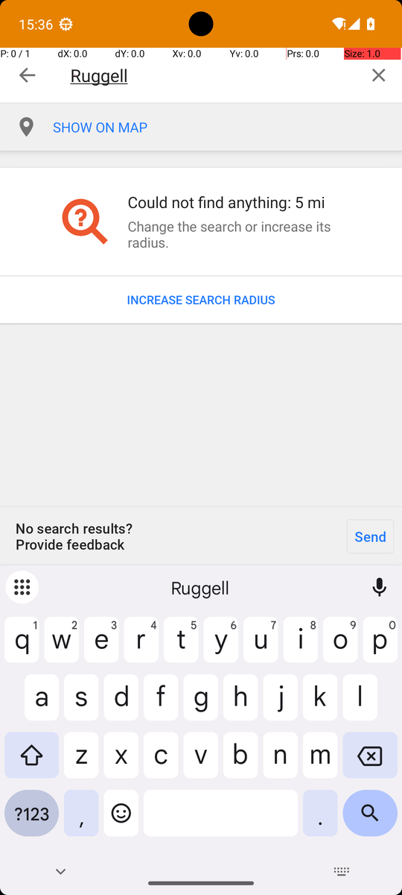
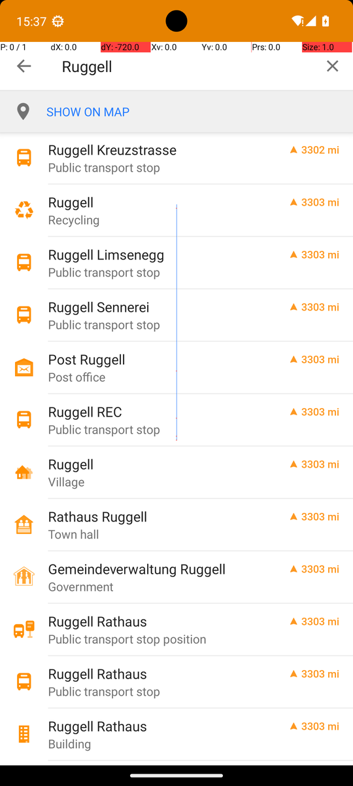
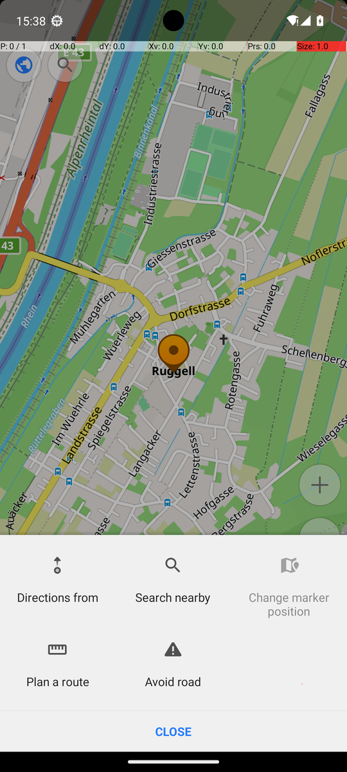
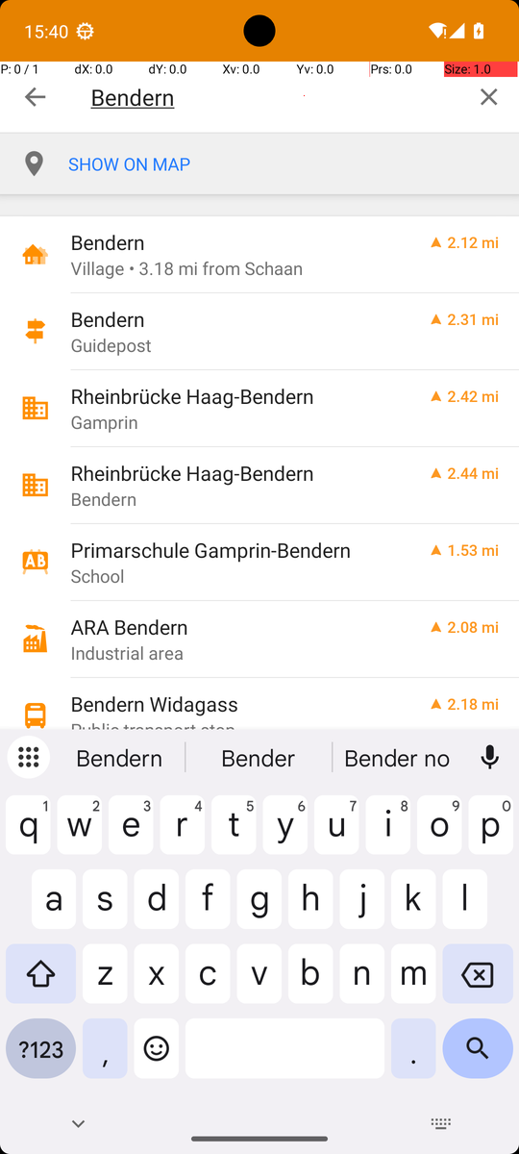
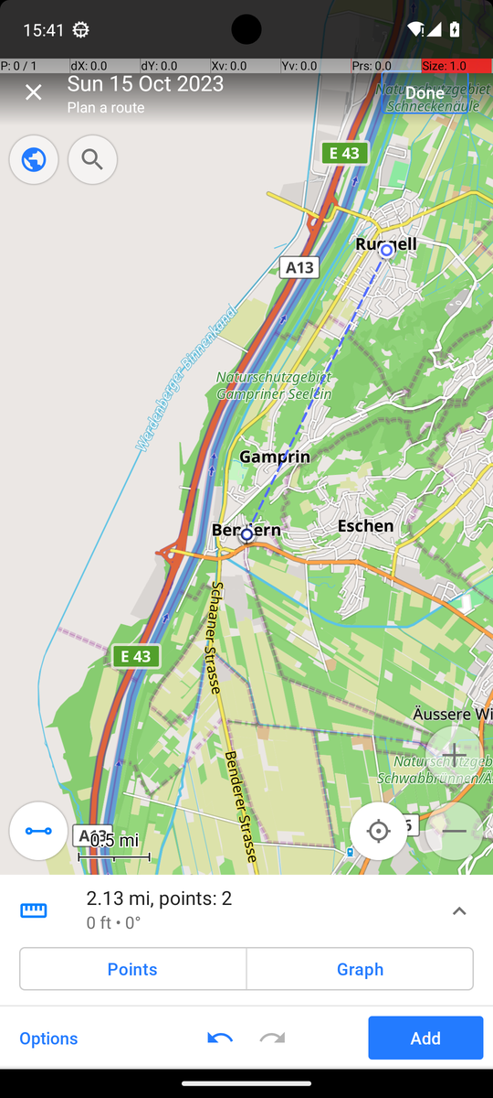
TRAJECTORY
One run, step by step: the OsmAnd track Ruggell to Bendern
Step 5
Step 9
Step 11
Step 16
Step 22
Step 23
“I need to tap "INCREASE SEARCH RADIUS" to expand the search area and find the place.”
“The "Ruggell" row labeled "Village" is visible and is the correct location.”
“I should tap it to start creating the route, which will allow me to add the next waypoint "Bendern" in the correct order.”
“I should tap this row to select it as the second waypoint for the track.”
“To save the track with both waypoints in the correct order, I should tap "Done" to complete the route creation and save the track.”
“The track has been created with both waypoints "Ruggell" and "Bendern" in the correct order and is now saved.”
Agentic AI in Modern Business · AndroidWorld GUI agent
10

Slide 11
EVALUATION
How we tested: frozen code, three runs per task
Frozen
Three runs per task
Judged independently
▪ Final agent: tag team-agent-final-v66
▪ Six tasks run on v65: same code
▪ Markor re-run on v66 after a Skill fix
▪ Seeds 42, 43, 44
▪ OsmAnd: 31, 314, 366 = the slide's route
▪ Failures kept, never rerun
▪ Official AndroidWorld verifier
▪ The model's “finish” never counts
▪ Step budget about 2–4× reference
Summary row
Trajectory log
Screen recording
Course fields (D1 p.49), written by the runner during the run
Every screenshot, model reply, check and result, step by step
The whole run on video, in one or more clips
Kept for every one of the 21 runs. The full run log follows right after the results.
Agentic AI in Modern Business · AndroidWorld GUI agent
11

Slide 12
RESULTS
17 of 21 runs passed; every task passed at least twice
Row | Task | Run 1 | Run 2 | Run 3 | Passed
Warm-up | SystemWifiTurnOn | PASS s42 | PASS s43 | PASS s44 | 3/3
Warm-up | ContactsAddContact | PASS s42 | FAIL s43 other: navigation | PASS s44 | 2/3
Real work | SimpleSmsSend | PASS s42 | PASS s43 | PASS s44 | 3/3
Real work | FilesMoveFile | PASS s42 | FAIL s43 false_done | PASS s44 | 2/3
Real work | SimpleCalendarAddOneEvent | PASS s42 | PASS s43 | PASS s44 | 3/3
Multi-app | MarkorCreateNoteAndSms | FAIL s42 grounding | PASS s43 | PASS s44 | 2/3
Multi-app | OsmAndTrack | PASS s31 | PASS s314 | FAIL s366 grounding | 2/3
s = task seed. Official AndroidWorld verifier. Tag team-agent-final-v66 (six tasks run on v65, same code).
Agentic AI in Modern Business · AndroidWorld GUI agent
12

Slide 13
RESULTS
Run log (1/2): one row per run
Model AutoGLM-Phone-9B (Z.ai), version v65, grounding by coordinates. Rows written by the runner during each run; click a run to open its log.
Task | Run | Seed | Observation | Steps / budget | Verifier | Failure class | Clips | Note
SystemWifiTurnOn | 1 of 3 | 42 | screenshot + labels | 5 / 12 | PASS | — | 1 | Settings > Internet > Wi-Fi on; finished
SystemWifiTurnOn | 2 of 3 | 43 | screenshot + labels | 5 / 12 | PASS | — | 1 | Same 5-step path; finished
SystemWifiTurnOn | 3 of 3 | 44 | screenshot + labels | 5 / 12 | PASS | — | 1 | Same 5-step path; finished
ContactsAddContact | 1 of 3 | 42 | screenshot | 12 / 16 | PASS | — | 1 | Name, scroll, number, Save; finished
ContactsAddContact | 2 of 3 | 43 | screenshot | 11 / 16 | FAIL | other: navigation | 1 | Swiped past Phone field; no-progress stop
ContactsAddContact | 3 of 3 | 44 | screenshot | 11 / 16 | PASS | — | 1 | Name, scroll, number, Save; finished
SimpleSmsSend | 1 of 3 | 42 | screenshot | 9 / 20 | PASS | — | 1 | New conversation, number, message, send
SimpleSmsSend | 2 of 3 | 43 | screenshot | 7 / 20 | PASS | — | 1 | Chinese app name resolved; sent in 7 steps
SimpleSmsSend | 3 of 3 | 44 | screenshot | 7 / 20 | PASS | — | 1 | Chinese app name resolved; sent in 7 steps
FilesMoveFile | 1 of 3 | 42 | screenshot | 17 / 25 | PASS | — | 1 | Scrolled to file, Move to, MOVE; finished
FilesMoveFile | 2 of 3 | 43 | screenshot | 13 / 25 | FAIL | false_done | 1 | Moved look-alike file, then finished
FilesMoveFile | 3 of 3 | 44 | screenshot | 13 / 25 | PASS | — | 1 | Same procedure; 1 malformed reply corrected
SimpleCalendarAddOneEvent | 1 of 3 | 42 | screenshot | 20 / 35 | PASS | — | 1 | Title, text, date, time, length; 1 fix
SimpleCalendarAddOneEvent | 2 of 3 | 43 | screenshot | 21 / 35 | PASS | — | 1 | Saved event; 1 unsupported action fixed
SimpleCalendarAddOneEvent | 3 of 3 | 44 | screenshot | 16 / 35 | PASS | — | 1 | Saved event in 16 steps; no refusals
Agentic AI in Modern Business · AndroidWorld GUI agent
13

Slide 14
RESULTS
Run log (2/2): the two multi-app tasks
Model AutoGLM-Phone-9B (Z.ai), grounding by coordinates; Markor rows v66, OsmAnd v65 (same code). Click a run to open its log.
Task | Run | Seed | Observation | Steps / budget | Verifier | Failure class | Clips | Note
MarkorCreateNoteAndSms | 1 of 3 | 42 | screenshot + Skill | 18 / 40 | FAIL | grounding | 1 | Note saved; Share > Plain Text sent its text to SMS Messenger; number confirmed. The model then said the SMS button was at the top right and tapped [940, 60] four times; the button was at the right of the message bar. No-progress stop.
MarkorCreateNoteAndSms | 2 of 3 | 43 | screenshot + Skill | 18 / 40 | PASS | — | 1 | New file, name and .txt, text, Save; More options > Share > Plain Text > SMS Messenger; number and checkmark; the text was already in the message field, so it only tapped SMS.
MarkorCreateNoteAndSms | 3 of 3 | 44 | screenshot + Skill | 18 / 40 | PASS | — | 2 | Same path as run 2: the note's text was shared with Share > Plain Text, not typed again; SMS sent in 18 steps.
OsmAndTrack | 1 of 3 | 31 | screenshot + tree + Skill | 22 / 90 | PASS | — | 4 | Before the run the runner restored OsmAnd's map (the Files runs had cleared storage). Three radius increases and one scroll found the Ruggell village; Actions > Plan a route; searched Bendern, SHOW ON THE MAP, Back x3, Add, Done. The Favorite button and one unfocused Type were refused.
OsmAndTrack | 2 of 3 | 314 | screenshot + tree + Skill | 23 / 90 | PASS | — | 3 | Same procedure as run 1; the accessibility service's “keeps stopping” dialog appeared and the model closed it; one unfocused Type was refused. Shown on slide 10.
OsmAndTrack | 3 of 3 | 366 | screenshot + tree + Skill | 16 / 90 | FAIL | grounding | 2 | Ruggell became route point 1 and the crash dialog was closed; in the second search the code stated “Tap Clear at [941, 83]” but the model tapped [941, 57], the top edge of the button, three times with no effect. No-progress stop.
Agentic AI in Modern Business · AndroidWorld GUI agent
14

Slide 15
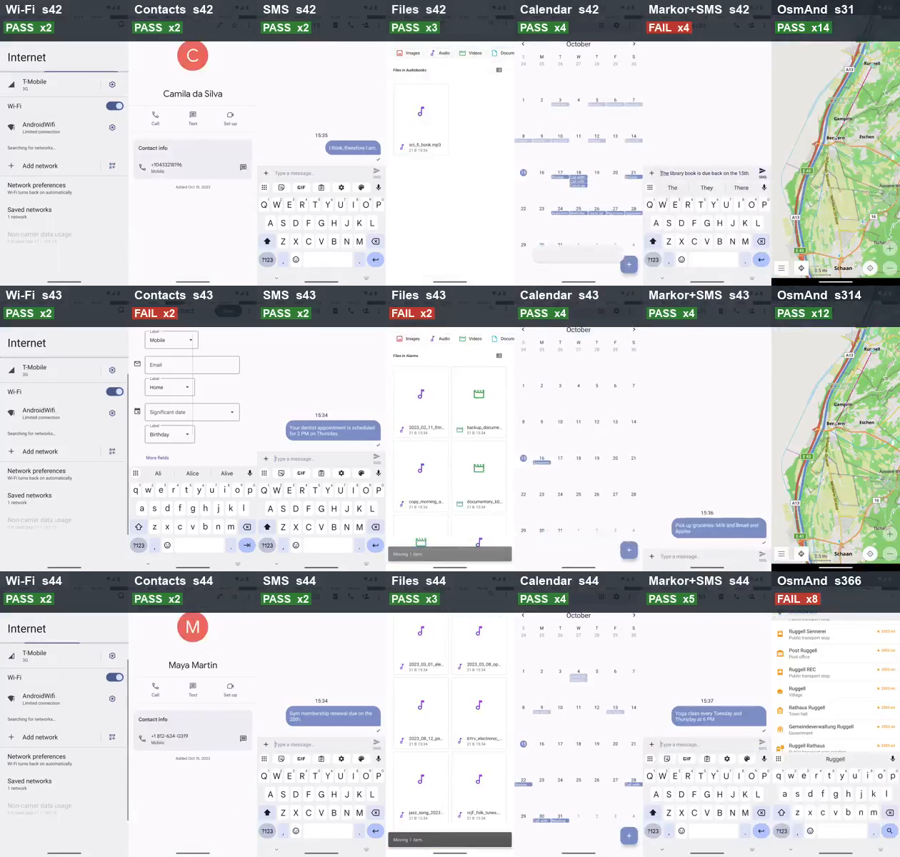
DEMO
All 21 evaluation runs at once (sped up)
How to read it
▪ Columns: Wi-Fi, Contacts, SMS, Files, Calendar, Markor + SMS, OsmAnd
▪ Rows: run 1, 2, 3 (seeds 42 / 43 / 44; OsmAnd 31 / 314 / 366)
▪ Label: verdict and speed-up (x2)
▪ Each clip stops on its final screen
Agentic AI in Modern Business · AndroidWorld GUI agent
15

Slide 16
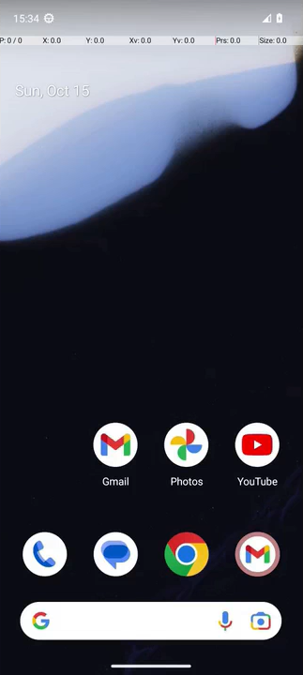
DEMO
Warm-up: SystemWifiTurnOn
Clip goes here
Wi-Fi, seed 42
Success
▪ Seed 42
▪ 5 steps, PASS
▪ Switched Wi-Fi on
▪ Finished on its own
Agentic AI in Modern Business · AndroidWorld GUI agent
16

Slide 17
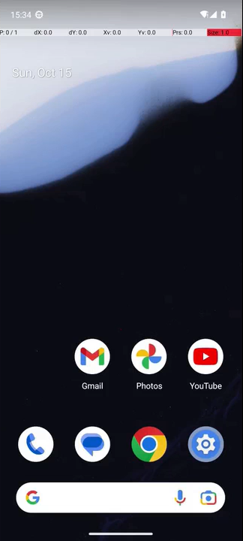

DEMO
Warm-up: ContactsAddContact
Clip goes here
Contacts, seed 42
Success
Clip goes here
Contacts, seed 43
Failure
▪ Seed 42
▪ 12 steps, PASS
▪ Name, scroll, number, save
▪ Finished on its own
▪ Seed 43
▪ 11 steps, FAIL
▪ Swiped past the Phone field
▪ Stopped for no progress
Agentic AI in Modern Business · AndroidWorld GUI agent
17

Slide 18
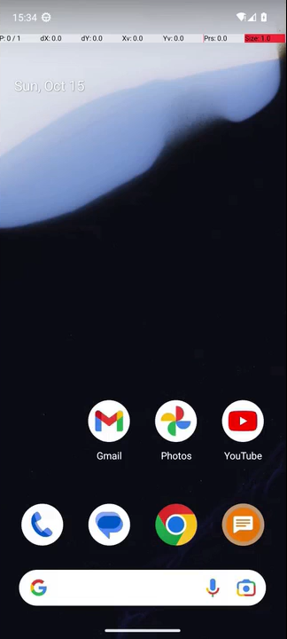
DEMO
Real work: SimpleSmsSend
Clip goes here
SMS, seed 42
Success
▪ Seed 42
▪ 9 steps, PASS
▪ New conversation, number, message, send
Agentic AI in Modern Business · AndroidWorld GUI agent
18

Slide 19
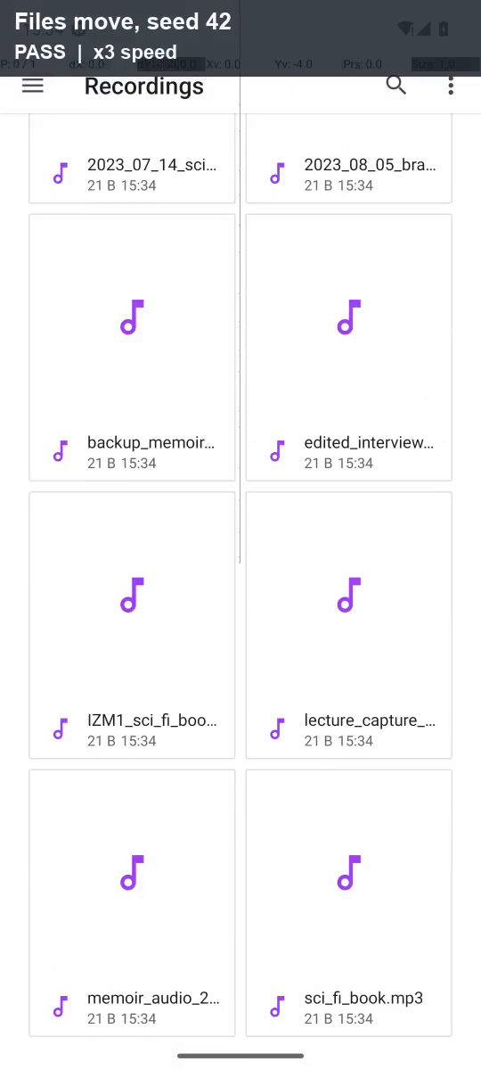
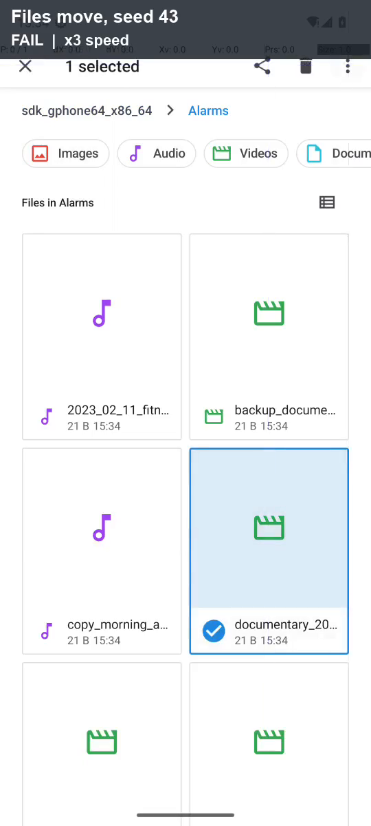
DEMO
Real work: FilesMoveFile
Success
Failure
▪ Seed 42
▪ 17 steps, PASS
▪ Chose the file whose full name was visible
▪ Seed 43
▪ 13 steps, FAIL
▪ Moved a look-alike file, then said done
Agentic AI in Modern Business · AndroidWorld GUI agent
19

Slide 20

DEMO
Real work: SimpleCalendarAddOneEvent
Clip goes here
Calendar, seed 42
Success
▪ Seed 44
▪ 16 steps, PASS
▪ Title, text, date, time, length
▪ Event saved, no refusal
Agentic AI in Modern Business · AndroidWorld GUI agent
20

Slide 21
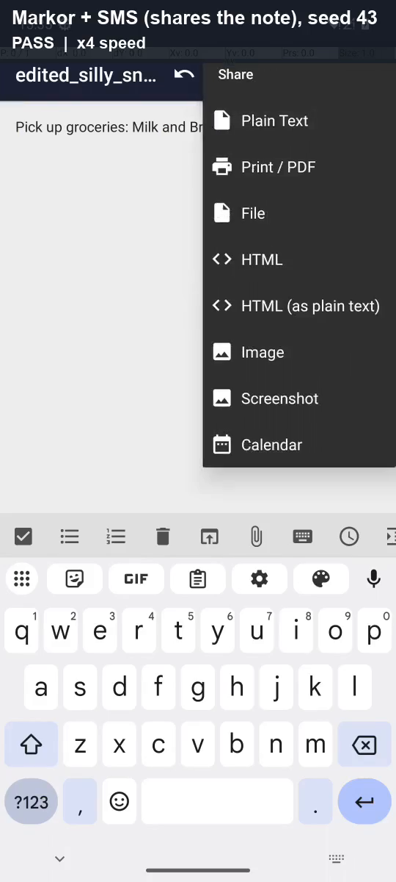
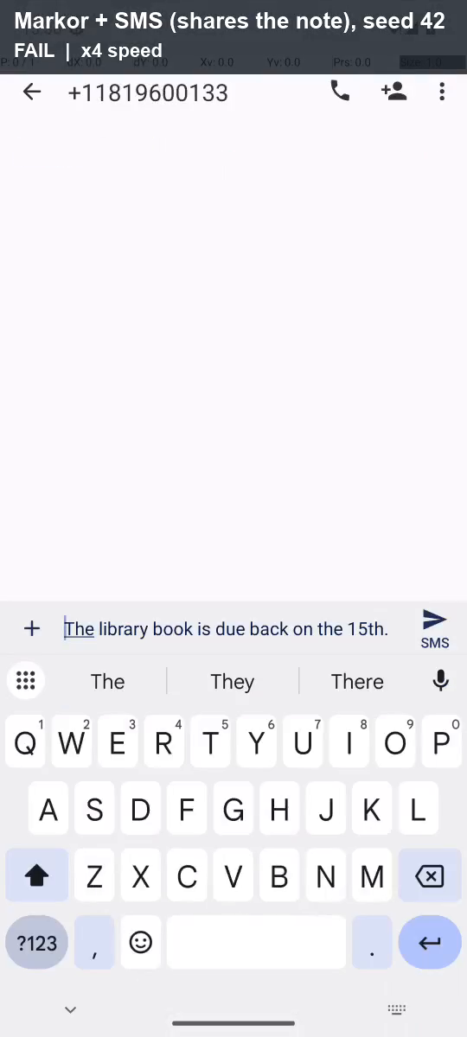
DEMO
Multi-app and memory: MarkorCreateNoteAndSms
Success
Failure
▪ Seed 43
▪ 18 steps, PASS
▪ Shared the note (Share > Plain Text), then sent the SMS
▪ Seed 42
▪ 18 steps, FAIL
▪ Shared the note, then tapped the top edge instead of SMS
Agentic AI in Modern Business · AndroidWorld GUI agent
21

Slide 22


DEMO
Multi-app and memory: OsmAndTrack
Clip goes here
OsmAnd, seed 314
Success
Clip goes here
OsmAnd, seed 366
Failure
▪ OsmAnd, seed 314
▪ 23 steps, PASS
▪ Route Ruggell to Bendern saved
▪ Closed a crash dialog
▪ OsmAnd, seed 366
▪ 16 steps, FAIL
▪ Tapped [941, 57], not [941, 83]
▪ Clear button missed 3 times
Agentic AI in Modern Business · AndroidWorld GUI agent
22

Slide 23
FAILURE ANALYSIS
How 284 project runs ended: the setup failed most often
The five failure classes (D1 p.50)
▪ grounding: the tap lands on nothing
▪ too_early: acting on a loading screen
▪ lost_value: a value is lost or invented
▪ wrong_app: the wrong app is used
▪ false_done: says done, verifier fails
▪ Final evaluation: false_done 1, grounding 2, other 1
Agentic AI in Modern Business · AndroidWorld GUI agent
23

Slide 24
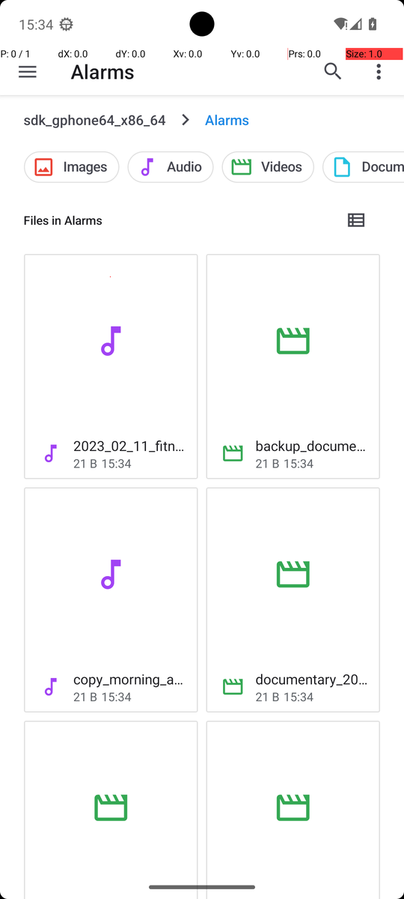
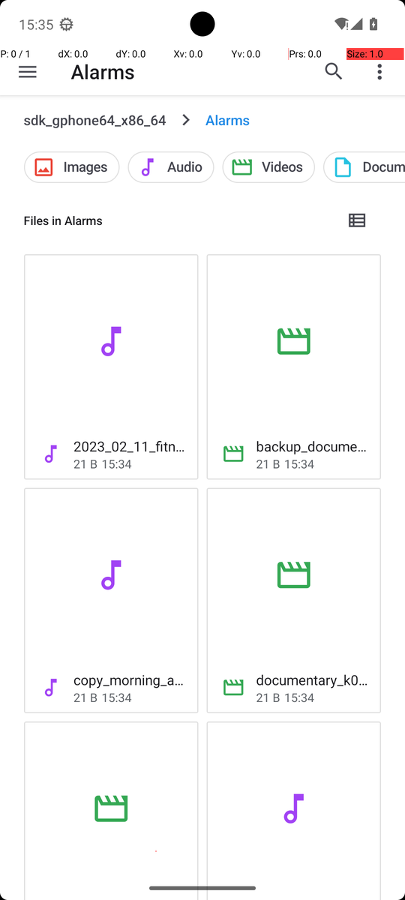
FAILURE ANALYSIS
Deep dive: a false finish caused by a look-alike file
Steps | What happened | Assessment
1–4 | Opened Files, the storage root, then Alarms | Correct
5 | Grid with cut-off names; long-pressed “documentary_20…” | Wrong object
6–11 | More options > Move to > Movies > MOVE | Correct steps, wrong file
12–13 | Waited for “Moving 1 item”, then finish | false_done
Model: “I see the "documentary_2023_03_14.mp4" file in the Alarms folder, which matches the required file "documentary.mp4" (assuming it is named differently here).”
Class
Fix layer
false_done (D1 p.50); root cause: a look-alike chosen from a truncated name
Instruction: list view or exact search. Program: check the full name before Move
Agentic AI in Modern Business · AndroidWorld GUI agent
24

Slide 25
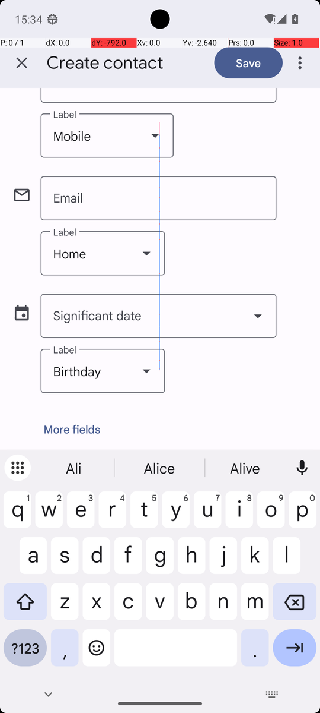
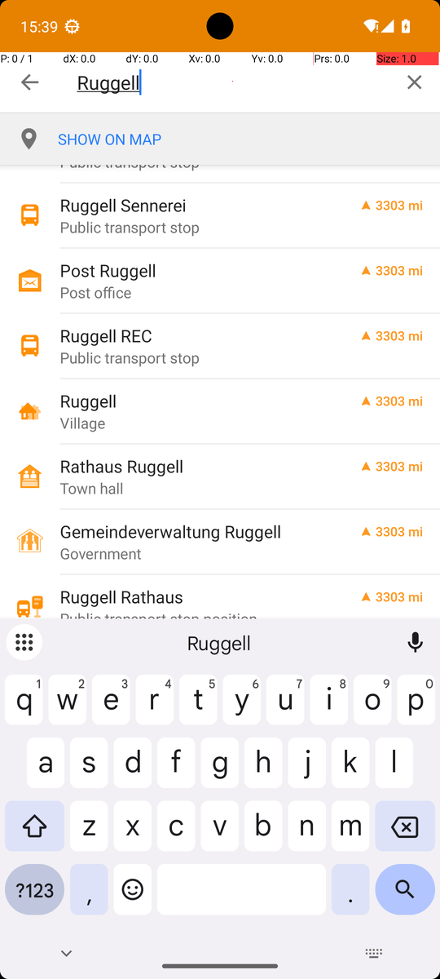
FAILURE ANALYSIS
Two more failures, and why runs of one task differ
Contacts s43: other
OsmAnd s366: grounding
Two swipes went past the Phone field; four more changed only the blinking cursor, which our check counted as a change.
Code: “Tap Clear at [941, 83]”. Model tapped [941, 57], the top edge of the button, three times: no effect.
Same task, two frozen evaluations | Run 1 | Run 2 | Run 3
OsmAnd v61 (Skill experiment) | FAIL | PASS | PASS
OsmAnd v65 (final) | PASS | PASS | FAIL
Contacts v42 (earlier) | PASS | PASS | PASS
Contacts v65 (final) | PASS | FAIL | PASS
Left: Contacts s43, Phone field cut off at the top. Right: OsmAnd s366, Clear button at the top right.
Agentic AI in Modern Business · AndroidWorld GUI agent
25

Slide 26
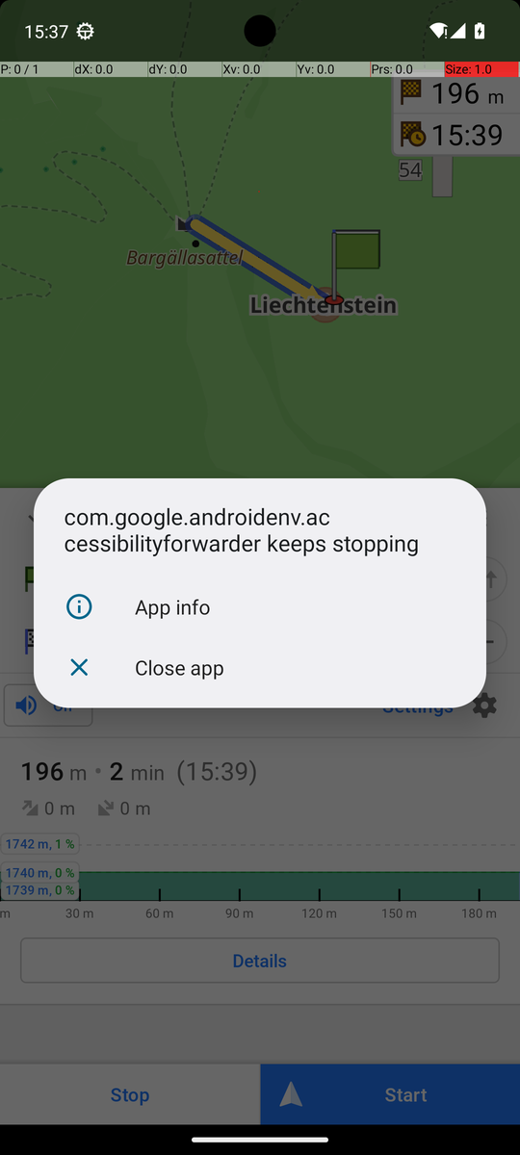
FAILURE ANALYSIS
Not every failure is the model: test-setup problems
Symptom | Root cause | Fix
Model “waited” on a black screen | Emulator GPU mode returned all-black frames | Headless host-GPU emulator; black frames stop the run
Screen recording stopped | Android tools restarted their server on a timeout | Keep the server; longer app-start timeout
App start timed out | Cold start longer than 5 s | 30 s launch timeout
“keeps stopping” dialog | Accessibility service crash (11 of 25 OsmAnd runs) | Model closes it; empty tree read again
OsmAnd map missing | Files task initialization deletes shared storage | Check the map before OsmAnd; rerun official setup
Trust the harness before judging the model: without these fixes, setup faults would look like agent failures.
Agentic AI in Modern Business · AndroidWorld GUI agent
26

Slide 27
IMPROVEMENT
The hardest task: from zero passes to two of three
What changed
▪ Skill as text: the model often ignored it
▪ Rules on the model’s words: bypassed
▪ Program reads the screen (accessibility tree)
▪ Skill as code: next step + tap centre
▪ Each fix tested on practice seeds, never on the evaluation seeds
Agentic AI in Modern Business · AndroidWorld GUI agent
27

Slide 28
IMPROVEMENT
Before and after: only the Skill changed
OsmAnd, seeds 31 / 314 / 366 | No Skill | Skill
Official verifier PASS | 0 / 3 | 2 / 3
Searched the place name only | 0 / 3 | 3 / 3
Route started with a searched place | 0 / 3 | 2 / 3
Saved a track | 0 / 3 | 2 / 3
Mean steps | 23.3 | 18.7
Frozen v61 (tag osmand-extra-v61); identical source hashes in both batches; only task_skills differs. Three runs per side is a small sample.
Agentic AI in Modern Business · AndroidWorld GUI agent
28

Slide 29
IMPROVEMENT
Every failure taught us something we built into the final agent
Failure we saw | Cause | Change | Final result
Markor: message “Not sent” | Share > File attaches the note: MMS | Skill: Share > Plain Text, then SMS | Markor 2 / 3
Markor: typing refused | Custom editor not seen as a text field | Focus check accepts the editor | Markor 2 / 3
SMS app name in Chinese | Two apps allowed, name unclear | Alias table for known translations | Markor 2 / 3
OsmAnd map missing | Files initialization clears storage | Map check + official setup | OsmAnd 2 / 3
OsmAnd 0 / 3 | Long procedure, model loses its place | Skill as code + GUI tree | OsmAnd 2 / 3
Every change has an automatic offline test (38 tests in total) that fails on the old code and passes on the new code.
Agentic AI in Modern Business · AndroidWorld GUI agent
29

Slide 30
OUR WORK IN NUMBERS
Behind the final result
~300
66
1,531
recorded runs across the project
agent versions with a written reason
steps executed in this agent's runs
1,722
38
€0.51
model calls in this agent's runs
automatic offline tests
model cost of all local runs
Agentic AI in Modern Business · AndroidWorld GUI agent
30

Slide 31
FINDINGS
What we learned, and what is still limited
Findings
Limitations
▪ Trust the harness first: setup faults looked like agent failures
▪ The verifier decides: false completions are real and dangerous
▪ Where knowledge lives matters: prompt < reminder each step < code
▪ Long tasks fail by small errors: one missed tap is enough
▪ Checks catch traps: 7 actions stopped in the final runs
▪ Three runs per task: small sample
▪ One model, one laptop, one emulator
▪ OsmAnd Skill works only for OsmAnd
▪ Two tasks used extra screen labels
▪ Fixes after the freeze are not evaluated
Agentic AI in Modern Business · AndroidWorld GUI agent
31

Slide 32
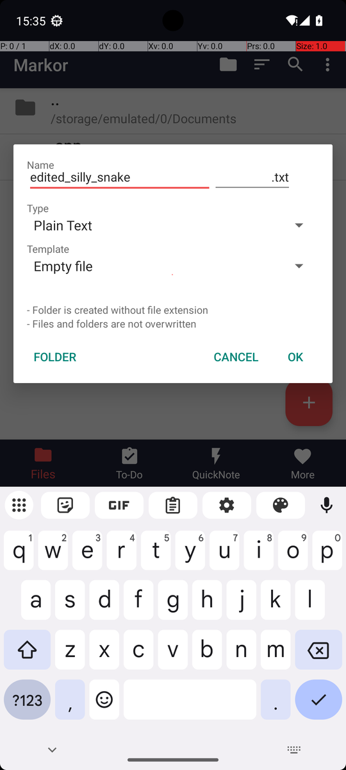
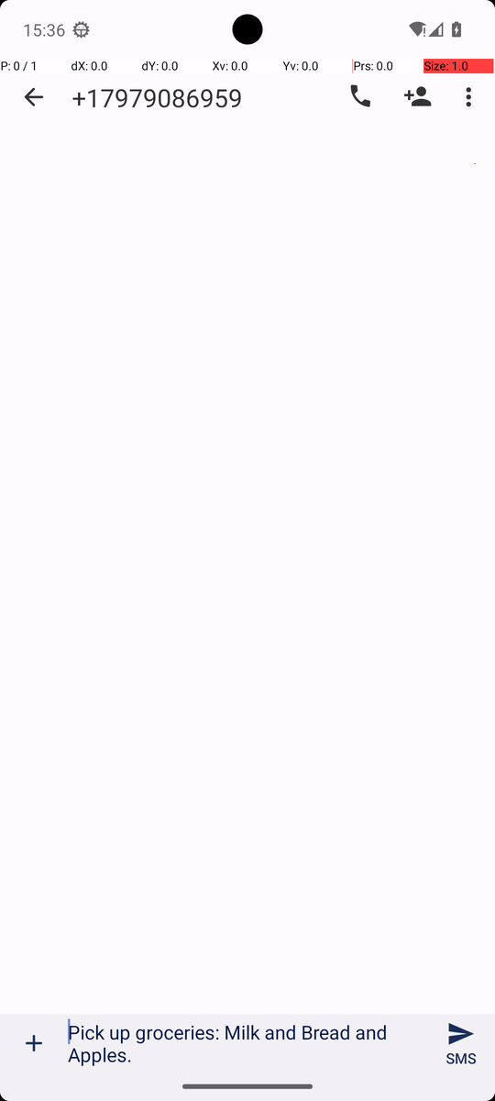
AGENTIC AI IN MODERN BUSINESS · PRESENTATION
Thank you
Questions are welcome
https://github.com/Chenschenschen/androidworld-gui-agent/tree/team-agent
Model: AutoGLM-Phone-9B-Multilingual (Z.ai)
Benchmark: AndroidWorld (Google Research)

Slide 33
APPENDIX
What the agent can do, and what it sees in each task
Action | Example
Tap | do(action="Tap", element=[500, 335])
Type | do(action="Type", text="Ruggell")
Swipe | do(action="Swipe", start=[500,560], end=[500,260])
Launch | do(action="Launch", app="markor")
Back / Wait | do(action="Back")
Finish | finish(message="Track saved")
Task | Observation
Wi-Fi | Screenshot + Settings labels
Contacts | Screenshot only
SMS | Screenshot only
Files | Screenshot only
Calendar | Screenshot only
Markor + SMS | Screenshot only (+ text Skill)
OsmAnd | Screenshot + accessibility tree (+ coded Skill)
Grounding: coordinates on a 0–1000 grid. Where labels are given, the step text also lists each label's tap centre.
Agentic AI in Modern Business · AndroidWorld GUI agent
33

Slide 34
APPENDIX
Steps used versus the course's reference steps
Agentic AI in Modern Business · AndroidWorld GUI agent
34

Slide 35
APPENDIX
Speed and cost: about 0.066 € for all 21 runs
1.47 M
tokens for all 21 final runs
€0.066
model cost of the final evaluation
(€0.045 per million tokens)
1.75 s
median time per model call
Agentic AI in Modern Business · AndroidWorld GUI agent
35

