Slide 1
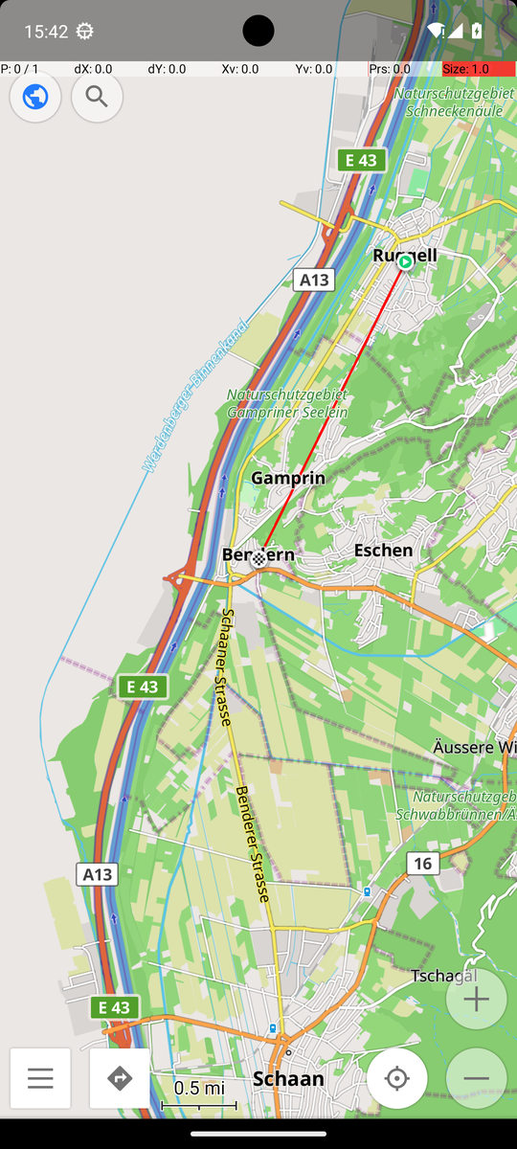
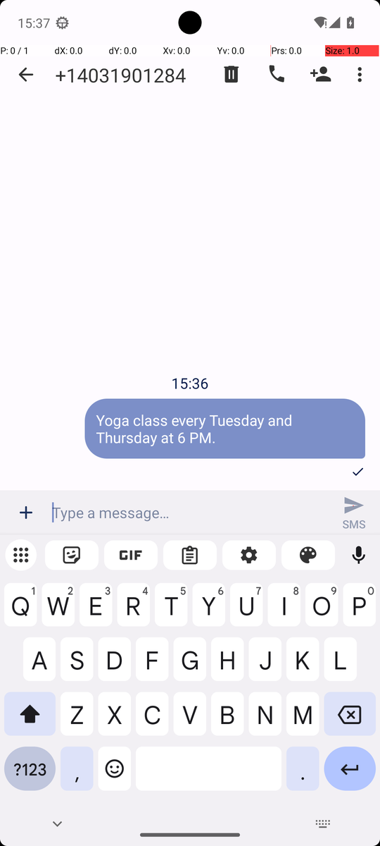
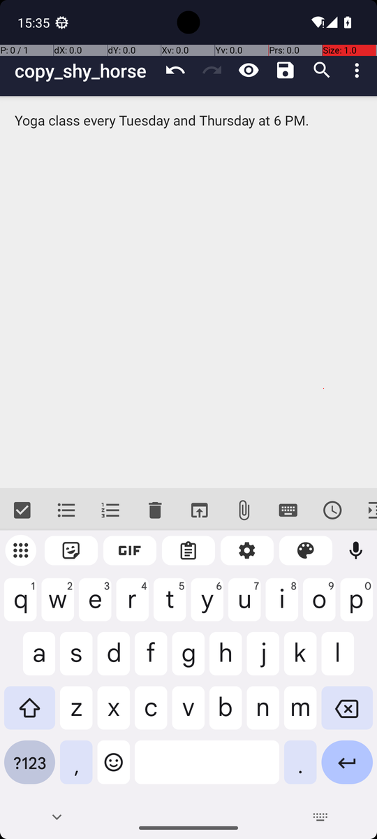
AGENTIC AI IN MODERN BUSINESS · PRESENTATION
TUM School of Management
One GUI agent for seven
AndroidWorld tasks
An agent that looks at the phone screen and decides where to tap, evaluated with the official AndroidWorld verifier.
TEAM MEMBERS
LECTURERS
Danh Phuong Le
Ssu-Cheng Chen
Hayati Ömer Koç
Jia Qi
Tin Nghia Nguyen
03824340
03827578
03801613
03812325
03826855
Haoyuan Jiang
Xuerui Zhang
Zhenyu Wang
Real screens from our evaluation runs
Notes:
Hello everyone, and thank you for having us.
Our project is a GUI agent for Android. A GUI agent uses a phone the way a person does: it looks at the screen and decides where to tap or what to type.
In the next 25 minutes we will show how we built one agent, how we tested it on seven AndroidWorld tasks, where it failed, and how we improved it.

Slide 2
AT A GLANCE
One agent, seven tasks: 18 of 21 runs passed the official check
18 / 21
7 tasks
~300
65
runs passed the official
AndroidWorld verifier
covering easy, medium
and hard (D1 task list)
recorded runs across
the whole project
agent versions, each
change tested and logged
Rigorous
Cheap and fast
Honest
▪ One frozen version for all 21 runs
▪ Every run screen-recorded
▪ Official checker decides success
▪ About 0.065 € model cost for 21 runs
▪ 1.77 s median per model call
▪ Hosted model, laptop without GPU
▪ Failures kept, analysed, not rerun
▪ Fixes tested on other task seeds
▪ Extra inputs disclosed per task
Agentic AI in Modern Business · AndroidWorld GUI agent
2
Notes:
Here is the short version.
We built one agent and gave it seven tasks from AndroidWorld, from easy to the hardest one on the course list. Each task ran three times on one frozen version, and every run was screen-recorded.
18 of the 21 runs passed. Pass means the official AndroidWorld checker looked at the phone's data and confirmed the task was done. The model's own "I am done" does not count.
Behind this result there is a lot of work: about 300 recorded runs across the project and 65 versions of the agent.
And it was cheap: the model cost for all 21 final runs was about 0.065 euro.

Slide 3
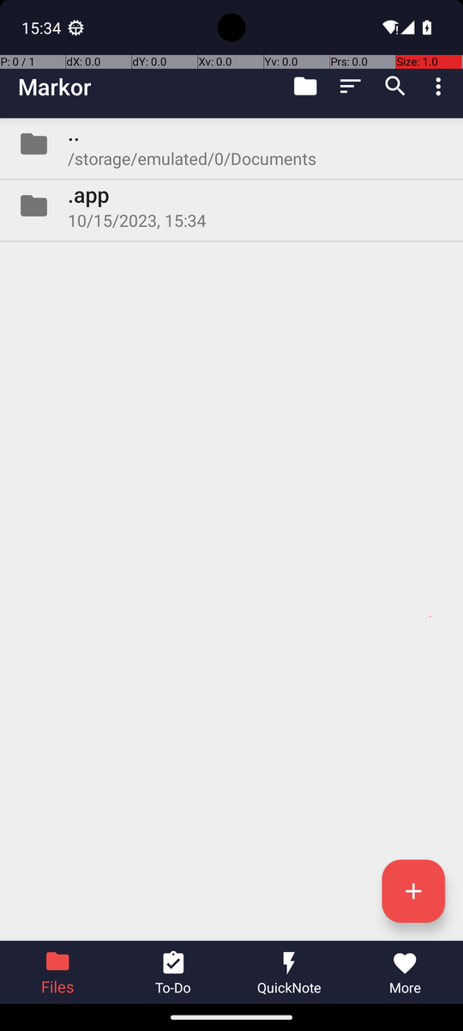
USE CASE
A phone assistant that uses apps the way a person does
Who it helps
People who find phones hard to use, busy users with repeated tasks, teams that test apps.
What it needs
Only the screen: no special app interface. It reads, taps, types and swipes like a person.
What it is told
One sentence in plain English, for example: “Create a note named … and share its content via SMS.”
One of our runs: a note created in Markor, then sent as an SMS
Agentic AI in Modern Business · AndroidWorld GUI agent
3
Notes:
Our use case is a phone assistant for everyday tasks.
You tell it in plain words what you want, for example "Send this message to this number", and it opens the right app and does the steps on the screen.
This is useful because it works with normal apps. It needs no special interface from the app maker. It only needs the screen, like a person.
In business this helps with three things: helping people who find phones hard to use, saving time on repeated phone tasks, and testing apps automatically.

Slide 4
TASKS
Seven tasks from all three difficulty rows of the course list
Row | Task | What the agent is told (short) | Reference steps
Warm-up | SystemWifiTurnOn | Turn Wi-Fi on | 3
Warm-up | ContactsAddContact | Create a contact with a name and number | 5
Real work | SimpleSmsSend | Send a message to a number with Simple SMS Messenger | 6
Real work | FilesMoveFile | Move a file from one folder to another | 10
Real work | SimpleCalendarAddOneEvent | Create an event on a date and hour, with title and length | 17
Multi-app | MarkorCreateNoteAndSms | Create a note, then share its text with a number via SMS | 9
Multi-app | OsmAndTrack | Save a track: Ruggell, then Bendern (the slide's instance) | 60
Reference steps: the number of steps AndroidWorld lists for each task (course slide D1 p.7).
Agentic AI in Modern Business · AndroidWorld GUI agent
4
Notes:
The course asks for at least three tasks, at least one from each difficulty row. We chose seven, so we could see patterns, not just single cases.
Two warm-up tasks: turn on Wi-Fi and add a contact.
Three real-work tasks: send an SMS, move a file, and add a calendar event with date, time and length.
Two multi-app tasks: write a note in Markor and send it by SMS, which uses two apps, and OsmAndTrack, the hardest task on the list, with a reference of 60 steps.
For the six template tasks AndroidWorld fills in random names and numbers. For OsmAnd we used exactly the route on the course slide: Ruggell, then Bendern.

Slide 5
MODEL
Why AutoGLM-Phone-9B, and what we tried first
 | AutoGLM-Phone-9B (Z.ai API) | GELab-Zero 4B (local, Ollama)
Built for | Phone GUI control | Phone GUI control
Where it runs | Hosted API | Laptop GPU (8 GB), partial offload
Speed per model call | 1.77 s median (296 calls) | 19–21 s per screenshot request
Action format | Native do(...) / finish(...), parsed reliably | Bare tokens our parser rejected
Cost | €0.045 per million tokens | Free, but slow
Our results | 18 / 21 in the final evaluation | Contacts: 1 PASS in 6 trials
Leaderboard | AutoGLM-Mobile (9B) 80.2% on AndroidWorld* | —
Our first attempt (v1–v10)
▪ Started with GELab-Zero, the model on the course slide
▪ Model larger than the 8 GB GPU: ~20 s per screenshot request
▪ Contacts: 1 of 6 trials passed
▪ Wi-Fi: invalid action format, false “Wi-Fi is on”
▪ Switched to the hosted AutoGLM model
* Community leaderboard entry (google-research/android_world); the listed checkpoint may differ from the hosted model we call.
Agentic AI in Modern Business · AndroidWorld GUI agent
5
Notes:
Next, the model. The course says any model is fine, as long as we name it. Ours is AutoGLM-Phone-9B-Multilingual, which we use through the Z.ai API.
We did not start with it. Our first versions used GELab-Zero 4B, the model on the course slide, running locally with Ollama on a laptop GPU with 8 gigabytes of memory. The model did not fit completely on the GPU, so one screenshot request took about 20 seconds. Only one of six Contacts trials passed, and in a Wi-Fi run the model answered in a format our parser could not accept, and even said Wi-Fi was on when it was not. That was our first unsuccessful attempt.
AutoGLM is trained for phone screens and has a clear action format. Our median time per model call was 1.77 seconds, and the price is 0.045 euro per million tokens.
On the AndroidWorld leaderboard a 9B AutoGLM-Mobile entry is listed at 80.2 percent. That entry may not be the exact hosted version we use, so we only say it is one of the top-ranked model families.

Slide 6
AGENT DESIGN
One class, one step(): observe, decide, check, act, record
1 Observe
2 Decide
3 Check
4 Act
5 Record
Screenshot
(+ GUI labels for
some tasks)
AutoGLM picks
one action
Format, screen point,
focus, task rules
Tap, type, swipe,
launch, back
Trajectory log
+ screen video
repeat until the model says finish, or the step budget ends → official AndroidWorld verifier: PASS / FAIL
step() in AutoGLMAgent (autoglm_agent.py)
Same agent for all seven tasks
Reads the screen and the task, chooses one action, checks it, executes it, and reports whether the model said it is done.
Task-specific knowledge is loaded as data (completion rule, optional Skill). The model still decides every action.
Agentic AI in Modern Business · AndroidWorld GUI agent
6
Notes:
This is how the agent works. It is one Python class with one method, step, as the course asks.
Each step does five things.
First, observe: take a screenshot of the phone. For Wi-Fi and OsmAnd it also gets text labels of the screen, and we report this for every run.
Second, decide: send the task, the recent history and the screenshot to the model. The model answers with one action, for example tap at this point, or type this text.
Third, check: our code checks the action before anything happens on the phone. Is the format valid? Is the point on the screen? Is a text field really focused before we type?
Fourth, act: run the action on the emulator.
Fifth, record: save the screenshot, the model's answer and the result in the trajectory log, while the screen recorder runs.
This repeats until the model says finish or the step budget ends. Then the official checker decides pass or fail. All seven tasks use this same class.

Slide 7
AGENT DESIGN
Context and Skills: what goes into each model request
Every request
Markor Skill (text)
OsmAnd Skill (code)
▪ System prompt: action rules
▪ Completion rule: what “done” looks like
▪ Last 20 steps of history
▪ Newest screenshot
▪ Status: step number, last result
▪ Loaded only for this task
▪ Fact: Share attaches the file and makes a failing MMS
▪ Procedure: name + extension, Save, launch SMS, plain text, SMS button
▪ Repeated each step as a reminder
▪ Recognises the screen from the GUI tree
▪ States the next step and its tap centre
▪ Refuses actions the screen shows to be wrong
▪ Model still chooses every action
No fixed list of taps: Skills add app knowledge, the model makes every decision.
Agentic AI in Modern Business · AndroidWorld GUI agent
7
Notes:
What does the model receive at each step?
A system prompt with the action rules and a short completion rule, for example: the contact must be saved, a filled form is not enough.
The last 20 steps of history, the newest screenshot, and a short status text.
For two tasks we add a Skill. A Skill is app knowledge, loaded only for its task, as in the course's Skills idea.
For Markor it is text: use a plain SMS, never Markor's Share menu, because that sends an MMS that fails.
For OsmAnd the Skill is code. It reads the screen and tells the model the next step and where to tap. The model still decides and acts, and it did not always follow the advice.
So nothing is a fixed list of taps. The model makes every decision.

Slide 8
AGENT DESIGN
A safety net: actions are checked before they reach the phone
Check | Why | Final runs
Type with no focused text field | Text would go nowhere | 3
Malformed reply | Not exactly one action | 2
Unsupported action | Not in the action list | 1
Truncated reply | Answer cut off | 1
OsmAnd Favorite button | Saves a favourite, not a route point | 1
How a refusal works
▪ The action is not executed
▪ The model gets the reason in the same step
▪ One correction per step; a second invalid reply ends the run
▪ All refusals are logged
8
Without these checks, the agent would have typed into nothing, saved a favourite instead of a route point, or acted on a broken reply. Six of the seven runs with a refusal still passed.
actions stopped in the final runs
(7 of 21 runs had one or more)
Agentic AI in Modern Business · AndroidWorld GUI agent
8
Notes:
Our check step catches bad actions before they happen.
The general checks work for every task: an action must have the right format, a point must be on the screen, and typing is only allowed when a text field is focused. Otherwise the text would go nowhere.
Task checks protect against known traps. For OsmAnd, the star button on a place card saves a favourite, not a route point, so we refuse it.
When we refuse an action, the model gets one correction in the same step, with the reason.
In the 21 final runs these checks stopped 8 actions. Without them, some of these passing runs would have failed.

Slide 9
IMPLEMENTATION
Implementation: four parts and how they talk
AutoGLM model
Agent
Runner
Phone
Z.ai API (HTTPS)
autoglm-phone-multilingual
key kept in .env, not in git
AutoGLMAgent.step()
autoglm_agent.py
prompt, Skills, task config
run_task.py
task setup, recorder, loop,
verifier, logs
Android emulator: Pixel 6,
Android 13, headless
AndroidWorld setup + verifier
request /
one action
step() /
result
adb: screen,
tap, type
Batch evaluation
Quality
Reproduce
▪ evaluate_tasks.py runs task x seed batches
▪ Records a source fingerprint
▪ Stops if the code changes mid-batch
▪ 38 offline tests (no phone needed)
▪ Frozen git tag for the evaluation
▪ Every run: summary, log, video
▪ git checkout team-agent-final-v65
▪ evaluate_tasks.py --tasks ... --seeds 42 43 44 --run-all-seeds
▪ Python 3.11, Windows laptop, no GPU needed
Agentic AI in Modern Business · AndroidWorld GUI agent
9
Notes:
How is it implemented? Four parts work together.
The Android emulator runs a Pixel 6 phone with Android 13, without a window. AndroidWorld sets up each task from its seed and, at the end, its official verifier checks the result.
Our runner, run_task.py, prepares the task, starts the screen recorder, calls the agent step by step, then asks the verifier and writes the logs.
The agent, the AutoGLMAgent class in autoglm_agent.py, builds each request and checks each answer. The model itself runs behind the Z.ai API.
Around this, evaluate_tasks.py runs whole batches and stops if the code changes during a batch, and 38 offline tests protect every fix. One command reproduces the whole evaluation.

Slide 10
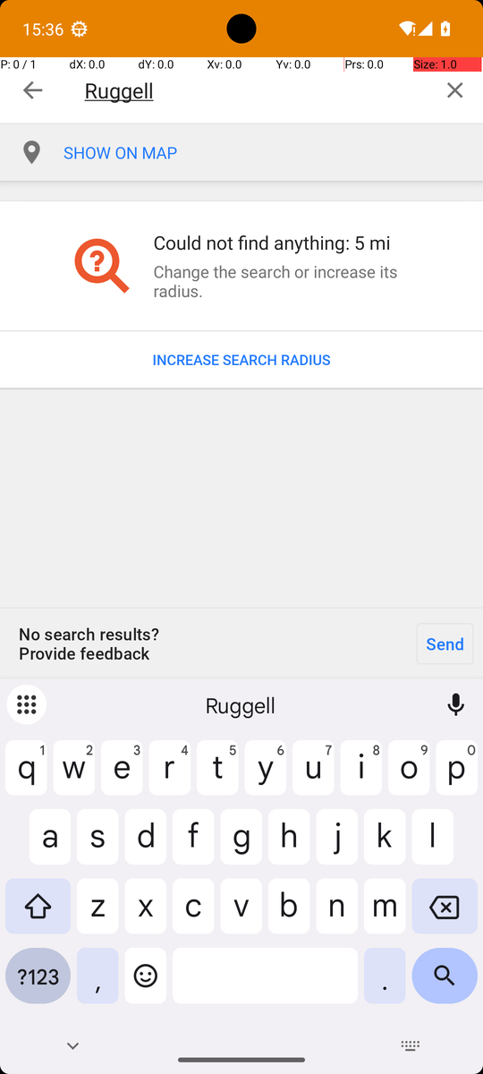
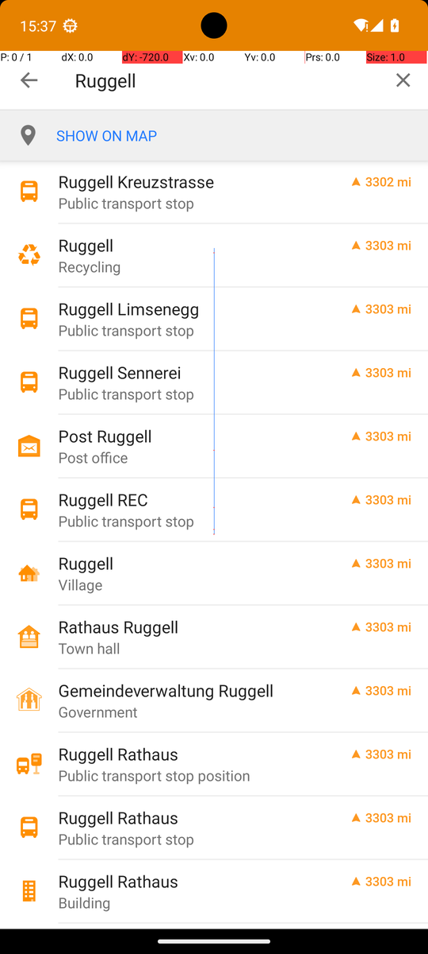
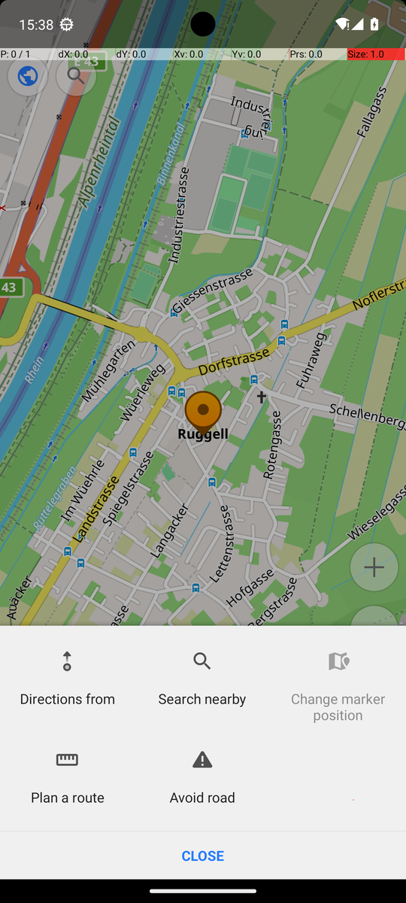
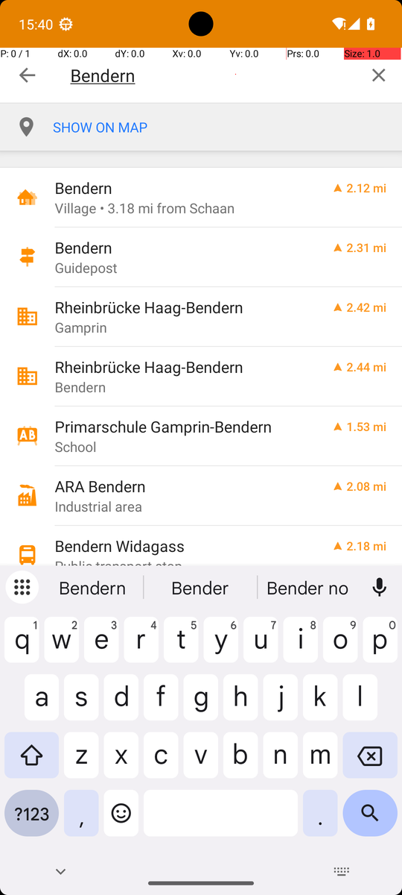
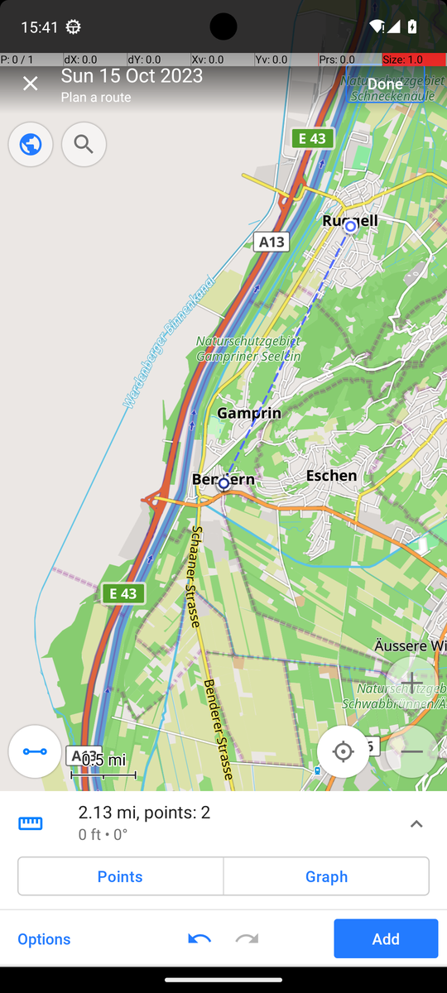
TRAJECTORY
One run, step by step: the OsmAnd track Ruggell to Bendern
Step 5
Step 9
Step 11
Step 16
Step 22
Step 23
“I need to tap "INCREASE SEARCH RADIUS" to expand the search area and find the place.”
“The "Ruggell" row labeled "Village" is visible and is the correct location.”
“I should tap it to start creating the route, which will allow me to add the next waypoint "Bendern" in the correct order.”
“I should tap this row to select it as the second waypoint for the track.”
“To save the track with both waypoints in the correct order, I should tap "Done" to complete the route creation and save the track.”
“The track has been created with both waypoints "Ruggell" and "Bendern" in the correct order and is now saved.”
Agentic AI in Modern Business · AndroidWorld GUI agent
10
Notes:
Here is one full run from the final evaluation: the hardest task, OsmAnd, with seed 314. It passed in 23 steps.
The model searched for Ruggell. The first search found nothing nearby, so it increased the search radius three times, scrolled the results, and picked the row labelled Village.
From the place menu it chose Plan a route, so Ruggell became the first point of the route.
Then it searched for Bendern, picked the village, went back to the route panel and tapped Add. The panel showed two points. It tapped Done, which saves the track, and called finish.
On the way it closed a crash dialog, and our check refused one Type because no text field was focused.
The official checker then read the saved track and confirmed both points in the right order. Under each picture is a sentence from the model's own reasoning, taken from the log.

Slide 11
EVALUATION
How we tested: one frozen version, three runs per task
Frozen
Three runs per task
Judged independently
▪ Git tag team-agent-final-v65
▪ Same source fingerprint in both batches
▪ No changes during the batch
▪ Seeds 42, 43, 44
▪ OsmAnd: 31, 314, 366 = the slide's route
▪ Failures kept, never rerun
▪ Official AndroidWorld verifier
▪ The model's “finish” never counts
▪ Step budget about 2–4× reference
Summary row
Trajectory log
Screen recording
Course fields (D1 p.49), written by the runner during the run
Every screenshot, model reply, check and result, step by step
The whole run on video, in one or more clips
Kept for every one of the 21 runs. The full run log follows right after the results.
Agentic AI in Modern Business · AndroidWorld GUI agent
11
Notes:
How did we test?
First, we froze the code. The final version has a git tag, and both evaluation batches have the same source fingerprint, so all 21 runs come from exactly the same agent.
Each task ran three times with fixed task seeds, 42, 43 and 44. For OsmAnd we used 31, 314 and 366, because these three seeds produce exactly the route on the course slide.
Success is decided only by the official AndroidWorld verifier, which reads the phone's data.
Every run keeps three records: a summary row with the fields from the course, written by our runner while the run happens; a step-by-step trajectory log; and a screen recording. You will see all 21 rows right after the results.
We did not rerun failures. A rerun of the same code only measures luck.

Slide 12
RESULTS
18 of 21 runs passed; every task passed at least twice
Row | Task | Run 1 | Run 2 | Run 3 | Passed
Warm-up | SystemWifiTurnOn | PASS s42 | PASS s43 | PASS s44 | 3/3
Warm-up | ContactsAddContact | PASS s42 | FAIL s43 other: navigation | PASS s44 | 2/3
Real work | SimpleSmsSend | PASS s42 | PASS s43 | PASS s44 | 3/3
Real work | FilesMoveFile | PASS s42 | FAIL s43 false_done | PASS s44 | 2/3
Real work | SimpleCalendarAddOneEvent | PASS s42 | PASS s43 | PASS s44 | 3/3
Multi-app | MarkorCreateNoteAndSms | PASS s42 | PASS s43 | PASS s44 | 3/3
Multi-app | OsmAndTrack | PASS s31 | PASS s314 | FAIL s366 grounding | 2/3
s = task seed. Official AndroidWorld verifier. One frozen version (tag team-agent-final-v65).
Agentic AI in Modern Business · AndroidWorld GUI agent
12
Notes:
Here are all 21 runs. Blue is pass, orange is fail.
Wi-Fi, SMS, Calendar and Markor passed all three runs.
Contacts, Files and OsmAnd passed two of three.
Both multi-app tasks together passed five of six, including OsmAndTrack, the hardest task on the list.
The three failures are all different. One is a false finish, one is a missed tap, and one is a navigation problem. We will look at each of them in a moment.
Please keep in mind that three runs is a small sample. Three of three does not mean the task always works.

Slide 13
RESULTS
Run log (1/2): one row per run
Model AutoGLM-Phone-9B (Z.ai), version v65, grounding by coordinates. Rows written by the runner during each run; click a run to open its log.
Task | Run | Seed | Observation | Steps / budget | Verifier | Failure class | Clips | Note
SystemWifiTurnOn | 1 of 3 | 42 | screenshot + labels | 5 / 12 | PASS | — | 1 | Settings > Internet > Wi-Fi on; finished
SystemWifiTurnOn | 2 of 3 | 43 | screenshot + labels | 5 / 12 | PASS | — | 1 | Same 5-step path; finished
SystemWifiTurnOn | 3 of 3 | 44 | screenshot + labels | 5 / 12 | PASS | — | 1 | Same 5-step path; finished
ContactsAddContact | 1 of 3 | 42 | screenshot | 12 / 16 | PASS | — | 1 | Name, scroll, number, Save; finished
ContactsAddContact | 2 of 3 | 43 | screenshot | 11 / 16 | FAIL | other: navigation | 1 | Swiped past Phone field; no-progress stop
ContactsAddContact | 3 of 3 | 44 | screenshot | 11 / 16 | PASS | — | 1 | Name, scroll, number, Save; finished
SimpleSmsSend | 1 of 3 | 42 | screenshot | 9 / 20 | PASS | — | 1 | New conversation, number, message, send
SimpleSmsSend | 2 of 3 | 43 | screenshot | 7 / 20 | PASS | — | 1 | Chinese app name resolved; sent in 7 steps
SimpleSmsSend | 3 of 3 | 44 | screenshot | 7 / 20 | PASS | — | 1 | Chinese app name resolved; sent in 7 steps
FilesMoveFile | 1 of 3 | 42 | screenshot | 17 / 25 | PASS | — | 1 | Scrolled to file, Move to, MOVE; finished
FilesMoveFile | 2 of 3 | 43 | screenshot | 13 / 25 | FAIL | false_done | 1 | Moved look-alike file, then finished
FilesMoveFile | 3 of 3 | 44 | screenshot | 13 / 25 | PASS | — | 1 | Same procedure; 1 malformed reply corrected
SimpleCalendarAddOneEvent | 1 of 3 | 42 | screenshot | 20 / 35 | PASS | — | 1 | Title, text, date, time, length; 1 fix
SimpleCalendarAddOneEvent | 2 of 3 | 43 | screenshot | 21 / 35 | PASS | — | 1 | Saved event; 1 unsupported action fixed
SimpleCalendarAddOneEvent | 3 of 3 | 44 | screenshot | 16 / 35 | PASS | — | 1 | Saved event in 16 steps; no refusals
Agentic AI in Modern Business · AndroidWorld GUI agent
13
Notes:
Here is the full log, one row per run, sorted by task, as the course asks.
Each row has the course's fields: task, run, the observation, steps against the budget, the verifier result, the failure class, the recording and a short note. The model, version and grounding are the same for every run, so they are in the line above the table.
Our runner writes these rows while each run happens, so nothing is filled in from memory. Each run number links to its full step-by-step log on GitHub.
The notes show small things the checks handled, for example the SMS runs where the model wrote the app name in Chinese and our runner still understood it.

Slide 14
RESULTS
Run log (2/2): the two multi-app tasks
Model AutoGLM-Phone-9B (Z.ai), version v65, grounding by coordinates. Rows written by the runner during each run; click a run to open its log.
Task | Run | Seed | Observation | Steps / budget | Verifier | Failure class | Clips | Note
MarkorCreateNoteAndSms | 1 of 3 | 42 | screenshot + Skill | 18 / 40 | PASS | — | 2 | Created the note with the right name and text and saved it; launched Simple SMS Messenger by a Chinese name (resolved by the alias table); typed the same text into a new plain SMS and sent it.
MarkorCreateNoteAndSms | 2 of 3 | 43 | screenshot + Skill | 18 / 40 | PASS | — | 2 | Typed the name, replaced the extension with .txt, typed and saved the text, then sent it as a plain SMS. One truncated model reply was retried.
MarkorCreateNoteAndSms | 3 of 3 | 44 | screenshot + Skill | 15 / 40 | PASS | — | 2 | New file, name and extension, text, Save; then Simple SMS Messenger, number, the text, SMS button. 15 steps.
OsmAndTrack | 1 of 3 | 31 | screenshot + tree + Skill | 22 / 90 | PASS | — | 4 | Before the run the runner restored OsmAnd's map (the Files runs had cleared storage). Three radius increases and one scroll found the Ruggell village; Actions > Plan a route; searched Bendern, SHOW ON THE MAP, Back x3, Add, Done. The Favorite button and one unfocused Type were refused.
OsmAndTrack | 2 of 3 | 314 | screenshot + tree + Skill | 23 / 90 | PASS | — | 3 | Same procedure as run 1; the accessibility service's “keeps stopping” dialog appeared and the model closed it; one unfocused Type was refused. Shown on slide 10.
OsmAndTrack | 3 of 3 | 366 | screenshot + tree + Skill | 16 / 90 | FAIL | grounding | 2 | Ruggell became route point 1 and the crash dialog was closed; in the second search the code stated “Tap Clear at [941, 83]” but the model tapped [941, 57], the top edge of the button, three times with no effect. No-progress stop.
Agentic AI in Modern Business · AndroidWorld GUI agent
14
Notes:
The second part shows the two hard tasks, with longer notes.
All three Markor runs followed the Skill: save the note, then send its text as a plain SMS. One run needed the alias table, because the model named the SMS app in Chinese.
The first OsmAnd run had to restore the map first, because the Files task had cleared the phone's storage. The only failure here, OsmAnd run 3, reached the first route point and then missed the Clear button. We come back to it in the failure analysis.

Slide 15
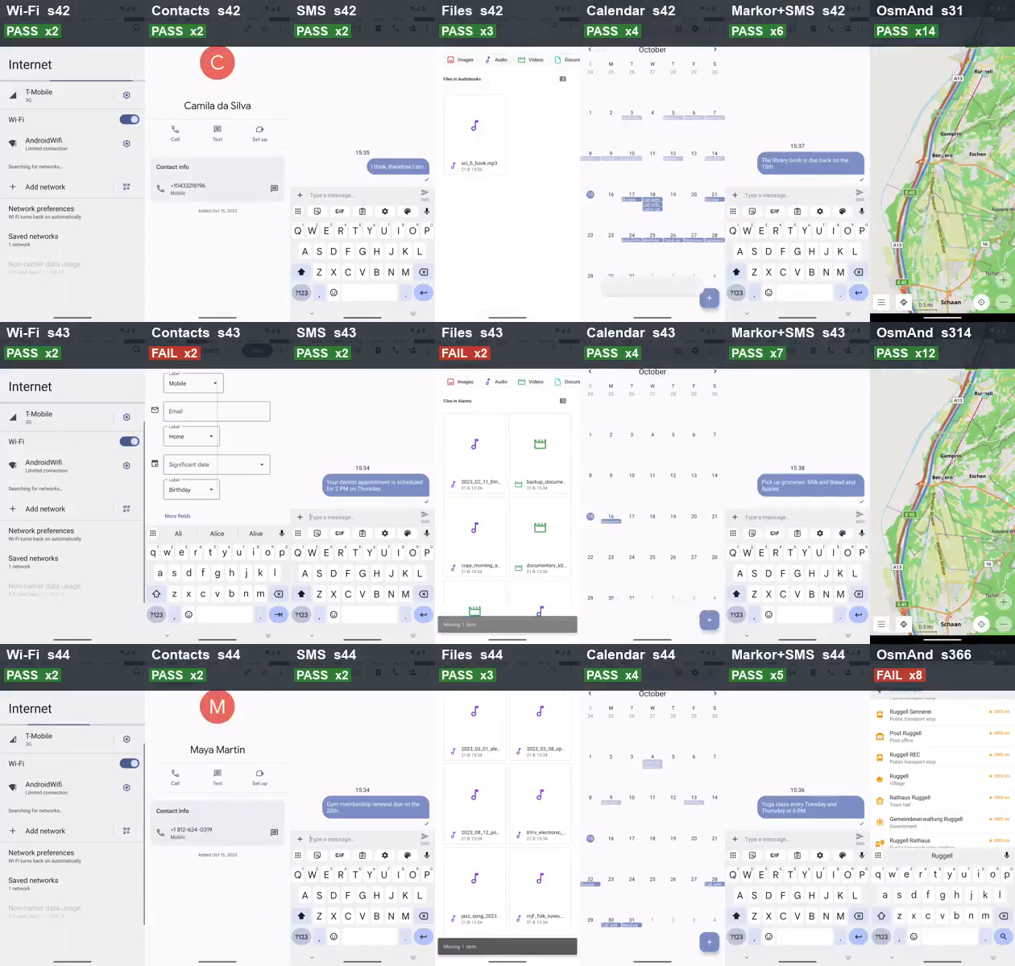
DEMO
All 21 evaluation runs at once (sped up)
How to read it
▪ Columns: Wi-Fi, Contacts, SMS, Files, Calendar, Markor + SMS, OsmAnd
▪ Rows: run 1, 2, 3 (seeds 42 / 43 / 44; OsmAnd 31 / 314 / 366)
▪ Label: verdict and speed-up (x2)
▪ Each clip stops on its final screen
Agentic AI in Modern Business · AndroidWorld GUI agent
15
Notes:
Now the demo. This video shows all 21 evaluation runs at the same time.
Each column is one task, each row is one run. The label says the task, the seed, pass or fail, and how much the video is sped up. Each clip ends on the final screen.
You can see the difference in length: Wi-Fi is sped up only two times, OsmAnd about ten times or more.
Look at the orange labels: Contacts seed 43, Files seed 43 and OsmAnd seed 366. These are the three failures we explain next.

Slide 16
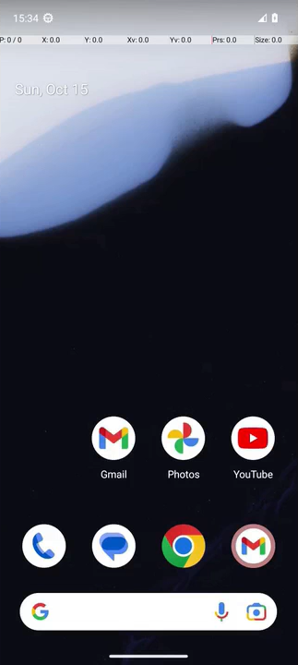
DEMO
Warm-up: SystemWifiTurnOn
Clip goes here
Wi-Fi, seed 42
Success
▪ Seed 42
▪ 5 steps, PASS
▪ Switched Wi-Fi on
▪ Finished on its own
Agentic AI in Modern Business · AndroidWorld GUI agent
16
Notes:
Here are two runs of the same task, Files, at a speed you can follow. Both are three times faster.
On the left, seed 42. The folder holds look-alike files whose names are cut off. The agent scrolls until it sees the full name, sci_fi_book.mp3, selects exactly that file and moves it to Audiobooks. The file disappears from Recordings, and the agent goes to Audiobooks to check before it says done. The checker says pass.
On the right, seed 43. Everything looks right: it opens the folder, selects a file, and moves it to Movies. But watch the file name in the grid. The name is cut off, and the agent picks a file that only looks like the right one. Then it says it is done. The checker says fail.
Same app, same kind of screen, one different choice. This brings us to the failure analysis.

Slide 17
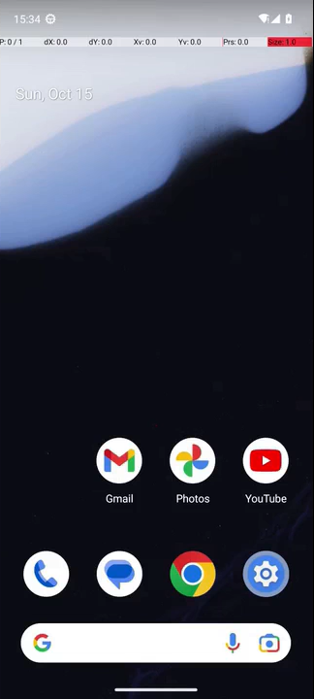

DEMO
Warm-up: ContactsAddContact
Clip goes here
Contacts, seed 42
Success
Clip goes here
Contacts, seed 43
Failure
▪ Seed 42
▪ 12 steps, PASS
▪ Name, scroll, number, save
▪ Finished on its own
▪ Seed 43
▪ 11 steps, FAIL
▪ Swiped past the Phone field
▪ Stopped for no progress
Agentic AI in Modern Business · AndroidWorld GUI agent
17
Notes:
Here are two runs of the same task, Files, at a speed you can follow. Both are three times faster.
On the left, seed 42. The folder holds look-alike files whose names are cut off. The agent scrolls until it sees the full name, sci_fi_book.mp3, selects exactly that file and moves it to Audiobooks. The file disappears from Recordings, and the agent goes to Audiobooks to check before it says done. The checker says pass.
On the right, seed 43. Everything looks right: it opens the folder, selects a file, and moves it to Movies. But watch the file name in the grid. The name is cut off, and the agent picks a file that only looks like the right one. Then it says it is done. The checker says fail.
Same app, same kind of screen, one different choice. This brings us to the failure analysis.

Slide 18
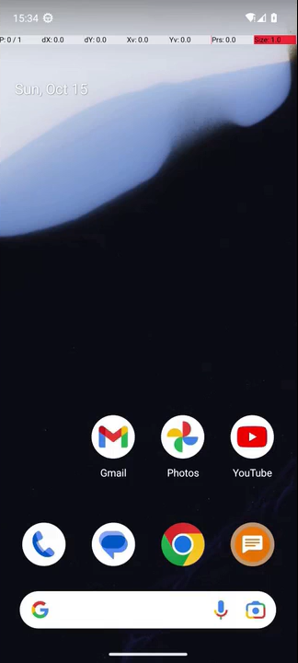
DEMO
Real work: SimpleSmsSend
Clip goes here
SMS, seed 42
Success
▪ Seed 42
▪ 9 steps, PASS
▪ New conversation, number, message, send
Agentic AI in Modern Business · AndroidWorld GUI agent
18
Notes:
Here are two runs of the same task, Files, at a speed you can follow. Both are three times faster.
On the left, seed 42. The folder holds look-alike files whose names are cut off. The agent scrolls until it sees the full name, sci_fi_book.mp3, selects exactly that file and moves it to Audiobooks. The file disappears from Recordings, and the agent goes to Audiobooks to check before it says done. The checker says pass.
On the right, seed 43. Everything looks right: it opens the folder, selects a file, and moves it to Movies. But watch the file name in the grid. The name is cut off, and the agent picks a file that only looks like the right one. Then it says it is done. The checker says fail.
Same app, same kind of screen, one different choice. This brings us to the failure analysis.

Slide 19
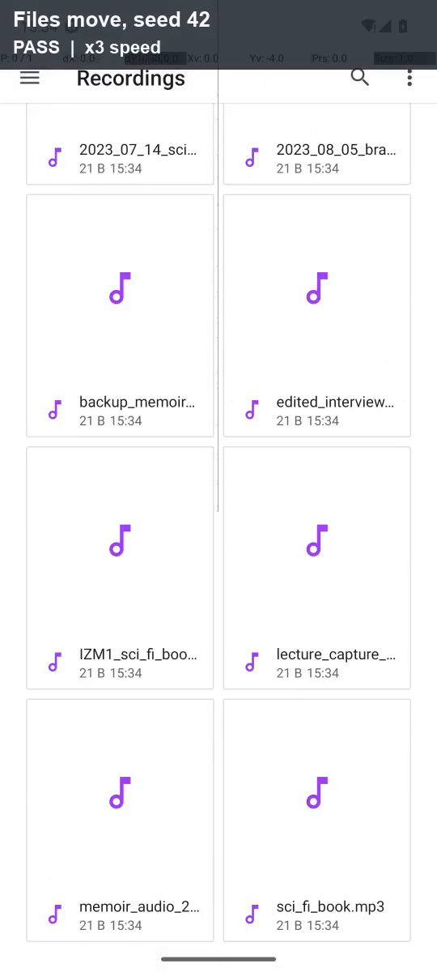
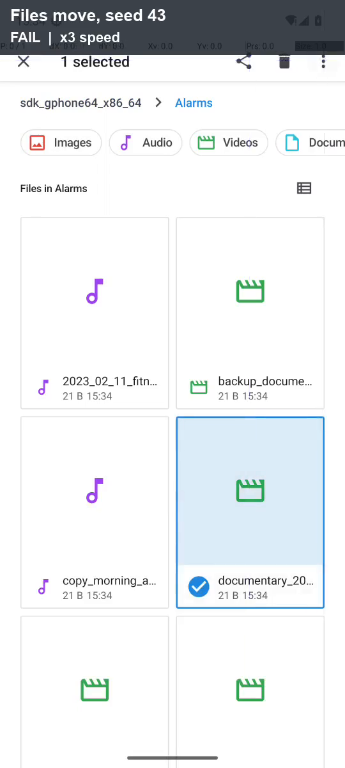
DEMO
Real work: FilesMoveFile
Success
Failure
▪ Seed 42
▪ 17 steps, PASS
▪ Chose the file whose full name was visible
▪ Seed 43
▪ 13 steps, FAIL
▪ Moved a look-alike file, then said done
Agentic AI in Modern Business · AndroidWorld GUI agent
19
Notes:
Here are two runs of the same task, Files, at a speed you can follow. Both are three times faster.
On the left, seed 42. The folder holds look-alike files whose names are cut off. The agent scrolls until it sees the full name, sci_fi_book.mp3, selects exactly that file and moves it to Audiobooks. The file disappears from Recordings, and the agent goes to Audiobooks to check before it says done. The checker says pass.
On the right, seed 43. Everything looks right: it opens the folder, selects a file, and moves it to Movies. But watch the file name in the grid. The name is cut off, and the agent picks a file that only looks like the right one. Then it says it is done. The checker says fail.
Same app, same kind of screen, one different choice. This brings us to the failure analysis.

Slide 20

DEMO
Real work: SimpleCalendarAddOneEvent
Clip goes here
Calendar, seed 42
Success
▪ Seed 44
▪ 16 steps, PASS
▪ Title, text, date, time, length
▪ Event saved, no refusal
Agentic AI in Modern Business · AndroidWorld GUI agent
20
Notes:
Here are two runs of the same task, Files, at a speed you can follow. Both are three times faster.
On the left, seed 42. The folder holds look-alike files whose names are cut off. The agent scrolls until it sees the full name, sci_fi_book.mp3, selects exactly that file and moves it to Audiobooks. The file disappears from Recordings, and the agent goes to Audiobooks to check before it says done. The checker says pass.
On the right, seed 43. Everything looks right: it opens the folder, selects a file, and moves it to Movies. But watch the file name in the grid. The name is cut off, and the agent picks a file that only looks like the right one. Then it says it is done. The checker says fail.
Same app, same kind of screen, one different choice. This brings us to the failure analysis.

Slide 21
DEMO
Multi-app and memory: MarkorCreateNoteAndSms
Clip goes here
Markor, seed 42
Success
Clip goes here
Markor + SMS, seed 44
Failure
▪ Seed ?
▪ ? steps, PASS
▪ Saved the note, then sent it as an SMS
▪ Seed ?
▪ … steps, FAIL
▪ Wrote the same message instead of copy-pasting
Agentic AI in Modern Business · AndroidWorld GUI agent
21
Notes:
Here are two runs of the same task, Files, at a speed you can follow. Both are three times faster.
On the left, seed 42. The folder holds look-alike files whose names are cut off. The agent scrolls until it sees the full name, sci_fi_book.mp3, selects exactly that file and moves it to Audiobooks. The file disappears from Recordings, and the agent goes to Audiobooks to check before it says done. The checker says pass.
On the right, seed 43. Everything looks right: it opens the folder, selects a file, and moves it to Movies. But watch the file name in the grid. The name is cut off, and the agent picks a file that only looks like the right one. Then it says it is done. The checker says fail.
Same app, same kind of screen, one different choice. This brings us to the failure analysis.

Slide 22
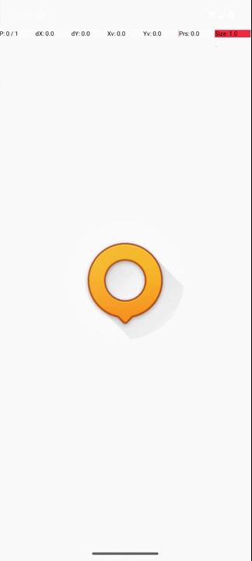

DEMO
Multi-app and memory: OsmAndTrack
Clip goes here
OsmAnd, seed 314
Success
Clip goes here
OsmAnd, seed 366
Failure
▪ OsmAnd, seed 314
▪ 23 steps, PASS
▪ Route Ruggell to Bendern saved
▪ Closed a crash dialog
▪ OsmAnd, seed 366
▪ 16 steps, FAIL
▪ Tapped [941, 57], not [941, 83]
▪ Clear button missed 3 times
Agentic AI in Modern Business · AndroidWorld GUI agent
22
Notes:
Here are two runs of the same task, Files, at a speed you can follow. Both are three times faster.
On the left, seed 42. The folder holds look-alike files whose names are cut off. The agent scrolls until it sees the full name, sci_fi_book.mp3, selects exactly that file and moves it to Audiobooks. The file disappears from Recordings, and the agent goes to Audiobooks to check before it says done. The checker says pass.
On the right, seed 43. Everything looks right: it opens the folder, selects a file, and moves it to Movies. But watch the file name in the grid. The name is cut off, and the agent picks a file that only looks like the right one. Then it says it is done. The checker says fail.
Same app, same kind of screen, one different choice. This brings us to the failure analysis.

Slide 23
FAILURE ANALYSIS
How 275 project runs ended: the setup failed most often
The five failure classes (D1 p.50)
▪ grounding: the tap lands on nothing
▪ too_early: acting on a loading screen
▪ lost_value: a value is lost or invented
▪ wrong_app: the wrong app is used
▪ false_done: says done, verifier fails
▪ Final evaluation: false_done 1, grounding 1, other 1
Agentic AI in Modern Business · AndroidWorld GUI agent
23
Notes:
Before we look at single failures, here is the bigger picture: all 275 runs in our project that have a machine-readable summary, from the first tests to the final evaluation.
96 runs passed. Among the rest, the largest group is not the model at all: 60 runs ended with setup or other errors, for example the emulator, the recorder or a crashed service.
Next come no-progress stops: the agent repeated an action and nothing changed, so our rule stopped the run early instead of wasting the budget. Then invalid replies, and runs that used up the step budget.
The most dangerous group is false completion: the model says done, but the checker says fail. We saw 19 of these. The course calls this false_done, and our completion rules and checks are there to reduce it.

Slide 24
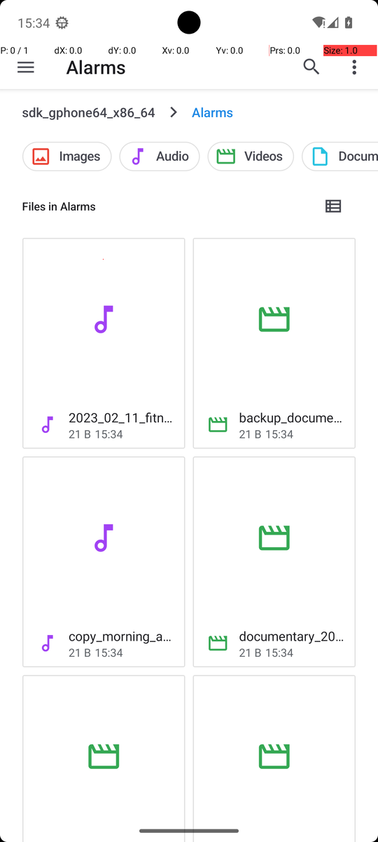
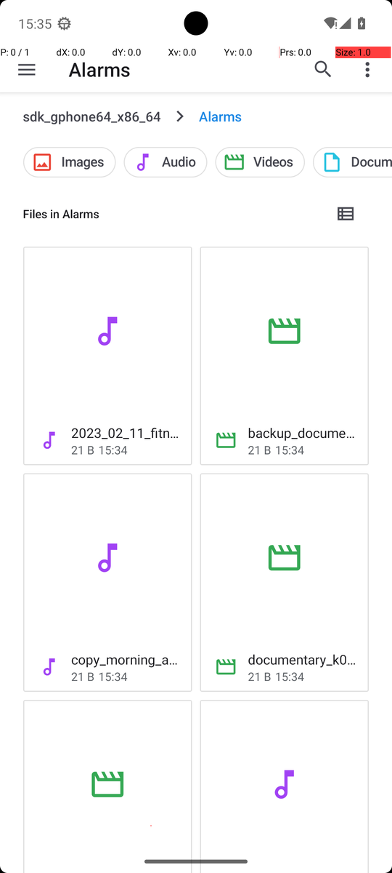
FAILURE ANALYSIS
Deep dive: a false finish caused by a look-alike file
Steps | What happened | Assessment
1–4 | Opened Files, the storage root, then Alarms | Correct
5 | Grid with cut-off names; long-pressed “documentary_20…” | Wrong object
6–11 | More options > Move to > Movies > MOVE | Correct steps, wrong file
12–13 | Waited for “Moving 1 item”, then finish | false_done
Model: “I see the "documentary_2023_03_14.mp4" file in the Alarms folder, which matches the required file "documentary.mp4" (assuming it is named differently here).”
Class
Fix layer
false_done (D1 p.50); root cause: a look-alike chosen from a truncated name
Instruction: list view or exact search. Program: check the full name before Move
Agentic AI in Modern Business · AndroidWorld GUI agent
24
Notes:
Our main failure analysis: Files, seed 43. The task: move documentary dot mp4 from Alarms to Movies.
AndroidWorld puts distractor files with similar names in the same folder. In the grid view, the names are cut off.
At step 5 the agent saw "documentary underscore 20..." and picked it. In its reasoning it even wrote "assuming it is named differently here". So it guessed, and it invented the full name.
Then it did the move perfectly, waited for "Moving 1 item", and finished with the message that the file was moved. The verifier failed it, because the real file never moved.
Class: false_done. The root cause is choosing a look-alike from a truncated name.
Where to fix it: in the instructions, switch to list view or search for the exact name. And in the program, a check before Move that the selected name is exactly the requested one. That is the course's idea of a check step before declaring done.

Slide 25
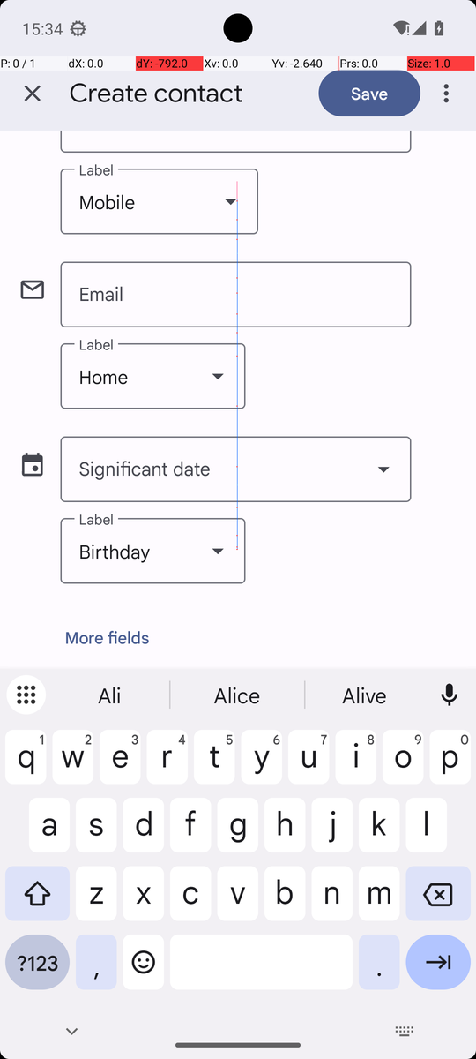
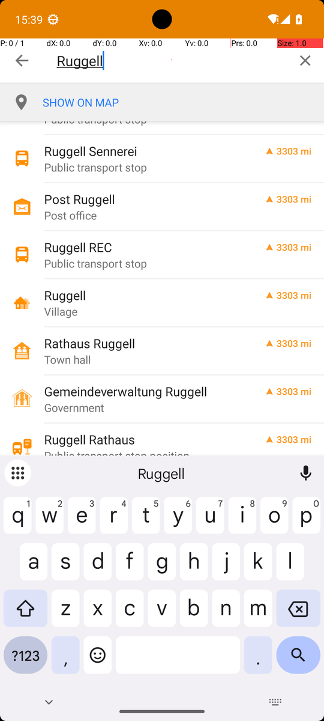
FAILURE ANALYSIS
Two more failures, and why runs of one task differ
Contacts s43: other
OsmAnd s366: grounding
Two swipes went past the Phone field; four more changed only the blinking cursor, which our check counted as a change.
Code: “Tap Clear at [941, 83]”. Model tapped [941, 57], the top edge of the button, three times: no effect.
Same task, two frozen evaluations | Run 1 | Run 2 | Run 3
OsmAnd v61 (Skill experiment) | FAIL | PASS | PASS
OsmAnd v65 (final) | PASS | PASS | FAIL
Contacts v42 (earlier) | PASS | PASS | PASS
Contacts v65 (final) | PASS | FAIL | PASS
Left: Contacts s43, Phone field cut off at the top. Right: OsmAnd s366, Clear button at the top right.
Agentic AI in Modern Business · AndroidWorld GUI agent
25
Notes:
The other two failures.
Contacts, seed 43: the agent swiped to find the phone field, but two swipes went past it to the end of the form. Then it kept swiping in the same direction. Our own feedback did not help: the blinking text cursor counted as a screen change, so the agent was told its swipe had worked. We classify this as other, a navigation problem.
OsmAnd, seed 366: our code said "tap Clear at 941, 83". The model tapped at 941, 57, the very top edge of the button, three times, and nothing happened. That is grounding: the tap lands on nothing.
An important pattern: the same task can pass on one run and fail on another. OsmAnd was two of three in two separate frozen evaluations, but different runs failed, for different reasons. Long tasks have many steps, and each step is a chance for a small error.

Slide 26
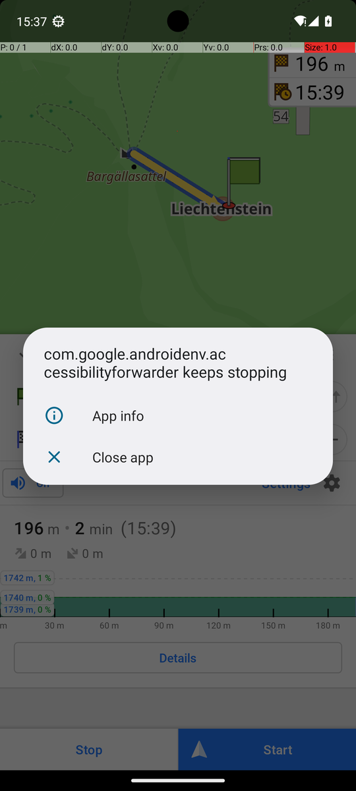
FAILURE ANALYSIS
Not every failure is the model: test-setup problems
Symptom | Root cause | Fix
Model “waited” on a black screen | Emulator GPU mode returned all-black frames | Headless host-GPU emulator; black frames stop the run
Screen recording stopped | Android tools restarted their server on a timeout | Keep the server; longer app-start timeout
App start timed out | Cold start longer than 5 s | 30 s launch timeout
“keeps stopping” dialog | Accessibility service crash (11 of 25 OsmAnd runs) | Model closes it; empty tree read again
OsmAnd map missing | Files task initialization deletes shared storage | Check the map before OsmAnd; rerun official setup
Trust the harness before judging the model: without these fixes, setup faults would look like agent failures.
Agentic AI in Modern Business · AndroidWorld GUI agent
26
Notes:
Not every failure is the model's fault. We found several problems in the test setup itself, and we fixed them before trusting any result.
On our laptop the emulator first returned black screenshots, so the model was waiting on a black screen. The screen recorder died when the Android tools restarted their server. A cold app start took longer than the default five seconds.
Two problems were special. AndroidWorld's accessibility service crashed in 11 of 25 OsmAnd runs with it; the model learned to close the dialog. And the official initialization of the Files task deletes every file in shared storage, including OsmAnd's offline map. So before each OsmAnd run our runner now checks the map and restores it.
Our lesson: trust the test harness first, then judge the model.

Slide 27
IMPROVEMENT
The hardest task: from zero passes to two of three
What changed
▪ Skill as text: the model often ignored it
▪ Rules on the model’s words: bypassed
▪ Program reads the screen (accessibility tree)
▪ Skill as code: next step + tap centre
▪ Each fix tested on practice seeds, never on the evaluation seeds
Agentic AI in Modern Business · AndroidWorld GUI agent
27
Notes:
Now the improvement. We focused on OsmAndTrack, the hardest task. It needs about 20 correct steps in a map app.
This chart shows all our OsmAnd runs, grouped by version, and how many passed.
For a long time nothing passed: 46 runs with zero passes. With the Skill only as text, and later with rules based on the model's own words, the agent never saved a correct track.
Two changes made the difference. First, we gave the program eyes: the accessibility tree, so the code can read the real screen. Second, we turned the Skill into code: it recognises the screen and gives the next step and where to tap.
After that, 8 of the next 15 runs passed, and both frozen evaluations reached two of three.

Slide 28
IMPROVEMENT
Before and after: only the Skill changed
OsmAnd, seeds 31 / 314 / 366 | No Skill | Skill
Official verifier PASS | 0 / 3 | 2 / 3
Searched the place name only | 0 / 3 | 3 / 3
Route started with a searched place | 0 / 3 | 2 / 3
Saved a track | 0 / 3 | 2 / 3
Mean steps | 23.3 | 18.7
Frozen v61 (tag osmand-extra-v61); identical source hashes in both batches; only task_skills differs. Three runs per side is a small sample.
Agentic AI in Modern Business · AndroidWorld GUI agent
28
Notes:
This is our documented improvement with before and after results.
We ran the slide's exact OsmAnd task three times with the Skill and three times without it. Same frozen code, same seeds, same model. Only the Skill was switched on or off.
Without the Skill: zero of three. The model typed "Ruggell, Liechtenstein", which only finds the country, and two runs used navigation, which never saves a track.
With the Skill: two of three passed.
The chart on the right shows the milestones. Without the Skill the agent never reached the first real milestone.
To be fair, this is app knowledge in code, and it only works for OsmAnd. A new app would need its own procedure.

Slide 29
IMPROVEMENT
Every failure taught us something we built into the final agent
Failure we saw | Cause | Change | Final result
Markor: message “Not sent” | Markor’s Share menu makes an MMS | Markor Skill: plain SMS, SMS button | Markor 3 / 3
Markor: typing refused | Custom editor not seen as a text field | Focus check accepts the editor | Markor 3 / 3
SMS app name in Chinese | Two apps allowed, name unclear | Alias table for known translations | Markor 3 / 3
OsmAnd map missing | Files initialization clears storage | Map check + official setup | OsmAnd 2 / 3
OsmAnd 0 / 3 | Long procedure, model loses its place | Skill as code + GUI tree | OsmAnd 2 / 3
Every change has an automatic offline test (38 tests in total) that fails on the old code and passes on the new code.
Agentic AI in Modern Business · AndroidWorld GUI agent
29
Notes:
The improvement was not only OsmAnd. While building the final agent, each failure led to one small, tested change.
For Markor, an earlier analysis found that sharing the file from Markor sends an MMS that fails. We turned that into the Markor Skill, and the final runs passed three of three.
Markor's editor uses a custom text box, so our focus check refused typing. We fixed the check.
The model sometimes translated the SMS app name into Chinese. With two apps in one task we could not guess which one it meant, so we added an alias table.
And the Files task deleted OsmAnd's map, so we added the map check.
Each fix came from one recorded failure and has an automatic test.

Slide 30
OUR WORK IN NUMBERS
Behind the final result
~300
65
1,453
recorded runs across the project
agent versions with a written reason
steps executed in this agent's runs
1,642
38
€0.48
model calls in this agent's runs
automatic offline tests
model cost of all local runs
Agentic AI in Modern Business · AndroidWorld GUI agent
30
Notes:
A few numbers show the work behind the result.
About 300 recorded runs across the project, 65 versions of the agent, 38 automatic tests, and 1453 executed steps in this agent's runs alone.
Every version change has a written reason, and every run has its log. This is what lets us explain the failures today, instead of guessing.

Slide 31
FINDINGS
What we learned, and what is still limited
Findings
Limitations
▪ Trust the harness first: setup faults looked like agent failures
▪ The verifier decides: false completions are real and dangerous
▪ Where knowledge lives matters: prompt < reminder each step < code
▪ Long tasks fail by small errors: one missed tap is enough
▪ Checks catch traps: 8 actions stopped in the final runs
▪ Three runs per task: small sample
▪ One model, one laptop, one emulator
▪ OsmAnd Skill works only for OsmAnd
▪ Two tasks used extra screen labels
▪ Fixes after the freeze are not evaluated
Agentic AI in Modern Business · AndroidWorld GUI agent
31
Notes:
To finish, what did we learn?
One: trust the test setup before you judge the model. Black screens and lost videos looked like agent failures at first.
Two: the official checker must decide, not the model. False completions are real, and they are the most dangerous failure.
Three: where knowledge lives matters. A Skill in the system prompt was ignored. Repeated each step it was followed. As code it worked best.
Four: long tasks fail by small errors adding up. A missed tap or a wrong guess at any step is enough.
Our limitations: three runs per task is a small sample; we used one model; the OsmAnd Skill only works for OsmAnd; and two tasks used extra screen labels, which we report in the results.

Slide 32
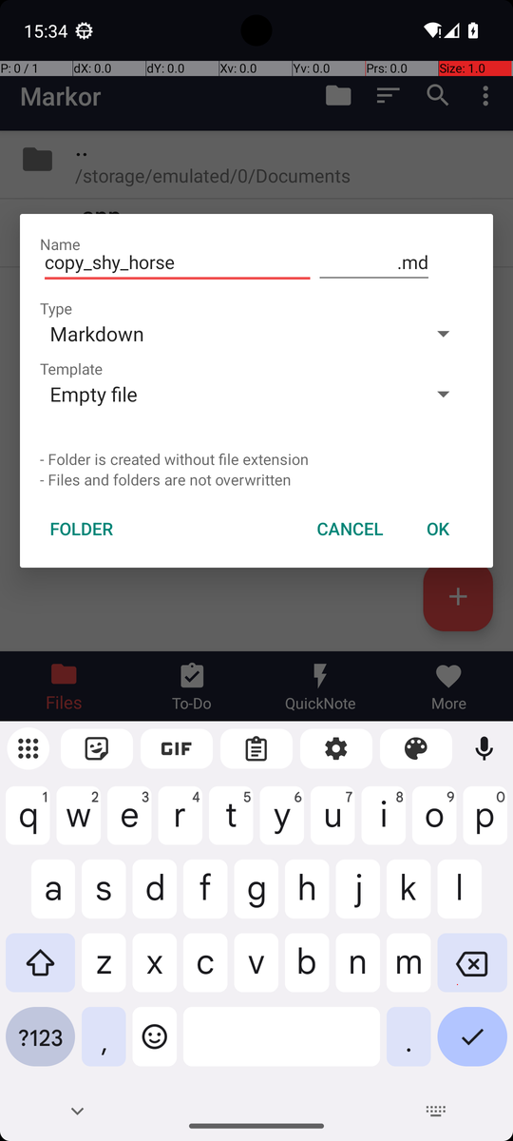
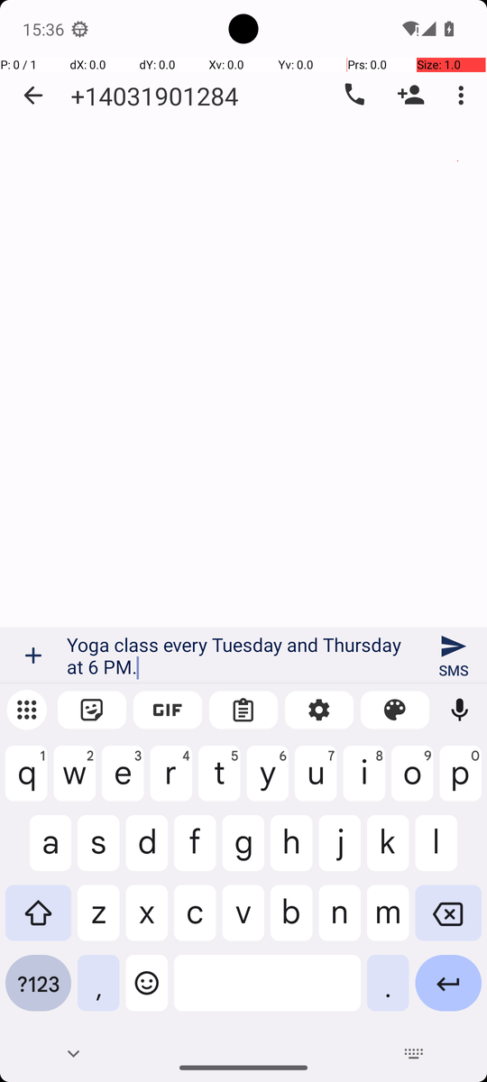
AGENTIC AI IN MODERN BUSINESS · PRESENTATION
Thank you
Questions are welcome
https://github.com/Chenschenschen/androidworld-gui-agent/tree/team-agent
Model: AutoGLM-Phone-9B-Multilingual (Z.ai)
Benchmark: AndroidWorld (Google Research)
Notes:
Thank you for listening. We are happy to take your questions.

Slide 33
APPENDIX
What the agent can do, and what it sees in each task
Action | Example
Tap | do(action="Tap", element=[500, 335])
Type | do(action="Type", text="Ruggell")
Swipe | do(action="Swipe", start=[500,560], end=[500,260])
Launch | do(action="Launch", app="markor")
Back / Wait | do(action="Back")
Finish | finish(message="Track saved")
Task | Observation
Wi-Fi | Screenshot + Settings labels
Contacts | Screenshot only
SMS | Screenshot only
Files | Screenshot only
Calendar | Screenshot only
Markor + SMS | Screenshot only (+ text Skill)
OsmAnd | Screenshot + accessibility tree (+ coded Skill)
Grounding: coordinates on a 0–1000 grid. Where labels are given, the step text also lists each label's tap centre.
Agentic AI in Modern Business · AndroidWorld GUI agent
33
Notes:
The model can use seven actions: tap, type, swipe, launch an app, go back, wait, and finish. Taps use coordinates on a grid from 0 to 1000.
What the agent sees is the screenshot. For two tasks it also gets text labels of the screen elements. For Wi-Fi these come from the Settings app. For OsmAnd they come from AndroidWorld's accessibility tree, the same information a screen reader uses.
We show this openly because it changes what we measure: five tasks were solved from the screenshot alone, two had extra help. The course example log on slide 49 also lists "accessibility tree" as an observation type, so this is allowed, but it must be reported.

Slide 34
APPENDIX
Steps used versus the course's reference steps
Agentic AI in Modern Business · AndroidWorld GUI agent
34
Notes:
This chart compares the steps our agent used in passing runs with the reference steps from the course list.
On simple tasks the agent needs a few more steps than the reference, for example because it checks the result or opens a menu first.
Markor needs about twice the reference, because the agent types the text twice, once in the note and once in the SMS, instead of sharing it.
On OsmAnd it is the other way round: the reference is 60 steps, and our agent needed only about 22, because the coded Skill leads it along the shortest path.
The light bar is the step budget, the maximum we allow before we stop a run.

Slide 35
APPENDIX
Speed and cost: about 0.065 € for all 21 runs
1.45 M
tokens for all 21 final runs
€0.065
model cost of the final evaluation
(€0.045 per million tokens)
1.77 s
median time per model call
Agentic AI in Modern Business · AndroidWorld GUI agent
35
Notes:
How long and how expensive was it?
Simple tasks finished in about one to two minutes. Markor took about four minutes and OsmAnd about nine, including app start and setup time.
All 21 runs together used about 1.45 million tokens. At 0.045 euro per million tokens, that is about 0.065 euro.
Even the whole project, all local development runs together, cost only about 0.48 euro in model calls.
The model answers fast, 1.77 seconds per call at the median. Most of the time per step is the phone: waiting for screens to load, typing, and saving logs and video.

