Slide 1
CB23F35 · LOW-CODE APPLICATION DEVELOPMENT USING ZOHO CREATOR
₹
SpendGuard
Enterprise Expense Policy and Claim Management Application
Claim · Score · Approve · Audit
Policy-driven expense control
on Zoho Creator
Chenthan Amuthan D · 2116240701090
B.E. Computer Science and Engineering
Rajalakshmi Engineering College

Slide 2
THE PROBLEM
Expense claims are slow, error-prone and hard to audit
Data duplication and errors
Delayed approvals
Receipt amounts are retyped into spreadsheets, causing discrepancies and duplicate submissions.
E-mail approvals stay trapped in inboxes, delaying reimbursement to employees.
No real-time visibility
Compliance and fraud exposure
Management cannot see departmental spend instantly, so budget control is reactive.
Out-of-policy amounts and altered or reused receipts are hard to detect by hand.
2

Slide 3
THE SOLUTION
Claims, reports and live dashboards
7
7
2
Linked forms
List reports
Dashboards
Expense Claim, Expense Policy, Employee, Department, Claim Review, Reimbursement and Audit Log.
One per form; the main claims report colour-codes risk green, amber or red.
SpendGuard Dashboard and Executive Dashboard with KPI panels, pie, bar and status charts.
3

Slide 4
THE SOLUTION
Automation, access and smart assistance
7
4
AI
Workflows
Role profiles
OCR and e-mail
3 Deluge scripts, form workflows, an approval process, a lifecycle Blueprint, a weekly digest schedule and a payout webhook.
Administrator, Finance Manager, Department Staff and Portal Auditor, with record-level criteria for staff.
Zia AI OCR reads receipts into the claim; Zoho Mail sends risk alerts and the weekly digest.
4

Slide 5
OBJECTIVES
What the project set out to do
01
02
03
Design a relational data model and forms for claims, policies, employees, departments, reviews, reimbursements and audit records
Automate risk scoring, status transitions, audit logging and notifications with Deluge and workflows
Provide role-based dashboards and reports for finance teams and department managers
04
05
06
Integrate AI OCR so uploaded receipts are parsed automatically
Add approval, reimbursement creation and a weekly pending-reimbursement digest
Deploy across Development, Stage and Production with strict role-based access
5

Slide 6
USERS AND ROLES
Four roles, one shared claim record
Administrator
Finance Manager
Maintains policies, departments and employees; manages users, role profiles and audit logs.
Reviews claims by risk level, OCR text and receipt; approves or rejects with remarks.
Department Staff
Portal Auditor
Submits claims with receipts and tracks status; sees only their own claims.
Read-only access through the portal to claims, reviews and the audit log.
Record-level criteria: staff only see claims where Employee is the logged-in user
6

Slide 7
SYSTEM ARCHITECTURE
Three tiers on Zoho Creator
Presentation
Integrations
Web UI, mobile views, SpendGuard Dashboard and Executive Dashboard pages
AI OCR on receipts, Zoho Mail alerts, REST webhook for payouts.
▼
Application and logic
Security
Form workflows, approval process, lifecycle Blueprint, scheduled digest, 3 Deluge scripts
Permission profiles, record-level criteria, HTTPS and encrypted file storage.
▼
Data and storage
Hosting
Relational Creator forms, lookups, receipt file storage, audit log records
Fully managed on Zoho Creator; no servers to run.
7

Slide 8
DATA MODEL
Seven forms linked by lookups
Department
Employee
Claim looks up Employee, Department, Policy
Code, Head, Budget
Details, Department
Child forms look up Claim: one-to-many.
Claim Review: many-to-one
Expense Claim
Decision, approved amount and remarks per claim.
Amount, Risk Score, OCR, Receipt
Reimbursement: one-to-one
Expense Policy
Claim Review
Created automatically for an approved claim.
Max amount, Category
Decision, Approved Amt
Audit Log: many-to-one
Reimbursement
Audit Log
Previous and new status, actor and timestamp.
Approved claims
Status changes
Expense Claim is the central entity; child forms look it up.
8

Slide 9
PROCESS DESIGN
The claim lifecycle
1
Staff submits claim with receipt
Risk rules
Above policy maximum: High. No policy and above ₹10,000: Medium. Otherwise Low.
2
Initialize workflow writes first audit entry
3
Risk score vs policy: Low, Medium or High
Blueprint
Controls claim stage transitions through the lifecycle.
4
Alert e-mail for Medium / High claims
5
Finance Manager reviews via approval
Rejections
Approved amount set to ₹0 and a “Claim Rejected” audit entry is written.
6
Reimbursement created, audit logged
9

Slide 10
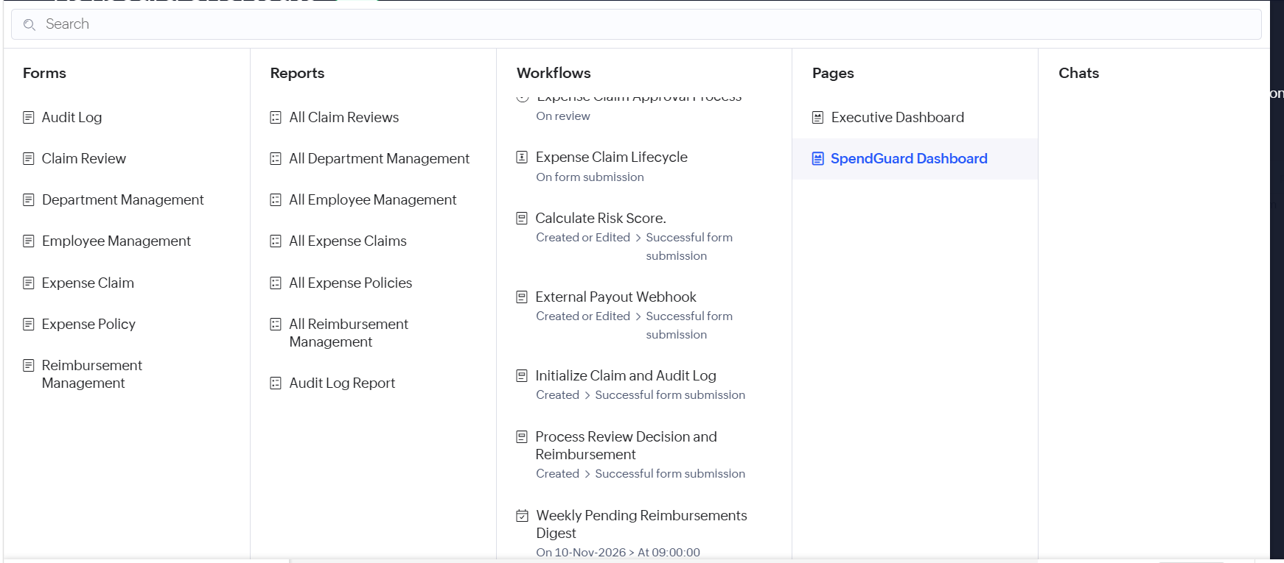
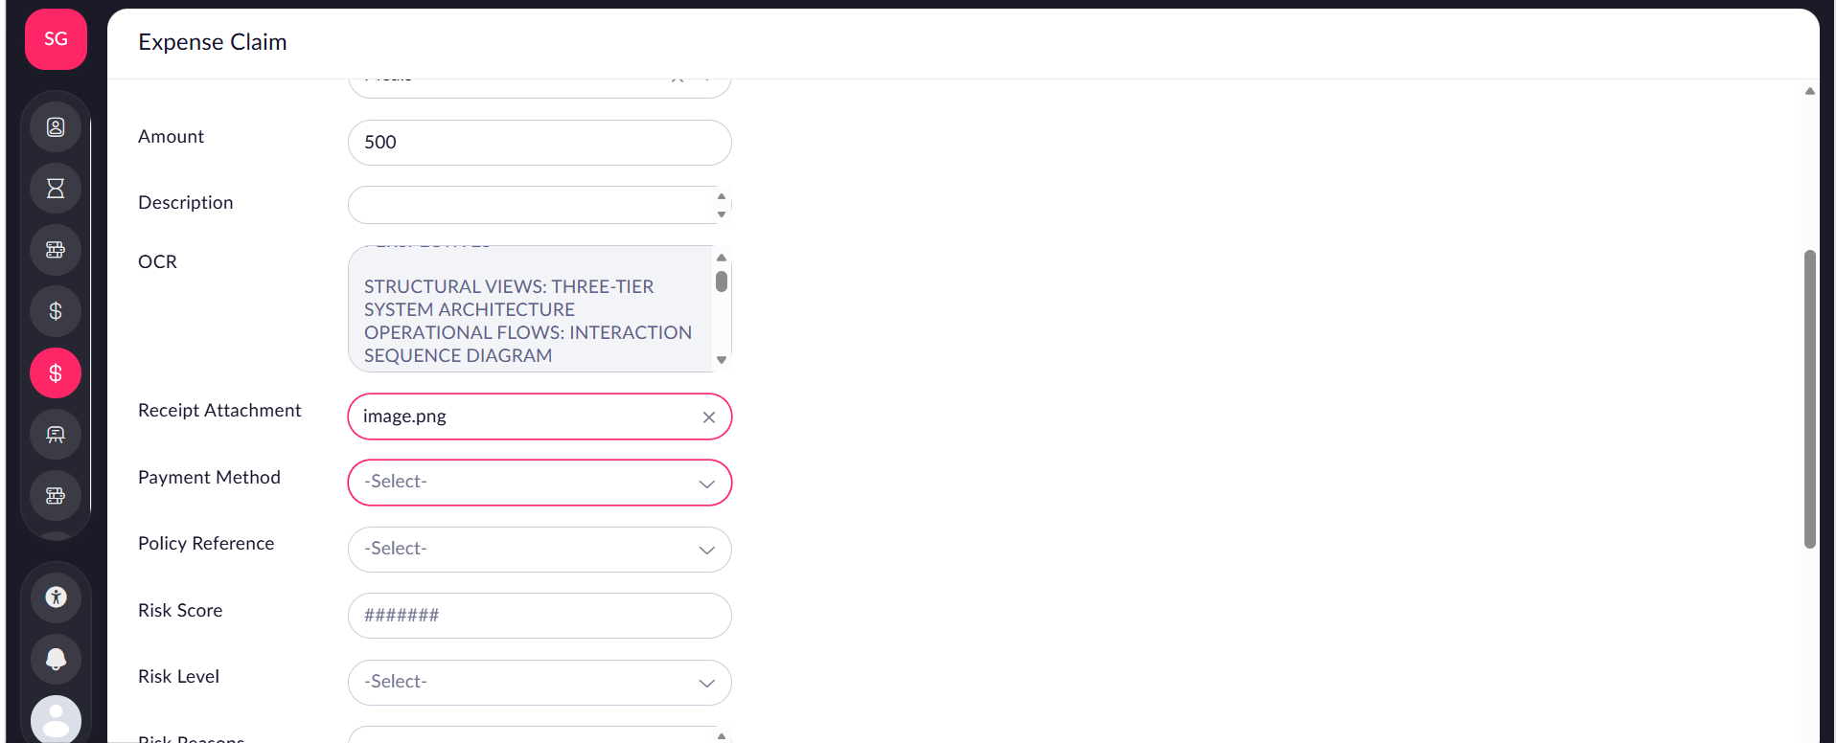
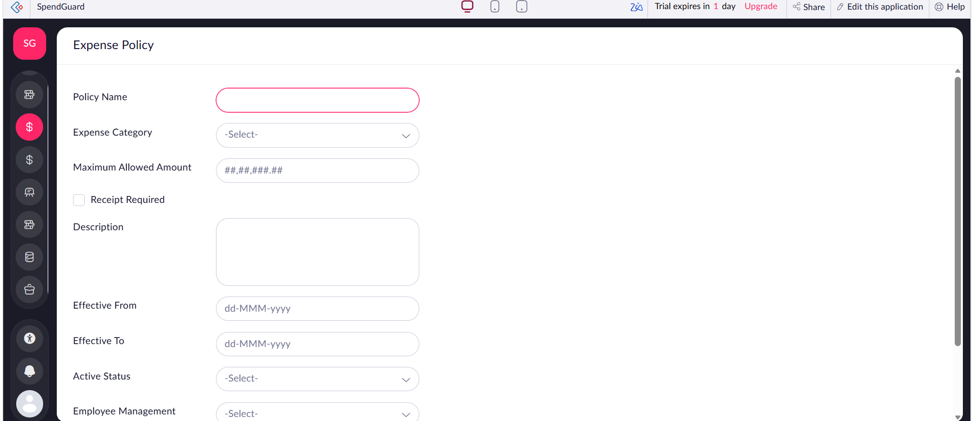
IMPLEMENTATION · FORMS
Forms capture every step
Application menu: forms, reports, workflows, pages
Expense Claim form with OCR field and receipt
Auto-number Claim IDs
Lookups between forms
Receipt upload with OCR
Mandatory field validation
Expense Policy form
10

Slide 11
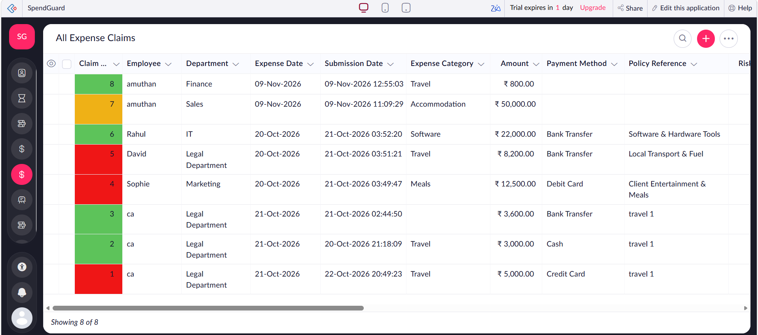
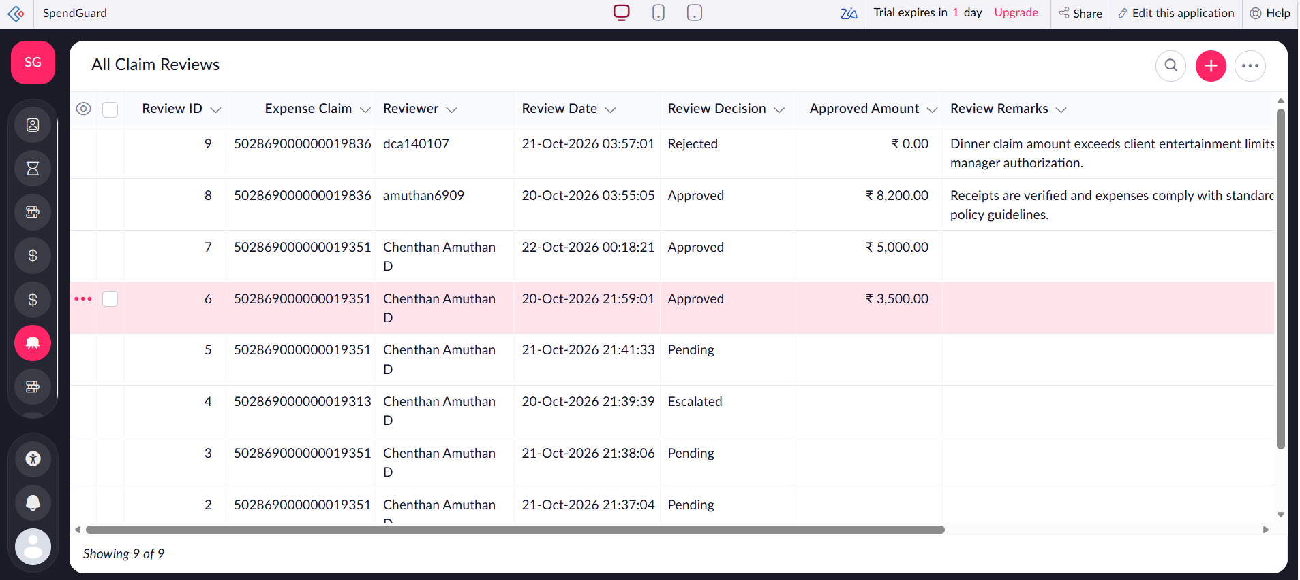
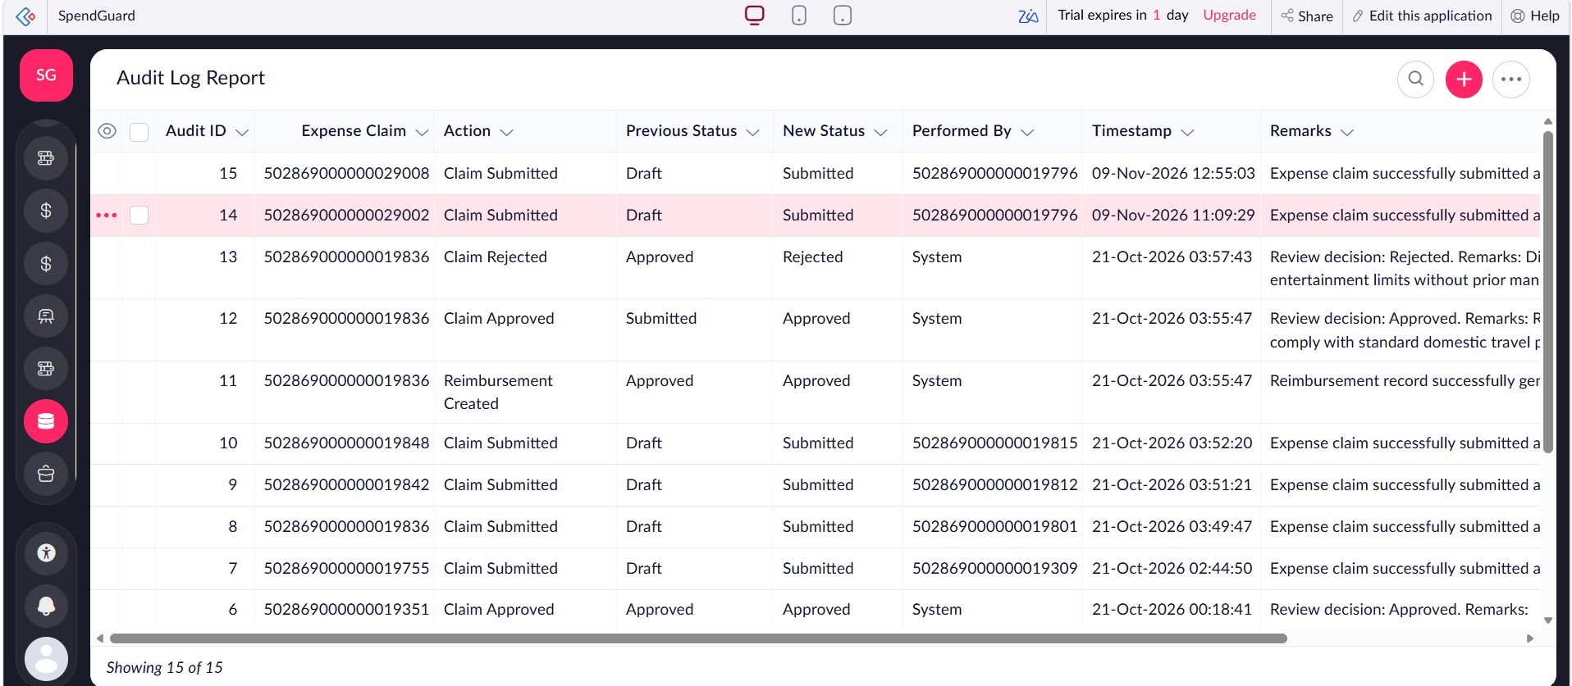
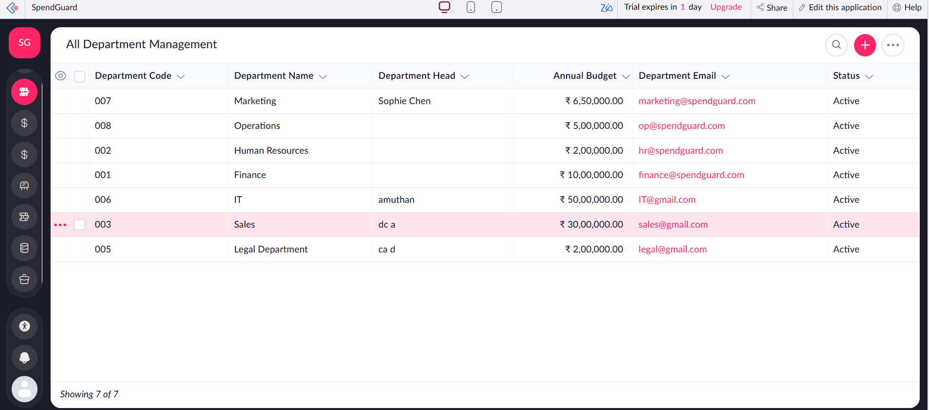
IMPLEMENTATION · REPORTS
Seven list reports
All Expense Claims with risk colour coding
All Claim Reviews
Audit Log Report
All Department Management
11

Slide 12
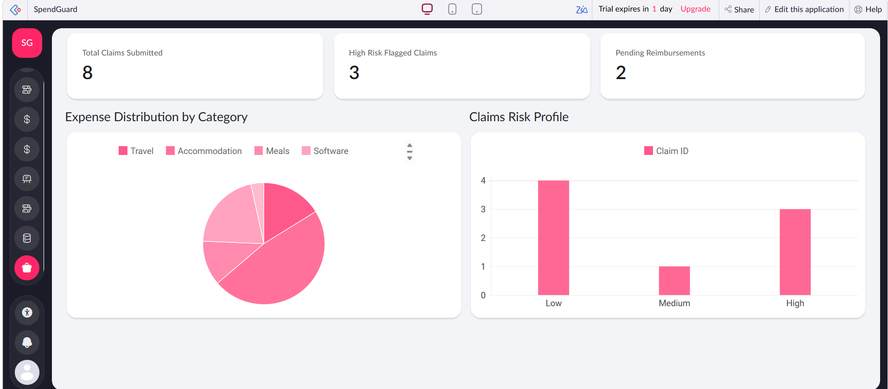
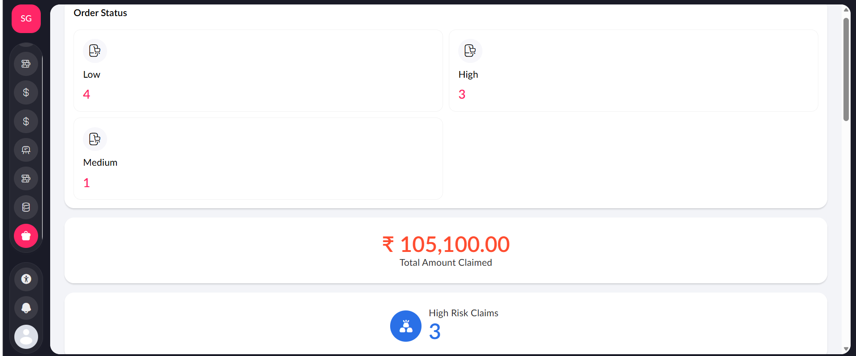
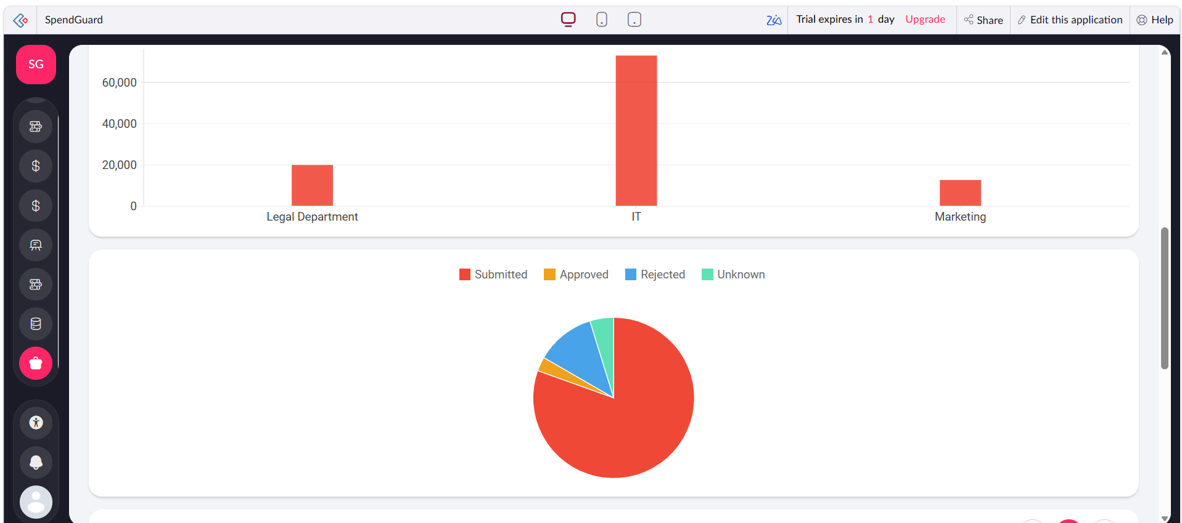
IMPLEMENTATION · DASHBOARDS
Two dashboards, live KPIs
3 KPI panels
Total claims 8 · High risk 3 · Pending reimbursements 2
Risk mix
Low 4 · Medium 1 · High 3
SpendGuard Dashboard: KPI panels, pie and bar charts
₹1,05,100
Total amount claimed across 8 claims
Risk counts and total claimed
Executive Dashboard
12

Slide 13
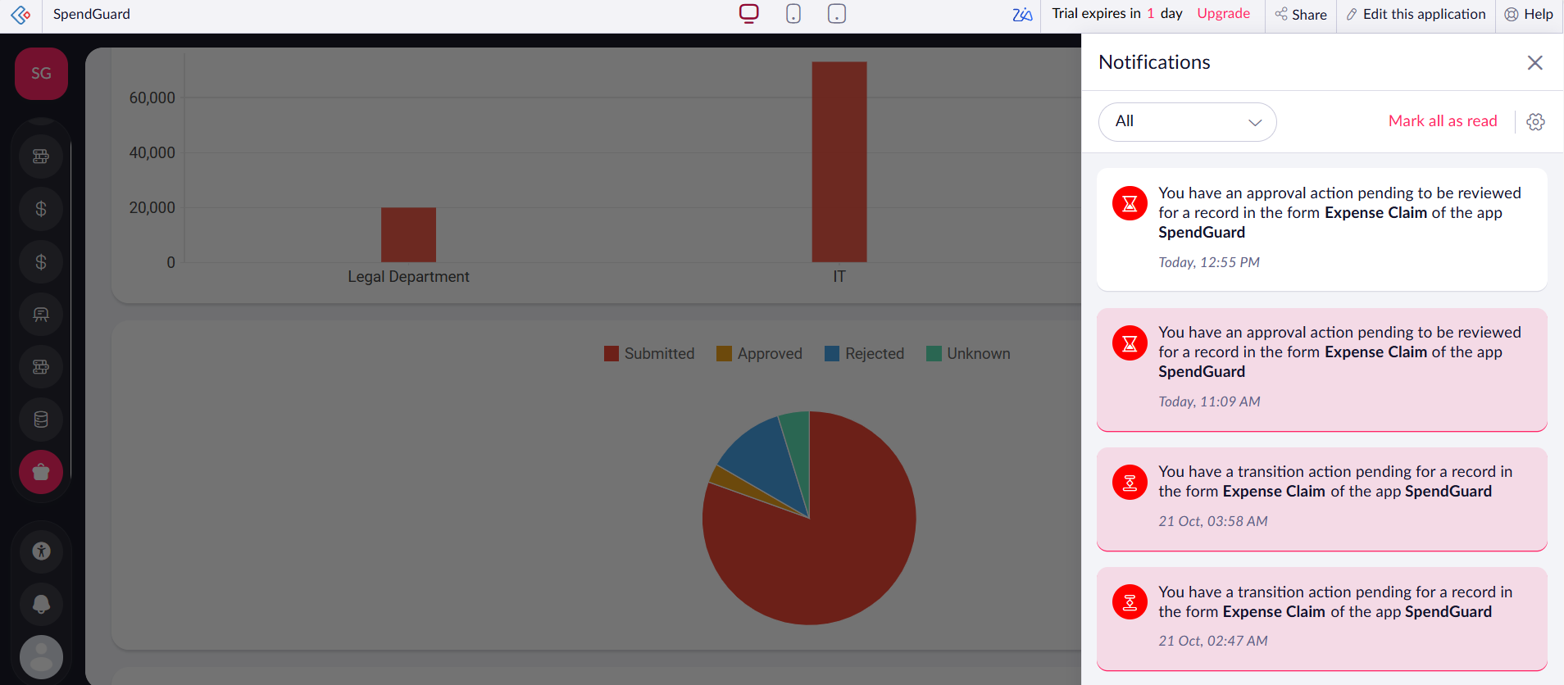
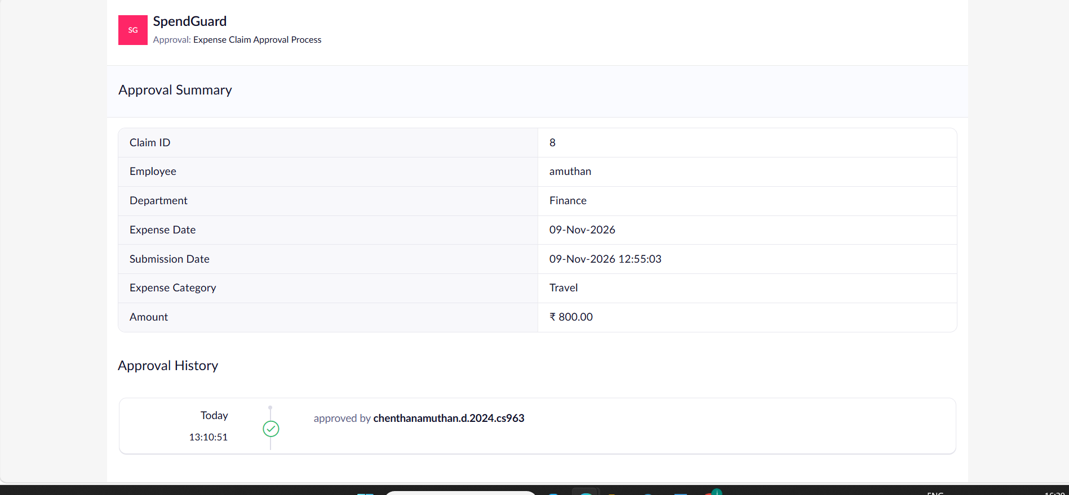
IMPLEMENTATION · AUTOMATION
Workflows do the routine work
Calculate Risk Score
Initialize Claim and Audit Log
Sets score, level and reasons on every create or edit; alerts on Medium/High
Writes the “Claim Submitted” audit entry
Approval Process
Review Decision
Sends request to reviewers; records approve or reject
Updates claim status, creates reimbursement and audit entries
In-app approval notifications
Weekly Digest
Payout Webhook
Schedule at 09:00 e-mails pending reimbursements
Posts approved claims to an external REST endpoint
Approval summary and history, claim 8
13

Slide 14
IMPLEMENTATION · INTEGRATIONS AND AI
OCR, e-mail and webhook
Zia AI OCR
Extracts receipt text into the claim, removing manual transcription.
Zoho Mail
Risk alerts and the weekly pending-reimbursement digest via sendmail.
Receipt attachment mapped to AI OCR field
REST webhook
Native Creator charts and KPI panels provide the analytics; no pro-code extension was needed.
Sends approved-claim data to an external payment system.
14

Slide 15
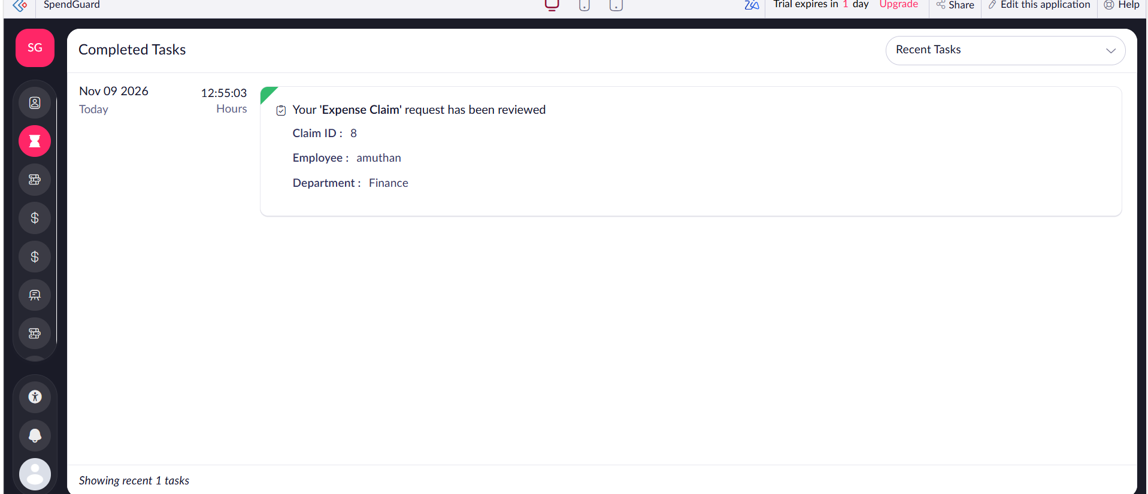
IMPLEMENTATION · SECURITY
Access control and safeguards
Role-based permission profiles
Record-level criteria: staff see own claims
Receipts in encrypted file storage
Zoho-hosted authentication, HTTPS
Audit Log: action, status change, actor, time
Creator audit trail for admin changes
Completed Tasks after review
15

Slide 16
TESTING AND DEPLOYMENT
Tested, then published to production
9 / 9
3
Nov 2026
test cases passed, each mapped to a functional requirement
defects found and closed: null policy, blank fields, rejection audit
Development → Stage → Production; UAT on stage by staff, manager and auditor roles
Live URL: creatorapp.zoho.in/dcamuthan123/spendguard
16

Slide 17
RESULTS · DEMO SCENARIO
One claim, end to end
Staff submits claim 8 (₹800, Travel, Finance) with receipt
OCR fills the receipt text; risk is scored
Reviewer gets an in-app notification
Finance Manager approves with remarks
Claim moves to Completed Tasks; audit entries logged
Dashboards update: 8 claims, ₹1,05,100
Approval summary and history
Notifications for pending approvals
17

Slide 18
CONCLUSION
What was achieved and what comes next
Achieved
Future enhancements
Policy-driven risk scoring on every claim
Approval, reimbursement and full audit trail
Live KPI dashboards for finance
Receipt OCR and role-based access
Built in one semester on a low-code platform
Credit-card feed reconciliation
Predictive overspend forecasting with Zia
Kanban and calendar claim views
Subform line items for multi-item claims
SAP / Tally integration and bank payouts
18

Slide 19
SPENDGUARD
Thank you
Chenthan Amuthan D
2116240701090
B.E. CSE, Rajalakshmi Engineering College

