Slide 1
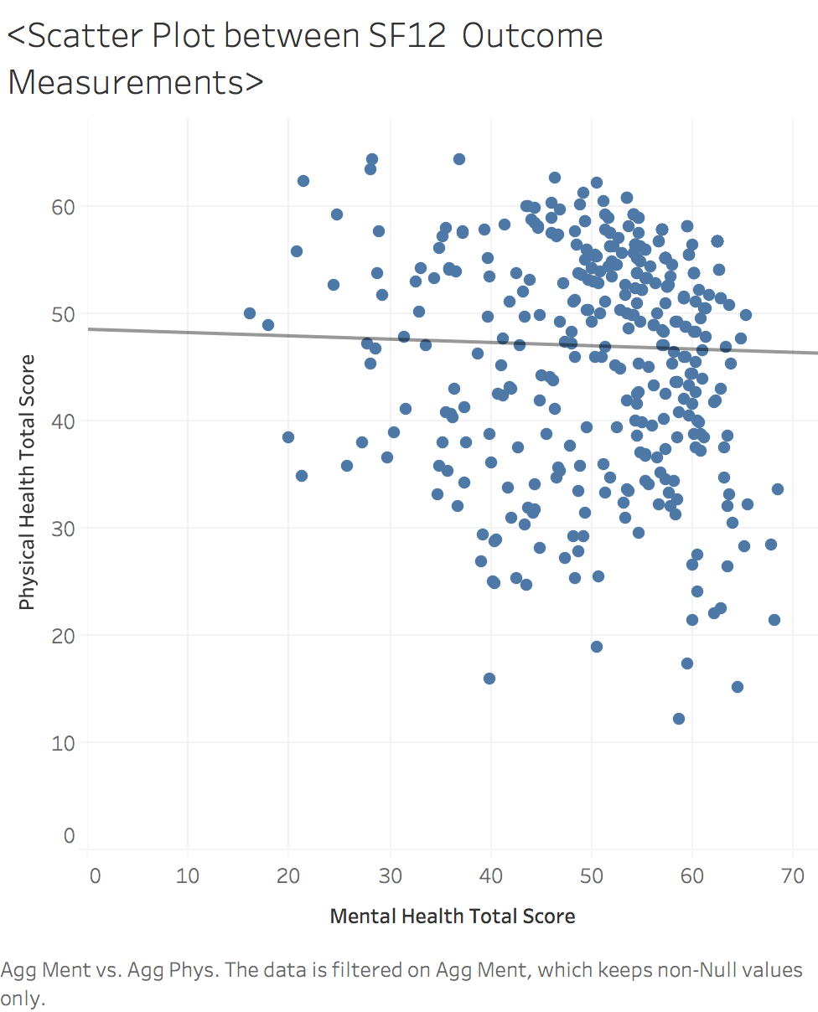

Spearman Correlation Matrix

