Slide 1
Denoising Diffusion Probabilistic Models (DDPM)
Presented by Chenwei Xu
Northwestern University

Slide 2
Part 1: Overview
Part 2: Diffusion Process
Part 3: Evidence Lower Bound (ELBO)
Part 4: ELBO of DDPM
Part 5: Training and Inference

Slide 3
Part 1: Overview

Slide 4



What is Diffusion Model?
Assumption: “Real data is already in Random Noise; Diffusion model retrieve the “real” data by denoising
What we want
(“Real” Data)
retrieve
denoise
What we have
(Random Noise)
What we don’t want
(Noise)
Notes:
https://en.wikipedia.org/wiki/File:Proten_ligand_binding.PNG

Slide 5
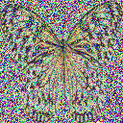
Basic Concepts
Forward (Diffusion) Process
Add noise
Add noise
Reverse (Generation) Process
Denoise
Denoise
Notes:
https://en.wikipedia.org/wiki/File:Proten_ligand_binding.PNG

Slide 6





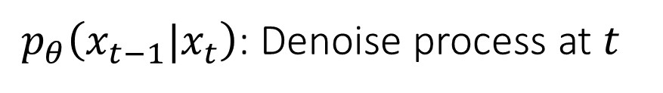







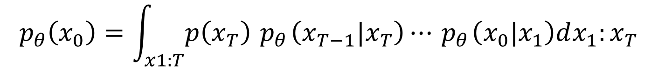


Reverse Process in DDPM
Random Noise
Step 999
Step $T=$ 1000
Denoise
Denoise
$$θ$$
$$θ$$
$$x_{T}$$
$$x_{999}$$
$$x_{998}$$
Step 2
Step 1
Denoise
Denoise
$$θ$$
$$θ$$
$$x_{2}$$
$$x_{1}$$
$$x_{0}$$
$${ p}_{θ}\left(x_{0}\right)=\int_{x1:T}{p\left(x_{T}\right)}{ p}_{θ}\left(x_{T−1}|x_{T}\right)⋯{ p}_{θ}\left(x_{0}|x_{1}\right)dx_{1}:x_{T}$$
${ p}_{θ}\left(x_{t−1}|x_{t}\right)$: Denoise process at $t$
Notes:
https://en.wikipedia.org/wiki/File:Proten_ligand_binding.PNG

Slide 7







Diffusion Process in DDPM
Random Noise
Step 999
Step $T=$ 1000
Add
Noise
Add
Noise
$$x_{T}$$
$$x_{999}$$
$$x_{998}$$
Step 2
Step 1
Add
Noise
Add
Noise
$$x_{2}$$
$$x_{1}$$
$$x_{0}$$
Also called: Forward Process
Notes:
https://en.wikipedia.org/wiki/File:Proten_ligand_binding.PNG

Slide 8
Part 2: Diffusion Process

Slide 9


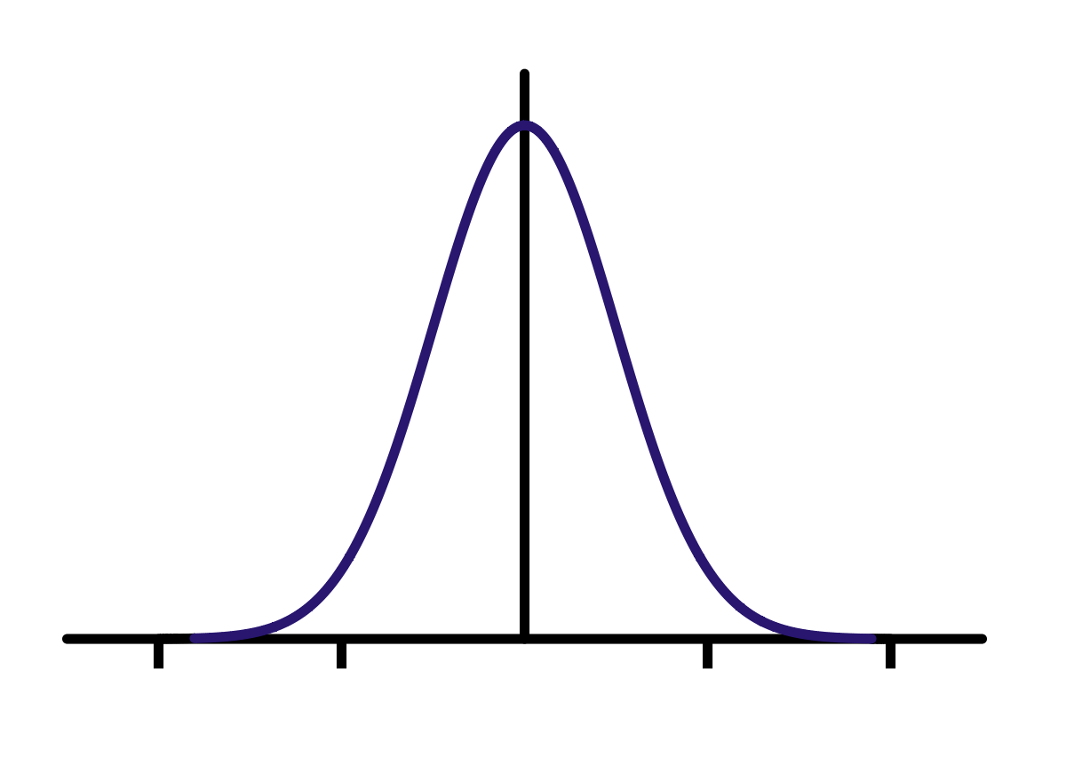


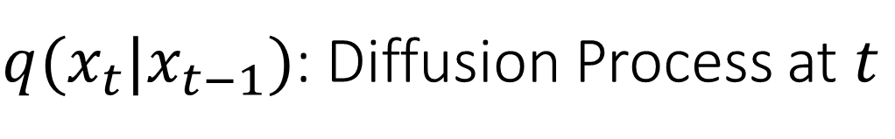










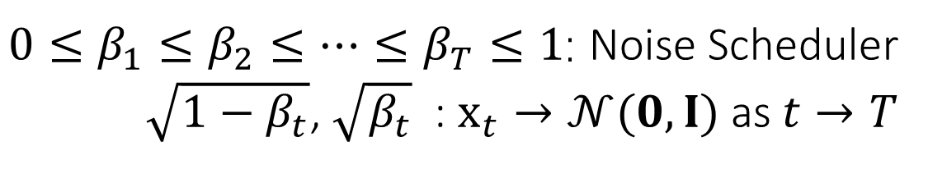
$q(x_{t}|x_{t−1})$: Diffusion Process at $t$
Step $t$
Step $1$
…
Add Noise
…
Add Noise
$q(x_{t}|x_{t−1})$
$$=$$
$$\sqrt{1−β_{t}}$$
$$+$$
$$\sqrt{β_{t}}$$
$$\sim$$
$$x_{t}$$
$$x_{t−1}$$
$ε_{t}$: Noise
$$𝒩(0,I)$$
$0≤β_{1}≤β_{2}≤⋯≤β_{T}≤1$: Noise Scheduler
$\sqrt{1−β_{t}}$, $\sqrt{β_{t}}$ : $x_{t}→𝒩(0,I)$ as $t→T$
Notes:
https://en.wikipedia.org/wiki/File:Proten_ligand_binding.PNG

Slide 10
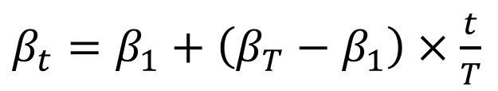
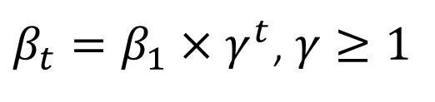
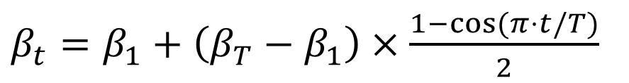
Noise Scheduler Examples
Linear:
$β_{t}=$ $β_{1}+\left(β_{T}−β_{1}\right)×\frac{t}{T}$
Cosine:
$β_{t}=$ $β_{1}+\left(β_{T}−β_{1}\right)×\frac{1−cos⁡(π⋅t/T)}{2}$
Geometric
$β_{t}=$ $β_{1}×γ^{t}$, $γ≥1$
Others…
Notes:
https://en.wikipedia.org/wiki/File:Proten_ligand_binding.PNG

Slide 11
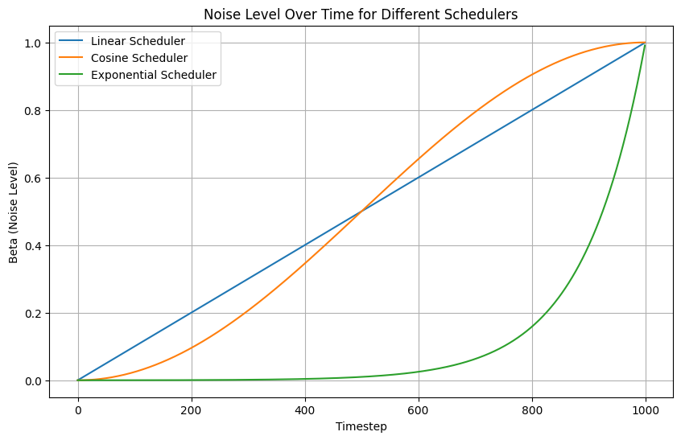





Notes:
https://en.wikipedia.org/wiki/File:Proten_ligand_binding.PNG

Slide 12








Efficiency in Adding Noise
$$x_{t}$$
Efficient
1 step
$t$steps
$$x_{0}$$
$$x_{1}$$
Inefficient
$$x_{T}$$
Step 1
Step 2
…
Step $T$
Notes:
https://en.wikipedia.org/wiki/File:Proten_ligand_binding.PNG

Slide 13








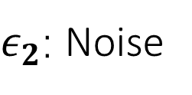



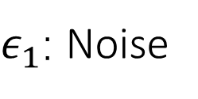





$q(x_{1}|x_{0})$: Drive $x_{1}$by Adding Noise to $x_{0}$
$$=$$
$$\sqrt{1−β_{1}}$$
$$+$$
$$\sqrt{β_{1}}$$
$$\sim$$
$$x_{1}$$
$$x_{0}$$
$ε_{1}$: Noise
$$𝒩(0,I)$$
$$=$$
$$\sqrt{1−β_{2}}$$
$$+$$
$$\sqrt{β_{2}}$$
$$\sim$$
$$x_{2}$$
$$x_{1}$$
$ε_{2}$: Noise
$$𝒩(0,I)$$
Notes:
https://en.wikipedia.org/wiki/File:Proten_ligand_binding.PNG

Slide 14



















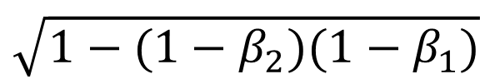
$q(x_{2}|x_{0})$: Drive $x_{2}$by Adding Noise to $x_{0}$
$$=$$
$$\sqrt{1−β_{2}}$$
$$\sqrt{1−β_{1}}$$
$$+$$
$$\sqrt{1−β_{2}}\sqrt{β_{1}}$$
$$\sim 𝒩(0,I)$$
$$x_{2}$$
$x_{0}$: data
$$ε_{1}$$
Ind.
$$+$$
$$\sqrt{β_{2}}$$
$$\sim 𝒩(0,I)$$
$$ε_{2}$$
$$=$$
$$\sqrt{1−β_{2}}$$
$$\sqrt{1−β_{1}}$$
$$+$$
$$\sqrt{1−(1−β_{2})(1−β_{1})}$$
$$\sim 𝒩(0,I)$$
$$x_{0}$$
Notes:
https://en.wikipedia.org/wiki/File:Proten_ligand_binding.PNG

Slide 15



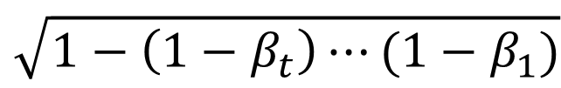
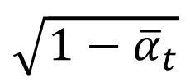









$q(x_{t}|x_{0})$: Drive $x_{t}$by Adding Noise to $x_{0}$ (Continued.)
$$=$$
$$\sqrt{1−β_{t}}⋯\sqrt{1−β_{0}}$$
$$\sqrt{1−\left(1−β_{t}\right)⋯(1−β_{1})}$$
$$+$$
$$x_{0}$$
$$\sim 𝒩(0,I)$$
$$x_{t}$$
$$\sqrt{1−{\overline{α}}_{t}}$$
$α_{t}=$ $\left(1−β_{t}\right)$
${\overline{α}}_{t}=$ $α_{1}α_{2}⋯α_{t}$
$$=$$
$$\sqrt{{\overline{α}}_{t}}$$
$$+$$
$$x_{0}$$
$$\sim 𝒩(0,I)$$
Sample $x_{t}$ from $x_{0}$ in 1 time step
$$q\left(x_{t} | x_{0}\right)=𝒩(x_{t}|\sqrt{{\overline{α}}_{t}}x_{0},\sqrt{1−{\overline{α}}_{t}}I)$$
Notes:
https://en.wikipedia.org/wiki/File:Proten_ligand_binding.PNG

Slide 16
Part 3: Evidence Lower Bond

Slide 17







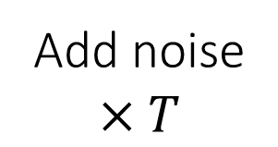

VAE vs. Diffusion Model
VAE: Variation Auto Encoder
VAE (another kind of generative model)
Encoder
Decoder
$$x$$
$$z$$
$$x$$
Use VAE as a trivial example for explaining diffusion
Diffusion
$$×T$$
Add noise
$$×T$$
Denoise
$$x_{0}$$
$$x_{1},x_{2},⋯$$
$$x_{T}$$
$$x_{0}$$
Notes:
https://en.wikipedia.org/wiki/File:Proten_ligand_binding.PNG

Slide 18




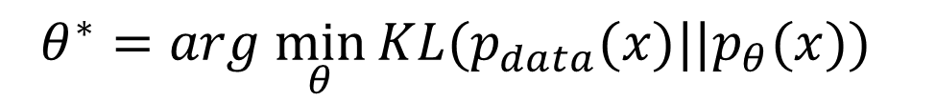





Common Objective in Generative Models
$$p_{θ}(x)$$
$$p_{data}(x)$$
$$θ$$
Network
close
$$x$$
$$z$$
$$θ^{∗}=arg \min_{θ}{KL(p_{data}(x)||p_{θ}(x))}$$
Notes:
https://en.wikipedia.org/wiki/File:Proten_ligand_binding.PNG

Slide 19
Common Objective in Generative Models
$$p_{θ}(x)$$
$$p_{data}(x)$$
$$θ$$
Network
close
$$x$$
$$z$$
$$θ^{∗}=arg \min_{θ}{KL(p_{data}(x)||p_{θ}(x))}$$
Notes:
https://en.wikipedia.org/wiki/File:Proten_ligand_binding.PNG

Slide 20
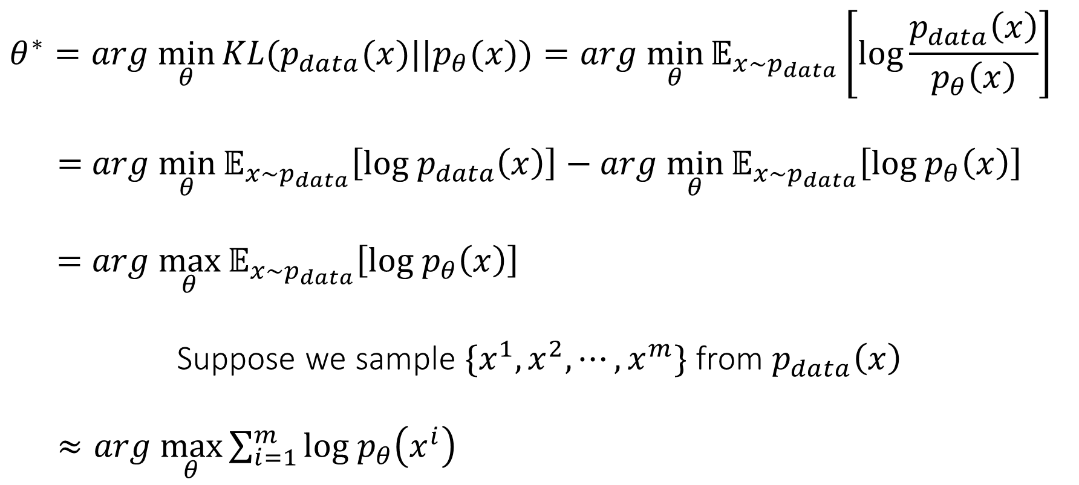

KL-Divergence and Maximum Likelihood Estimation
$$θ^{∗}=arg \min_{θ}{KL(p_{data}(x)||p_{θ}(x))}=arg \min_{θ}{𝔼_{x\sim p_{data}}\left[log\frac{p_{data}\left(x\right)}{p_{θ}\left(x\right)}\right]}$$
$=$ $arg \min_{θ}{𝔼_{x\sim p_{data}}\left[log{ p}_{data}\left(x\right)\right]}−arg \min_{θ}{𝔼_{x\sim p_{data}}\left[log{ p}_{θ}\left(x\right)\right]}$
$$=arg \max_{θ}{𝔼_{x\sim p_{data}}\left[log{ p}_{θ}\left(x\right)\right]}$$
Suppose we sample $\{x^{1}, x^{2},⋯,x^{m}\}$ from $p_{data}\left(x\right)$
$≈arg \max_{θ}{\sum_{i=1}^{m}{log{ p}_{θ}\left(x^{i}\right)}}$
No $θ$ here
Maximum Likelihood Estimation
Notes:
https://en.wikipedia.org/wiki/File:Proten_ligand_binding.PNG

Slide 21






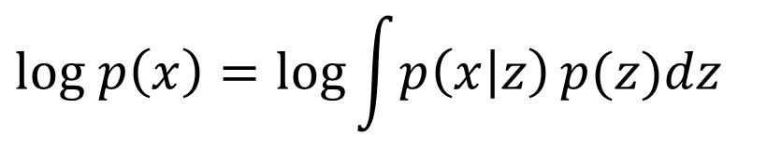

Compute $log p\left(x\right)$ is impossible
$$log p\left(x\right)=\log{\int{p\left(x | z\right)}p(z)dz}$$
Consider all possible $z$
Encoder
Decoder
$$q\left(z | x\right)$$
$$p\left(x | z\right)$$
$$x$$
$$z$$
$$x$$
Notes:
https://en.wikipedia.org/wiki/File:Proten_ligand_binding.PNG

Slide 22
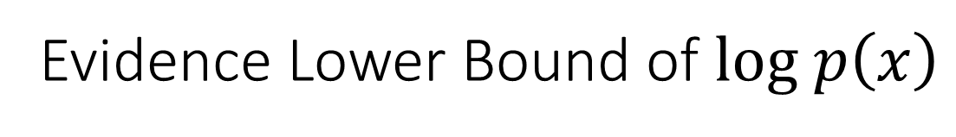

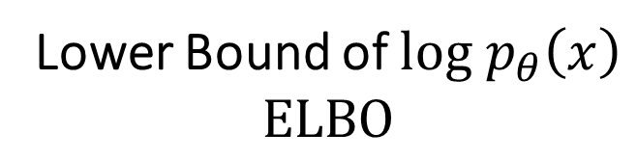
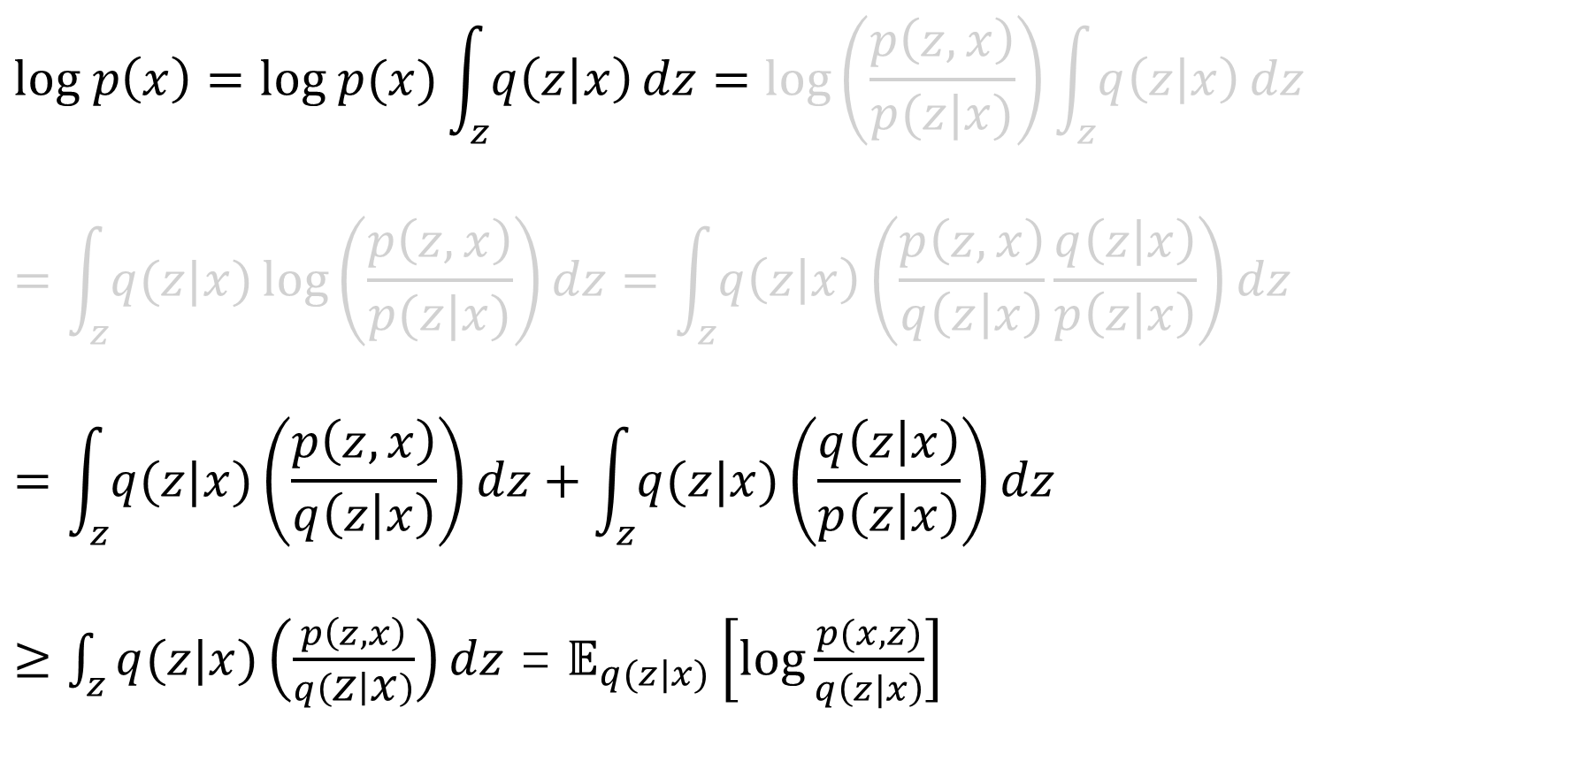
Evidence Lower Bound of $log p\left(x\right)$
$$log p\left(x\right)=log p(x)\int_{z}{q\left(z | x\right)}dz=log\left(\frac{p\left(z,x\right)}{p(z|x)}\right)\int_{z}{q\left(z | x\right)}dz$$
$$=\int_{z}{q(z|x)}\log\left(\frac{p\left(z,x\right)}{p(z|x)}\right)dz=\int_{z}{q\left(z | x\right)}\left(\frac{p\left(z,x\right)}{q\left(z | x\right)}\frac{q\left(z | x\right)}{p\left(z | x\right)}\right)dz$$
$$=\int_{z}{q(z|x)}\left(\frac{p\left(z,x\right)}{q\left(z | x\right)}\right)dz+\int_{z}{q(z|x)}\left(\frac{q\left(z | x\right)}{p\left(z | x\right)}\right)dz$$
$≥$ $\int_{z}{q(z|x)}\left(\frac{p\left(z,x\right)}{q\left(z | x\right)}\right)dz$ = $𝔼_{q(z|x)}\left[log\frac{p(x,z)}{q\left(z|x\right)}\right]$
Encoder, can be any distribution
$$KL(q\left(z|x\right)||p(z|x))≥0$$
Lower Bound of $log{ p}_{θ}\left(x\right)$
$$ELBO$$
Notes:
https://en.wikipedia.org/wiki/File:Proten_ligand_binding.PNG

Slide 23

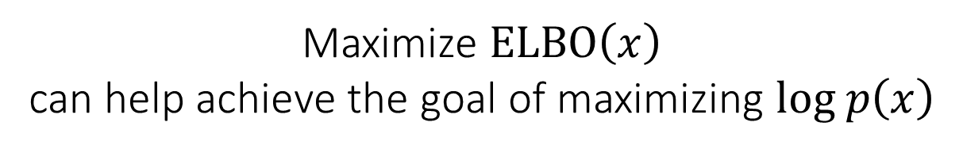



$$ELBO\left(x\right)$$
$$log p\left(x\right)$$
$$KL(q\left(z|x\right)||p(z|x))$$
$$ELBO\left(x\right)$$
Maximize $ELBO\left(x\right)$
can help achieve the goal of maximizing $log p\left(x\right)$
Notes:
https://en.wikipedia.org/wiki/File:Proten_ligand_binding.PNG

Slide 24

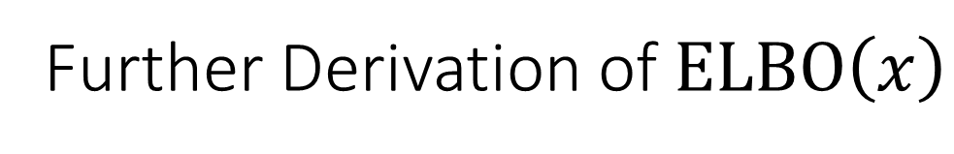



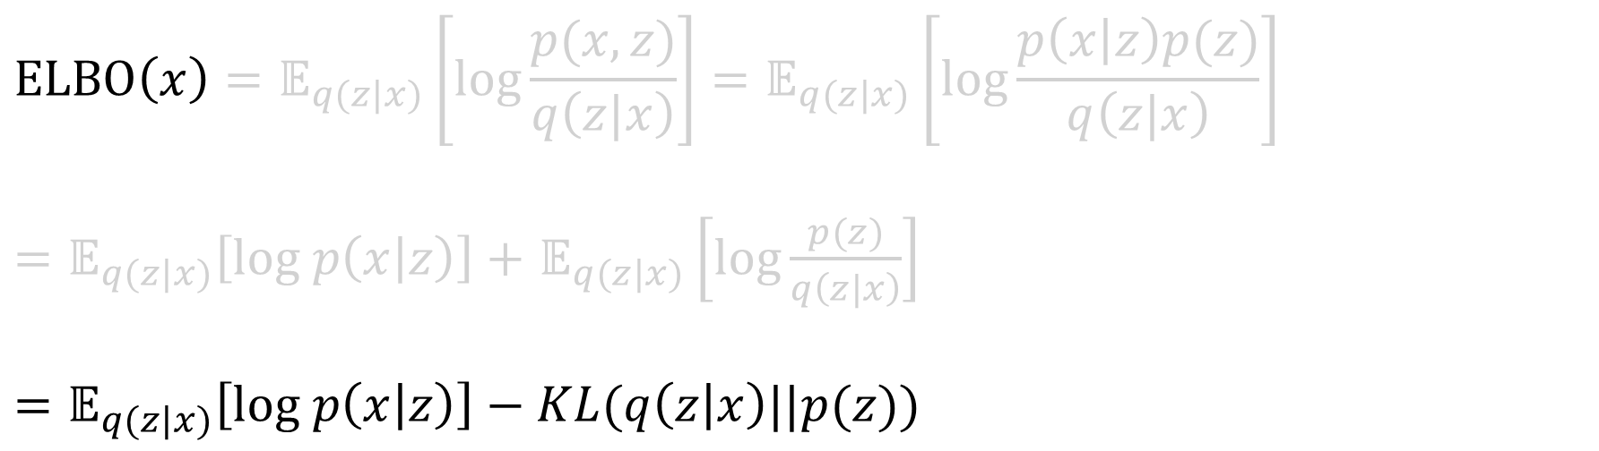

Further Derivation of $ELBO\left(x\right)$
$$ELBO\left(x\right)=𝔼_{q(z|x)}\left[log\frac{p(x,z)}{q\left(z|x\right)}\right]=𝔼_{q(z|x)}\left[log\frac{p\left(x | z\right)p(z)}{q\left(z|x\right)}\right]$$
$=𝔼_{q(z|x)}\left[log p\left(x | z\right)\right]+$ $𝔼_{q(z|x)}\left[log\frac{p(z)}{q\left(z|x\right)}\right]$
$$=𝔼_{q(z|x)}\left[log p\left(x | z\right)\right]−KL(q\left(z | x\right)||p(z))$$
How good the encoder is
how good the decoder is
Encoder
Decoder
$$q\left(z | x\right)$$
$$p\left(x | z\right)$$
$$x$$
$$z$$
$$x$$
Notes:
https://en.wikipedia.org/wiki/File:Proten_ligand_binding.PNG

Slide 25
Part 4: ELBO of DDPM

Slide 26
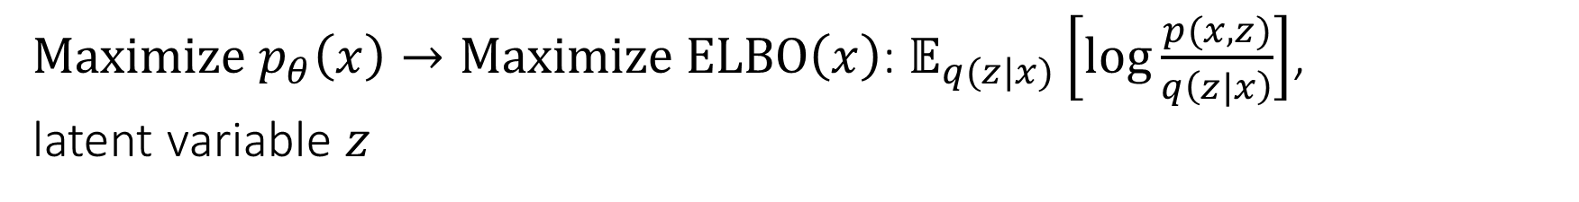
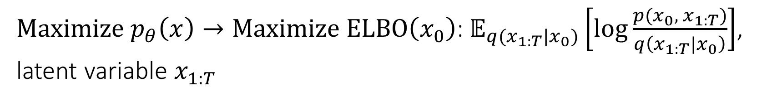
Optimization Goal of DDPM
VAE
$Maximize{ p}_{θ}\left(x\right)→Maximize ELBO\left(x\right)\text{: }𝔼_{q(z|x)}\left[log\frac{p(x,z)}{q\left(z|x\right)}\right]$, latent variable $z$
Encoder
Diffusion
$Maximize{ p}_{θ}\left(x\right)→Maximize ELBO\left(x_{0}\right)\text{:} 𝔼_{q(x_{1:T}|x_{0})}\left[log\frac{p(x_{0}, x_{1:T})}{q\left(x_{1:T}|x_{0}\right)}\right]$, latent variable $x_{1:T}$
Diffusion (Forward) Process
Notes:
https://en.wikipedia.org/wiki/File:Proten_ligand_binding.PNG

Slide 27
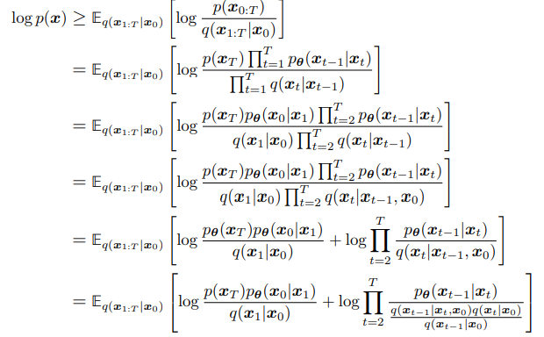

Evidence Lower Bond of DDPM
$$EBLO=𝔼_{q(x_{1:T}|x_{0})}\left[log\frac{p(x_{0:T})}{q\left(x_{1:T}|x_{0}\right)}\right]$$
Understanding Diffusion Models: A Unified Perspective
https://arxiv.org/pdf/2208.11970
Notes:
https://en.wikipedia.org/wiki/File:Proten_ligand_binding.PNG

Slide 28
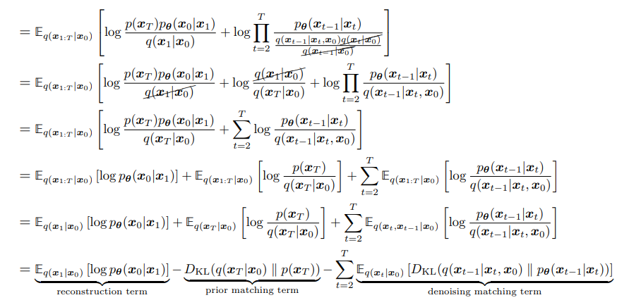
Evidence Lower Bond of DDPM (Continued.)
Also called “consistency term”
Notes:
https://en.wikipedia.org/wiki/File:Proten_ligand_binding.PNG

Slide 29
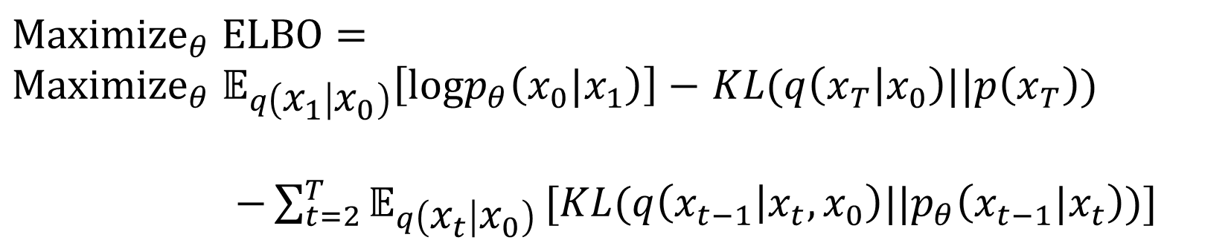
Optimization Goal
$${Maximize}_{θ} ELBO=$$
${{Maximize}_{θ} 𝔼}_{q\left(x_{1} | x_{0}\right)}\left[logp_{θ}\left(x_{0}|x_{1}\right)\right]−$ $KL(q\left(x_{T} | x_{0}\right)||p\left(x_{T}\right))$
$−\sum_{t=2}^{T}{𝔼_{q\left(x_{t} | x_{0}\right)}}[KL(q\left(x_{t−1} | x_{t},x_{0}\right)||p_{θ}\left(x_{t−1}|x_{t}\right))]$
Notes:
改

Slide 30
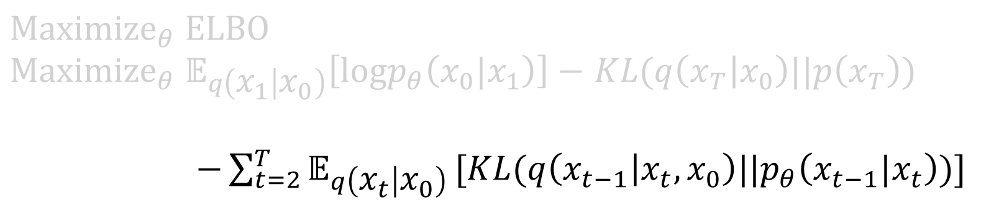
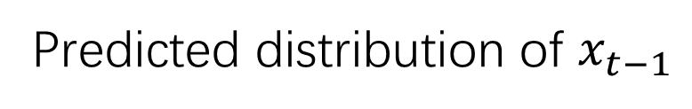
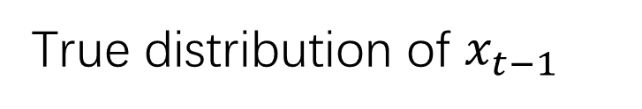
Consistency Term
$${Maximize}_{θ} ELBO$$
${{Maximize}_{θ} 𝔼}_{q\left(x_{1} | x_{0}\right)}\left[logp_{θ}\left(x_{0}|x_{1}\right)\right]−$ $KL(q\left(x_{T} | x_{0}\right)||p\left(x_{T}\right))$
$−\sum_{t=2}^{T}{𝔼_{q\left(x_{t} | x_{0}\right)}}[KL(q\left(x_{t−1} | x_{t},x_{0}\right)||p_{θ}\left(x_{t−1}|x_{t}\right))]$
True distribution of $x_{t−1}$
Predicted distribution of $x_{t−1}$
Notes:
改

Slide 31





$$q\left(x_{t−1} | x_{t},x_{0}\right)$$
$$q\left(x_{t−1} | x_{t},x_{0}\right)$$
$$x_{0}$$
$$x_{t}$$
$$x_{t−1}$$
$=\frac{q\left(x_{t−1},x_{t},x_{0}\right)}{q(x_{t},x_{0})}=$ $\frac{q\left(x_{t}|x_{t−1}\right)q\left(x_{t−1}|x_{0}\right)q(x_{0})}{q(x_{t}|x_{0})q(x_{0})}=$ $\frac{q\left(x_{t}|x_{t−1}\right)q\left(x_{t−1}|x_{0}\right)}{q(x_{t}|x_{0})}$
Notes:
https://en.wikipedia.org/wiki/File:Proten_ligand_binding.PNG

Slide 32
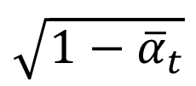


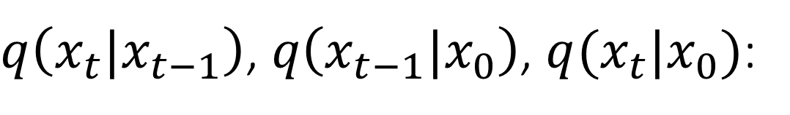



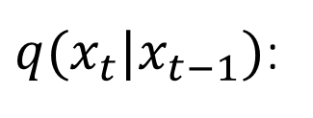


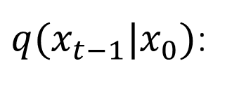
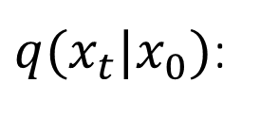
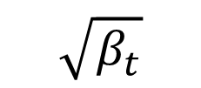

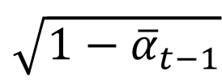
$q\left(x_{t}|x_{t−1}\right)\text{,} q\left(x_{t−1}|x_{0}\right)$, $q(x_{t}|x_{0})$:
Known, Gaussian
$q(x_{t}|x_{t−1})$:
$$=$$
$$\sqrt{1−β_{t}}$$
$$+$$
$$\sqrt{β_{t}}$$
Known, Gaussian
$q(x_{t−1}|x_{0})$:
$$=$$
$$\sqrt{{\overline{α}}_{t−1}}$$
$$+$$
$$\sqrt{1−{\overline{α}}_{t−1}}$$
Known, Gaussian
$q(x_{t}|x_{0})$:
$$=$$
$$\sqrt{{\overline{α}}_{t}}$$
$$+$$
$$\sqrt{1−{\overline{α}}_{t}}$$
Notes:
https://en.wikipedia.org/wiki/File:Proten_ligand_binding.PNG

Slide 33
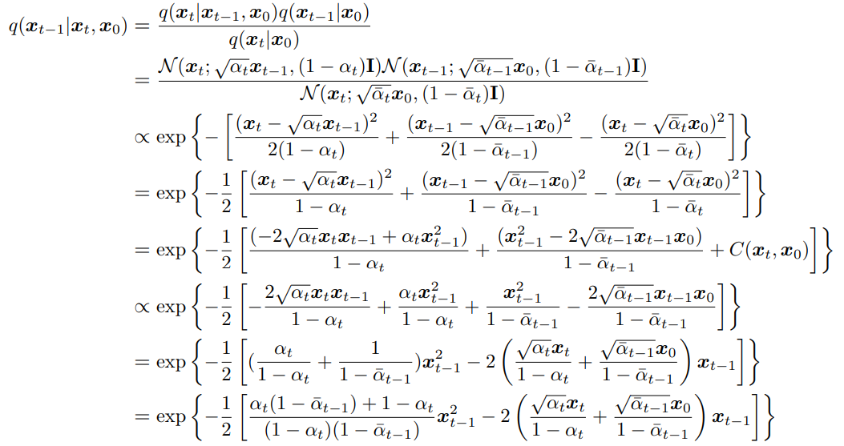

Derivation of $q\left(x_{t−1} | x_{t},x_{0}\right)$
https://arxiv.org/pdf/2208.11970
Notes:
https://en.wikipedia.org/wiki/File:Proten_ligand_binding.PNG

Slide 34
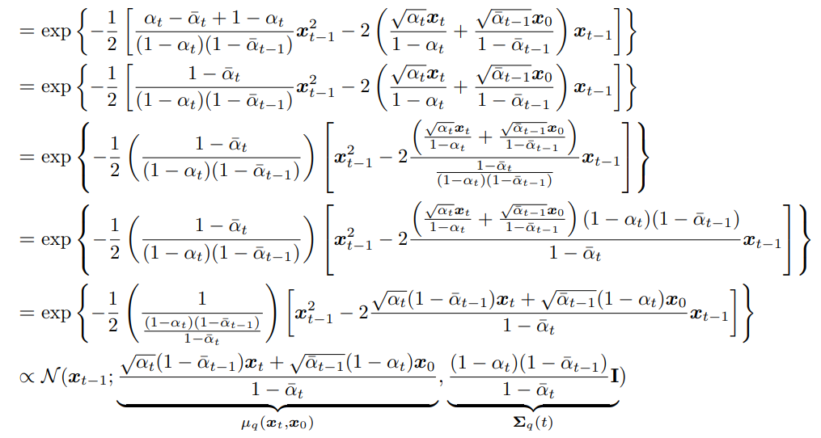
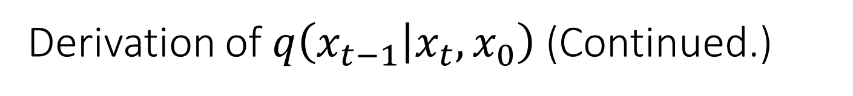
Derivation of $q\left(x_{t−1} | x_{t},x_{0}\right)$ (Continued.)
Notes:
https://en.wikipedia.org/wiki/File:Proten_ligand_binding.PNG

Slide 35


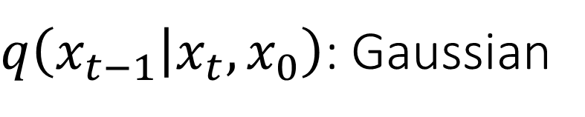



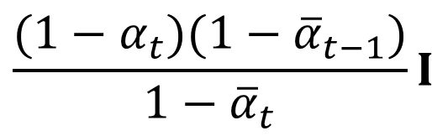
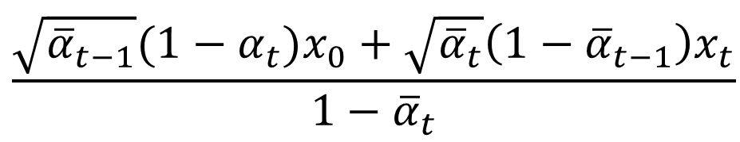
$q\left(x_{t−1} | x_{t},x_{0}\right)$: Gaussian
$$x_{0}$$
Gaussian
$$x_{t}$$
$$x_{t−1}$$
Mean
Variance
$$\frac{\sqrt{{\overline{α}}_{t−1}}(1−α_{t})x_{0}+\sqrt{{\overline{α}}_{t}}\left(1−{\overline{α}}_{t−1}\right)x_{t}}{1−{\overline{α}}_{t}}$$
$$\frac{(1−α_{t})(1−{\overline{α}}_{t−1})}{1−{\overline{α}}_{t}}I$$
$$μ_{q}(x_{t},x_{0})$$
$$Σ_{q}\left(x_{t}\right)I=σ_{q}^{2}(t)$$
Notes:
https://en.wikipedia.org/wiki/File:Proten_ligand_binding.PNG

Slide 36
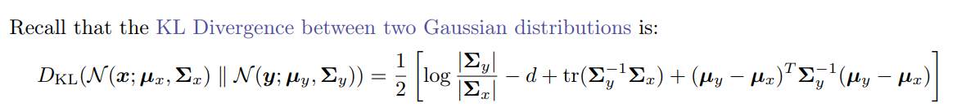
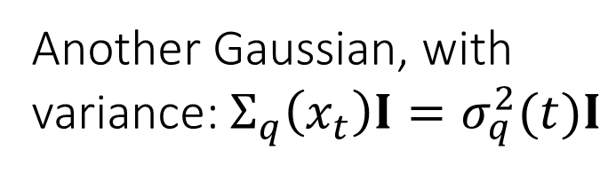
Optimization Goal in Consistency Term
A Gaussian
$$𝔼_{q\left(x_{t} | x_{0}\right)}[KL(q\left(x_{t−1} | x_{t},x_{0}\right)||p_{θ}\left(x_{t−1}|x_{t}\right))]$$
Another Gaussian, with variance: $Σ_{q}\left(x_{t}\right)I=σ_{q}^{2}(t)I$
How to minimize the KL divergence?
fixed
Closer
tunable
fixed
fixed
Notes:
https://en.wikipedia.org/wiki/File:Proten_ligand_binding.PNG

Slide 37
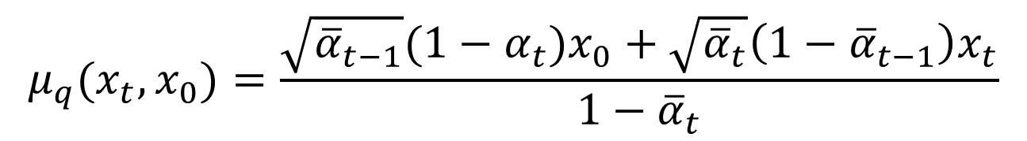



Optimization Goal in Consistency Term (Continued)
$$μ_{q}(x_{t},x_{0})=\frac{\sqrt{{\overline{α}}_{t−1}}(1−α_{t})x_{0}+\sqrt{{\overline{α}}_{t}}\left(1−{\overline{α}}_{t−1}\right)x_{t}}{1−{\overline{α}}_{t}}$$
Denoise
$$μ_{θ}(x_{t})$$
$$x_{t}$$
$$θ$$
Notes:
https://en.wikipedia.org/wiki/File:Proten_ligand_binding.PNG

Slide 38


Optimization Goal in Consistency Term
$$arg min_{θ}\frac{1}{{2σ}_{q}^{2}(t)}[{||μ_{θ}\left(x_{t}\right)−μ_{q}(x_{t},x_{0})||}_{2}^{2}]$$
Loss Function
https://arxiv.org/pdf/2403.18103
Notes:
https://en.wikipedia.org/wiki/File:Proten_ligand_binding.PNG

Slide 39



$$μ_{θ}(x_{t})$$
$$μ_{θ}\left(x_{t}\right)=\frac{\sqrt{{\overline{α}}_{t}}\left(1−{\overline{α}}_{t−1}\right)}{1−{\overline{α}}_{t}}x_{t}+\frac{\sqrt{{\overline{α}}_{t−1}}{(1−α_{t})}_{t}}{1−{\overline{α}}_{t}}{\hat{x}}_{θ}\left(x_{t}\right)$$
A neural Network, i.e. U-Net
Align with
$μ_{q}\left(x_{t},x_{0}\right)=\frac{\sqrt{{\overline{α}}_{t}}\left(1−{\overline{α}}_{t−1}\right)}{1−{\overline{α}}_{t}}x_{t}+\frac{\sqrt{{\overline{α}}_{t−1}}(1−α_{t})}{1−{\overline{α}}_{t}}$ $x_{0}$
Notes:
https://en.wikipedia.org/wiki/File:Proten_ligand_binding.PNG

Slide 40


$$\text{U}\text{−}\text{Net}$$
U-Net: Convolutional Networks for Biomedical Image Segmentation
https://arxiv.org/pdf/1505.04597
Notes:
https://en.wikipedia.org/wiki/File:Proten_ligand_binding.PNG

Slide 41


$$p_{θ}\left(x_{t−1}|x_{t}\right)$$
$p_{θ}\left(x_{t−1}|x_{t}\right)=𝒩(x_{t−1}|μ_{θ}(x_{t}),σ_{q}^{2}(t)I$)
$→x_{t−1}=μ_{θ}\left(x_{t}\right)+$ $σ_{q}^{2}\left(t\right)z,$ where $z\sim$ $𝒩(0,I$)
$=\frac{\sqrt{{\overline{α}}_{t}}\left(1−{\overline{α}}_{t−1}\right)}{1−{\overline{α}}_{t}}x_{t}+\frac{\sqrt{{\overline{α}}_{t−1}}{(1−α_{t})}_{t}}{1−{\overline{α}}_{t}}{\hat{x}}_{θ}\left(x_{t}\right)$ $+$ $σ_{q}^{2}\left(t\right)z$
Will explain in the inference part
Notes:
https://en.wikipedia.org/wiki/File:Proten_ligand_binding.PNG

Slide 42






Rewrite Loss Function in Consistency Term
$$\frac{1}{{2σ}_{q}^{2}(t)}[{||μ_{θ}\left(x_{t}\right)−μ_{q}(x_{t},x_{0})||}_{2}^{2}]$$
$$=\frac{1}{{2σ}_{q}^{2}(t)}[{||\frac{\sqrt{{\overline{α}}_{t−1}}β_{t}}{1−{\overline{α}}_{t}}{\hat{x}}_{θ}\left(x_{t}\right)−\frac{\sqrt{{\overline{α}}_{t−1}}β_{t}}{1−{\overline{α}}_{t}} x_{0}||}_{2}^{2}]$$
$$=\frac{1}{{2σ}_{q}^{2}(t)}\frac{{\overline{α}}_{t−1}{\left(1−α_{t}\right)}^{2}}{{\left(1−{\overline{α}}_{t}\right)}^{2}}[{||{\hat{x}}_{θ}\left(x_{t}\right)− x_{0}||}_{2}^{2}]$$
$${\hat{x}}_{θ}$$
$$x_{t}$$
$$x^{pred}$$
$$x_{0}$$
in consistency: $t≥2$
Notes:
https://en.wikipedia.org/wiki/File:Proten_ligand_binding.PNG

Slide 43
Rewrite Loss Function in Consistency Term
$$\frac{1}{{2σ}_{q}^{2}(t)}[{||μ_{θ}\left(x_{t}\right)−μ_{q}(x_{t},x_{0})||}_{2}^{2}]$$
$$=\frac{1}{{2σ}_{q}^{2}(t)}[{||\frac{\sqrt{{\overline{α}}_{t−1}}β_{t}}{1−{\overline{α}}_{t}}{\hat{x}}_{θ}\left(x_{t}\right)−\frac{\sqrt{{\overline{α}}_{t−1}}β_{t}}{1−{\overline{α}}_{t}} x_{0}||}_{2}^{2}]$$
$$=\frac{1}{{2σ}_{q}^{2}(t)}\frac{{\overline{α}}_{t−1}{\left(1−α_{t}\right)}^{2}}{{\left(1−{\overline{α}}_{t}\right)}^{2}}[{||{\hat{x}}_{θ}\left(x_{t}\right)− x_{0}||}_{2}^{2}]$$
Diffusion Model
$$x_{t}$$
$$x^{pred}$$
$$x_{0}$$
in consistency: $t≥2$
Notes:
https://en.wikipedia.org/wiki/File:Proten_ligand_binding.PNG

Slide 44

The Reconstruction Term
$${Maximize}_{θ} ELBO=$$
${{Maximize}_{θ}𝔼}_{q\left(x_{1} | x_{0}\right)}\left[logp_{θ}\left(x_{0}|x_{1}\right)\right]−$ $KL(q\left(x_{T} | x_{0}\right)||p\left(x_{T}\right))$
$−\sum_{t=2}^{T}{𝔼_{q\left(x_{t} | x_{0}\right)}}[KL(q\left(x_{t−1} | x_{t},x_{0}\right)||p_{θ}\left(x_{t−1}|x_{t}\right))]$
Notes:
https://en.wikipedia.org/wiki/File:Proten_ligand_binding.PNG

Slide 45






$\text{Reconstruction}$ Term
${ p}_{θ}\left(x_{0}|x_{1}\right)$: Recover $x_{0}$ from $x_{1}$
Need: $𝔼_{q\left(x_{1} | x_{0}\right)}\left[logp_{θ}\left(x_{0}|x_{1}\right)\right]$
Denoise
$$p_{θ}\left(x_{0}|x_{1}\right)$$
$$x_{0}$$
$$x_{1}$$
$𝒩(x_{0}|μ_{θ}(x_{1}),σ_{q}^{2}(1)I$)
Notes:
https://en.wikipedia.org/wiki/File:Proten_ligand_binding.PNG

Slide 46




$\text{Reconstruction}$ Term Derivation
$$\log{p_{θ}\left(x_{0}|x_{1}\right)}=\log{𝒩\left(x_{0} | μ_{θ}\left(x_{1}\right),σ_{q}^{2}\left(1\right)I\right)}=\log{\frac{1}{\sqrt{2πσ_{q}^{2}(1)}}e^{−\frac{{(x}_{0}−μ_{θ}{\left(x_{1}\right))}^{2} }{2σ_{q}^{2}(1)}}}$$
$=−log\sqrt{2πσ_{q}^{2}\left(1\right)}−$ $\frac{{(x}_{0}−μ_{θ}{\left(x_{1}\right))}^{2} }{2σ_{q}^{2}(1)}$
$$∝−\frac{{||μ_{θ}\left(x_{1}\right)−x_{0}||}_{2}^{2}}{2σ_{q}^{2}\left(1\right)}$$
$=−$ $\frac{1}{2σ_{q}^{2}\left(1\right)}$ ${||{\hat{x}}_{θ}\left(x_{1}\right)−x_{0}||}_{2}^{2}$
$${\overline{α}}_{0}=1$$
${\overline{α}}_{t}=\prod_{i=1}^{t}{α_{i}},{\overline{α}}_{1}=$ $α_{1}$
$$μ_{θ}\left(x_{1}\right)=\frac{\sqrt{{\overline{α}}_{1}}\left(1−{\overline{α}}_{0}\right)}{1−{\overline{α}}_{1}}x_{1}+\frac{\sqrt{{\overline{α}}_{0}}(1−α_{1})}{1−{\overline{α}}_{1}}{\hat{x}}_{θ}\left(x_{1}\right)$$
Notes:
https://en.wikipedia.org/wiki/File:Proten_ligand_binding.PNG

Slide 47





Match with Consistency Term
$${\overline{α}}_{0}=1$$
${\overline{α}}_{t}=\prod_{i=1}^{t}{α_{i}},{\overline{α}}_{1}=$ $α_{1}$
$$\log{p_{θ}\left(x_{0}|x_{1}\right)}$$
$=\frac{1}{2σ_{q}^{2}\left(1\right)}$ $\frac{{\overline{α}}_{0}{\left(1−α_{1}\right)}^{2}}{{\left(1−{\overline{α}}_{1}\right)}^{2}}$ ${||{\hat{x}}_{θ}\left(x_{1}\right)−x_{0}||}_{2}^{2}$ for $t=1$
$$1$$
$$=$$
($\text{Reconstruction}$ Term)
Recall: $\frac{1}{2σ_{q}^{2}(t)}\frac{{\overline{α}}_{t−1}{\left(1−α_{t}\right)}^{2}}{{\left(1−{\overline{α}}_{t}\right)}^{2}}{||{\hat{x}}_{θ}\left(x_{t}\right)− x_{0}||}_{2}^{2}$ for $t≥2$
(Consistency Term)
Notes:
https://en.wikipedia.org/wiki/File:Proten_ligand_binding.PNG

Slide 48






Prior Matching Term
$𝔼_{q\left(x_{1} | x_{0}\right)}\left[logp_{θ}\left(x_{0}|x_{1}\right)\right]−$ $KL(q\left(x_{T} | x_{0}\right)||p\left(x_{T}\right))$
$−\sum_{t=2}^{T}{𝔼_{q\left(x_{t} | x_{0}\right)}}[KL(q\left(x_{t−1} | x_{t},x_{0}\right)||p_{θ}\left(x_{t−1}|x_{t}\right))]$
Add
Noise
Add
Noise
…
$$x_{0}$$
$$q\left(x_{T} | x_{0}\right)→𝒩(0,I)$$
$$KL$$
No $θ$ to train, measure how good the noise scheduler is
$$p(x_{T})=𝒩(0,I)$$
Notes:
https://en.wikipedia.org/wiki/File:Proten_ligand_binding.PNG

Slide 49



Rewrite the ELBO
$\frac{1}{2σ_{q}^{2}\left(1\right)}$ $\frac{{\overline{α}}_{0}{\left(1−α_{1}\right)}^{2}}{{\left(1−{\overline{α}}_{1}\right)}^{2}}$ ${||{\hat{x}}_{θ}\left(x_{1}\right)−x_{0}||}_{2}^{2}$
$${Maxmize}_{θ} ELBO=$$
$${Maxmize}_{θ}𝔼_{q\left(x_{1} | x_{0}\right)}\left[logp_{θ}\left(x_{0}|x_{1}\right)\right]−KL(q\left(x_{T} | x_{0}\right)||p\left(x_{T}\right))$$
$−\sum_{t=2}^{T}{𝔼_{q\left(x_{t} | x_{0}\right)}}[KL(q\left(x_{t−1} | x_{t},x_{0}\right)||p_{θ}\left(x_{t−1}|x_{t}\right))]$
$\frac{1}{σ_{q}^{2}(t)}\frac{{\overline{α}}_{t−1}{\left(1−α_{t}\right)}^{2}}{{\left(1−{\overline{α}}_{t}\right)}^{2}}{||{\hat{x}}_{θ}\left(x_{t}\right)− x_{0}||}_{2}^{2}$
Notes:
https://en.wikipedia.org/wiki/File:Proten_ligand_binding.PNG

Slide 50








ELBO and Loss Function
$$ELBO=−\sum_{t=1}^{T}{𝔼_{q\left(x_{t} | x_{0}\right)}}[\frac{1}{2σ_{q}^{2}(t)}\frac{{\overline{α}}_{t−1}{\left(1−α_{t}\right)}^{2}}{{\left(1−{\overline{α}}_{t}\right)}^{2}}{||{\hat{x}}_{θ}\left(x_{t}\right)− x_{0}||}_{2}^{2}\text{]}$$
Loss Function: $$θ^{∗}={argmin}_{θ}\sum_{t=1}^{T}{\frac{1}{2σ_{q}^{2}(t)}\frac{{\overline{α}}_{t−1}{\left(1−α_{t}\right)}^{2}}{{\left(1−{\overline{α}}_{t}\right)}^{2}}{𝔼_{q\left(x_{t} | x_{0}\right)}[||{\hat{x}}_{θ}\left(x_{t}\right)− x_{0}||}_{2}^{2}]}$$
For a particular $x_{t}$:
Image Prediction
$${argmin}_{θ}{||{\hat{x}}_{θ}\left(x_{t}\right)− x_{0}||}_{2}^{2}$$
$$x_{t}$$
$${\hat{x}}_{θ}\left(x_{t}\right)$$
$$x_{0}$$
$${\hat{x}}_{θ}$$
Notes:
https://en.wikipedia.org/wiki/File:Proten_ligand_binding.PNG

Slide 51
Part 5: Training and Inference

Slide 52



Training in Image Prediction
Repeat:
Pick $x_{0}$ from training dataset
Pick $t$ from $Uniform[1,T]$
Draw a sample $x_{t}\sim 𝒩(x_{t}|\sqrt{{\overline{α}}_{t}}x_{0},\sqrt{1−{\overline{α}}_{t}}I)$
Take gradient descent step on:
${∇_{θ}||{\hat{x}}_{θ}\left(x_{t}\right)− x_{0}||}_{2}^{2}$
$$x_{0}$$
$$x_{t}$$
Notes:
https://en.wikipedia.org/wiki/File:Proten_ligand_binding.PNG

Slide 53

Training in Image Prediction (Batch Version)
batch size
Repeat:
Pick $x_{0}^{1:N}(x_{0}^{1},x_{0}^{2},⋯,x_{0}^{N})$ from training dataset
Pick $t^{1:N}(t^{1},t^{2},⋯,t^{N})$ with $t^{n}\sim Uniform[1,T]$ for $n$ in $1:T$
Draw $x^{1:N}$, for $n^{th}$ samples:
$x^{n}\sim 𝒩(\sqrt{{\overline{α}}_{t^{n}}}x_{0}^{n},\sqrt{1−{\overline{α}}_{t^{n}}}I)$
Take gradient descent step on:
${∇_{θ}||{\hat{x}}_{θ}\left(x^{1:N}\right)− x_{0}^{1:N}||}_{2}^{2}$
Notes:
https://en.wikipedia.org/wiki/File:Proten_ligand_binding.PNG

Slide 54


Recall: $p_{θ}\left(x_{t−1}|x_{t}\right)$
$p_{θ}\left(x_{t−1}|x_{t}\right)=𝒩(x_{t−1}|μ_{θ}(x_{t}),σ_{q}^{2}(t)I$)
$→x_{t−1}=μ_{θ}\left(x_{t}\right)+$ $σ_{q}^{2}\left(t\right)z,$ where $z\sim$ $𝒩(0,I$)
$=\frac{\sqrt{{\overline{α}}_{t}}\left(1−{\overline{α}}_{t−1}\right)}{1−{\overline{α}}_{t}}x_{t}+\frac{\sqrt{{\overline{α}}_{t−1}}{(1−α_{t})}_{t}}{1−{\overline{α}}_{t}}{\hat{x}}_{θ}\left(x_{t}\right)$ $+$ $σ_{q}^{2}\left(t\right)z$
Notes:
https://en.wikipedia.org/wiki/File:Proten_ligand_binding.PNG

Slide 55





Inference in Image Prediction
Sample a Noise $x_{T}$ $\sim 𝒩(0,I)$
Repeat from $t=T$ to $t=1$:
Update according to ${x_{t−1}\sim p}_{θ}\left(x_{t−1}|x_{t}\right)$
$x_{t−1}=\frac{\sqrt{{\overline{α}}_{t}}\left(1−{\overline{α}}_{t−1}\right)}{1−{\overline{α}}_{t}}x_{t}+\frac{\sqrt{{\overline{α}}_{t−1}}{(1−α_{t})}_{t}}{1−{\overline{α}}_{t}}{\hat{x}}_{θ}\left(x_{t}\right)$ $+$ $σ_{q}^{2}\left(t\right)z$
$$x_{T}$$
Generation Diversity
$$x_{t}$$
$$x_{t}$$
$$z$$
Notes:
https://en.wikipedia.org/wiki/File:Proten_ligand_binding.PNG

Slide 56















Add Noise in Generation
Non-deterministic Generation:
$$x_{t−1}$$
$$z_{1}$$
$$x_{t−1}$$
$$z_{2}$$
$$x_{t}$$
$$x_{t−1}$$
$$z_{3}$$
$z_{1},z_{2},z_{3}\sim$ $𝒩(0,I$)
Notes:
https://en.wikipedia.org/wiki/File:Proten_ligand_binding.PNG

Slide 57

Inference in Image Prediction (Batch Version)
Sample a Noise $x_{T}^{1:N}$ $\sim 𝒩(0,I)$
Repeat from $t=T$ to $t=1$:
Sample $z^{1:N}$ from $𝒩(0,I$)
Update $x_{t−1}^{1:N}$, with each ${x_{t−1}^{n}\sim p}_{θ}\left(x_{t−1}^{n}|x_{t}^{n}\right)$
$x_{t−1}^{1:N}=\frac{\sqrt{{\overline{α}}_{t}}\left(1−{\overline{α}}_{t−1}\right)}{1−{\overline{α}}_{t}}x_{t}^{1:N}+\frac{\sqrt{{\overline{α}}_{t−1}}{(1−α_{t})}_{t}}{1−{\overline{α}}_{t}}{\hat{x}}_{θ}\left(x_{t}^{1:N}\right)$ $+$ $σ_{q}^{2}\left(t\right)z^{1:N}$
Notes:
https://en.wikipedia.org/wiki/File:Proten_ligand_binding.PNG

Slide 58















Noise Prediction
Forward Process:
$$=$$
$$\sqrt{{\overline{α}}_{t}}$$
$$+$$
$$\sqrt{1−{\overline{α}}_{t}}$$
$$x_{t}$$
$$x_{0}$$
$$ε_{0}\sim 𝒩(0,I)$$
Image Predictor
$${\hat{x}}_{θ}$$
$$x_{t}$$
$$x_{0}$$
Noise Predictor
Experimentally better
$$x_{t}$$
$${\hat{ε}}_{θ}$$
$$x_{t}$$
$$ε_{0}$$
$$x_{0}$$
Notes:
https://en.wikipedia.org/wiki/File:Proten_ligand_binding.PNG

Slide 59





Optimization Goal Noise Prediction
$$x_{t}=\sqrt{{\overline{α}}_{t}}x_{0}+\sqrt{1−{\overline{α}}_{t}}ε_{0}$$
$x_{0}=$ $\frac{x_{t}−\sqrt{1−{\overline{α}}_{t}}ε_{0}}{\sqrt{{\overline{α}}_{t}}}$
$$ε_{0}\sim 𝒩(0,I)$$
$$μ_{q}(x_{t},x_{0})=\frac{\sqrt{{\overline{α}}_{t−1}}(1−α_{t})x_{0}+\sqrt{{\overline{α}}_{t}}\left(1−{\overline{α}}_{t−1}\right)x_{t}}{1−{\overline{α}}_{t}}$$
$$μ_{θ}(x_{t})$$
Notes:
https://en.wikipedia.org/wiki/File:Proten_ligand_binding.PNG

Slide 60




Optimization Goal Noise Prediction (Continued)
$$μ_{q}\left(x_{t},x_{0}\right)=\frac{\sqrt{{\overline{α}}_{t−1}}\left(1−α_{t}\right)\frac{x_{t}−\sqrt{1−{\overline{α}}_{t}}ε_{0}}{\sqrt{{\overline{α}}_{t}}}+\sqrt{{\overline{α}}_{t}}\left(1−{\overline{α}}_{t−1}\right)x_{t}}{1−{\overline{α}}_{t}}=\frac{1}{\sqrt{{\overline{α}}_{t}}}(x_{t}−\frac{1−α_{t}}{\sqrt{1−{\overline{α}}_{t}}\sqrt{α_{t}}}ε_{0})$$
Image Predictor
$μ_{θ}\left(x_{t}\right)$ $=\frac{1}{\sqrt{{\overline{α}}_{t}}}(x_{t}−\frac{1−α_{t}}{\sqrt{α_{t}}\sqrt{1−{\overline{α}}_{t}}}{\hat{ε}}_{θ}(x_{t}))$
$μ_{q}\left(x_{t},x_{0}\right)=\frac{\sqrt{{\overline{α}}_{t}}\left(1−{\overline{α}}_{t−1}\right)}{1−{\overline{α}}_{t}}x_{t}+\frac{\sqrt{{\overline{α}}_{t−1}}(1−α_{t})}{1−{\overline{α}}_{t}}$ $x_{0}$
$$μ_{θ}\left(x_{t}\right)=\frac{\sqrt{{\overline{α}}_{t}}\left(1−{\overline{α}}_{t−1}\right)}{1−{\overline{α}}_{t}}x_{t}+\frac{\sqrt{{\overline{α}}_{t−1}}(1−α_{t})}{1−{\overline{α}}_{t}}{\hat{x}}_{θ}\left(x_{t}\right)$$
Notes:
https://en.wikipedia.org/wiki/File:Proten_ligand_binding.PNG

Slide 61


Rewrite ELBO
Image Predictor
$$ELBO=−\sum_{t=1}^{T}{𝔼_{q\left(x_{t} | x_{0}\right)}}[\frac{1}{2σ_{q}^{2}(t)}\frac{{\overline{α}}_{t−1}{\left(1−α_{t}\right)}^{2}}{{\left(1−{\overline{α}}_{t}\right)}^{2}}{||{\hat{x}}_{θ}\left(x_{t}\right)− x_{0}||}_{2}^{2}\text{]}$$
Noise Predictor
$$ELBO=−\sum_{t=1}^{T}{𝔼_{q\left(x_{t} | x_{0}\right)}}[\frac{1}{2σ_{q}^{2}(t)}\frac{{\overline{α}}_{t−1}{\left(1−α_{t}\right)}^{2}}{{\left(1−{\overline{α}}_{t}\right)}^{2}}{||{\hat{ε}}_{θ}\left(x_{t}\right)− ε_{0}||}_{2}^{2}\text{]}$$
Notes:
https://en.wikipedia.org/wiki/File:Proten_ligand_binding.PNG

Slide 62


Training in Noise Prediction
Repeat:
Pick $x_{0}$ from training dataset
Pick $t$ from $Uniform[1,T]$
Draw $ε_{0}$ noise from $𝒩(0,I)$
Drive $x_{t}=\sqrt{{\overline{α}}_{t}}x_{0}+\sqrt{1−{\overline{α}}_{t}}ε_{0}$
Take gradient descent step on:
${∇_{θ}||{\hat{ε}}_{θ}\left(x_{t}\right)−ε_{0}||}_{2}^{2}$
$$x_{t}$$
Notes:
https://en.wikipedia.org/wiki/File:Proten_ligand_binding.PNG

Slide 63

Training in Noise Prediction (Batch Version)
Repeat:
Pick $x_{0}^{1:N}$ from training dataset
Pick $t^{1:N}$, with $t^{n}\sim Uniform[1,T]$
Draw $ε_{0}^{1:N}$ , with $ε_{0}^{n}\sim 𝒩(0,I)$
Drive$x^{1:N}$, for $n^{th}$ samples:
$x^{n}=\sqrt{{\overline{α}}_{t^{n}}}x_{0}^{n}+\sqrt{1−{\overline{α}}_{t^{n}}}ε_{0}^{n}$
Take gradient descent step on:
${∇_{θ}||{\hat{ε}}_{θ}\left(x^{1:N}\right)−ε_{0}^{1:N}||}_{2}^{2}$
Notes:
https://en.wikipedia.org/wiki/File:Proten_ligand_binding.PNG

Slide 64



Rewrite $p_{θ}\left(x_{t−1}|x_{t}\right)$
$p_{θ}\left(x_{t−1}|x_{t}\right)=𝒩(x_{t−1}|μ_{θ}(x_{t}),σ_{q}^{2}(t)I$)
$→x_{t−1}=μ_{θ}\left(x_{t}\right)+$ $σ_{q}^{2}\left(t\right)z,$ where $z\sim$ $𝒩(0,I$)
$=\frac{1}{\sqrt{{\overline{α}}_{t}}}(x_{t}−\frac{1−α_{t}}{\sqrt{1−{\overline{α}}_{t}}\sqrt{α_{t}}}{\hat{ε}}_{θ}\left(x_{t}\right))+$ $σ_{q}^{2}\left(t\right)z$
$μ_{θ}\left(x_{t}\right)$ $=\frac{1}{\sqrt{{\overline{α}}_{t}}}(x_{t}−\frac{1−α_{t}}{\sqrt{α_{t}}\sqrt{1−{\overline{α}}_{t}}}{\hat{ε}}_{θ}(x_{t}))$
Notes:
https://en.wikipedia.org/wiki/File:Proten_ligand_binding.PNG

Slide 65

Inference in Noise Prediction
Sample a Noise $x_{T}$ $\sim 𝒩(0,I)$
Repeat from $t=T$ to $t=1$:
Draw $z$ from $𝒩(0,I)$
Update according to ${x_{t−1}\sim p}_{θ}\left(x_{t−1}|x_{t}\right)$
$x_{t−1}=\frac{1}{\sqrt{{\overline{α}}_{t}}}(x_{t}−\frac{1−α_{t}}{\sqrt{1−{\overline{α}}_{t}}\sqrt{α_{t}}}{\hat{ε}}_{θ}\left(x_{t}\right))$ $+$ $σ_{q}^{2}\left(t\right)z$
$$x_{T}$$
Notes:
https://en.wikipedia.org/wiki/File:Proten_ligand_binding.PNG

Slide 66

Inference in Noise Prediction (Batch Version)
Sample $n$ noise $x_{T}^{1:N}$, with $x_{T}^{n}$ $\sim 𝒩(0,I)$
Repeat from $t=T$ to $t=1$:
Draw $z^{1:N}$, with $z^{n}\sim 𝒩(0,I)$
Update $x_{t−1}^{1:N}$:
$x_{t−1}^{1:N}=\frac{1}{\sqrt{{\overline{α}}_{t}}}(x_{t}^{1:N}−\frac{1−α_{t}}{\sqrt{1−{\overline{α}}_{t}}\sqrt{α_{t}}}{\hat{ε}}_{θ}{(x}_{t}^{1:N}))$ $+$ $σ_{q}^{2}\left(t\right)z^{1:N}$
Notes:
https://en.wikipedia.org/wiki/File:Proten_ligand_binding.PNG

