Slide 1
Parallel Training
Chenwei Xu
Northwestern University

Slide 2
Part 1: Overview
Part 2: Data Parallel
Part 3: Model Parallel
Part 4: Mixed Data and Model Parallel
Part 5: Zero-1,2,3
Part 6: DeepSpeed & Huggingface API

Slide 3
Part 1: Overview

Slide 4
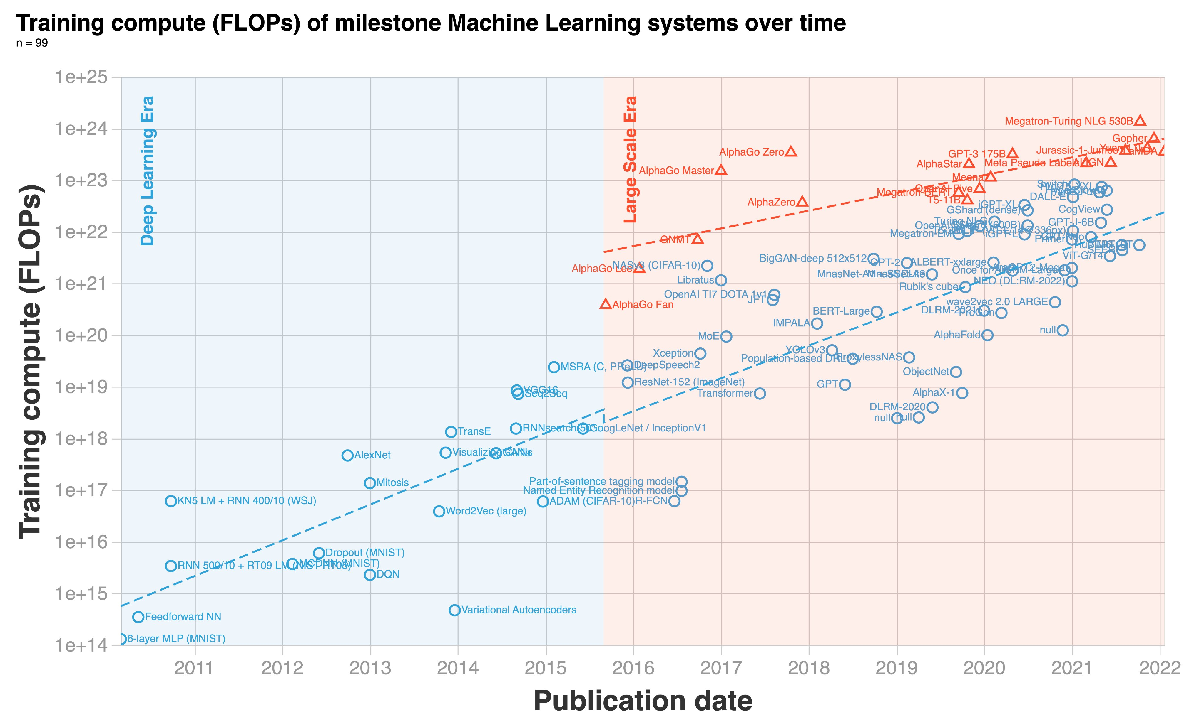
Larger Model Larger Data
More Training
*FLOPs: Floating Point Operations

Slide 5
Parallel Training:
Enable more trainings for larger model and larger data using multiple machines
How?

Slide 6



Data Parallel
Model Parallel
Partition of Data
Partition of Model
…

Slide 7
Combined Data and Model Parallel
…

Slide 8
Part 2: Data Parallel

Slide 9
What is Data Parallel ?
Each GPU:
holds a complete copy of model
handles different batch of data
computes gradient independently
…

Slide 10

Two Data Parallel Methods:
Naïve Data Parallel
Distributed Data Parallel
GPU: 0
GPU: 0
GPU: 1
GPU: 1
GPU: 2
GPU: 3
GPU: 3
GPU: 2
Have main device (GPU :0)
No main device

Slide 11

Naïve Data Parallel
Main device (GPU: 0) communicates to others
GPU: 0
…
GPU: 1
GPU: 2
GPU: 3

Slide 12


Initialization
Processor : 0
Initialization
Single processor sends model and optimizer to each GPU
Model
Model
Optimizer
…
Optimizer
…
GPU: 0
GPU: 1

Slide 13
Forward
Processor : 0
Batch: 1
Forward Pass
Single processor sends data to each GPU
Batch: 0
GPU: 0
GPU: 1
Model
Optimizer
Model
Optimizer

Slide 14
Gradient Calculation
GPU: 0
GPU: 1
Gradient Calculation
Each single GPU calculate gradient independently
Model
Batch: 0
Model
Batch: 1
Optimizer
Optimizer
Gradient: 0
Gradient: 1

Slide 15
Gradient Collection and Aggregation
Average Gradient
Main device (GPU: 0) collect all gradients to the and average
Gradient: 1
GPU: 0
GPU: 1
Average(Gradient: 0, Gradient: 1)

Slide 16
Gradient Distribution
Gradient Distribution
GPU:0 send averaged gradient to each other devices
Model Update
Each GPU updates its parameter use averaged gradient
Averaged Gradient
GPU: 0
GPU: 1

Slide 17
Communication:
Intra nodes: low bandwidth
Inter node: high bandwidth
high
Limitation:
Only favor single node* setting
Node: 0
low
high
Node: 1
node*: a single computation unit in cluster* contains multiple GPUs
Cluster*: a server contains multiple nodes
bandwidth*: number of data communicate per unit of time

Slide 18
Distributed Data Parallel
(DDP)
Enables multiple nodes training
Node: 0
Node: 2
Node: 1
Intra Nodes
PyTorch Distributed: Experiences on Accelerating Data Parallel Training

Slide 19
Distributed Data Parallel
(DDP)
Each device/node communicates to the other one in a “Ring”
No “main device” in this scenario
GPU: 0
GPU: 1
GPU: 3
GPU: 2
Inter Node
PyTorch Distributed: Experiences on Accelerating Data Parallel Training

Slide 20

Distributed Initialization
Inter Node
Initialization
Each processor sends model and optimizer to each GPU
Processor : 0
Processor : 1
Processor : 2
Processor : 3
Model
Model
Model
Model
Optimizer
Optimizer
Optimizer
Optimizer
…
…
…
…
GPU: 0
GPU: 1
GPU: 2
GPU: 3

Slide 21
Forward
Inter Node
Processor : 0
Processor : 1
Processor : 2
Processor : 3
Forward Pass
Each processor sends data to each GPU, calculates loss independently
Batch: 0
Batch: 1
Batch: 2
Batch: 3
GPU: 0
GPU: 1
GPU: 2
GPU: 3
Loss: 0
Loss: 1
Loss: 2
Loss: 3

Slide 22
DDP Gradient Update
Time
Intuition
Calculate and Communicate at the same time
Aggregate small amounts of gradients one time
Calculating
Gradient₃
Gradient₃
GPU: 0
GPU:1
Loss: 0
Gradient₃
Gradient₃
GPU:2
GPU:3
Aggregate

Slide 23
Gradient Calculation
Backpropagation
Time
Tow Observations
Gradients are calculated sequentially
Each layer’s gradients are much smaller than whole model gradients
Gradient₀
Gradient₁
Gradient₂
Gradient₃
Loss: 0

Slide 24
Gradient Buckets
Bucket
A small portion of gradients to communicate
Each communication only about one bucket instead of whole model, why?
Communication Overhead
Gradient₀
Gradient₁
Gradient₃
Gradient₂
Bucket
Gradient₃
Whole
Gradients

Slide 25

How to Send and Recieve Buckets?
Gradient₃
Gradient₃
DDP
Each GPU only communicates to adjacent one
Inter Nodes
Node: 0
GPU: 0
GPU: 1
Intra Nodes
Node: 1
GPU: 3
GPU: 2
Gradient₃
Gradient₃

Slide 26

Gradient Communication
Gradient₃
Gradient₃
Gradient₃
Ring Communication
For each GPU:
Send its gradient to next GPU
Receive previous GPU’s gradient
GPU: 0
GPU: 1
Gradient₃
Gradient₃
Gradient₃
GPU: 3
GPU: 2
Gradient₃
Gradient₃
(n-1 communication total)
n: number of total GPUs

Slide 27
Gradient Average
Agg ( )
Gradient₃
Gradient₃
Gradient₃
Gradient₃
Gradient₃
Gradient₃
Gradient₃
Gradient₃
Ring AllReduce:
Aggregate gradients on each machine once receive all gradients
GPU: 0
GPU: 1
GPU: 3
GPU: 2
Gradient₃
Gradient₃
Gradient₃
Gradient₃
Gradient₃
Gradient₃
Gradient₃
Gradient₃

Slide 28
Part 3: Model Parallel

Slide 29
What is Model Parallel ?
Each GPU holds a part of model
Each GPU computes dependently

Slide 30








Two Model Parallel Methods:
Tensor Parallel*
Pipeline Parallel
$$W_{1,1}$$
$$×$$
$$=$$
$$x_{1}$$
$$x_{2}$$
$$Y_{1}$$
$$Y_{2}$$
$$W_{1,2}$$
* tensor manipulation: mathematical operations like addition, multiplication

Slide 31


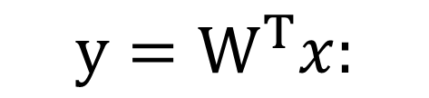














Tensor Parallel
$$y=W^{T}x:$$
$$×$$
$$=$$
$$x$$
$$y$$
$$W$$
Split tensor manipulation in different machine
Tensor Parallel$:$
$$×$$
$$W_{1}$$
$$x_{1}$$
$$=$$
$$+$$
$$y_{1}$$
$$y_{2}$$
$$×$$
$$W_{2}$$
$$x_{2}$$
*Megatron-LM: Training Multi-Billion Parameter Language Models Using Model Parallelism

Slide 32
Pipeline Parallel (Naïve*)
Split model layers in different parts
Each part in a single GPU
GPU :0
GPU: 1
GPU: 2
* Advanced Approach in Part 4: Mixed Parallel

Slide 33
When use?
If single GPU cannot hold single tensor manipulation*:
Tensor Parallel
Else if single GPU cannot hold whole model:
Model Parallel
Else:
Data Parallel
* tensor manipulation: mathematical operations like addition, multiplication

Slide 34
Part 4: Mixed Parallel

Slide 35

Key Issue in Pipeline Parallel: GPU Waiting
Forward
Backward
Wait
Wait
Loss
Wait
Wait
Update
GPU: 2
GPU: 2
Wait
Wait
Wait
Wait
Update
GPU: 1
GPU: 1
Wait
Wait
Wait
Wait
Update
GPU: 0
GPU: 1
Gradient
Gradient
Gradient
Only 1 GPU works each moment

Slide 36

Solution for Previous Issue
Forward
Loss: 0
Loss: 1
+Data Parallel:
When one GPU finished current batch, let it run another batch
Wait
Wait
GPU: 2
GPU: 2
Wait
Wait
GPU: 1
GPU: 1
Wait
Wait
GPU: 0
GPU: 0
Batch: 0
Batch: 1
*GPipe: Efficient Training of Giant Neural Networks using Pipeline Parallelism

Slide 37
Solution for Previous Issue
Backward
Loss: 1
Loss:0
Compute Gradients:
Compute the gradient for each parts
Wait
Wait
GPU: 0
GPU: 0
Wait
Wait
GPU: 1
GPU: 1
Wait
Wait
GPU: 2
GPU: 2
Gradient: 1
Gradient:0
Gradient: 1
*GPipe: Efficient Training of Giant Neural Networks using Pipeline Parallelism

Slide 38
Solution for Previous Issue
Gradient: 0
Gradient: 1
Agg( )
Update
GPU: 2
Gradient: 0
Gradient: 1
Agg( )
Update
GPU: 1
Gradient: 0
Gradient: 1
Agg( )
Update
GPU: 0
Model Update:
Once one iteration finished, update the model using aggregating gradients
*GPipe: Efficient Training of Giant Neural Networks using Pipeline Parallelism

Slide 39
Reduce the Percentage of “Wait” With more Batches
Forward
Backward
Wait
Wait
Wait
Wait
GPU: 2
GPU: 2
GPU: 2
GPU: 2
GPU: 2
GPU: 2
Wait
Wait
GPU: 1
GPU: 1
GPU: 1
GPU: 1
GPU: 1
GPU: 1
……
GPU: 0
GPU: 0
GPU: 0
GPU: 0
GPU: 0
GPU: 0
Batch: 0
Batch: 1
Batch: 2
*GPipe: Efficient Training of Giant Neural Networks using Pipeline Parallelism

Slide 40
Part 5: Zero-1,2,3

Slide 41
Zero is Memory Optimization for
Optimizer, Gradients, Parameters

Slide 42
Memory Issue in Data Parallel
GPU: 0
Memory Cost:
Each GPU keeps a whole copy of Parameters, Gradients, and Optimizer
Model
Batch: 0
Optimizer
GPU: 1
Model
Batch: 0
Optimizer

Slide 43
Larger Model, More Memory Occupancy
How much memory needs for 1 more parameter?
model parameter + gradient + optimizer states*
Model Parameters
Gradients
Optimizer States*
Optimizer States*: States needed for updating gradients, such as variance of gradients in Adam

Slide 44
What is Zero?
Model Parameters
Part 0
Part 1
Gradients
Optimizer States*
GPU: 0
Model Parameters
Gradients
Optimizer States*
GPU: 1
Reduce Memory Cost:
Each GPU keeps a part of Parameters, Gradients, and Optimizer
Data Parallel
Model Parameters
Part 0
Gradients
Optimizer States*
GPU: 1
Model Parameters
Part 1
Gradients
Optimizer States*
GPU: 1
Zero

Slide 45
Model Parameters
Gradients
Optimizer States*
GPU: 0
Zero-1
Reduce Optimizer State
Model Parameters
Gradients
Three Stages of Zero
Optimizer States*
GPU: 0
Zero-2
Reduce Gradients
Model Parameters
Gradients
Optimizer States*
GPU: 0
Zero-3
Reduce Parameters

Slide 46

Zero-1: Reduce Optimizer
Reduce Optimizer States
Each GPU keeps:
part of optimizer states,
whole copy of model parameters and gradients
GPU: 0
GPU: 1
Model Parameters
Gradients
Optimizer States

Slide 47
Zero-1: Reduce Optimizer
Part 0
Part 1
AllReduce:
Send the optimizer states to the corresponding GPU and aggregate
GPU: 0
Aggregate
Part 0
Part 1
GPU: 1
send part 1 from GPU:0 to GPU: 1
and aggregate with part 1 on GPU: 1

Slide 48
Zero-1: Reduce Optimizer
Gradient Update:
Update the gradient using corresponding optimizer states
Part 0
GPU: 0
Update
Part 0
GPU: 1
Update part 0 of gradients using part 0 of optimizer states

Slide 49
Zero-2: Reduce Gradients
Reduce Optimizer States
Each GPU keeps:
part of optimizer states and gradients
whole copy of model parameters
GPU: 0
GPU: 1
Model Parameters
Gradients
Optimizer States

Slide 50
Zero-2: Reduce Gradients
Part 0
Part 1
AllReduce:
Send the gradients to the corresponding GPU and aggregate
GPU: 0
Aggregate
Part 0
Part 1
GPU: 1
send part 1 from GPU:0 to GPU: 1
and aggregate with part 1 on GPU: 1

Slide 51
Zero-2: Reduce Gradients
Parameter Update:
Update the parameters using corresponding gradients
* Gradient update same as Zero-1
Part 0
GPU: 0
Update
Part 0
GPU: 1

Slide 52
Zero-3: Reduce Parameters
Reduce Optimizer States
Each GPU keeps:
part of optimizer states, gradients, and model parameters
GPU: 0
GPU: 1
Model Parameters
Gradients
Optimizer States

Slide 53
Zero-3: Reduce Parameters
Part 0
Part 1
AllReduce:
Send the parameters to the corresponding GPU and aggregate
GPU: 0
Aggregate
Part 0
Part 1
GPU: 1

Slide 54
Zero-3: Reduce Parameters
Part 0
Part 1
Forward and Backward:
Send the parameters to other GPU when needed
GPU: 0
Aggregate
Part 0
Part 1
GPU: 1

Slide 55
Part 6: DeepSpeed & Huggingface API

Slide 56
Intro to DeepSpeed
DeepSpeed: Optimization Library for DeepLearning
Training
Zero
Inference
Model
Compression
4Science

Slide 57
Define model and data as single GPU
# Import Library
import os
from transformers import Trainer, TrainingArguments
# Define the model and dataset
model = YourModel()
trn, val = TrainDataset(), ValidDataset()

Slide 58
# Define TrainingArguments
training_args = TrainingArguments(
output_dir=‘./results’, # store checkpoints
num_train_epochs=YourEpochs,
per_device_train_batch_size=YourBatchSize,
per_device_eval_batch_size=YourBatchSize,
# local_rank=int(os.environ[‘LOCAL_RANK’]), # if DDP
# deep_speed=‘./ds_config.json’ # if Zero )

Slide 59
# Define Trainer
trainer = Trainer(
model=model,
args=TrainingArguments, # Previous Defined
train_dataset=trn,
eval_dataset=val)

Slide 60
Launch Training For Distributed Data Parallel
# Define Trainer
# Define node and port
head_node_ip = YourHeadNodeIP
port = YourPort
torchrun --nnodes=2 \ # number of nodes using
--nproc_per_node=2 \ # number of GPU per node
# …other configs
YourTrainScript.py
Automatically find and allocate GPUs.

Slide 61
Launch Training For DeepSpeed
deepspeed YourTrainScript.py --deepspeed
--deepspeed_config ds_config.json

