Slide 1
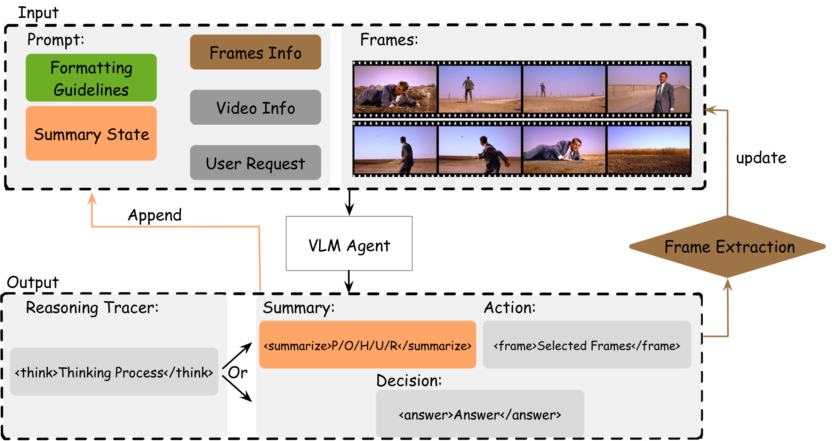
OPENING
REVISE: Towards Sparse Video Understanding and Reasoning
Reading group framing for long-video QA under sparse evidence
Long videos contain far more visual evidence than a model can process productively in one pass
The paper reframes video QA as iterative evidence gathering instead of dense viewing
The central design move is to keep a compact summary state while requesting only new, useful frames
REVISE overview
REVISE

Slide 2
OPENING
Why This Paper Matters
PREVIEW 01
Long-video QA is mostly a retrieval problem disguised as a context-window problem
PREVIEW 02
Relevant evidence is sparse and depends on the question, so uniform sampling wastes budget
PREVIEW 03
REVISE turns frame access into an iterative reasoning loop that can stop early when evidence is sufficient
REVISE

Slide 3
OPENING
Roadmap
Set up the task: what makes long-video question answering hard
Place REVISE in the landscape of caption pipelines, frame selectors, and agentic methods
Then ask whether its summary-as-state loop is the right abstraction for sparse video reasoning
EDITORIAL READ
Set up the task: what makes long-video question answering hard
Place REVISE in the landscape of caption pipelines, frame selectors, and agentic methods
Then ask whether its summary-as-state loop is the right abstraction for sparse video reasoning
SPEAKER CUE
Use this slide to frame the section transition
Contrast the current limitation with the mechanism REVISE introduces.
Keep the right rail compact so the left-side bullets remain the primary reading path.

Slide 4
CONTEXT
Task Setup: Long-Video Question Answering
Input is a user question plus a long sequence of video frames spread across time
The model must recover the answer from temporally distributed evidence, not just local appearance
In practice the system also has to respect a fixed visual-context budget, so it cannot inspect everything
EDITORIAL READ
Input is a user question plus a long sequence of video frames spread across time
The model must recover the answer from temporally distributed evidence, not just local appearance
In practice the system also has to respect a fixed visual-context budget, so it cannot inspect everything
SPEAKER CUE
Use this slide to frame the section transition
Contrast the current limitation with the mechanism REVISE introduces.
Keep the right rail compact so the left-side bullets remain the primary reading path.
REVISE · NExT-QA · EgoSchema · VideoEspresso

Slide 5
CONTEXT
Why Long Videos Break Naive VLM Inference
Information overload: dense uniform sampling feeds many redundant frames into the model
Key-information awareness: the few decisive moments may occur at different temporal scales and are easy to miss
Those two failures interact, because wasted context budget makes it even harder to include the frames that matter
EDITORIAL READ
Information overload: dense uniform sampling feeds many redundant frames into the model
Key-information awareness: the few decisive moments may occur at different temporal scales and are easy to miss
Those two failures interact, because wasted context budget makes it even harder to include the frames that matter
SPEAKER CUE
Use this slide to frame the section transition
Contrast the current limitation with the mechanism REVISE introduces.
Keep the right rail compact so the left-side bullets remain the primary reading path.
REVISE · VideoTree

Slide 6
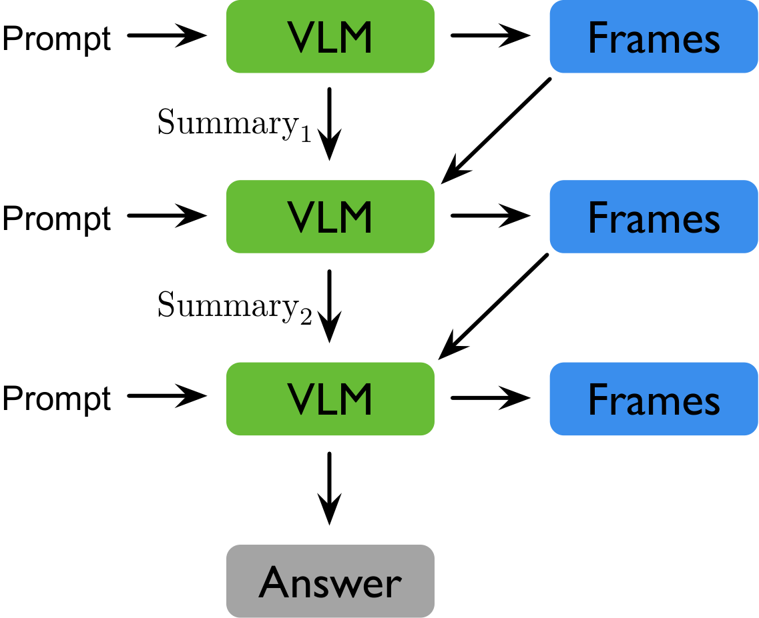
CONTEXT
The Core Claim Is Semantic Sparsity
Why this example matters
Only a small subset of frames is actually relevant to a given question
The target subset changes with the question, so a fixed sampling policy is structurally mismatched
A good system should accumulate verified evidence while keeping the active context compact
Summary-as-state as compact carryover memory
REVISE

Slide 7
CONTEXT
Benchmarks Stress Different Time Scales
NExT-QA focuses on short-to-medium videos with causal, temporal, and descriptive questions
EgoSchema pushes toward longer egocentric clips where useful evidence is buried in routine activity
VideoEspresso emphasizes sparse core-frame reasoning across diverse fine-grained reasoning categories
EDITORIAL READ
NExT-QA focuses on short-to-medium videos with causal, temporal, and descriptive questions
EgoSchema pushes toward longer egocentric clips where useful evidence is buried in routine activity
VideoEspresso emphasizes sparse core-frame reasoning across diverse fine-grained reasoning categories
SPEAKER CUE
Use this slide to frame the section transition
Contrast the current limitation with the mechanism REVISE introduces.
Keep the right rail compact so the left-side bullets remain the primary reading path.
NExT-QA · EgoSchema · VideoEspresso

Slide 8
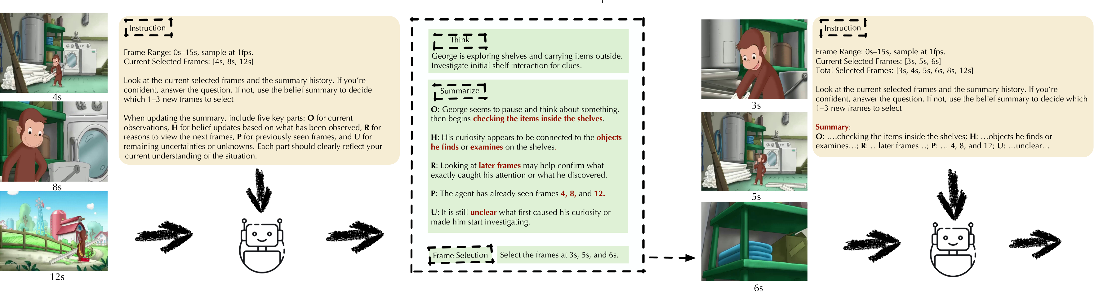
CONTEXT
What Fails In A One-Shot Pass
Why this example matters
Uniformly sampled frames give broad coverage but weak diagnostic evidence for the actual question
If the first pass misses the decisive moment, the model has no mechanism to ask for targeted follow-up evidence
The result is either bloated context or brittle answers built from partial observations
Multi-round example showing targeted follow-up frames
REVISE · VideoAgent · VideoTree

Slide 9
LANDSCAPE
The Field Is Shifting From Dense Viewing To Selective Reasoning
Early video-VLM systems mostly tried to pack more frames or captions into one inference call
Newer work treats frame access as a bottleneck to manage, not just a larger context to fill
That shift creates room for methods that retrieve evidence, reason over it, and decide when to continue
EDITORIAL READ
Early video-VLM systems mostly tried to pack more frames or captions into one inference call
Newer work treats frame access as a bottleneck to manage, not just a larger context to fill
That shift creates room for methods that retrieve evidence, reason over it, and decide when to continue
SPEAKER CUE
Use this slide to frame the section transition
Contrast the current limitation with the mechanism REVISE introduces.
Keep the right rail compact so the left-side bullets remain the primary reading path.
LLoVi · MovieChat · VideoAgent · VideoTree

Slide 10
LANDSCAPE
A Useful Taxonomy Of Long-Video QA Methods
Dense video-LLMs trade simplicity for heavy context use and redundancy
Caption or memory pipelines compress the video into text, gaining scale but often losing fine visual detail
Query-aware frame selectors and agentic multi-round systems move closer to question-specific evidence gathering
DENSE VIDEO-LLMS
CAPTION / MEMORY PIPELINES
Process many frames in one pass with direct visual tokens
Compress video into textual descriptions or memory before reasoning
Strength: Preserve raw visual detail and keep the pipeline simple
Weakness: Consume context budget quickly and revisit redundant evidence
Fit: Shorter videos or tasks where broad visual coverage matters more than targeted retrieval
Strength: Scale to longer videos by moving reasoning into text space
Weakness: May discard the fine-grained visual cues needed for the final answer
Fit: Narrative or event-level questions that tolerate abstraction
QUERY-AWARE FRAME SELECTORS
AGENTIC MULTI-ROUND REASONING
Rank or sample likely-relevant frames conditioned on the prompt
Alternate between reasoning, requesting evidence, and deciding when to stop
Strength: Improve efficiency by spending budget on candidate evidence
Weakness: Often make an early relevance decision without an evolving uncertainty state
Fit: Settings where one good retrieval pass is often enough
Strength: Support adaptive follow-up when the first pass is insufficient
Weakness: Need a stable memory representation to avoid history bloat or drift
Fit: Long-form QA where evidence is sparse and question-specific
LLoVi · MovieChat · VideoAgent · VideoTree · Q-Frame · FlexibleFrameSelection · ActiveVideoPerception

Slide 11
LANDSCAPE
Caption / Memory Pipelines Compress First, Reason Later
Their strength is scale: captions or textual memories let an LLM traverse long videos without raw visual overload
Their weakness is fidelity: once the abstraction is textual, subtle visual cues may already be gone
These methods are strongest when the question is answerable from high-level event summaries rather than precise frame evidence
ASPECT
FAMILY A
FAMILY B
Aspect
Family A
Family B
Primary representation
Best-case payoff
Failure mode
When to prefer it
Text summaries, captions, or compressed memory slots
Long-horizon coverage with manageable context cost
Early compression can hide the exact visual cue the question depends on
Questions are answerable from semantic summaries
Direct frame evidence remains available only indirectly
Strong for coarse event structure and high-level narrative recall
Downstream reasoning cannot recover detail that was never preserved
The talk task values scale more than frame-level fidelity
LLoVi · MovieChat · VideoAgent

Slide 12
LANDSCAPE
Query-Aware Frame Selection Improves Efficiency, But Often Stays Single-Pass
Selection methods try to rank or sample frames that are likely to matter for the prompt
They reduce wasted compute, but many still make the key decision before enough evidence has been gathered
Without an explicit evolving state, it is harder to represent what is known, what is missing, and why another frame is needed
LANDSCAPE
LANDSCAPE
What improves
What remains limited
Cuts redundant frame processing relative to dense uniform sampling
Makes visual budget explicitly question-aware
Can be paired with strong back-end VLMs without redesigning the whole stack
Many selectors still commit to relevance judgments in effectively one pass
Selection quality depends on weak early signals before ambiguity is resolved
They usually lack an explicit state for beliefs, uncertainties, and next-step rationale
VideoTree · Q-Frame · FlexibleFrameSelection · AdaptiveKeyframeSampling

Slide 13
LANDSCAPE
Agentic Methods Add Iteration And Tool Use
Agentic systems can observe, reflect, and request new evidence instead of committing to a single retrieval step
This is closer to how a human would solve long-video QA: inspect, update the hypothesis, then probe the missing piece
The open question is what memory representation keeps those loops stable instead of letting them drift or bloat
LANDSCAPE
LANDSCAPE
What agentic loops add
Why memory becomes central
Iterative evidence requests instead of fixed retrieval
A natural place for uncertainty-driven follow-up
The option to stop early once the answer is sufficiently supported
The agent must preserve verified evidence across rounds
Full history replay is expensive and can amplify drift
A compact state representation is needed to keep the loop interpretable and stable
VideoAgent · ActiveVideoPerception · AIR · VideoBrain · FrameMind · FrameThinker

Slide 14
LANDSCAPE
Where REVISE Fits
Why this example matters
REVISE combines direct visual reasoning with multi-round frame requests, so it does not have to collapse everything into captions first
Its distinctive bet is summary-as-state: carry forward only compact, structured evidence instead of the full visual or conversational history
That makes the method interesting both as a plug-and-play controller for closed models and as an RL target for open models
Bridge from landscape to REVISE
REVISE · VideoAgent · VideoTree · RAGEN

