Slide 1
CS 341 honor’s project
Cluster system power management via network
Professor: Lawrence Angrave
Instructor: Hassam Uddin
Student: Chen-Wei Chou

Slide 2
Topic
Goal
Network Topology
Features
Demo

Slide 3
Goal
Utilize the reboot mechanism to restore the healthy status of cluster nodes.
Adopt the heartbeat approach to determine if nodes are healthy or dead.
The project can be applied to advanced high-availability cluster systems and distributed systems.

Slide 4

Network topology
In this project, I utilize 10 computing nodes to demonstrate a sample cluster system, with one machine serving as a cyber power controller to manage the power of the target node.

Slide 5
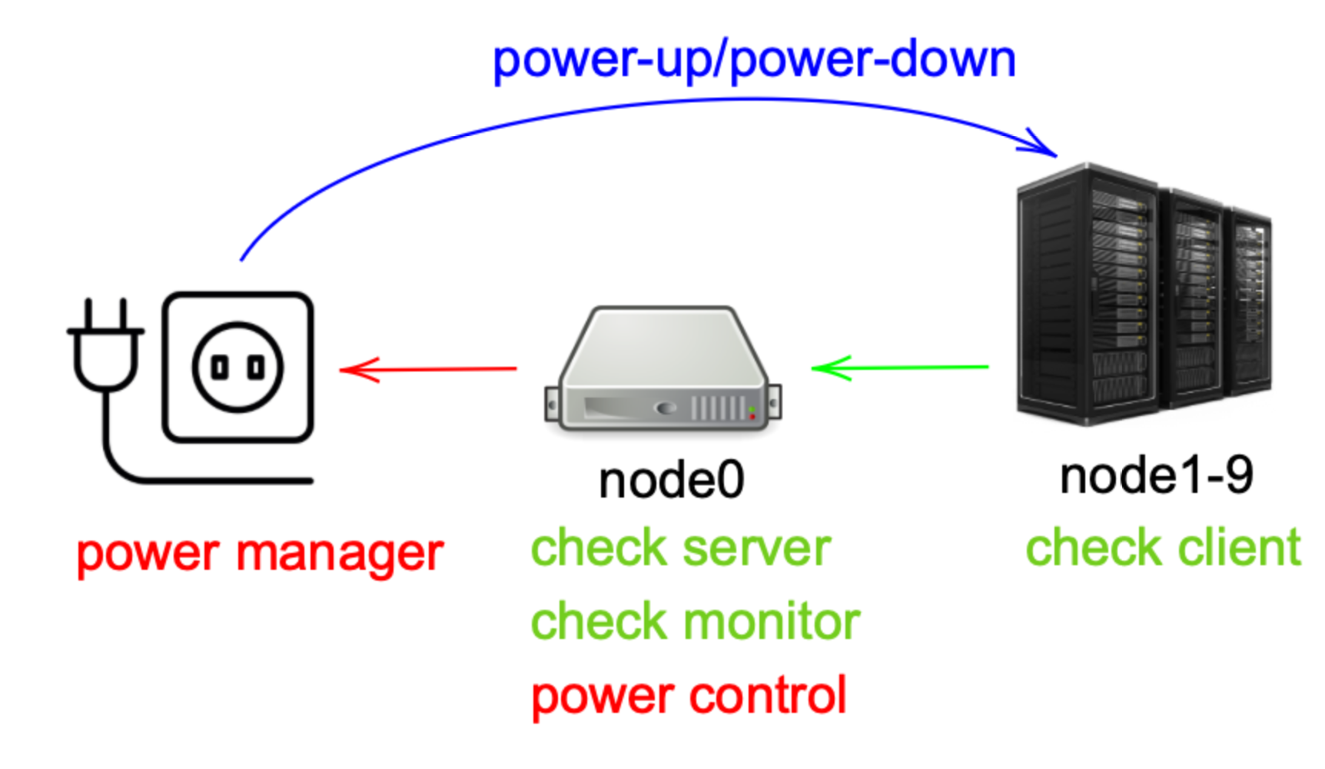
Network topology
Notes:
Ref:
https://www.freepnglogos.com/images/server-28491.html
https://www.freeiconspng.com/img/3692
https://www.freeiconspng.com/img/36127

Slide 6
feature
Node0:
server: Receives heartbeat signals from nodeX, where X ranges from 1 to 9.
serverd: A server daemon ensures that the server program can successfully run when the node starts up..
powerctl: Control which node will be rebooted.
checkmon: Monitor the health status of nodeX, where X ranges from 1 to 9.

Slide 7
feature
nodeX where X is 1 to 9:
client: Send a heartbeat signal to node0.
clientd: A client daemon ensures that the client program can successfully run when the node starts up.
crash: Simulate a crash scenario.

Slide 8
feature
Power device:
powerman: Power management to power up/power down the target machine.

Slide 9
demo
https://filedn.com/lEQ3OJnPdzDzbJhCstTdU4B/cs341/demo_v1.mp4

