Slide 1
Reachability of Non-smooth systems via Lexicographic Jacobian
Chenxi Ji
Advised by: Sayan Mitra, Huan Zhang
Date: 01/25
Notes:
Research Interest: Control, Formal Verification

Slide 2

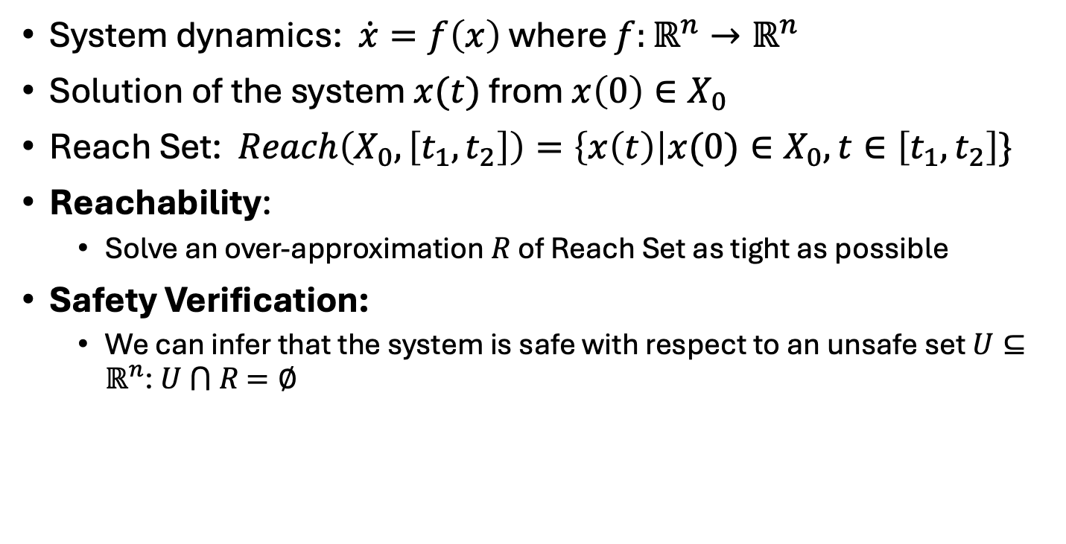



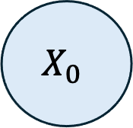

Motivation: Reachability for Safety Verification
$$Initial Set$$
$$X_{0}$$
System dynamics: $\dot{x}=f\left(x\right)$ where $f:ℝ^{n}→ℝ^{n}$
Solution of the system $x(t)$ from $x\left(0\right)∈X_{0}$
Reach Set: $Reach\left(X_{0},\left[t_{1},t_{2}\right]\right)=\left\{x\left(t\right)\right|x(0)∈X_{0}, t∈\left[t_{1},t_{2}\right]\}$
Reachability:
Solve an over-approximation $R$ of Reach Set as tight as possible
Safety Verification:
We can infer that the system is safe with respect to an unsafe set $U⊆ℝ^{n}$: $U$ $⋂$ $R$ $=∅$
$$U$$
$x(∙)$
$$R$$
$$Reach\left(X_{0},\left[T\right]\right)$$

Slide 3
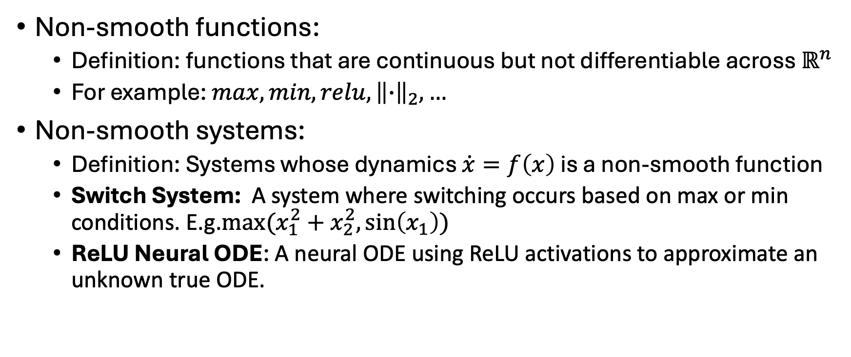
Motivation: Non-smooth Systems
Non-smooth functions:
Definition: functions that are continuous but not differentiable across $ℝ^{n}$
For example: $max, min, relu, {\left\|∙\right\|}_{2}, …$
Non-smooth systems:
Definition: Systems whose dynamics $\dot{x}=f\left(x\right)$ is a non-smooth function
Switch System: A system where switching occurs based on max or min conditions. E.g.$max⁡(x_{1}^{2}+x_{2}^{2},\sin\left(x_{1}\right))$
ReLU Neural ODE: A neural ODE using ReLU activations to approximate an unknown true ODE.

Slide 4

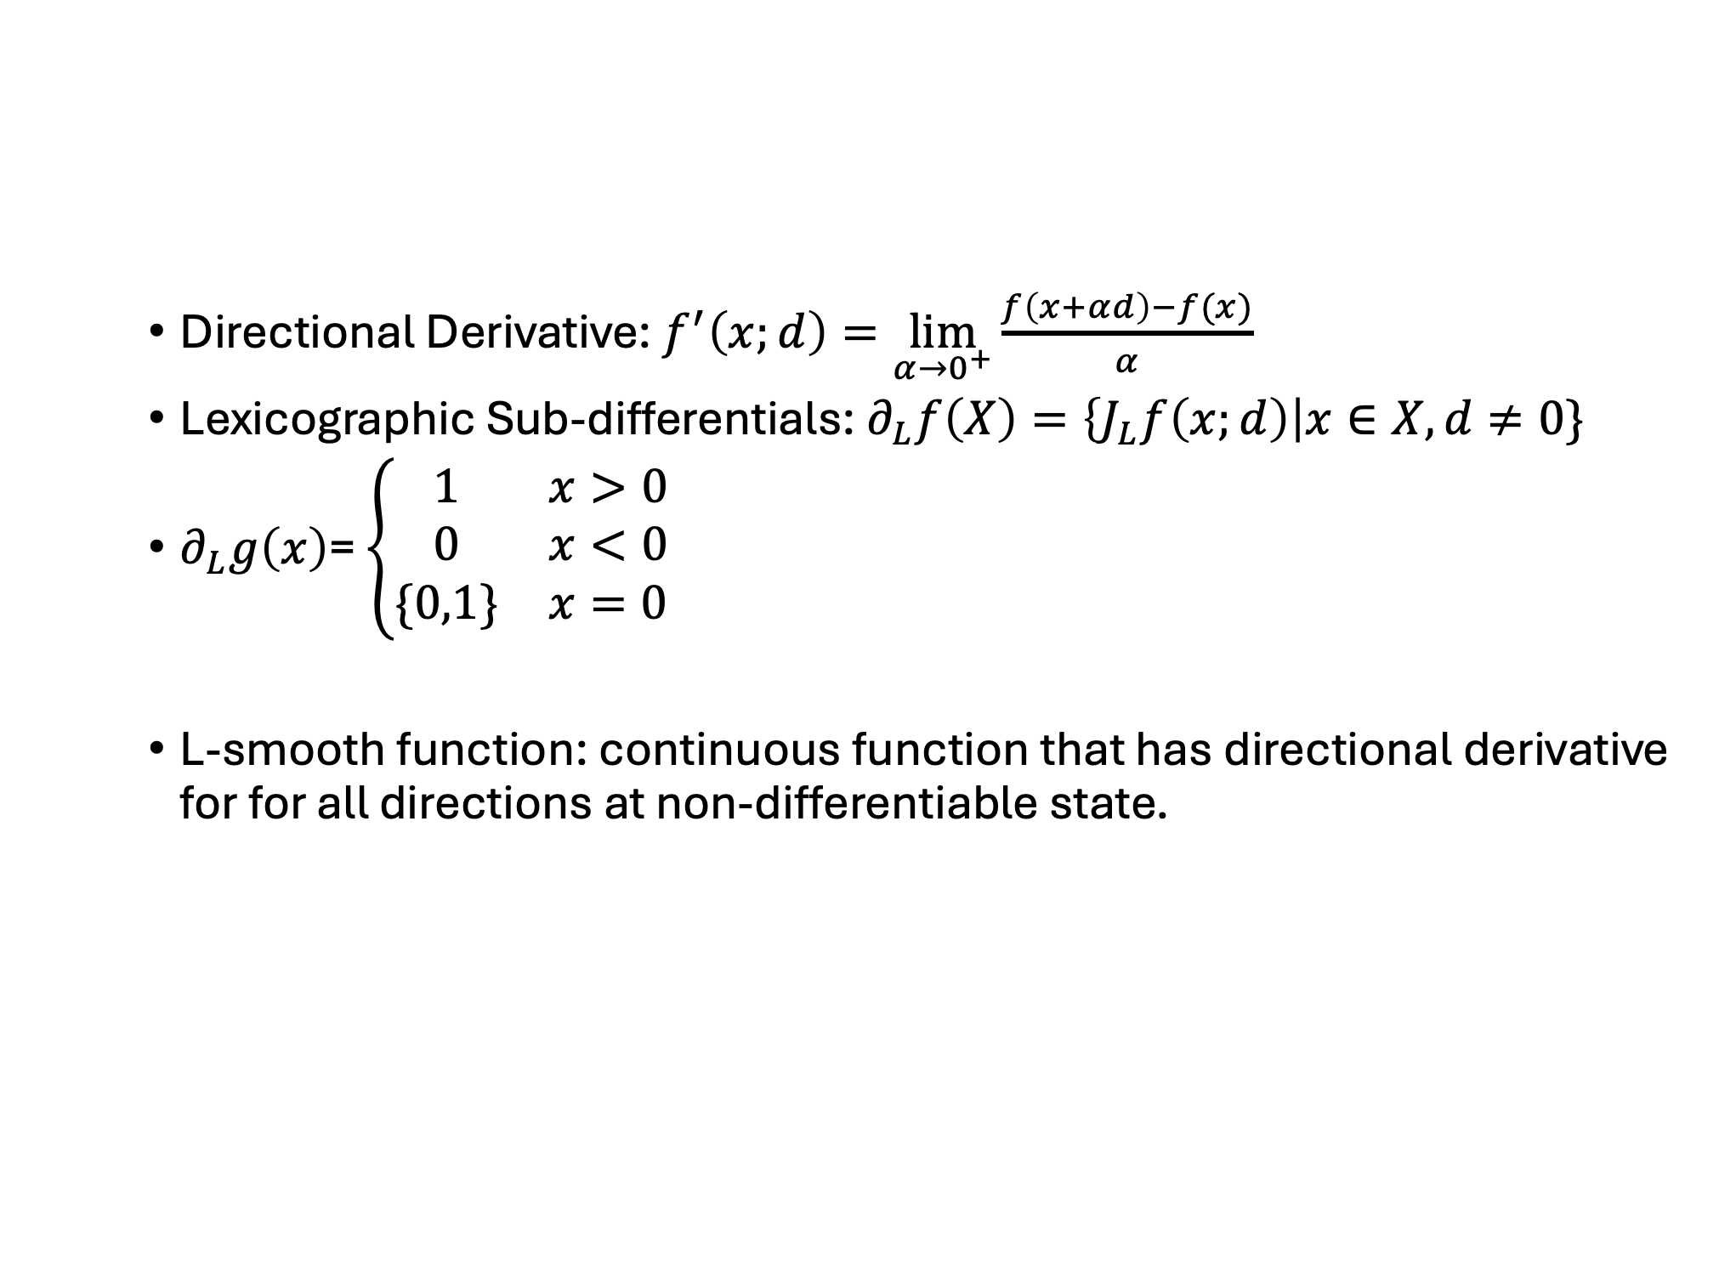








Background: Lexicographic Jacobian for single input and single output function
Directional Derivative: $f^{′}\left(x;d\right)=\lim_{α→0^{+}}{\frac{f\left(x+αd\right)−f(x)}{α}}$
Lexicographic Sub-differentials: $∂_{L}f\left(X\right)=\left\{J_{L}f\left(x;d\right)\right|x∈X, d≠0\}$
$∂_{L}g\left(x\right)$= $\left\{\begin{matrix}1 & x>0 \\ 0 & x<0 \\ \{0,1\} & x=0\end{matrix}\right.$
L-smooth function: continuous function that has directional derivative for for all directions at non-differentiable state.
$$ReLU(x)$$
$$∂_{L} ReLU(x)$$
$$1$$
$$1$$
$$0$$
$$1$$
$$x$$
$$0$$
$$x$$
[1] Nesterov, Y. (2005). Lexicographic differentiation of nonsmooth functions. Mathematical programming, 104, 669-700.

Slide 5



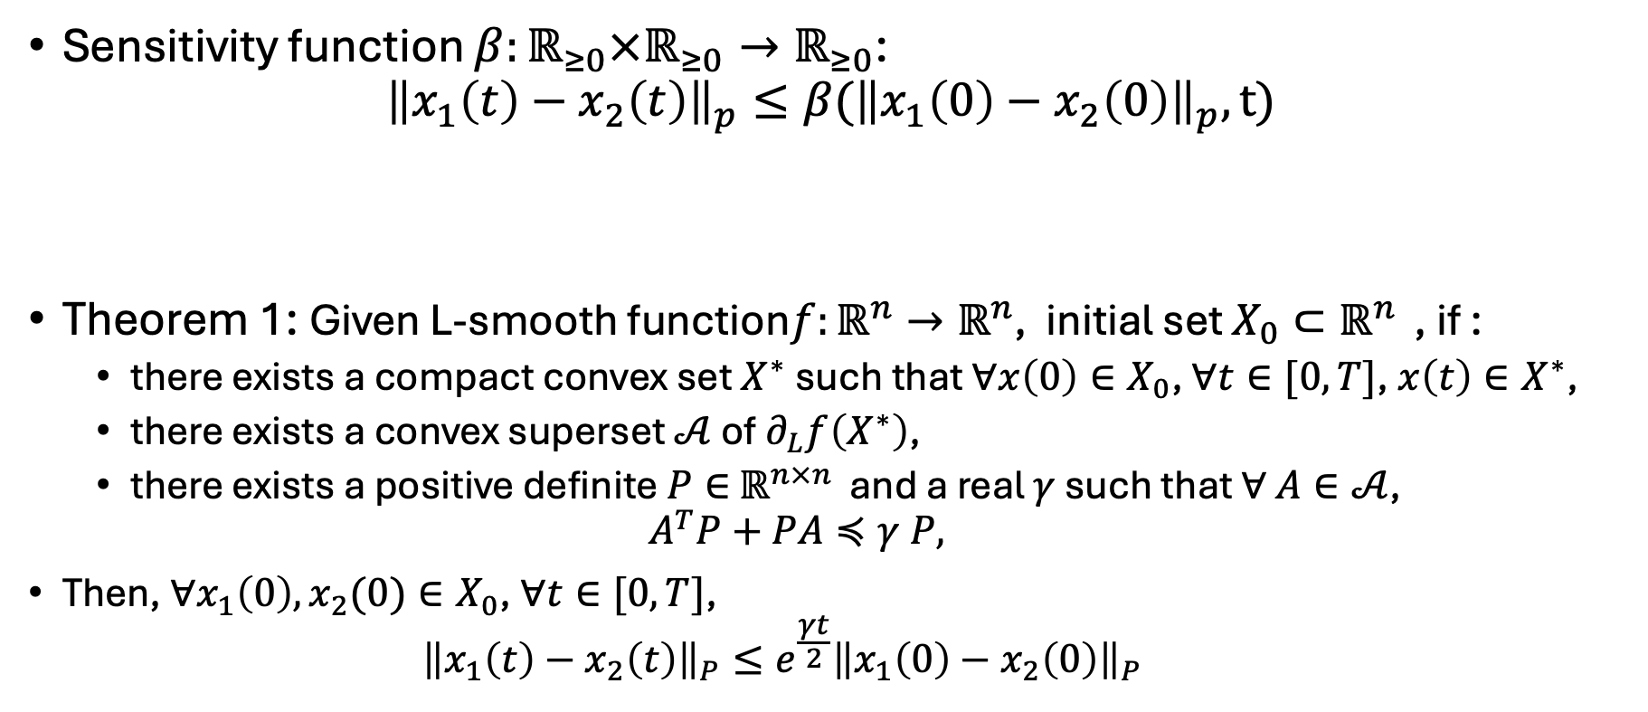



Sensitivity Function Bounding Distance between Two Solutions
$$Initial Set$$
$$x_{2}\left(0\right)−x_{1}(0)$$
Sensitivity function $β:ℝ_{≥0}×ℝ_{≥0}→ℝ_{≥0}$:
$${\left\|x_{1}\left(t\right)−x_{2}\left(t\right)\right\|}_{p}≤β({\left\|x_{1}\left(0\right)−x_{2}\left(0\right)\right\|}_{p},t)$$
Theorem 1: Given L-smooth function$f:ℝ^{n}→ℝ^{n}$, initial set $X_{0}⊂ℝ^{n }$, if :
there exists a compact convex set $X^{∗}$such that $∀x\left(0\right)∈X_{0}$, $∀t∈[0,T]$, $x\left(t\right)∈X^{∗}$,
there exists a convex superset $𝒜$ of $∂_{L}f\left(X^{∗}\right)$,
there exists a positive definite $P∈$ $ℝ^{n×n }$and a real $γ$ such that $∀$ $A∈𝒜$,
$$A^{T}P+PA≼γ P,$$
Then, $∀x_{1}\left(0\right),x_{2}(0)∈X_{0}$, $∀t∈[0,T]$,
$${\left\|x_{1}\left(t\right)−x_{2}\left(t\right)\right\|}_{P}≤e^{\frac{γt}{2}}{{\left\|x_{1}\left(0\right)−x_{2}\left(0\right)\right\|}_{P}}^{}$$
$x_{1}(∙)$
$x_{2}(∙)$
$$x_{2}\left(t\right)−x_{1}(t)$$
$$Reach Set$$

Slide 6











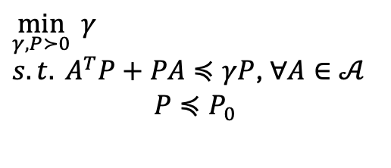




Animation of Reachable Set Computation
State domain $R^{n}$
Jacobian domain $R^{n×n}$
$$X^{∗}$$
$$X^{∗}$$
$$∂_{L}f(X^{∗})$$
$$𝒜$$
$$E_{P}(x(T))$$
$$Reach(X_{0},T)$$
$$𝒜$$
$$x(T)$$
$$x(0)$$
$$E_{P_{0}}(x(0))$$
$$\min_{γ,P≻0}{γ}$$
$s.t. A^{T}P+PA≼γP$, $∀A∈𝒜$
$$P≼P_{0}$$
$$P$$
$$γ,P$$
$$P=Pe^{−\frac{γT}{2}}$$

Slide 7
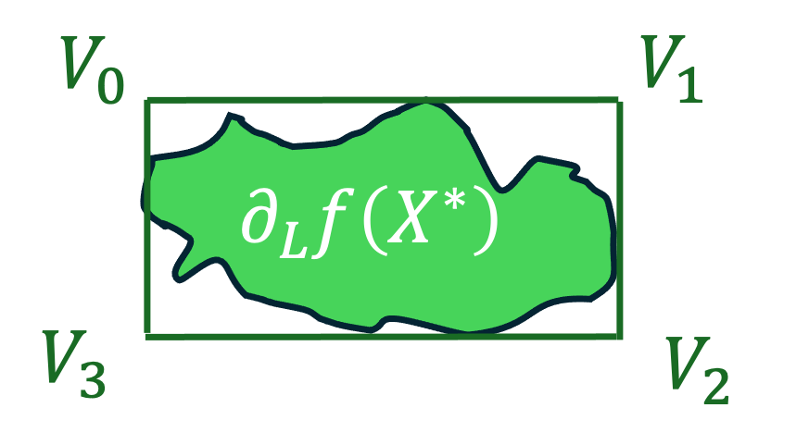
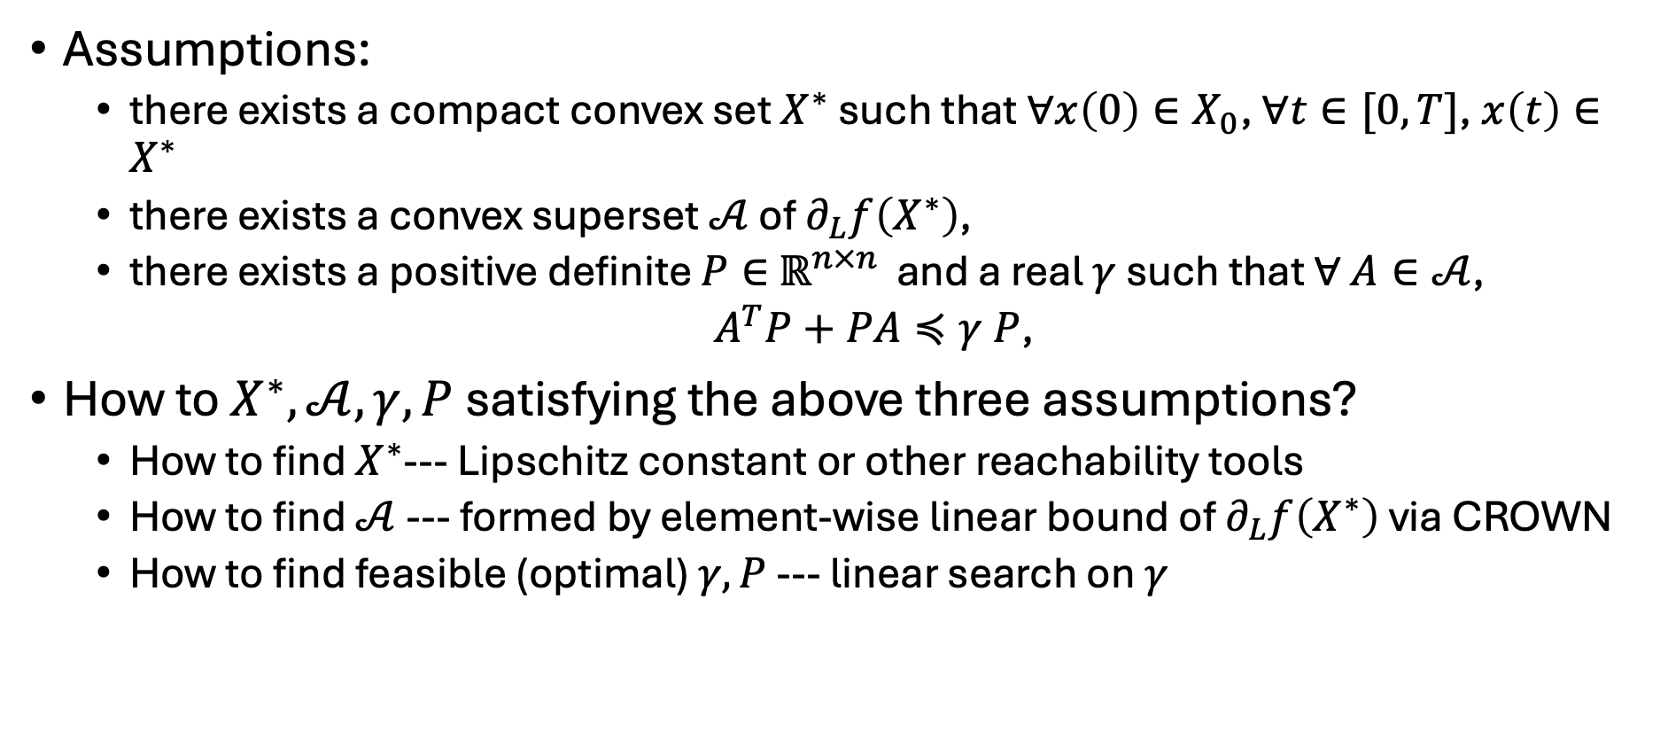
Three Assumptions in Theorem 1
Assumptions:
there exists a compact convex set $X^{∗}$such that $∀x\left(0\right)∈X_{0}$, $∀t∈[0,T]$, $x\left(t\right)∈X^{∗}$
there exists a convex superset $𝒜$ of $∂_{L}f\left(X^{∗}\right)$,
there exists a positive definite $P∈$ $ℝ^{n×n }$and a real $γ$ such that $∀$ $A∈𝒜$,
$A^{T}P+PA≼γ P$,
How to $X^{∗},𝒜,γ,P$ satisfying the above three assumptions?
How to find $X^{∗}$--- Lipschitz constant or other reachability tools
How to find $𝒜$ --- formed by element-wise linear bound of $∂_{L}f\left(X^{∗}\right)$ via CROWN
How to find feasible (optimal) $γ,P$ --- linear search on $γ$

Slide 8
Experiment Results

Slide 9
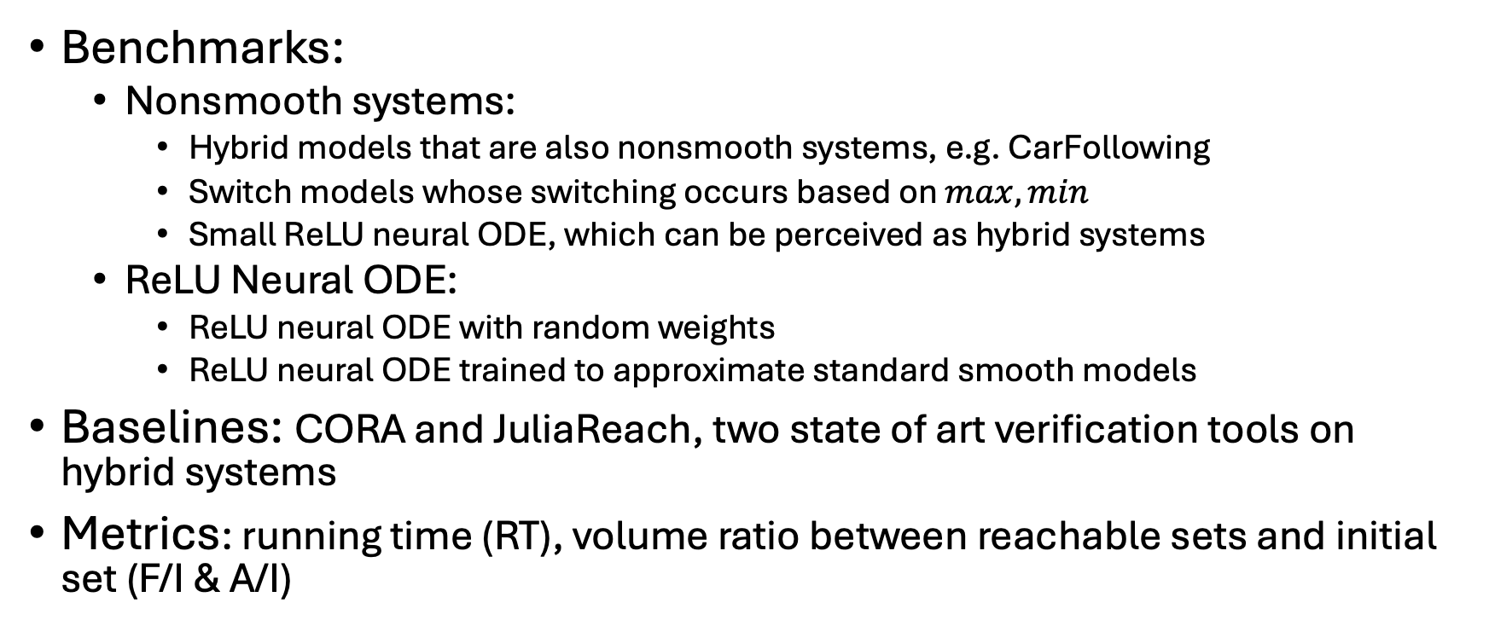
Benchmark and Baselines
Benchmarks:
Nonsmooth systems:
Hybrid models that are also nonsmooth systems, e.g. CarFollowing
Switch models whose switching occurs based on $max, min$
Small ReLU neural ODE, which can be perceived as hybrid systems
ReLU Neural ODE:
ReLU neural ODE with random weights
ReLU neural ODE trained to approximate standard smooth models
Baselines: CORA and JuliaReach, two state of art verification tools on hybrid systems
Metrics: running time (RT), volume ratio between reachable sets and initial set (F/I & A/I)

Slide 10
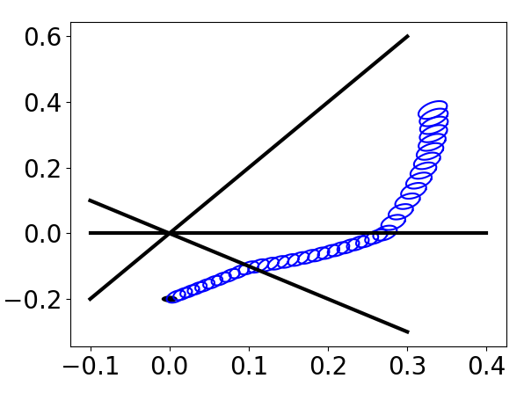
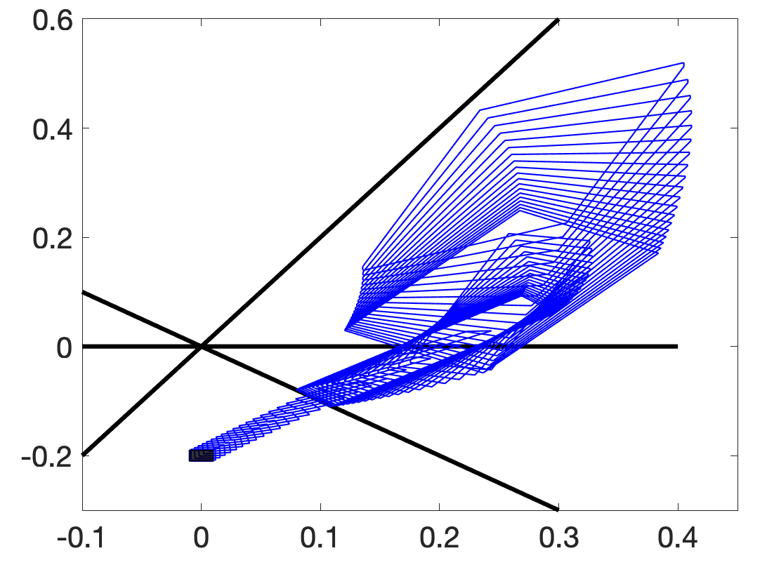
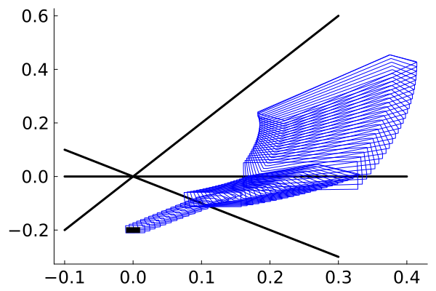
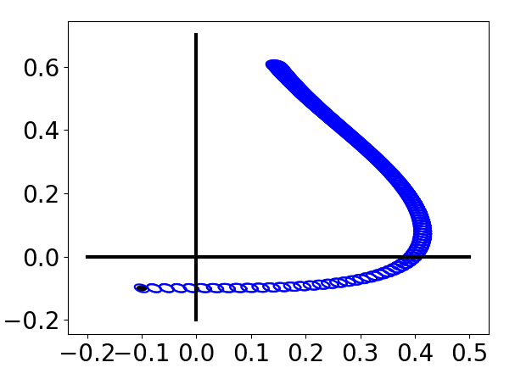
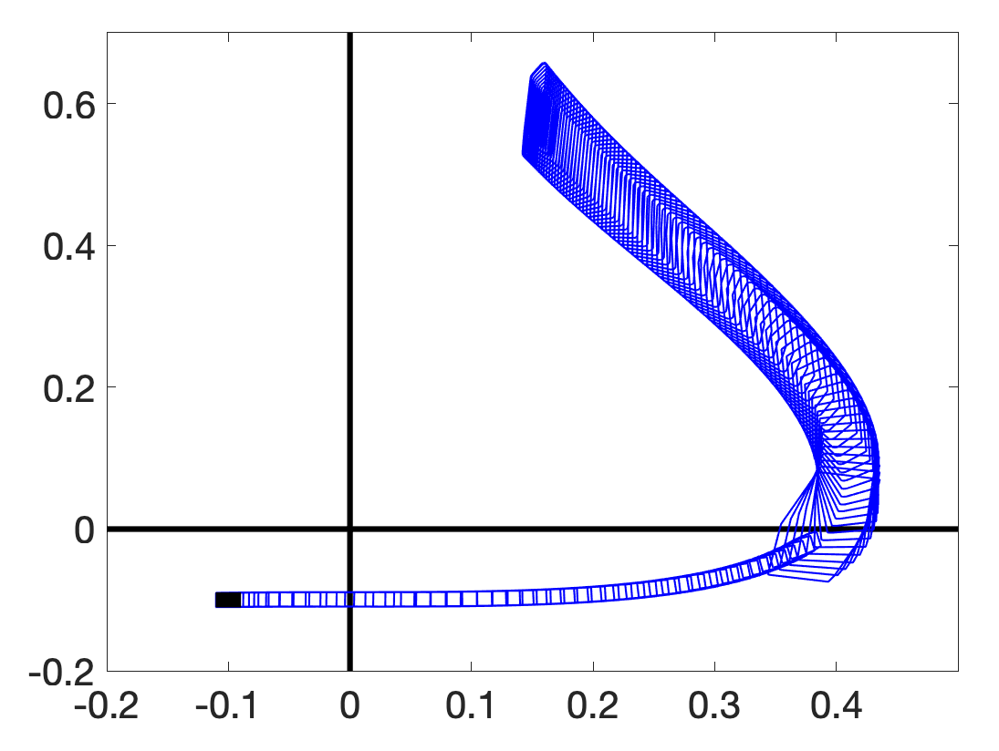
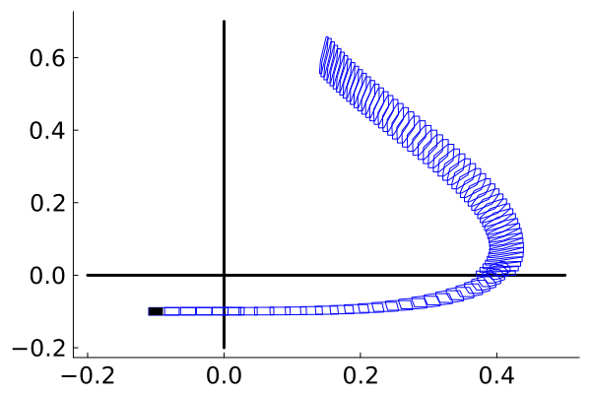
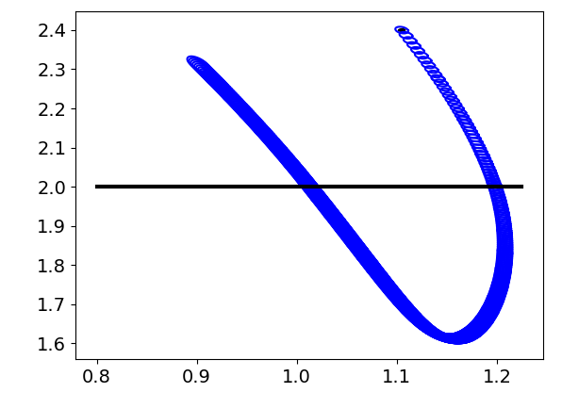
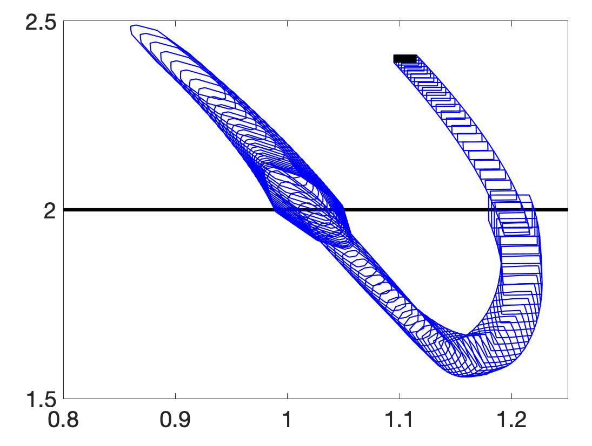
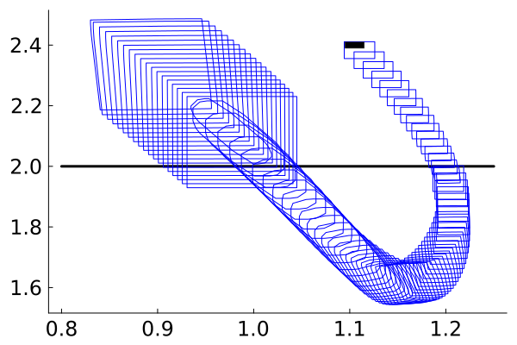

















Results on Non-smooth Systems
$$Ours$$
$$CORA$$
$$JuliaReach$$
$$SmallNN−1$$
1 Tighter reachable sets
2 Avoid blowing-up near nonsmooth hyperplane
$$x_{2}$$
$$x_{1}$$
$$x_{1}$$
$$x_{1}$$
$$Switch−Rob$$
$$x_{3}$$
$$x_{2}$$
$$x_{2}$$
$$x_{2}$$
$$Switch−LL$$
$$x_{4}$$
$$x_{2}$$
$$x_{2}$$
$$x_{2}$$
Notes:
Possible to add sampled trajectories

Slide 11
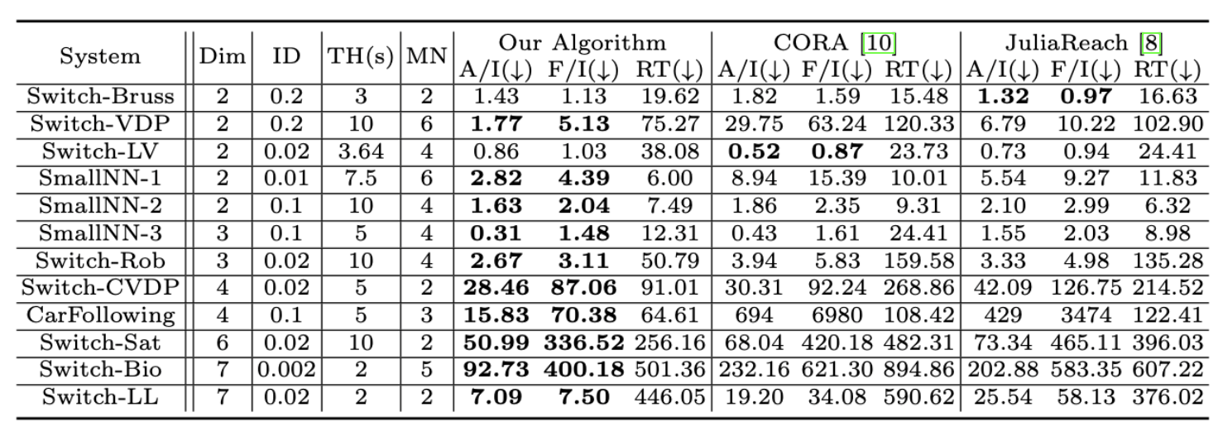
Results on Non-smooth Systems
Tighter reachable set on 10 over 12 models
Faster computation on 8 over 12 models.
At most, 10 times more accurate

Slide 12
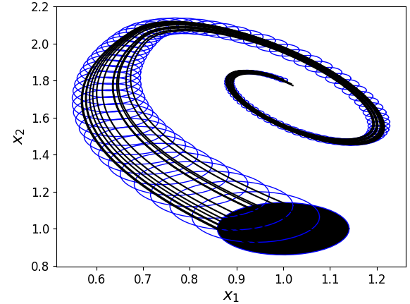
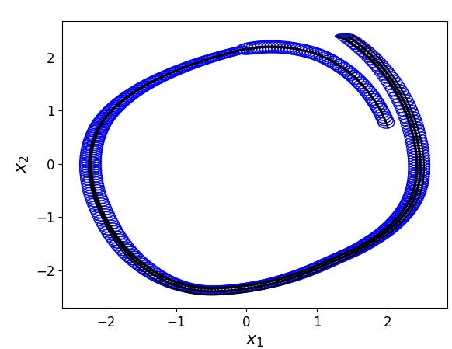
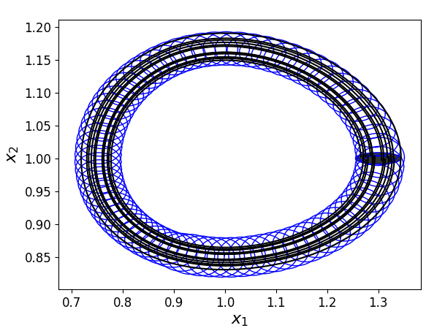
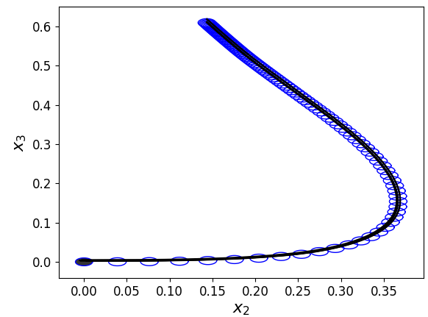
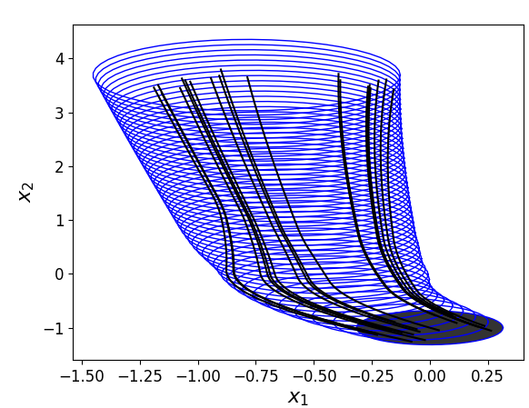
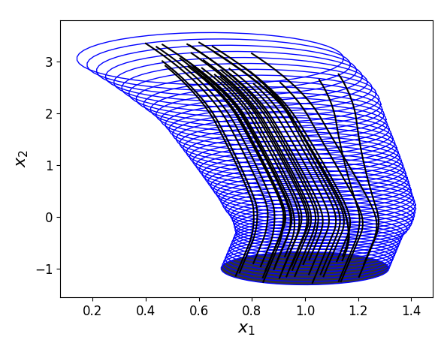
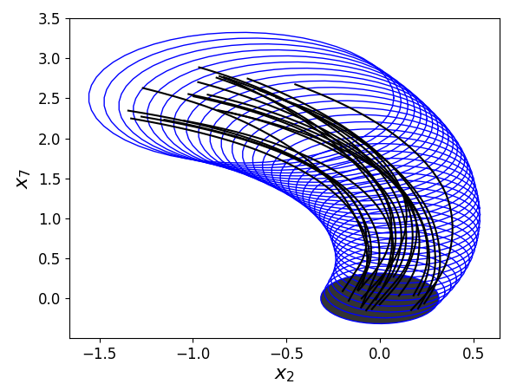
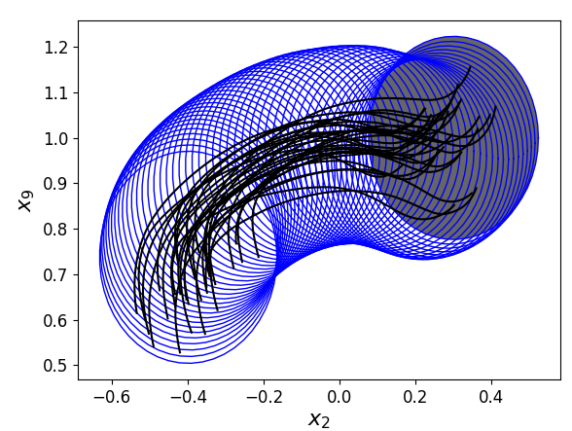
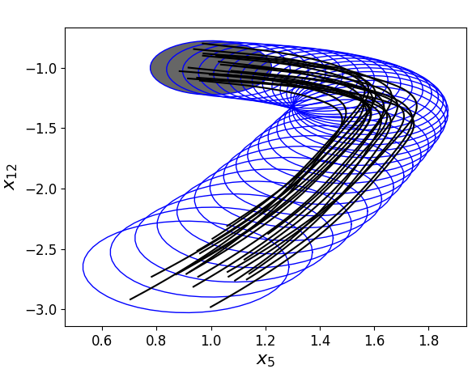









Results on ReLU Neural ODE
$$Approx−Bruss$$
$$Approx−VDP$$
$$Approx−LV$$
1 Sound over-approximation
2 Not too much conservativeness
$$Approx−Rob$$
$$randNN2$$
$$randNN3$$
$$randNN8$$
$$randNN10$$
$$randNN12$$

Slide 13
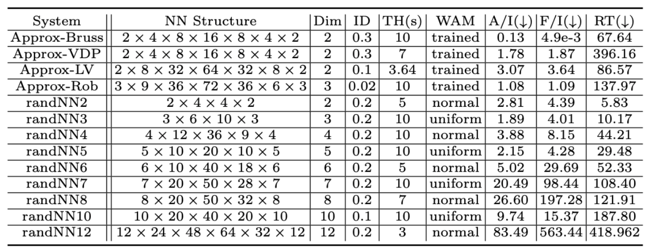
Results on ReLU Neural ODE
Works for systems up to 12 dimension and 200 neurons

Slide 14
Conclusion
Our novel approach provides a sound over-approximation of the reachable set via sensitivity functions and linear bound on Lexicographic Jacobians.
Our method achieves 50% more accurate, up to 10 times more accurate on nonsmooth benchmarks compared with top 2 hybrid verification tools (CORA and JuliaReach).
Our method enables reachability analysis for ReLU neural ODEs up to 12 dimensions and 200 neurons. To our knowledge, this is the first method capable of such analysis.
Next: Replace Lexicographic Jacobian by a generalized Taylor model

Slide 15
Thanks

