Slide 1
Chapter 11: Storage and File Structure

Slide 2
Chapter 11: Storage and File Structure
Overview of Physical Storage Media
Magnetic Disks
RAID
Tertiary Storage
Storage Access
File Organization
Organization of Records in Files
Data-Dictionary Storage
Storage Structures for Object-Oriented Databases

Slide 3
Classification of Physical Storage Media
Speed with which data can be accessed
Cost per unit of data
Reliability
  data loss on power failure or system crash
  physical failure of the storage device
Can differentiate storage into:
  volatile storage: loses contents when power is switched off
  non-volatile storage:
    Contents persist even when power is switched off.
    Includes secondary and tertiary storage, as well as batter- backed up main-memory.

Slide 4
Physical Storage Media
Cache – fastest and most costly form of storage; volatile; managed by the computer system hardware.
Main memory:
  fast access (10s to 100s of nanoseconds; 1 nanosecond = 10^{–9} seconds)
  generally too small (or too expensive) to store the entire database
    capacities of up to a few Gigabytes widely used currently
    Capacities have gone up and per-byte costs have decreased steadily and rapidly (roughly factor of 2 every 2 to 3 years)
  Volatile — contents of main memory are usually lost if a power failure or system crash occurs.

Slide 5
Physical Storage Media (Cont.)
Flash memory
  Data survives power failure
  Data can be written at a location only once, but location can be erased and written to again
    Can support only a limited number (10K – 1M) of write/erase cycles.
    Erasing of memory has to be done to an entire bank of memory
  Reads are roughly as fast as main memory
  But writes are slow (few microseconds), erase is slower
  Cost per unit of storage roughly similar to main memory
  Widely used in embedded devices such as digital cameras
  Is a type of EEPROM (Electrically Erasable Programmable Read-Only Memory)

Slide 6
Physical Storage Media (Cont.)
Magnetic-disk
  Data is stored on spinning disk, and read/written magnetically
  Primary medium for the long-term storage of data; typically stores entire database.
  Data must be moved from disk to main memory for access, and written back for storage
    Much slower access than main memory (more on this later)
  direct-access – possible to read data on disk in any order, unlike magnetic tape
  Capacities range up to roughly 400 GB currently
    Much larger capacity and cost/byte than main memory/flash memory
    Growing constantly and rapidly with technology improvements (factor of 2 to 3 every 2 years)
  Survives power failures and system crashes
    disk failure can destroy data, but is rare

Slide 7
Physical Storage Media (Cont.)
Optical storage
  non-volatile, data is read optically from a spinning disk using a laser
  CD-ROM (640 MB) and DVD (4.7 to 17 GB) most popular forms
  Write-one, read-many (WORM) optical disks used for archival storage (CD-R, DVD-R, DVD+R)
  Multiple write versions also available (CD-RW, DVD-RW, DVD+RW, and DVD-RAM)
  Reads and writes are slower than with magnetic disk
  Juke-box systems, with large numbers of removable disks, a few drives, and a mechanism for automatic loading/unloading of disks available for storing large volumes of data

Slide 8
Physical Storage Media (Cont.)
Tape storage
  non-volatile, used primarily for backup (to recover from disk failure), and for archival data
  sequential-access – much slower than disk
  very high capacity (40 to 300 GB tapes available)
  tape can be removed from drive ⇒ storage costs much cheaper than disk, but drives are expensive
  Tape jukeboxes available for storing massive amounts of data
    hundreds of terabytes (1 terabyte = 10⁹ bytes) to even a petabyte (1 petabyte = 10¹² bytes)

Slide 9
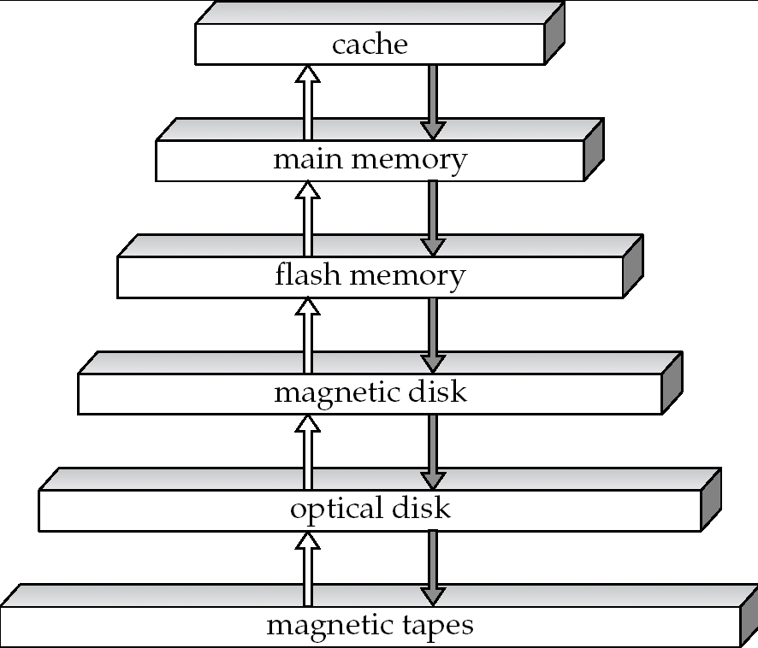
Storage Hierarchy

Slide 10
Storage Hierarchy (Cont.)
primary storage: Fastest media but volatile (cache, main memory).
secondary storage: next level in hierarchy, non-volatile, moderately fast access time
  also called on-line storage
  E.g. flash memory, magnetic disks
tertiary storage: lowest level in hierarchy, non-volatile, slow access time
  also called off-line storage
  E.g. magnetic tape, optical storage

Slide 11
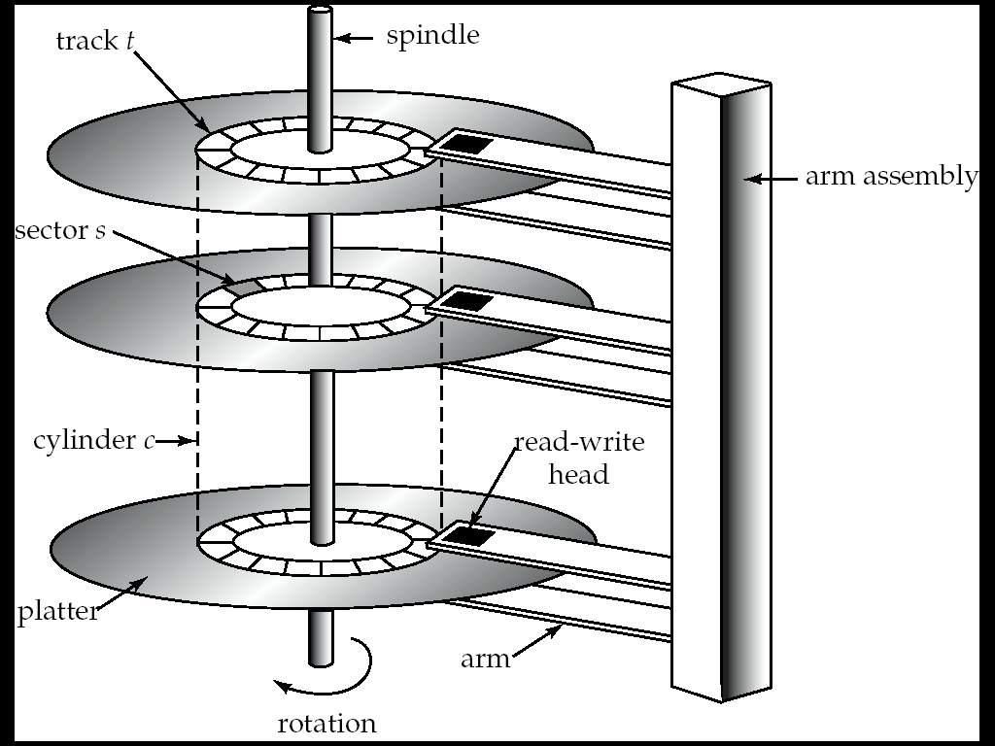
Magnetic Hard Disk Mechanism
NOTE: Diagram is schematic, and simplifies the structure of actual disk drives

Slide 12
Magnetic Disks
Read-write head
  Positioned very close to the platter surface (almost touching it)
  Reads or writes magnetically encoded information.
Surface of platter divided into circular tracks
  Over 50K-100K tracks per platter on typical hard disks
Each track is divided into sectors.
  A sector is the smallest unit of data that can be read or written.
  Sector size typically 512 bytes
  Typical sectors per track: 500 (on inner tracks) to 1000 (on outer tracks)
To read/write a sector
  disk arm swings to position head on right track
  platter spins continually; data is read/written as sector passes under head
Head-disk assemblies
  multiple disk platters on a single spindle (1 to 5 usually)
  one head per platter, mounted on a common arm.
Cylinder i consists of i^{th} track of all the platters

Slide 13
Magnetic Disks (Cont.)
Earlier generation disks were susceptible to head-crashes
  Surface of earlier generation disks had metal-oxide coatings which would disintegrate on head crash and damage all data on disk
  Current generation disks are less susceptible to such disastrous failures, although individual sectors may get corrupted
Disk controller – interfaces between the computer system and the disk drive hardware.
  accepts high-level commands to read or write a sector
  initiates actions such as moving the disk arm to the right track and actually reading or writing the data
  Computes and attaches checksums to each sector to verify that data is read back correctly
    If data is corrupted, with very high probability stored checksum won’t match recomputed checksum
  Ensures successful writing by reading back sector after writing it
  Performs remapping of bad sectors

Slide 14
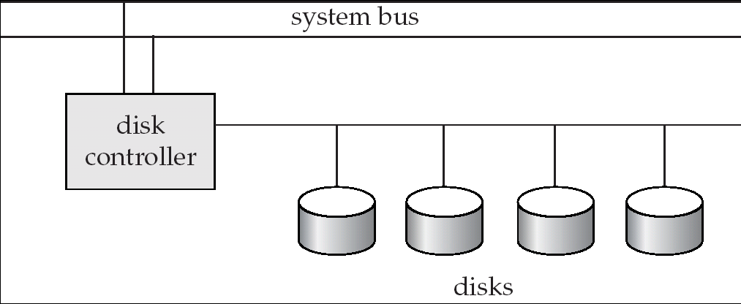
Disk Subsystem
Multiple disks connected to a computer system through a controller
  Controllers functionality (checksum, bad sector remapping) often carried out by individual disks; reduces load on controller
Disk interface standards families
  ATA (AT adaptor) range of standards
  SATA (Serial ATA)
  SCSI (Small Computer System Interconnect) range of standards
  Several variants of each standard (different speeds and capabilities)

Slide 15
Performance Measures of Disks
Access time – the time it takes from when a read or write request is issued to when data transfer begins. Consists of:
  Seek time – time it takes to reposition the arm over the correct track.
    Average seek time is 1/2 the worst case seek time.
      Would be 1/3 if all tracks had the same number of sectors, and we ignore the time to start and stop arm movement
    4 to 10 milliseconds on typical disks
  Rotational latency – time it takes for the sector to be accessed to appear under the head.
    Average latency is 1/2 of the worst case latency.
    4 to 11 milliseconds on typical disks (5400 to 15000 r.p.m.)
Data-transfer rate – the rate at which data can be retrieved from or stored to the disk.
  25 to 100 MB per second max rate, lower for inner tracks
  Multiple disks may share a controller, so rate that controller can handle is also important
    E.g. ATA-5: 66 MB/sec, SATA: 150 MB/sec, Ultra 320 SCSI: 320 MB/s
    Fiber Channel (FC2Gb): 256 MB/s

Slide 16
Performance Measures (Cont.)
Mean time to failure (MTTF) – the average time the disk is expected to run continuously without any failure.
  Typically 3 to 5 years
  Probability of failure of new disks is quite low, corresponding to a
  “theoretical MTTF” of 500,000 to 1,200,000 hours for a new disk
    E.g., an MTTF of 1,200,000 hours for a new disk means that given 1000 relatively new disks, on an average one will fail every 1200 hours
  MTTF decreases as disk ages

Slide 17
Optimization of Disk-Block Access
Block – a contiguous sequence of sectors from a single track
  data is transferred between disk and main memory in blocks
  sizes range from 512 bytes to several kilobytes
    Smaller blocks: more transfers from disk
    Larger blocks: more space wasted due to partially filled blocks
    Typical block sizes today range from 4 to 16 kilobytes
Disk-arm-scheduling algorithms order pending accesses to tracks so that disk arm movement is minimized
  elevator algorithm : move disk arm in one direction (from outer to inner tracks or vice versa), processing next request in that direction, till no more requests in that direction, then reverse direction and repeat

Slide 18
Optimization of Disk Block Access (Cont.)
File organization – optimize block access time by organizing the blocks to correspond to how data will be accessed
  E.g. Store related information on the same or nearby cylinders.
  Files may get fragmented over time
    E.g. if data is inserted to/deleted from the file
    Or free blocks on disk are scattered, and newly created file has its blocks scattered over the disk
    Sequential access to a fragmented file results in increased disk arm movement
  Some systems have utilities to defragment the file system, in order to speed up file access

Slide 19
Optimization of Disk Block Access (Cont.)
Nonvolatile write buffers speed up disk writes by writing blocks to a non-volatile RAM buffer immediately
  Non-volatile RAM: battery backed up RAM or flash memory
    Even if power fails, the data is safe and will be written to disk when power returns
  Controller then writes to disk whenever the disk has no other requests or request has been pending for some time
  Database operations that require data to be safely stored before continuing can continue without waiting for data to be written to disk
  Writes can be reordered to minimize disk arm movement
Log disk – a disk devoted to writing a sequential log of block updates
  Used exactly like nonvolatile RAM
    Write to log disk is very fast since no seeks are required
    No need for special hardware (NV-RAM)
File systems typically reorder writes to disk to improve performance
  Journaling file systems write data in safe order to NV-RAM or log disk
  Reordering without journaling: risk of corruption of file system data

Slide 20
RAID
RAID: Redundant Arrays of Independent Disks
  disk organization techniques that manage a large numbers of disks, providing a view of a single disk of
    high capacity and high speed by using multiple disks in parallel, and
    high reliability by storing data redundantly, so that data can be recovered even if a disk fails
The chance that some disk out of a set of N disks will fail is much higher than the chance that a specific single disk will fail.
  E.g., a system with 100 disks, each with MTTF of 100,000 hours (approx. 11 years), will have a system MTTF of 1000 hours (approx. 41 days)
  Techniques for using redundancy to avoid data loss are critical with large numbers of disks
Originally a cost-effective alternative to large, expensive disks
  I in RAID originally stood for ``inexpensive’’
  Today RAIDs are used for their higher reliability and bandwidth.
    The “I” is interpreted as independent

Slide 21
Improvement of Reliability via Redundancy
Redundancy – store extra information that can be used to rebuild information lost in a disk failure
E.g., Mirroring (or shadowing)
  Duplicate every disk. Logical disk consists of two physical disks.
  Every write is carried out on both disks
    Reads can take place from either disk
  If one disk in a pair fails, data still available in the other
    Data loss would occur only if a disk fails, and its mirror disk also fails before the system is repaired
      Probability of combined event is very small
        Except for dependent failure modes such as fire or building collapse or electrical power surges
Mean time to data loss depends on mean time to failure,
and mean time to repair
  E.g. MTTF of 100,000 hours, mean time to repair of 10 hours gives mean time to data loss of 500*10⁶ hours (or 57,000 years) for a mirrored pair of disks (ignoring dependent failure modes)

Slide 22
Improvement in Performance via Parallelism
Two main goals of parallelism in a disk system:
  1. Load balance multiple small accesses to increase throughput
  2. Parallelize large accesses to reduce response time.
Improve transfer rate by striping data across multiple disks.
Bit-level striping – split the bits of each byte across multiple disks
  In an array of eight disks, write bit i of each byte to disk i.
  Each access can read data at eight times the rate of a single disk.
  But seek/access time worse than for a single disk
    Bit level striping is not used much any more
Block-level striping – with n disks, block i of a file goes to disk (i mod n) + 1
  Requests for different blocks can run in parallel if the blocks reside on different disks
  A request for a long sequence of blocks can utilize all disks in parallel

Slide 23

RAID Levels
Schemes to provide redundancy at lower cost by using disk striping combined with parity bits
  Different RAID organizations, or RAID levels, have differing cost, performance and reliability characteristics
RAID Level 0: Block striping; non-redundant.
  Used in high-performance applications where data lose is not critical.
RAID Level 1: Mirrored disks with block striping
  Offers best write performance.
  Popular for applications such as storing log files in a database system.

Slide 24
RAID Levels (Cont.)
RAID Level 2: Memory-Style Error-Correcting-Codes (ECC) with bit striping.
RAID Level 3: Bit-Interleaved Parity
  a single parity bit is enough for error correction, not just detection, since we know which disk has failed
    When writing data, corresponding parity bits must also be computed and written to a parity bit disk
    To recover data in a damaged disk, compute XOR of bits from other disks (including parity bit disk)

Slide 25
RAID Levels (Cont.)
RAID Level 3 (Cont.)
  Faster data transfer than with a single disk, but fewer I/Os per second since every disk has to participate in every I/O.
  Subsumes Level 2 (provides all its benefits, at lower cost).
RAID Level 4: Block-Interleaved Parity; uses block-level striping, and keeps a parity block on a separate disk for corresponding blocks from N other disks.
  When writing data block, corresponding block of parity bits must also be computed and written to parity disk
  To find value of a damaged block, compute XOR of bits from corresponding blocks (including parity block) from other disks.

Slide 26
RAID Levels (Cont.)
RAID Level 4 (Cont.)
  Provides higher I/O rates for independent block reads than Level 3
    block read goes to a single disk, so blocks stored on different disks can be read in parallel
  Provides high transfer rates for reads of multiple blocks than no-striping
  Before writing a block, parity data must be computed
    Can be done by using old parity block, old value of current block and new value of current block (2 block reads + 2 block writes)
    Or by recomputing the parity value using the new values of blocks corresponding to the parity block
      More efficient for writing large amounts of data sequentially
  Parity block becomes a bottleneck for independent block writes since every block write also writes to parity disk

Slide 27
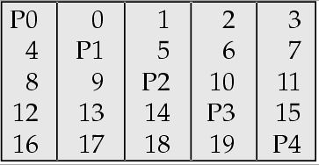
RAID Levels (Cont.)
RAID Level 5: Block-Interleaved Distributed Parity; partitions data and parity among all N + 1 disks, rather than storing data in N disks and parity in 1 disk.
  E.g., with 5 disks, parity block for nth set of blocks is stored on disk (n mod 5) + 1, with the data blocks stored on the other 4 disks.

Slide 28
RAID Levels (Cont.)
RAID Level 5 (Cont.)
  Higher I/O rates than Level 4.
    Block writes occur in parallel if the blocks and their parity blocks are on different disks.
  Subsumes Level 4: provides same benefits, but avoids bottleneck of parity disk.
RAID Level 6: P+Q Redundancy scheme; similar to Level 5, but stores extra redundant information to guard against multiple disk failures.
  Better reliability than Level 5 at a higher cost; not used as widely.

Slide 29
Choice of RAID Level
Factors in choosing RAID level
  Monetary cost
  Performance: Number of I/O operations per second, and bandwidth during normal operation
  Performance during failure
  Performance during rebuild of failed disk
    Including time taken to rebuild failed disk
RAID 0 is used only when data safety is not important
  E.g. data can be recovered quickly from other sources
Level 2 and 4 never used since they are subsumed by 3 and 5
Level 3 is not used anymore since bit-striping forces single block reads to access all disks, wasting disk arm movement, which block striping (level 5) avoids
Level 6 is rarely used since levels 1 and 5 offer adequate safety for almost all applications
So competition is between 1 and 5 only

Slide 30
Choice of RAID Level (Cont.)
Level 1 provides much better write performance than level 5
  Level 5 requires at least 2 block reads and 2 block writes to write a single block, whereas Level 1 only requires 2 block writes
  Level 1 preferred for high update environments such as log disks
Level 1 had higher storage cost than level 5
  disk drive capacities increasing rapidly (50%/year) whereas disk access times have decreased much less (x 3 in 10 years)
  I/O requirements have increased greatly, e.g. for Web servers
  When enough disks have been bought to satisfy required rate of I/O, they often have spare storage capacity
    so there is often no extra monetary cost for Level 1!
Level 5 is preferred for applications with low update rate,
and large amounts of data
Level 1 is preferred for all other applications

Slide 31
Hardware Issues
Software RAID: RAID implementations done entirely in software, with no special hardware support
Hardware RAID: RAID implementations with special hardware
  Use non-volatile RAM to record writes that are being executed
  Beware: power failure during write can result in corrupted disk
    E.g. failure after writing one block but before writing the second in a mirrored system
    Such corrupted data must be detected when power is restored
      Recovery from corruption is similar to recovery from failed disk
      NV-RAM helps to efficiently detected potentially corrupted blocks
        Otherwise all blocks of disk must be read and compared with mirror/parity block

Slide 32
Hardware Issues (Cont.)
Hot swapping: replacement of disk while system is running, without power down
  Supported by some hardware RAID systems,
  reduces time to recovery, and improves availability greatly
Many systems maintain spare disks which are kept online, and used as replacements for failed disks immediately on detection of failure
  Reduces time to recovery greatly
Many hardware RAID systems ensure that a single point of failure will not stop the functioning of the system by using
  Redundant power supplies with battery backup
  Multiple controllers and multiple interconnections to guard against controller/interconnection failures

Slide 33
Optical Disks
Compact disk-read only memory (CD-ROM)
  Removable disks, 640 MB per disk
  Seek time about 100 msec (optical read head is heavier and slower)
  Higher latency (3000 RPM) and lower data-transfer rates (3-6 MB/s) compared to magnetic disks
Digital Video Disk (DVD)
  DVD-5 holds 4.7 GB , and DVD-9 holds 8.5 GB
  DVD-10 and DVD-18 are double sided formats with capacities of 9.4 GB and 17 GB
  Slow seek time, for same reasons as CD-ROM
Record once versions (CD-R and DVD-R) are popular
  data can only be written once, and cannot be erased.
  high capacity and long lifetime; used for archival storage
  Multi-write versions (CD-RW, DVD-RW, DVD+RW and DVD-RAM) also available

Slide 34
Magnetic Tapes
Hold large volumes of data and provide high transfer rates
  Few GB for DAT (Digital Audio Tape) format, 10-40 GB with DLT (Digital Linear Tape) format, 100 GB+ with Ultrium format, and 330 GB with Ampex helical scan format
  Transfer rates from few to 10s of MB/s
Currently the cheapest storage medium
  Tapes are cheap, but cost of drives is very high
Very slow access time in comparison to magnetic disks and optical disks
  limited to sequential access.
  Some formats (Accelis) provide faster seek (10s of seconds) at cost of lower capacity
Used mainly for backup, for storage of infrequently used information, and as an off-line medium for transferring information from one system to another.
Tape jukeboxes used for very large capacity storage
  (terabyte (10¹² bytes) to petabye (10¹⁵ bytes)

Slide 35
Storage Access
A database file is partitioned into fixed-length storage units called blocks. Blocks are units of both storage allocation and data transfer.
Database system seeks to minimize the number of block transfers between the disk and memory. We can reduce the number of disk accesses by keeping as many blocks as possible in main memory.
Buffer – portion of main memory available to store copies of disk blocks.
Buffer manager – subsystem responsible for allocating buffer space in main memory.

Slide 36
Buffer Manager
Programs call on the buffer manager when they need a block from disk.
  If the block is already in the buffer, buffer manager returns the address of the block in main memory
  If the block is not in the buffer, the buffer manager
    Allocates space in the buffer for the block
      Replacing (throwing out) some other block, if required, to make space for the new block.
      Replaced block written back to disk only if it was modified since the most recent time that it was written to/fetched from the disk.
    Reads the block from the disk to the buffer, and returns the address of the block in main memory to requester.

Slide 37
Buffer-Replacement Policies
Most operating systems replace the block least recently used (LRU strategy)
Idea behind LRU – use past pattern of block references as a predictor of future references
Queries have well-defined access patterns (such as sequential scans), and a database system can use the information in a user’s query to predict future references
  LRU can be a bad strategy for certain access patterns involving repeated scans of data
    For example: when computing the join of 2 relations r and s by a nested loops
    for each tuple tr of r do
    for each tuple ts of s do
    if the tuples tr and ts match …
  Mixed strategy with hints on replacement strategy provided
  by the query optimizer is preferable

Slide 38
Buffer-Replacement Policies (Cont.)
Pinned block – memory block that is not allowed to be written back to disk.
Toss-immediate strategy – frees the space occupied by a block as soon as the final tuple of that block has been processed
Most recently used (MRU) strategy – system must pin the block currently being processed. After the final tuple of that block has been processed, the block is unpinned, and it becomes the most recently used block.
Buffer manager can use statistical information regarding the probability that a request will reference a particular relation
  E.g., the data dictionary is frequently accessed. Heuristic: keep data-dictionary blocks in main memory buffer
Buffer managers also support forced output of blocks for the purpose of recovery (more in Chapter 17)

Slide 39
File Organization
The database is stored as a collection of files. Each file is a sequence of records. A record is a sequence of fields.
One approach:
  assume record size is fixed
  each file has records of one particular type only
  different files are used for different relations
  This case is easiest to implement; will consider variable length records later.

Slide 40
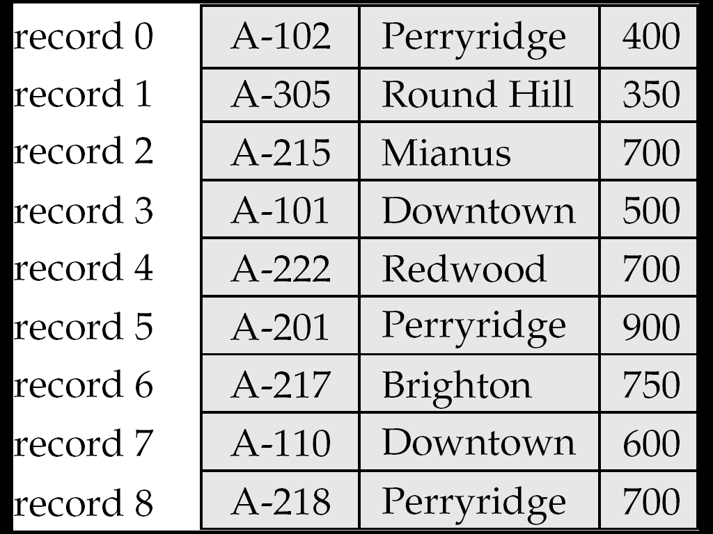
Fixed-Length Records
Simple approach:
  Store record i starting from byte n ∗ (i – 1), where n is the size of each record.
  Record access is simple but records may cross blocks
    Modification: do not allow records to cross block boundaries
Deletion of record i:
alternatives:
  move records i + 1, . . ., n
  to i, . . . , n – 1
  move record n to i
  do not move records, but
  link all free records on a
  free list

Slide 41
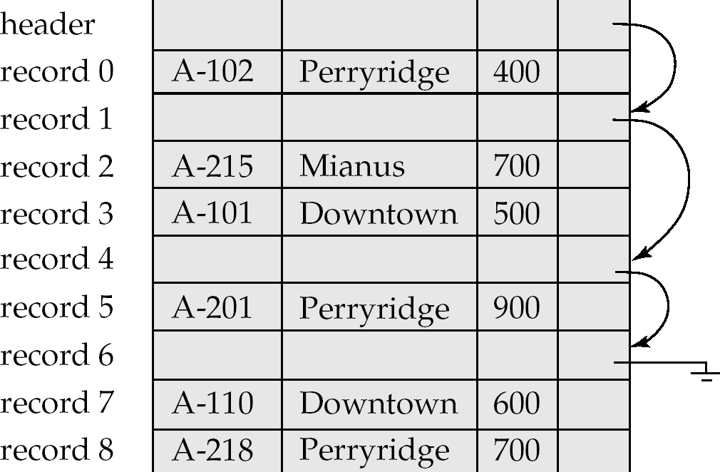
Free Lists
Store the address of the first deleted record in the file header.
Use this first record to store the address of the second deleted record, and so on
Can think of these stored addresses as pointers since they “point” to the location of a record.
More space efficient representation: reuse space for normal attributes of free records to store pointers. (No pointers stored in in-use records.)

Slide 42
Variable-Length Records
Variable-length records arise in database systems in several ways:
  Storage of multiple record types in a file.
  Record types that allow variable lengths for one or more fields.
  Record types that allow repeating fields (used in some older data models).

Slide 43
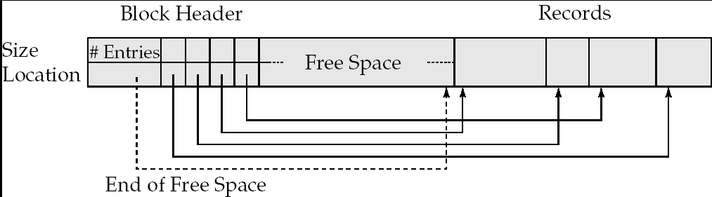
Variable-Length Records: Slotted Page Structure
Slotted page header contains:
  number of record entries
  end of free space in the block
  location and size of each record
Records can be moved around within a page to keep them contiguous with no empty space between them; entry in the header must be updated.
Pointers should not point directly to record — instead they should point to the entry for the record in header.

Slide 44
Organization of Records in Files
Heap – a record can be placed anywhere in the file where there is space
Sequential – store records in sequential order, based on the value of the search key of each record
Hashing – a hash function computed on some attribute of each record; the result specifies in which block of the file the record should be placed
Records of each relation may be stored in a separate file. In a multitable clustering file organization records of several different relations can be stored in the same file
  Motivation: store related records on the same block to minimize I/O

Slide 45
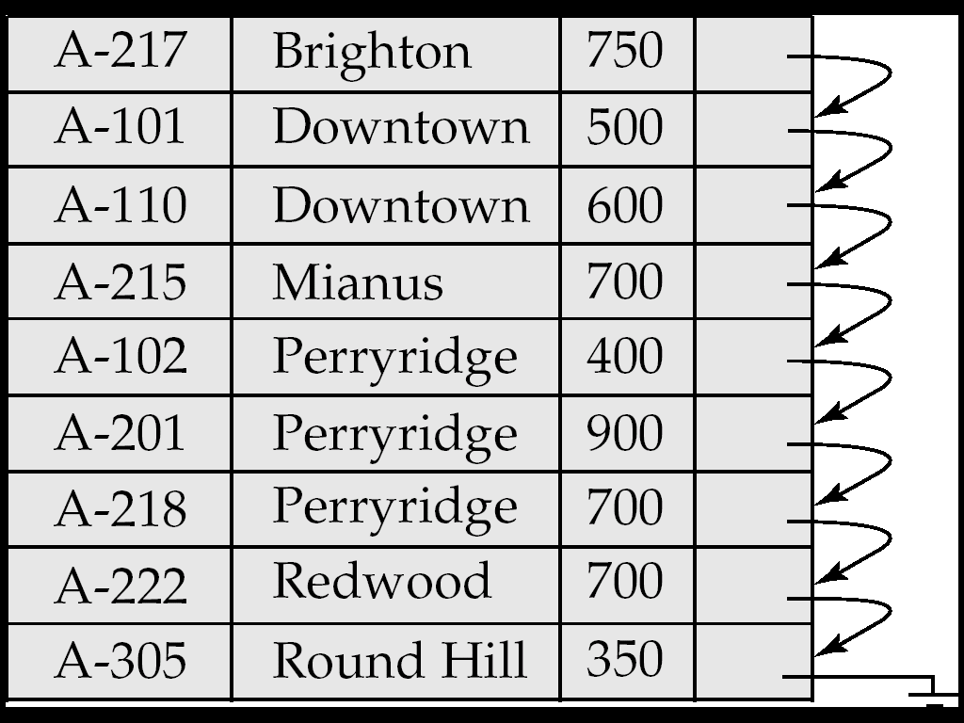
Sequential File Organization
Suitable for applications that require sequential processing of the entire file
The records in the file are ordered by a search-key

Slide 46
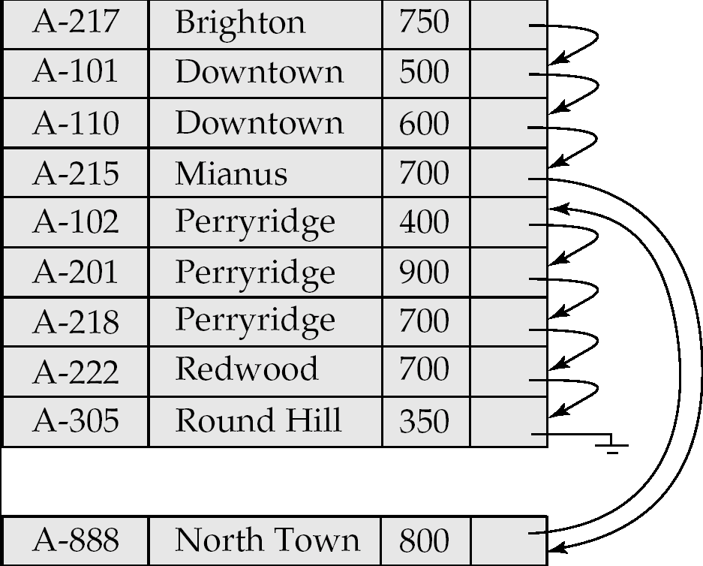
Sequential File Organization (Cont.)
Deletion – use pointer chains
Insertion –locate the position where the record is to be inserted
  if there is free space insert there
  if no free space, insert the record in an overflow block
  In either case, pointer chain must be updated
Need to reorganize the file
from time to time to restore
sequential order

Slide 47
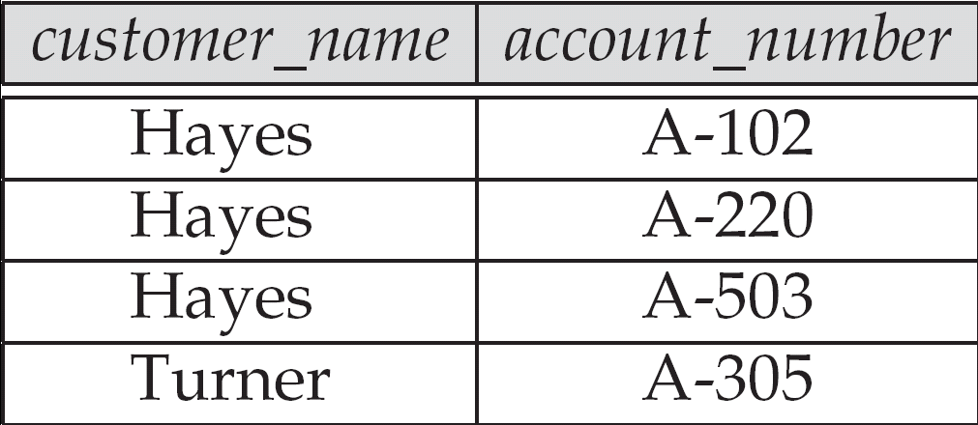
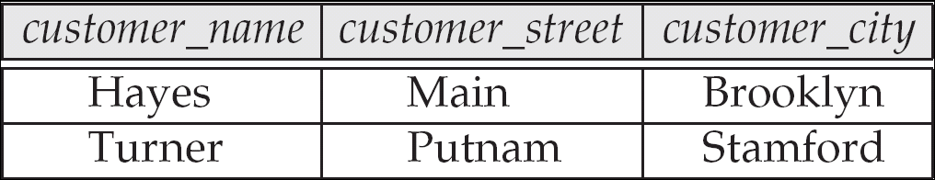
Multitable Clustering File Organization
Store several relations in one file using a multitable clustering file organization

Slide 48
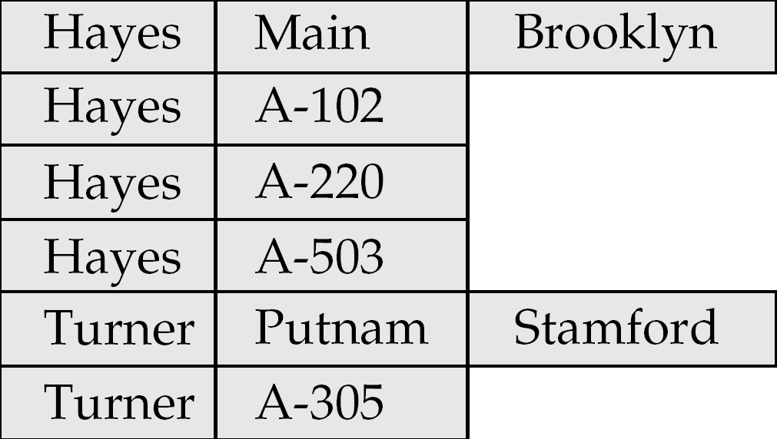
Multitable Clustering File Organization (cont.)
Multitable clustering organization of customer and depositor:
  good for queries involving depositor customer, and for queries involving one single customer and his accounts
  bad for queries involving only customer
  results in variable size records
  Can add pointer chains to link records of a particular relation

Slide 49
Data Dictionary Storage
Data dictionary (also called system catalog) stores metadata; that is, data about data, such as
Information about relations
  names of relations
  names and types of attributes of each relation
  names and definitions of views
  integrity constraints
User and accounting information, including passwords
Statistical and descriptive data
  number of tuples in each relation
Physical file organization information
  How relation is stored (sequential/hash/…)
  Physical location of relation
Information about indices (Chapter 12)

Slide 50
Data Dictionary Storage (Cont.)
Catalog structure
  Relational representation on disk
  specialized data structures designed for efficient access, in memory
A possible catalog representation:
Relation_metadata = (relation_name, number_of_attributes,
storage_organization, location)
Attribute_metadata = (attribute_name, relation_name, domain_type,
position, length)
User_metadata = (user_name, encrypted_password, group)
Index_metadata = (index_name, relation_name, index_type,
index_attributes)
View_metadata = (view_name, definition)

Slide 51
End of Chapter 11

Slide 52
Record Representation
Records with fixed length fields are easy to represent
  Similar to records (structs) in programming languages
  Extensions to represent null values
    E.g. a bitmap indicating which attributes are null
Variable length fields can be represented by a pair
(offset,length)
where offset is the location within the record and length is field length.
  All fields start at predefined location, but extra indirection required for variable length fields
A-102
10
400
Perryridge
account_number
balance
branch_name
Example record structure of account record

Slide 53
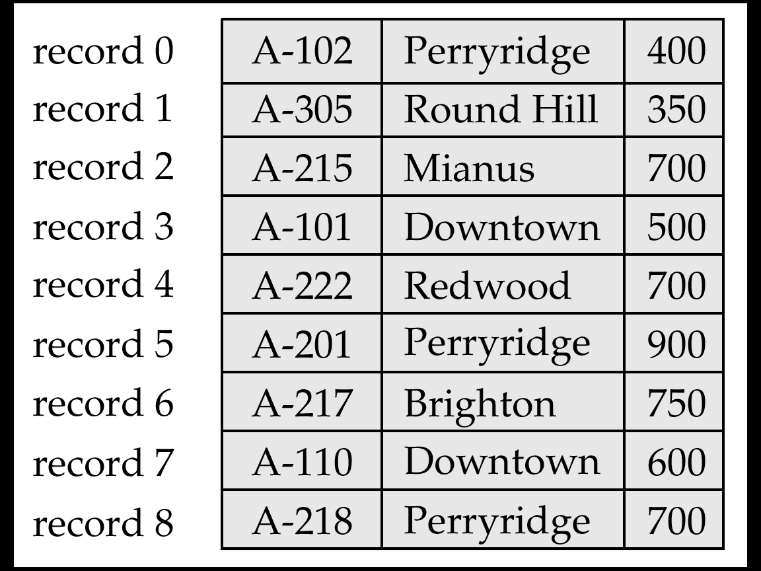
File Containing account Records

Slide 54
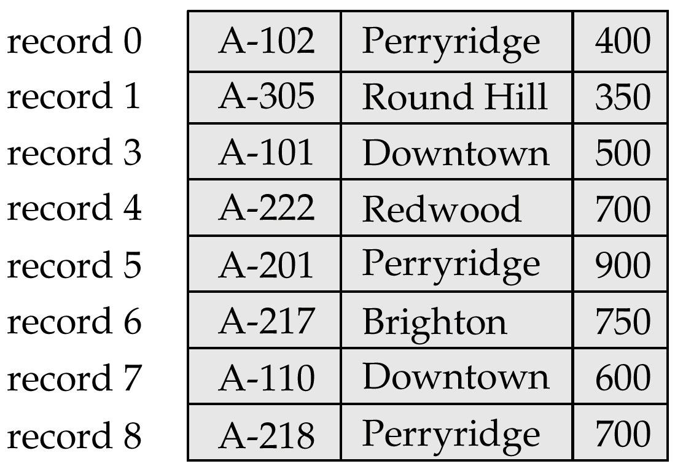
File of Figure 11.6, with Record 2 Deleted and All Records Moved

Slide 55
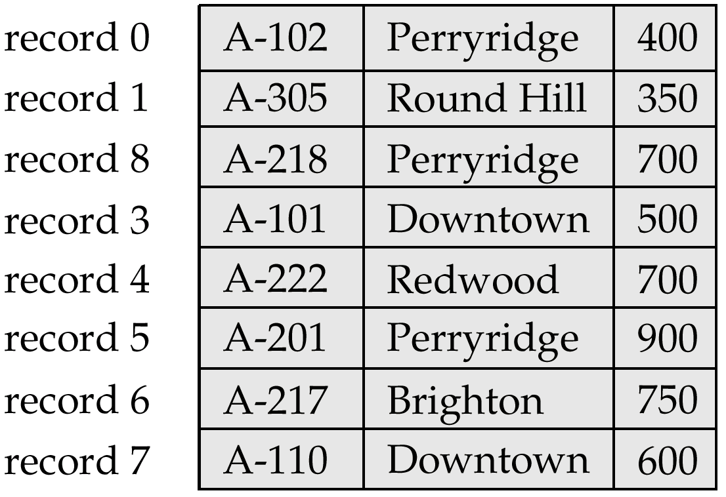
File of Figure 11.6, With Record 2 deleted and Final Record Moved

Slide 56
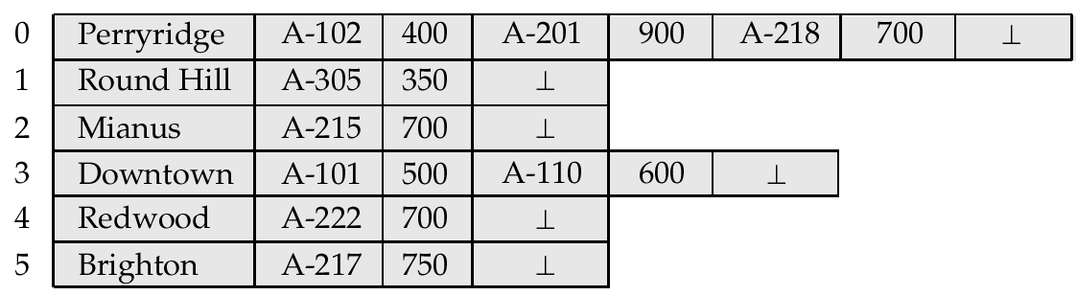
Byte-String Representation of Variable-Length Records

Slide 57
Clustering File Structure

Slide 58
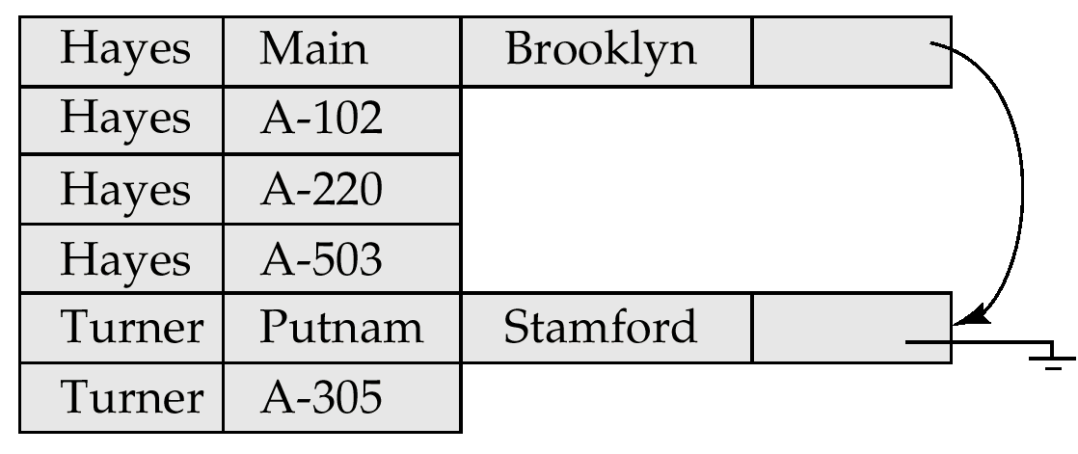
Clustering File Structure With Pointer Chains

Slide 59
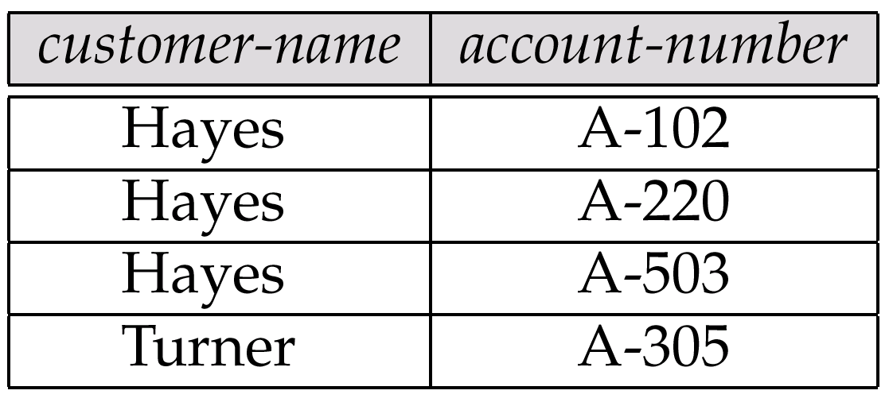
The depositor Relation

Slide 60
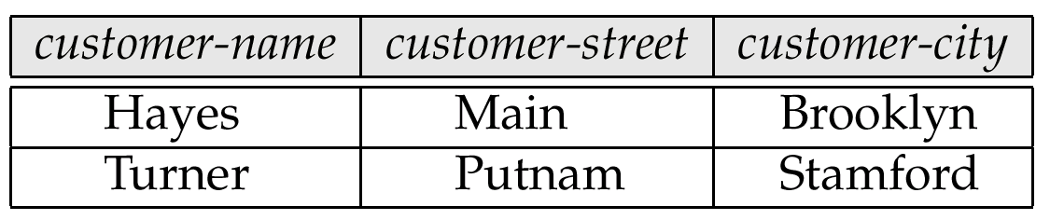
The customer Relation

Slide 61
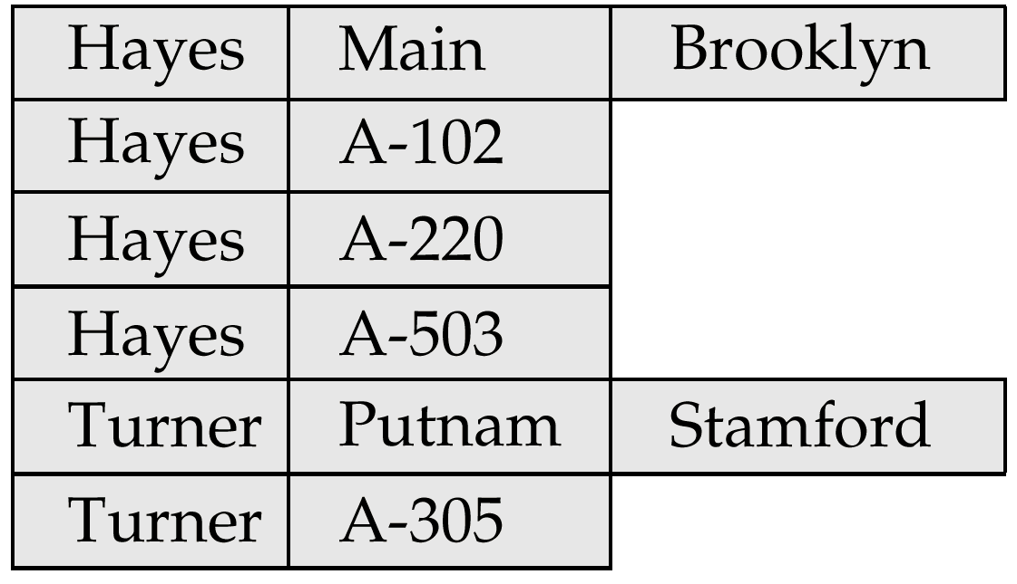
Clustering File Structure

Slide 63
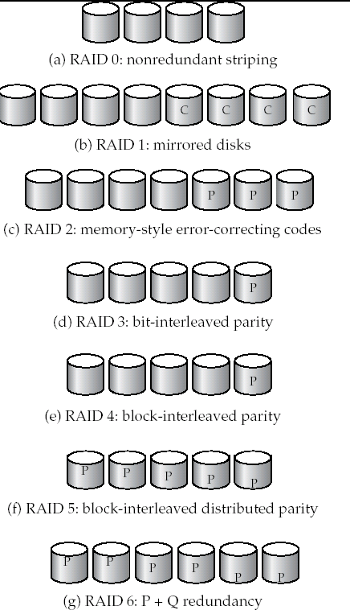
Figure 11.4

Slide 64
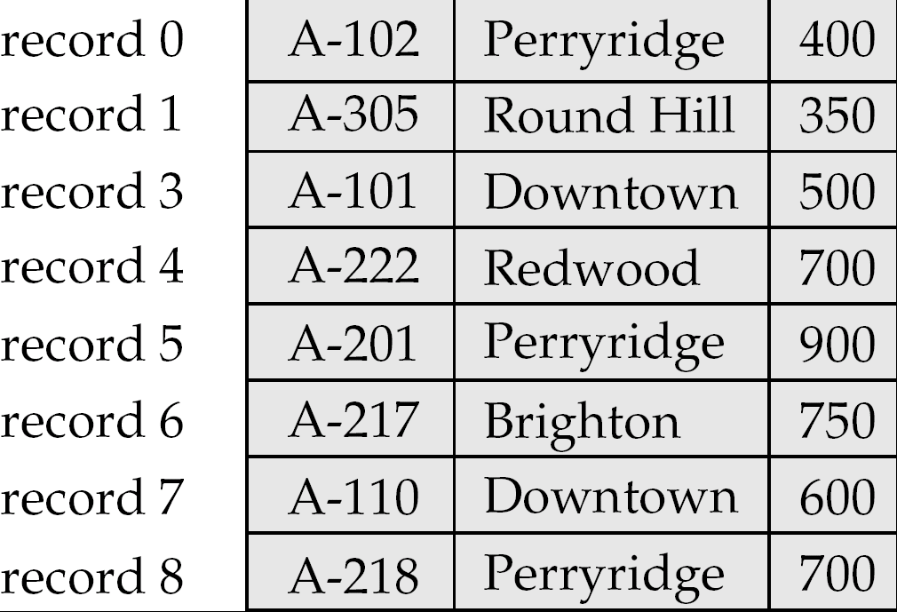
Figure 11.7

Slide 65
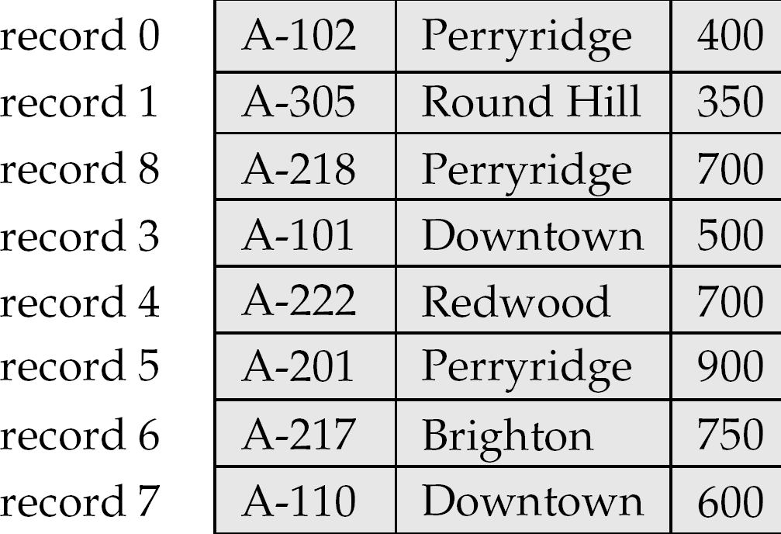
Figure 11.8

Slide 66
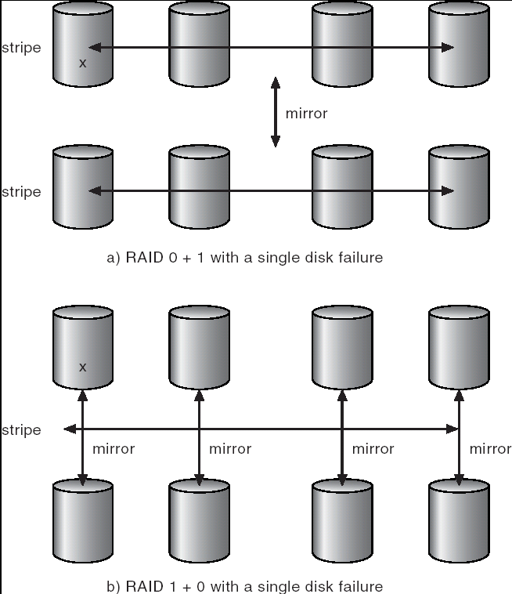
Figure 11.100

Slide 67
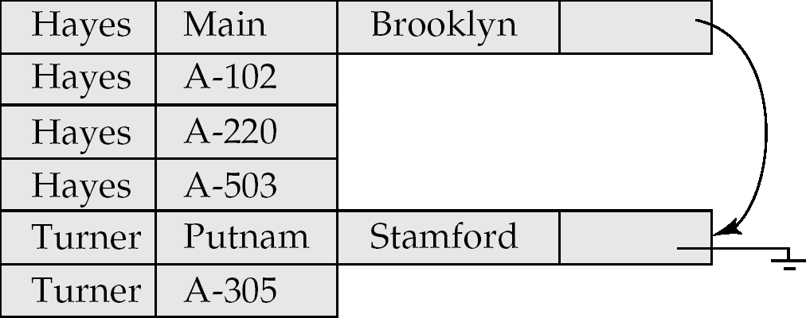
Figure 11.20

Slide 68
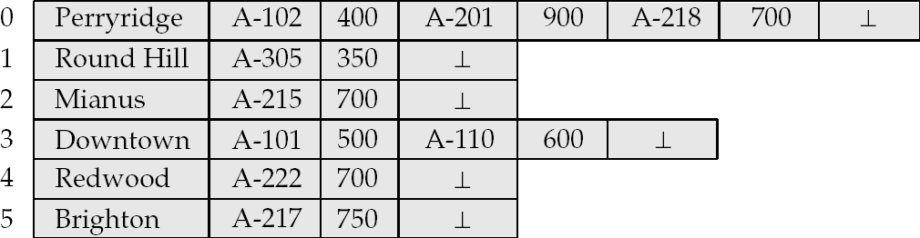
Byte-String Representation of Variable-Length Records
Byte string representation
  Attach an end-of-record (⊥) control character to the end of each record
  Difficulty with deletion
  Difficulty with growth

Slide 69
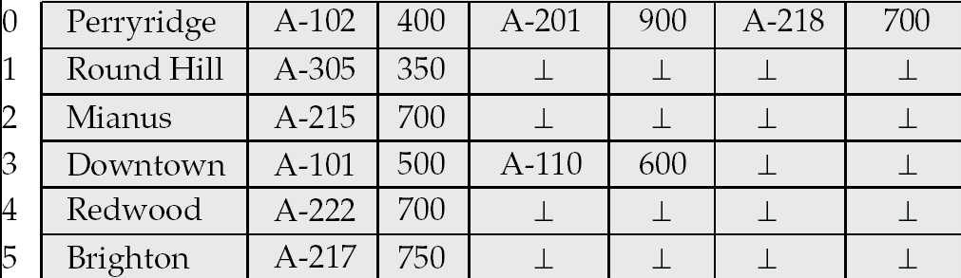
Fixed-Length Representation
Use one or more fixed length records:
  reserved space
  pointers
Reserved space – can use fixed-length records of a known maximum length; unused space in shorter records filled with a null or end-of-record symbol.

Slide 70
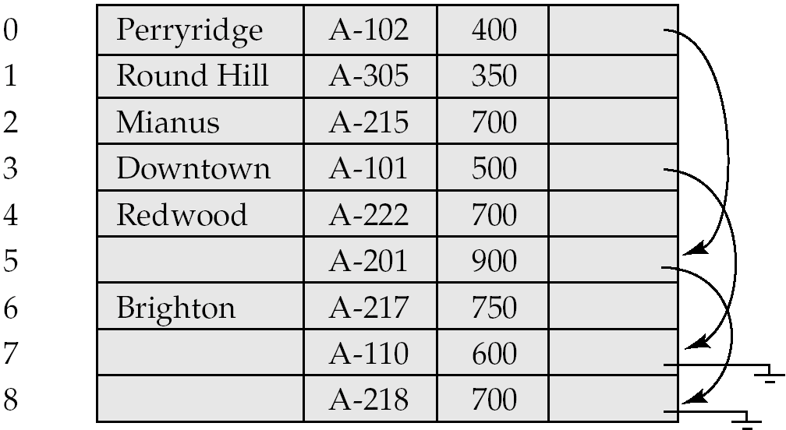
Pointer Method
Pointer method
  A variable-length record is represented by a list of fixed-length records, chained together via pointers.
  Can be used even if the maximum record length is not known

Slide 71
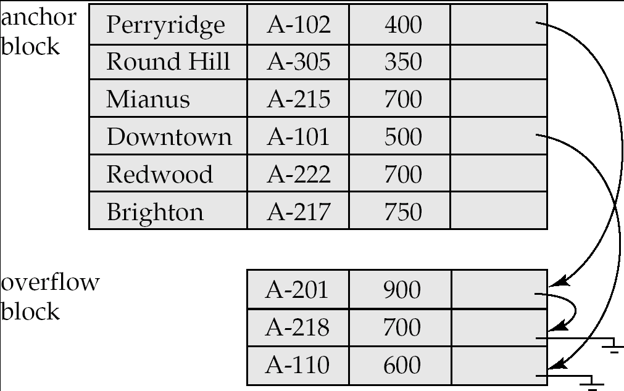
Pointer Method (Cont.)
Disadvantage to pointer structure; space is wasted in all records except the first in a a chain.
Solution is to allow two kinds of block in file:
  Anchor block – contains the first records of chain
  Overflow block – contains records other than those that are the first records of chairs.

Slide 72
Mapping of Objects to Files
Mapping objects to files is similar to mapping tuples to files in a relational system; object data can be stored using file structures.
Objects in O-O databases may lack uniformity and may be very large; such objects have to managed differently from records in a relational system.
  Set fields with a small number of elements may be implemented using data structures such as linked lists.
  Set fields with a larger number of elements may be implemented as separate relations in the database.
  Set fields can also be eliminated at the storage level by normalization.
    Similar to conversion of multivalued attributes of E-R diagrams to relations

Slide 73
Mapping of Objects to Files (Cont.)
Objects are identified by an object identifier (OID); the storage system needs a mechanism to locate an object given its OID (this action is called dereferencing).
  logical identifiers do not directly specify an object’s physical location; must maintain an index that maps an OID to the object’s actual location.
  physical identifiers encode the location of the object so the object can be found directly. Physical OIDs typically have the following parts:
  1. a volume or file identifier
  2. a page identifier within the volume or file
  3. an offset within the page

Slide 74
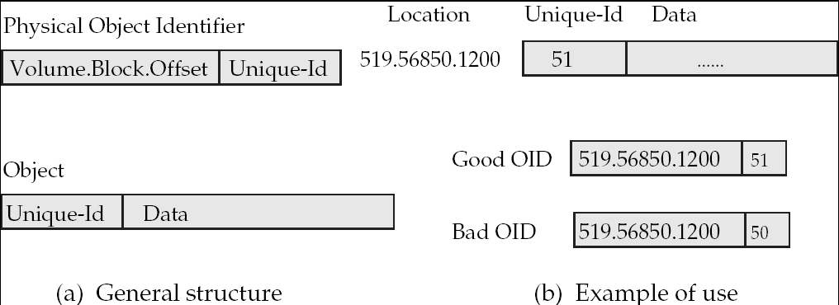
Management of Persistent Pointers
Physical OIDs may be a unique identifier. This identifier is stored in the object also and is used to detect references via dangling pointers.

Slide 75
Management of Persistent Pointers (Cont.)
Implement persistent pointers using OIDs; persistent pointers are substantially longer than are in-memory pointers
Pointer swizzling cuts down on cost of locating persistent objects already in-memory.
Software swizzling (swizzling on pointer deference)
  When a persistent pointer is first dereferenced, the pointer is swizzled (replaced by an in-memory pointer) after the object is located in memory.
  Subsequent dereferences of of the same pointer become cheap.
  The physical location of an object in memory must not change if swizzled pointers pont to it; the solution is to pin pages in memory
  When an object is written back to disk, any swizzled pointers it contains need to be unswizzled.

Slide 76
Hardware Swizzling
With hardware swizzling, persistent pointers in objects need the same amount of space as in-memory pointers — extra storage external to the object is used to store rest of pointer information.
Uses virtual memory translation mechanism to efficiently and transparently convert between persistent pointers and in-memory pointers.
All persistent pointers in a page are swizzled when the page is first read in.
  thus programmers have to work with just one type of pointer, i.e., in-memory pointer.
  some of the swizzled pointers may point to virtual memory addresses that are currently not allocated any real memory (and do not contain valid data)

Slide 77
Hardware Swizzling
Persistent pointer is conceptually split into two parts: a page identifier, and an offset within the page.
  The page identifier in a pointer is a short indirect pointer: Each page has a translation table that provides a mapping from the short page identifiers to full database page identifiers.
  Translation table for a page is small (at most 1024 pointers in a 4096 byte page with 4 byte pointer)
  Multiple pointers in page to the same page share same entry in the translation table.

Slide 78
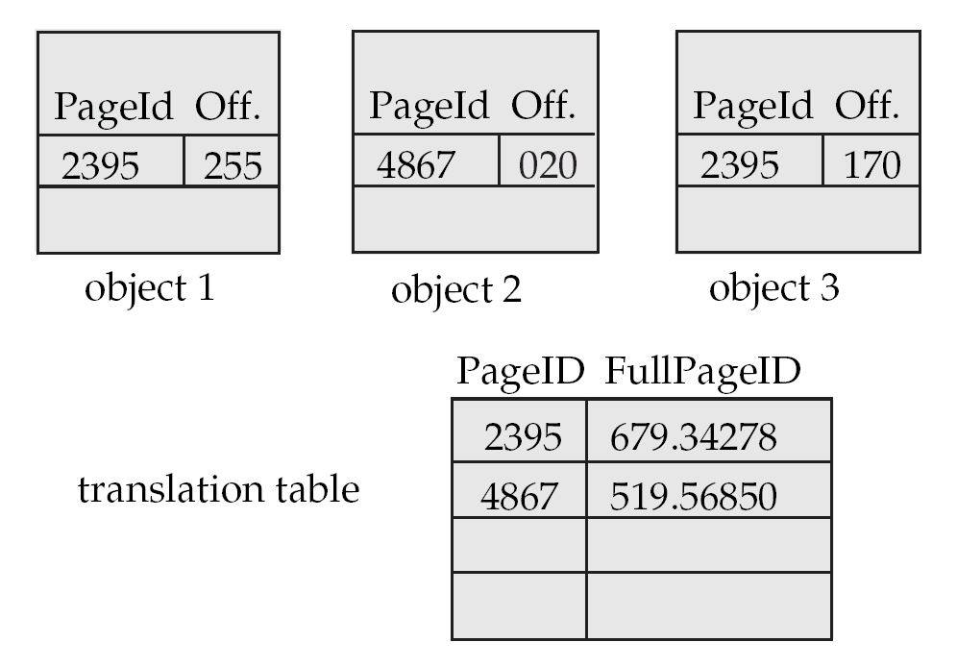
Hardware Swizzling (Cont.)
Page image before swizzling (page located on disk)

Slide 79
Hardware Swizzling (Cont.)
When system loads a page into memory the persistent pointers in the page are swizzled as described below
  Persistent pointers in each object in the page are located using object type information
  For each persistent pointer (p_{i}, o_{i}) find its full page ID P_{i}
    If P_{i} does not already have a virtual memory page allocated to it, allocate a virtual memory page to P_{i} and read-protect the page
      Note: there need not be any physical space (whether in memory or on disk swap-space) allocated for the virtual memory page at this point. Space can be allocated later if (and when) Pi is accessed. In this case read-protection is not required.
      Accessing a memory location in the page in the will result in a segmentation violation, which is handled as described later
    Let v_{i} be the virtual page allocated to P_{i} (either earlier or above)
    Replace (p_{i}, o_{i}) by (v_{i}, o_{i})
  Replace each entry (p_{i}, P_{i}) in the translation table, by (v_{i}, P_{i})

Slide 80
Hardware Swizzling (Cont.)
When an in-memory pointer is dereferenced, if the operating system detects the page it points to has not yet been allocated storage, or is read-protected, a segmentation violation occurs.
The mmap() call in Unix is used to specify a function to be invoked on segmentation violation
The function does the following when it is invoked
  Allocate storage (swap-space) for the page containing the referenced address, if storage has not been allocated earlier. Turn off read-protection
  Read in the page from disk
  Perform pointer swizzling for each persistent pointer in the page, as described earlier

Slide 81
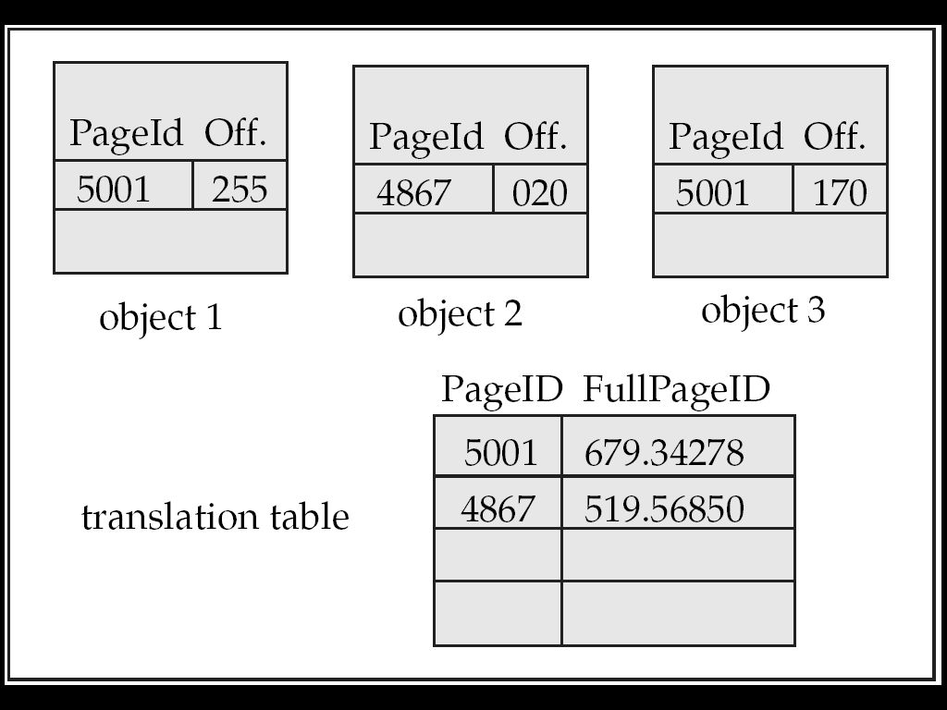
Hardware Swizzling (Cont.)
Page image after swizzling
Page with short page identifier 2395 was allocated address 5001. Observe change in pointers and translation table.
Page with short page identifier 4867 has been allocated address 4867. No change in pointer and translation table.

Slide 82
Hardware Swizzling (Cont.)
After swizzling, all short page identifiers point to virtual memory addresses allocated for the corresponding pages
  functions accessing the objects are not even aware that it has persistent pointers, and do not need to be changed in any way!
  can reuse existing code and libraries that use in-memory pointers
After this, the pointer dereference that triggered the swizzling can continue
Optimizations:
  If all pages are allocated the same address as in the short page identifier, no changes required in the page!
  No need for deswizzling — swizzled page can be saved as-is to disk
  A set of pages (segment) can share one translation table. Pages can still be swizzled as and when fetched (old copy of translation table is needed).
A process should not access more pages than size of virtual memory — reuse of virtual memory addresses for other pages is expensive

Slide 83
Disk versus Memory Structure of Objects
The format in which objects are stored in memory may be different from the formal in which they are stored on disk in the database. Reasons are:
  software swizzling – structure of persistent and in-memory pointers are different
  database accessible from different machines, with different data representations
  Make the physical representation of objects in the database independent of the machine and the compiler.
  Can transparently convert from disk representation to form required on the specific machine, language, and compiler, when the object (or page) is brought into memory.

Slide 84
Large Objects
Large objects : binary large objects (blobs) and character large objects (clobs)
  Examples include:
    text documents
    graphical data such as images and computer aided designs audio and video data
Large objects may need to be stored in a contiguous sequence of bytes when brought into memory.
  If an object is bigger than a page, contiguous pages of the buffer pool must be allocated to store it.
  May be preferable to disallow direct access to data, and only allow access through a file-system-like API, to remove need for contiguous storage.

Slide 85
Modifying Large Objects
If the application requires insert/delete of bytes from specified regions of an object:
  B⁺-tree file organization (described later in Chapter 12) can be modified to represent large objects
  Each leaf page of the tree stores between half and 1 page worth of data from the object
Special-purpose application programs outside the database are used to manipulate large objects:
  Text data treated as a byte string manipulated by editors and formatters.
  Graphical data and audio/video data is typically created and displayed by separate application
  checkout/checkin method for concurrency control and creation of versions

