Slide 1
UCOS-II中断和时钟相关函数说明

Slide 2
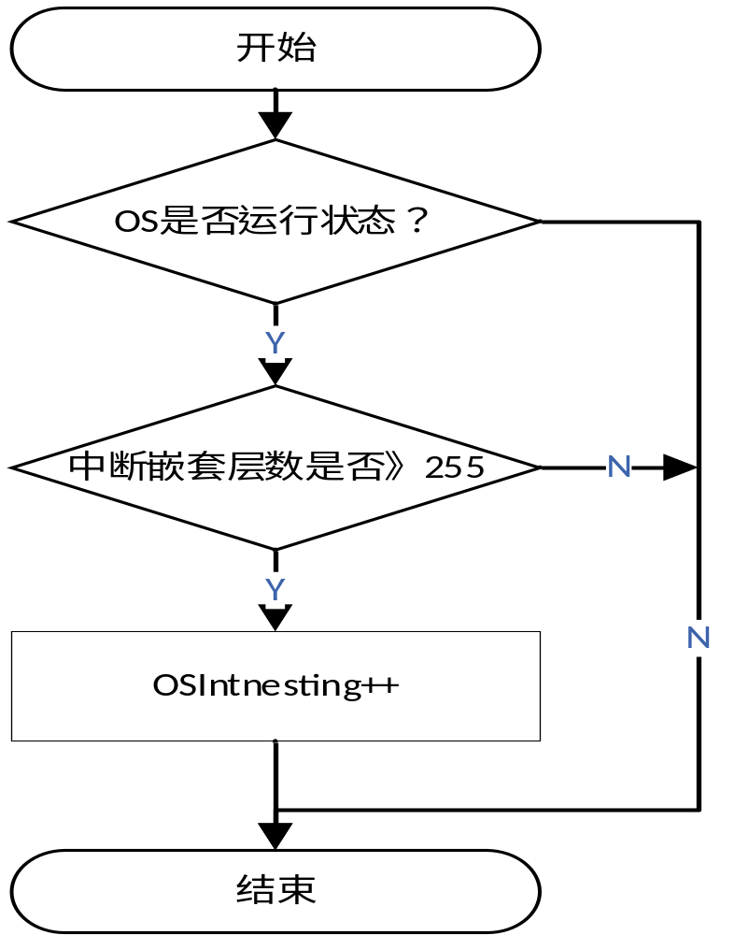
OSIntEnter()流程图

Slide 3
void OSIntEnter (void)
{
if (OSRunning == TRUE) {
if (OSIntNesting < 255) {
/* Increment ISR nesting level */
OSIntNesting++;
}
}

Slide 4
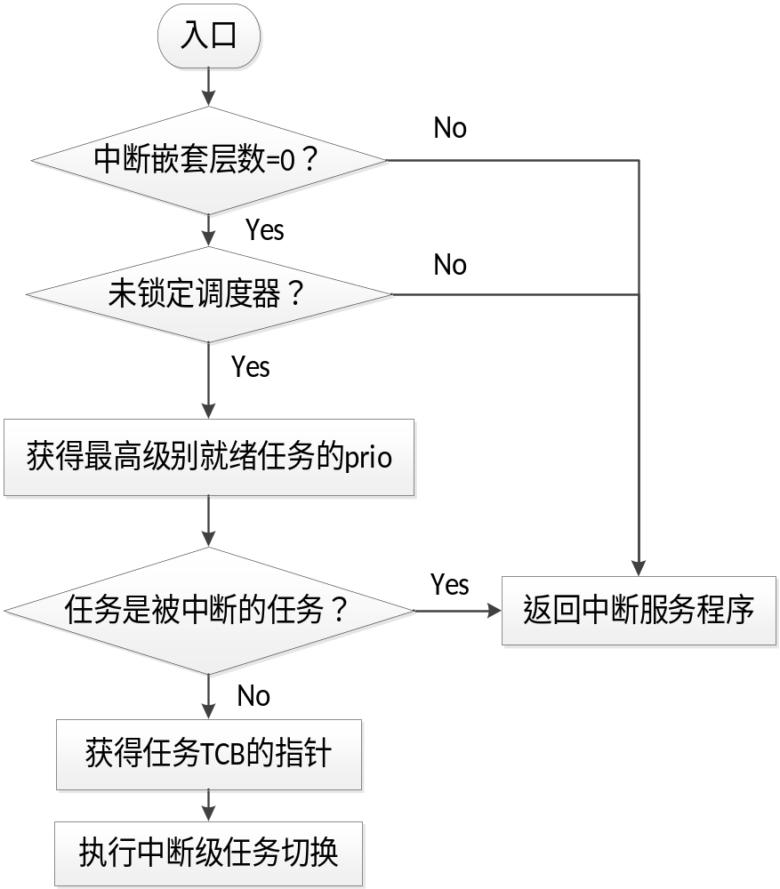
OSIntExit（）函数流程图

Slide 5
void OSIntExit (void)
{
#if OS_CRITICAL_METHOD == 3 /* Allocate storage for CPU status register */
OS_CPU_SR cpu_sr;
#endif
if (OSRunning == TRUE) {
OS_ENTER_CRITICAL();
if (OSIntNesting > 0) {/* Prevent OSIntNesting from wrapping*/
OSIntNesting--;
}

Slide 6
/* Reschedule only if all ISRs complete ... */
if ((OSIntNesting == 0) && (OSLockNesting == 0)) {
OSIntExitY = OSUnMapTbl[OSRdyGrp]; /* ... and not locked. */
OSPrioHighRdy = (INT8U)((OSIntExitY << 3)+ OSUnMapTbl[OSRdyTbl[OSIntExitY]]);
if (OSPrioHighRdy != OSPrioCur){/* No CtxSw if current task is highest rdy */
OSTCBHighRdy = OSTCBPrioTbl[OSPrioHighRdy];
OSCtxSwCtr++; /* Keep track of the number of ctx switches */
OSIntCtxSw(); /* Perform interrupt level ctx switch */
}
}
OS_EXIT_CRITICAL();
}
}

Slide 7
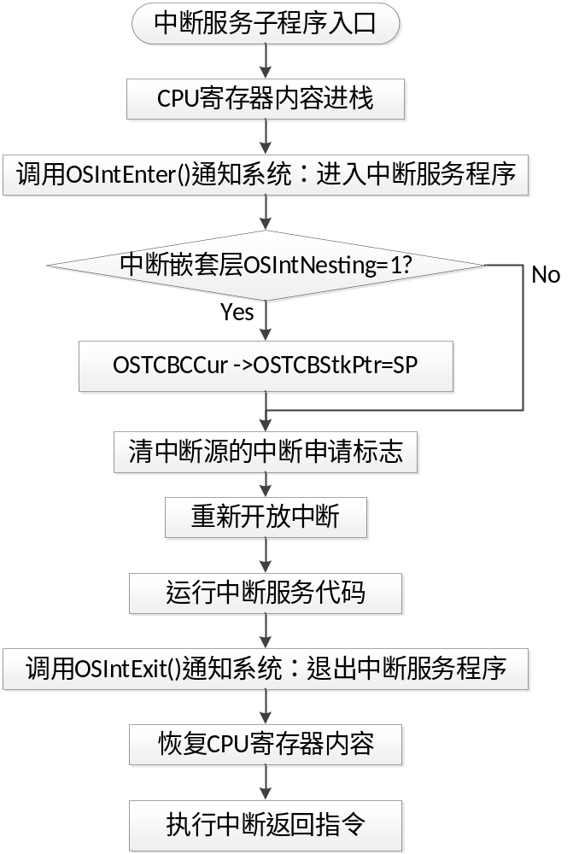
一个中断服务程序的完整流程

Slide 8
时钟相关函数
void Timer1Init(void)
{
T1IR = 0xffffffff; /* 清除Timer1的中断标示 */
T1TC = 0; /* Timer1的定时计数器TC赋初值 */
T1TCR = 0x01; /* Timer1使能 & 解复位 */
T1MCR = 0x03; /* 设置Timer1 匹配控制寄存器：
当T1TC==T1MR0时，Timer1 复位并产生中断 */
T1MR0 = (Fpclk / OS_TICKS_PER_SEC); /* 设置匹配常数 */
}
OS_TICKS_PER_SEC的定义在OS_config.h中：
#define OS_TICKS_PER_SEC 200

Slide 9
void Timer0_Exception(void)
{
T0IR = 0x01;
VICVectAddr = 0; //通知中断控制器清除中断信号
OSTimeTick();
}

Slide 10
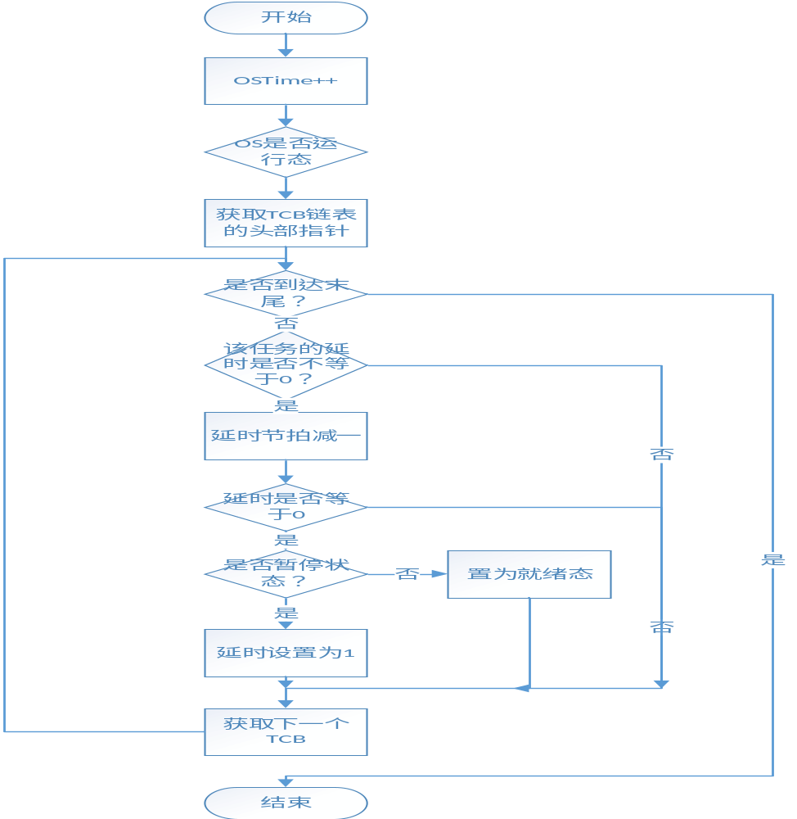
OSTimeTick()流程图

Slide 11
void OSTimeTick (void)
{
#if OS_CRITICAL_METHOD == 3 /* Allocate storage for CPU status register */
OS_CPU_SR cpu_sr;
#endif
OS_TCB *ptcb;
OSTimeTickHook(); /* Call user definable hook*/
#if OS_TIME_GET_SET_EN > 0
OS_ENTER_CRITICAL(); /* Update the 32-bit tick counter*/
OSTime++;
OS_EXIT_CRITICAL();
#endif
if (OSRunning == TRUE) {
ptcb = OSTCBList; /* Point at first TCB in TCB list*/

Slide 12
while (ptcb->OSTCBPrio != OS_IDLE_PRIO) {/* Go through all TCBs in TCB list */
OS_ENTER_CRITICAL();
if (ptcb->OSTCBDly != 0) { /* Delayed or waiting for event with TO */
if (--ptcb->OSTCBDly == 0) { /* Decrement nbr of ticks to end of delay */
if ((ptcb->OSTCBStat & OS_STAT_SUSPEND) == OS_STAT_RDY) { /* Is task suspended? */
OSRdyGrp|= ptcb->OSTCBBitY; /* No, Make task R-to-R (timedout)*/
OSRdyTbl[ptcb->OSTCBY] |= ptcb->OSTCBBitX;
} else { /* Yes, Leave 1 tick to prevent ... */
ptcb->OSTCBDly = 1; /* ... loosing the task when the ... */
} /* ... suspension is removed. */
}
}
ptcb = ptcb->OSTCBNext; /* Point at next TCB in TCB list */
OS_EXIT_CRITICAL();
}
}
}

Slide 13
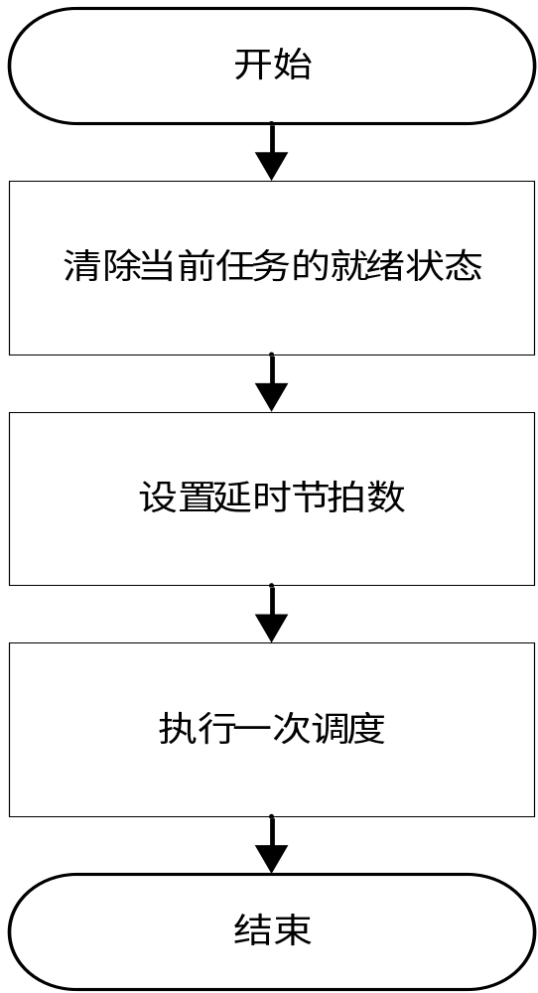
OSTimeDly()流程图

Slide 14
void OSTimeDly (INT16U ticks)
{
#if OS_CRITICAL_METHOD == 3 /* Allocate storage for CPU status register */
OS_CPU_SR cpu_sr;
#endif
if (ticks > 0) { /* 0 means no delay! */
OS_ENTER_CRITICAL();
if ((OSRdyTbl[OSTCBCur->OSTCBY] &= ~OSTCBCur->OSTCBBitX) == 0)
{ /* Delay current task */
OSRdyGrp &= ~OSTCBCur->OSTCBBitY;
}
OSTCBCur->OSTCBDly = ticks; /* Load ticks in TCB */
OS_EXIT_CRITICAL();
OS_Sched(); /* Find next task to run! */
}
}

Slide 15
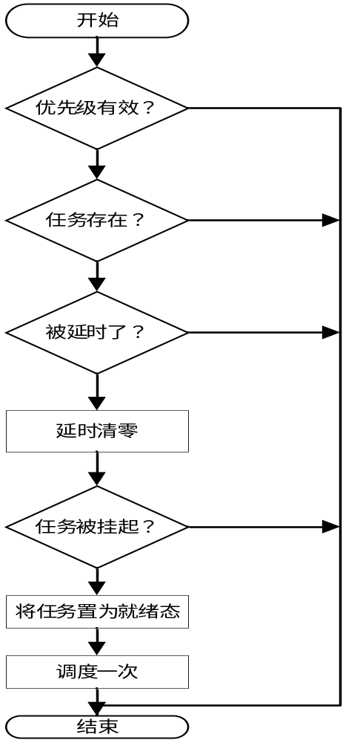
OSTimeDlyResume()流程图

Slide 16
INT8U OSTimeDlyResume (INT8U prio)
{
#if OS_CRITICAL_METHOD == 3 /* Allocate storage for CPU status register */
OS_CPU_SR cpu_sr;
#endif
OS_TCB *ptcb;
if (prio >= OS_LOWEST_PRIO) {
return (OS_PRIO_INVALID);
}
OS_ENTER_CRITICAL();
ptcb = (OS_TCB *)OSTCBPrioTbl[prio]; /* Make sure that task exist */
if (ptcb != (OS_TCB *)0) {
if (ptcb->OSTCBDly != 0) { /* See if task is delayed */
ptcb->OSTCBDly = 0; /* Clear the time delay */

Slide 17
if ((ptcb->OSTCBStat & OS_STAT_SUSPEND) == OS_STAT_RDY) { /* See if task is ready to run */
OSRdyGrp|= ptcb->OSTCBBitY; /* Make task ready to run */
OSRdyTbl[ptcb->OSTCBY] |= ptcb->OSTCBBitX;
OS_EXIT_CRITICAL();
OS_Sched(); /* See if this is new highest priority*/
} else {
OS_EXIT_CRITICAL(); /* Task may be suspended */
}
return (OS_NO_ERR);
} else {
OS_EXIT_CRITICAL();
return (OS_TIME_NOT_DLY); /* Indicate that task was not delayed */
}
}
OS_EXIT_CRITICAL();
return (OS_TASK_NOT_EXIST); /* The task does not exist*/
}

Slide 18
谢谢观看！

