Slide 1
NL to SQL Translator Tool for individuals to run unstructured queries against databases
Haipeng Liu
Xingyu Chen

Slide 2
Sprint goal
Start developing our own model
Choose suitable database and NLP tool

Slide 3
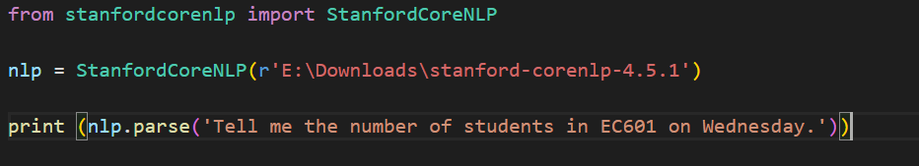
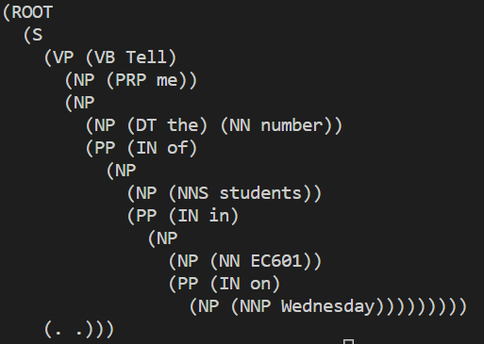
Achievement
Test the function of Stanford-CoreNLP

Slide 4
Problems
Find it time-consuming to train our own model.
Input natural language has to be strongly related to name of column in database.

Slide 5
Sprint4 goals
Do logical parsing based on CoreNLP output

