Slide 1
Numerical calculations of two-dimensional generalized Brillouin zone

Slide 2
Non-Bloch band theory and generalized Brillouin zone (GBZ)
Amoebic GBZ and strip GBZ
Reducing GBZ computation to root solving
Project structure

Slide 3
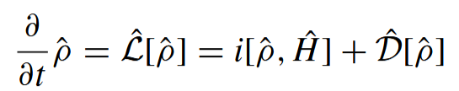

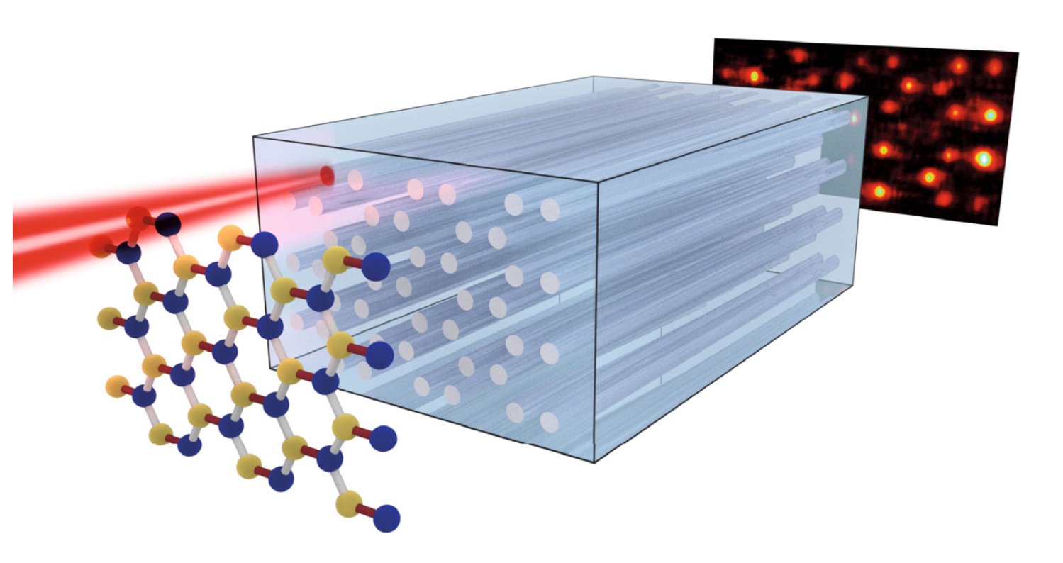
Non-Hermitian physics
Part 01
Non-Hermitian physics: Effective dynamics for some open systems
Liouvillian superoperator
Bosonic BdG Hamiltonian
Classical wave dynamics
F. Song, S. Yao, and Z. Wang,
Phys. Rev. Lett. 123, 170401 (2019).
A. McDonald, T. P.-Barnea, and A. A. Clerk, Phys. Rev. X 8, 041031 (2018).
Kremer, M. et al.
Nat Commun 10, 435 (2019).
Review: Y. Ashida, Z. Gong, and M. Ueda, Adv. Phys. 69, 249 (2020).

Slide 4

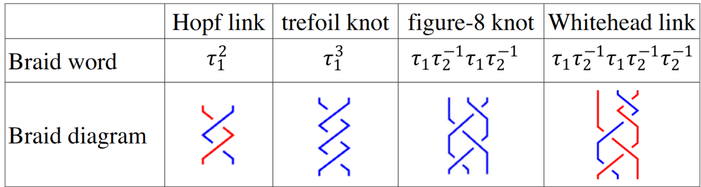
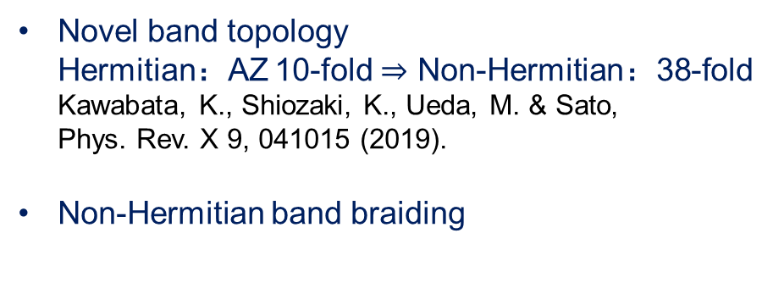
Non-Hermitian periodic lattices
Part 01
+
New physics
New applications
Novel band topology
Hermitian：AZ 10-fold $⇒$ Non-Hermitian：38-fold
Kawabata, K., Shiozaki, K., Ueda, M. & Sato,
Phys. Rev. X 9, 041015 (2019).
Non-Hermitian band braiding
Single-mode lasing
Zhu, B. et al.
Phys. Rev. Lett. 129, 013903 (2022).
Non-Hermitian sensing
Ehrhardt, C. & Larson, J.
Phys. Rev. Res. 6, 023135 (2024).
……
Hu, H. & Zhao, E.
Phys. Rev. Lett. 126, 010401 (2021).

Slide 5
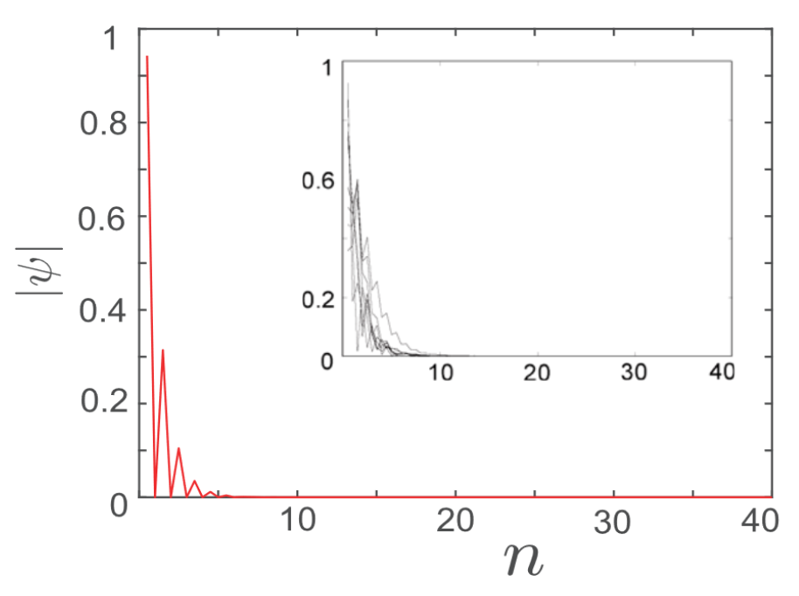
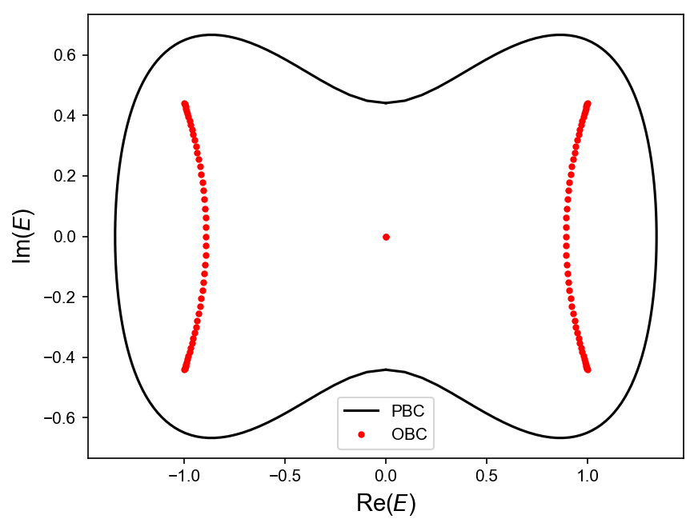
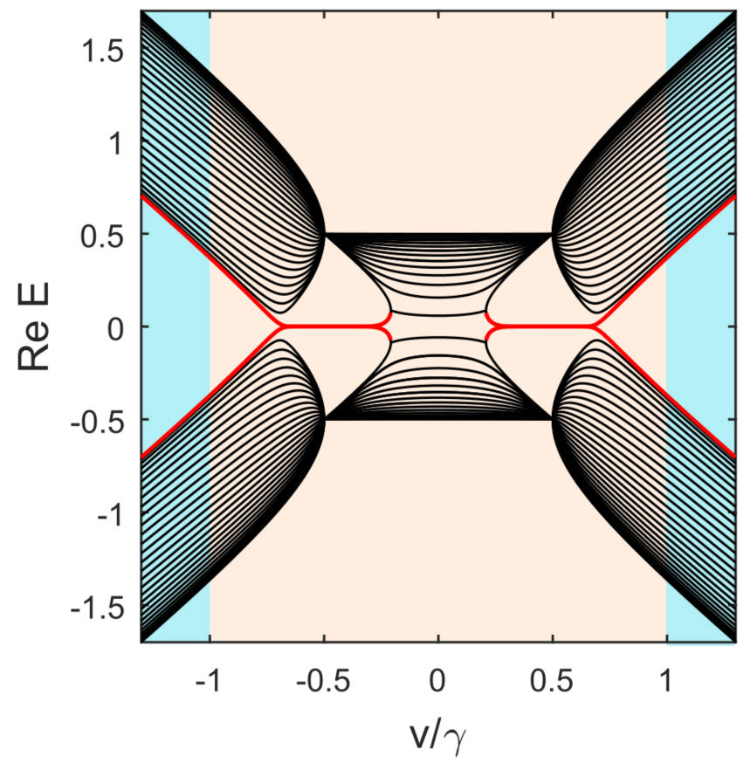

Non-Hermitian skin effect
Part 01
Hermitian lattices: Bloch band theory
Non-Hermitian lattices：NHSE
Bloch states
Energy bands
Breakdown of bulk-edge correspondence
Edge localization of states
PBC bands $≠$ OBC bands
Lee, T. E. Phys. Rev. Lett. 116, 133903 (2016).
Yao, S. & Wang, Z. Phys. Rev. Lett. 121, 086803 (2018).

Slide 6
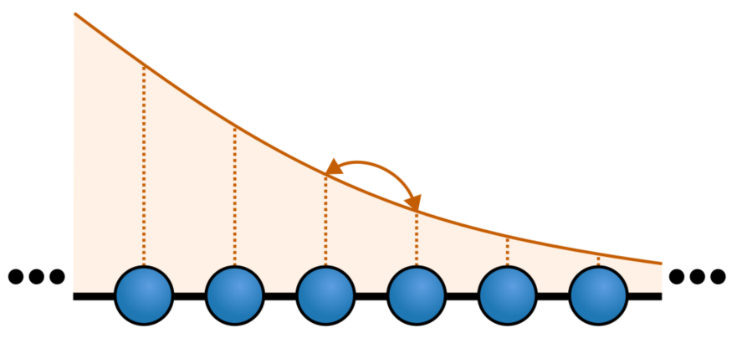
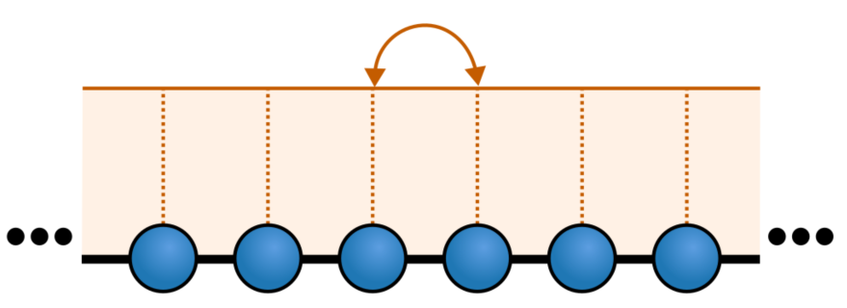
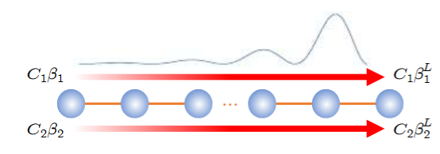
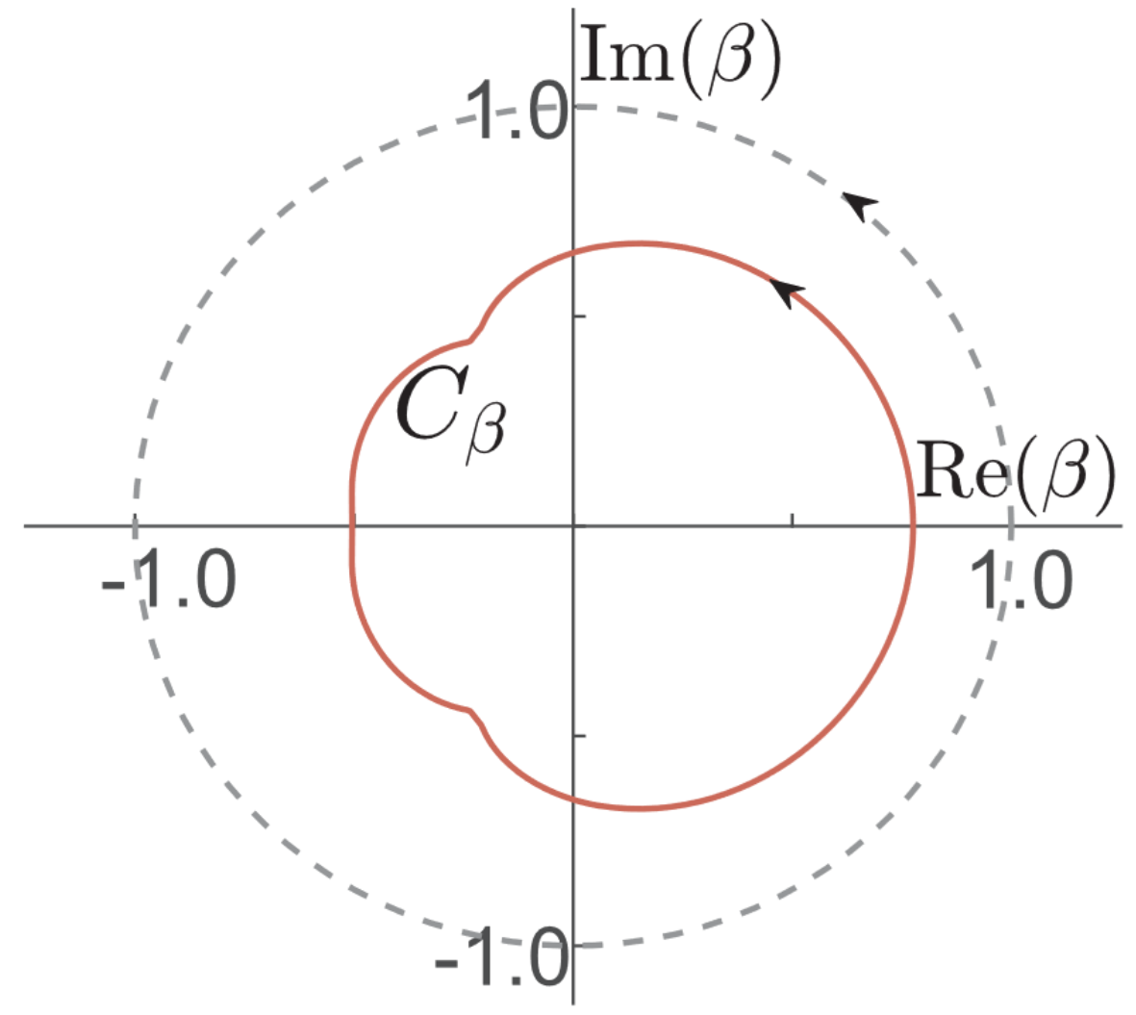


1D GBZ
Part 01
Bloch states
Non-Bloch states
2D complex plane
Generalized Brillouin zone (GBZ)
Constraints on $β$
Yao, S. & Wang, Z. Phys. Rev. Lett. 121, 086803 (2018).
Yokomizo, K. & Murakami, S. Phys. Rev. Lett. 123, 066404 (2019).

Slide 7
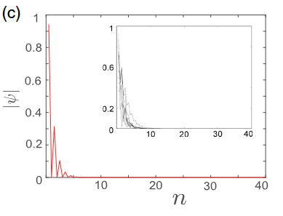
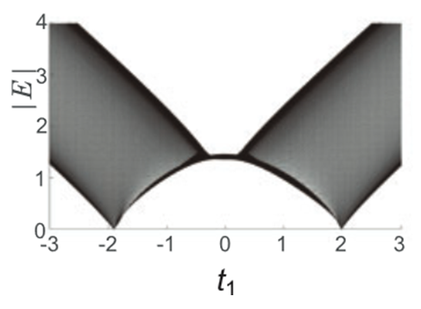
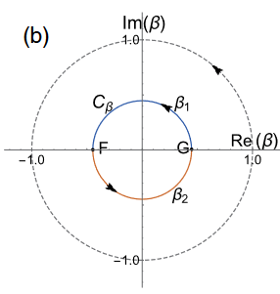
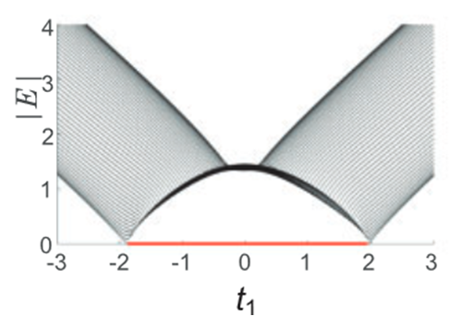
1D non-Bloch band theory
Part 01
Successful in describing 1D NHSE
Spectrum and topology
Localization of eigenstates
GBZ
OBC
Yao, S. & Wang, Z. Phys. Rev. Lett. 121, 086803 (2018).

Slide 8
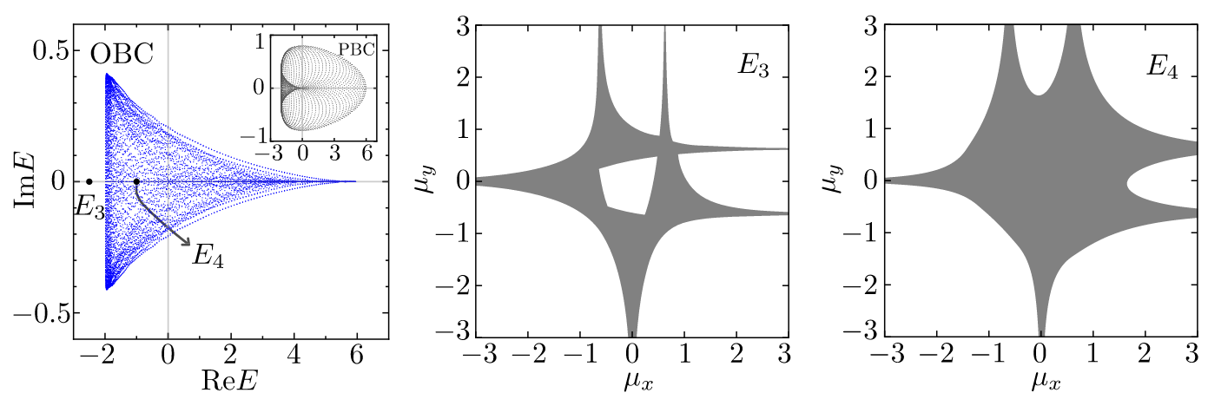
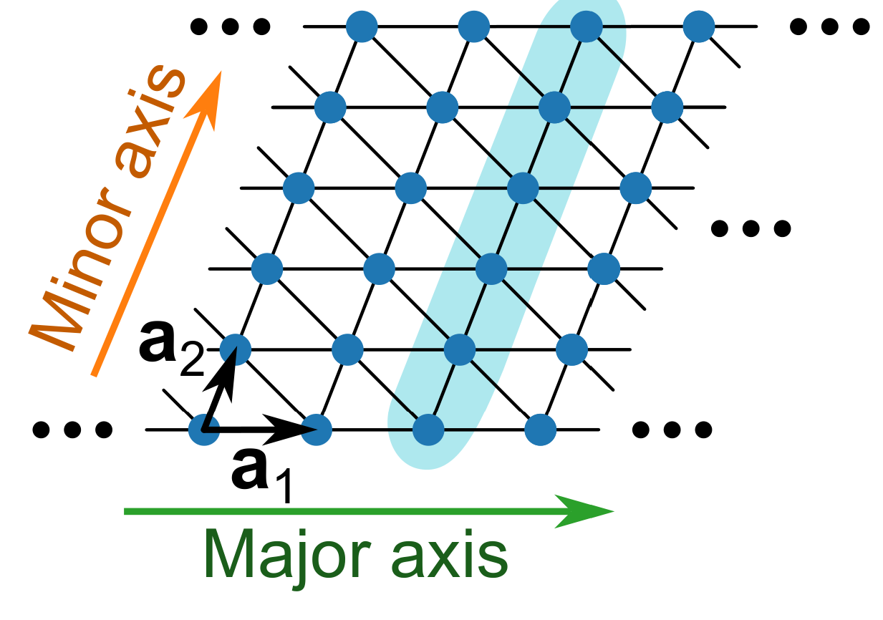
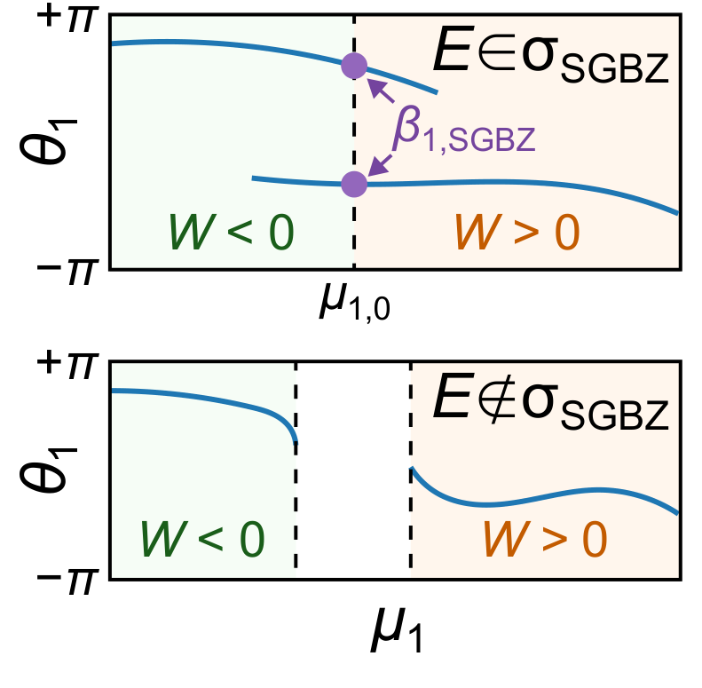
Non-Bloch band theory for 2D lattices
Part 01
Amoeba formulation： Geometry-independent GBZ
Strip-GBZ (SGBZ) formulation： OBC spectrum of a strip geometry with
Wang, H.-Y., Song, F. & Wang, Z.
Phys. Rev. X 14, 021011 (2024).
Xiong, Y., Xing, Z.-Y. & Hu, H.
arXiv. 2407.01296 (2024)
Wang, C., et al.
arXiv. 2506.22743 (2025).

Slide 9
Non-Bloch band theory and generalized Brillouin zone (GBZ)
Reducing GBZ computation to root solving
Bench mark
Applications

Slide 10
Amoeba formulation
Part 02

