Slide 1
Chap. 3
Force and Newton’s law
zwma@zju.edu.cn

Slide 2
Force and Motion
zwma@zju.edu.cn

Slide 3
The force laws
Environment
Force
Body
Motion
The motion laws
We consider a body on which no net force acts. In a reference frame, if the body is at rest, it will remain at rest; if the body is moving with constant velocity, it will continue to do so.
Such reference frame in which Newton’s first law is valid is called the inertial frame.
Newton’s First Laws
zwma@zju.edu.cn

Slide 4



S frames
inertial frames
S’ frames
Not an inertial frame
S’’ frames
zwma@zju.edu.cn

Slide 5
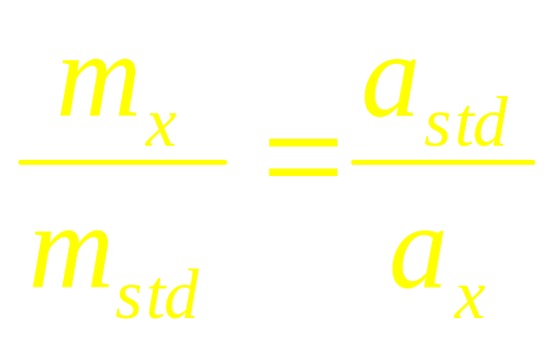
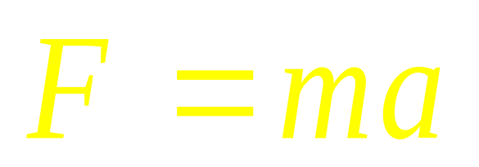
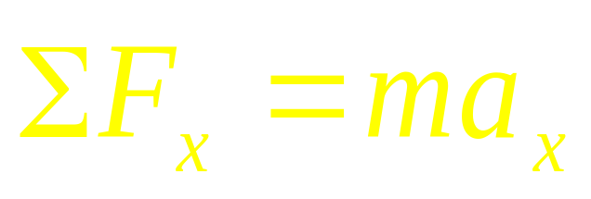
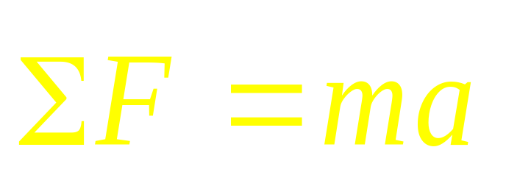
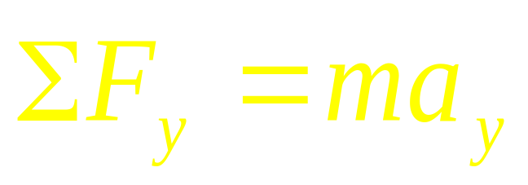
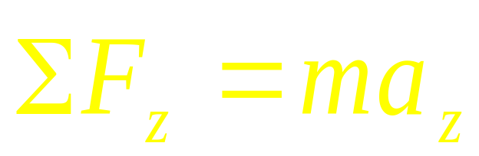
Same force acting on
Mass
Newton’s Second Laws
zwma@zju.edu.cn

Slide 6

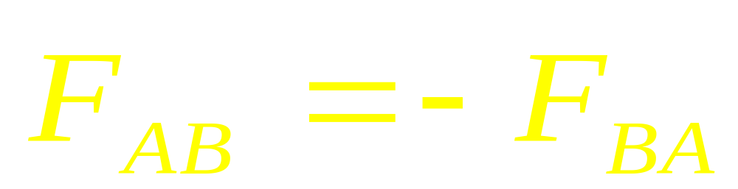
Newton’s Third Laws
zwma@zju.edu.cn

Slide 7
environment.
a
F’
F
The force is an interaction between
a body and its environment.
If F=0, the motion of the body will
remain unchanged.
1st Newton’s law
The force acts on a body that will accelerate or decelerate.
2nd Newton’s law
3rd Newton’s law
zwma@zju.edu.cn

Slide 8
W=mg
g
W
environment.
zwma@zju.edu.cn

Slide 9
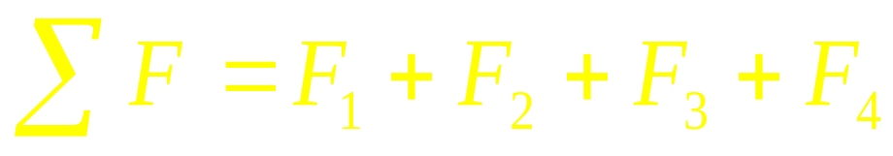
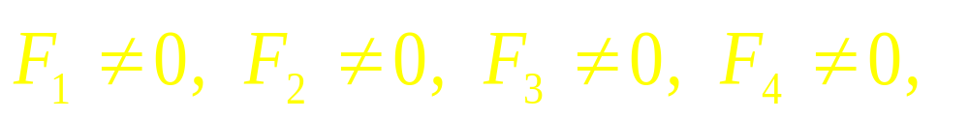
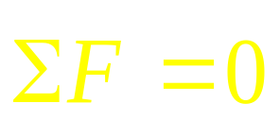
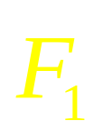

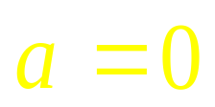
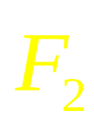

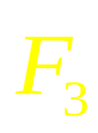

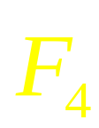

The force is a vector
No net force
zwma@zju.edu.cn

Slide 10
External force and internal force
F_{ext}
F_{ext}
F_{int} F_{int}
ext
ext
zwma@zju.edu.cn

Slide 11
UNIT OF FORCE
newton, N
1N = 1 Kg•m/s²
[ F ] = ML/T²
zwma@zju.edu.cn

Slide 12
Spring Force
L
zwma@zju.edu.cn

Slide 13
L+ΔL
Spring Force
zwma@zju.edu.cn

Slide 14
Tension force T
very thin
The ideal string :
negligible mass
i-1
i
i+1
T
T
T
spring scale
T
zwma

Slide 15
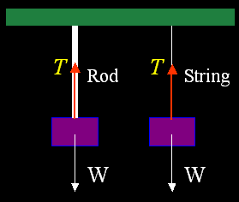
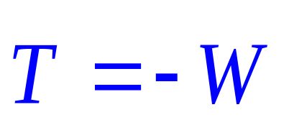
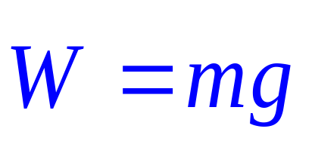
For a massless and non-stretch string (or rod), there is always an action-reaction pair at any point in the string (or rod).
zwma

Slide 16
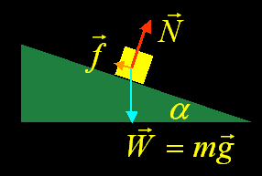
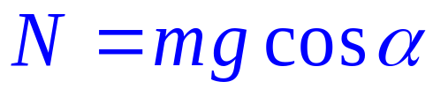
 Normal force N
The normal force is always perpendicular to the surface.
T and N are all elastic forces. They are passive forces.
zwma

Slide 17
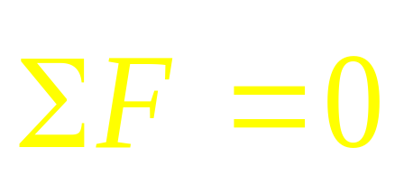
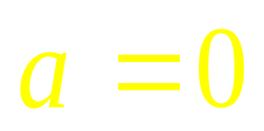
N
N
T
Normal Force
mg
T
mg

Slide 18
T₁=T₂ =T
m₂g>T
m₁g<T
N
a
N=m₁g
T₁
T₂
T₁
T<m₂g
a
T₂
m₁g
a
m₁g
m₂g
T₁=T₂=T
a=a
a
a=a
m₂g

Slide 19
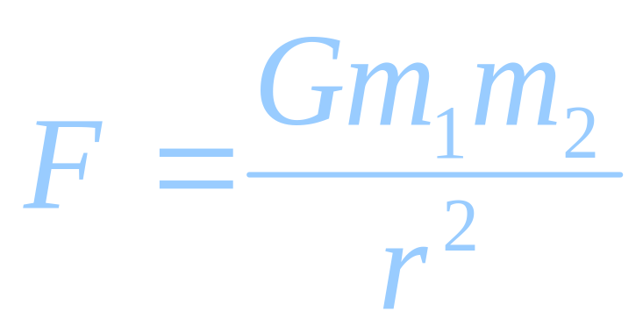
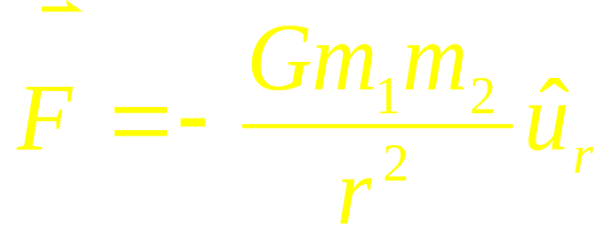
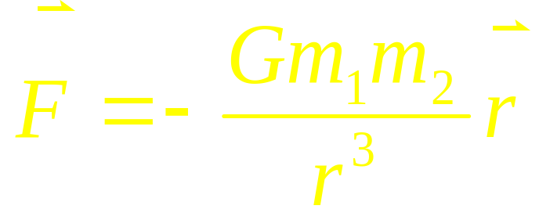
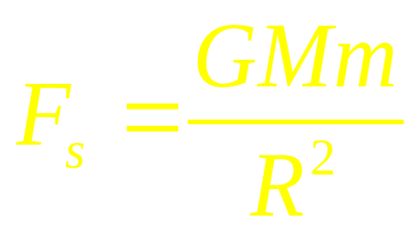
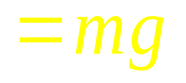
Gravitational Force
r
G gravitational constant

Slide 20
N
frictional force
Kinetic friction
f_{k} =μ_{k}N
Static friction
f_{s} = - ΣF_{ext}
≤ μ_{s}N
μ_{k} < μ_{s}

Slide 21
v=0
F
f _{s}= -F
f_{s}

Slide 22
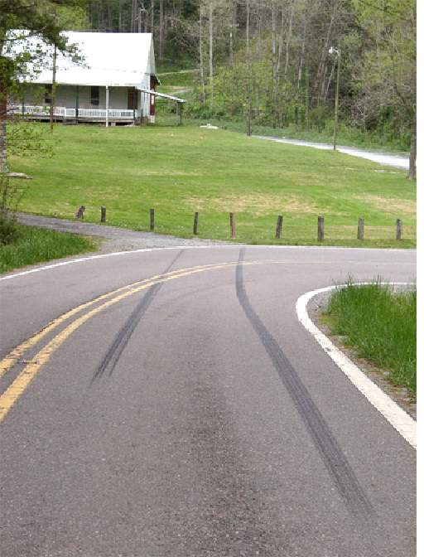
v=0
F
With ABS, the wheel rotates without slipping
f _{s}= -F
≤ μ_{s}N
With ABS, the car stop in shorter distance
f_{s}
v
f _{k} =μ_{k}N < μ_{s}N
F
f_{k}
f
f

Slide 23
The direction of frictional force?
v
F
f_{s}
f_{k}

Slide 24
All Force combination
Normal Force
L+ΔL
Spring Force
Frictional Force
Gravity
Tension
Gravity

Slide 25
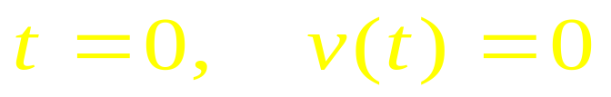
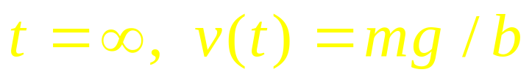
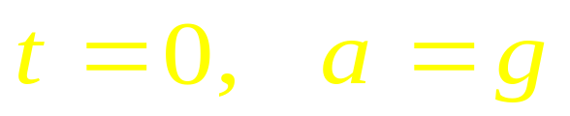
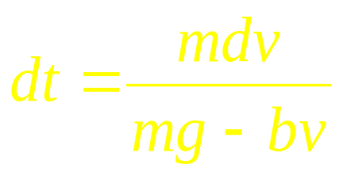

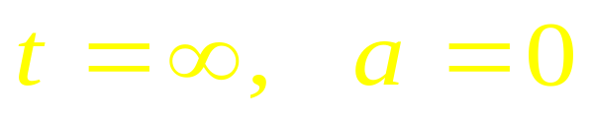
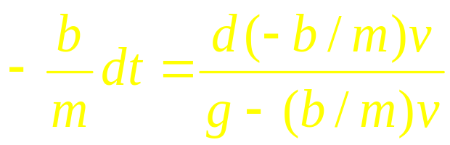
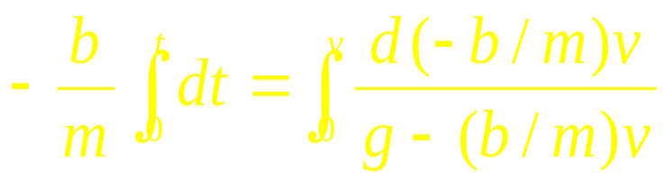
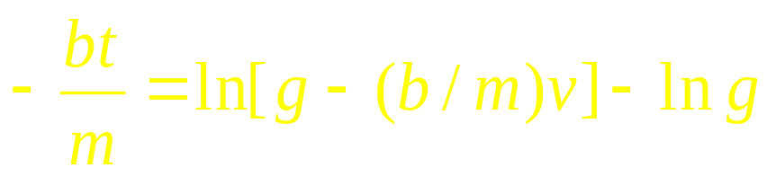
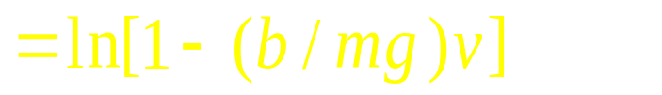
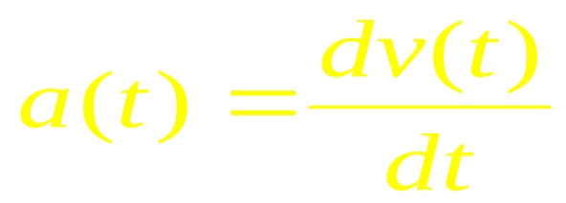
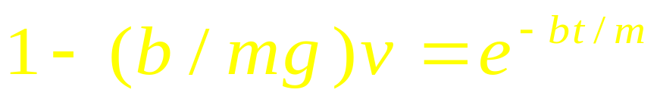
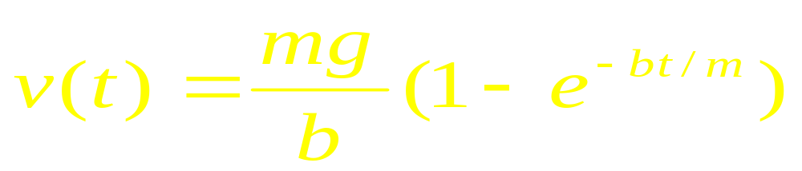
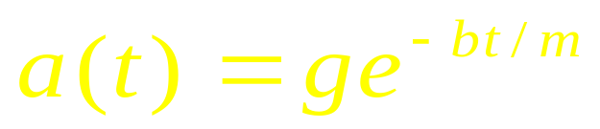
force depending on the velocity.
v(t)
D
D = bv
Σ F = mg-bv
= ma
a(t)
D
mg-bv = m dv/dt
mg/b
t
t
mg
mg
mg
zwma@zju.edu.cn

Slide 26
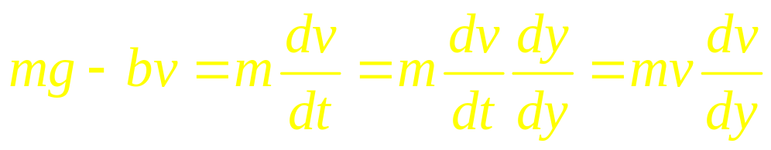
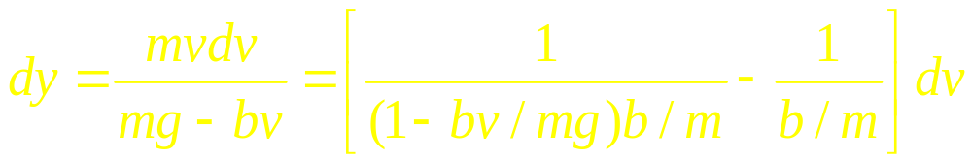
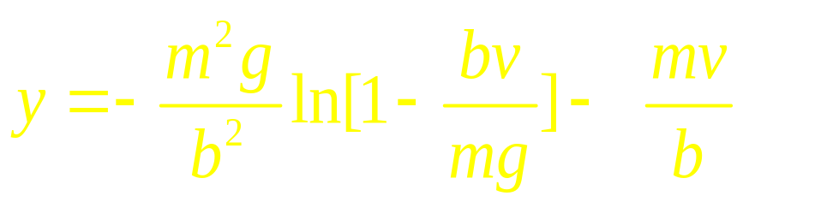
force depending on the velocity.
D
D = bv
Σ F = mg-bv
= ma
Position dependent forces
D
Time dependent forces
mg
mg
mg
zwma@zju.edu.cn

Slide 27
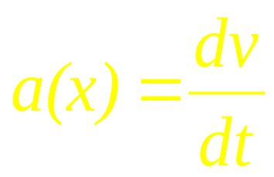
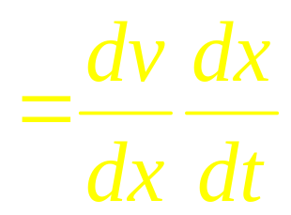
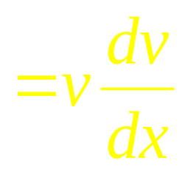
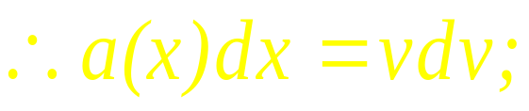
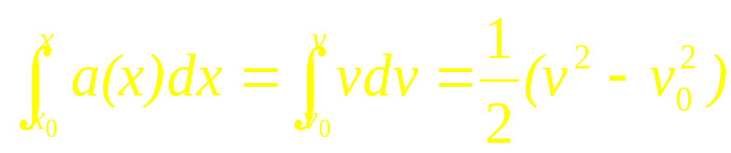
Force dependent on the position
F=F(r). Thus a depends on the position, i.e, a(r).
For one dimension, a=a(x)
zwma@zju.edu.cn

Slide 28
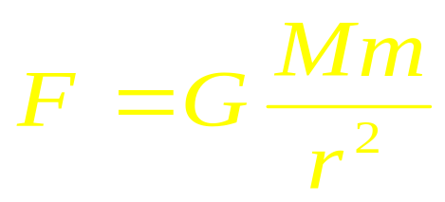










Example
An object, located at 2R away from the center of the earth, is falling from rest vertically. R is the radius of the earth. Find the speed when it arrives at the earth’s surface. The drag force on the object by the air and the spin of the earth are ignorable.
v
2R
R
zwma@zju.edu.cn

Slide 29






Time dependent forces
Example: A car moves with the velocity v₀ alone the x axis. If a(t)= - ct, how much time it passes and how far it travels when it stops?
F=F(t). Thus a is equal a(t)
v_{o}
F
a(t)=- ct, c>0
x
x₀
zwma@zju.edu.cn

Slide 30




Example:
A uniform rob with the mass m and the
length L is perpendicularly fixed on the rotating axis.
When it rotates with a angular speed ω, find the tension
force of the rob at every point if the gravitation force is
ignorable.
Answer:
ω
m,L
dr
zwma@zju.edu.cn

Slide 31
Chap. 4
MOTION IN 2-
and 3-DIMENSIONS
zwma@zju.edu.cn

Slide 32


Projectile motion-two dimension
v
zwma@zju.edu.cn

Slide 33
Path Equation:
v
Horizontal Range:
zwma@zju.edu.cn

Slide 34

Uniform Circular motion
Δv
v
θ
r
Tangential Acceleration
Centripetal Acceleration
zwma@zju.edu.cn

Slide 35
Uniform Circular motion
Δv
v
θ
r
Tangential Acceleration
Centripetal Acceleration
zwma@zju.edu.cn

Slide 36

The Dynamics of Uniform Circular Motion

Slide 37
pendulum
Banked curve
N
θ
F
T
θ
mg
F
mg

Slide 38
In Nature Coordinates

Slide 39
Example
The position vector of a particle is
What is the tangential and centripetal acceleration, at t =0?
How to calculate the radial and
poloidal velocity?
Another simple way to calculate the
tangential and centripetal acceleration

Slide 40
Relative motion
y’
r_{s} = r_{ss’}+ r_{s’}
v_{s} = v_{ss’} + v_{s’}
y
S’
a_{s} = a_{ss’} + a_{s’}
r_{s’}
S
r_{s}
o’
x’
r_{ss’}
o
x

Slide 41



Relative motion:
Relative position:
B
A
Relative velocity:
Relative acceleration:
zwma@zju.edu.cn

Slide 42
j
Exercises
When t=0
v=? a=?
v
i
H
L
zwma@zju.edu.cn

Slide 43






Example: The flow speed in a river with the width l is linearly
dependent on the distance away from the bank of the river.
The maximum flow speed is v₀. A boat with the speed v departs
from a bank. When the boat arrives at the position that is l/4 away
from the bank, there is no enough fuel to reach another bank for the
boat. Then, the boat return back the original bank with the speed v/2
and the direction perpendicular to the flow velocity. Find how far
away from the departed position when the boat arrives the bank.
Answer:
The boat velocity is
We have
, then
The boat trajectory is
, thus
zwma@zju.edu.cn

Slide 44




The returning boat velocity is
We have
, then
The boat position:
zwma@zju.edu.cn

Slide 45
Exercises
P63 7, 9
P86 15, 18, 20
P87 23
zwma@zju.edu.cn

