Slide 1
Chap. 5
Applications of Newton’s Laws

Slide 2
Limitations of Newton’s laws
The speed of motion << c
In the macro-scale
Inertia frame
its velocity is constant relative to one another
If a frame S’ moves with acceleration, it is not an inertial frames.
Noninertial frames and pseudoforces
How can we do?

Slide 3
Noninertial frames and pseudoforces
a’
F_{p}
a
F_{p}
F
a
inertial force
Pseudoforce
In both cases,
F≠ma′Newton’s law are violated.

Slide 4
We assume m₁< m₂ +m₃ and m₂< m₃
T₁
a
Noninertial Frame
T₁ - m₁g= m₁ a
Pseudoforce, (-ma)
T₁=2 T₂
m₁
T₂
T₂
T₂ + m₂a – m₂g= m₂ a’
a
m₂a
m₃a
m₃g – m₃a - T₂ = m₃ a’
m₁g
a’
m₂
m₃
a=?
a’
m₂g
m₃g

Slide 5
What is the frame?
Noninertial frames with rotation
a=v²/r
F=mv²/r

Slide 6

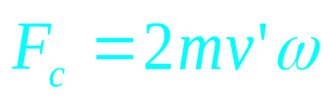
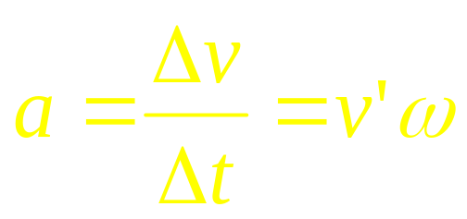
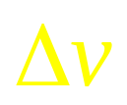
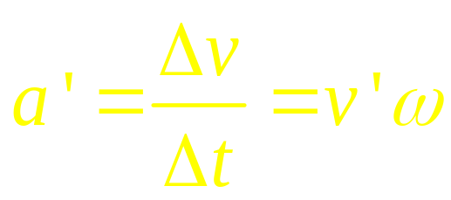
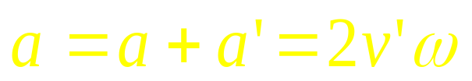

What is the frame?
Noninertial frames with rotation
Δv = rω - r’ω
r’
=(r –r’)ω
r
v’
Coriolis force
=v’ Δt ω
v’
a
Δv= v’Δθ
Δv= v’ Δt ω

Slide 7
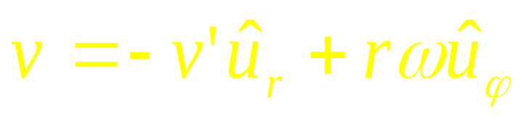
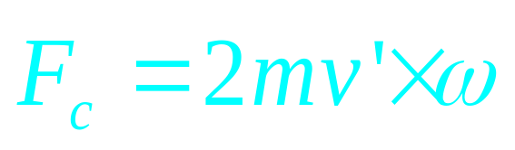
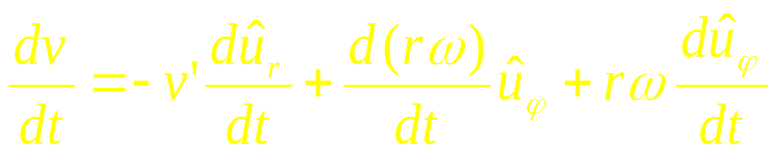

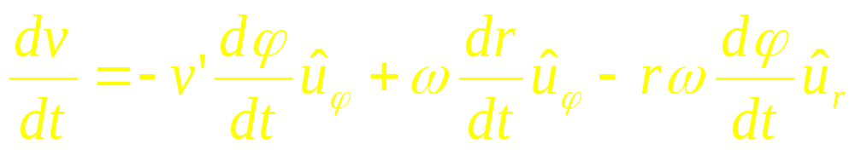
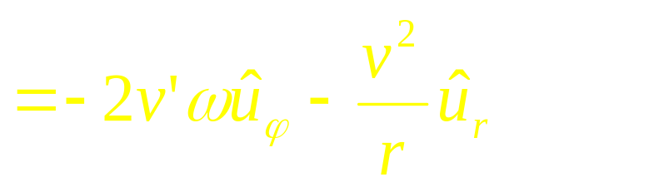
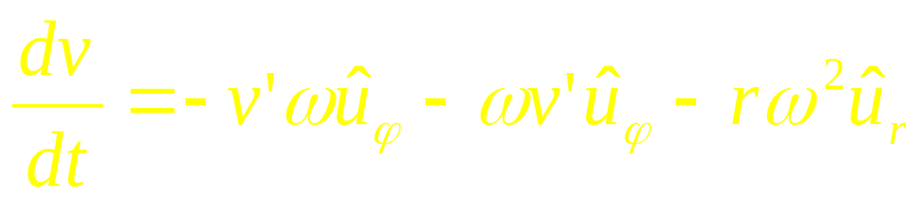

What is the frame?
Noninertial frames with rotation
v’
Coriolis force
F=mv²/r

Slide 8
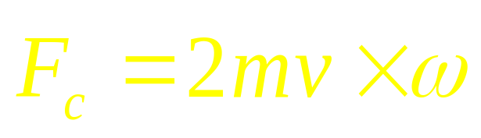
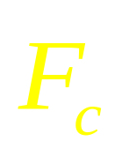
ω
ω
v

Slide 9
ω
ω
v
ω
v

Slide 10
Chap. 5
Exercises
11 (P110 ), 18 (P111), 39 (P113)
Problems
17, 18 (P116)

