Slide 1
Chapter 6
Momentum

Slide 2
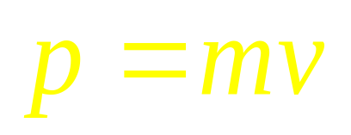
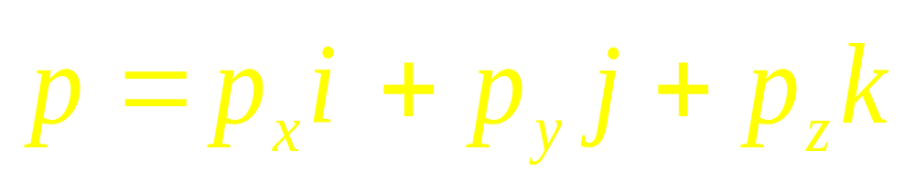
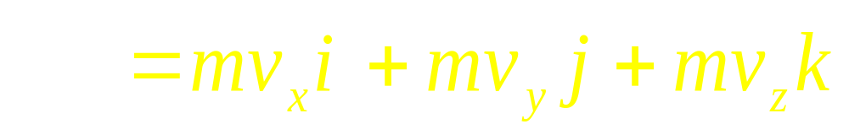
Linear momentum
The momentum p of a body is defined as:

Slide 3
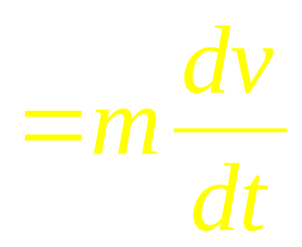
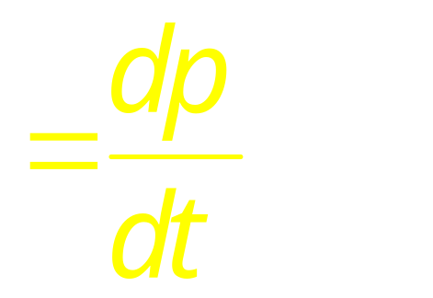
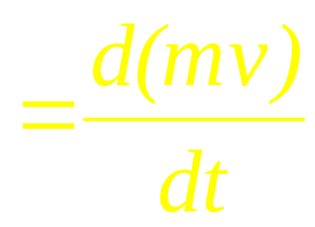
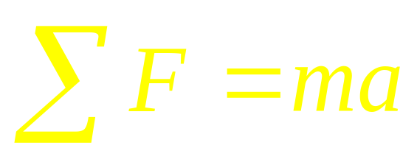
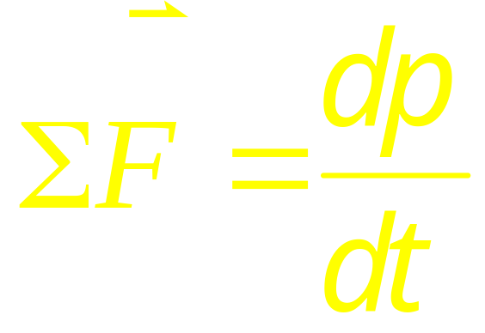
This is another form of Newton’s second law.

Slide 4
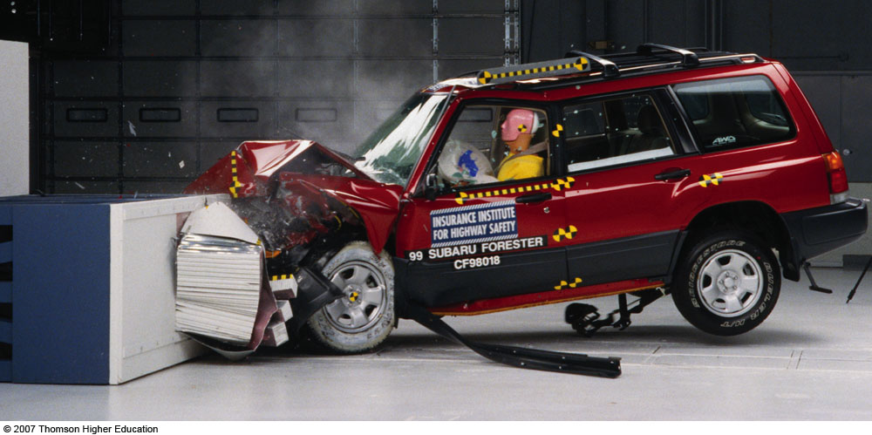
Collision

Slide 6
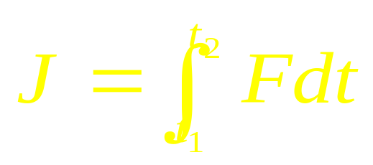
F
What is the force between two bodys?
F(t)
impulse冲量
The area under the F(t) curve is J.
F_{av}
J = F_{av} (t₂-t₁) = F_{av} Δt
t₁ t₂
t

Slide 7
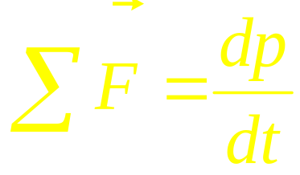
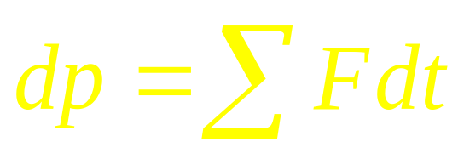
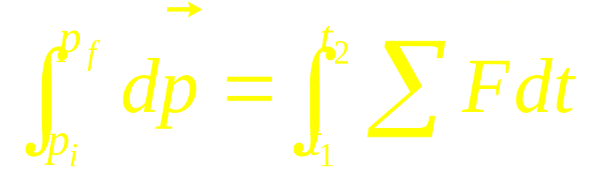
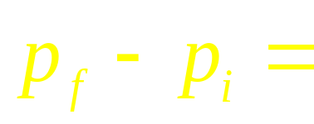
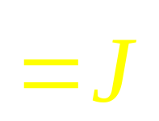
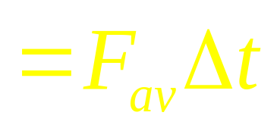
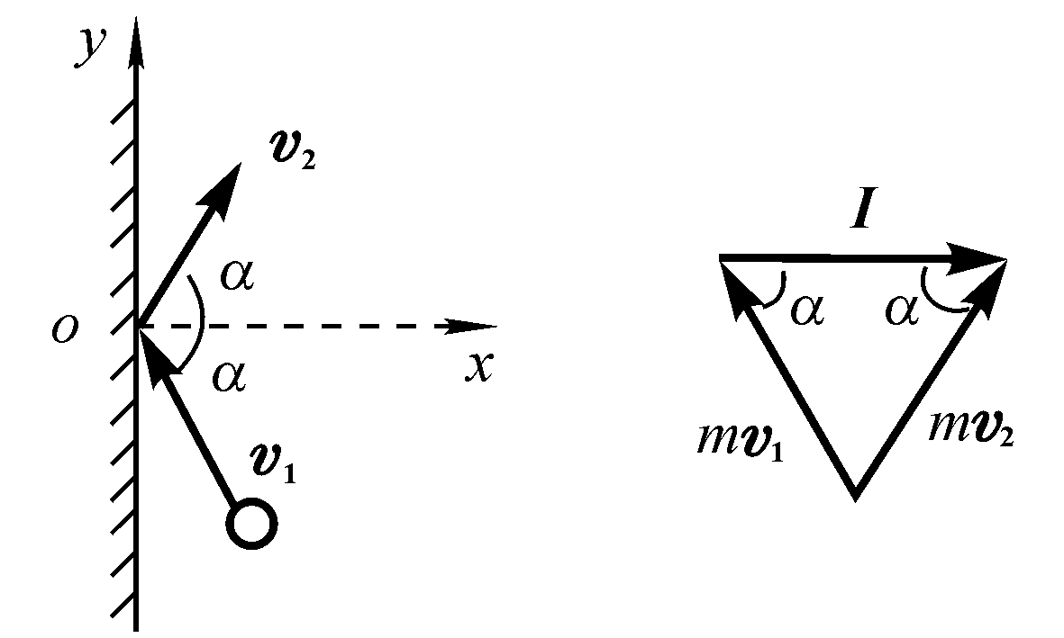
y
J
impulse-momentum theorem.
p_{f}
J
p_{i}
x

Slide 8
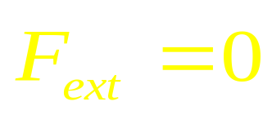
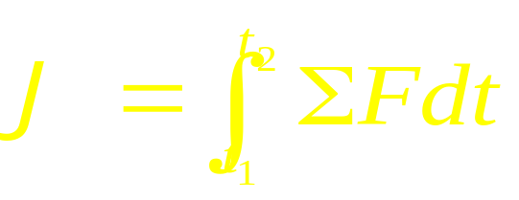
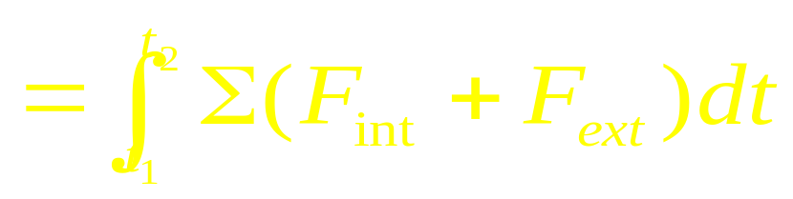
Conservation of momentum
F_{ext}
F_{ext}
F_{int} F_{int}

Slide 9
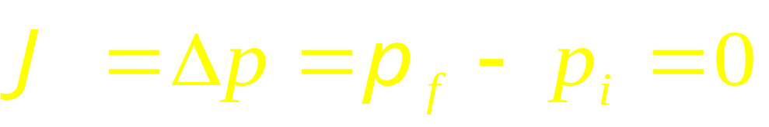
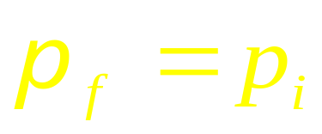
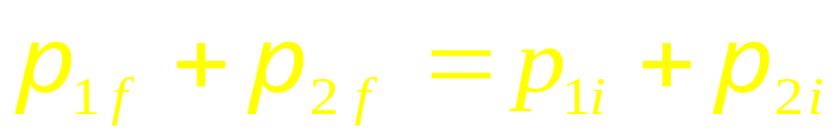
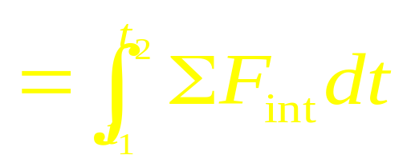
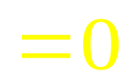
Conservation of momentum
The frame of reference.
Although p₁and p₂ may both change, their vector
sum stays the same.
F_{int} F_{int}
Conservation of momentum consists of three components formulas.

Slide 10
Collision in 1-D

Slide 11
Collision in 1-D

Slide 12
Collision in 1-D

Slide 13


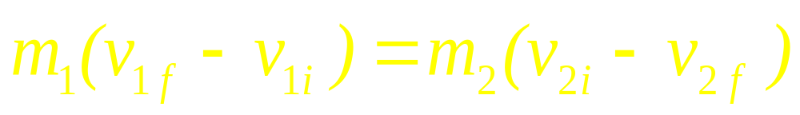
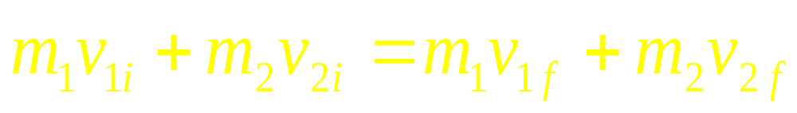
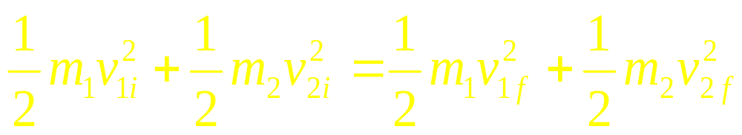
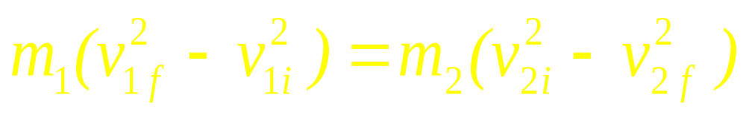
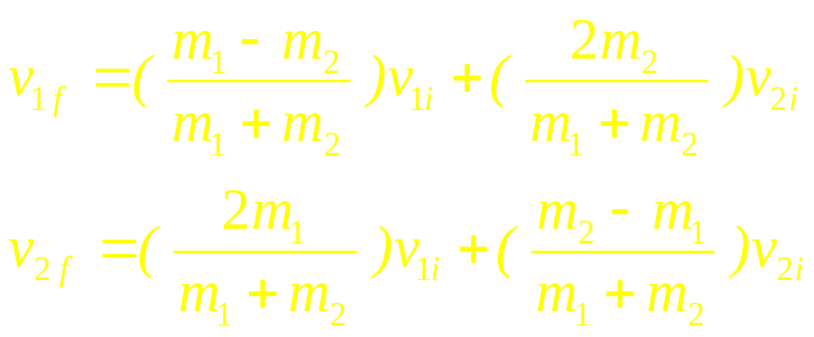
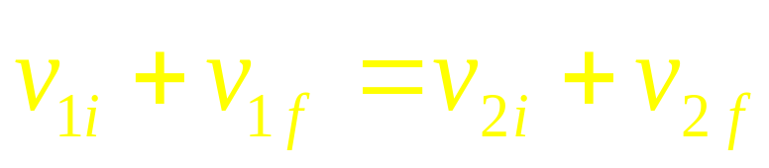
Collision in 1-D
v
v
v
v
For elastic collision

Slide 14
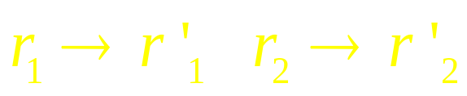
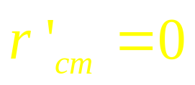
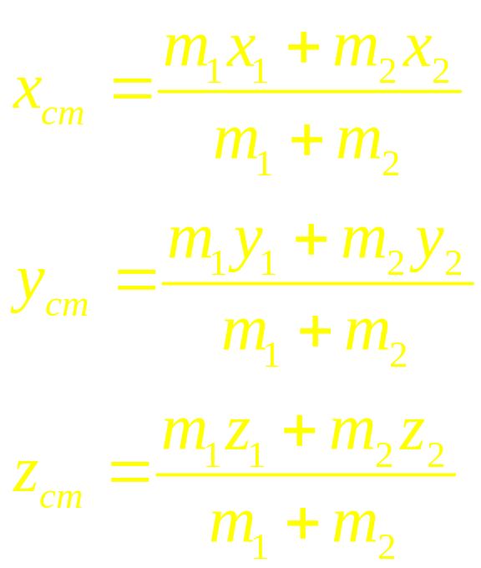
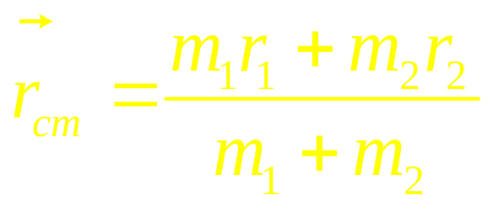
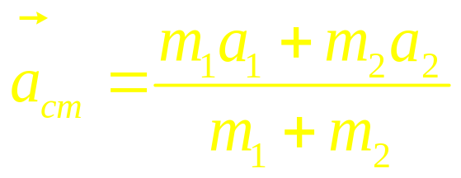
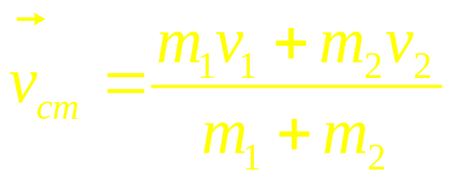
Two-particle systems
cm frame
The center-of-mass reference frame
m₁
m₂
C
r_{cm}
r₁
r₂
The center of mass
lab frame
The laboratory reference frame

Slide 15
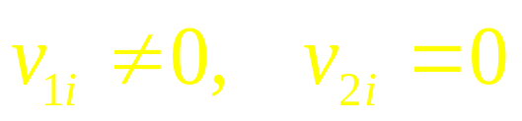
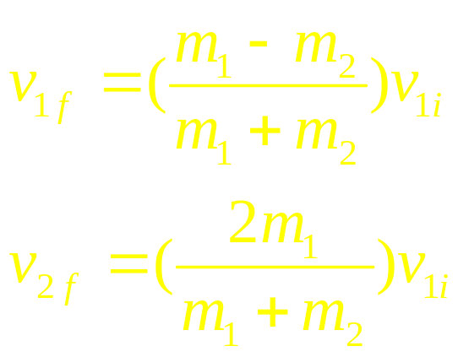
lab frame
m₁
m₂
v₁
v_{cm}

Slide 16
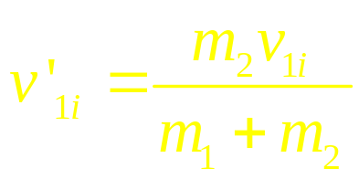
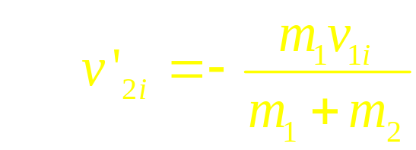
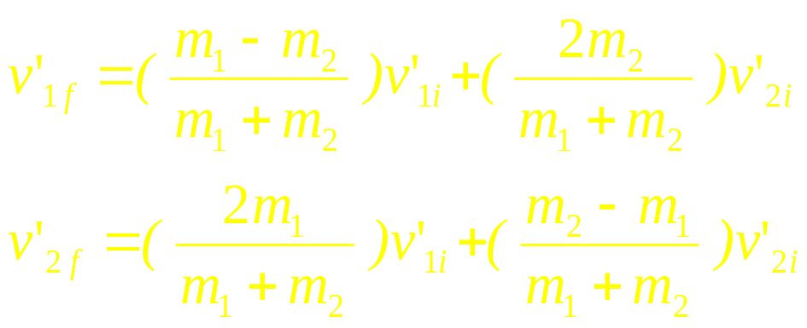
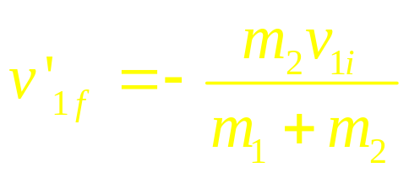
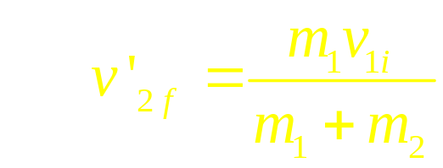
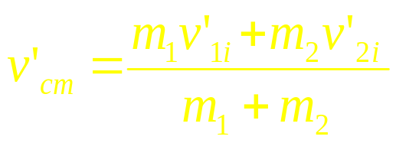
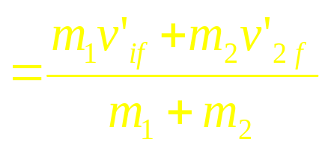

m₁
m₂
CM Frame
v₁

Slide 17
lab frame
cm frame
v_{cm}

Slide 18
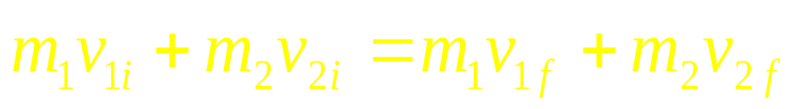
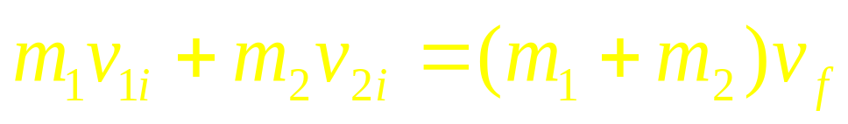
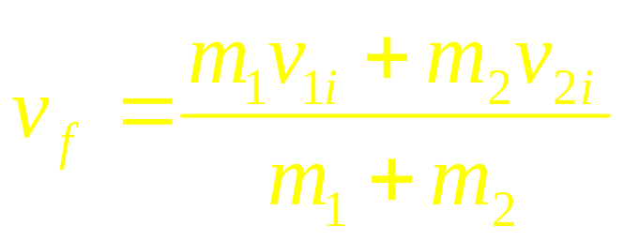
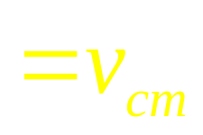
For completely inelastic collision
m₂
m₁
v_{1i}
m₁ + m₂
v_{f}

Slide 19




lab frame
cm frame
v_{cm}
v’_{cm}

Slide 20











Example
r
m₁ =1
m₂ =2
m₁ =1
m₂ =2

Slide 21






Example
For elastic collision
m₁ =1
m₁ =1
m₂ =2
m₂ =2
CM Frame
m₁ =1
m₂ =2
Move in one line

Slide 22







The center of mass
m₂
m₁
One Particle
Two Particles
C
r₁
r₂
CM frame
Lab frame

Slide 23
Question:
A wall moves with v in the x direction and
A ball moves with -v. What is the velocity of the ball after it
collided the wall. The wall mass is mush larger than the ball.
Which one is correct?
(a) v , (b) 2v , (c) 3v , (d) 4v

Slide 24
CHAP. 6
Problems
10, 14, 16, 17, 19 (P136)

