Slide 1
Chapter 7
Systems of Particles

Slide 2
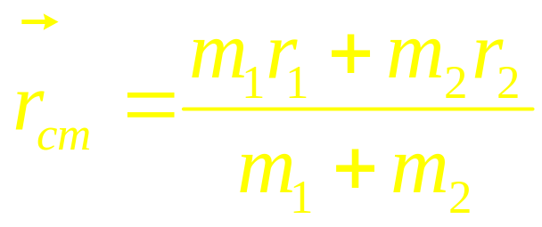
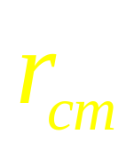
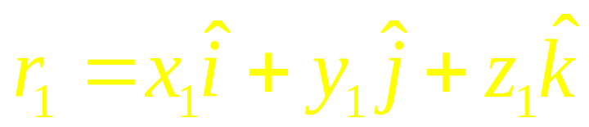
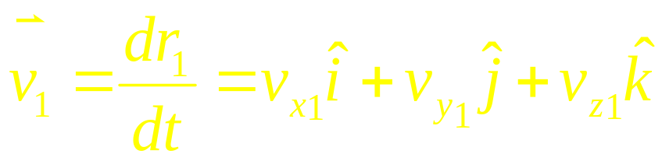
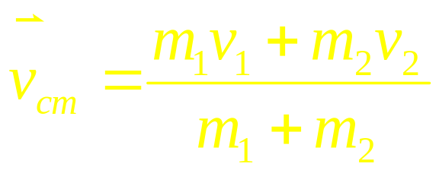
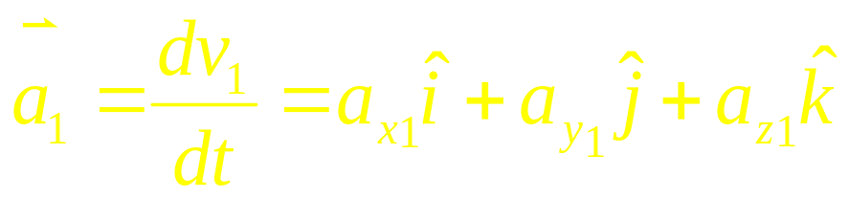
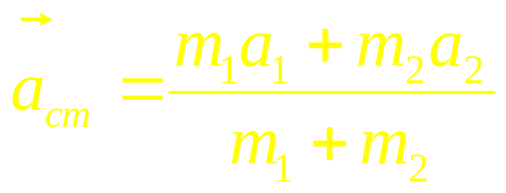
The center of mass
m₂
m₁
One Particle
Two Particles
C
r₁
r₂
CM frame
Lab frame

Slide 3
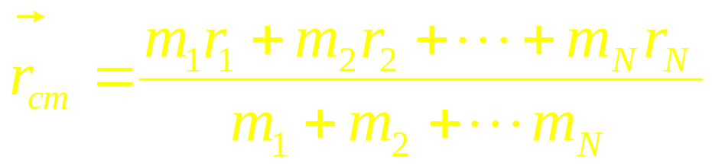
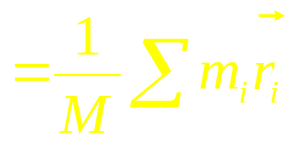
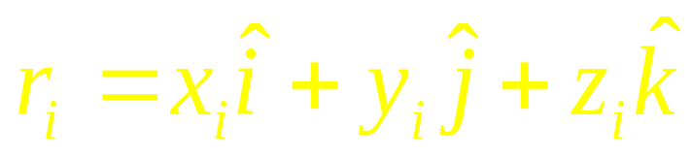
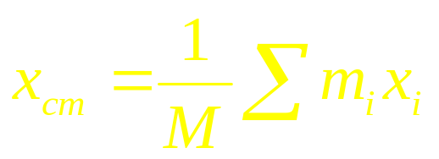
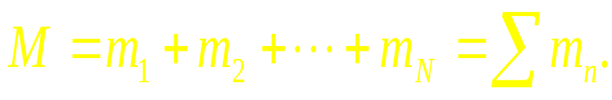
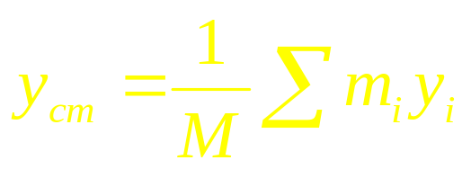
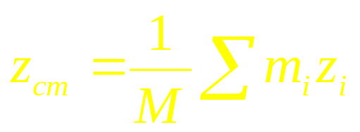
Many particle system
The center of mass
Many particles

Slide 4
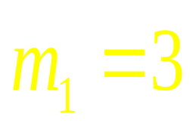

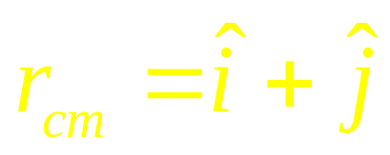
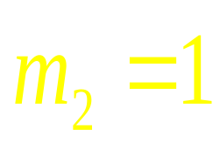

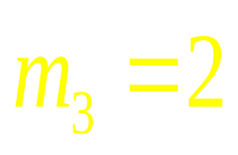
Example
(1,1)
Where is the center of mass?

Slide 5
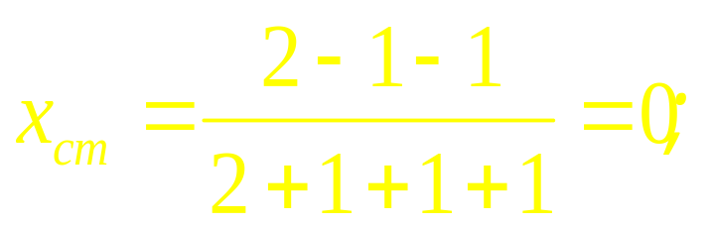
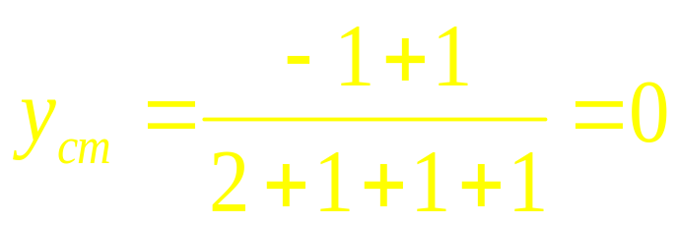
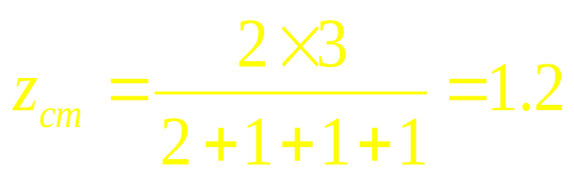
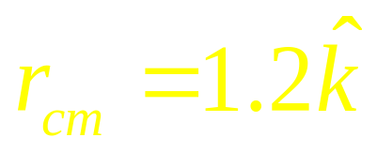
Example
(0,0,3)
(0,0,1.2)
(-1,1,0)
(-1,-1,0)
(2,0,0)
Where is the center of mass?

Slide 6
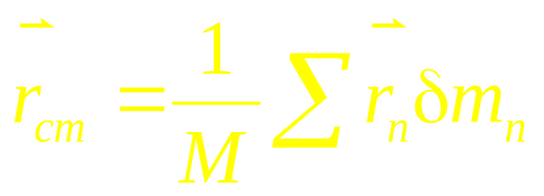

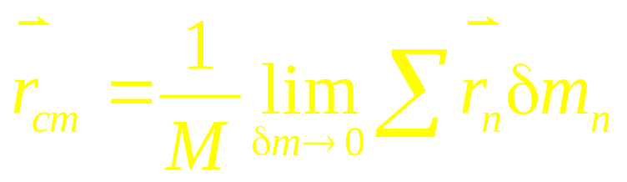
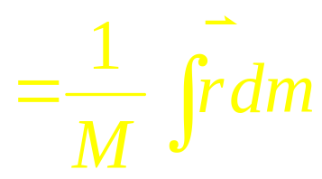
A solid body
(Many particles)
Center of mass of solid objects
δm

Slide 7


dm?
solid body
is mass density of volume
plane
dm=σdS, σ is mass density of plane
line
dm=λdl, λ is mass density of line

Slide 8
Example
Where is the center of mass?

Slide 9
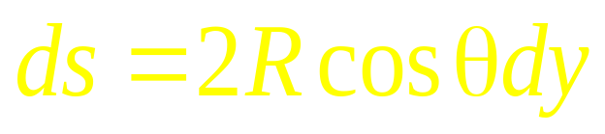
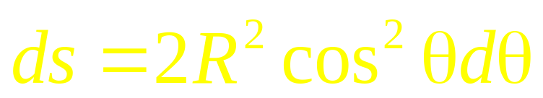
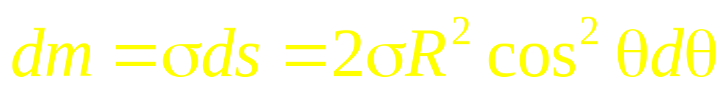

Slide 10
Center of mass of solid objects
+
+
+
+

Slide 11
Center of mass of solid objects

Slide 12
Center of mass of solid objects
Why?
If a irregular objects can be divided into several parts
We can find the center of mass of each part ,
+ c
Treating each part as a particle located at its own center of mass
We can find the center of mass of the combination.

Slide 13
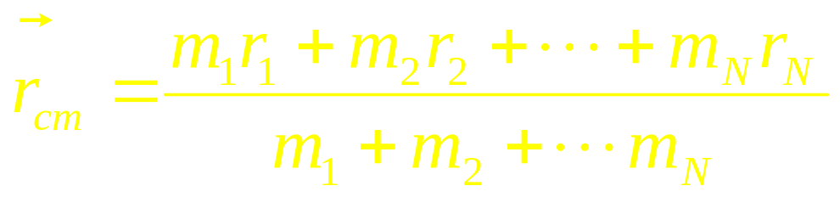
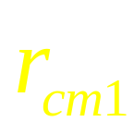
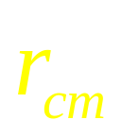
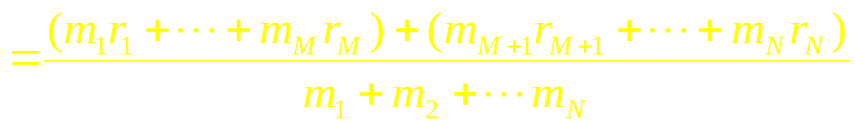
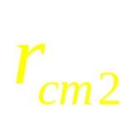
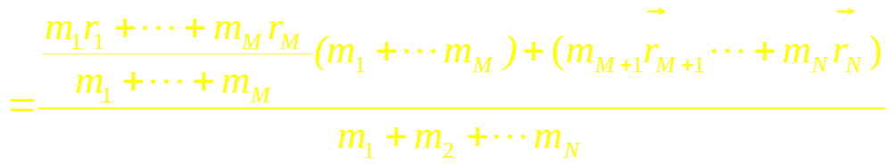
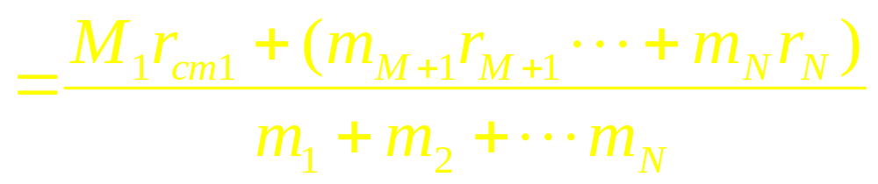
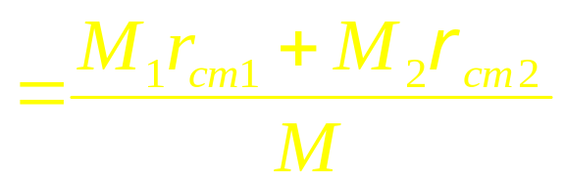

Slide 14
+
+
+

Slide 15
Ball
+
+
+

Slide 16
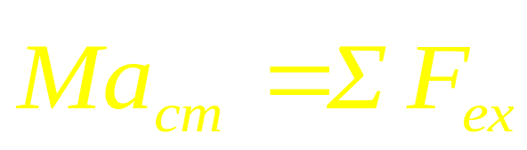
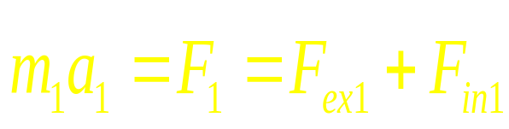
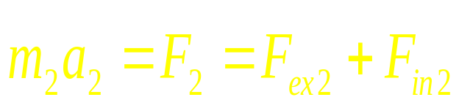
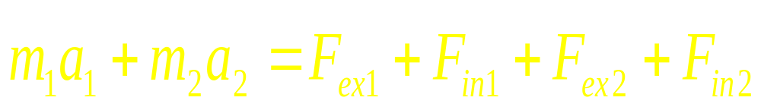
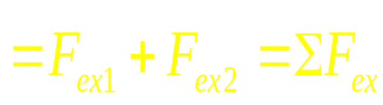
Two-particle systems
F_{ex1}
F_{ex2}
m₁
m₂
F_{in1} F_{in2}
r₁
r₂

Slide 17
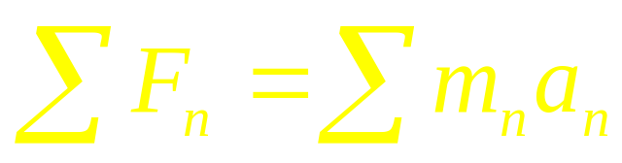
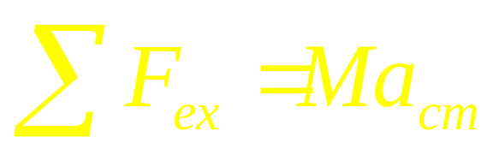
Many particles

Slide 18
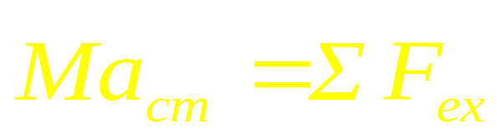
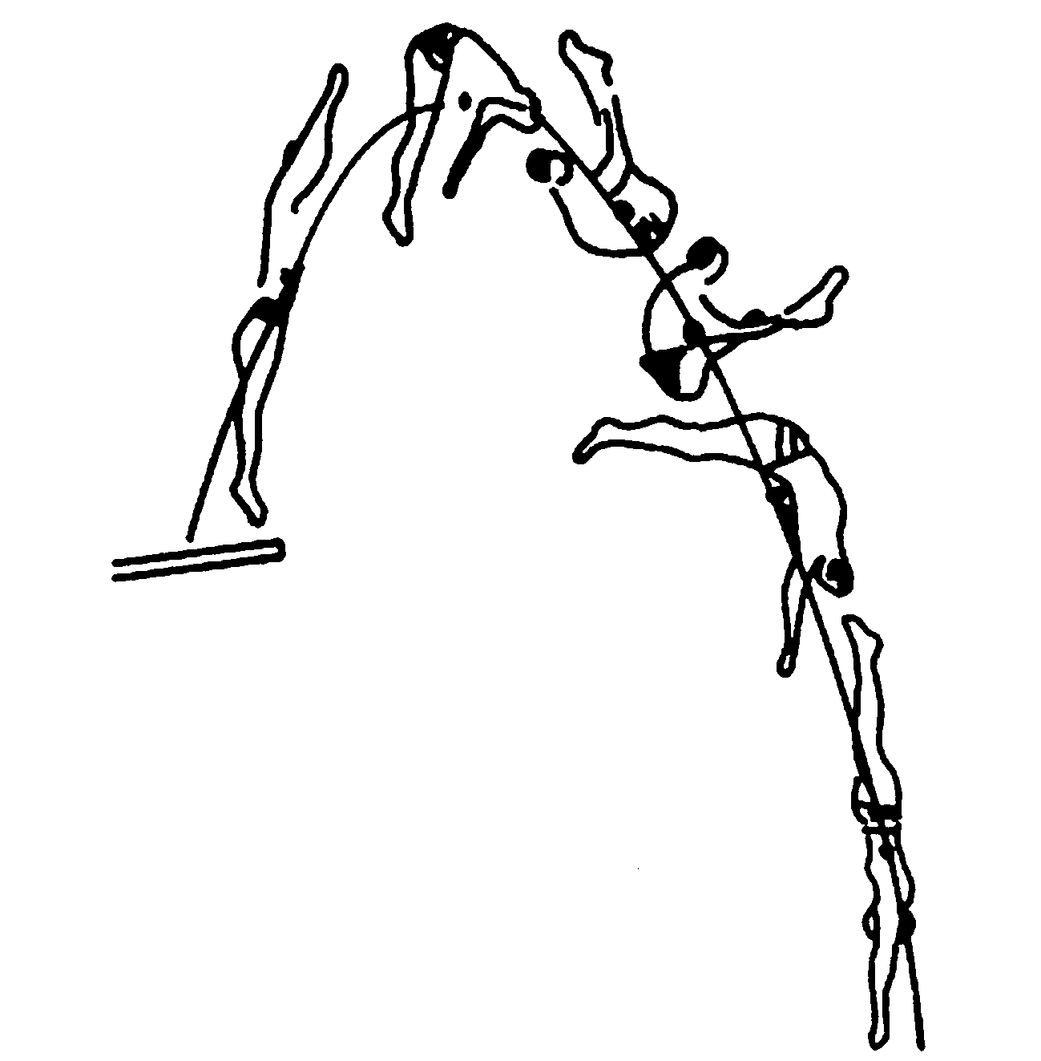
Motion of solid body
The motion of mass center
The motion about mass center

Slide 19
Example
m
m
v_{cm}

Slide 20
Example
m
m
v_{cm}

Slide 21
Example
m
m
v_{cm}

Slide 22
Example
m
m
v_{cm}

Slide 23
Example
m
m
v_{cm}

Slide 24
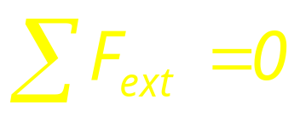
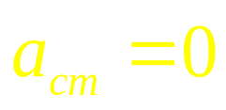
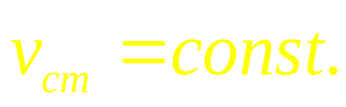
Example
m
m
v_{cm}
The motion of mass center
The motion about mass center

Slide 25
cm Frame
m
m

Slide 26
cm Frame
m
c
m

Slide 27
cm Frame
m
c
m

Slide 28
cm Frame
m
c
m

Slide 29
cm Frame
m
c
m

Slide 30
cm Frame
c
The motion about mass center

Slide 31
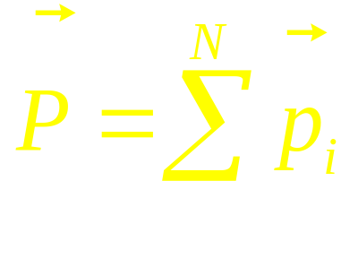
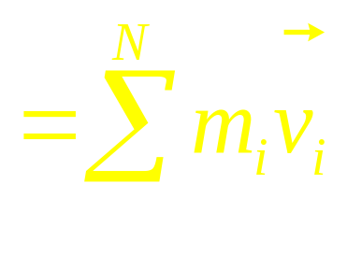



Conservation of momentum in a system of particles
If ΣF_{ext}=0, the total linear momentum P of the system remains unchanged. This is the law of conservation of momentum in a system of particles. It can be written as three components formula.

Slide 32










Lab Frame
cm Frame
In the cm frame the total momentum is zero
C
The cm frame called zero momentum reference frame.
m_{i}

Slide 33







Systems of variable mass
u
v
v+dv
dM
M
M+dM
time t
time t+dt

Slide 34








Systems of variable mass
If we neglect gravity

Slide 35


To raise the velocity of the spaceship, use multistage rocket.

Slide 36


To raise the velocity of the spaceship, use multistage rocket.

Slide 37





To raise the velocity of the spaceship, use multistage rocket.

Slide 38






Sands drop from a stationary hopper at a rate of 0.134 kg/s onto a conveyor belt moving with a speed of 0.96m/s. What net force must be applied to the belt in order to keep it moving at a constant speed?
v

Slide 39








Example 1:
The fuel burning rate of a rocket is α=1.29x10³kg/s.
The weight of the rocket is M_{i}=2.72x10⁶kg. (1) How large speed of the
ejected gas is needed for the rocket taking off? If the ejected gas
with a constant speed u=5.5x10⁴m/s lasts T=155s, (2) how large
speed of the rocket can reach? and (3) how is the rocket away
from the Earth?
Answer:

Slide 40
CHAP 7
Exercises
P155:11, 13, 14, 17, 18
Problems
P157:3,10

