Slide 1
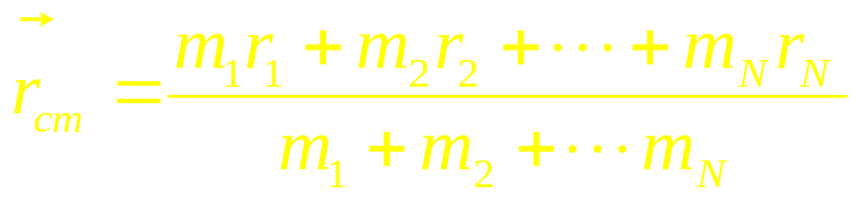
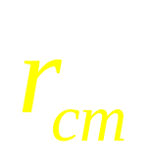
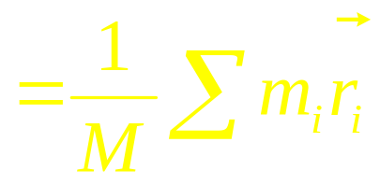
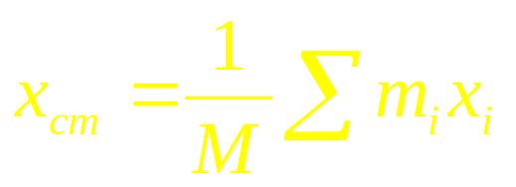
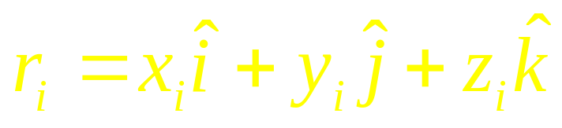
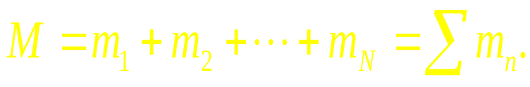
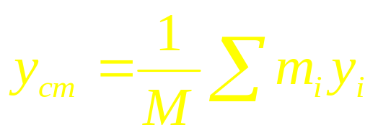
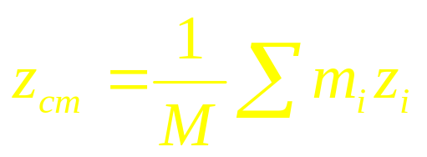
The center of mass
Many particles

Slide 2
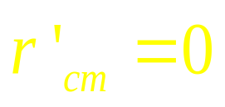
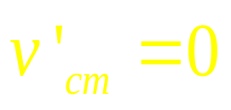
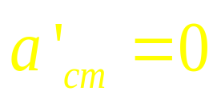


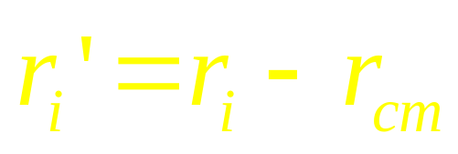
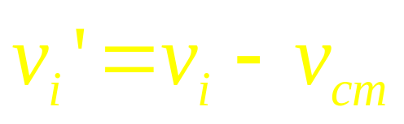
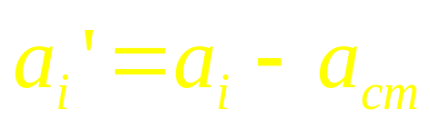
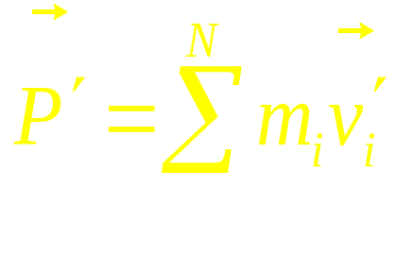
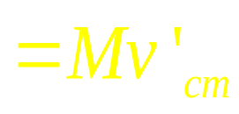
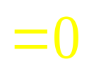
Lab Frame
cm Frame
In the cm frame the total momentum is zero
C
The cm frame called zero momentum reference frame.
m_{i}

Slide 3
Many particles
One particle
Particle system

Slide 4
Motion of solid body
The motion of mass center
The motion about mass center
How can we study the motion about mass center?
Rotational motion

Slide 5
Chapter 8
Rotational Kinematics

Slide 6
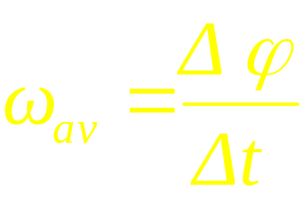
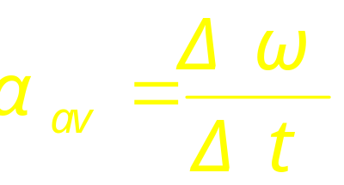
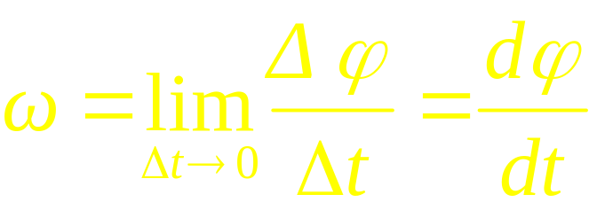
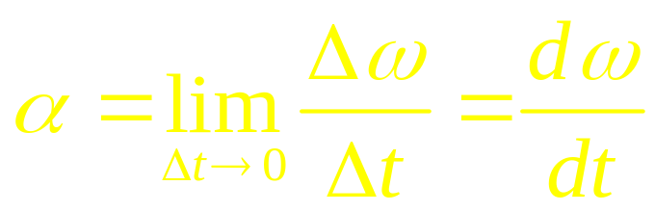
Rotational motion
ω
Linear motion
Rotational motion
ΔS
Δφ
v
ω
p”
p’
p
a
α
average angular acceleration
average angular velocity
Direction and magnitude of the velocity is different
The rotational motion is the same for p and p’, p”
instantaneous angular acceleration
instantaneous angular velocity

Slide 7

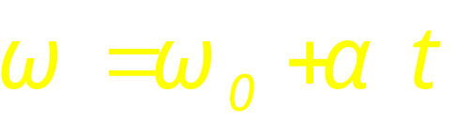
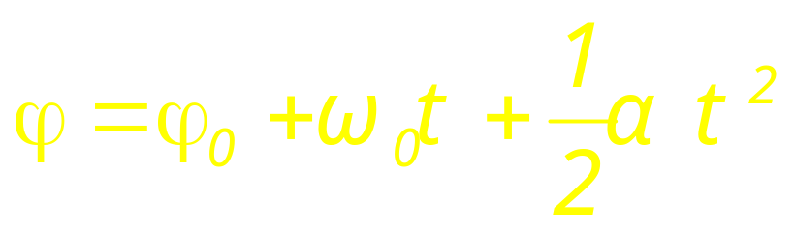
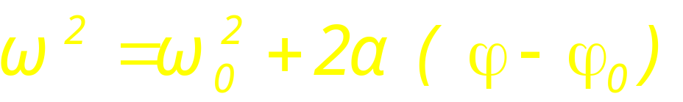
Linear motion
Rotational motion
Rotation with constant angular acceleration

Slide 8

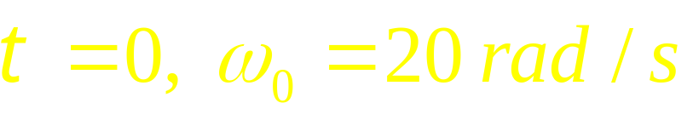


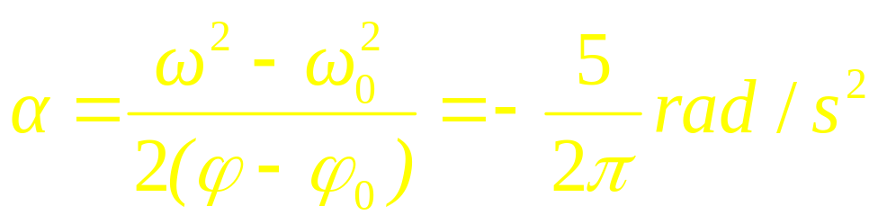
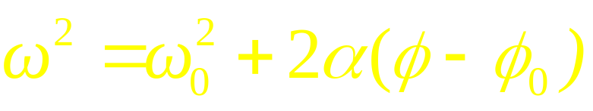
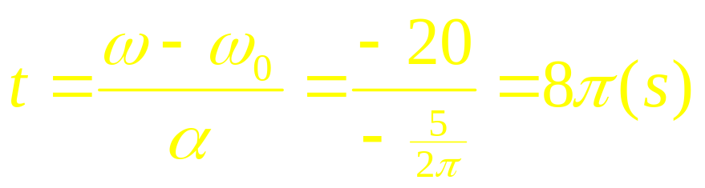
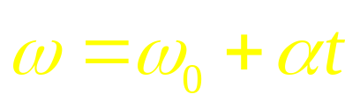
Example

Slide 9
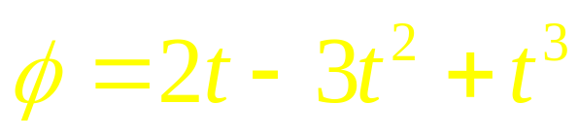
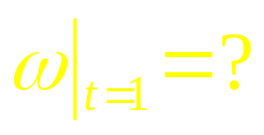
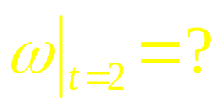
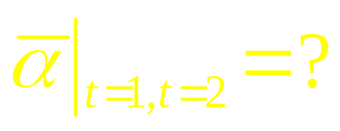
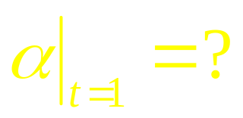
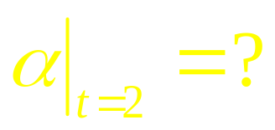
Example

Slide 10
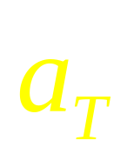







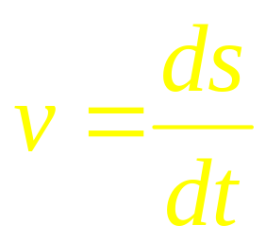
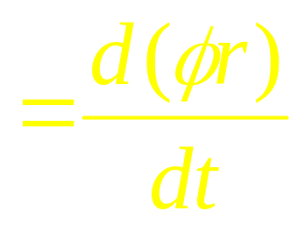
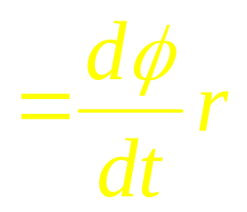



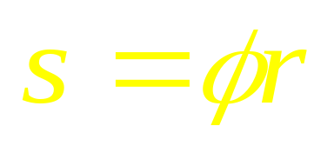
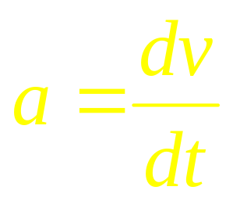
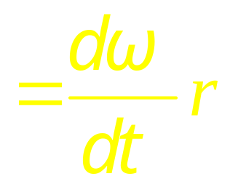

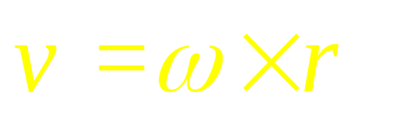
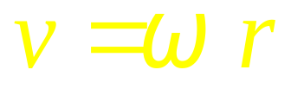
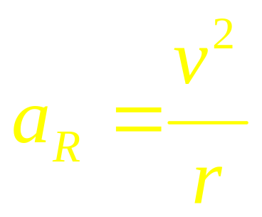
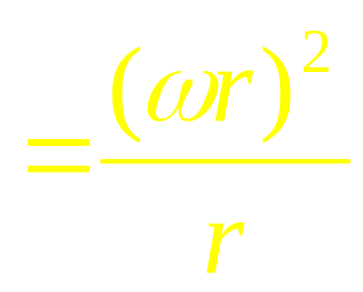
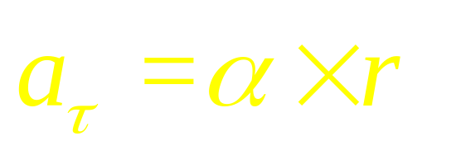
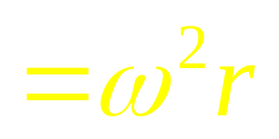

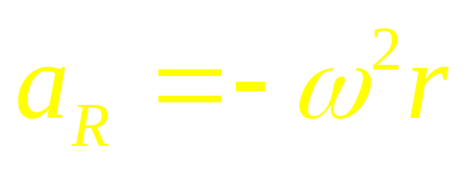
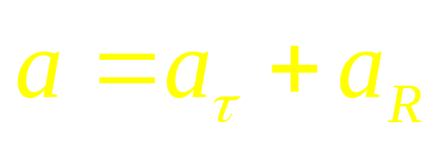
Relationships between linear and angular variables
Linear motion
S
Rotational motion
φ

Slide 11









Rotational quantities as vectors
v, a_{t}
Angular displacement
a_{R}
r
Angular velocity
Angular acceleration

Slide 12


In plane polar coordinates
j
φ
i

Slide 13






Slide 14
Rotational quantities as vectors
ΔΦ₁
ΔΦ₂
ΔΦ₂
ΔΦ₁
ΔΦ₁+ΔΦ₂≠ ΔΦ₂+ΔΦ₁
ΔΦ is not a vector

Slide 15
Rotational quantities as vectors
ΔΦ→ δΦ,
δΦ₁+δΦ₂=δΦ₂+δΦ₁
δΦ is a vector

Slide 16



Example

Slide 17


Example

Slide 18

Force and Motion
The force is an interaction between
a body and its environment.
The force acting on a body
will accelerate it
How about the Force and Rotation

Slide 19
CHAP 8
Exercises
P171: 3,30,32
Problems
P173: 6, 7

