Slide 1
Chapter 12
Potential Energy

Slide 2
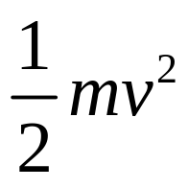
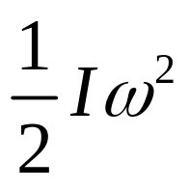
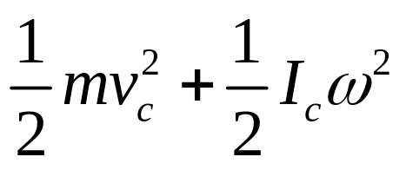
The Energy in the World
Thermal Energy
Electrical Energy
Atomic Energy
Chemical Energy
Mechanical Energy
Kinetic Energy
Potential Energy
Conservative forces

Slide 3
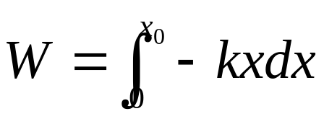
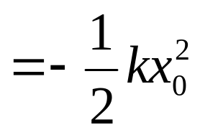
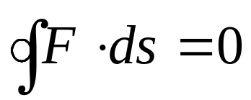
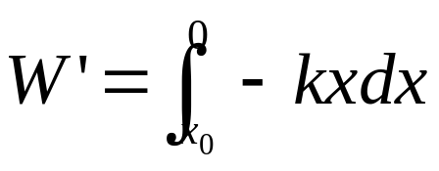
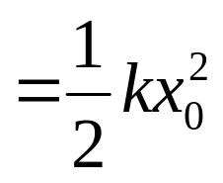
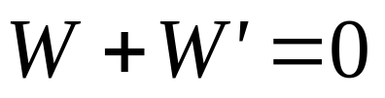



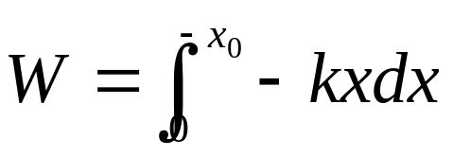
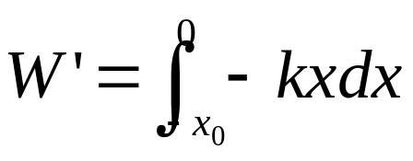
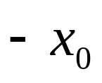
Conservative forces
zero total work during any round trip

Slide 4
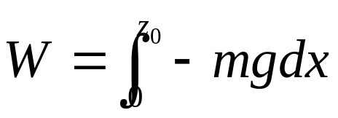
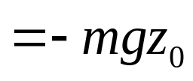


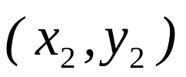
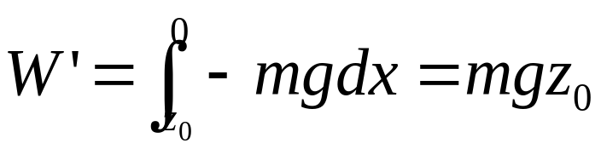
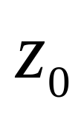
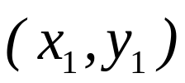
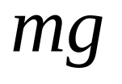

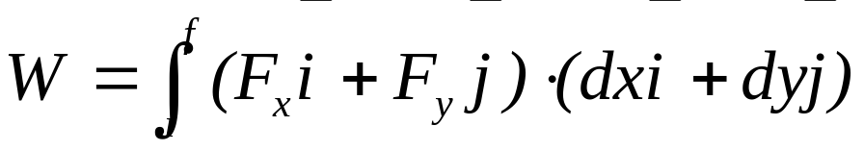
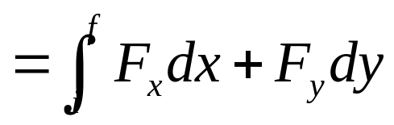
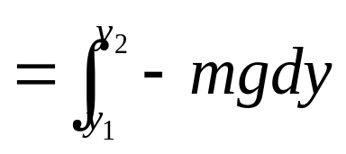
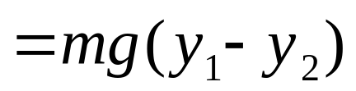
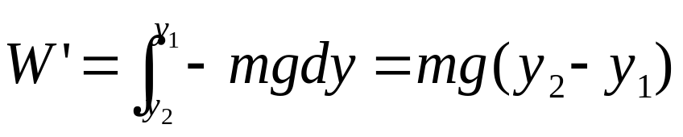
zero total work during any round trip
zero total work during any round trip

Slide 5

If a body moves under a force that does no total work during any round trip.
conservative force
The spring force, gravity and universal gravitation are three examples of conservative force.
zero total work during any round trip

Slide 6
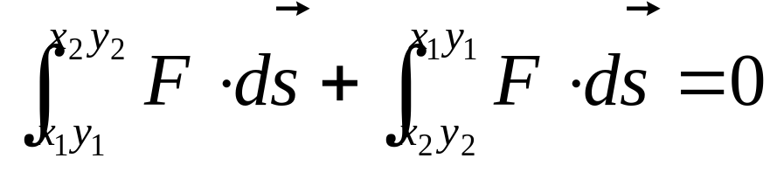
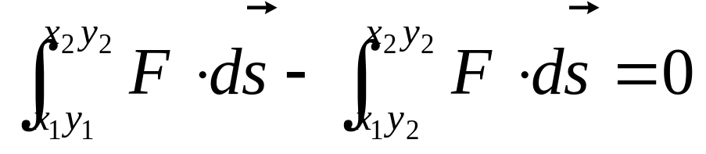
If a body moves under a force that does no total work during any round trip.
conservative force
The spring force, gravity and universal gravitation are three examples of conservative force.

Slide 7
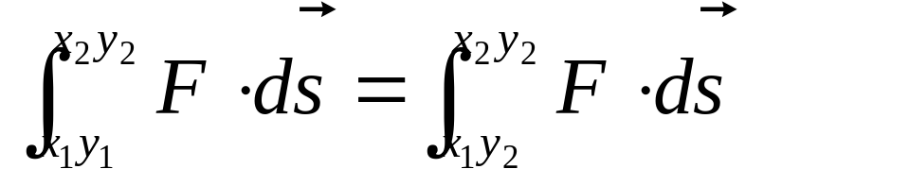
If a body moves under a force that does no total work during any round trip.
conservative force
If the work done by a force is independent of the path. This force is a conservative force
The spring force, gravity and universal gravitation are three examples of conservative force.

Slide 8
The spring energy, gravity and universal gravitation energy.
Potential
Energy
Energy
Work
done by conservative force
independent of the path
dependent on the position

Slide 9
Because the work done by the conservative force is independent of the path taken between the two point, we can introduce a new concept,
potential energy
represented by the symbol U.
We define the change in potential energy associated with a conservative force as:
- ΔU=U_{i} -U_{f}= W
ΔU=U_{i} -U_{f}= - W

Slide 10
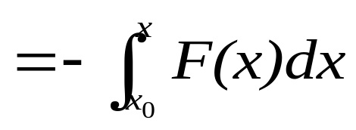
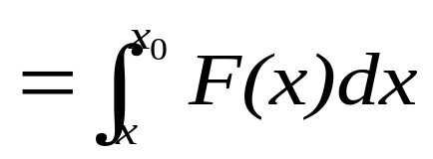
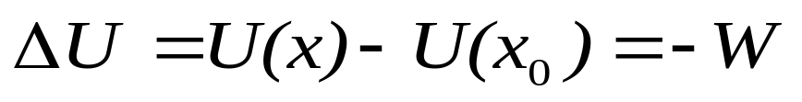
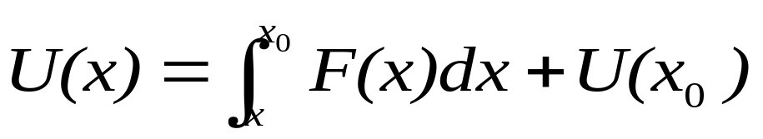
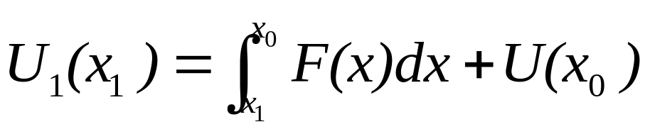
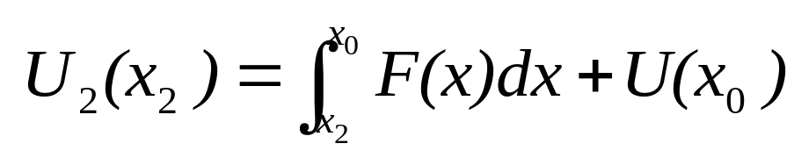
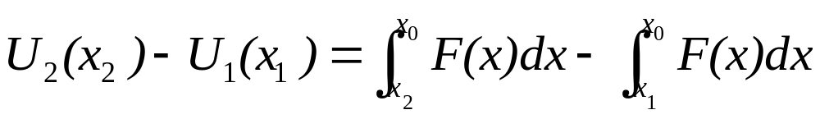
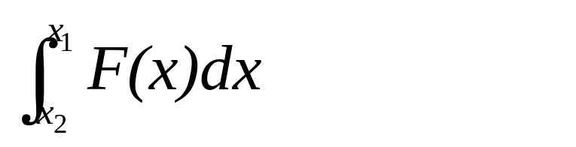
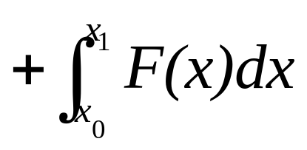
For one dimensional motion, a conservative force F(x) acts on a particle that moves from the initial coordinate x₀ to the final coordinate x.
Here U(x₀) is the potential energy of an arbitrary reference point. It can be free to choose any convenient value because it can not change the difference of the potential energy for two locations.

Slide 11
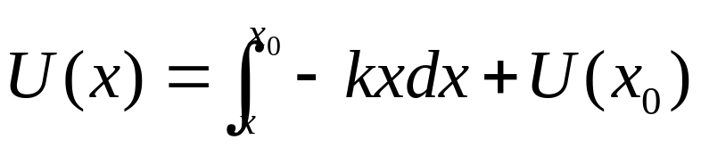
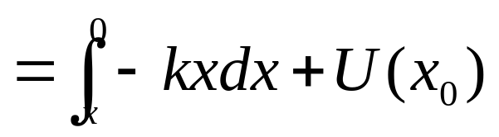
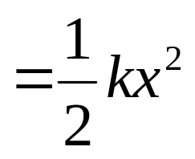
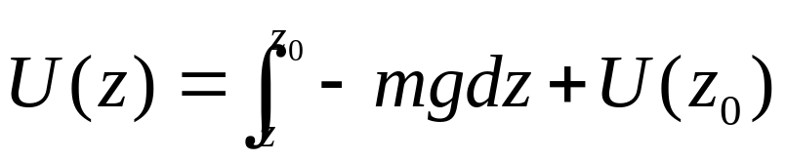
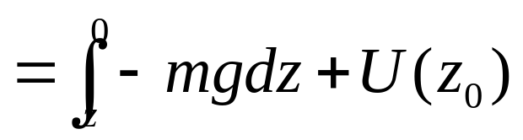

The spring force : F(x)= -kx
If we choose the reference position x₀ of the block in the spring being its relaxed state (x₀ =0), then U(x₀)=0.
The force of gravity: F(z)=-mg
If we choose the reference point y₀ at the surface of the earth and z₀ =0, then we have U(z₀)=0.

Slide 12
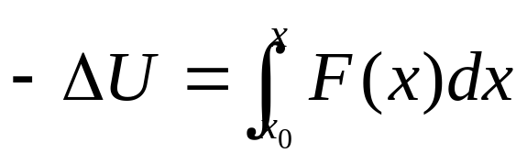
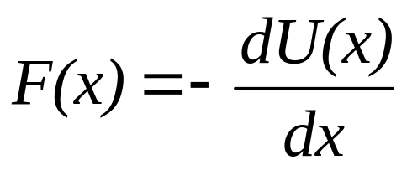
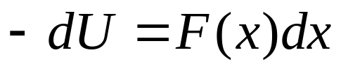
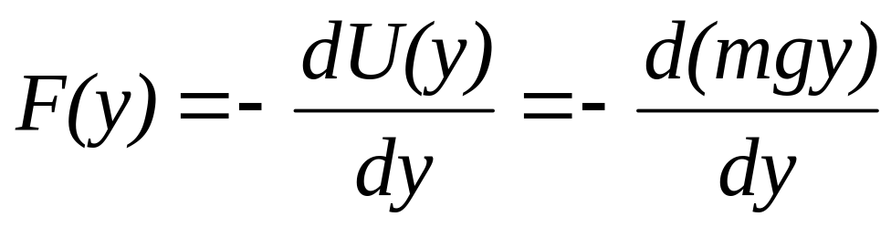

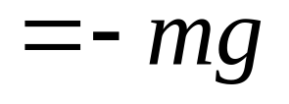
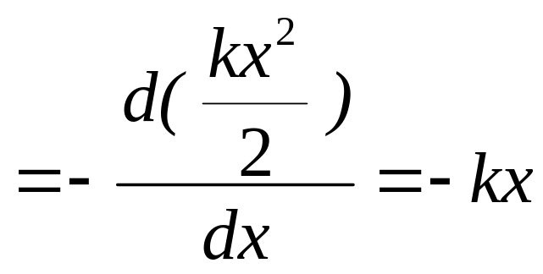

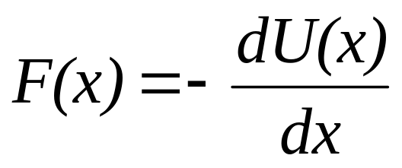
The relation between force and potential energy:
conservative force
potential energy

Slide 13
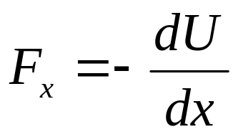
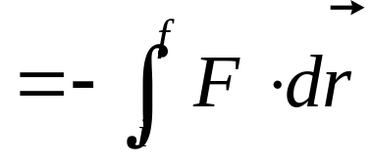







Three-dimensional conservative system
A particle moves along a path from i to f. A conservative force F acts on the particle.
F is the negative gradient of the potential energy U(x,y,z).
conservative force
potential energy

Slide 14



Example:

Slide 15
Conservation of mechanical energy
Consider an isolated system: The internal forces are conservational forces
W= -ΔU
W=Δ K
ΔK= - ΔU
Δ(K+U)=0
K+U=E=constant
E is called mechanical energy of the conservative system.

Slide 16







In moving from x₀ to x, the velocity of a particle it is acted on a conservative force will change from v₀ to v.
Conservation of mechanical energy

Slide 17









One-dimensional conservation systems:
Force =0
equilibrium points
Unstable equilibrium
Neutral equilibrium
Stable equilibrium

Slide 18














Example:
Find v of the rolling cylinder when the center of mass move down from height h at the rest.
N
f
mg
θ

Slide 19










Example:
Find v of the rolling cylinder when the center of mass move down from height h at the rest.
shell
ball
N
f
mg
θ

Slide 20



A solid ball with mass m and radius r
Example
r<<R
Rolling without slipping

Slide 21


















Example

Slide 22






Example

Slide 23







Example

Slide 24



















Example
ω₀
Rolling without slipping
a = ?

Slide 25











Example
ω₀
Rolling without slipping
a = ?

Slide 26
m, L

Slide 27











m, L

Slide 28
















Example: The potential energy function for the force between two atoms in a diatomic molecule can be expressed approximately as follows:
Find (1) the force between the atoms. (2) the equilibrium separation between the atoms. (3) the minimum energy necessary to break the molecule apart.
x

Slide 29
CHAP.12
Exercises
P272:7, 9, 15

