Slide 1
Chapter 13
Conservation
of energy

Slide 2
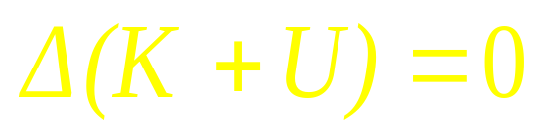
The Energy in the World
Thermal Energy
Electrical Energy
Atomic Energy
Chemical Energy
Mechanical Energy
Kinetic Energy
Potential Energy
No work done on a system by external forces
The internal force is conservation force

Slide 3

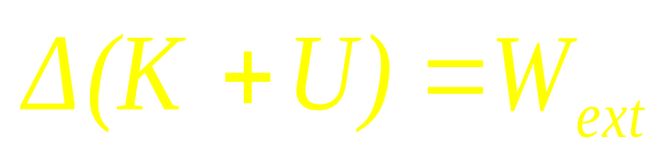
Work done on a system by external forces
The internal force is conservation force
System?
System K, U

Slide 8

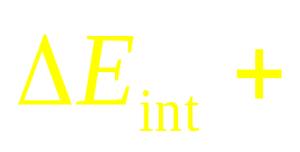
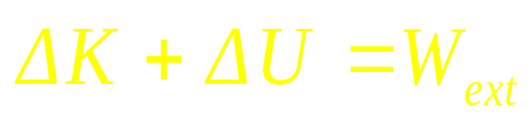
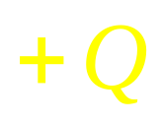
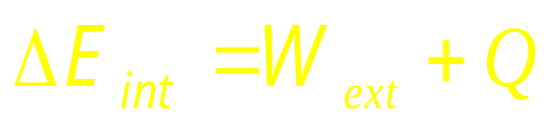
Work done on a system by external forces
The internal force is conservation force
The internal force is not conservation force
System K, U
Mechanical Energy
The first law of thermodynamics

Slide 9
Work done on a system by external forces
The internal force is not conservation force
System K, U
Mechanical Energy

Slide 10
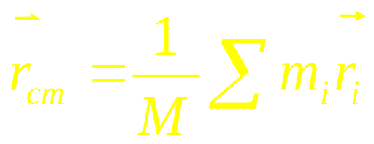
The center of mass
System K, U
The momentum of system
The force on system
The energy on system?

Slide 11
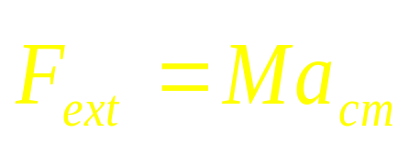
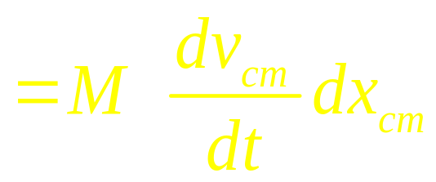
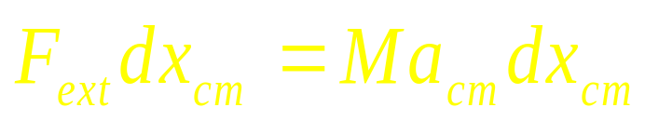
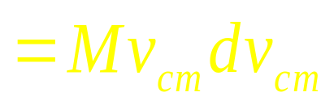
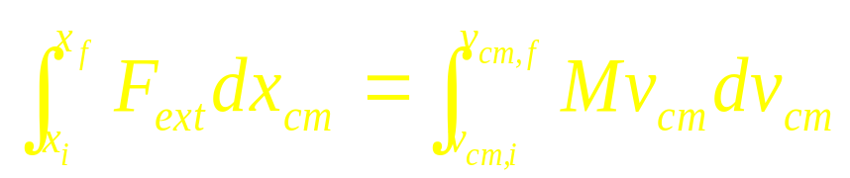
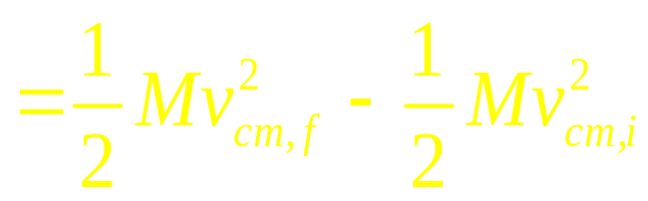
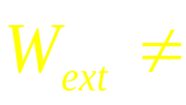
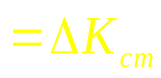
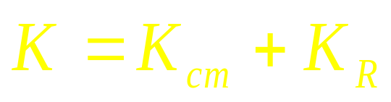
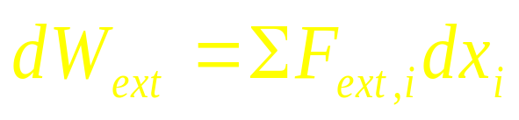
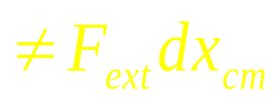
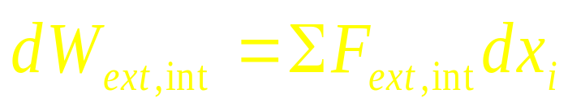
The energy on system
Center-of-mass energy
The center-of-mass energy equation (COM)

Slide 12


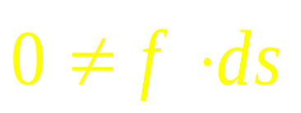

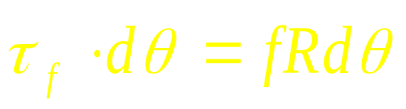
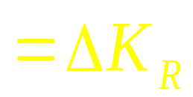

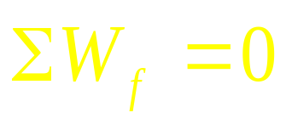

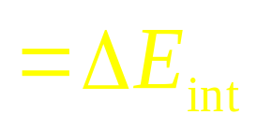
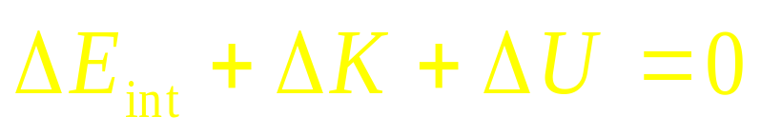


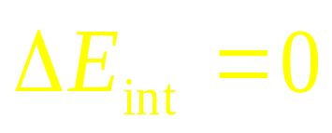
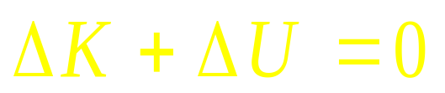

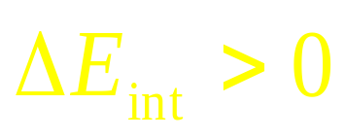
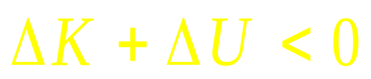
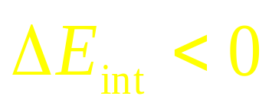
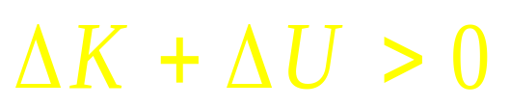
Work from friction force
Internal force
Rotation without slipping
Rotation with slipping

Slide 13
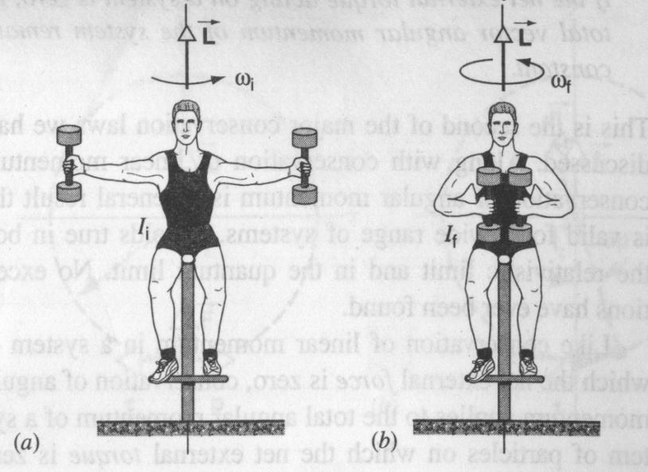
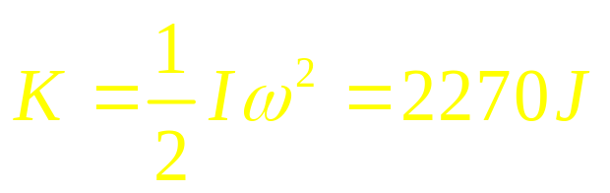
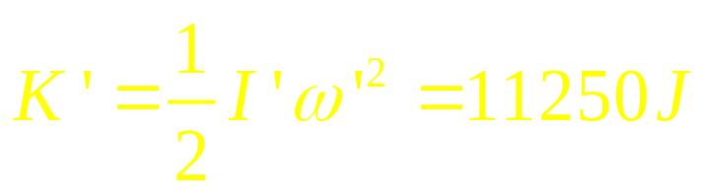

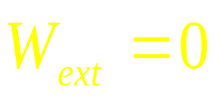
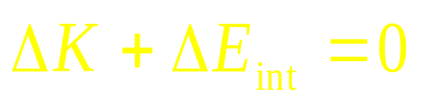
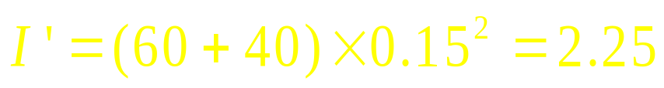
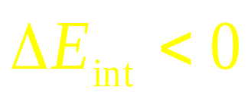



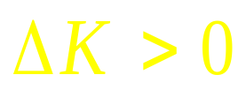

Slide 14
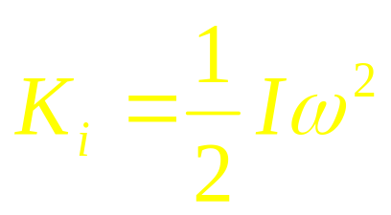
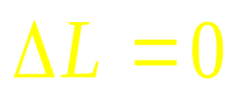
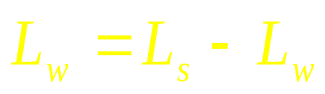
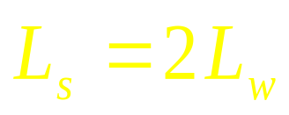
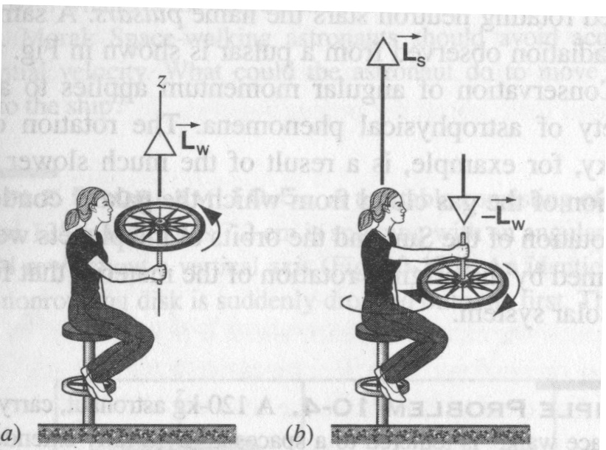
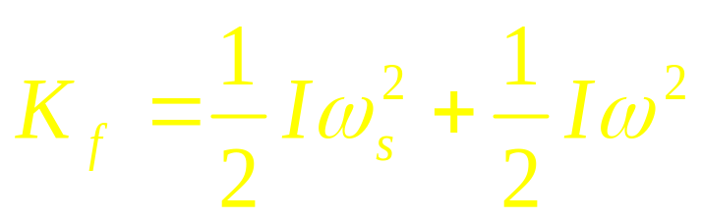

Slide 15
A block with mass m and initial speed v, its speed gradually decreases to zero when it travel a distance d
Example
v
d
30°
Find (1) ΔE_{int} for the system of block + table+Earth due to friction. (2) If the block slide from the rest back down the table, find the speed when the block passes through the initial point.

Slide 16
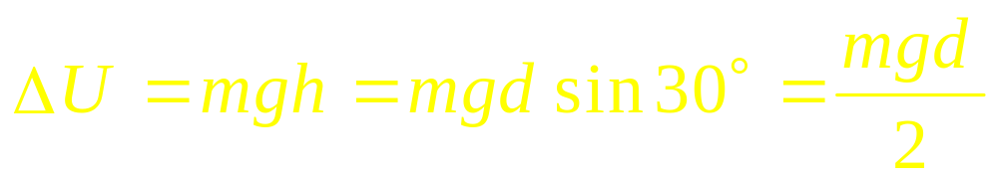
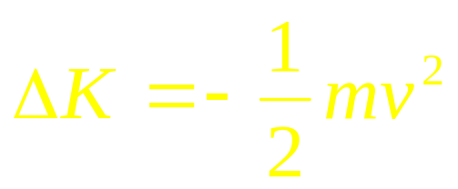
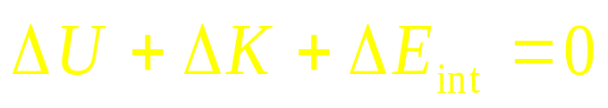
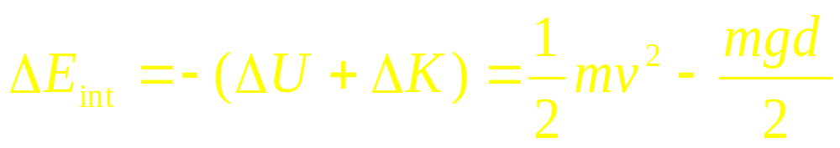
Example
v
d
30°

Slide 17
A cylinder with mass m and initial speed v, it rolls without slipping, its speed gradually decreases to zero when it travel a distance d
Example
v
d
30°
Find (1) ΔE_{int} for the system of cylinder + table+Earth due to friction. (2) If cylinder rolls from the rest back down the table, find the speed when it passes through the initial point.

Slide 18
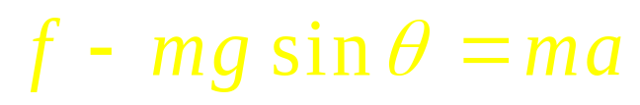












Example
v
f
d
30°

Slide 19







Example
v
f
d
30°

Slide 20





Rolling without slipping

Slide 21
ω₀
Example

Slide 22
ω ω
Example

Slide 23
ω ω
Example

Slide 24
m, l
m, v

Slide 25
m, l
m, v

Slide 26

m, l

Slide 27







During collision
After collision

Slide 28
m, l
m, v_{o}

Slide 29
m, l
m, v_{o}

Slide 30




During collision
m, l
v
After collision

Slide 31
m, l
m, v₀

Slide 32
m, l
m, v₀

Slide 33


Elastic collision
v
After collision

Slide 34
m, l
m, v₀

Slide 35
m, l
m, v₀

Slide 36














For elastic collision:
m, v
C

Slide 37













Slide 38




During collision
inelastic collision
m, l
m, v₀
After collision

Slide 39





Review

Slide 40
CHAP.13
Exercises
P296 : 14, 15, 19
Problems
P297: 1, 2, 5

