Slide 1
The force laws
Environment
Force
Body
Motion
Many Particles
(Particle System)
The motion laws
One Particle
Solid
Fluid

Slide 2
CHAP.15
FLUID STATICS

Slide 3

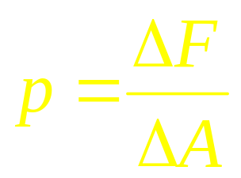
Many particles
matter
Solid
Liquid Gas
F
F
Condensed Matter
Fluid
Pressure
F
F
zwma@zju.edu.cn

Slide 4
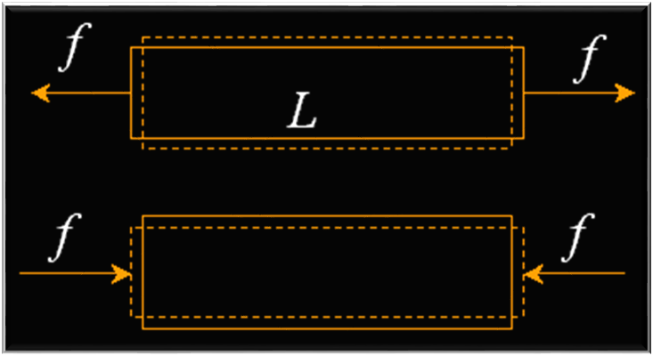
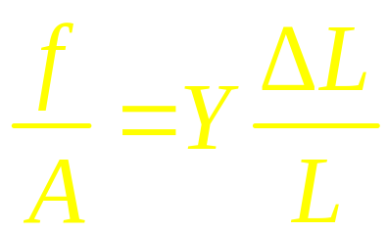
Fluids and Solids
solids: stress and strain (应力和应变）
Y: Young’s modulus
zwma@zju.edu.cn

Slide 5
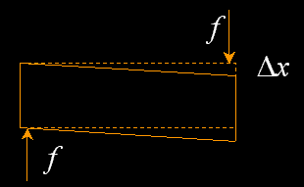
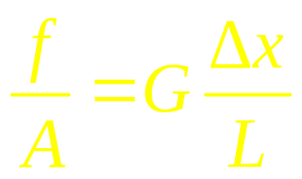
Shearing stress
G: Shear modulus
solid: compression force, tensile force, shearing force
liquid: compression force, tensile force, no shearing force
gas: compression force, no tensile force, no shearing force
zwma@zju.edu.cn

Slide 6
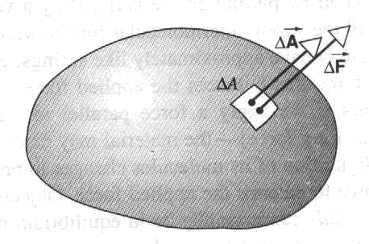
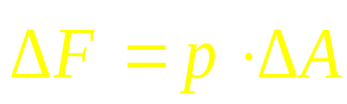
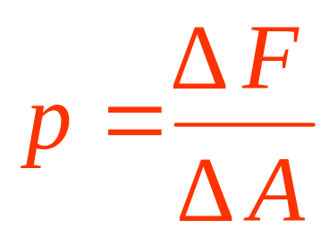
Pressure and Density
Pressure
The unit of pressure: pascal (1Pa= 1N/m²), or atmosphere (atm), bar (1bar=10⁵Pa), mm of Hg.
zwma@zju.edu.cn

Slide 7
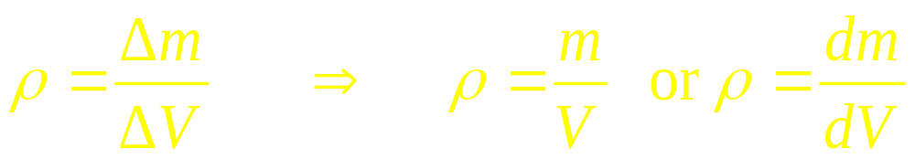
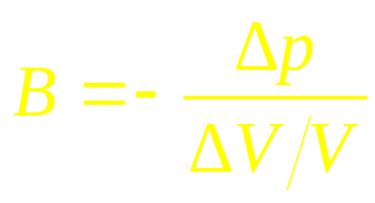
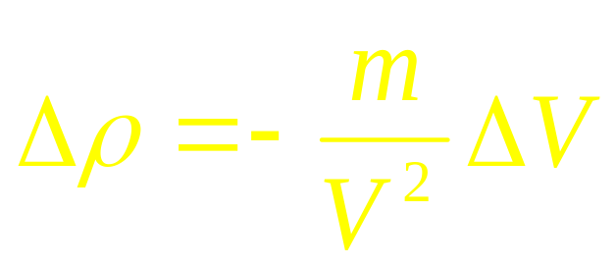
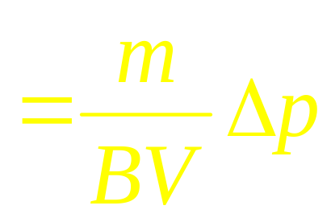
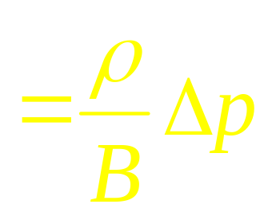
Density:
Hydraulic stress
Bulk modulus:
zwma@zju.edu.cn

Slide 8
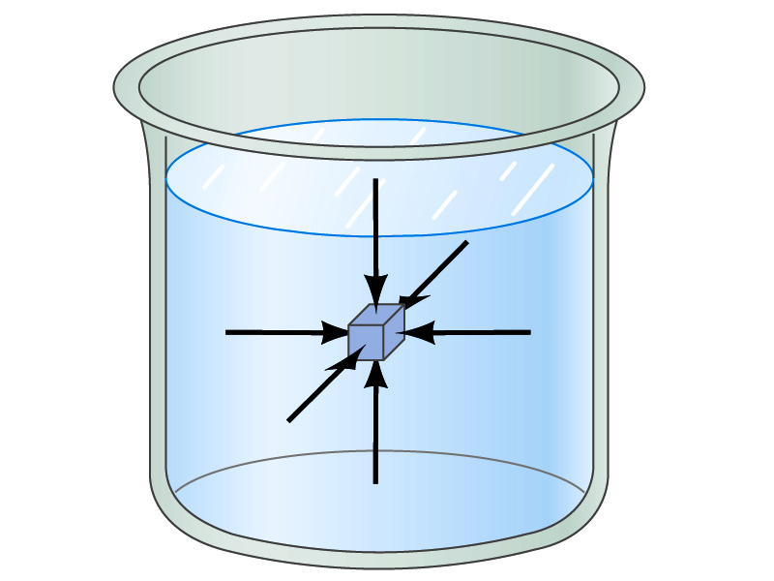
Fluids at Rest
Pressure is the same in every direction in a static fluid at a given depth; if it were not, the fluid would flow.
zwma@zju.edu.cn

Slide 9
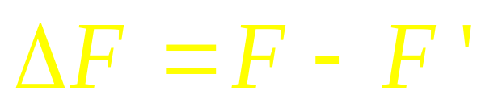
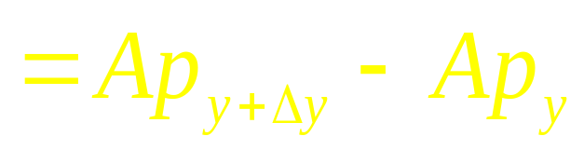
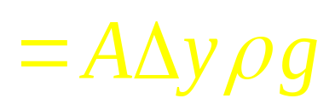
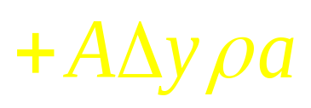

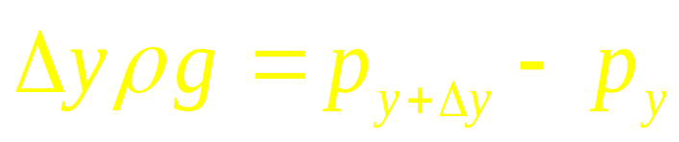
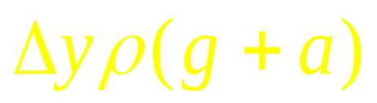
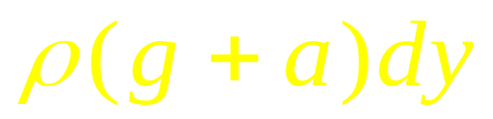
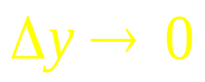
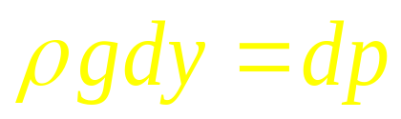
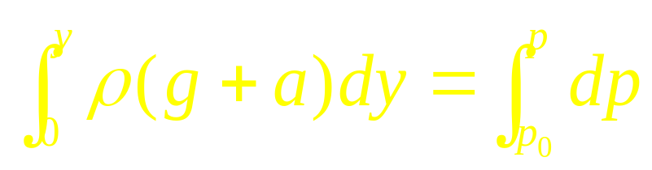

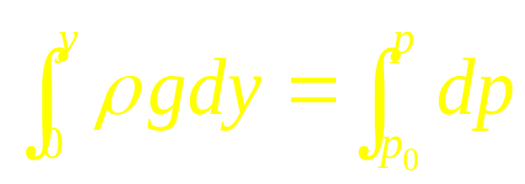
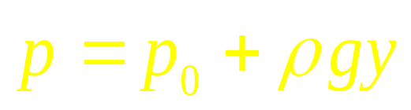
Pressure in the liquid
P_{o}
0
y
F
F’
y+Δy
y
zwma@zju.edu.cn

Slide 10
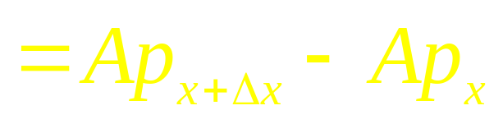
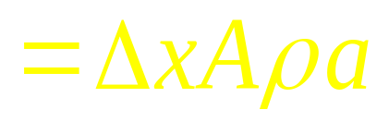
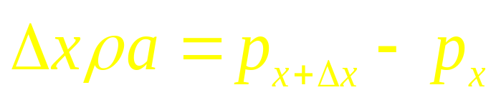


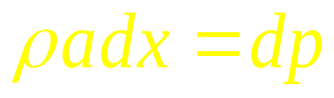
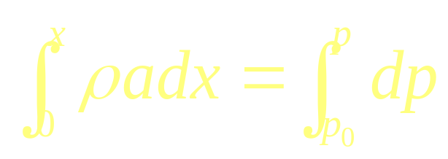
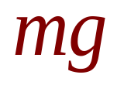
Pressure in the liquid
P_{o}
X
Y
Α
zwma@zju.edu.cn

Slide 11
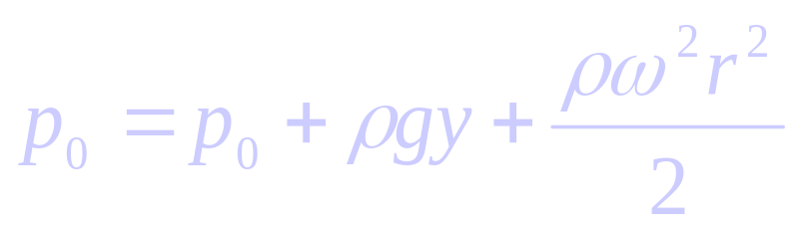
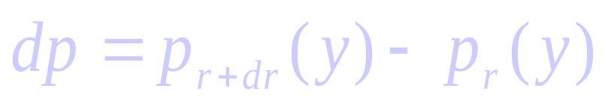

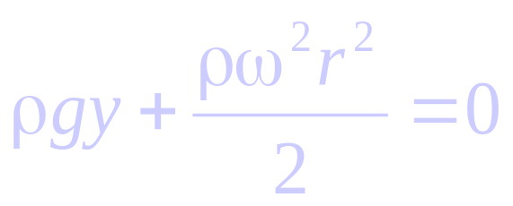
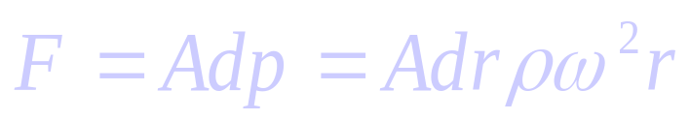

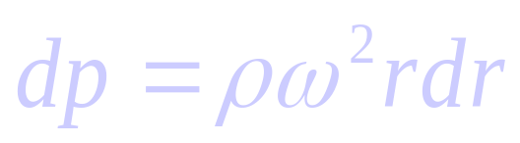
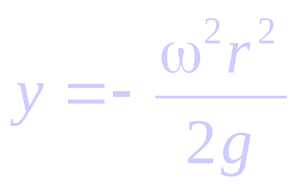
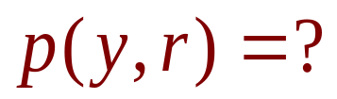
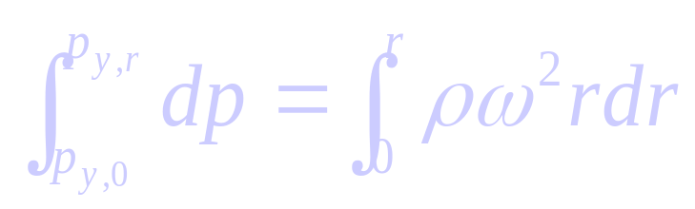
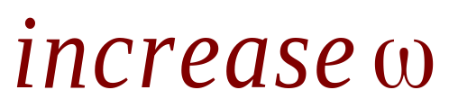
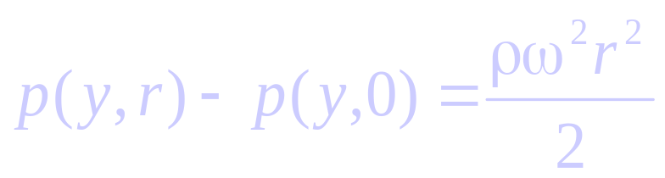
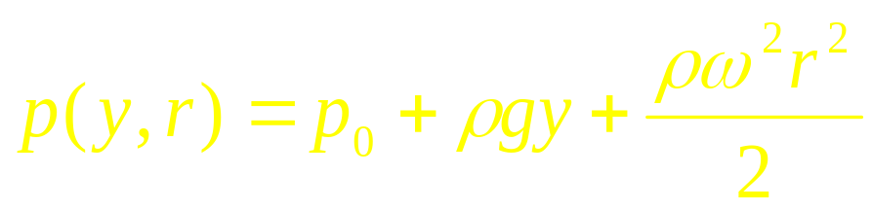
On the surface
Pressure in the liquid
P_{o}
0
A
y
r
r
r+dr
y
zwma@zju.edu.cn

Slide 12
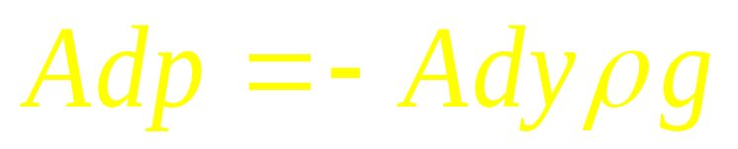

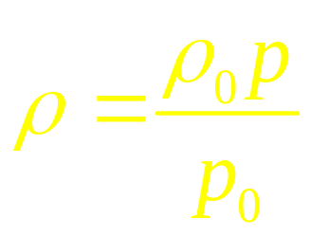
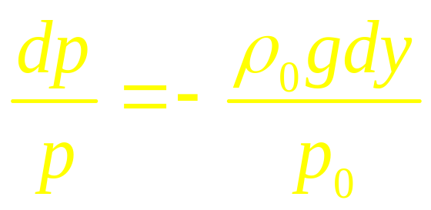
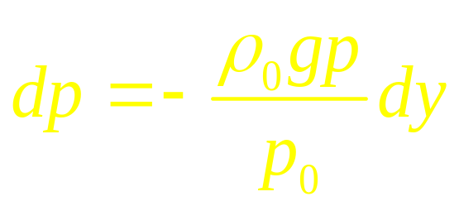
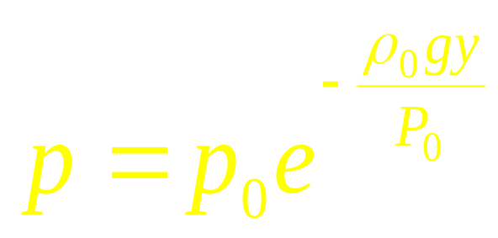
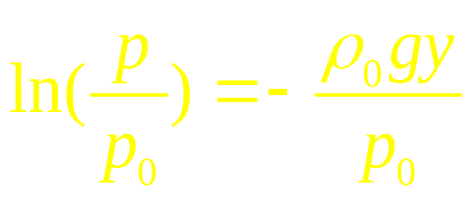
Pressure in atmosphere
y
dF
A
dy
mg
0
zwma@zju.edu.cn

Slide 13
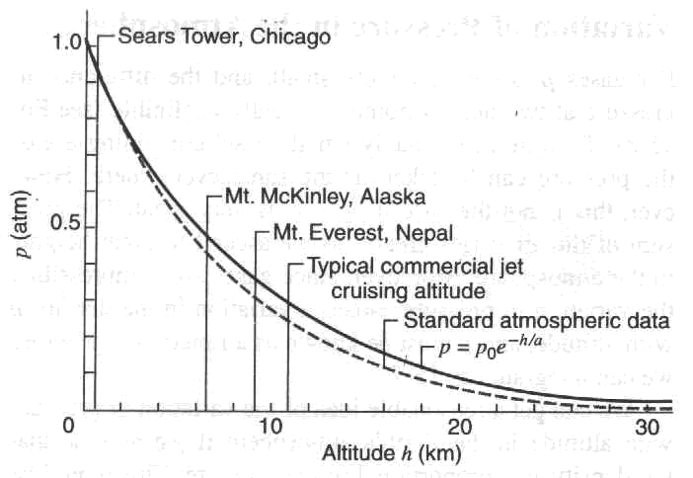

zwma@zju.edu.cn

Slide 14





Atmosphere
r
A
dr
R
zwma@zju.edu.cn

Slide 15
Pressure
Pascal’s Principle:
P_{o}
Pressure applied to an enclosed fluid is transmitted undiminished to every portion of the fluid and to the wall of the containing vessel.
0
y
y
P = P_{o} + ρgy
zwma@zju.edu.cn

Slide 16



Pressure
P_{ext}
P’_{ext}
P = P_{ext} + ρgy
0
P = P'_{ext} + ρgy
P_{ext} = P'_{ext}
y
y
zwma@zju.edu.cn

Slide 17


The hydraulic lift is an application of Pascal’s law. The size of the fluid-filled container is exaggerated for clarity.
zwma@zju.edu.cn

Slide 18

zwma@zju.edu.cn

Slide 19


Pascal’s Principle and
Archimedes’s Principle
You insert a straw of length l into a tall glass of water.
You place your finger over the top of the straw, capturing some air above the water but preventing any additional air from getting in or out, and then you lift the straw from the water.
You find that the straw retains the water.
zwma@zju.edu.cn

Slide 20







Archimedes’s Principle: Α body wholly or partially immersed in a fluid is buoyed up by a force equal in magnitude to the weight of the fluid displaced by the body
zwma@zju.edu.cn

Slide 21






Example: Archimedes: Is the crown gold?
Solution:
gold should be 19.3g/cm³
11.3g/cm³ means it is lead
zwma@zju.edu.cn
Notes:
Figure 13-16. (a) A scale reads the mass of an object in air—in this case the crown of Example 13–10. All objects are at rest, so the tension F_{T} in the connecting cord equals the weight of the object: F_{T} = mg. We show the free-body diagram of the crown, and F_{T} is what causes the scale reading (it is equal to the net downward force on the scale, by Newton’s third law). (b) Submerged, the crown has an additional force on it, the buoyant force F_{B}. The net force is zero, so F_{T}’ + F_{B} = mg (=w). The scale now reads m’ = 13.4 kg, where m’ is related to the effective weight by w’ = m’g. Thus F_{T}’ = w’ = w - F_{B}.
Solution: The scale reads the weight minus the buoyant force. The mass of the object is its density times its volume; the mass of the displaced water, which is equal to the difference in masses, is the density of water times the same volume. Therefore, the ratio of the total mass to the mass difference is the ratio of densities; this gives a density of 11.3 (gold is 19.3). This crown would appear to be made of lead.

Slide 22



A Titanic Surprise
That’s only the tip of the iceberg(12%)
zwma@zju.edu.cn

Slide 23

mg
F_{b}
Note that the center of buoyancy
mg
F_{b}
mg
F_{b}
zwma@zju.edu.cn

Slide 24

Measurement of Pressure
zwma@zju.edu.cn

Slide 25


Surface Tension and Capillarity
Question:
Capillarity Surface Tension
zwma@zju.edu.cn

Slide 26


Surface tension
γ is the surface force per unit length.
zwma@zju.edu.cn

Slide 27






Surface tension
l
F = γ l
Surface tension potential energy
zwma@zju.edu.cn

Slide 28



Wetting
γ₁
No wetting
γ₂
γ₁ < γ₂
zwma@zju.edu.cn

Slide 29

zwma@zju.edu.cn
Notes:
Figure 13-35. U-shaped wire apparatus holding a film of liquid to measure surface tension (γ = F/2l).

Slide 30

Because of surface tension, some objects more dense than water may not sink.
zwma@zju.edu.cn
Notes:
Figure 13-36. A water strider.

Slide 31

Soap and detergents lower the surface tension of water. This allows the water to penetrate materials more easily.
Water molecules are more strongly attracted to glass than they are to each other; just the opposite is true for mercury.
zwma@zju.edu.cn
Notes:
Figure 13-38. (a) Water “wets” the surface of glass, whereas (b) mercury does not “wet” the glass.

Slide 32

If a narrow tube is placed in a fluid, the fluid will exhibit capillarity.
zwma@zju.edu.cn
Notes:
Figure 13-39. Capillarity.

Slide 33
CHAP 15
Problems
P348:7, 8,11,13,17

